Slide 1
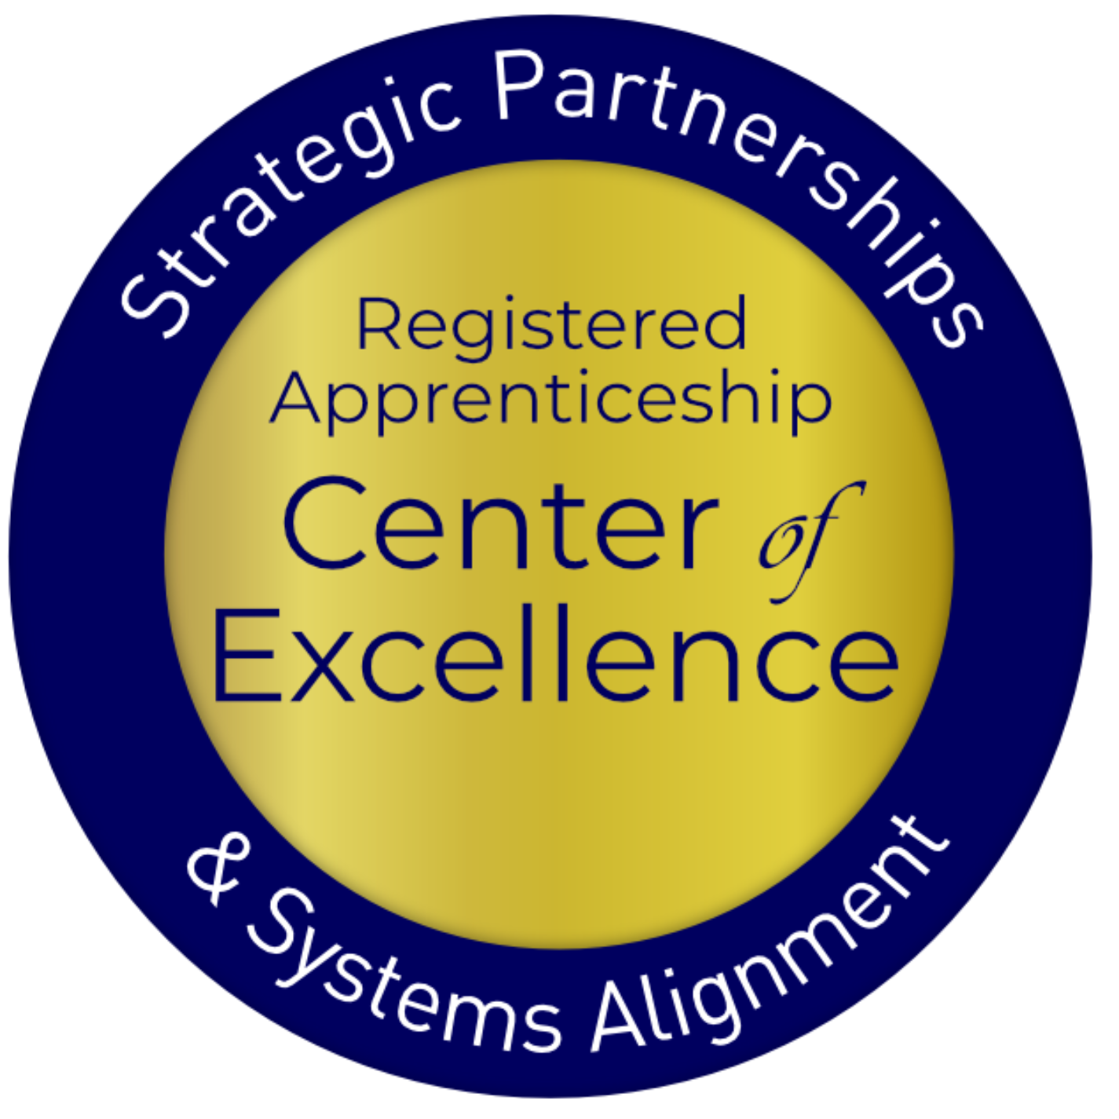
Linking Secondary and Post-Secondary CTE to Pre-Apprenticeship

Slide 2
USDOL Center of Excellence
Mission: Scale partnerships to accelerate adoption of Registered Apprenticeship (RA) and improve RA alignment with our nation's workforce and education systems
Notes:
NK
Center represents first-ever investment by DOL to create and deliver TA specifically focused on shrinking the gap between apprenticeship and our nation’s workforce and education systems

Slide 3
Our Work – Three Strategies
Provide technical assistance (TA) on a national scale to:
RA program sponsors
State and local workforce boards and American Job Center (AJC) programs and operators
K-12, college and university AE and Career and Technical Education programs
State and federal policymakers
Engage and build partnership with and between essential RA stakeholders
Coordinate with federal and state investments
Notes:
NK

Slide 4
Apprenticeship: Why and What

Slide 5
Understanding Apprenticeship
How would you rate your general knowledge of Registered Apprenticeship?
How would you rate your knowledge of the existing Registered Apprenticeship programs in your local area?
Notes:
Show of hands—Fist to Five career apprenticeship
RA knowledge-Group about 60% Exceptional, Very Good, Good,
Local and State Plans-48%
Knowledge—around 52%

Slide 6
What is Apprenticeship?
A Proven Workforce
Solution
Registered Apprenticeship is an industry-driven, high-quality career pathway enabling employers to develop new hires and upskill current workers for critical occupations.
Notes:
NK•
Most time-tested, proven method of developing skilled talent
• It is NOT – only for skilled trade roles, unions, or entry-level jobs
• It IS – for businesses of all sizes in all sectors and any occupation that requires approximately at least a year of training to be considered professional
• New tool for most businesses to add to their human capital strategy – need to establish new partnerships to recruit, train, and retain new talent
• A WIOA-aligned strategy across all titles

Slide 7
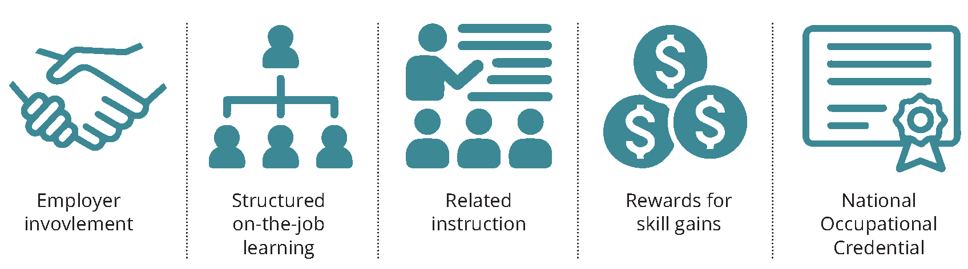
Five Core Components
Notes:
MC
Undergirding all RA programs is the fact that to be effective they must be business-driven
• 4 core components:
1. OJT – structured, aligned with industry-validated KSAs for occupation; can be time-based (i.e. 1-4 years), competency-based or a hybrid
2. Related Instruction – minimum of 144 contact hours; typically includes both technical (occupational-specific) and “soft” skills; can be provided by education/training partner (i.e. ABE, CTE program; high school; 2- or 4-year college; in-house instructors, etc.)
3. Wage progression – employers decide upon pay rates for apprentices (must be paid position); include opportunity(ies) for 1+ pay bumps during program to encourage retention and completion
4. National credential(s) – all RA program completers earn a USDOL certificate of completion indicating they are a credentialed professional for their occupation and most programs typically embed or align with multiple industry valued certifications.

Slide 8
What’s Driving RA Expansion?
Facts
Half-life of skills is five years
Shrinking labor market participation rate
Rapidly evolving technology, Artificial Intelligence (AI), automation, robotics
Implications
Shift from K-12 to lifelong learning
Career pathways with opportunities for advancement not just a job
Businesses will need to "build, not buy" talent by training them
Notes:
NK

Slide 9
Spanning all Sectors

Slide 10
Businesses Using RA
Notes:
MC
Apprenticeship has gone mainstream
• We have built upon the solid foundation laid by skilled trades to modernize and scale to new, emerging and high-growth industries and occupations
• RA has grown in popularity as employers realize they need structured plans to expand the resources of talent, train new hires and upskill incumbent workers, and fill quickly needed new roles
• In 2020 alone, more than 3100 new apprenticeship programs were established nationwide; representing a growth of 73% in a little over 10 years.

Slide 11
Why They're Choosing RA
Attract New Talent : 70% of workers would be “extremely” or “very” likely to switch to a new employer offering training opportunities
Proven ROI : Employers report on average $1.47 for every $1 invested in RA – highly cost effective in the long term
Diversify Workforce : With a training plan in place from day one, employers can take a skills-based approach to hiring which creates much larger, more diverse talent pipeline
Would you switch to a new employer for training opportunities?
Sources: Gallup 2021, USDOL
Notes:
MC
In a tight labor market more employees want career pathways, not jobs – firms that offer training are viewed as "employers of choice"
Apprenticeship offers unique resources including potential tax credits, wage reimbursement, training cost offsets and supportive services
Apprenticeship has proven to create more diverse workforces

Slide 12
Why They're Choosing RA
Better Rate of Hire
Higher 1-Year+ Retention Rate
Sources: Apprenticeship.gov (USDOL),
National Association of Colleges & Employers “2020 Internship & Co-Op Report”
Notes:
MC
Pts in referred hires: 94% of apprentices become regular full-time employees upon program completion compared to 55.5% for interns and 36.5% for co-op participants
Loyal workforce: 91% of apprentices remain employed after their first year compared to only 62% of interns and 49% of co-op participants
That result lowers the cost of churn (on average this costs employers 100 – 150% of professional position salary to replace w/in first 12 months), increases productivity, generates positive ROI (on average employers report $1.47 ROI for every $1 invested)

Slide 13
Pre-Apprenticeship: What, Why and How

Slide 14
What is Pre-Apprenticeship?
A program or set of strategies designed to prepare individuals for entry into RA programs.
Not federally overseen / not in National Apprenticeship Act = more flexibility
Expanding and some SAA implications
Notes:
NK•
Most time-tested, proven method of developing skilled talent
• It is NOT – only for skilled trade roles, unions, or entry-level jobs
• It IS – for businesses of all sizes in all sectors and any occupation that requires approximately at least a year of training to be considered professional
• New tool for most businesses to add to their human capital strategy – need to establish new partnerships to recruit, train, and retain new talent
• A WIOA-aligned strategy across all titles

Slide 15
6 High-Quality Hallmarks
Transparent entry and success requirements
Training in skills sought by employers
Skills training through WBL and hands-on learning
Student support for persistence
Results in 1+ industry-valued credentials
Direct entry/preferred application for linked RAP
Notes:
NK•
Most time-tested, proven method of developing skilled talent
• It is NOT – only for skilled trade roles, unions, or entry-level jobs
• It IS – for businesses of all sizes in all sectors and any occupation that requires approximately at least a year of training to be considered professional
• New tool for most businesses to add to their human capital strategy – need to establish new partnerships to recruit, train, and retain new talent
• A WIOA-aligned strategy across all titles

Slide 16
Role of CTE in RA
Engage Employers
Create Student Pathways
Collaborate with Workforce
Supply a pool of candidates
Deliver relevant workforce training (soft skills and technical skills) that maps to required related instruction
Design on-ramp to accelerate entry
Leverage students’ instruction and experience to achieve multiple outcomes
Provide training and instruction for in-demand careers
Recruit program candidates (adults)
Access funding for training costs (ITA)
Access supportive services for WIOA-eligible students
Notes:
MC

Slide 17
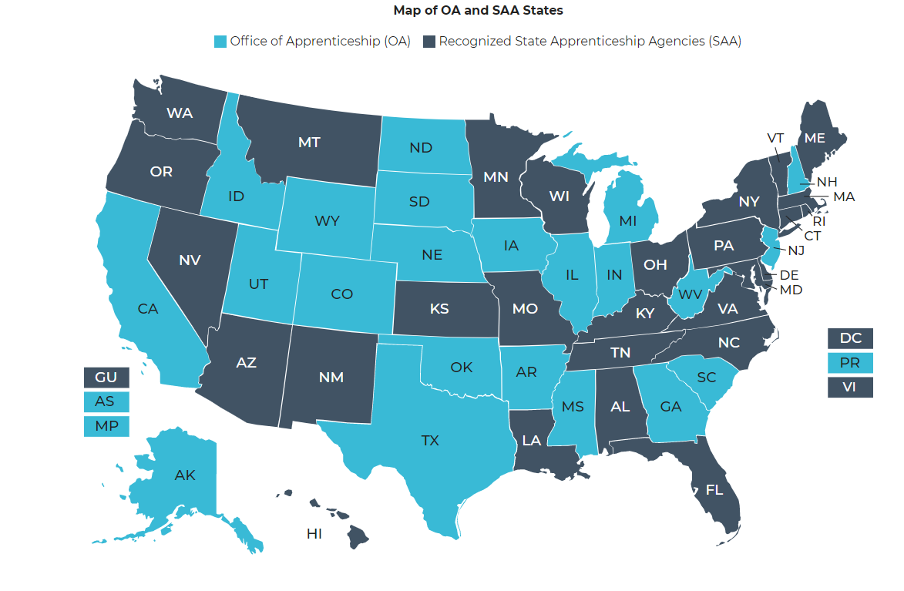
Getting Started: System Connection
Identify local RA sponsors with programs aligned with your programming
https://www.apprenticeship.gov/about-us/state-offices
Notes:
MC and NK: https://drive.google.com/file/d/11h-EbGI2AvFrJlWPV-LdKUXqKMrBlGCC/view?usp=sharing
Addresses 5 hallmarks of high-quality pre-apprenticeship:
1. Partner with RA sponsor (could be business/college/intermediary)
2. Include directly relevant, industry-informed training and education (I.e. courses in soft skills, technical instruction)
3. Implement hands-on training for pre-apprentice program
4. Align with industry credentials
5. Incorporate opportunity for pre-apprentices to access supportive services

Slide 18
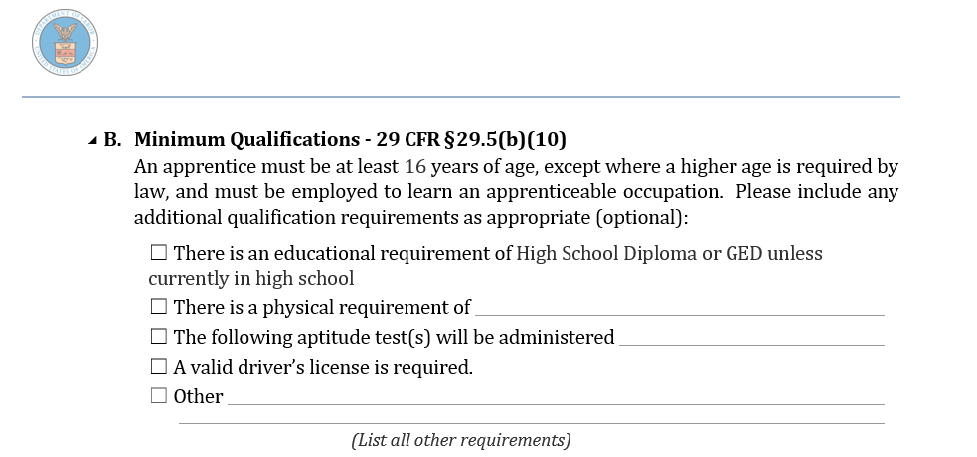
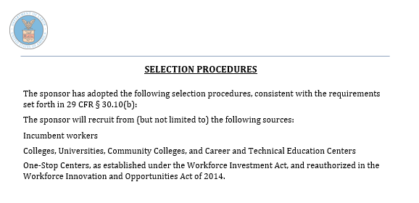
Employer Talk: Quals and Entry
All RAPs have Minimum Qualifications and Selection Procedures
Show:
What applicants will need/be able to pass
Prospective talent pool sources
Can be used for students’ RAP application work
Can help with pre-app program marketing
Notes:
MC and NK: https://drive.google.com/file/d/11h-EbGI2AvFrJlWPV-LdKUXqKMrBlGCC/view?usp=sharing
Addresses 5 hallmarks of high-quality pre-apprenticeship:
1. Partner with RA sponsor (could be business/college/intermediary)
2. Include directly relevant, industry-informed training and education (I.e. courses in soft skills, technical instruction)
3. Implement hands-on training for pre-apprentice program
4. Align with industry credentials
5. Incorporate opportunity for pre-apprentices to access supportive services

Slide 19
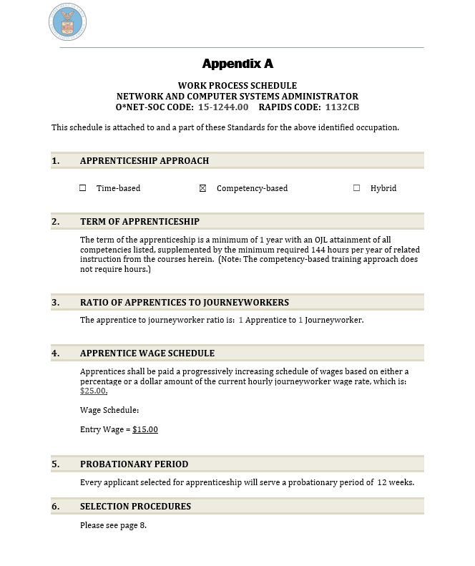
Employer Talk: Standards Review
Discuss Program Standards
Mapping to Program
Minimum qualifications
Selection procedures
Ideal core knowledge (RI)
Ideal basic foundational skills (OJL)
Evaluate current program for alignment
curriculum for RI
Lab work, WBL for OJL
Hours (for TB programs) or competencies (for HY/CB programs)
Notes:
MC and NK: https://drive.google.com/file/d/11h-EbGI2AvFrJlWPV-LdKUXqKMrBlGCC/view?usp=sharing
Addresses 5 hallmarks of high-quality pre-apprenticeship:
1. Partner with RA sponsor (could be business/college/intermediary)
2. Include directly relevant, industry-informed training and education (I.e. courses in soft skills, technical instruction)
3. Implement hands-on training for pre-apprentice program
4. Align with industry credentials
5. Incorporate opportunity for pre-apprentices to access supportive services

Slide 20
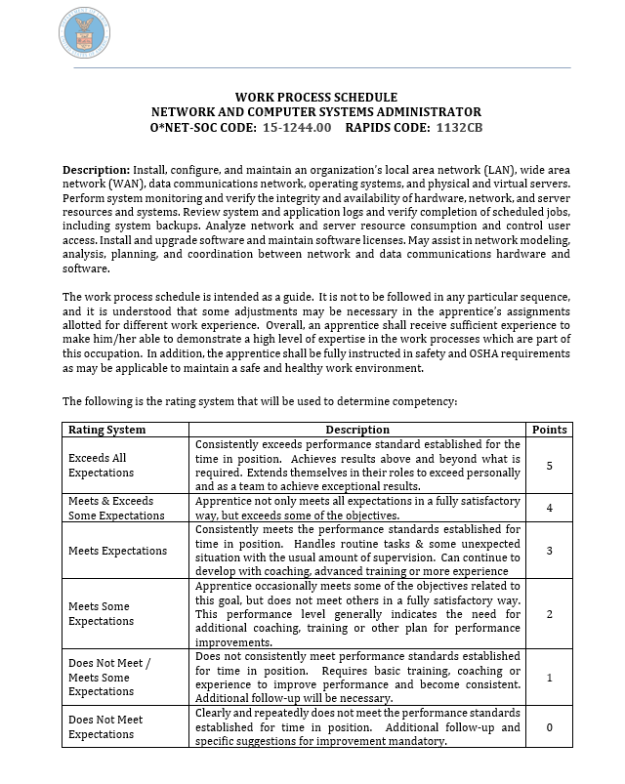
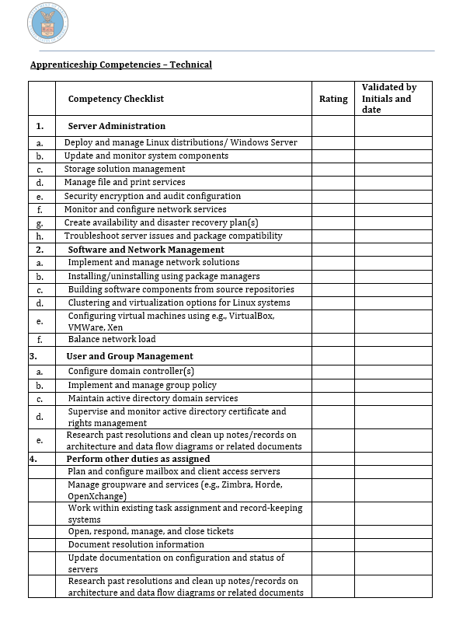
Employer Talk: OJL Mapping
All RAPs have Work Process (OJL) Outlines
Show model:
Time-based
Hybrid
Competency-based
Show core skills required for RAP – can map to CTE lab work, WBL
Notes:
MC and NK: https://drive.google.com/file/d/11h-EbGI2AvFrJlWPV-LdKUXqKMrBlGCC/view?usp=sharing
Addresses 5 hallmarks of high-quality pre-apprenticeship:
1. Partner with RA sponsor (could be business/college/intermediary)
2. Include directly relevant, industry-informed training and education (I.e. courses in soft skills, technical instruction)
3. Implement hands-on training for pre-apprentice program
4. Align with industry credentials
5. Incorporate opportunity for pre-apprentices to access supportive services

Slide 21
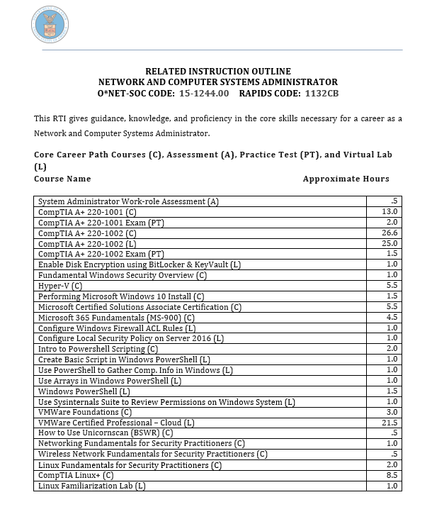
Employer Talk: RI Mapping
All RAPs have RI Outlines
Min. 144 hours/yr
Show:
Core technical instruction
Employability instruction
Can be mapped to CTE courses
Notes:
MC and NK: https://drive.google.com/file/d/11h-EbGI2AvFrJlWPV-LdKUXqKMrBlGCC/view?usp=sharing
Addresses 5 hallmarks of high-quality pre-apprenticeship:
1. Partner with RA sponsor (could be business/college/intermediary)
2. Include directly relevant, industry-informed training and education (I.e. courses in soft skills, technical instruction)
3. Implement hands-on training for pre-apprentice program
4. Align with industry credentials
5. Incorporate opportunity for pre-apprentices to access supportive services

Slide 22
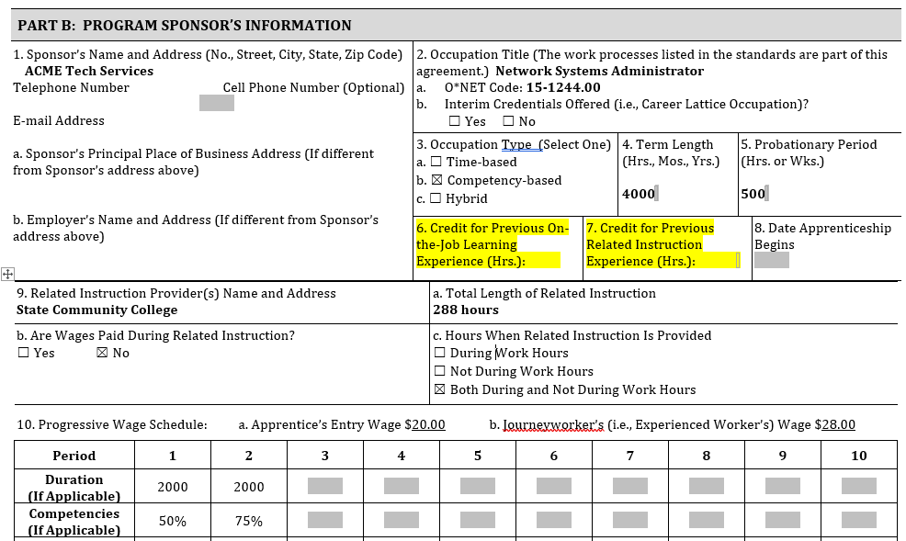
Employer Talk: CPE/CPL
Provide Employer Partner with CPE/CPL Tool
Maximizes students’ pre-apprenticeship program investment
Accelerates apprentice program completion timeframe
Notes:
MC and NK: https://drive.google.com/file/d/11h-EbGI2AvFrJlWPV-LdKUXqKMrBlGCC/view?usp=sharing
Addresses 5 hallmarks of high-quality pre-apprenticeship:
1. Partner with RA sponsor (could be business/college/intermediary)
2. Include directly relevant, industry-informed training and education (I.e. courses in soft skills, technical instruction)
3. Implement hands-on training for pre-apprentice program
4. Align with industry credentials
5. Incorporate opportunity for pre-apprentices to access supportive services

Slide 23
Next Step: Partnership Work
Collaborating with Employer
Working with Workforce
Identify employer-based options for pre-RA to RA entry process (i.e. job shadowing,
Co-design program application and referral process
Identify potential support services for pre-apprentices to facilitate completion (i.e. transportation, equipment, etc.)
Notes:
MC and NK: https://drive.google.com/file/d/11h-EbGI2AvFrJlWPV-LdKUXqKMrBlGCC/view?usp=sharing
Addresses 5 hallmarks of high-quality pre-apprenticeship:
1. Partner with RA sponsor (could be business/college/intermediary)
2. Include directly relevant, industry-informed training and education (I.e. courses in soft skills, technical instruction)
3. Implement hands-on training for pre-apprentice program
4. Align with industry credentials
5. Incorporate opportunity for pre-apprentices to access supportive services

Slide 24
Go To Market
Employers want to know that successful program completers:
Will have relevant foundational skills (experience can be applied toward OJL requirement through credit for prior experience)
Will have relevant technical knowledge (coursework can be applied to RTI requirement through CPL)
have successfully earned related credential/certification – or are equipped and eligible to test out
meet minimum qualifications
may be eligible for continued workforce supportive services during RAP
Goal: Direct entry agreement
Notes:
MC and NK: https://drive.google.com/file/d/11h-EbGI2AvFrJlWPV-LdKUXqKMrBlGCC/view?usp=sharing
Addresses 5 hallmarks of high-quality pre-apprenticeship:
1. Partner with RA sponsor (could be business/college/intermediary)
2. Include directly relevant, industry-informed training and education (I.e. courses in soft skills, technical instruction)
3. Implement hands-on training for pre-apprentice program
4. Align with industry credentials
5. Incorporate opportunity for pre-apprentices to access supportive services

Slide 25
Thank You
Katie Adams
Senior Director
katie.adams@safalpartners.com
Connect with the Center
https://dolcoe.safalapps.com
Become a Partner
Open your camera
Scan QR code

