Slide 1
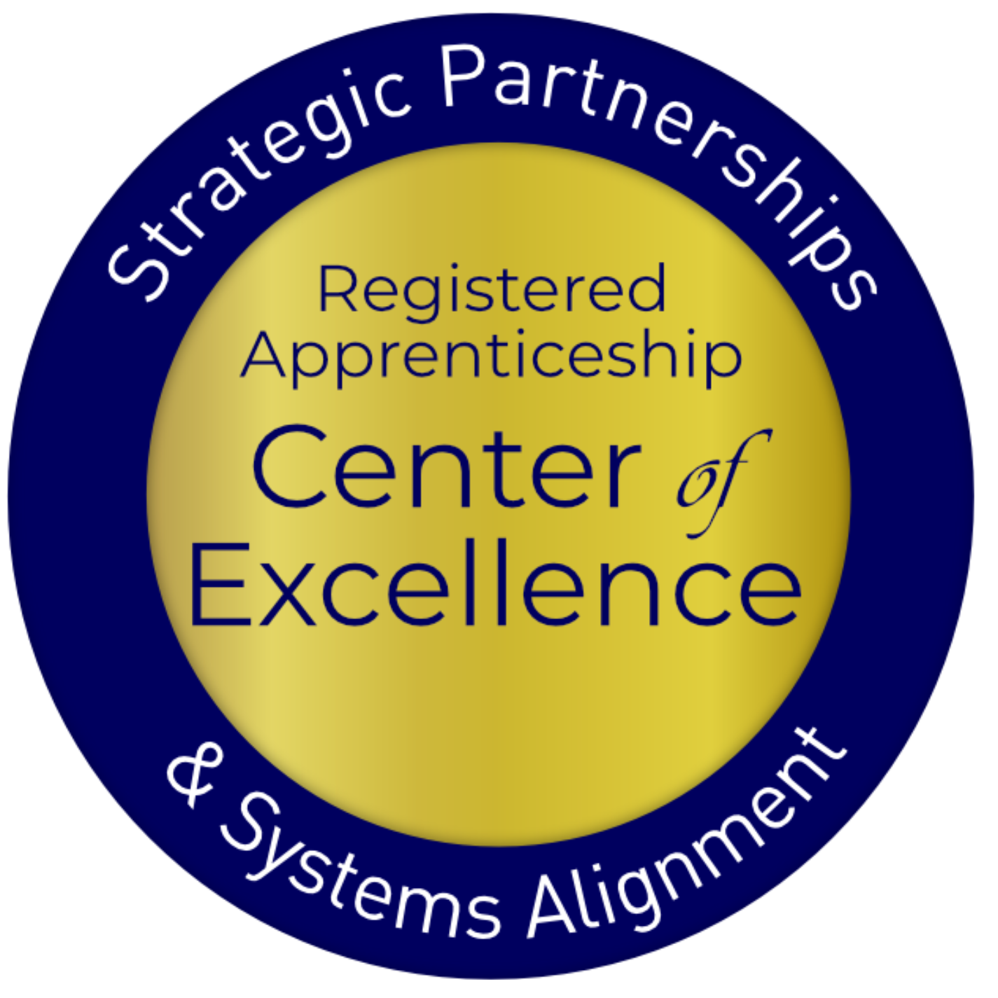
Expanding Employment Opportunities for your Students through Pre-Apprenticeship and Registered Apprenticeship

Slide 2
Agenda
Describe knowledge gaps identified around registered apprenticeship (RA) through the preliminary findings from the Adult Education (AE) and RA survey.
Consider how to close those knowledge gaps and increase awareness on how to link AE to RA programs (RAPs).
Identify strategies to map an adult education integrated education and training (IET) program to pre-apprenticeship and RA.
Learn about the pre-apprenticeship framework, U.S. Department of Education’s IET Design Toolkit, and other federal resources to support IET alignment to RA.
Notes:
Katie

Slide 3
US Department of Labor (DOL) Center of Excellence
Mission: Scale partnerships to accelerate adoption of Registered Apprenticeship (RA) and improve RA alignment with the nation's workforce and education systems.
Notes:
Katie
Center represents first-ever investment by DOL to create and deliver TA specifically focused on shrinking the gap between apprenticeship and our nation’s workforce and education systems

Slide 4
The Center’s Work – Three Strategies
Provide technical assistance (TA) on a national scale to:
RA program sponsors
State and local workforce boards and American Job Center (AJC) programs and operators
K-12, college and university, Adult Education, and Career and Technical Education programs
State and federal policymakers
Engage and build partnerships with and between essential RA stakeholders
Coordinate with federal and state investments
Notes:
Katie

Slide 5
What is Apprenticeship?
A Proven Workforce
Solution
Registered Apprenticeship is an industry-driven, high-quality career pathway enabling employers to develop new hires and upskill current workers for critical occupations.
Notes:
KA
Most time-tested, proven method of developing skilled talent
• It is NOT – only for skilled trade roles, unions, or entry-level jobs
• It IS – for businesses of all sizes in all sectors and any occupation that requires approximately at least a year of training to be considered professional
• New tool for most businesses to add to their human capital strategy – need to establish new partnerships to recruit, train, and retain new talent
• A WIOA-aligned strategy across all titles

Slide 6
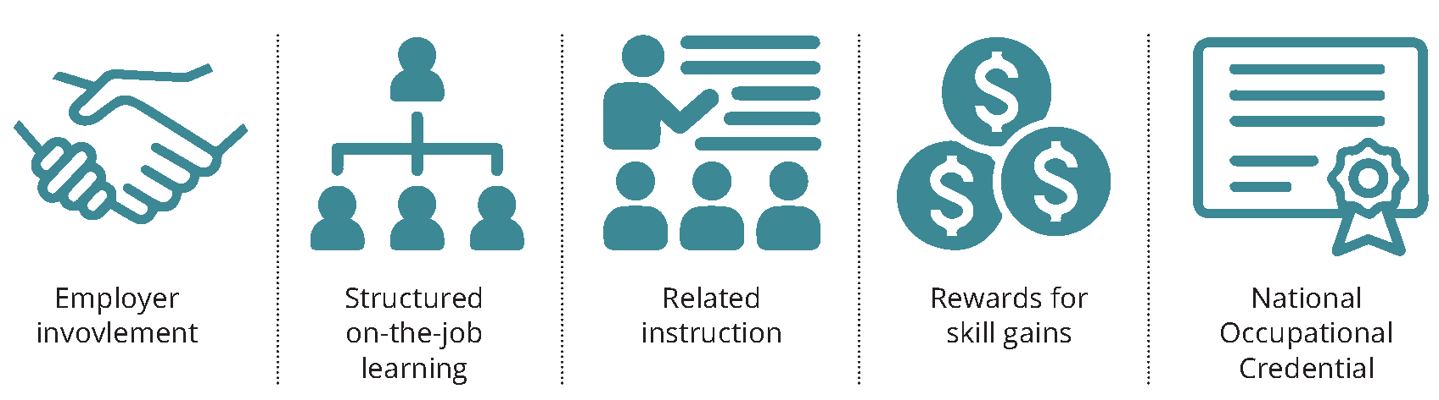
Five Core Components
Notes:
KA
For all RA programs to be effective, they must be business-driven—the first of the 5 core components:
4 core components:
1. OJT/OJL – structured, aligned with industry-validated KSAs for occupation; can be time-based, (i.e., 1-4 years), competency-based, or a hybrid.
2. Related Instruction – minimum of 144 contact hours; typically includes both technical (occupational-specific) and “soft” skills; can be provided by education/training partner (i.e., adult education IET program, career and technical education (CTE) program; high school; 2- or 4-year college)
3. Wage progression – employers decide upon pay rates for apprentices (must be paid position); include opportunity(ies) for 1+ pay bumps during program to encourage retention and completion.
4. National credential(s) – all RA program completers earn a USDOL certificate of completion indicating they are a credentialed professional for their occupation and most programs typically embed or align with multiple industry valued certifications.

Slide 7
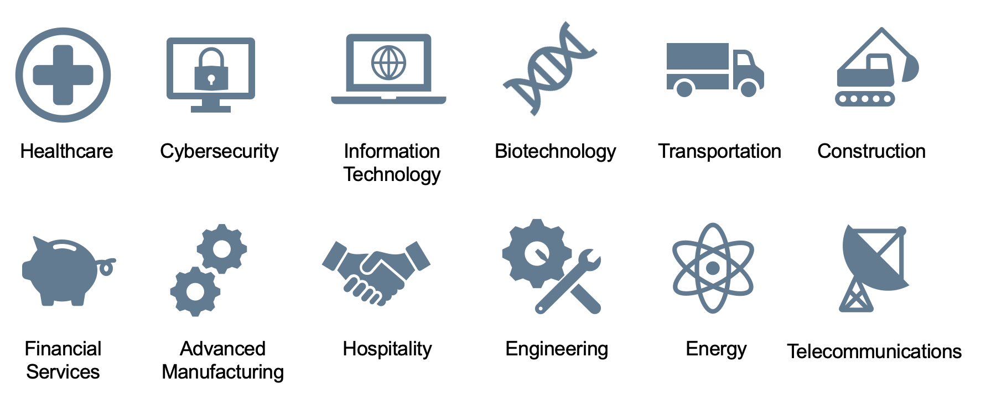
Spans all Sectors
Notes:
KA

Slide 8
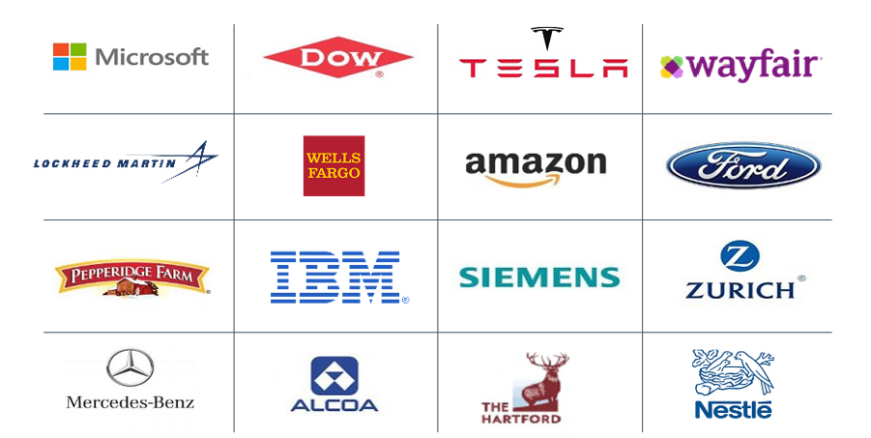
Businesses Using RA
Notes:
MC
Apprenticeship has gone mainstream
• We have built upon the solid foundation laid by skilled trades to modernize and scale to new, emerging and high-growth industries and occupations
• RA has grown in popularity as employers realize they need structured plans to expand the resources of talent, train new hires and upskill incumbent workers, and fill quickly needed new roles
• In 2020 alone, more than 3100 new apprenticeship programs were established nationwide; representing a growth of 73% in a little over 10 years.

Slide 9
Why Organizations Choose RA
Attract New Talent : 70% of workers would be “extremely” or “very” likely to switch to a new employer offering training opportunities
Proven ROI : Employers report on average $1.47 for every $1 invested in RA – highly cost effective in the long term
Diversify Workforce : With a training plan in place from day one, employers can take a skills-based approach to hiring which creates much larger, more diverse talent pipeline
Would you switch to a new employer for training opportunities?
Sources: Gallup 2021, USDOL
Notes:
MC
In a tight labor market more employees want career pathways, not jobs – firms that offer training are viewed as "employers of choice"
Apprenticeship offers unique resources including potential tax credits, wage reimbursement, training cost offsets and supportive services
Apprenticeship has proven to create more diverse workforces

Slide 10
Clear Benefits of RA
Better Rate of Hire
Higher 1-Year+ Retention Rate
Sources: Apprenticeship.gov (USDOL),
National Association of Colleges & Employers “2020 Internship & Co-Op Report”
Notes:
MC
Pts in referred hires: 94% of apprentices become regular full-time employees upon program completion compared to 55.5% for interns and 36.5% for co-op participants
Loyal workforce: 91% of apprentices remain employed after their first year compared to only 62% of interns and 49% of co-op participants
That result lowers the cost of churn (on average this costs employers 100 – 150% of professional position salary to replace w/in first 12 months), increases productivity, generates positive ROI (on average employers report $1.47 ROI for every $1 invested)

Slide 11
Apprenticeship and IET: Why and What
Notes:
NK

Slide 12
Preliminary Findings of Center's AE RA
Knowledge Survey
Awareness
Resources
Collaboration
75%
(average)
Know where to access RA state-specific and general resources
60%
(average)
How-to guides, employer engagement guides, and IET program mapping resources
69%
Interested in participating in focus groups for input on TA resources
Notes:
NK: Safal and COABE disseminated a survey the end of last year to gauge awareness and TA resource needs in the AE field to support pre-apprenticeship and RAP opportunities. We had over 1200 respondents and will be publishing a report in the next couple months detailing the findings.
The initial data shows a similarity of the feedback you all gave us (or not).

Slide 13
In 2017, only FOUR local Adult Education programs in the U.S. self-reported sponsoring a RAP.
What are the challenges in aligning AE with RA?
Awareness about ways to integrate IET with pre-apprenticeship and RA
Meaningful, ongoing connection between adult education, industry, and apprenticeship system to create and sustain high-quality pre-apprenticeship and RA programs (RAPs)
Coordination with the workforce system to enroll eligible adult learners in WIOA Title I services to receive training, supportive services, etc. while co-enrolled in a RAP
Sources: 2017 COABE Survey of AE Members
Notes:
MC
To start with we want to acknowledge a couple of things we know can inhibit adult education programs in integrating IET with pre-apprenticeship and RAP. The first is simply awareness about how to do it with access to resources, tools, and people to support it. It means finding ways to build on what’s already being done through IET programs and then connecting that with pre-apprenticeship and RA programs—so it’s not just an add-on or one more thing to do. Just as an IET program is never developed by only one person, aligning an IET program with pre-apprenticeship and RAP is a team effort. It is super helpful to include industry and apprenticeship representatives to co-plan and co-define the curriculum for the related training instruction RTI and IET from the outset. The last potential challenge is coordination with the state and local workforce boards to co-enroll eligible adults in WIOA Title I services and RAPs. The good news is these are all surmountable and we the Center of Excellence with Katie and team are here to help.
To set the context, let’s review the makings of an IET and then Katie will walk us through Pre-Apprenticeship and RA.
Next Slide

Slide 14
What is Integrated Education and Training (IET)?
IET is “…a service approach that provides adult education and literacy activities concurrently and contextually with workforce preparation activities and workforce training for a specific occupation or occupational cluster for the purpose of educational and career advancement.”
Notes:
MC
To start with we want to acknowledge a couple of things we know can inhibit adult education programs in integrating IET with pre-apprenticeship and RAP. The first is simply awareness about how to do it with access to resources, tools, and people to support it. It means finding ways to build on what’s already being done through IET programs and then connecting that with pre-apprenticeship and RA programs—so it’s not just an add-on or one more thing to do. Just as an IET program is never developed by only one person, aligning an IET program with pre-apprenticeship and RAP is a team effort. It is super helpful to include industry and apprenticeship representatives to co-plan and co-define the curriculum for the related training instruction RTI and IET from the outset. The last potential challenge is coordination with the state and local workforce boards to co-enroll eligible adults in WIOA Title I services and RAPs. The good news is these are all surmountable and we the Center of Excellence with Katie and team are here to help.
To set the context, let’s review the makings of an IET and then Katie will walk us through Pre-Apprenticeship and RA.
Next Slide

Slide 15
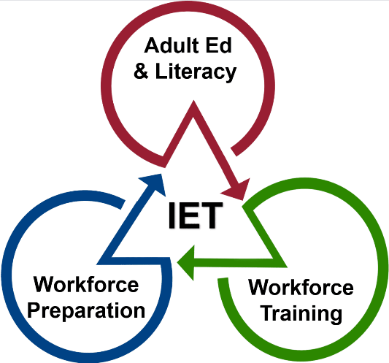
Three Components of IET
Adult education and literacy activities, workforce preparation activities, and workforce training activities must:
Be of sufficient intensity and quality
Be based on the most rigorous research
Occur simultaneously
Use occupationally relevant materials
Be organized through a single set of learning objectives (SSLO) to include adult education content standards, workforce preparation skills, and workforce training competencies.
Be part of a career pathway
Notes:
MC
To start with we want to acknowledge a couple of things we know can inhibit adult education programs in integrating IET with pre-apprenticeship and RAP. The first is simply awareness about how to do it with access to resources, tools, and people to support it. It means finding ways to build on what’s already being done through IET programs and then connecting that with pre-apprenticeship and RA programs—so it’s not just an add-on or one more thing to do. Just as an IET program is never developed by only one person, aligning an IET program with pre-apprenticeship and RAP is a team effort. It is super helpful to include industry and apprenticeship representatives to co-plan and co-define the curriculum for the related training instruction RTI and IET from the outset. The last potential challenge is coordination with the state and local workforce boards to co-enroll eligible adults in WIOA Title I services and RAPs. The good news is these are all surmountable and we the Center of Excellence with Katie and team are here to help.
To set the context, let’s review the makings of an IET and then Katie will walk us through Pre-Apprenticeship and RA.
Next Slide

Slide 16
AE IET Programs' Intersection with RA
Support Business Engagement
Create Career Pathways
Support Business Engagement
Supply a pool of candidates
Design on-ramp to accelerate entry
Connect with Partners
Access WIOA funding through Individual Training Accounts (ITAs) for training costs*
Deliver relevant workforce preparation skills and workforce training competencies that can map to RA required RTI
Leverage learners’ education and experience to achieve multiple outcomes
Provide training and instruction for in-demand careers
Access supportive services for WIOA-eligible students
Submit IET program for approval to be on state and local Eligible Training Provider List (ETPL)
Create Career Pathways
Obtain funding from WIOA Individual Training Accounts (ITAs) for training costs*
Access supportive services for WIOA-eligible students
After IET program is approved as one of the state's Eligible Training Provider List (ETPL)
Supply a pool of candidates
Deliver relevant workforce preparation skills and workforce training competencies that can map to RA required related instruction
Design on-ramp to accelerate entry
Leverage learners’ education and experience to achieve multiple outcomes
Provide training and instruction for in-demand careers
Notes:
MC
Here we are getting into how Adult education IET programs intersect with RA. For businesses, AE supplies a pool of candidates. I always say, Adult Education programs nationally represent the largest high school in America with the added difference that many of our learners have both prior life and work experience that makes them even more attractive as potential employees. Usually, adult education can also deliver the relevant workforce prep and workforce training competencies at low to no cost which can map to the RA required related instruction component. The work we do, if designed correctly, can accelerate the learners entry to further training and employment for in-demand careers.
Katie could you share more about how AE IET program providers can connect with other partners to develop a successful pre-RA program?
Katie and then
NEXT SLIDE

Slide 17
Pre-Apprenticeship and IET: What and How
Notes:
NK

Slide 18
What is Pre-Apprenticeship?
A program or set of strategies designed to prepare individuals for entry into RAPs
Provides RAP sponsors with established pipeline of candidates
Not federally regulated so more flexibility by developers in selecting components, establishing requirements
High-Quality Career Preparation
Direct entry/ preferred application for linked RAP
Notes:
NK•

Slide 19
Hallmarks of a High-Quality Pre-Apprenticeship Programs
Transparent entry and success requirements
Training in skills sought by employers
Skills training through OJL and hands-on learning
Student support for persistence
Results in 1+ industry-valued credentials
Direct entry/ preferred application for linked RAP
Notes:
NK•

Slide 20
Getting Started: Mapping IET to Pre-Apprenticeship & RAPs
Notes:
MC

Slide 21
3 Guiding Principles for Pre-Apprenticeship IET Program Design
Notes:
Katie
It will be helpful to know some of the terminology that is specific to Registered Apprenticeship one of those terms is RA sponsor. An RA sponsor is xxx. The idea here is that you don’t want or need to start from scratch. One component of the IET programs is to provide training for learners to acquire the skills needed by employers. When looking for potential IET opportunities, it’s essential to have a sense of which industries and businesses are:
Hiring
Paying living wages
Offering a career pathway
Challenged to recruit the skilled workers needed to meet industry demand
If a partner or sponsor is implementing a specific occupational training program, it’s the perfect opportunity to explore leveraging that training for an IET/pre-apprenticeship program.
If you don’t already have it, you’ll need to gather information about state IET policies and local career pathway activities to ensure that you develop an IET program opportunity that complies with state requirements and aligns with career pathway activities as required under WIOA and pre-apprenticeship program requirements in your state.

Slide 22
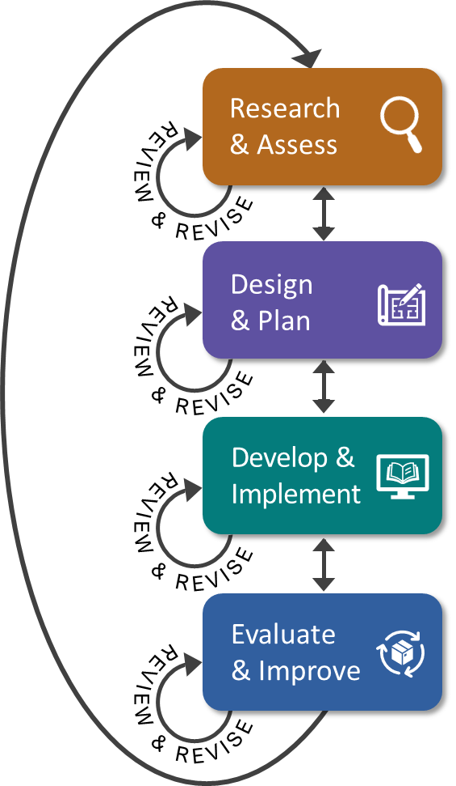
4 Iterative Phases
Approach to designing a pre- apprenticeship program aligned with IET federal requirements
Follows the same process outlined in US Department of Education IET Design Toolkit (Office of Career Technical and Adult Education IET Design Toolkit)
Notes:
Katie
It will be helpful to know some of the terminology that is specific to Registered Apprenticeship one of those terms is RA sponsor. An RA sponsor is xxx. The idea here is that you don’t want or need to start from scratch. One component of the IET programs is to provide training for learners to acquire the skills needed by employers. When looking for potential IET opportunities, it’s essential to have a sense of which industries and businesses are:
Hiring
Paying living wages
Offering a career pathway
Challenged to recruit the skilled workers needed to meet industry demand
If a partner or sponsor is implementing a specific occupational training program, it’s the perfect opportunity to explore leveraging that training for an IET/pre-apprenticeship program.
If you don’t already have it, you’ll need to gather information about state IET policies and local career pathway activities to ensure that you develop an IET program opportunity that complies with state requirements and aligns with career pathway activities as required under WIOA and pre-apprenticeship program requirements in your state.

Slide 23
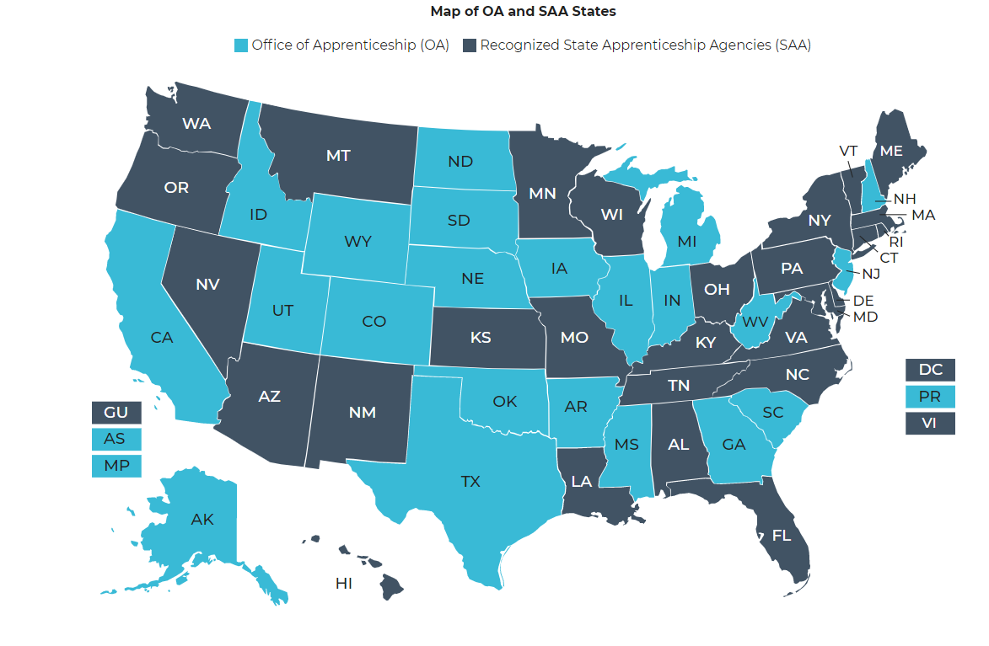
Research and Assess: Connect With RA System
Identify local RAP sponsors to have discussions re: connecting your IET program as a pre-apprenticeship
Determine if your state has pre-apprenticeship program requirements
https://www.apprenticeship.gov/about-us/state-offices
Notes:
Katie
It will be helpful to know some of the terminology that is specific to Registered Apprenticeship one of those terms is RA sponsor. An RA sponsor is xxx. The idea here is that you don’t want or need to start from scratch. One component of the IET programs is to provide training for learners to acquire the skills needed by employers. When looking for potential IET opportunities, it’s essential to have a sense of which industries and businesses are:
Hiring
Paying living wages
Offering a career pathway
Challenged to recruit the skilled workers needed to meet industry demand
If a partner or sponsor is implementing a specific occupational training program, it’s the perfect opportunity to explore leveraging that training for an IET/pre-apprenticeship program.
If you don’t already have it, you’ll need to gather information about state IET policies and local career pathway activities to ensure that you develop an IET program opportunity that complies with state requirements and aligns with career pathway activities as required under WIOA and pre-apprenticeship program requirements in your state.

Slide 24
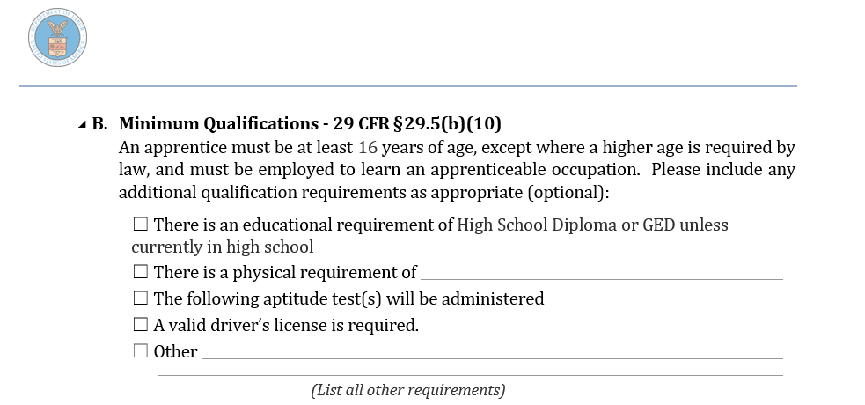
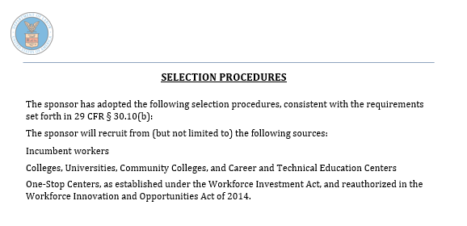
Design and Plan: RAP Entry Requirements, Qualifications
All RAPs have Minimum Qualifications and Selection Procedures
What applicants will need/be able to pass
Prospective talent pool sources
Can be used for adults’ RAP application work
Can help with pre-app program marketing
Notes:
Katie

Slide 25
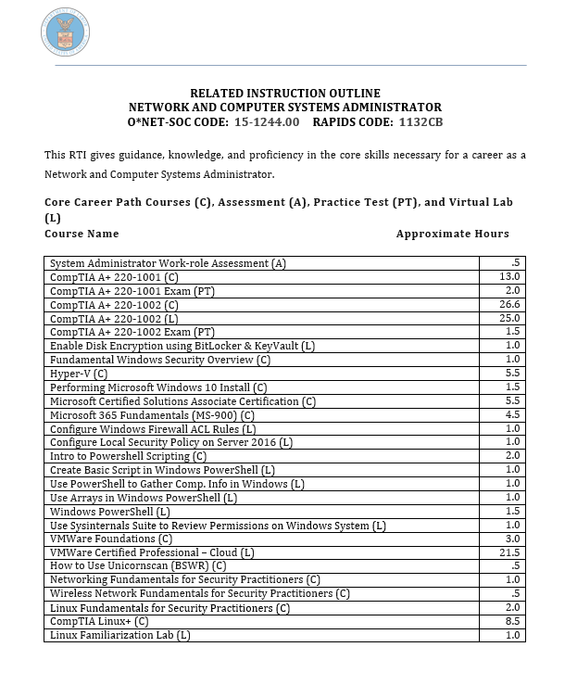
Design and Plan: Related Technical Instruction Mapping
RAP Related Instruction Outlines (require Minimum 144 hours per year)
Core technical instruction (maps to IET Component: Workforce Training Competencies)
Employability instruction (maps to IET Component: Workforce Preparation Skills)
Notes:
Katie

Slide 26
Design and Plan: Partnering for Enrollment and Services
Collaborate with Sponsors and Businesses
Coordinate with Community and Workforce Partners
Review the IET Design Toolkit for helpful ways to take the next step in partnering to develop a pre-apprenticeship program.
Identify employer-based options for pre-RA to RA entry process (i.e., job shadowing)
Co-design program application and referral process with
Identify potential support services for pre-apprentices to facilitate completion (i.e., transportation, equipment, etc.)
Notes:
Katie
Ensure the applicant meets enrollment criteria for the RA program and identifies types of supports needed.
Consider:
An individual learner success plan that includes elements that support learner needs, accessibility needs, and college and career planning, as appropriate.
Enrollment criteria, including required assessment(s) for entry and passing score(s), .
Program registration intake forms that incorporate the individual learner success plan.
Learner materials to distribute during intake.
Ensure learners have the necessary support to persist and succeed in the IET/Pre-Apprenticeship program.
Consider:
Individual counseling to address learners’ unique challenges.
Direct learner activities that are comprehensive, well integrated, and supported by quality tools.
Tracking systems that support ongoing monitoring and documentation of attendance hours, services, and outcomes.
Effective policies, practices, and infrastructures that support staff and partners.
A cohort or mentoring program for learners.

Slide 27
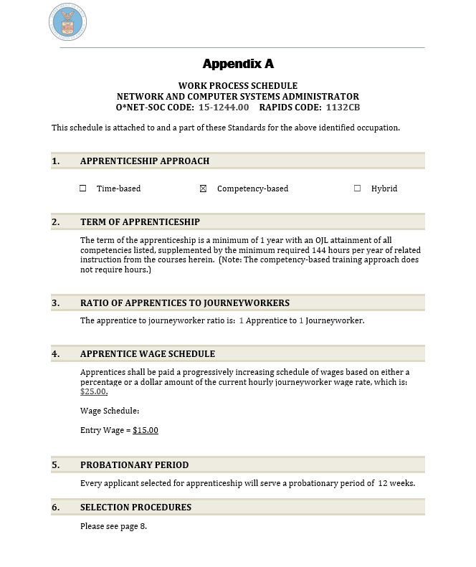
Develop and Implement: Standards Review = SSLO
Discuss Program Standards
Mapping to IET Program
Minimum qualifications
Selection procedures
Ideal core knowledge (RI)
Ideal basic foundational skills (OJL)
Evaluate program for alignment
RTI Curriculum
WBL or OJL
Required hours (for IET programs) or competencies (for IET programs)
Notes:
KA discuss program standards
MC maps to IET during the co-planning and designing process

Slide 28
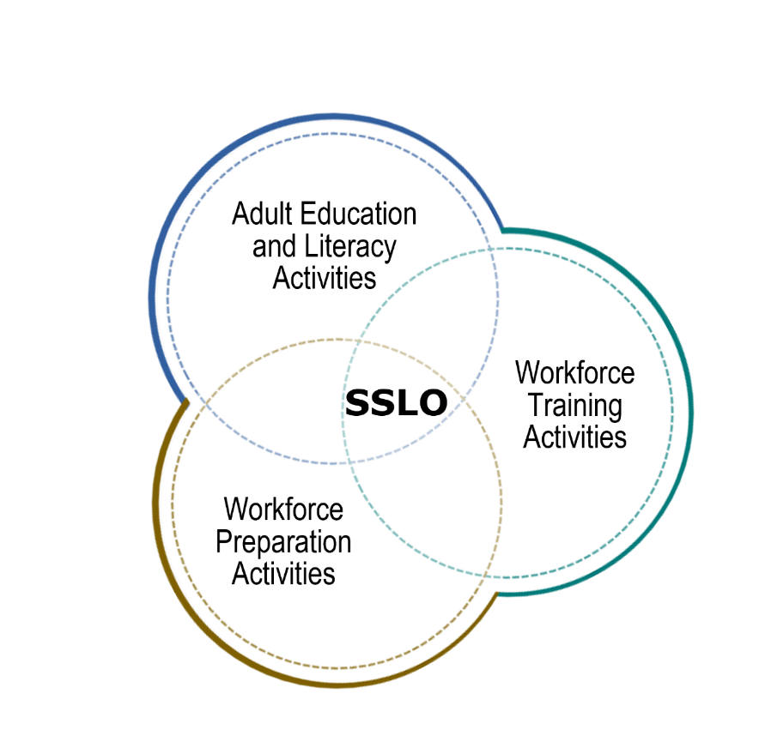
Develop and Implement: Standards Review = SSLO
An IET program has a single set of learning objectives that identifies the specific:
Adult education content
Workforce preparation activities
Workforce training (RA program) competencies
Program activities are organized to function cooperatively.
Together, the individual integrated learning objectives become the single set of learning objectives for the IET / pre-apprenticeship program.
Example: OJL
Notes:
KA discuss program standards
MC maps to IET during the co-planning and designing process

Slide 29
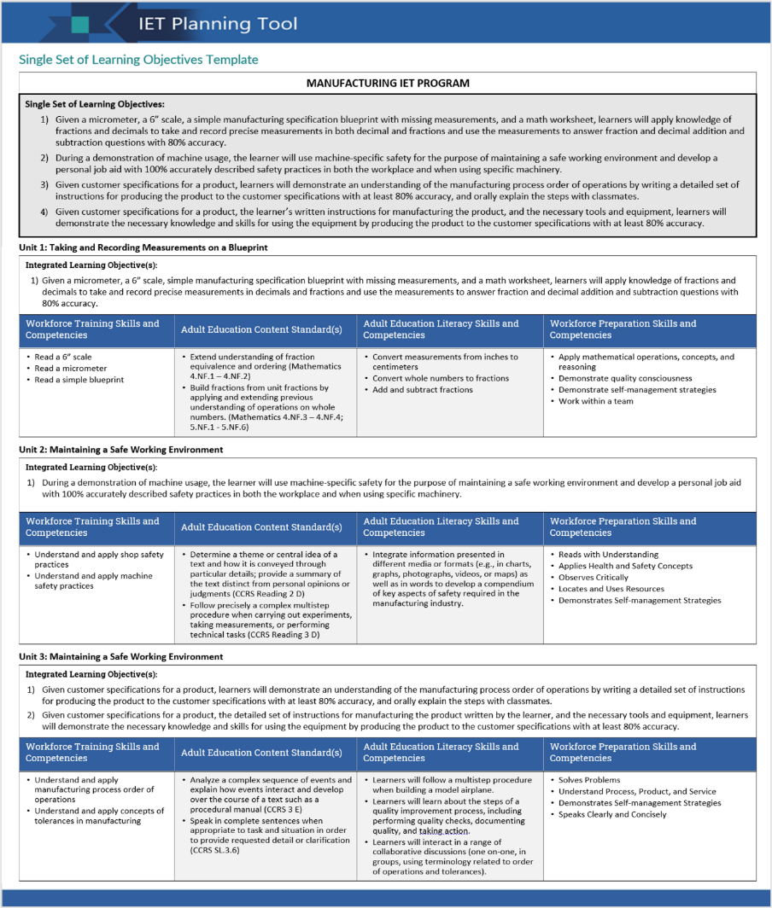
Example of a Completed SSLO Template
Notes:
MC
You can find this template in the IET Design Toolkit Here’s what a completed SSLO template (what we have been describing as a mapping process) for a three-unit IET Pre-apprenticeship program might look like.
This template works for when you are identifying the workforce training skills and competencies first and then creating the integrated learning objectives for the program’s SSLO.
You can see the list of learning objectives that make up the SSLO in the top gray portion.
Below that section are three separate tables—one for each unit of instruction.
Katie is going to walk us through other elements of the planning and development process.
NEXT SLIDE

Slide 30
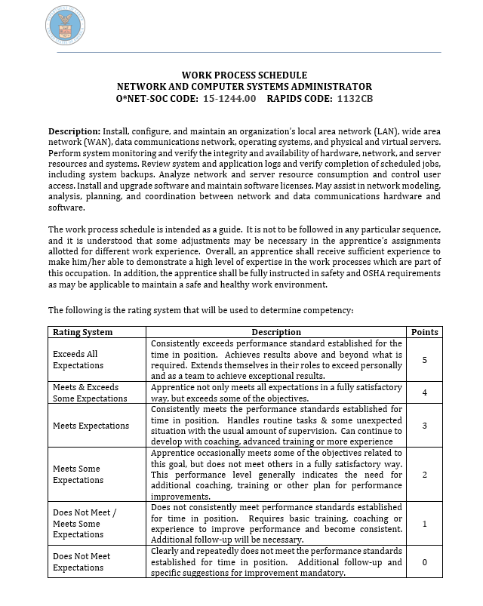
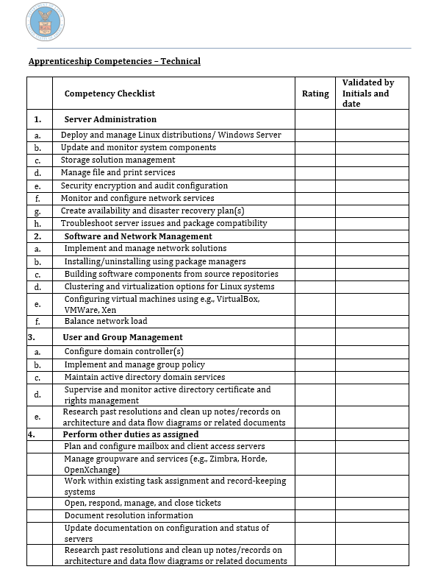
Develop and Implement: On the Job Learning = Workforce Training
All RAPs have Work Process (OJL) Outlines
Show model:
Time-based
Hybrid
Competency-based
Show core skills required for RAP – can map to IET
Notes:
Katie
Ensure that program participants understand the career pathway and strategies for a smooth transition to from the pre-apprenticeship to RA program.
Integrate into programs in three ways:
Include intentional activities that orient learners to the full career pathway, including on ramps, off ramps, transferrable skills
Provide counseling customized to individual learners, including goal setting and transitional supports.
Integrate activities into the curriculum, e.g., OJL, job shadow experiences.

Slide 31
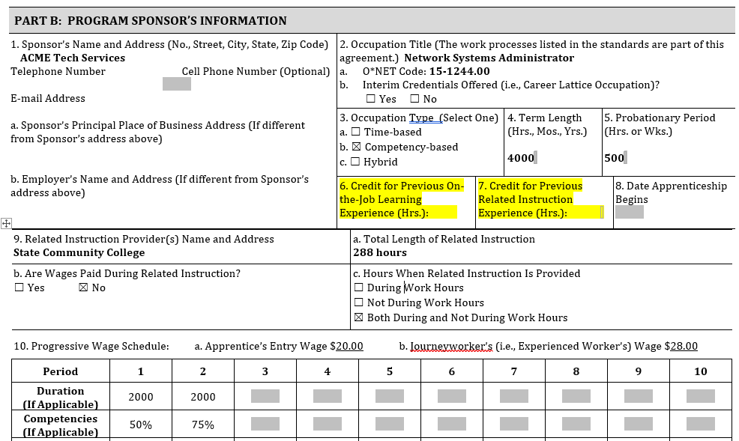
Develop and Implement: Credit for Previous Experience (CPE) & Credit for Prior Learning (CPL)
Reporting IET Pre-Apprenticeship Work through CPE/CPL to RAP Sponsor
Maximizes students’ pre-apprenticeship program time
Accelerates apprentice program completion timeframe
Notes:
Katie

Slide 32
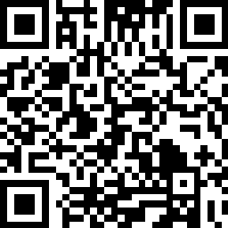
Let’s get started!
Notes:
MC first two and NK last two
Hopefully, this has gotten everyone excited about the possibility of bringing a pre-apprenticeship/IET program to your learners. To get going, your very first action step would be to identify partners sponsoring or supporting an RA and then secondly, if not familiar to you already scout out those community organizations that can provide supportive services for our learners.
After solidifying your partner employer, and possibility RA sponsor, the co-planning work begins. Assemble your Design team and together define the goals for the pre-apprenticeship from the participant, program, and partner’s perspective.
With your goals in mind, it’s time for the co-planning the curriculum to include contextualizing the adult education and literacy activities within the workforce training skills, identifying workforce prep activities, short-term certifications, then aligning the IET with the RTI requirements for CPL. The IET Toolkit will be invaluable in this phase of the process. Nicole is going to talk us through the next parts
NK
We have talked a good deal about these elements previously, links are embedded here to some of the key partners, materials, and resources (including a QR code to the COE website resources).

Slide 33
Thank You and Resources
Katie Adams
Chief Development Officer
katie.adams@safalpartners.com
Michelle Carson
Senior Director
michelle.carson@safalpartners.com
Nicole Klues
Project Director
nicole.klues@safalpartners.com
Access Resources, Request TA:
https://dolcoe.safalapps.com
Scan to Become a Center Partner!
Notes:
Katie

