Slide 1
Braiding Grants and Workforce Funding for Apprenticeship Supportive Services

Slide 2
Presenters
Katie Adams
Angela Baker
Chief Delivery Officer
Safal Partners
Registered Apprenticeship
Subject Matter Expert
Safal Partners
Safal Partners © 2023

Slide 3
Welcome and Agenda
Center of Excellence Overview
Funding Sources to Support Registered Apprenticeship (RA)
Braiding Funds for RA
Spotlight: Special School District of St. Louis County’s Adult CTE Department
Scenarios
Questions and Discussion
Safal Partners © 2023

Slide 4
Center of Excellence Overview
U.S. DOL initiative to increase systems alignment across apprenticeship, education, and workforce
Led by Safal Partners; 5 national partners
We provide no-cost TA including:
Monthly webinars
Quarterly virtual office hours
Individual TA/coaching sessions
Online resources (desk aids, guides, frameworks, etc.)
Visit our website, request TA

Slide 5
Online Resources, On-Demand TA
Registered Apprenticeship Partner Profile Questionnaire
https://dolcoe.safalapps.com/resources/resourcesandtools

Slide 6
Funding Sources, Supportive Services for RA
Safal Partners © 2023

Slide 7
Five Components of RA
Employer Involvement
Structured On-the-Job Learning (OJL)
Related Instruction (RI)
Rewards for Skill Gains
National Occupational Credential
Safal Partners © 2023

Slide 8
Supportive Services
Community services
Transportation
Dependent care
Housing
Needs-related payments
Educational testing
Accommodations for disabilities
Legal aid services
Referrals to health care
Work attire and work tools
Necessary items for postsecondary education classes
Payments and fees for employment and training-related applications, tests, and certifications.
Safal Partners © 2023
Notes:
Services may include, but are not limited to, the following:
(a) Linkages to community services;
(b) Assistance with transportation;
(c) Assistance with child care and dependent care;
(d) Assistance with housing;
(e) Needs-related payments, as described at §§ 680.930, 680.940, 680.950, 680.960, and 680.970;
(f) Assistance with educational testing;
(g) Reasonable accommodations for individuals with disabilities;
(h) Legal aid services;
(i) Referrals to health care;
(j) Assistance with uniforms or other appropriate work attire and work-related tools, including such items as eyeglasses and protective eye gear;
(k) Assistance with books, fees, school supplies, and other necessary items for students enrolled in postsecondary education classes; and
(l) Payments and fees for employment and training-related applications, tests, and certifications.

Slide 9
A World of Funding Options
Workforce System
Workforce Innovation and Opportunity Act (WIOA)
Non-WIOA Funding
Federal Funding
State-Based Funding
Private Funding
Safal Partners © 2023
Notes:
Services may include, but are not limited to, the following:
(a) Linkages to community services;
(b) Assistance with transportation;
(c) Assistance with child care and dependent care;
(d) Assistance with housing;
(e) Needs-related payments, as described at §§ 680.930, 680.940, 680.950, 680.960, and 680.970;
(f) Assistance with educational testing;
(g) Reasonable accommodations for individuals with disabilities;
(h) Legal aid services;
(i) Referrals to health care;
(j) Assistance with uniforms or other appropriate work attire and work-related tools, including such items as eyeglasses and protective eye gear;
(k) Assistance with books, fees, school supplies, and other necessary items for students enrolled in postsecondary education classes; and
(l) Payments and fees for employment and training-related applications, tests, and certifications.

Slide 10
WIOA - In School Youth (Ages 14-21)
Eligibility
Funding Sources
Age: 14 to 21
Attending school
One or more barriers:
Low income
Basic skills deficient
English language learner
Justice system-involved
Homeless
Parenting
Has a disability
Paid Work Experience
On-the-Job Learning (OJL) reimbursement
Supportive Services
25% WIOA Youth Funding – IS Youth
Safal Partners © 2023
Notes:
An ISY is an individual who is: (a) Attending school (as defined by State law), including secondary and postsecondary school; (b) Not younger than age 14 or (unless an individual with a disability who is attending school under State law) older than age 21 at time of enrollment;
Under federal guidance, the maximum amount of youth funds allowable for ISY: 25%
Low-income: receiving or eligible to receive free or reduced lunch
Potential Funding Sources:
ISY can fund paid work experience, this can be done through what is referred to as WEX (work experience) or OJT (On the job training) this would cover OJL reimbursement to the employer. The other potential funding is supportive services. Note: ISY cannot use ITAs, ITAs are used typically for the funding of occupational skills training.
Eligibility:
Age: 14 to 21
Attending school (secondary or postsecondary)
Low income
One or more additional conditions
Basic skills deficient
English language learner
An offender
Homeless, a runaway, or (previously) involved with the foster care system
Pregnant or parenting
Has a disability
Requires additional assistance to enter or complete education or enter or sustain employment

Slide 11
WIOA - Out of School Youth (Ages 16-24)
Eligibility
Funding Sources
Age: 16-24
Not attending school
One or more barriers to employment
Occupational Skills Training
Related Instruction (RI) tuition
Paid Work Experience (OJL reimbursement)
Supportive Services
75% WIOA Youth Funding – OOS Youth
Safal Partners © 2023
Notes:
Eligibility: The youth cannot be younger than the age of 16 or older than the age of 24 at the time of enrollment. They need to be not attending school, either a dropout or a recipient of a secondary school diploma or it’s equivalent. They must also have one or more barriers to employment. These barriers include: a school dropout, basic skills deficient or ELL, an offender, homeless, in foster care or aged out of foster care, pregnant or parenting, individual with a disability, or low income and in need of additional assistance to enter or complete an education program or secure or hold employment.
Note on funding requirements: “Priorities: Out-of-School Youth – A minimum of 75 percent of the Youth funds allocated to States and local areas, except for the local area expenditures for administration, must be used to provide services to OSY. Work Experience – Not less than 20 percent of Youth funds allocated to the local area, except for the local area expenditures for administration, must be used to provide paid and unpaid work experiences.”
Potential Funding Sources:
OSY can fund occupational skills training, which would be the RI tuition for an RA program. They can also help with paid work experience, this can be done through what is referred to as WEX (work experience) or OJT (On the job training) this would cover OJL reimbursement to the employer. The other potential funding is supportive services.

Slide 12
WIOA – Adult (Age 18+)
Eligibility
Funding Sources
Age: 18 or older
U.S. citizen or authorized to work in the U.S.
Selective Service Registration, as required
Occupational Skills Training (RI tuition)
On-the-job Training (OJL reimbursement)
Supportive Services
Safal Partners © 2023
Notes:
Selective Service: males who are 18 or older and born on or after January 1, 1960, unless an exception is justified.
For low-income requirements refer to state and local policies on any income or self sufficiency limits. Standard Low-income criteria: SNAP recipient, TANF recipient, SSI; family income does not exceed poverty line or is 70% of the lower living standard; is homeless; is a foster child; individual with a disability whose own income does not meet the income requirements
Priority of Service:
Veterans and eligible spouses who meet low-income criteria OR are basic-skills deficient (BSD) or English Language Learners (ELL)
Non-veterans who meet low-income criteria OR are BSD or ELL
Veterans or eligible spouses who do NOT meet WIOA low-income criteria and are NOT BSD or ELL
Non-veterans who do NOT meet WIOA low-income criteria and are NOT BSD or ELL but who have one or more significant barriers to full-time employment that leads to self-sufficiency
Disability, homelessness, offender, no high school diploma or GED, poor work history, lack of occupational skills for a self-sufficient family wage
TEGL 7-20: 75% of adults served should be in a priority population (low-income, BSD, ELL, Veterans or qualified spouses
Potential funding sources: Adult funding can be used to support occupational skills training for RI tuition, on-the-job training funds which can be used for OJL reimbursement, or supportive services.

Slide 13
WIOA – Additional Sources
Dislocated Worker
Incumbent Worker
Available to certain laid off or unemployed workers
Could provide occupational skills training costs, on-the-job training costs, and/or supportive services
Designed to meet requirements of an employer to retain a skilled workforce or avert a layoff
Commitment from employer to retain workers trained
Safal Partners © 2023
Notes:
Dislocated Worker is another type of WIOA formula funding. The eligibility for dislocated worker gets more in depth but is intended for individuals who have been laid off or received layoff notice from their employer. These include business closures as well as smaller layoffs. The services available to a dislocated worker will be similar to the adult services which can provide occupational skills training, OJT costs and/or supportive services. The main difference here is eligibility and the funding that a local area may have available. Every state and local area has allocations for both dislocated worker participants and adult participants.
Incumbent Worker Training (IWT) is a type of work-based training and upskilling designed to ensure that employees of a company can acquire the skills necessary to retain employment and/or advance within the company, or to acquire the skills necessary to avert a layoff. IWT is an employer service designed to develop a highly skilled workforce which will result in increased financial viability, stability, competitiveness, and productivity. To avert the risk of closing, IWT may be developed with a business or business association to maintain its competitive status, incorporate new technology, or prevent downsizing. IWT can also be an important means of ensuring an adequate workforce for vital community services, whether in the private or public sector. Workers participating in IWT will benefit by enhancing their existing skills, learning new skills, or earning employer- or industry-recognized credentials, in addition to retaining employment, maintaining their careers, and/or increasing their earnings potential. IWT will also allow the opportunity for back-filling vacated positions resulting from the promotion of newly trained workers. Local workforce development areas (local areas) can use up to 20 percent of their Adult and Dislocated Worker program allocations to provide for the federal share of the cost of providing IWT, you will want to check local and state policy on IWT to see how your local area uses IWT and the availability of funding.

Slide 14
WIOA – Additional Sources 2
Dislocated Worker
Incumbent Worker
Available to certain laid off or unemployed workers
Could provide occupational skills training costs, on-the-job training costs, and/or supportive services
Designed to meet requirements of an employer to retain a skilled workforce or avert a layoff
Commitment from employer to retain workers trained
Safal Partners © 2023
Notes:
Dislocated Worker is another type of WIOA formula funding. The eligibility for dislocated worker gets more in depth but is intended for individuals who have been laid off or received layoff notice from their employer. These include business closures as well as smaller layoffs. The services available to a dislocated worker will be similar to the adult services which can provide occupational skills training, OJT costs and/or supportive services. The main difference here is eligibility and the funding that a local area may have available. Every state and local area has allocations for both dislocated worker participants and adult participants.
Incumbent Worker Training (IWT) is a type of work-based training and upskilling designed to ensure that employees of a company can acquire the skills necessary to retain employment and/or advance within the company, or to acquire the skills necessary to avert a layoff. IWT is an employer service designed to develop a highly skilled workforce which will result in increased financial viability, stability, competitiveness, and productivity. To avert the risk of closing, IWT may be developed with a business or business association to maintain its competitive status, incorporate new technology, or prevent downsizing. IWT can also be an important means of ensuring an adequate workforce for vital community services, whether in the private or public sector. Workers participating in IWT will benefit by enhancing their existing skills, learning new skills, or earning employer- or industry-recognized credentials, in addition to retaining employment, maintaining their careers, and/or increasing their earnings potential. IWT will also allow the opportunity for back-filling vacated positions resulting from the promotion of newly trained workers. Local workforce development areas (local areas) can use up to 20 percent of their Adult and Dislocated Worker program allocations to provide for the federal share of the cost of providing IWT, you will want to check local and state policy on IWT to see how your local area uses IWT and the availability of funding.

Slide 15
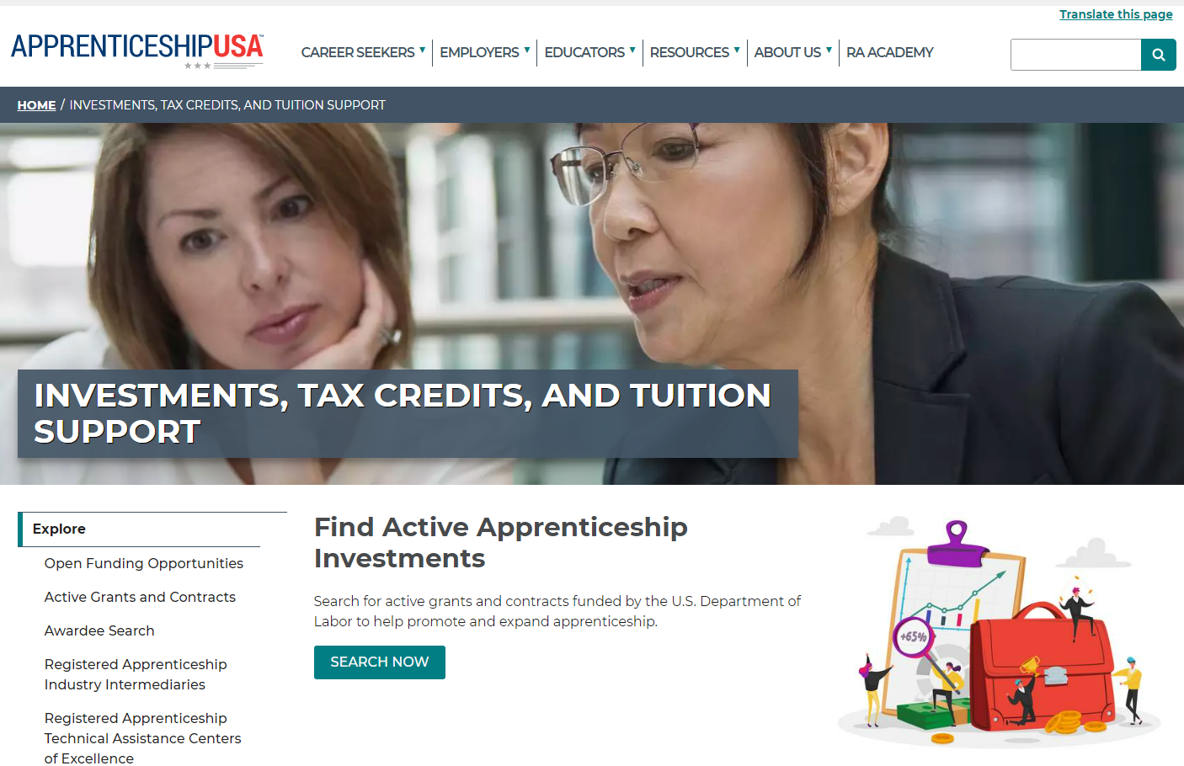
DOL Grants and Contracts
Types
Industry Intermediary, Youth Contracts
H-1B, OA RA Grants (ABA, CSG, Scaling Apprenticeship)
Sources of Support
Incentive funding
Program sponsorship
Related Instruction
Technical Assistance
Safal Partners © 2023

Slide 16
State Funding, Private Sources
Increasing number of states providing:
Direct incentive (per apprentice) funding
Tuition subsidy to offset RTI costs
Grants to support program start-up, expansion, sustainability
Private foundations increasingly supporting RA and youth RA
Safal Partners © 2023

Slide 17
Spotlight: Special School District (SSD) of St. Louis County’s Adult CTE Department
Safal Partners © 2023

Slide 18
SSD Adult Technical Education
Healthcare S.T.A.R.S (Successful Training pre-Apprenticeship with Resource Support) Program
Funding:
Previous - Missouri Apprentice Ready (MAR)
covered program costs and limited supportive services
Current - Gateway Apprenticeship Hub – ABA Grant
covers certain costs and related/approved supportive services
Safal Partners © 2023
Notes:
SSD Adult Technical Education Programs
Healthcare S.T.A.R.S (Successful Training pre-Apprenticeship with Resource Support) Program
Funding:
Previous funding Missouri Apprentice Ready (MAR) Funding – covered program costs and limited supportive services.
Current funding Gateway Apprenticeship Hub – ABA Grant – covers certain costs and related/approved supportive services.

Slide 19
SSD Adult Technical Education 2
Certified Nurse Assistant (CNA) Apprenticeship Program, Multiple Occupations
Funding:
WIOA Title 1B – Individual Training Account (ITA) – Related Instruction
National Industry Intermediaries
Missouri Apprentice Ready (MAR)
Health Careers Advancement Program (HCAP)
Urban Institute, covers youth apprentices ages 16-21
Safal Partners © 2023
Notes:
Certified Nurse Assistant (CNA) Apprenticeship Program, Multiple Occupations
Funding:
WIOA Title 1B – ITAs – funds the related instruction component and WIOA available supportive services funding
Missouri Apprentice Ready (MAR) – funds cover supportive services and/or a portion of program cost
Health Careers Advancement Program (HCAP), National Industry Intermediary – covers a variety of costs and supportive services
Urban Institute, National Industry Intermediary, covers youth apprentices ages 16-21 years of age, funding covers a variety of costs and supportive services

Slide 20
RA Program Outcomes
74 Percent Completion Rate
Program outcomes prior to supportive services funding
78 Percent Completion Rate
Program outcomes after supportive services funding
Safal Partners © 2023

Slide 21
Braiding Funds to Support RA
Students
WIOA
Veterans Benefits
SNAP/TANF
Tuition
Fees
Supplies
Wrap-Around Services
Institution
State/Federal Grants
DOL – Apprenticeship Grants
State Workforce Grants
Adult Ed Grant Funds
Safal Partners © 2023

Slide 22
Example of Braiding Funding
Julie - $6000 income/yr, 1 child, single, 20yo
Goes to the American Job Center
Says she wants to be a Nurse (CNA)
LWC looks at the ETPL
Is co-enrolled in WIOA Title 1 and an RA program
Now she qualifies for supportive services
HCAP
MAR Grant
Youth – Urban Institute
Supportive Services
Pre-Apprenticeship
Transportation Assistance
Registered Apprenticeship
SNAP/TANF
Child-Care
Rent Assistance
Transportation
WIOA Individual Training Account (ITA)
Safal Partners © 2023

Slide 23
Key Points for Braiding Funding
Safal Partners © 2023

Slide 24
Can You Braid Funding to Support Your Students?
Identify most likely supportive service needs of students
Identify potential funding sources
Create a plan for each funding source
Coordinate with the organizations providing funding
Allocate funds from each source according to your program's budget
Ensure compliance with the regulations of each funding source
Maintain clear and accurate financial records
Safal Partners © 2023
Notes:
Identify all potential funding sources, including federal grants, state funding, industry contributions, private donations, and more, to support grant activities, particularly covering RTI and OJT costs.
Create a comprehensive plan outlining the purposes, activities, and costs associated with each funding source.
Coordinate with the agencies providing the funds and secure their support for your efforts to combine funds effectively.
Allocate funds from each source according to your program's budget, covering various aspects such as apprentice wages, instructional costs, materials, and administrative expenses.
Ensure compliance with the regulations of each funding source, meeting reporting requirements, and documenting fund utilization.
Maintain clear and accurate financial records for each funding source, facilitating auditing and accountability processes.

Slide 25
Next Steps
Safal Partners © 2023

Slide 26
Workforce Collaboration Scenario
Scenario:
Work with LWB to get on ETPL
Work with AJC to co-market program
LWB can do on-site pre-eligibility screening at program event
Initial WIOA or non-WIOA determination
Enroll students for supportive services
LWB can go onsite to do soft skills training, career building work
Safal Partners © 2023

Slide 27
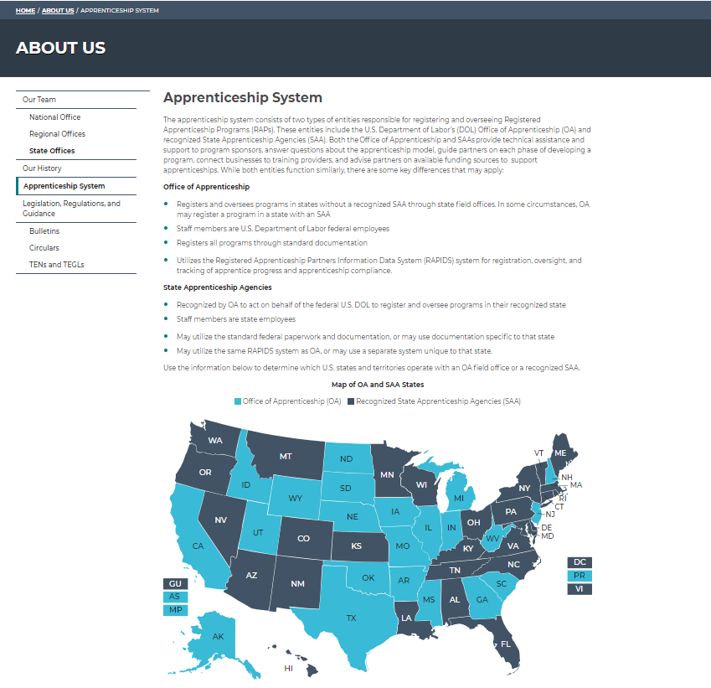
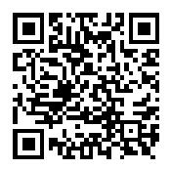
Suggested Next Steps
Meet with LWB to discuss:
funding opportunities
board’s support of RA programs, policies
getting on ETPL
Meet with local apprenticeship training representative (ATR)
Identify local/regional apprenticeship networks
Safal Partners © 2023

Slide 28
Questions and Discussion

Slide 29
Contact Us, Become a Partner
Scan for Partner Form
Katie Adams
Chief Delivery Officer
Safal Partners
Katie.Adams@SafalPartners.com
Angela Baker
Subject Matter Expert
Safal Partners
Angela.Baker@safalpartners.com

Slide 30
Email us your questions at RA_COE@SafalPartners.com
For more information, visit: dolcoe.safalapps.com
Safal Partners © 2023

