Slide 1
Apprenticeship 201: The Next Level of Success and Sustainability for Apprenticeship Programs and System Alignment
April 25, 2024

Slide 2
Presenters
Melissa Aguilar-Southard Director and Lead SME, Safal Partners
Haylie Schuster Engagement Manager, Safal Partners
Angela Baker Subject Matter Expert, Safal Partners
Safal Partners © 2024

Slide 3
Welcome and Agenda
Center of Excellence Overview
Registered Apprenticeship (RA) Alignment with WIOA Performance Metrics
Levels of Alignment Overview
Enhancing Alignment – Promising Practices
Questions
Wrap Up
Safal Partners © 2024

Slide 4
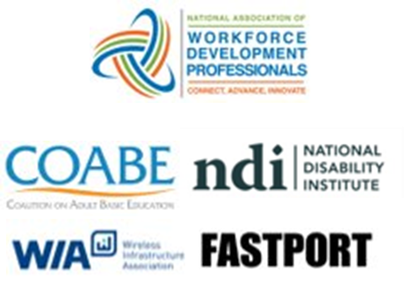
1. Center of Excellence Overview
U.S. DOL initiative to increase systems alignment across apprenticeship, education, and workforce
Led by Safal Partners
Collaboration with five national partners
4

Slide 5
2. Center of Excellence Overview
We provide no-cost TA including:
Monthly webinars
Quarterly virtual office hours
Individual TA/coaching sessions
Online resources (desk aids, guides, frameworks, etc.)
DOL CoE Resource and Tools
Visit our website & request TA
4

Slide 6
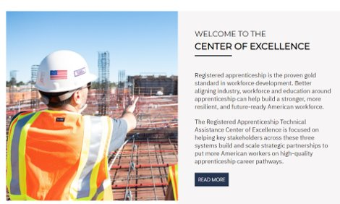
Online Resources, On-Demand TA
Registered Apprenticeship Partner Profile Questionnaire
DOL CoE Resource and Tools
5

Slide 7
Key Apprenticeship Stakeholders

Slide 8
Key Apprenticeship Partners and Stakeholders
USDOL Office of Apprenticeship or State Apprenticeship Agency
RA Program Sponsors & Employers
Educational Institutions
Unions/Labor Organizations
Intermediaries
Workforce System Organizations
Community-Based Organizations
8

Slide 9
What Do Partners Provide?
Paid on-the-job Learning (OJL)
Related Instruction (RI)
Supportive Services
Technical Assistance (TA)
Funding
Apprentice/Employer Recruiting
RA Program Awareness
9

Slide 10
RA Alignment with WIOA Performance Metrics
10
Safal Partners © 2024

Slide 11
1. RA Alignment with WIOA Performance Metrics
Percentage of apprentices who complete the program and still with their employer one year later?
RA helps you meet WIOA 2nd and 4th quarter employed
91%
RA provides skills training that aligns for both education and the workforce system for the credential attainment common measure.
Percentage of apprentices who complete the program and receive a credential?
100%
11
Safal Partners © 2024
Notes:
Haylie

Slide 12
2. RA Alignment with WIOA Performance Metrics
Higher median earnings after 2nd quarter is also usually met since RA programs require wage increase(s).
Average starting salary of RA completers?
$70- $80K
RA is a collaborative workforce development strategy; it helps you move beyond transactional relationships with businesses to meet the effectiveness in serving employers performance measure.
# of employers, more than # of occupations, positive post-program benefits between $$$ / year
150K
1000
$25-30K
12
Safal Partners © 2024
Notes:
Haylie

Slide 13
Gauging Your RA System Alignment
13

Slide 14
RA System Alignment Is….
Convening stakeholders (business, education, workforce, economic development, etc.) to effectively expand RA for key sectors, occupations, and populations.
Not a top-down or bottom-up strategy – rather it is a collaborative network strategy.
A process that is often non-linear, but always seeks to make RA more effective for the community being served.
A way to build future-ready talent pipelines when it is truly integrated into education and workforce systems.
Able to 10x impact across key areas such as policy alignment, job seeker referrals, employer costs, and WIOA performance measures.
14

Slide 15
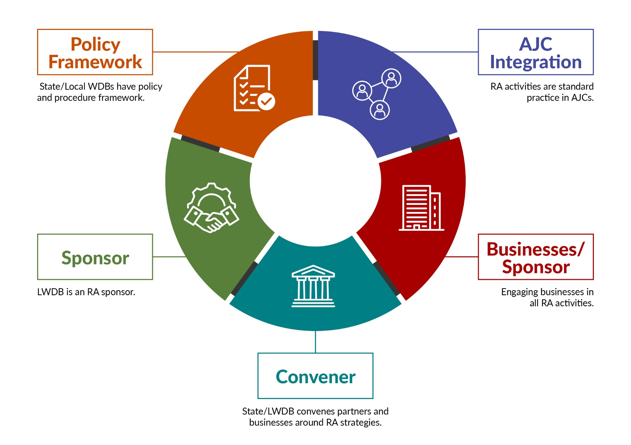
RA System Alignment
15

Slide 16
Purpose of RA Alignment Tool
Origin… Discussions with DOL Office of Apprenticeship (OA) re: visualizing alignment of RA activities
Purpose… Meant as a tool for you to enhance your RA activities
Soft Rollout for Feedback… ETA Vision 2030 Convening (Chicago), COE December and January Office Hours
16

Slide 17
Policy Framework - Indicators
Indicators of having a strong policy framework to align RA are:
RA representative on WDB
RAPs on ETPL
WIOA Plans set goals for RA and inclusion of underserved populations
Co-enrollment policy directives
RA funding allocations
Partners are engaged in RA activities
State/Local WDBs streamline policies and processes to make it easier for businesses to use RA, (i.e., maintaining an inventory of RTI curriculum)
17

Slide 18
Policy Framework – Actionable Items
Actionable Items:
Seek out RA representatives for WDB membership from labor and non-labor sources
Review and revise policies to ensure inclusiveness of RA activities internally
Establish state/local RA steering committee
Streamline process to include RAPs on state/local ETPLs
Advocate for dedicated funding allocations for RA activities, including dedicated staff in the America’s Job Centers (AJC)
Create MOUs with non-traditional partners for targeted population engagement
18

Slide 19
AJC Integration - Indicators
Indicators that RA expertise is integrated into each AJC to support RA
Case managers purposefully screen and refer job seekers to RAPs
Co-enrollment procedures are used consistently by case managers and across all mandatory partners (i.e., TANF)
Apprentices are supported throughout the RA program
Mandatory partners work with AJCs to engage ‘shared’ job seekers in RAPs
Outreach to job seekers communicates the benefit of being an apprentice and focuses on underserved populations
Case managers receive RA training on a regular basis and may be considered an RA subject matter expert (SME)
Wagner-Peyser staff share RA information to job seekers and employers with a warm handoff to AJC / BSR staff as warranted
19

Slide 20
AJC Integration – Actionable Items
Actionable Items:
Ask regional Apprenticeship Training Representative (ATR) to provide RA training to staff on a regular basis or to hold regular meetings with staff on RA
Assign staff to be apprenticeship SMEs
Provide staff with a listing of all RAPs in the region
Provide a desk guide to ensure co-enrollment is entered in case management system
Embed a RA SME with offsite Mandatory partners to focus on RA work with their job seekers and employers
20

Slide 21
Businesses / Sponsors - Indicators
Indicators to demonstrate employers are supported with RA as a talent pipeline solution:
BSRs….
guide employers through the RA process, from hiring an apprentice to becoming a RAP Sponsor
drive outreach to businesses about the benefits of RAPs, including availability of On-the-Job Training (OJT) funds
interact with intermediaries to assist businesses with RAP development
provide collateral and education to partners for their business engagement efforts
communicate regularly with case managers about apprenticeship openings
regularly work with regional ATRs to promote and develop RAPs
State/local Rapid Response efforts include RA activities
21

Slide 22
Businesses / Sponsors – Actionable Items
Train BSRs on RA, including using intermediaries and working with region ATRs
Host roundtables and apprenticeship accelerators for businesses to learn about RA collectively
Create/share Apprenticeship.gov materials re: RA benefits for employers
Host apprenticeship job fairs to fill open positions
Present RA information at employer events (e.g. Chamber of Commerce, Economic Development)
Use OJT contracts to support businesses costs of apprenticeship
Set up regular communication with ATRs and partner organizations regarding RAPs
State encourages and provides guidance on using Rapid Response funds for RA
22

Slide 23
Convenor- Indicators
Indicators to demonstrate stakeholder engagement:
State/Local WDBs provide regional RA information sessions to economic development organizations, businesses, and public sector entities
Sector Strategy initiatives include RA as a strategy for building the talent pipeline
Create and maintain a network (hub) of RA sponsored programs to accelerate employer participation and to provide technical assistance
State/Local WDBs collaborate on high-demand, industry specific RA programs including technical assistance and funding
Collaborative RA efforts include mandatory partners as part of convening activities
23

Slide 24
Convenor- Actionable Items
Actionable Items:
State/LWDB evaluate Labor Market Information (LMI) to establish high-demand occupational focus for RA
Engage State or LWDB to jointly establish and host RA hubs
Engage State ATRs to jointly develop RA standards for businesses at the local level
Engage public sector entities to develop group RA programs
State and/or local WDB pursue funding to support industry specific RA initiatives
24

Slide 25
Sponsor - Indicators
Indicators for WDB as a RA Sponsor:
LWDB has a RAP for in-demand occupation(s)
Occupations are regularly added to RAP based upon labor market information
Educational system is engaged with LWDB to provide Related Instruction (RI) as warranted for occupations
RA sponsorship is sustainable through braided funding (i.e., WIOA, grants, partner resources)
LWDB uses sponsorship to target underserved populations for RA programs
LWDB provides the administrative support, mentor training, and technical assistance to employers joining the RAP
LWDB ensures ability to support businesses/apprentices longer term with WIOA and non-WIOA funding
25

Slide 26
Sponsor – Actionable Items
Actionable Items:
Connect with LWDBs who are RA sponsors to understand the process
Determine high-demand occupation to begin RA sponsorship through convening and LMI data
Engage with State ATRs to complete the RA paperwork
Host regular meetings with businesses/public sector to ensure their engagement in the RA once established
Work with educational partners to establish Related Instruction partnerships
26

Slide 27
Additional Opportunities…
27

Slide 28
What is the Investing in America Agenda
The Investing in America Agenda - consists of extensive resources and rules to support the advancement of Registered Apprenticeship:
The Bipartisan Infrastructure Bill - $550 billion in new funds for infrastructure.
The CHIPS and Science Act - $52.7 billion for American semiconductor research, development, manufacturing, and workforce development.
The American Rescue Plan - $1.9 trillion recovery bill with more than $40 billion for workforce development.
The Inflation Reduction Act - Nearly $1.2 trillion in incentives for green energy and increased Affordable Care Act (ACA) subsidies.
Safal Partners © 2024

Slide 29
Real Numbers…
29

Slide 30
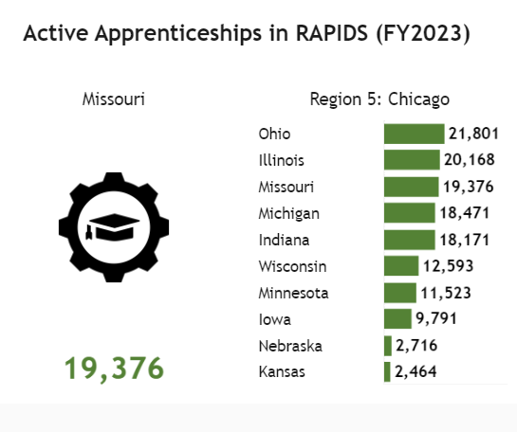
1. Where is Missouri in Co-Enrollment Numbers?
30

Slide 31
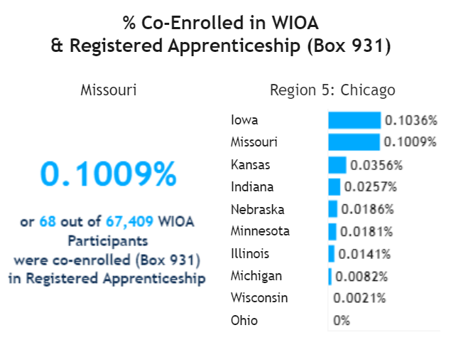
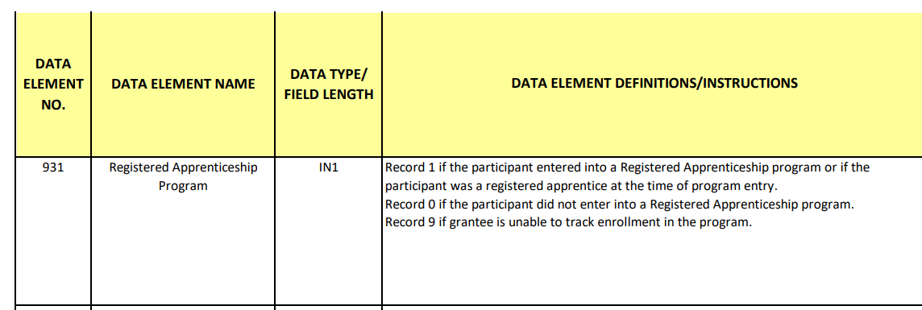
2. Where is Missouri in Co-Enrollment Numbers?
31

Slide 32
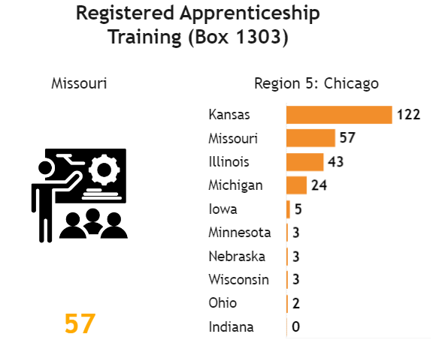
3. Where is Missouri in Co-Enrollment Numbers?
32

Slide 33
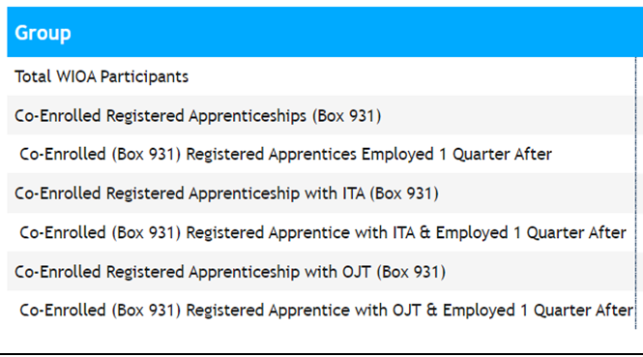
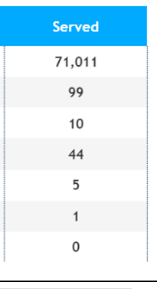
4. Where is Missouri in Co-Enrollment Numbers?
When using numbers to tell a story, report what’s most impactful to your reader or listener.
What’s impactful about these numbers?
33

Slide 34
Questions and Discussion
34

Slide 35
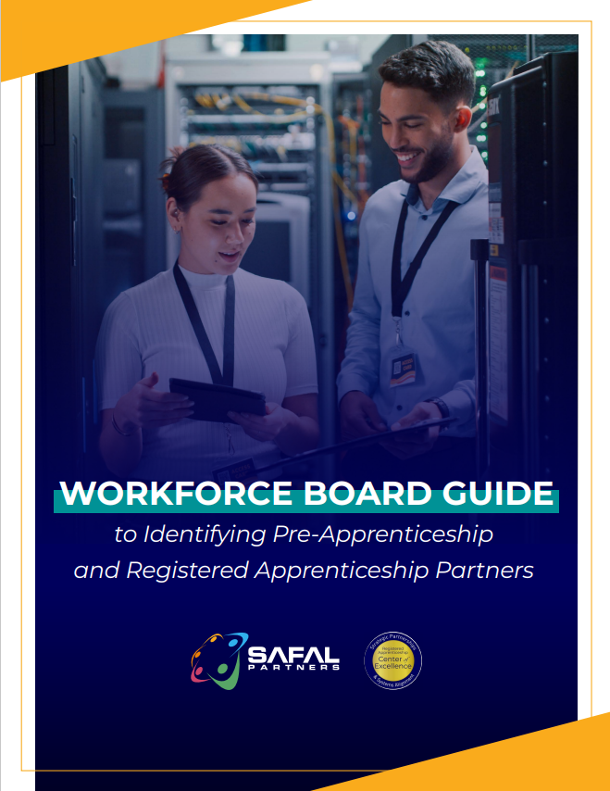
Resources
Workforce Board Guide to Identify Partnership
Registered Apprenticeship Partner Profile Questionnaire
35

Slide 36
Become a Center Partner
Receive no-cost expert TA, materials, and assistance
Network with potential partners nationwide
Be nationally recognized for your work
Be an Apprenticeship Partner Form
36

Slide 37
Email us your questions at RA_COE@SafalPartners.com
THANK YOU FOR JOINING US
For more information, visit: dolcoe.safalapps.com

