Slide 1
Unlocking Registered Apprenticeship and
Pre-Apprenticeship Opportunities
Grow Your Program with Employer Engagement
March 2024

Slide 2




Presenters
Katie Adams
Chief Delivery Officer
Safal Partners
Nicole Klues
Project Director
Safal Partners
Dr. Amber Gallup
Adult Education Director
NM Higher Education Department
Safal Partners © 2024

Slide 3

Welcome and Agenda
Center of Excellence Overview
Registered Apprenticeship and Pre-Apprenticeship
IET and Pre-Apprenticeship Alignment
Engagement Strategies
Questions and Discussion
Safal Partners © 2024

Slide 4


1. Center of Excellence Overview
U.S. DOL initiative to increase systems alignment across apprenticeship, education, and workforce
Led by Safal Partners; 5 national partners

Slide 5

2. Center of Excellence Overview
We provide no-cost TA including:
  Monthly webinars
  Quarterly virtual office hours
  Individual TA/coaching sessions
  Online resources (desk aids, guides, frameworks, etc.)
DOL CoE Resource and Tools
Visit our website, request TA

Slide 6

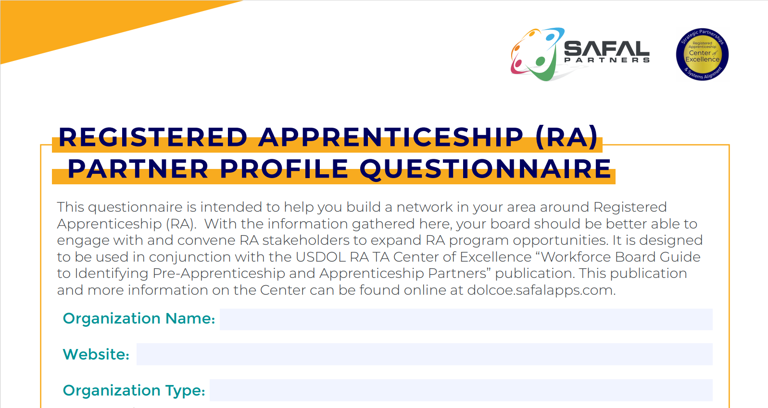

Online Resources, On-Demand TA
Registered Apprenticeship Partner Profile Questionnaire
DOL CoE Resource and Tools

Slide 7
1. Polling
How would you rate your knowledge of knowledge of Registered Apprenticeship?

Slide 8
Registered Apprenticeship and Pre-Apprenticeship
Safal Partners © 2024

Slide 9
What is Apprenticeship?
Registered Apprenticeship is an industry-driven, high-quality career pathway enabling employers to develop new hires and upskill current workers for critical occupations.
A Proven Workforce Solution
Safal Partners © 2024

Slide 10



Five Core Components
Employer Involvement
Structured On-the-Job Learning (OJL)
Related Instruction (RI)
Rewards for Skill Gains
National Occupational Credential
Safal Partners © 2024

Slide 11

Spans all Sectors
Healthcare
Cybersecurity
Information Technology
Education
Transportation
Construction
Financial Services
Advanced Manufacturing
Hospitality
Engineering
Energy
Tele-
communications

Slide 12
Benefits of Registered Apprenticeship
Benefits to employers:
Attract New Talent: 70% of workers would be “extremely” or “very” likely to switch to a new employer offering training opportunities
Proven ROI: Employers report on average $1.47 for every $1 invested in RA – highly cost effective in the long term
Diversify Workforce: With a training plan in place from day one, employers can take a skills-based approach to hiring which creates much larger, more diverse talent pipeline
Benefits to apprentices:
Cost: Much less costly for apprentice than traditional college
Retention Rate: 93% of apprentices who complete a Registered Apprenticeship retain employment
Credential: Culminates in a national occupational credential
Wages: Apprentices typically earn $300,000 more over their careers than peers
Sources: Gallup 2021, USDOL
Safal Partners © 2024

Slide 13
What is Pre-Apprenticeship?
A program or set of strategies designed to prepare individuals for entry into RAPs
Provides RA sponsors with established pipeline of candidates
Not federally regulated so more flexibility for developers in selecting components, establishing requirements
High-Quality Career Preparation
Safal Partners © 2024

Slide 14
Quality Framework for Pre-Apprenticeship Programs
Transparent entry and success requirements
Training and Curriculum Alignment w/ Needs of Employers
Skills training through OJL
Offer wraparound supports
Results in 1+ industry-valued credentials
Transition into RA program
Safal Partners © 2024

Slide 15

Strategy to Drive Equity
Reducing barriers to the job market often faced by marginalized populations
Promising pathway to Registered Apprenticeship Programs (RAPs)
Positive impact on earnings growth (nearly double)
Safal Partners © 2024

Slide 16
Aligning IET to Pre-Apprenticeship
Safal Partners © 2024

Slide 17
Integrated Education and Training (IET)
IET is “…a service approach that provides adult education and literacy activities concurrently and contextually with workforce preparation activities and workforce training for a specific occupation or occupational cluster for the purpose of educational and career advancement.”
Safal Partners © 2024

Slide 18
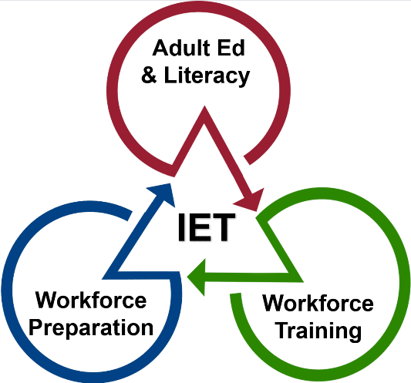
Three Components of Integrated Education and Training (IET)
Adult education and literacy activities, workforce preparation activities, and workforce training activities must:
Be of sufficient intensity and quality
Be based on the most rigorous research
Occur simultaneously
Use occupationally relevant materials
Be organized through a single set of learning objectives (SSLO) to include adult education content standards, workforce preparation skills, and workforce training competencies.
Be part of a career pathway
Safal Partners © 2024

Slide 19
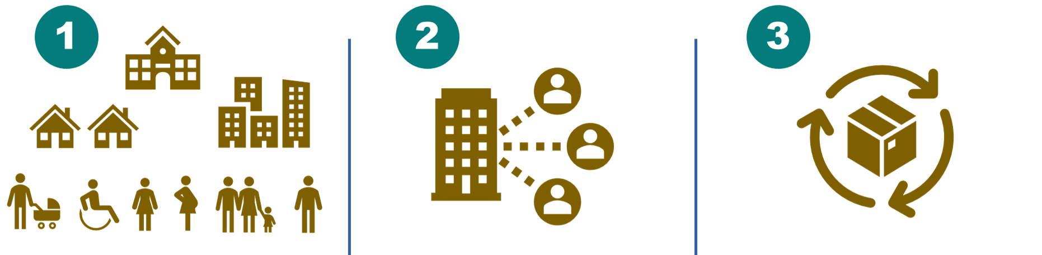
3 Guiding Principles for Pre-Apprenticeship IET Program Design
Design with learner and community needs in mind.
Collaborate with partners.
Adopt a continuous improvement approach.
Safal Partners © 2024

Slide 20
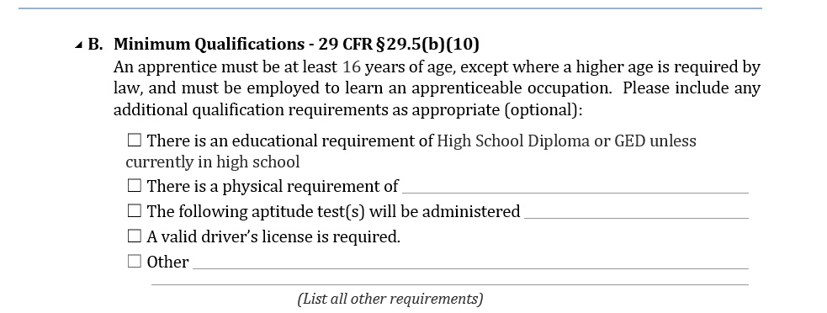

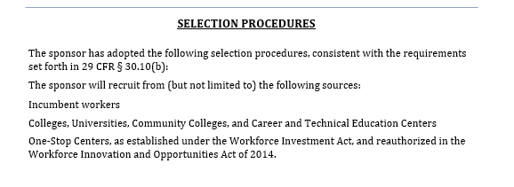
Design and Plan: RA Entry Requirements, Qualifications
All RA programs have Minimum Qualifications and Selection Procedures
Safal Partners © 2024

Slide 21
Design and Plan: Partnering for Enrollment and Services
Collaborate with Sponsors and Businesses
Ensure that pre-apprenticeship completers can access the RA program and how
Coordinate with Community and Workforce Partners
Identify potential support services for pre-apprentices to facilitate completion (i.e., transportation, equipment, etc.)
Use the IET Design Toolkit. Take the next steps in partnering to develop a pre-apprenticeship program.
Safal Partners © 2024

Slide 22
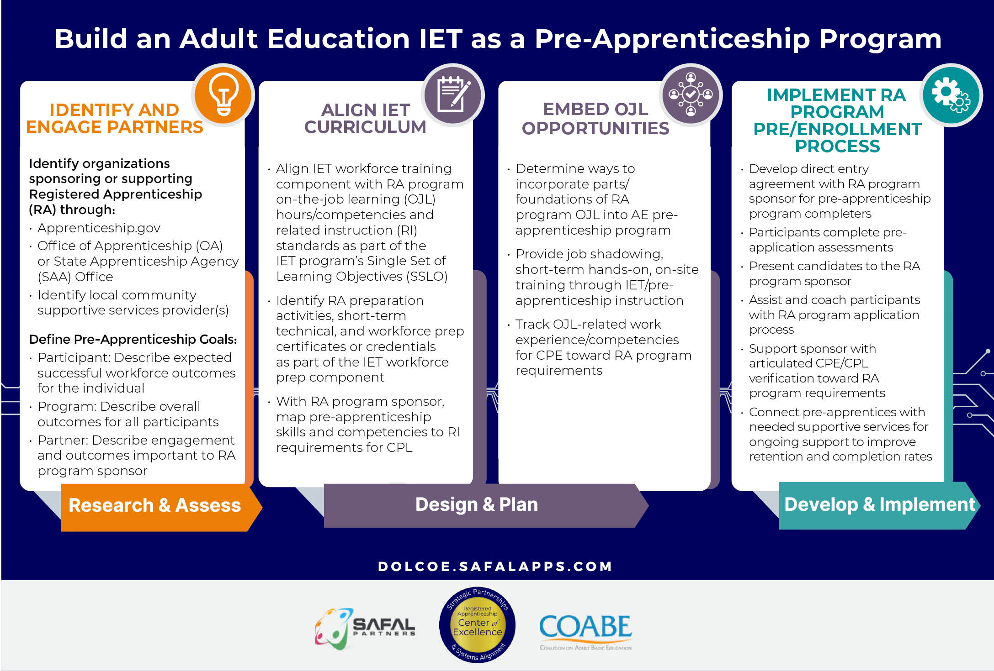
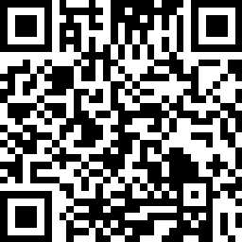
Bridging the Classroom to Careers through Apprenticeship

Slide 23
Employer Engagement: Expanding Opportunities
Safal Partners © 2024

Slide 24
RA Knowledge Surveys
Key Findings…
Workforce: 42% had "no" or "very little" understanding of how
to communicate benefits of RA to local employers
Workforce: 46% had "no" or "very little" or no knowledge of how RA correlates with key WIOA performance measures
Adult Education: 34% not currently partnering with a RA program
Adult Education: 32% of were not currently partnering with a LWDB to support RA
Sources: Final Baseline Report.pdf (safalapps.com)

Slide 25
2. Polling
Does your team work closely with local workforce board?
Safal Partners © 2024

Slide 26
Starting Point
Starting Point

Slide 27

Engaging Local Workforce Board
Attend the regular meetings as a representative of Adult Education; join a committee.
Present information on definition and benefits of the IET model and how it can support RA.
Ask them to help identify RA programs, facilitate contact, and access/understand LMI and ETPL.
Gain understanding of the process for IET students to access Title I funding for tuition and training expenses.
Build personal relationships over time.
Safal Partners © 2024

Slide 28
How to Engage Employers
Business Speak
Apprenticeship Speak
Outreach and Selection
Work Processes/ Competencies
Related Technical Instruction
On-the-Job Training/On-the-Job Learning
Graduated Wages Scale
Certificate of Completion
Recruitment and Interviewing
Job Descriptions/Position Responsibilities
Internal/External Training, Education, or On-boarding
Mentoring/Supervision of Work, Performance Reviews
Merit-Based Increases, Performance Increases
Position/Title Change
Safal Partners © 2024

Slide 29

Spotlight: New Mexico
Attending regular local workforce board meetings in a coordinated way
Using an MOU addendum strategy to make mutual partnership responsibilities clearer
IET Institute: work teams that include workforce partners
Workforce partners will be crucial for the introductions to employers

Slide 30

Resources
Safal Center of Excellence
Apprenticeship Professionals Learning Network
Getting Started with Pre-Apprenticeship Partnerships
Building Partnerships and Collaborations with Workforce and Education System
Integrated Education and Training Design Toolkit
Pre-Apprenticeship: Pathways for Women into High Wage Careers

Slide 31
Questions and Discussion

Slide 32

Contact Us, Become a Partner
Receive no-cost expert TA,
materials, and assistance
Network with potential
partners nationwide
Be nationally recognized for
your work
Be an Apprenticeship Partner Form

Slide 33
Email us your questions at RA_COE@SafalPartners.com
THANK YOU FOR JOINING US
For more information, visit: dolcoe.safalapps.com
Safal Partners © 2024

