Slide 1
Understanding Registered Apprenticeship as a
Business Services Opportunity
Industry and Workforce
Session I
April 23, 2024

Slide 2



Center of Excellence Overview
U.S. DOL initiative to increase systems alignment across apprenticeship, education, and workforce
Led by Safal Partners; 5 national partners
We provide no-cost TA including:
  Monthly webinars
  Quarterly virtual office hours
  Individual TA/coaching sessions
  Online resources (desk aids, guides, frameworks, etc.)
Visit our website, request TA
Notes:
Safal was awarded the opportunity to lead the US DOL Registered Apprenticeship Technical Assistance Center of Excellence for Strategic Partnerships and Systems Alignment in 2021.
We are here to help close the gap between the apprenticeship and workforce systems and accelerate partnerships across education, economic development, and other partners to increase adoption of RA nationwide.
The Center is supported by five national partners including the National Association of Workforce Development Professionals, the Coalition on Adult Basic Education, the National Disability Institute, FASTPORT, and the Wireless Infrastructure Association.
Our national partners were strategically chosen to help us reach specific groups whether on the workforce, education or employer side
The Center of Excellence provides no-cost technical assistance – online, in-person and through hybrid delivery - to accelerate sustainable partnerships and align apprenticeship, workforce and education systems.

Slide 3
Agenda
Welcome and Introduction
How Registered Apprenticeship is structured and works in concert with the workforce system
Recent RA system initiatives, funding opportunities, and partners
WIOA funding and RA
How to speak to employers about RA
Q&A

Slide 4

Poll #1
What is your role in the workforce system?
  Business Service Representative (BSR)
  Workforce staff that has some BSR responsibility
  Workforce Manager/Administrator
  Local Veterans Employment Representative (LVER)
  Other

Slide 5

Introduction: RA as a Critical Workforce Development Tool
Michael Qualter
Deputy Administrator
Office of Apprenticeship
U.S. Department of Labor

Slide 6

Registered Apprenticeship Basics
Jeff Smith
Workforce Liaison / Program Analyst
Office of Apprenticeship
U.S Department of Labor

Slide 7

ABOUT US
886K+
25K+
7,454
85%
FY 2023 FAST FACTS
Apprentices served
Active apprenticeship programs
New apprenticeship programs since 2021
Growth of new apprentices over the past decade
OUR MISSION
The U.S. Department of Labor’s Office of Apprenticeship promotes and oversees quality, accessible Registered Apprenticeship opportunities for workers seeking higher-skilled, higher-paying jobs and engages employers seeking to build a qualified, diverse, and inclusive workforce.
Learn more at our About Us fact sheet

Slide 8
Core Components of Registered Apprenticeship
Industry Led
Programs are industry-vetted and approved to ensure alignment with industry standards and apprentices are trained for highly skilled, high-demand occupations.
Paid Job
Apprenticeships are jobs! Apprentices earn progressive wage increases as their skills and productivity increase.
Structured On-the-Job Learning/Mentorship
Programs provide structured on-the-job training to prepare for a successful career, which includes instruction from an experienced mentor.
Supplemental Education
Apprentices are provided supplemental classroom education based on the employers' unique training needs to ensure quality and success.
Diversity
Programs are designed to reflect the communities in which they operate through strong non-discrimination, anti-harassment, and recruitment practices to ensure access, equity, and inclusion.
Quality & Safety
Apprentices are afforded worker protections while receiving rigorous training to equip them with the skills they need to succeed and the proper training and supervision they need to be safe.
Credentials
Apprentices earn a portable, nationally-recognized credential within their industry.

Slide 9

Types of Registered Apprenticeship
Time-based, competency-based, or hybrid
Some programs are managed by a joint apprenticeship training committee
Individual or group sponsorship

Slide 10












A DIVERSE RANGE OF INDUSTRIES
Agriculture
Healthcare
Cybersecurity
Biotechnology
Transportation
Construction
Energy
Hospitality
Financial
Services
Information
Technology
Education
Advanced
Manufacturing
Critical
Supply Chain
Infrastructure
Engineering
Telecommunications
Notes:
Apprenticeship spans hundreds of occupations, including careers in:
Early Childhood Education
K-12 Education
Health care
Cybersecurity
Information technology
Biotechnology
Transportation
Construction
Financial services
Advanced manufacturing
Hospitality
Engineering
Energy
Telecommunications

Slide 11
















Growing Apprenticeship
SUCCESSFUL ENGAGEMENT WITH MAJOR EMPLOYERS TO GROW APPRENTICESHIP

Slide 12
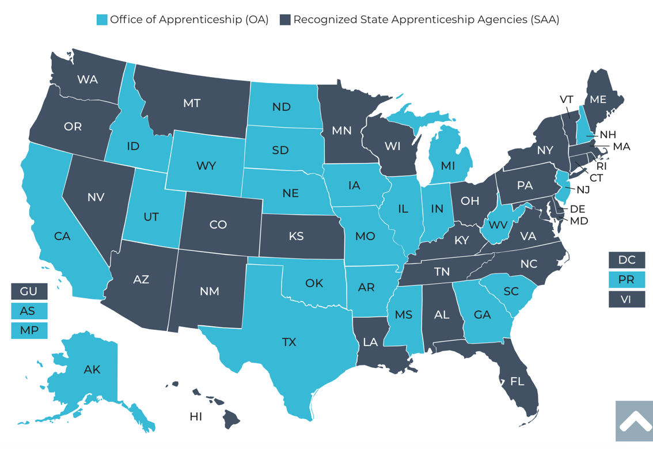
The Apprenticeship System
25 states and territories are Office of Apprenticeship (OA) states
32 states and territories have state apprenticeship agencies (SAA)

Slide 13


Program Registration
State-registered programs (SAA states)
Federally registered programs
National programs: multi-state, national programs
National Program Standards must receive reciprocal approval in all states

Slide 14

What Do Apprenticeship Standards Look Like?
An occupation and O*NET code, identification of apprenticeship type, program length
Sponsor responsibilities (such as record-keeping, health and safety)
Apprentice qualifications, selection procedures, wage progression
Work process schedule (on-the-job learning)
Related instruction outline (144 hours per 2,000 OJT hours)

Slide 15






Benefits of Apprenticeship – Business Case
Skilled Workforce
Recruit and develop a diverse and highly-skilled workforce
Improved Productivity
Improve profitability and positive impact to your bottom line
Reduced Turnover
Minimize cost with reduced turnover and liability
Customizable Training
Create flexible training options that ensure workers develop the right skills
Retain Workers
94% of apprentices continue employment after completing an apprenticeship
Diversity
Foster a diverse and inclusive culture
Notes:
A Registered Apprenticeship program is a documented plan designed to move an apprentice from a low or no skill entry level position to full occupational proficiency. This systematic training approach provides consistency in training and builds competency across the industry, which in turn will improve safety, quality, and efficiency. Upon completion of the program, an apprentice earns a Completion of Registered Apprenticeship certificate, a nationally recognized credential.

Slide 16
RA and WIOA Business Services
BSRs are ideally situated to help companies understand all their options, including Registered Apprenticeship
Companies partnering on WIOA services will likely be interested in apprenticeship as an important option
Employer partners are looking to minimize the number of different contacts, meetings, and reports
Workforce and apprenticeship systems can benefit each other
Apprenticeship is an important option for business partners receiving WIOA services.

Slide 17

Recent RA System Initiatives and Funding Opportunities
Executive Order: Scaling and Expanding the Use of Registered Apprenticeships in Industries and the Federal Government and Promoting Labor-Management Forums
TEN 23-23: Quality Pre-Apprenticeship Programs
Notice of proposed rulemaking to enhance the National Apprenticeship System
Building Pathways to Infrastructure Jobs grant
Apprenticeship Building America
State Apprenticeship Expansion grants

Slide 18



Partners and Resources
Industry Intermediaries for Registered Apprenticeship
Apprenticeship Ambassadors
Apprenticeship Trailblazers
Youth Apprenticeship Week
Advanced Manufacturing Sprint

Slide 19




















Apprenticeship Funding
– ACCESSING RESOURCES
For more information, check out the Industry Intermediary fact sheet on Apprenticeship.gov
Registered Apprenticeship Industry Intermediaries: Through a partnership with DOL, these 20 industry intermediaries offer expertise to help employers and labor organizations successfully launch, promote, and expand RA programs in growing industries.
Information Technology
Clean Energy
Early Childhood Education
Education
Early Childhood Education
Notes:
Optional/draft talking points:
The slide shows you the eighteen Intermediaries that make up the sixteen Industry Intermediary Contractors and the four Youth Apprenticeship Intermediaries.
As you can see, we've added the specific industry and sub-sector under each Intermediary logo. We're currently servicing multiple industry sectors, including healthcare, information technology, public service, the Care Economy, supply chain, cybersecurity, advanced manufacturing, transportation, construction, telecommunications, and hospitality.

Slide 20
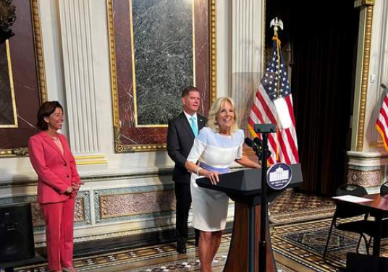
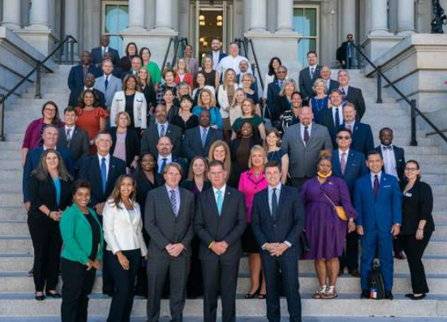
Apprenticeship Ambassador Initiative
The Apprenticeship Ambassador Initiative creates a national network of employers, labor organizations, industry associations, program sponsors, educators, workforce intermediaries, apprentices, community-based organizations, and other stakeholders to serve as champions for expanding and diversifying Registered Apprenticeship.
For more information check out the Apprenticeship Ambassador page on Apprenticeship.gov
Notes:
Secretary Walsh, in coordination with Vice President Kamala Harris, Ambassador Susan Rice, Governor Gretchen Whitmer, Mayor Randall Woodfin, Secretaries Gina Raimondo and Miguel Cardona, AFL-CIO President Elizabeth Schuler, Service Employees International Union President Mary Kay Henry, and Employers Siemens and CVS Health announced this new Apprenticeship Ambassador initiative on November 15, 2021 during National Apprenticeship Week in this announcement video.
NOTE: Image is hyperlinked
https://youtu.be/EEhHGL-9rgQ

Slide 21

Apprentice Trailblazer Initiative
The Apprentice Trailblazer Initiative is designed to create a national network of diverse apprentices and apprenticeship graduates of all ages and backgrounds to feature their stories and hear their perspectives, show how Registered Apprenticeships increase opportunities for underserved populations, and bring awareness to other career seekers who may be interested in becoming apprentices.
The first cohort of 57 Trailblazers was announced during National Apprenticeship Week, 2023.
Notes:
Applications for the first cohort are due by September 30, 2023.
We plan to announce the first cohort of Apprentice Trailblazers during NAW 2023.

Slide 22


SAVE THE DATE FOR
YOUTH APPRENTICESHIP WEEK - MAY 5-11, 2024
Youth Apprenticeship Week (YAW) is a nationwide celebration that highlights the benefits and value of Registered Apprenticeship programs for youth, ages 16-24.
YAW builds on the success of NAW and is a key part of the Department's Youth Employment Works Strategy. It challenges us to deepen partnerships across sectors and provide "no wrong door" to quality career pathways, paid work and wrap around services, and hire young workers through youth apprenticeships.
YAW is an opportunity for stakeholders to host events to showcase how Registered Apprenticeship creates a sustainable pipeline of skilled and diverse talent for youth across multiple high-demand industries such as cybersecurity, healthcare, agriculture, gaming and graphics design, advanced manufacturing, clean energy, engineering, artificial intelligence, transportation, and robotics.
For more information go to: Youth Apprenticeship Week | Apprenticeship.gov

Slide 23
Advanced Manufacturing Apprenticeship Sprint
In the 109 days between October 6, 2023, and January 23, 2024:
+160
Organizations made new commitments
to workforce development and job quality.
4,937
NEW APPRENTICES WERE HIRED
New advanced manufacturing-related Registered Apprenticeship programs
and occupations have been created
or are newly under development.
+150
+127
  Advanced Manufacturing-related Apprenticeship Accelerators and outreach events were held by industry and workforce system partners.
Notes:
KC

Slide 24
Apprenticeship Funding 1

Slide 25

WIOA Funding and RA
Under WIOA, registered apprenticeship programs automatically qualify to be included on the state’s Eligible Training Provider List
Individual Training Accounts are an effective support for WIOA participants to enter an apprenticeship
Incumbent worker training and apprenticeship may be prioritized in WIOA state programs

Slide 26



FUNDING REGISTERED APPRENTICESHIP THROUGH WIOA
On-The-Job Training /
Related Training /
On-The-Job Learning
& Instruction
Supportive Services
On-The-Job Training (OJT) is
funded through a contract, not
Individual Training Accounts (ITAs). OJT contracts can cover one or multiple apprentices and, in some circumstances, OJT reimbursement under WIOA has increased from
50% to 75%.
Under WIOA, all classroom training is funded through ITAs. To take advantage of potential funding, programs must be on the state’s eligible training provider list. In addition to ITAs for individual apprentices, utilizing contracts for cohort training is also possible.
WIOA formula funds can be utilized
to provide a range of supportive services. If an ITA is used to fund the related training and instruction, the ITA can also be used to provide supportive services.
e.g., transportation & childcare
The workforce system supports the components of Registered Apprenticeship programs

Slide 27


APPRENTICESHIP FUNDING – ACCESSING RESOURCES
Open Funding Opportunities:
Connecting with Existing Registered Apprenticeship Investments
Are you looking for open funding opportunities to promote and expand apprenticeship? All DOL funding opportunities are posted on the apprenticeship.gov website
Are you looking for an organization currently funded by the U.S. Department of Labor to help promote and expand apprenticeship?
Visit DOL’s Registered Apprenticeship Awardee Search for a Database of apprenticeship investments, searchable by industry, location, and organization name. You can also learn more about accessing WIOA funding, state credits and tuition support.
Safal Partners © 2024

Slide 28
RA Helps Advance WIOA Goals
Adopting Registered Apprenticeship as a workforce strategy can help advance the goals of WIOA. RA:
Helps meet WIOA Performance Outcomes: employment rate, median earnings, credential attainment, and skill gains.
Gives more individuals on Individual Training Accounts an opportunity to move into living-wage jobs
Can help support Incumbent Worker Training
Can increase the need for and use of On-the-Job Training Contracts
Adds valued trainers to the Eligible Training Provider List
Training And Employment Guidance Letter WIOA No. 13-16: Operating Guidance for the Workforce Innovation and Opportunity Act

Slide 29

How to Speak to Employers about RA
Speak in the language of business:
  Return on investment, productivity, employee retention
Stress the benefits to the employer and its workers
Focus on results, not process
Employers are already investing in training—it makes sense to take part in the benefits of RA, including incentives to support program start-up and training expenses.

Slide 30

Conclusion
Registered Apprenticeship is the gold standard for training and workforce development.
Understanding RA is important to helping employers in your region to take advantage of the benefits of apprenticeship.
There are resources in the apprenticeship system and partners, such as industry intermediaries, to help your employers succeed.

Slide 31
Questions and Answers

Slide 32


BSR Training Series Sessions
Session 2: Making Apprenticeship Central to Workforce Innovation and Opportunity Act Business Services
How RA bolsters the success of WIOA business services
The RA System and the role of ATRs
How to coordinate and collaborate with ATRs and Navigators.
June 6th from 11am-12pm ET
Scan to Register:
Capstone for ATRs and BSRs: Collaborating to Expand Registered Apprenticeship
Interactive learning from workforce experts
Effective ATR and BSR partnerships
Implement training at the local level
June 13th from 11am-12:30pm ET
Scan to Register:

Slide 33

Become A Center Partner
Scan for Partner Form
Receive no-cost expert TA,
materials, and assistance
Network with potential
partners nationwide
Be nationally recognized for
your work
Notes:
If you’re interested in becoming a partner with the Center of Excellence, please take a moment to scan the QR code on screen. As a partner, you have the opportunity to receive no-cost technical assistance and materials, network with partners nationwide and be nationally recognized for your work.

Slide 34
Email us your questions at RA_COE@SafalPartners.com
For more information, visit: dolcoe.safalapps.com

