Slide 1
Gauging Workforce Board Alignment with Registered Apprenticeship (RA) DOL Center of Excellence Webinar
February 29, 2024

Slide 2
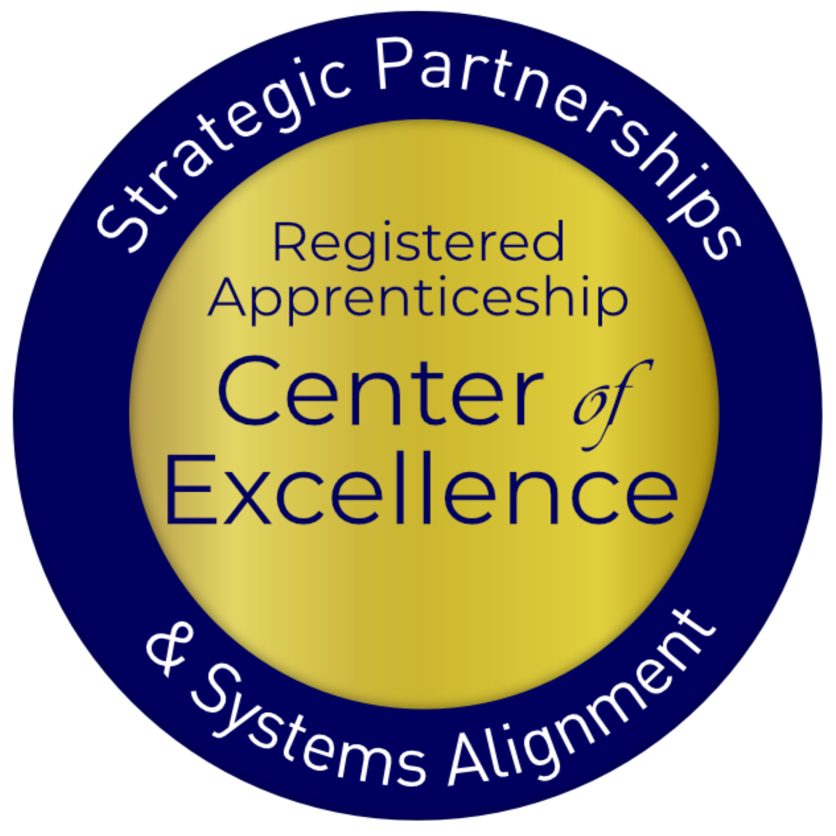
Presenters
Lisa Rice
Subject Matter Expert
Safal Partners
Jeffrey Smith
Workforce Liaison / Program Analyst
Office of Apprenticeship
U.S. Department of Labor
Haylie Schuster
Engagement Manager
Safal Partners
Safal Partners © 2024

Slide 3
Welcome and Agenda
Center of Excellence Overview
Recap of Part I
Review Levels 4 - 6
Questions
Wrap Up
Safal Partners © 2024

Slide 4
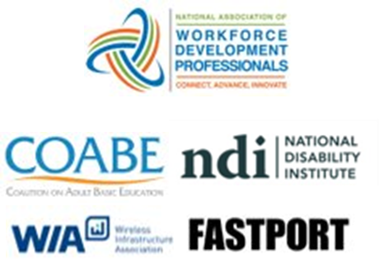
1. Center of Excellence Overview
U.S. DOL initiative to increase systems alignment across apprenticeship, education, and workforce
Led by Safal Partners
Collaboration with five national partners
4

Slide 5
2. Center of Excellence Overview
We provide no-cost TA including:
Monthly webinars
Quarterly virtual office hours
Individual TA/coaching sessions
Online resources (desk aids, guides, frameworks, etc.)
DOL CoE Resource and Tools
Visit our website & request TA
4

Slide 6
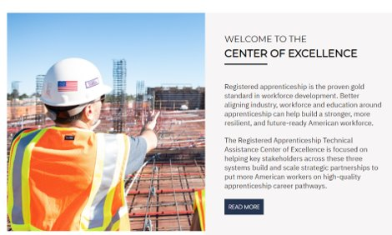
Online Resources, On-Demand TA
Registered Apprenticeship Partner Profile Questionnaire
DOL CoE Resource and Tools
5
Notes:
Our website is continually updated with relevant news, TA resources and tools including frameworks, case studies, webinars, customizable templates, questionnaires, and more.
Since 2021 more than 3,000 organizations have become no-cost Center partners and utilized our tools – such as the "RA Partner Profile Questionnaire" - to accelerate their organizations' understanding and effective usage of RA.
Link to Questionnaire - https://dolcoe.safalapps.com/sites/default/files/2022-11/Partnership%20Questionnaire.pdf
This questionnaire is intended to help you build a network in your area around Registered Apprenticeship (RA). With the information gathered here, your board should be better able to engage with and convene RA stakeholders to expand RA program opportunities. It is designed to be used in conjunction with the USDOL RA TA Center of Excellence “Workforce Board Guide to Identifying Pre-Apprenticeship and Apprenticeship Partners” publication. This publication and more information on the Center can be found online at dolcoe.safalapps.com﻿

Slide 7
Recap of Part I
Safal Partners © 2024

Slide 8
1. Levels 1 – 3 What We Heard
General
Ensure Individual Training Accounts (ITA) pieces address Eligible Training Provider List (ETPL) process inclusion
Ensure RA isn’t excluded, addressing unique situations of RA
Level 1 – Implementing Policy
Include making job seekers aware of RA’s
Safal Partners © 2024

Slide 9
2. Levels 1 – 3 What We Heard
Level 2 – Engaging Jobseekers
Include making employers aware of RA’s
Include RA Job Fairs with partners as step to move to Level 3
Address promoting RA with employers using outreach and marketing funds (Level 3 efforts as well)
Level 3 – Supporting Sponsors/Businesses
Address marketing efforts (Website with dedicated page, success stories, employer testimonials, educational resources for RA basics, and include a business case)
Streamlined process of aligning related technical instruction components from employer perspective to community college
Safal Partners © 2024

Slide 10
Levels 4 – 6 of RA Alignment
Safal Partners © 2024

Slide 11
1. DRAFT: Levels of Workforce Engagement in/Utilization of Registered Apprenticeship
*NOTE: While some LWDBs may move more quickly to become an RA program sponsor prior to embedding RA in AJCs or becoming a local and regional convener/hub, many boards view program sponsorship as a higher-level commitment because it requires dedicated funding and resources for overall program administration. In some cases, having access to non-WIOA funding (e.g., federal or state grant funds, philanthropic support and donations) may influence a board’s decision whether or not to serve as a sponsor earlier in the system alignment process.

Slide 12
2. DRAFT: Levels of Workforce Engagement in/Utilization of Registered Apprenticeship
Level 1 – Implementing Policy | Level 2 – Engaging Jobseekers | Level 3 – Supporting Sponsors/ Businesses
Best Practice: State/local RA steering committee, encouraging diversity of RA reps, regular communication protocol between workforce & RA system for ETPL requests | Best Practice: Utilize ITAs to help offset RTI costs, provide supportive services and referrals to other programs for support; co-enrolling WIOA/RA | Best Practice: Host join LWDB/RA System Apprenticeship Accelerators; structured training by RA for BSRs; utilizing OJT contracts to support employers’ apprentice wages
Reflected in: ETPLs listing RAPs | Reflected in: WIOA/RA co-enrollment ITA spending Supportive service provision | Reflected in: Increase in RA sponsors OJT contract spending for RA wage reimbursement
Steps to Move to Next Level: Train case managers on RA benefits for job seekers Create/provide tools to local RA sponsors for reverse referrals (for WIOA eligibility certification) | Steps to Move to Next Level: Train BSRs on RA Create/share Apprenticeship.gov materials on RA benefits for employers Review DOL Industry Intermediary list for assistance in employer engagement in high-priority occupations | Steps to Move to Next Level: Explore state models of co-locating RA expertise (i.e. FL, others) Discuss use of Governor’s Set Aside Funds with state board to support embedding RA SME in AJCs

Slide 13
3. DRAFT: Levels of Workforce Engagement in/Utilization of Registered Apprenticeship
Level 4 – Building RA Staffing, Partnerships | Level 5 – Serving as RA Convenor | Level 6 – Becoming an RA Sponsor**
Best Practice: Regular, proactive, collaborative work between workforce RA staff and Apprenticeship Training Representatives (ATR) (for industry, apprentice recruiting) | Best Practice: Create network of RA sponsored programs to accelerate employer participation; serve as fiscal agent for larger network* | Best Practice: Utilizing WIOA and non-WIOA funding (i.e., DOL, state grants) for program administration, employer/apprentice support
Reflected in: Increase in RA sponsors Increase in RA/WIOA co-enrollment Increase in funded services for RA support | Reflected in: Increase in participating employers Increase in apprentice support from WDB (WIOA and non-WIOA funding) | Reflected in: Participating employers Apprentice registrations
Steps to Move to Next Level: BSRs and AJC RA SMEs coordinate on which employers are responding to/engaged in RA outreach RA SMEs meet regularly and coordinate with ATRs on high-quality program development Co-enrollment training is delivered to case managers on rolling basis | Steps to Move to Next Level: LWDB evaluate local LMI, employer interest in RA LWDB meets with ATR to develop process for gathering information into RA standards LWDB develops strategy for dual-pronged RA implementation: employers to join RAP and employers to hire WIOA-certified job seekers for RA roles | Intentionally left blank.

Slide 14
Level Four: Partnerships
Level 4 – Building RA Staffing, Partnerships
Best Practice: Regular, proactive, collaborative work between workforce RA staff and Apprenticeship Training Representatives (ATR) (for industry, apprentice recruiting)
Reflected in: Increase in RA sponsors Increase in RA/WIOA co-enrollment Increase in funded services for RA support
Steps to Move to Next Level: BSRs and AJC RA SMEs coordinate on which employers are responding to/engaged in RA outreach RA SMEs meet regularly and coordinate with ATRs on high-quality program development Co-enrollment training is delivered to case managers on rolling basis
Other ways for the level to be reflected?
What data resources should be considered to indicate this level is occurring?
Are there other steps you would suggest that move the RA work forward from this level?

Slide 15
Level Five: Convening
Level 5 – Serving as RA Convenor
Best Practice: Create network of RA sponsored programs to accelerate employer participation; serve as fiscal agent for larger network*
Reflected in: Increase in participating employers Increase in apprentice support from WDB (WIOA and non-WIOA funding)
Steps to Move to Next Level: LWDB evaluate local LMI, employer interest in RA LWDB meets with ATR to develop process for gathering information into RA standards LWDB develops strategy for dual-pronged RA implementation: employers to join RAP and employers to hire WIOA-certified job seekers for RA roles
Other ways for the level to be reflected?
What data resources should be considered to indicate this level is occurring?
Are there other steps you would suggest that move the RA work forward from this level?

Slide 16
Level Six: Sponsoring
Are you an RA sponsor? If not, why not?
Are you utilizing WIOA funding for your RA sponsored program? Does your front-line staff know how to co-enroll?
What other non-WIOA funding are you utilizing for your program?
Level 6 – Becoming an RA Sponsor**
Best Practice: Utilizing WIOA and non-WIOA funding (i.e., DOL, state grants) for program administration, employer/apprentice support
Reflected in: Participating employers Apprentice registrations

Slide 17
Poll 1 – Which level best describes your organization’s current level of RA engagement?

Slide 18
1. Case Study: Apprentice Florida
Apprentice Florida (Levels 2, 3, 4, & 5)
State funding for Apprenticeship Navigators
Locals work regularly with Apprenticeship Training Representatives at state level
Incorporated RA in state level WIOA plan
Key Alignment Factors:
State leadership and policy changes
State/Local hosting of Apprenticeship Accelerators
Training components and success stories just for employers
Tools like PowerPoint templates, flyers for outreach, and toolkits for business, education and local workforce boards

Slide 19
2. Case Study: Apprentice Florida
Webinar of Demonstrated State Apprenticeship Leadership in 2020 Unified-Combined Plans Part Two Apprenticeship Expertise in AJCs

Slide 20
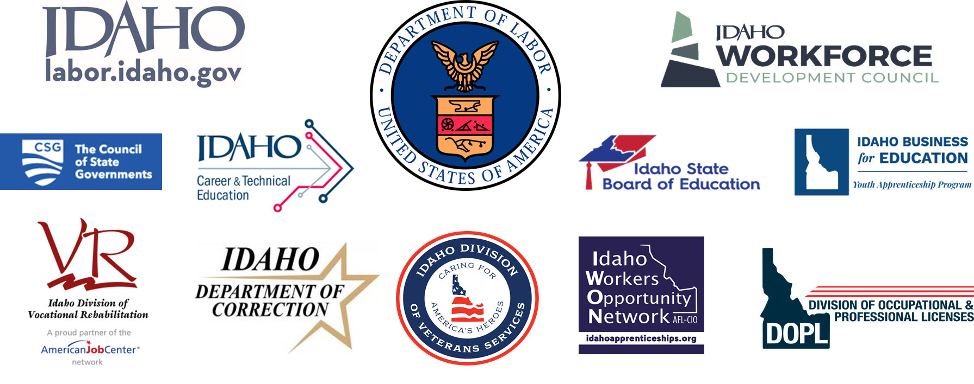
Case Study: Apprenticeship Idaho
Apprenticeship Idaho Partners (Levels 1, 2, & 3)
Includes all stakeholders at state and local level
National case study demonstrates in 6 years they had increases in apprentices and new RA programs
Key Alignment Factors:
State leadership and policy changes
Collaborative outreach and business engagement
Building capacity to develop and support RA programs
Webinar of Demonstrated State Apprenticeship Leadership in 2020 UnifiedCombined Plans Part 1

Slide 21
Questions and Discussion
2024

Slide 22
Poll #2 – Evaluation
Safal Partners © 2024

Slide 23
Become a Center Partner
Receive no-cost expert TA, materials, and assistance
Network with potential partners nationwide
Be nationally recognized for your work
Be an Apprenticeship Partner Form
23

Slide 24
Join the Celebration
Youth Apprenticeship Week (YAW) is a nationwide celebration that highlights the benefits and value of Registered Apprenticeship programs for youth, ages 16–24. Employers, educators, labor unions, and workforce professionals across the country are launching Registered Apprenticeship programs that allow youth to earn competitive wages while obtaining the relevant training and experience to start their careers. YAW is an opportunity for these stakeholders to host events to showcase how Registered Apprenticeship creates a sustainable pipeline of skilled and diverse talent across multiple high-demand industries such as:
Monday: “Parents and Guardians are a Priority” in Registered Apprenticeship
Tuesday: Youth Apprenticeships: Building Awareness, Myth Busting, Partnering with Educational Providers, and Creating Pathways through Pre-Apprenticeship
Wednesday: Expanding Youth Apprenticeship Opportunities for Underserved Populations
Thursday: National Youth Apprenticeship Signing Day
Friday: Federal Partners Day and Call to Action
Youth Apprenticeship Week Page

Slide 25
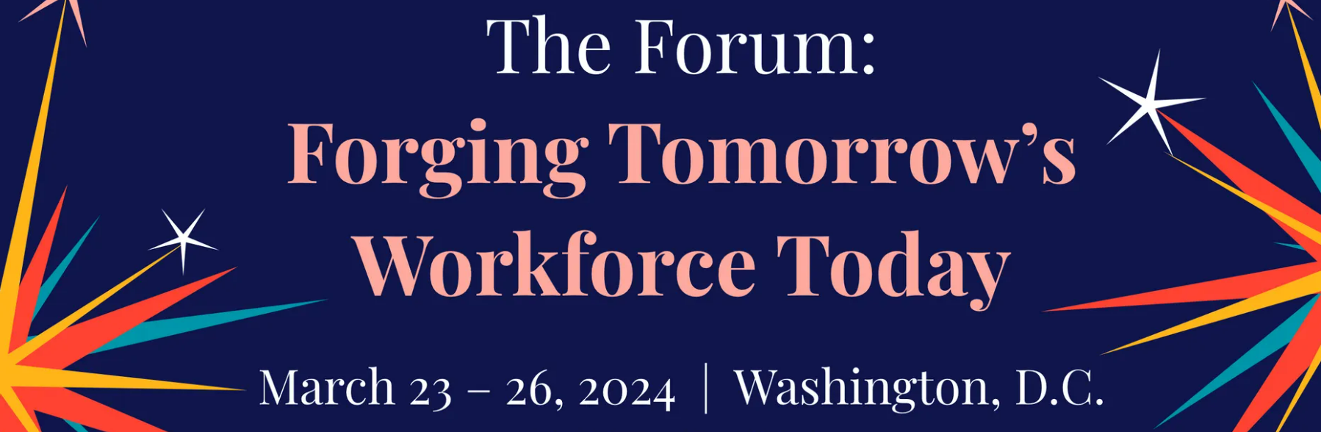
Upcoming COE Dates
40th Annual NAWDP Conference
May 20-22
Pre-Conference May 19
CoE and NLNC Workshops
NLNC Office Hours
NAWB 2024 Forum
May 23-26
CoE and NLNC Workshops
NLNC Office Hours
Safal Partners © 2024

Slide 26
Email us your questions at RA_COE@SafalPartners.com
THANK YOU FOR JOINING US
For more information, visit: dolcoe.safalapps.com
Safal Partners © 2024

