Slide 1
Investing in America Agenda
Positioning Your Board for Strategic Apprenticeship Partnerships
March 23-26, 2024

Slide 2

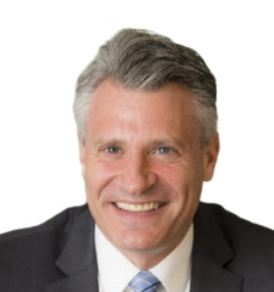

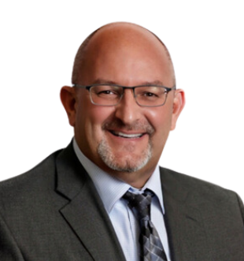
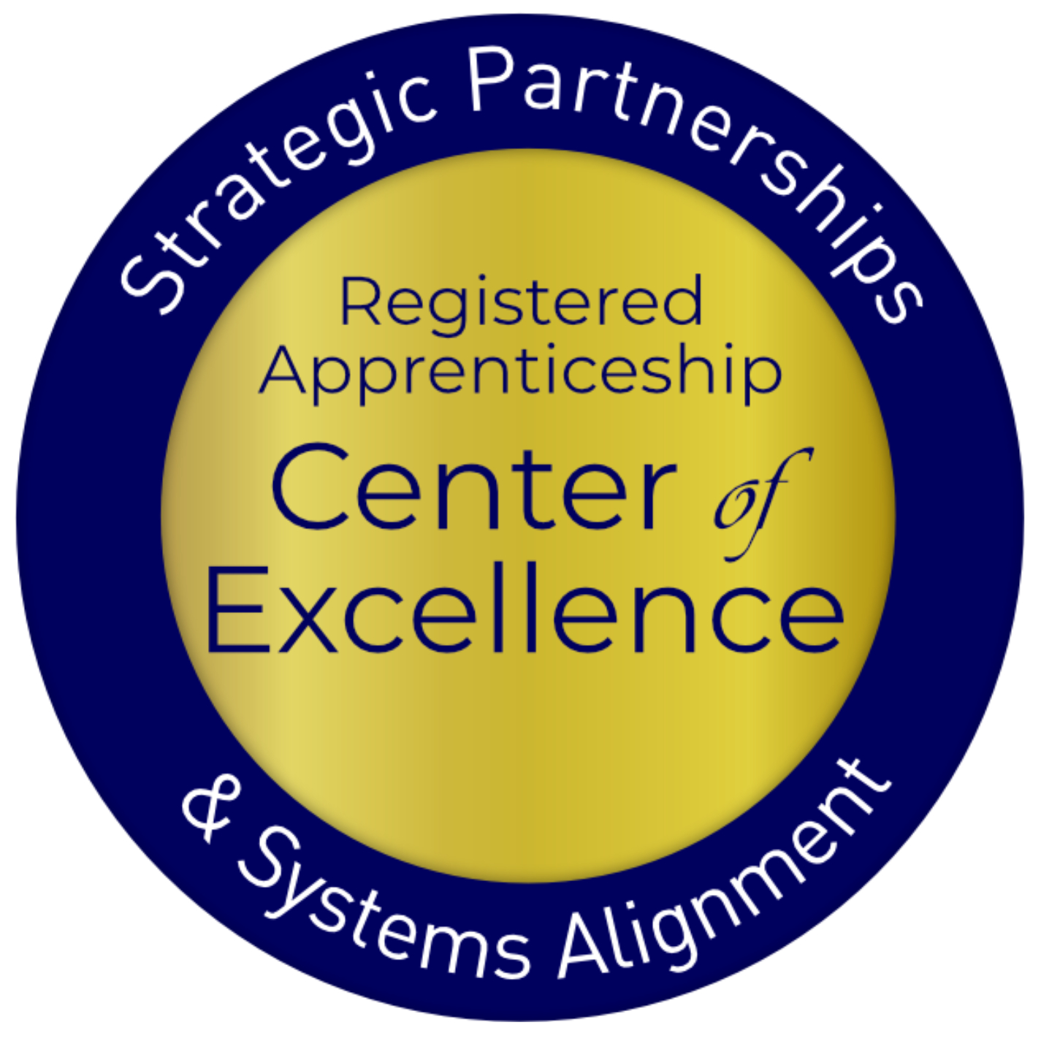
Presenters
Alan Dodkowitz
Brent Weil
Jeffrey Smith
James Disbro
Subject Matter Expert
Safal Partners
Subject Matter Expert
Wireless Infrastructure
Association
Workforce Liaison &
Program Analyst
DOL Office of
Apprenticeship
Senior Director, Regional
Alignment & Programs
Development
CareerSource Suncoast
Safal Partners © 2024

Slide 3
Welcome and Agenda
Center of Excellence Overview
Registered Apprenticeship (RA) in the Investing in America (IIA) agenda
Workforce Partnerships to Advance the Investing in America Agenda
The CareerSource Suncoast Approach
Questions
Wrap Up
Safal Partners © 2024

Slide 4

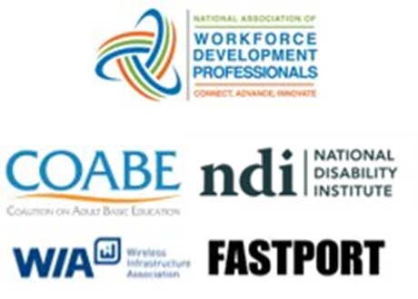
1. Center of Excellence Overview
U.S. DOL initiative to increase systems alignment across apprenticeship, education, and workforce
Led by Safal Partners
Collaboration with five national partners
4

Slide 5

2. Center of Excellence Overview
We provide no-cost TA including:
  Monthly webinars
  Quarterly virtual office hours
  Individual TA/coaching sessions
  Online resources (desk aids, guides, frameworks, etc.)
DOL CoE Resource and Tools
Visit our website & request TA
4

Slide 6
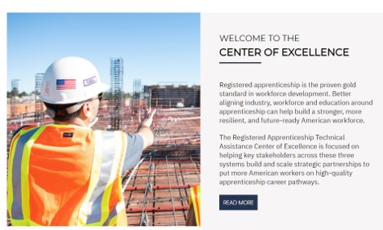
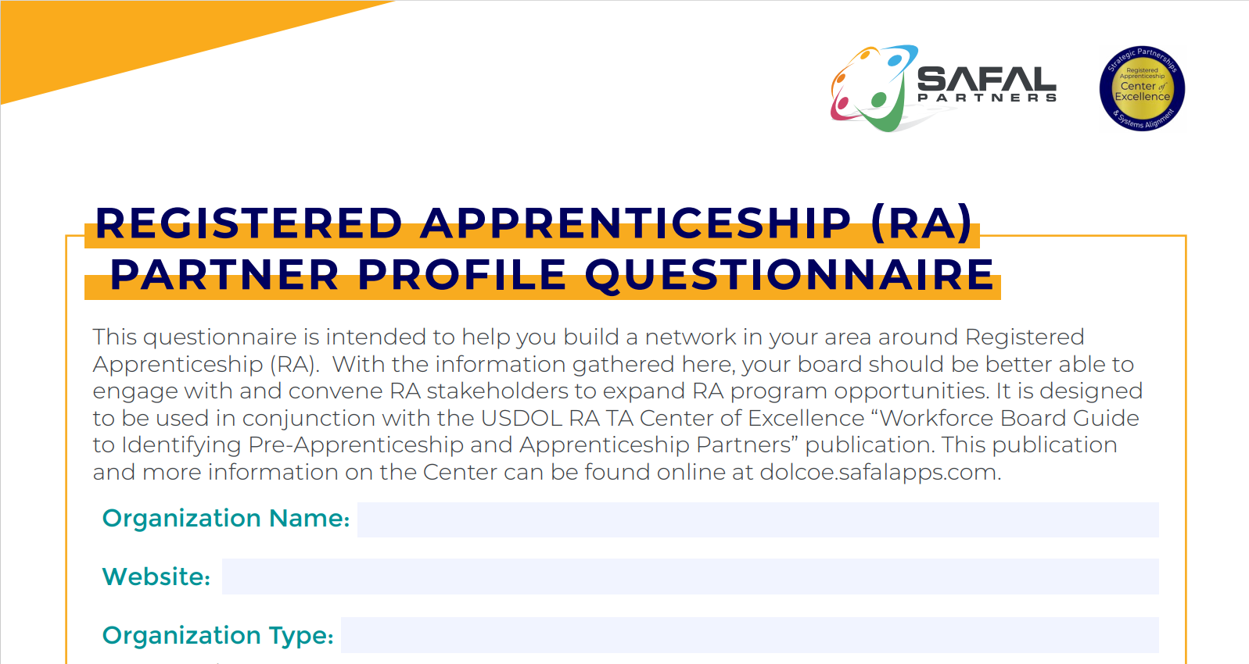

Online Resources, On-Demand TA
Registered Apprenticeship Partner Profile Questionnaire
DOL CoE Resource and Tools
5

Slide 7
Registered Apprenticeship-A Way to Train our Nation’s Workforce
Safal Partners © 2024
Notes:
Alan

Slide 8

What is Registered Apprenticeship?
Registered Apprenticeship is a proven, customizable, and structured model to find and train diverse new talent as well as upskill current workers in critical occupations.
Safal Partners © 2024

Slide 9



Five Core Components of Apprenticeship
Employer Involvement
Structured On-the-Job Learning (OJL)
Related Instruction (RI)
Rewards for
Skill Gains
National Occupational Credential
Safal Partners © 2024

Slide 10
Registered Apprenticeship in the Investing in America Agenda
Safal Partners © 2024

Slide 11

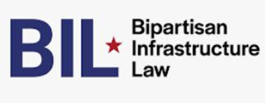


1. What is the Investing in America Agenda
The Investing in America Agenda - consists of extensive resources and rules to support the advancement of Registered Apprenticeship:
The Bipartisan Infrastructure Bill
$550 billion in new funds for infrastructure.
The CHIPS and Science Act
$52.7 billion for American semiconductor research, development, manufacturing, and workforce development.
Safal Partners © 2024

Slide 12
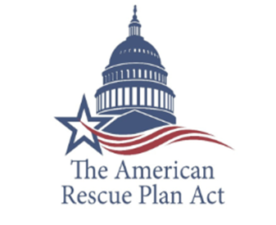
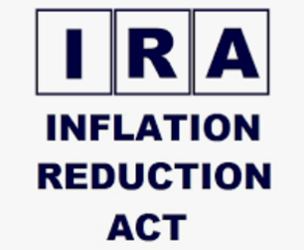
2. What is the Investing in America Agenda
The American Rescue Plan Act
$1.9 trillion recovery bill with more than $40 billion for workforce development.
The Inflation Reduction Act
Nearly $1.2 trillion in incentives for green energy and
increased Affordable Care Act (ACA) subsidies.
Safal Partners © 2024
Notes:
Alan

Slide 13

1. The Bipartisan Infrastructure Law (BIL)
Safe Streets and Roads for All (SS4A) Grant program:
$1 billion to enhance roadway safety and includes pre-apprenticeship, apprenticeship readiness, and youth service initiatives, with a clear path towards registered apprenticeships.
Building Pathways to Infrastructure Jobs Grant Program:
Supports enhanced training models in H-1B industries and focuses on sectors like advanced manufacturing, information technology, professional services, supporting renewable energy, transportation, and broadband infrastructure.
Workforce Development:
Expands existing workforce development programs encompassing trade schools, community colleges, and union training programs in Registered Apprenticeship. Participants gain expertise in conducting energy assessments for small-and mid-sized manufacturing businesses.
Safal Partners © 2024
Notes:
Alan

Slide 14

2. The Bipartisan Infrastructure Law (BIL)
Broadband Equity, Access, and Deployment (BEAD):
Provides $42.45 billion to expand high-speed internet access by funding planning, infrastructure deployment and adoption programs. States are using BEAD funds for Registered Apprenticeship.
National Electric Vehicle Infrastructure Formula Program:
Provides $5 billion to states to strategically deploy electric vehicle (EV) charging infrastructure and to establish an interconnected network to facilitate data collection, access, and reliability. States are using NEVI funds for Registered Apprenticeship.
Grid Resilience and Innovation Partnerships (GRIP) Program:
Includes $10.5 billion to enhance grid flexibility and improve the resilience of the power system against growing threats of extreme weather and climate change. Substantial opportunities are included for Registered Apprenticeship for opportunity youth to conduct this work.
Safal Partners © 2024
Notes:
Alan

Slide 15

The CHIPS and Science Act (CHIPS)
Regional Innovation and Technology Hubs:
These hubs will create jobs, spur regional economic development, and position communities throughout the country to lead in high-growth, high-wage sectors such as artificial intelligence, advanced manufacturing, and clean energy technology.
CHIPS for America Workforce and Education Fund:
The Fund is $200 million and provides $25 million for Fiscal Year (FY) 2023, $25 million for FY2024, and $50 million for each fiscal year 2025-2027.
Embedding Apprenticeship Within the Incentives Program:
Companies seeking funding via the CHIPS Incentives Program
must submit workforce development plans for facility operators
and construction workers, with applicants committing to hiring
individuals who complete training programs and to consider
partnerships with various skill-building programs, including
Registered Apprenticeships, pre-apprenticeships, community
and technical college programs, high school career pathways
and paid work-based learning initiatives in the semiconductor
industry.
Safal Partners © 2024
Notes:
Alan

Slide 16

1. The Inflation Reduction Act (IRA)
Labor Hours Requirements:
Ten separate tax credits in the IRA note that employers who access these funds must set aside a minimum of 15% of their labor hours for apprentices.
National Clean Investment Fund:
$14 billion to provide grants to 2–3 national nonprofit clean financing institutions to provide accessible, affordable financing for tens of thousands of clean technology projects across the country with a goal of supporting Registered Apprenticeship.
Domestic Manufacturing Conversion Grants:
$2 billion for applicants must commit to signing a project labor agreement that includes precise objectives related to investing in workforce
education and training and using registered apprentices and
creating opportunities for local workers to participate in the
construction project.
Safal Partners © 2024

Slide 17

2. The Inflation Reduction Act (IRA)
Environmental and Climate Justice Community Change Grants:
$2 billion in grants available to support community-driven projects that deploy clean energy. Grantees will be awarded based on the inclusion of pre-apprenticeships or Registered Apprenticeship Programs, that are worker-centered, demand-driven, and lead to good jobs.
Transmission Siting and Economic Development Program:
$760 million to siting authorities to carry out eligible activities that will facilitate the siting and permitting of covered transmission projects. Funding specifies partnerships with labor unions, workforce groups, apprenticeship programs, and pre-apprenticeship programs.
Latest and Zero Building Energy Cocde Adoption:
$1 billion for States and units of local government with the authority to adopt building energy codes to adopt and implement the latest building energy code. States are expected to include plans to engage opportunity youth with Registered Apprenticeship
a particular area.
Safal Partners © 2024

Slide 18
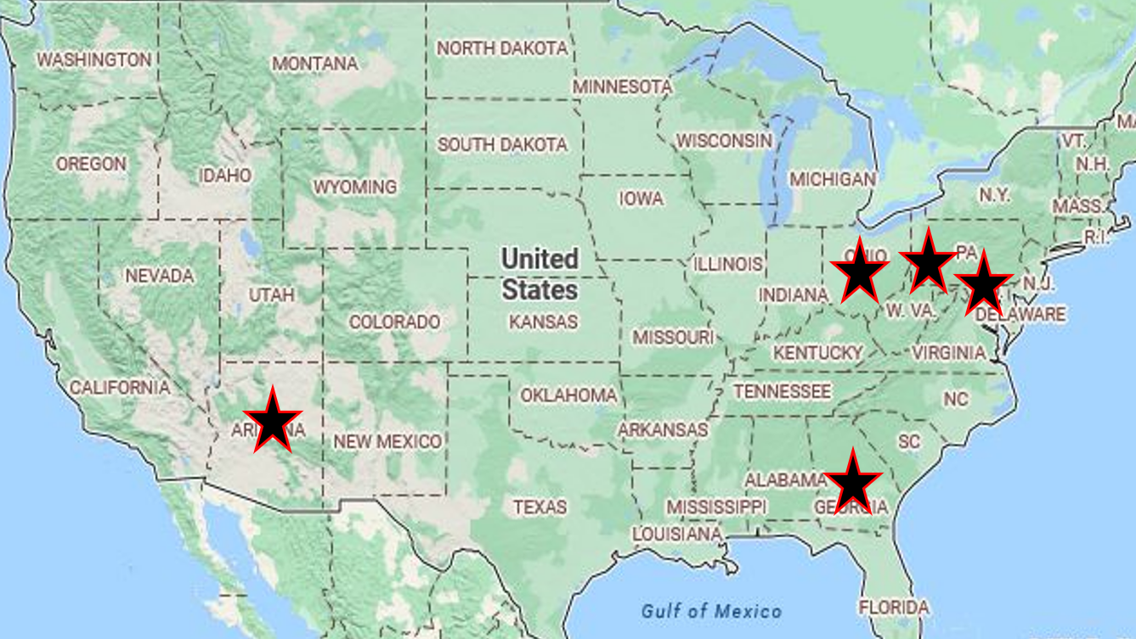
1. The American Rescue Plan Act (ARPA)
Workforce Hubs:
Five Workforce Hubs (Baltimore, Pittsburgh, Columbus, Phoenix, Augusta) developed to create labor opportunities in these cities.
Good Jobs Challenge:
$500 million grant to make investments in high-quality, locally led workforce systems to develop 32 industry-led, worker-centered training partnerships and systems across the country, which impacts 31 states and Puerto Rico and dramatically transform communities.
Workforce Development Funds:
Funding to state and local workforce development agencies to help them create and expand Registered Apprenticeship Programs (RAPs), provide training resources, and support outreach efforts to connect individuals with apprenticeship opportunities.
Safal Partners © 2024

Slide 19
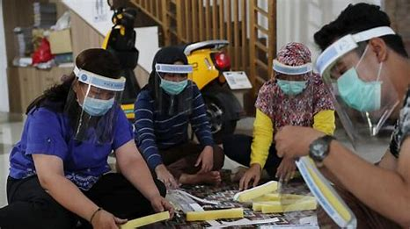
2. The American Rescue Plan Act (ARPA)
Training and Education:
Resources to enhance the quality of training, updates to program curriculum, and apprentice access to the knowledge and skills needed for their chosen trades.
Innovative Practices:
Encourages the development and implementation of innovative practices in RAPs. This may involve exploring new training methodologies, technology integration, and industry partnerships to enhance the effectiveness and relevance of apprenticeship training.
Community Health Worker Training Program:
$225.5 million awarded to 83 grantees to support training and apprenticeship to support an estimated 13,000 community health workers.
Safal Partners © 2024
Notes:
Jeff

Slide 20
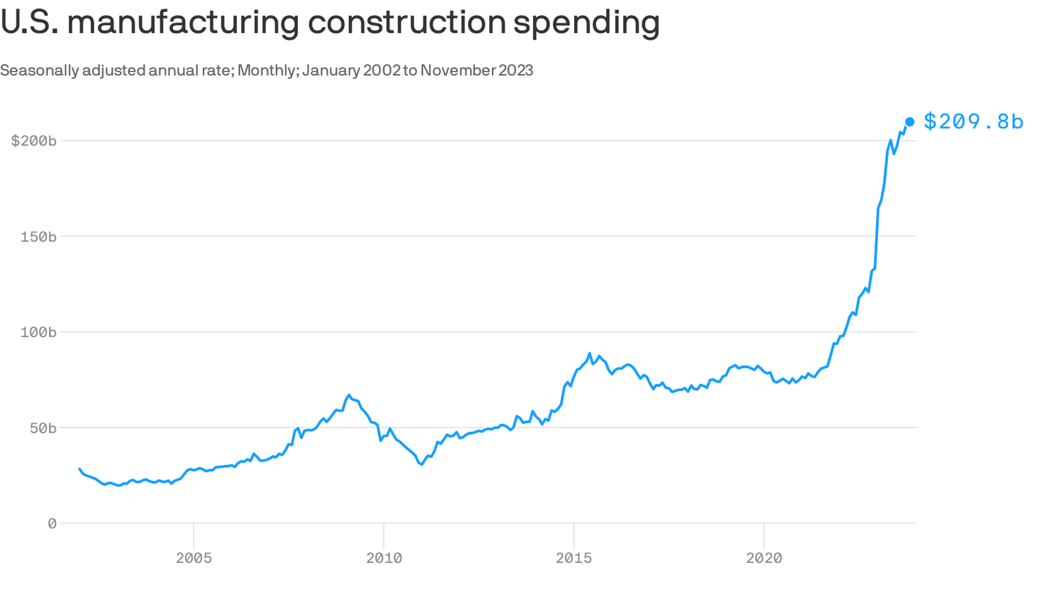
An Investment Boom Which Needs Apprentices
Safal Partners © 2024

Slide 21
Workforce Partnerships to Advance the Investing in America Agenda
Safal Partners © 2024

Slide 22
WIOA, ARPA, and State Alignment

Slide 23

1. ARPA, WIOA and Apprenticeship Alignment Case Study
In fall of 2022, the United States Department of Commerce awarded Maryland nearly $23 million dollars under the Good Jobs Challenge grant program to foster the development of a workforce to support the emerging offshore wind industry.
Maryland Works for Wind (MWW) is a regional consortium committed to establishing Maryland as the country’s premier destination for offshore
wind training, fabrication, and employment. The project includes a robust sectoral partnership inclusive of employers, unions, Local Workforce Development Areas, business alliances, and training providers. Collaboratively, the partners will cultivate a pipeline of skilled talent to support the emerging Offshore Wind clean energy industry.
Through MWW, MD Labor demonstrates its commitment to drive economic development, connect underrepresented populations to good-paying careers, and build upon existing investments. The success of MWW hinges on the development of a thriving and diverse ecosystem of Maryland-based partners
Safal Partners © 2024

Slide 24
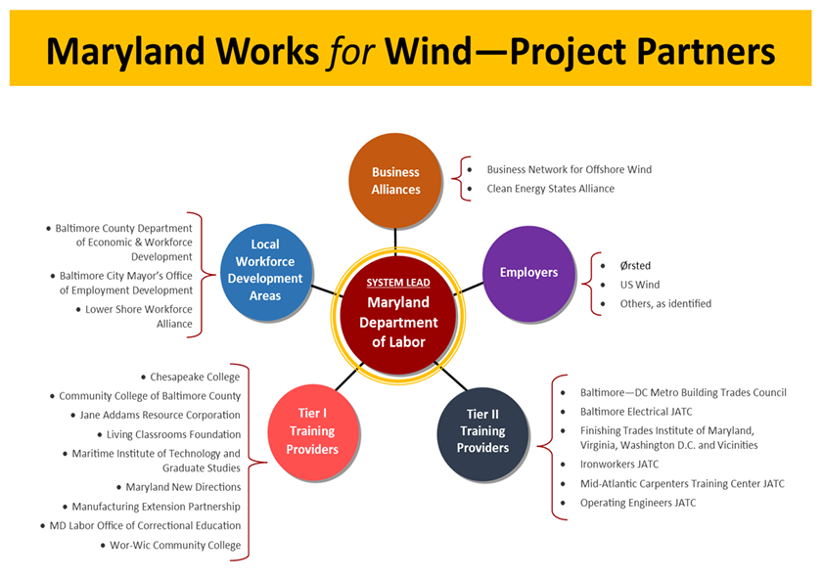
2. ARPA, WIOA and Apprenticeship Alignment Case Study
Safal Partners © 2024

Slide 25
WIA and the Bipartisan Infrastructure Law

Slide 26

Leadership in Broadband Workforce Development
2017: Became the national sponsor of the Telecommunications Industry Registered Apprenticeship Program (TIRAP), registered with the U.S. Department of Labor
2020: Awarded a 5-Year Closing the Skills Gap grant from the U.S. Department of Labor
2020: Named the Industry Intermediary for the telecommunications industry by DOL’s Office of Apprenticeship
2021: Selected as a core partner to DOL’s Registered Apprenticeship Center of Excellence
2022: Awarded a contract by the State of Ohio to be the lead Industry Intermediary for the Broadband and 5G Sector Partnership
2022: ACE announces recommendation of 14 community college credit hours for Telecommunications Tower Technician apprenticeship
2023: TIRAP expands to more than 100 employers and 16 occupations

Slide 27

Telecommunications Industry Registered Apprenticeship Program
TIRAP’s mission is to partner with stakeholders to promote safety, enhance quality, and enable education and advancement opportunities in the telecommunications workforce. TIRAP is a competency-based apprenticeship registered with the U.S. Department of Labor.
2017 Since 2017, National sponsor of the Telecommunications Industry Registered Apprenticeship Program - TIRAP
104 Employer sponsors currently enrolled
4500+ Registered Apprentices
16 Current Occupations

Slide 28
BEAD: Broadband Equity, Access, and Deployment
National Telecommunications and Information Administration
State Broadband Offices
Contracts and Subcontracts
5-year action plan
Workforce development plan
PLAs, training, apprenticeship, qualifications

Slide 29
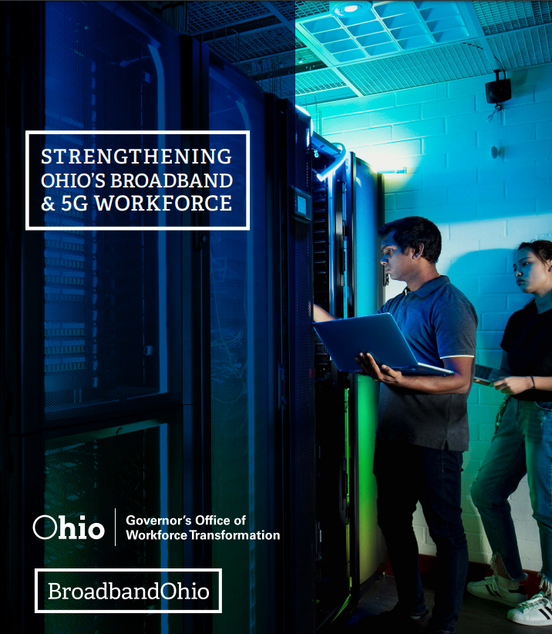
Statewide Strategy for Education and Workforce Development
WIA Selected as Industry Intermediary for Ohio State University’s Broadband and 5G Sector Partnership with the Ohio Governor’s Office of Workforce Transformation

Slide 30







Ohio Education and Training Partnerships
Center of Excellence
CTE and Adult Education
Community College
Workforce Development
4-year University

Slide 31
CareerSource Suncoast

Slide 32
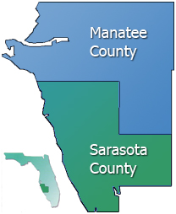

2. CareerSource Suncoast

Slide 33
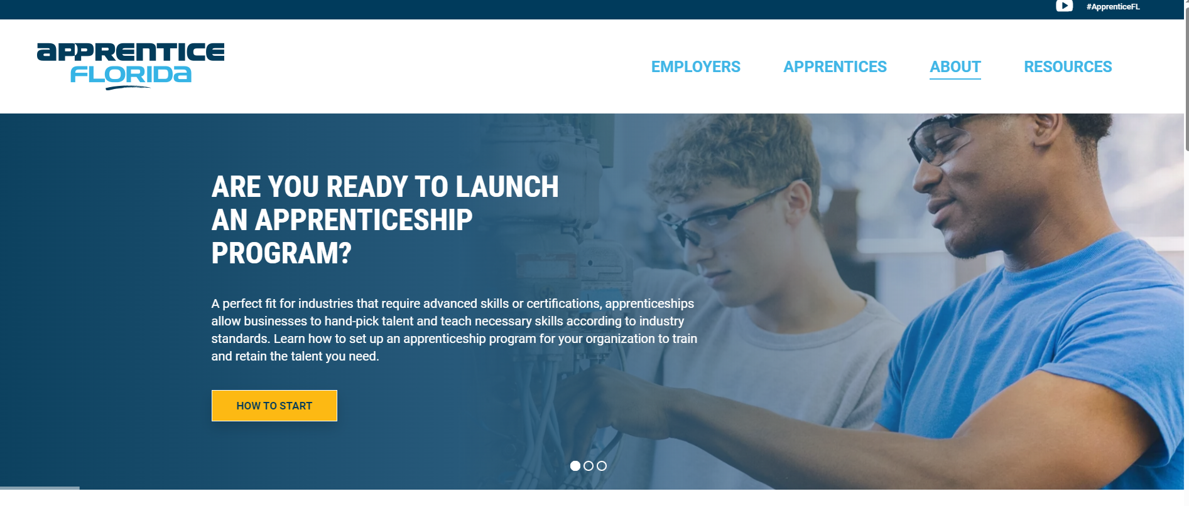



Apprentice Florida

Slide 34
1. Florida’s Apprenticeship Expansion Efforts
Florida Department of Education – Pathway to Career Opportunities Grant (PCOG)
The grant funds are to establish new, operate existing, or expand existing registered apprenticeship or pre-apprenticeship programs. High schools, school district career centers, school district charter technical career centers, Florida College System institutions and other entities are authorized to sponsor an apprenticeship or pre-apprenticeship program can be eligible.
  Since 2019, PCOGs have totaled in excess of $28M.
Florida is a State Apprenticeship Agency (SAA): supported by nine (9) Apprenticeship Training Representatives

Slide 35
2. Florida’s Apprenticeship Expansion Efforts
American Rescue Act
Florida Registered Apprenticeship Team
  Funding for Apprenticeship Navigators - dedicated staff who lead and support local and regional efforts to develop, expand, and support registered apprenticeship programs (RAPs) and registered pre-apprenticeship programs (pre-RAPs).
  CareerSource Florida maintains a position of Workforce Development Director to help support the Apprenticeship Navigators statewide with training.

Slide 36

Florida’s Innovative Registered Apprenticeship Programs
Florida has expanded RAP’s into non-traditional industries, including advanced manufacturing, aviation, aerospace, healthcare, IT and other emerging industries.
Innovative Registered Apprenticeship Programs
    Semiconductor Industry – Surface Mount Technician Operator
    EV Technology – EV Technician Program
    Division of Blind Services – Web Accessibility Specialist RAP (1st in the nation)
    Law Enforcement
    Education – K-12 Teacher Apprenticeship Program
    Healthcare – over 343 apprentices registered in various healthcare occupations

Slide 37
Florida’s Apprenticeship Accomplishments 2022-2023
Total # of active apprentices = 17,435 (5,005 new apprentices registered);
33% increase in the total # of newly registered apprentices over previous year;
303 Active Registered Apprenticeship Programs (RAPs) - 36 new from previous year;

Slide 38
“Orlando is Home to Magic & Microchips”
CHIPS and Science Act:
NeoCity – 500 Acre Epicenter of Semiconductor Manufacturing Reshoring - build an internationally recognized Semiconductor industry cluster that is globally competitive
    R&D, design, manufacturing and assembly+testing+packaging
      182 companies
      $780M revenue
      Employing 7,640 employees
    Mack Technologies (Brevard) - Semiconductor Industry
      Surface Mount Technician Operator RAP – 1st Nationwide

Slide 39
CareerSource Suncoast (CSS) Serving Manatee & Sarasota Counties
Sponsor - CareerSource Suncoast Apprenticeship Program, GNJ
  Started 2018 – collaborated with USDOL Intermediary Jobs For the Future (JFF) to establish first LWDB Sponsored RAP in Florida - Tool and Die Maker
  CSS is now one of three (3) LWDBs statewide to Sponsor RAPs in Florida
  Updated the CSS RAP Standards/Appendix 2023 to sponsor more occupations/employers

Slide 40
Cultivating an Environment for Registered Apprenticeship Programs
Apprenticeship Programs expansion and development
State and local support via policies, procedures and training
Level of investment from employers (skin in the game)
WIOA funding – work-based training and individual training accounts
  WIOA income eligibility and LWDB locally approved definitions of below self-sufficiency

Slide 41
Questions and Discussion
2024

Slide 42

Become a Center Partner
Receive no-cost expert TA,
materials, and assistance
Network with potential
partners nationwide
Be nationally recognized for
your work
Be an Apprenticeship Partner Form
42

Slide 43
Email us your questions at RA_COE@SafalPartners.com
THANK YOU FOR JOINING US
For more information, visit: dolcoe.safalapps.com
Safal Partners © 2024

