Slide 1
Engage Series
Uniting Registered Apprenticeship Programs and Tribal Workforce/ College Career Centers for Apprenticeship Recruitment
June 6, 2024
Notes:
Hello and WELCOME to the Center of Excellence, Engage Series: Uniting Registered Apprenticeship Programs and Tribal Workforce / College Career Centers for Apprenticeship Recruitment. We are very pleased to have you here. Please introduce yourself in the chat with your name and organization so we can get to know who is with us today. (next slide)

Slide 2

Moderator
Gene Ellis
Senior Subject Matter Expert
Safal Partners

Slide 3



Center of Excellence Overview
U.S. DOL initiative to increase systems alignment across apprenticeship, education, and workforce
Led by Safal Partners; 5 national partners
We provide no-cost TA including:
  Monthly webinars
  Quarterly virtual office hours
  Individual TA/coaching sessions
  Online resources (desk aids, guides, frameworks, etc.)
Visit our website, request TA

Slide 4
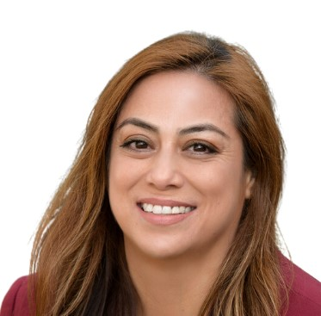
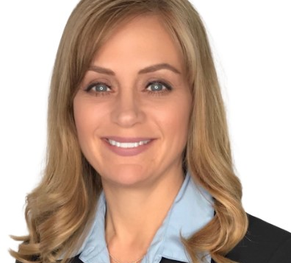
U.S. DOL Guest Speakers
Kayla Hilario
Corinna Pereira
Federal Project Officer
U.S. DOL Division of Indian and Native American Programs
Region 6 Multi-State Navigator
U.S. DOL Office of Apprenticeship
Notes:
Gene
It is my pleasure to introduce our guest speakers from the U.S. Department of Labor.
Kayla Olvera Hilario is a Federal Project Officer for the Department of Labor’s, Division of Indian and Native American Programs. She is an enrolled member of the Ione Band of Miwok Indians, a federally recognized Tribe outside of the Sacramento, CA region. Ms. Hilario has dedicated her career to working with tribal communities as both a state government employee and a non-profit practitioner.
Corinna is one of 6 Multi-State Navigators with USDOL’s Office of Apprenticeship. Her role is to provide oversight and technical assistance to state apprenticeship agencies in 6 states to include the Pacific Northwest states WA and OR. She also supports federal agency and tribal apprenticeship programs in her region and works closely with Safal Partners on projects that help bring awareness, information, and resources regarding registered apprenticeship to the public.
Kayla, I’ll pass it off to you.
Kayla speaks. Corrina speaks. Corrina says (next slide)

Slide 5
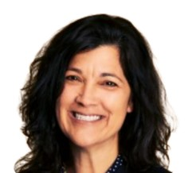



Today’s Presenters
Angela Baker
Michele Barutha
Alyssa Burgess
Brent Knight
Safal Partners
Cyber and Tech Industry Intermediary
Maritime Institute of Technology and Graduate Studies (MITAGS)
Maritime Apprenticeship Workboat Mate Program
Washington Association for Community Health
In Reach Career Pathways
The Certified Safety Specialist Apprenticeship Program (CSSAP)
Notes:
Gene
I am very pleased to welcome today’s presenters starting with Angela Baker, my colleague, at Safal Partners. Angela comes with a wealth of knowledge and experience as an apprenticeship subject matter expert with almost two decades of experience in Registered Apprenticeship and Continuing Technical Education.
Michele Barutha is a graduate of the Maritime Institute of Technology Graduate Studies Maritime Apprenticeship Workboat Mate Program. She has obtained a USCG 3rd Mate and 2nd Mate Unlimited license and has sailed onboard a variety of vessels including research vessels, training ships and passenger vessels. Since 2019, Michele has been training the next generation of apprentices as an Instructor at MITAGS and manages their three apprenticeship programs.
Alyssa Burgess is the Director of Career Pathways at Washington Association for Community Health. Over the past 5 years she has worked to increase the value, expansion, and sustainability of their InReach Career Pathways programs. Alyssa brings a wealth of knowledge to the table about healthcare apprenticeships, and she has worked with several other PCA’s to help them establish similar Health Profession Education Training programs.
Brent Knight is a subject matter expert in construction safety and health and lead Intuitive Safety Solutions, one of the largest safety consulting services firms in the construction sector in the United States. Brent has almost 30 years of experience in Union Labor, Marine Construction, and Safety and Supply. (next slide)

Slide 6
Agenda
Welcome and Introduction
Cyber and Tech Industry Intermediary Registered Apprenticeship Program
MITAGS Maritime Apprenticeship Workboat Mate Program
Washington Association for Community Health In Reach Career Pathways
The Certified Safety Specialist Apprenticeship Program (CSSAP)
Q&A
Notes:
Gene
Throughout today’s presentation, we will hear about the Cybersecurity and Technology Industry Intermediary, MITAGS Maritime Apprenticeship Workboat Mate Program, the Washington Association for Community Health In Reach Career Pathways, and The Certified Safety Specialist Apprenticeship Program.
We ask that you place your questions in the chat during the presentation or hold your questions until our Q&A section at the end. This will ensure time to hear from each presenter. (next slide)

Slide 7

Cyber and Tech Industry Intermediary
Notes:
Gene
And now I’ll pass it over to Angela Baker to tell us about Safal Partner’s work as a Cyber and Tech Industry Intermediary

Slide 8

U.S. DOL Cyber Leadership Offers:
technical expertise to build and/or facilitate approval of a customized program for your organization's own sponsorship if preferred
ongoing technical assistance to successfully launch and sustain your customized program
connections to federal, state, and local resources including funding support through tax credits
direct limited incentive funding on a per-apprentice basis to assist with non- wage program costs
help identifying potential candidates through a network of partners including two- and four-year colleges and universities, military installations, workforce systems partners, and community-based organizations serving targeted populations
ongoing program support such as marketing and administrative assistance
Notes:
Angela
Safal Partners is a US. Department of Labor Cyber and Tech Industry Intermediary for Registered Apprenticeship. We offer, at NO-COST:
technical expertise to build and/or facilitate approval of a customized program for your organization's own sponsorship if preferred
ongoing technical assistance to successfully launch and sustain your customized program
connections to federal, state, and local resources including funding support through tax credits
direct limited incentive funding on a per-apprentice basis to assist with non- wage program costs
help identifying potential candidates through a network of partners including two- and four-year colleges and universities, military installations, workforce systems partners, and community-based organizations serving targeted populations
ongoing program support such as marketing and administrative assistance

Slide 9

MITAGS Maritime Apprenticeship Workboat Mate Program
Notes:
Gene
Thank you, Angela. Now let’s hear from Michele Barutha about MITAGS Maritime Apprenticeship Workboat Mate Program. Michele….

Slide 10
Maritime Apprenticeship History
Originated in 2006 in recognition of upcoming mate and master shortages in the towing industry

Slide 11
Benefits
Participants:
Efficient
All programs are approved as 2-year programs
  360 required sea days
  About 6 months of classes

Slide 12
Benefits 2
Participants:
Comprehensive
Provides classes to adequately prepare apprentices for the license exams.
Through partner companies, provides more and more in-depth on-the-job training. Apprentices are required to learn/do everything the crew does.

Slide 13
Benefits 3
Participants:
Student Services
Help establishing payment and/or VA benefits
Ownership of training
Assistance with USCG applications Support in the classroom
Industry connections

Slide 14
Benefits 4 3
Participants:
Respected
The Workboat program has been running since 2006; amongst the current partner towing companies, the crews aboard the vessels respect what the program has been able to accomplish.
In two cohorts with WSF, there is a growing understanding and respect for what the apprenticeship program can accomplish.

Slide 15
Partner Companies
To complete the apprenticeship program, applicants are hired by a partner company to get their sea time and hands on training.
Current partner companies include:

Slide 16
Workboat Mate Partner Companies

Slide 17
Centerline Logistics
Oil transport, ship assist, general and rescues towing

Slide 18
Foss Maritime
Variety of services including ship assist, offshore wind, ocean towing

Slide 19
Western Towboat
Variety of services including ship assist and ocean towing

Slide 20
Sause Bros
Variety of services including ship assist and ocean towing

Slide 21
Unlimited Inland Mate Partner Companies

Slide 22
Washington State Ferries
Puget Sound

Slide 23
Grand River Navigation
Great Lakes

Slide 24
Occasional Partner Companies
These companies have participated in the past but not every year

Slide 25
Overseas Shipholding Group (OSG)

Slide 26

Washington Association for Community Health In Reach Career Pathways
Notes:
Gene
Thank you very much Michele. Now we will hear from Alyssa Burgess about In Reach Career Pathways at the Washington Association for Community Health.

Slide 27


InReach Career Pathways
Medical Assistant Apprenticeship Program
Sponsored by Washington Association for Community Health
WWW.INREACHPATHWAYS.ORG

Slide 28


About Us
Primary Care Association
  28 FQHC’s in WA
First healthcare apprenticeship program in Washington (2014)
WHAT WE BELEIVE
Mission + Values
Our mission is to cultivate an equitable and sustainable community health workforce through innovative education and training programs.
EQUITY | EXCELLENCE | COMMUNITY | EMPOWERMENT

Slide 29

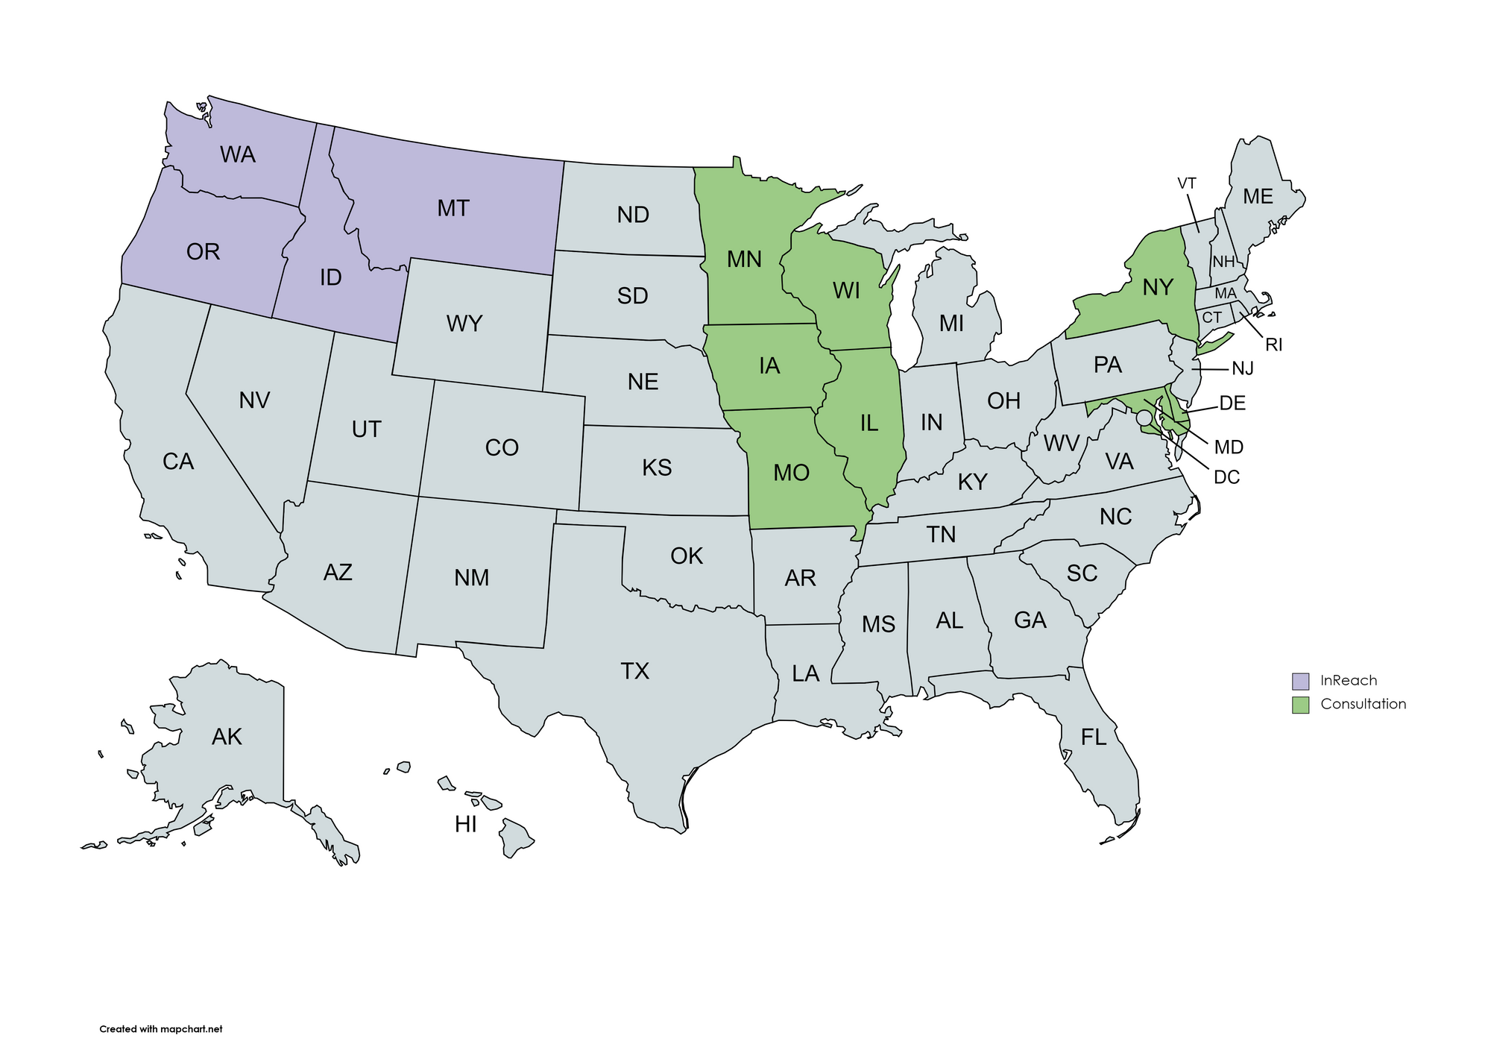
By The Numbers
475
ACTIVE APPRENTICES
46%
RURAL
TRAINING AGENTS
1100
GRADUATED APPRENTICES
12
REPRESENTED
STATES
80%
AVERAGE RETENTION RATE
98%
CCMA EXAM PASS RATE

Slide 30
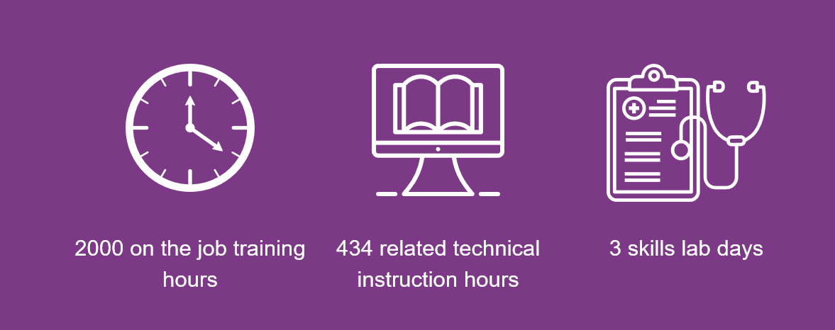
Program Overview
IR

Slide 31
MA Skills
Overview of required skills for this program:
Medical Asepsis
Vital Signs
Physical Exam
Eye & Ear Assessment & Procedures
Gynecological Exam & Prenatal Care
Colon Procedures
Pediatric Exam
Physical Agents used to Promote Tissue Healing
Minor Office Procedures
Sterilization & Disinfection
Administration of Medications
Cardiopulmonary Procedures
Medical Microbiology
Urinalysis
Phlebotomy
Blood Chemistry & Immunology

Slide 32

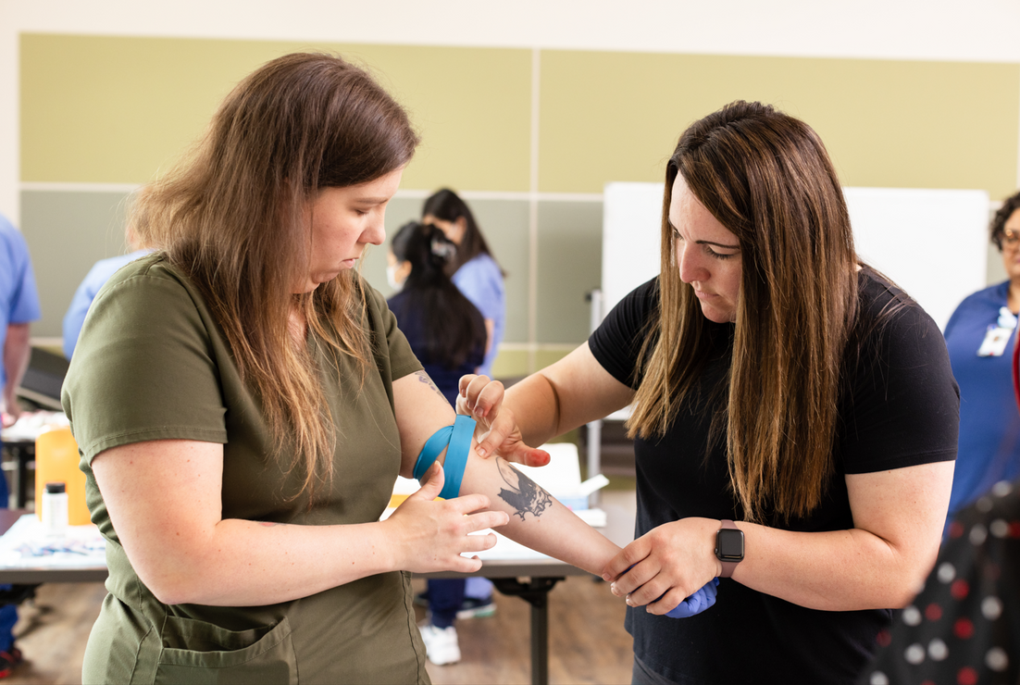
Employer Requirements
Recruit & select apprentices
Apprentice wages: $20/hr. avg
1:1 Coach
Tuition: $4850
Skill practice
General support
Contact person

Slide 33
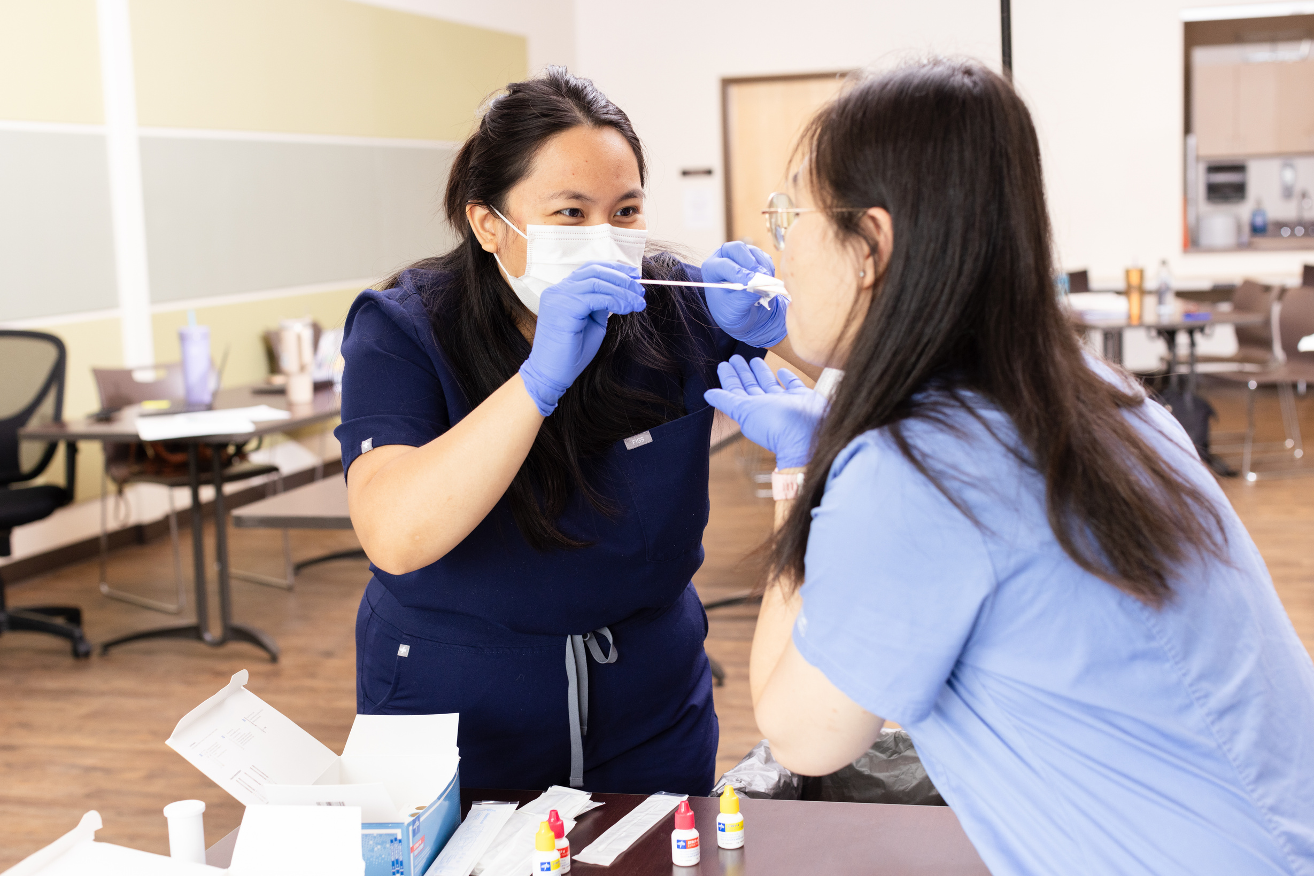
Benefits 5
EMPLOYER:
APPRENTICE:
  Grow your own
  Increased diversity & retention
  Clinic flow & re-training
  MA-C Cost
  10 Week trial period
  Remain local
  No student debt
  FTE Wages & Benefits
  Hands on learning
  Valued care team member

Slide 34

Cohort Cycles
1
Public Cohorts
  1-10 Apprentices
  Quarterly
Private Cohorts:
  Minimum of 12 Apprentices​
  Off cycle of public cohorts​
  Plan 2-3 months ahead of time
JANUARY
2
APRIL
3
JULY
4
Next Opportunity to Join!
  Enroll by 6/7/24
  Select Apprentices by 6/28/24
OCTOBER

Slide 35




Getting Started
Email us to connect with a dedicated program coordinator
  workforce@wacommunityhealth.org
New Employer Onboarding
InReach provides...
Recruitment Guide
Cost Benefit Analysis
Program Syllabus
Wage & Recruitment Data
Convened Peer Groups
Coach Training Course
And more!

Slide 36
Contact Us
Alyssa Burgess
Director of Career Pathways
aburgess@wacommunityhealth.org
WWW.INREACHPATHWAYS.ORG

Slide 37
The Certified Safety Specialist Apprenticeship Program (CSSAP)
Notes:
Gene
Thank you so much Alyssa. Next, we have Brent Knight from Intuitive Safety Solutions telling us about the certified safety specialist apprenticeship program. Brent….

Slide 38

CSSAP

Slide 39
CSSAP History
The Certified Safety Specialist Apprenticeship Program (CSSAP) was created and developed for mostly non-traditional students, by the safety industry, to marry the academic knowledge obtained in the classroom with the “real world” health and safety management application on the job. The CSSAP exists to educate and supplement industry needs and to prevent work related accidents and injuries.
Conceptualized in 2014
Officially registered in Washington in 2017
Licensed under the USDOL in 2020
Edmonds/Pierce OSH Advisory Board
DOL AAI grant

Slide 40
What is CSSAP?
The CSSAP is a two-year program with 4500 hours of On-the-Job (OJT) training accompanied by related supplemental instruction (RSI) provided through online education by Edmonds and Pierce Colleges. Training agents host an apprentice and the sponsor, ISS verifies progression through the program to completion.
Combines theory with application
4500 OJT, roughly 28-30 months
All RSI/RTI is online
Available in all 50 states

Slide 41
Apprentice Application Process
Open enrollment
Register at Edmonds or Pierce Colleges and declare OSH focus
Apply to CSSAP
Participate in an online, on demand, one-way interview
Apprentice candidates selected and ranked

Slide 42
Ideal Apprentice Candidates
Strong written and verbal communication skills
Outgoing with the ability to engage people
Strong mathematical skills
Good investigative and inspection skills
Organized, detail oriented with the ability to meet deadlines
Passion for Safety and the desire to help people
Injured workers

Slide 43
Ready for Placement
Very affordable to employers
Benefits provided by employer (Training Agent)
$3-5/hour to CSSAP
Journey wage of $72,500/yr.
Step | Hour Range or Competency Step | Hourly rate + Training Agent Company Benefits
1 | 0000-1125 hours | $20.91
2 | 1126-2250 hours | $24.40
3 | 2251-3375 hours | $27.88
4 | 3376-4500 hours | $31.37

Slide 44
Related Training Instruction (RTI)
All classes are online and on demand through either Edmonds or Pierce Colleges
Apprentices receive a 50% tuition discount on required classes
Apprentices receive a certificate in occupational safety and health
Certificate includes 40 credits comprised of 13 courses

Slide 45
Questions and Answers
Notes:
Corinna
Asks questions to presenters from the chat and opens it up to the audience to ask any questions.
STOP at 5 minutes before the hour and pass to Gene.

Slide 46

Contact Us, Become a Partner
Scan for Partner Form
Receive no-cost expert TA,
materials, and assistance
Network with potential
partners nationwide
Be nationally recognized for your work
Notes:
Gene
Thank you so much to all of our presenters for telling us all about these exciting apprenticeship opportunities. And we want to thank all of you for joining us today. We appreciate your participation.
We’d like to encourage you to become a partner with the Center of Excellence if you have not signed up yet. Please take a moment to scan the QR code on the screen. As a partner you have the opportunity to receive no-cost technical assistance and materials, network with partners nationwide, and be nationally-recognized for your work.
Colleen will pop up a short evaluation of this training and we would really appreciate your feedback as we plan for future trainings.
(Wait a minute). (Next slide)

Slide 47
Email us your questions at RA_COE@SafalPartners.com
For more information, visit: dolcoe.safalapps.com
Safal Partners © 2024

