Slide 1
ATRs and BSRs: Collaborating to Expand Registered Apprenticeship Capstone Session
June 13, 2024
Notes:
Nicole
Welcome to today’s webinar on ATRs and BSRs: Collaborating to Expand Registered Apprenticeship We would like to encourage attendee participation, so if you have not already done so, please introduce yourself in the chat – please include your name, organization, and how you are currently involved in Apprenticeship. (Next Slide)

Slide 2
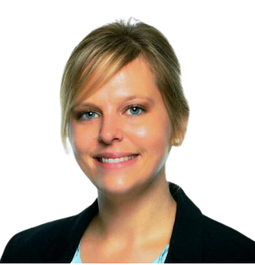
Moderator
Nicole Klues
Project Director
Safal Partners
Notes:
Nicole
My name is Nicole Klues and I am a Project Director with Safal Partners. It’s my pleasure to be your host today. (Next Slide)

Slide 3
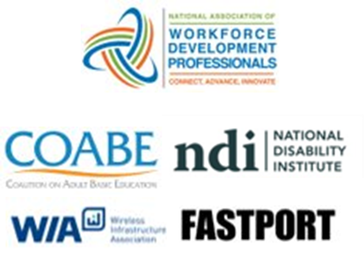
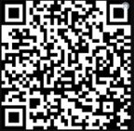
Center of Excellence Overview
U.S. DOL initiative to increase systems alignment across apprenticeship, education, and workforce
Led by Safal Partners; 5 national partners
We provide no-cost TA including:
Monthly webinars
Quarterly virtual office hours
Individual TA/coaching sessions
Online resources (desk aids, guides, frameworks, etc.)
Visit our website, request TA
Notes:
Nicole
Today’s session is produced by the U.S. Department of Labor Registered Apprenticeship Technical Assistance Center of Excellence for Strategic Partnerships & Systems Alignment. Safal Partners leads the Center along with five national partners.
The Center was established by DOL to scale national adoption of Registered Apprenticeships nationwide more rapidly by growing strategic partnerships and increasing alignment between apprenticeship and the workforce and education systems. The Center exists to provide no-cost technical assistance to key stakeholders through a variety of mechanisms including monthly webinars, quarterly virtual office hours, and customized individual TA/coaching sessions.
This session is being recorded and will be posted to the Center of Excellence website within 7-10 business days. We will place the website address in the chat. (Next Slide)

Slide 4
Training Acknowledgements
Notes:
Nicole
As we move into this final session today, we would like to take a moment to thank our national partners, Wireless Infrastructure Association and the National Association for Workforce Development Professionals in partnership with Strategic Workforce Solutions, for their expertise in developing in hosting the training sessions you all have been attending. (Next Slide)

Slide 5
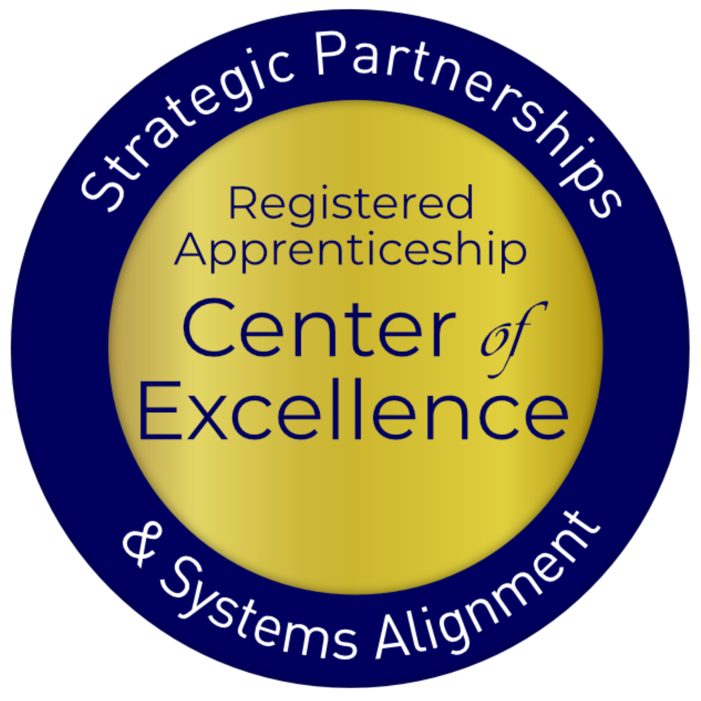
Agenda
Welcome and Introduction
Review of ATR and BSR Roles and Responsibilities
Keys to Effective Collaboration
Promising Practices from Maryland
Connect and Collaborate: Break-Out Rooms Discussion
Q&A
Notes:
Nicole
Today’s webinar is the final training session in our ATR and BSR training series. It is a culmination of 4 training sessions which covered the work of ATRs and BSRs and the importance of partnership and collaboration.
The agenda for today includes a quick recap of the review of ATR and BSR roles and responsibilities, as well as the keys to effective collaboration. We have a dynamic team from Maryland that will speak on their collaborative partnership, and we will round out today’s session with an opportunity for you to connect and collaborate with those in your region.
Throughout the presentation, please use the question and answer section at the bottom of your screen to pose a question. We will hold questions for our speakers until the end and will respond to as many as possible. (Next Slide)

Slide 6
Poll #1
What is your role in the workforce system?
Business Services Representative (BSR)
Apprenticeship Training Representative (ATR)
Workforce partner staff with some BSR responsibility
Apprenticeship Navigator (AN)
Workforce Manager/Administrator
Local Workforce Board Director or Staff
Other
Notes:
Nicole
Before we begin, we’d like to get to know who is in the audience today. Please tell us what your role is currently in the workforce system.
(Mention the results) (Next Slide)

Slide 7
Poll #2
Did you attend one or more of the previous training sessions?
Yes
No
Notes:
Nicole
We are also interested in learning how many of you attended one or more of the previous training sessions.
(Mention Results) (Next Slide)

Slide 8
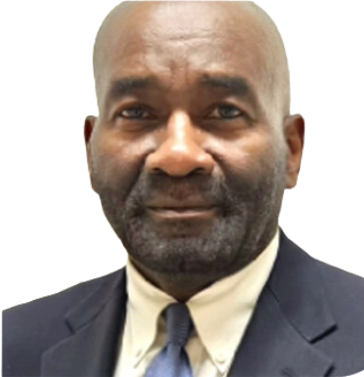
Guest Speakers
Michael Qualter
Deputy Administrator
Office of Apprenticeship
U.S. Department of Labor
Dr. Robert Kight, Ed.D.
Director of the Adult Services and Workforce System
Office of Workforce Investment
U.S. Department of Labor
Notes:
Nicole
For today’s final session, we are privileged to be joined by Michael Qualter, Deputy Administrator of the DOL Office of Apprenticeship and Dr. Robert Kite, the Director of the Adult Services and Workforce System from DOL ETA’s National Office of Workforce Investment. Together Michael and Robert represent the two sides of the collaboration we are highlighting today in this session.
Michael has graciously participated in many of the training sessions in this series. He has leadership responsibility for the oversight and administration of the National Apprenticeship system. Michael previously served as the Chief for the Division of Workforce, Operations and Investments in OA. He was responsible for management and oversight of over $700 million in investments to support apprenticeship expansion.
Robert is joining us as a leader of the workforce side of this equation. He is the Director of the Adult Services and Workforce System in the Office of Workforce Investment, Employment and Training Administration (ETA) of the U.S. Department of Labor (DOL). He oversees comprehensive adult employment services and dislocated worker programs that serve as the foundation of the public workforce system and provide necessary support and infrastructure for the network of approximately 2,600 American Job Centers. He has an extensive background in workforce development and career and technical education. Prior to joining the DOL, Mr. Kight provided leadership in the implementation of workforce development programs at both the state and local levels. He earned a Bachelor’s degree in political science from Tuskegee (Tuh-skee-gee) University, a Master’s degree in Public Administration from Auburn University and a Doctorate of Education specializing in management of programs from Nova Southeastern University.
We are honored to have them both here today.

Slide 9
ATRs and BSRs
Roles and Responsibilities Recap
Notes:
Nicole
Thank you, Michael and Robert for kicking off our session today. Before we dive in, I want to provide a brief recap of ATR and BSR responsibilities so they are fresh in our minds as we move forward today. (Next Slide)

Slide 10
Summary of ATR Responsibilities
Develop and implement RA programs
Manage and oversee RA programs to ensure adherence to laws and regulations
Provide technical assistance to employers, sponsors, and other stakeholders
Conduct outreach to promote apprenticeship programs
Provide support to apprentices and sponsors throughout the duration of the program
Notes:
Nicole
ATRs serve as the catalyst for registered apprenticeship development and oversight. Whether its developing an RA program, ensuring the program adheres to laws and regulations, or providing technical assistance to all stakeholders, including the apprentice, ATRs are committed to ensuring Registered Apprenticeship’s proven work-based learning strategy remains one of the primary solutions for meeting workforce needs with strong outcomes. (Next Slide)

Slide 11
Summary of BSR Responsibilities
BSRs meet with businesses to comprehend their talent needs including staffing requirements, skill gaps, and workforce challenges.
Services often include:
Employer Engagement & Relationship Building
Network and Collaboration
Facilitating Access to Funding
Compliance and Documentation
Data Analysis & Reporting
Safal Partners © 2024
Notes:
Nicole
BSRs play a pivotal role in understanding the needs and objectives of local businesses, tailoring workforce solutions to meet those needs effectively. Whether it's connecting employers with skilled talent, providing workforce training solutions, or facilitating access to resources and incentives, BSRs are committed to driving positive outcomes for both employers and job seekers.
By working hand in hand, ATRs and BSRs can maximize the impact of their efforts, including driving expansion in the registered apprenticeship landscape. (Next Slide)

Slide 12
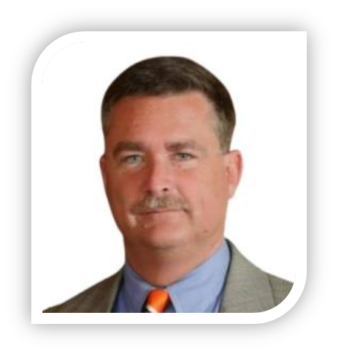
Guest Speaker
Jeffrey Smith
Workforce Liaison / Program Analyst
Office of Apprenticeship
U.S. Department of Labor
Safal Partners © 2024
Notes:
Nicole
And now I would like to introduce another one of our partners at the Office of Apprenticeship who has supported nearly all of the training sessions in this series, Jeff Smith. Jeff is a Workforce Liaison and Program Analyst with the US Dept of Labor’s Office of Apprenticeship. He has served in various positions related to workforce development, government relations, and development/public affairs throughout his career in both the public and private sectors.
Jeff recently joined the U.S. Department of Labor’s Office of Apprenticeship, working as the Workforce Liaison with their Division of Industry Engagement and Strategic Partnerships. Prior to this role, he most notably served as the senior Program Manager for Apprenticeship and Training with the Maryland Department of Labor, where among other duties he had oversight responsibilities for the state’s Apprenticeship Maryland youth apprenticeship initiative, which has grown to include all of Maryland’s twenty-four local public-school systems. (Next Slide)

Slide 13
Keys to Effective ATR and BSR Collaboration
Notes:
Nicole
Jeff is going to remind us all of the keys to effective collaboration between ATRs and BSRs. Jeff, welcome back and I’ll turn it over to you! (Next Slide)

Slide 14
The ATR-BSR Roles Intersect
Both roles require collaboration with stakeholders such as ATRs/BSRs, educational institutions, and industry associations to create comprehensive workforce solutions.
Safal Partners © 2024
Notes:
Let's explore the array of services offered at local workforce development agencies, particularly in catering to employer needs. These may include:
Employer Engagement & Relationship Building: Establishing and nurturing relationships with employers to understand their business models and foster long-term partnerships.
Networking and Collaboration: Organizing networking events and collaborating with educational institutions and industry associations to create comprehensive workforce solutions.
Facilitating Access to Funding: Educating employers about available workforce services, resources, and incentives such as tax credits or training programs.
Compliance and Documentation: Ensuring compliance with regulations and guidelines related to workforce development programs and maintaining accurate records.
Data Analysis and Reporting: Collecting and analyzing labor market information to understand trends and presenting findings to employers and stakeholders.
(NEXT SLIDE)

Slide 15
Levels of Interaction – Three Cs
Communication
Share information
Coordination
Work Together
Collaboration
Plan/Act Jointly
No matter what your current level of partnership is, you can take steps to enhance your work together.
Assess your current level of interaction and take specific actions to move to the next level
Notes:
No matter what your current level of partnership is, start by assessing the Three Cs of interaction with key stakeholders:
Communication: Teams need to be able to efficiently talk, ask questions, give answers, provide context, and offer guidance to one another.
Coordination: Teams need visibility of each others’ progress and direction.
Collaboration: Teams need agreed methods and common tools for working on shared tasks.
The Pros
Improved performance: Rather than focusing on individual talents, cross-functional teams leverage the collective talents and skill sets of the entire group. This allows teams to achieve goals efficiently.
Shared purpose: Cross-functional team members work together to achieve a common purpose. Sharing a common “why” improves engagement, fosters collaboration, and fuels business growth.
Learning opportunities: In a cross-functional team, team members are exposed to individuals with different interests, skills, and backgrounds. This is an excellent opportunity to network and learn a new set of skills, gaining insight into various roles at the organization.
Link: https://dolcoe.safalapps.com/sites/default/files/2024-06/Business Services Representatives Handout.pdf

Slide 16
Principles of Collaboration
Communication – Share Information:
Meet your counterpart and discuss how you can support each other in achieving common goals.
Share information, outcomes, and lists of companies you’re working with.
Announce when new programs or occupations get approved.
Coordination – Work Together:
Align services by establishing regular joint touch-base meetings.
Plan joint partner visits and create a strategic approach to company outreach.
Develop a shared informational database and asset map of resources to identify and track key stakeholders to include in outreach and engagement.
Collaboration – Plan/Act Jointly:
Align RA programs with LWDB performance outcomes to reach organizational goals.
Get buy-in from leadership and track outcomes to demonstrate impact.
Leverage apprenticeship system resources and engage employers effectively.
Enhancing interaction between ATRs and BSRs benefits employers and ensures coordinated efforts to address workforce needs.
Notes:
Internal Note:
Asset-Map-1-1.pdf (westmiworks.org)

Slide 17
Vision for Future Partnership
Innovation in service delivery
Adapting to evolving workforce needs
Enabling and facilitating collaborations with key partners

Slide 18
Promising Practices:
Maryland Team

Slide 19
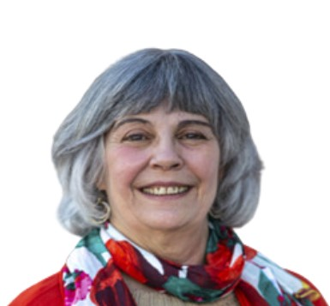
Today’s Presenters
Francine Trout
Retired Workforce Development Professional
Dolly Bermudez
Apprenticeship Coordinator
Howard County, MD, Office of Workforce Development
Sheila Jackson
Apprenticeship Navigator
Division of Workforce Development and
of Adult Learning
Maryland Department Labor

Slide 20
How Did We Start?
Outreach/Education Events for the community to learn the benefits of Apprenticeship
Held separate events for job seekers and businesses
Educated public officials and staff on the benefits of apprenticeship
NAW events, info sessions for job seekers and businesses, industry specific events such as IT.

Slide 21
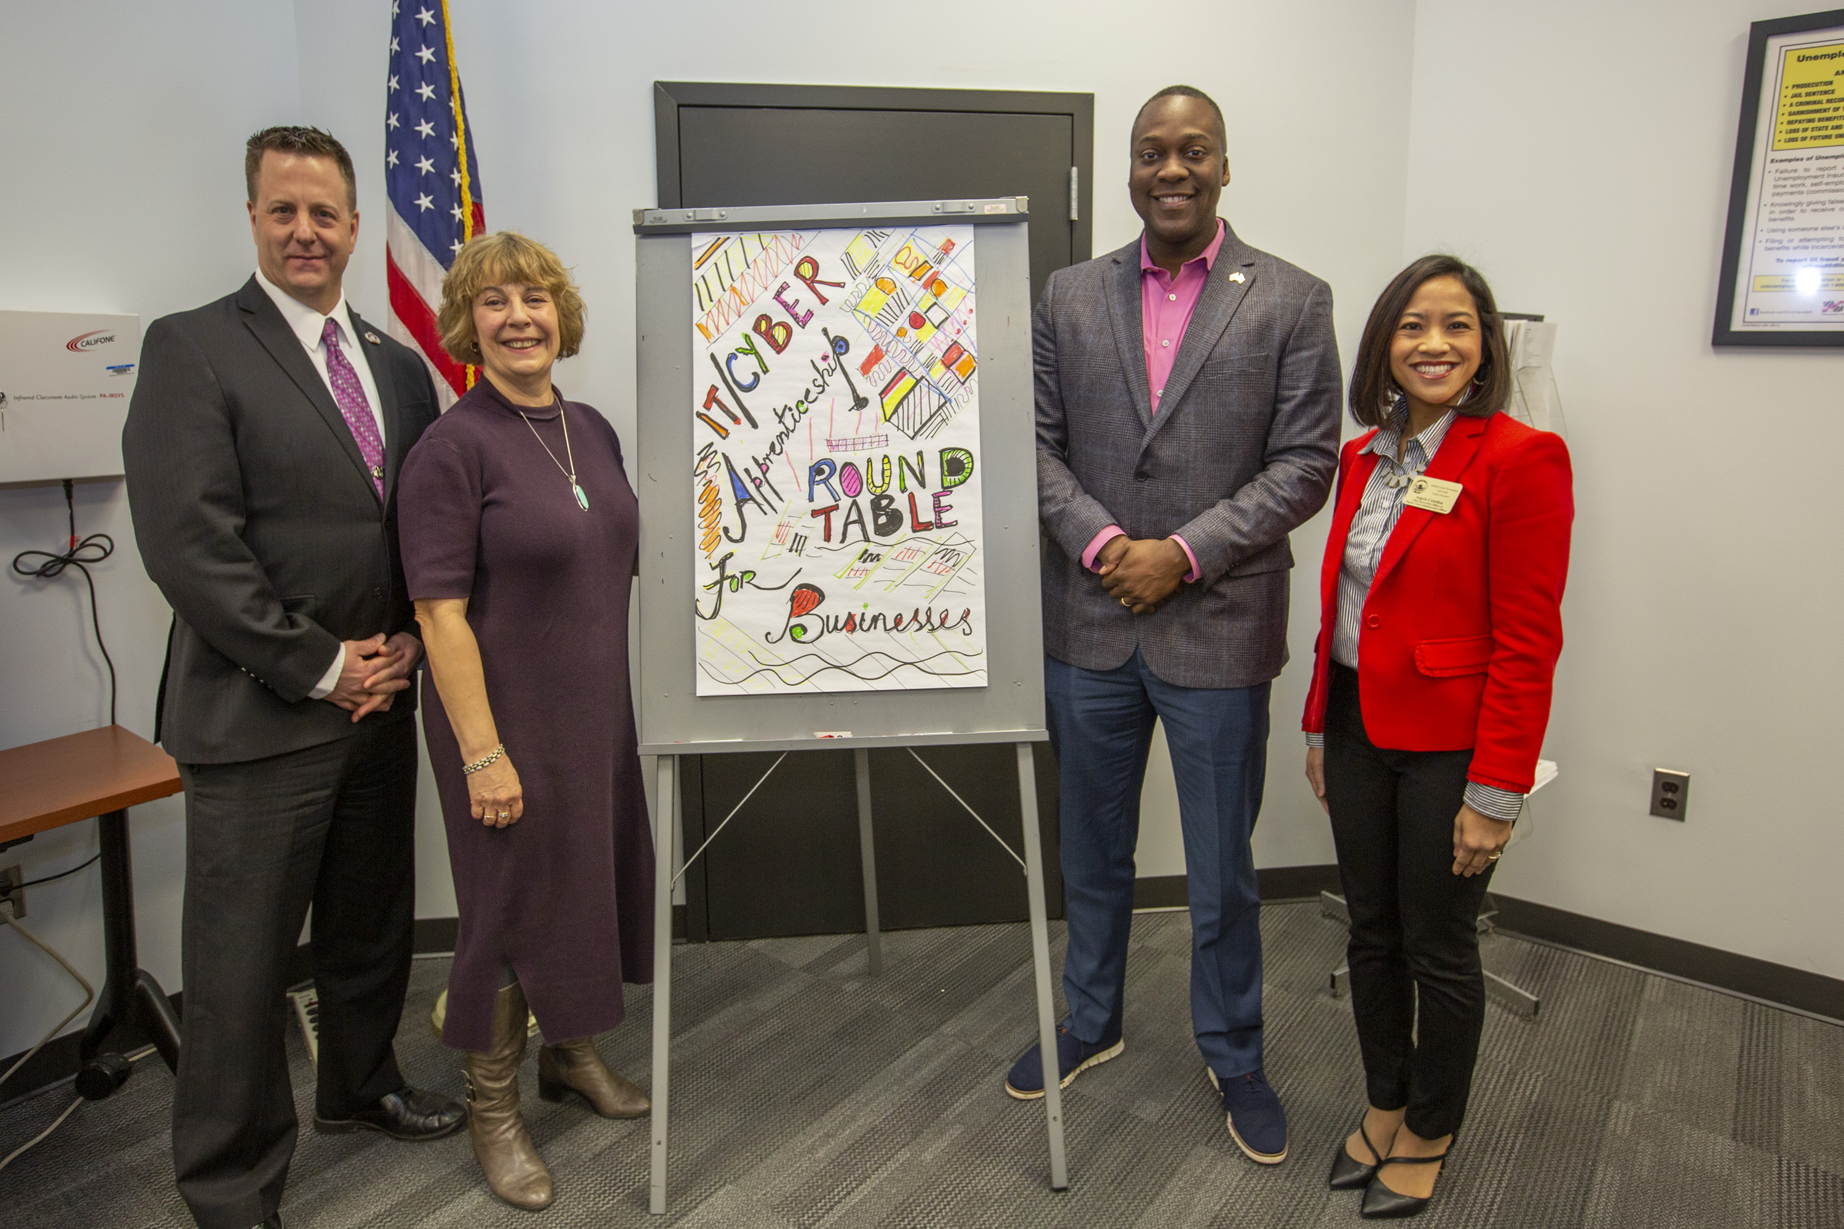
Building a system
Participated with the Howard County Public School System, IEC Chesapeake, MD DOL on a beta test for STA for high school students.​
Howard Community College began apprenticeship programs​
Ho Co WDA hired a dedicated apprenticeship coordinator​
Implemented the vision of the apprenticeship system in Howard County​

Slide 22
Funding
ARPA
WIOA
Pathways to Success
County Funds
MD DOL Funding
Notes:
Fran

Slide 23
System Partners
Howard County Workforce Development Area
MD Labor
Howard Community College
IEC Chesapeake (Non union electrical association)
Howard County Public School System
Safal Partners © 2024
Notes:
Fran

Slide 24
How We Work Together
Industry specific apprenticeship events/meetings
Business meetings
Share business contacts
No wrong door approach
Numerous joint events
National Apprenticeship Week
National Youth Apprenticeship Week
Youth job fairs
Incentives
Safal Partners © 2024
Notes:
Fran

Slide 25
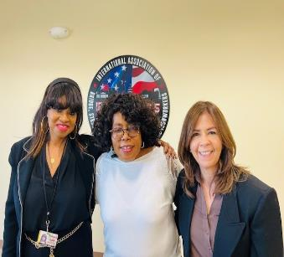
How We Work Together
COLLABORATION
Relationship building with MD DOL Navigator
Ho Co WDA developed a prospective plan
Visit customers together & facilitating events
Ho Co WDA created a local incentive program
Tailored and customized presentations for businesses based on industry needs
HCOWD created an Apprenticeship Newsletter, "The Blitz"
Engaging Employers and jobseekers to promote apprenticeship opportunities
Local, state, and federal Incentives
Safal Partners © 2024
Notes:
Dolly/Sheila

Slide 26
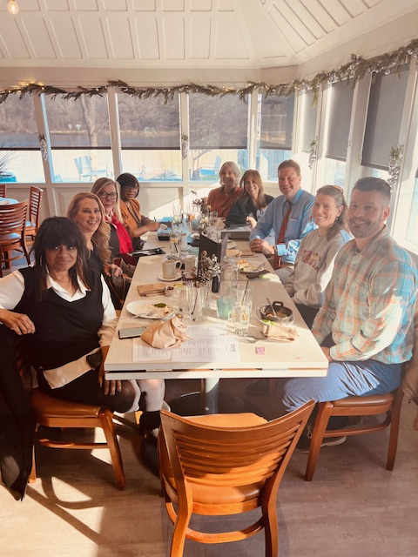
To Conclude
We are like a well-oiled machine fueled by great food and determination.
We are like a well oiled machine fueled by food and determination.
Safal Partners © 2024

Slide 27
Connect and Collaborate: Break-Out Room Discussions
Notes:
Nicole
Thank you so much for this great information and guidance Sheila, Dolly, Fran, and Jeff!
Throughout the course of this series, we’ve emphasized that system alignment cannot happen without collaboration and partnership. We’ve spent lots of time discussing the importance of and practical tips for building or enhancing partnerships and heard this echoed by Jeff, Fran, Dolly, and Sheila today, and this series will only be successful to the extent that we foster those further connections. Therefore, this next session is critical. (Next Slide)

Slide 28
Employment Training Administration Regions
Region 1
Connecticut
Maine
Massachusetts
New Hampshire
New Jersey
New York
Puerto Rico
Rhode Island
Vermont
Virgin Islands
Region 2
Delaware
Maryland
Pennsylvania
Virginia
Washington, D.C.
West Virginia
Region 3
Alabama
Florida
Georgia
Kentucky
Mississippi
North Carolina
South Carolina
Tennessee
Region 4
Arkansas
Colorado
Louisiana
Montana
New Mexico
North Dakota
Oklahoma
South Dakota
Texas
Utah
Wyoming
Region 5
Illinois
Indiana
Iowa
Kansas
Michigan
Minnesota
Missouri
Nebraska
Ohio
Wisconsin
Region 6
Alaska
American Samoa
Arizona
California
Commonwealth Northern Mariana Islands
Guam
Hawaii
Idaho
Nevada
Oregon
Palau
Washington
Safal Partners © 2024
Notes:
Nicole
In just a moment, we will be launching the breakout rooms to provide you the opportunity to connect with your peers. Breakout rooms will be labeled by US DOL-ETA Region numbers. When the rooms launch, you will see a “Join a Breakout Room” feature pop up on the bottom of your screen. Please self-select which breakout room to enter. If you are unsure of which region you belong to, please use this list to locate your area. You are also welcome to participate in another region’s conversation by coming back to the main room again to switch to another breakout room.
Facilitators will be waiting for you in each room and will lead the group through a series of questions to ultimately identify action items that can be executed in short and long terms.
We’re opening the rooms now and will see you back here in about 30 minutes!
[Breakouts begin]
Facilitators:
Region 1 – Haylie Schuster
Region 2 – Francine Trout
Region 3 – Alan Dodkowitz
Region 4 – Amy Lebednick / Olivia Blomstrom
Region 5 – Stacy O’Keefe
Region 6 – Joel Elsenbrook

Slide 29
Region Report-Outs
In the chat, please share
Something your region can do right away
Something your region would like to do that would require additional support, guidance or input
One question that your region has
Notes:
Nicole
Jeff, Fran, Dolly, Sheila--presenters
Welcome back! Glad to see everyone made it to their destination and our apologies to the folks that had a bit of a tech detour along the way—but we all made it! Staff were bouncing around between rooms and reported that some robust conversations were happening within the regions!
At this time, we’d like to request for each of our region volunteers to share their report out. Please feel free to come off of mute or place your report out in the chat. Be sure to tell us which region you are reporting for! We’d love to hear what you’ve identified as something your region can do right away, something your region would like to do that would require additional support/guidance/input, and one question that your region has. [Read through some of the feedback] (Next Slide)

Slide 30
Questions and Answers
Notes:
Nicole
We’d now like to open the session up for questions to our presenters. If you haven’t done so already, please place your question in the Q&A feature and we will address as many as possible. [Jana will send to you directly] (Next Slide)
You can mention that the Center of Excellence will be developing a follow up TA product to address their questions and provide the resources we've discussed today. By participating in this webinar, they will be notified via email when that product is ready!
Question for Q&A: Is Maryland an OA or SAA state? Does Maryland have apprenticeship staff or just the one apprenticeship coordinator working with local workforce office?
Question for Q&A: For our MD friends, Dolly, Fran, and Sheila--Do you do an in-depth work analysis of the employer's occupation?

Slide 31
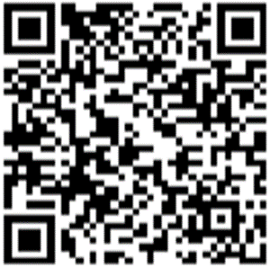
Become A Center Partner
Scan for Partner Form
Receive no-cost expert TA, materials, and assistance
Network with potential partners nationwide
Be nationally recognized for your work
Notes:
Nicole
Thank you all again for joining us today and your great participation in the
We would also like to take a moment to encourage you to become a partner with the Center of Excellence if you have not signed up yet. Please take a moment to scan the QR code on screen. As a partner you have the opportunity to receive no-cost technical assistance and materials, network with partners nationwide and be nationally-recognized for your work. (Next Slide)

Slide 32
Email us your questions at RA_COE@SafalPartners.com
For more information, visit: dolcoe.safalapps.com
Safal Partners © 2024
Notes:
Nicole
Jeff, Fran, Dolly, Sheila--presenters
Thank you all again for attending our session today! And big thanks to Jeff, Fran, Dolly, and Sheila for a great presentation. Colleen will be dropping in a short evaluation of this training and we would really appreciate your feedback as we plan future trainings. If you have any final questions for our presenters, please submit using the Q&A feature at the bottom of your screen. We will compile those questions and provide responses in a follow-up to today’s webinar. Have a great rest of your day!

