Slide 1
Promising Practices for Building Effective ATR/BSR Partnerships Session II
June 11, 2024

Slide 2
Moderator
Katie Adams
Chief Delivery Officer
Safal Partners

Slide 3
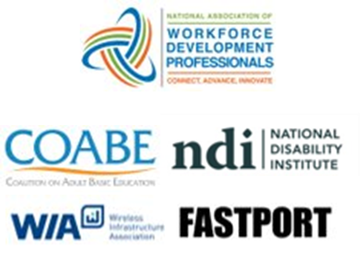
Center of Excellence Overview
U.S. DOL initiative to increase systems alignment across apprenticeship, education, and workforce
Led by Safal Partners; 5 national partners
We provide no-cost TA including:
Monthly webinars
Quarterly virtual office hours
Individual TA/coaching sessions
Online resources (desk aids, guides, frameworks, etc.)
Visit our website, request TA
Notes:
Today’s session is produced by the U.S. Department of Labor Registered Apprenticeship Technical Assistance Center of Excellence for Strategic Partnerships & Systems Alignment. Safal Partners leads the Center along with five national partners including the National Association of Workforce Development Professionals who helped develop this training.
The Center was established by DOL to scale national adoption of Registered Apprenticeships nationwide more rapidly by growing strategic partnerships and increasing alignment between apprenticeship and the workforce and education systems. The Center exists to provide no-cost technical assistance to key stakeholders – including OA and SAA directors and ATRs - through a variety of mechanisms including monthly webinars, quarterly virtual office hours, and customized individual TA/coaching sessions.

Slide 4
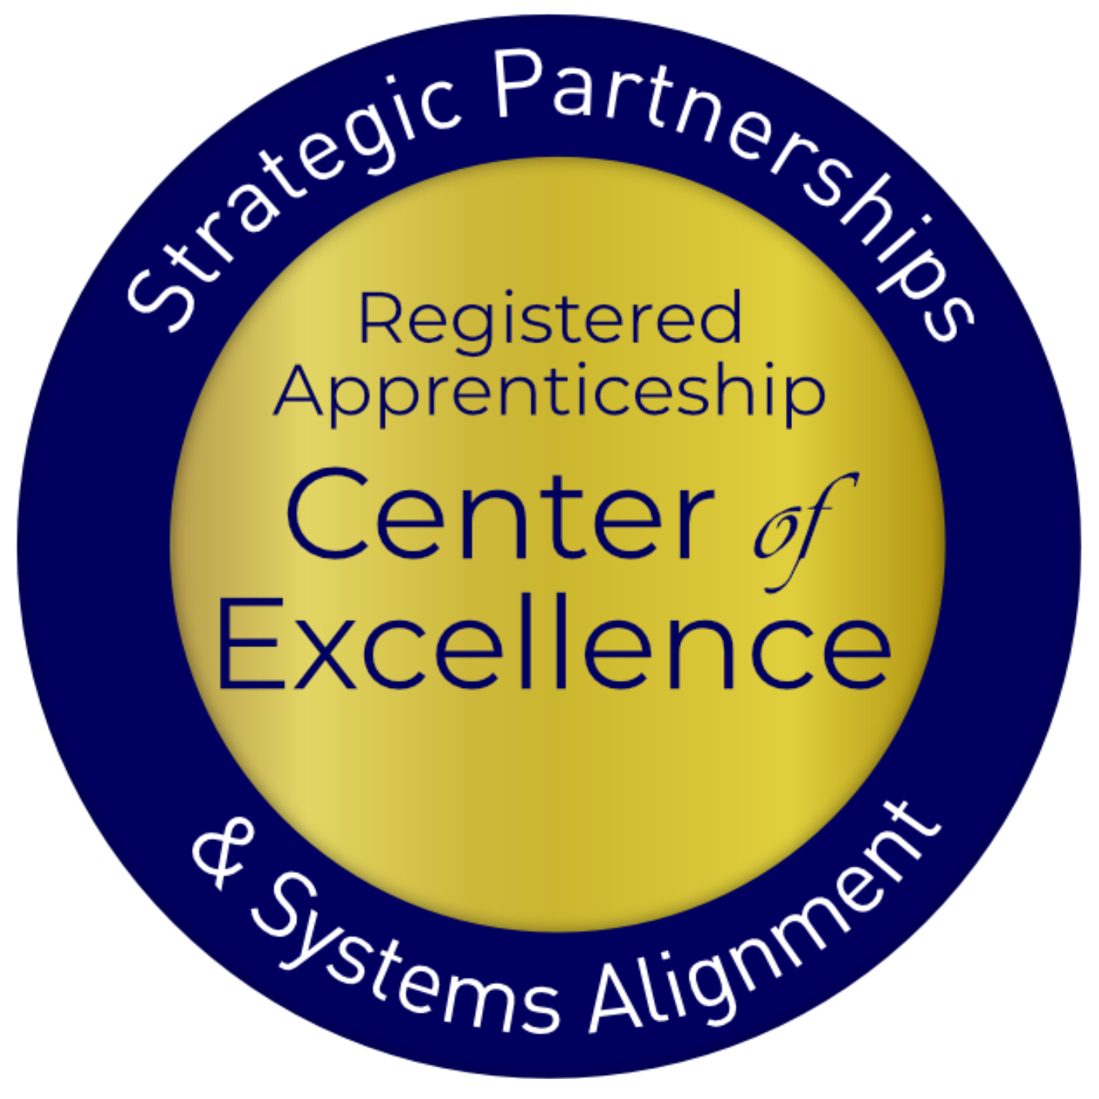
Agenda
Recap of Business Services and Job Seeker Services at the LWDB Level
Elements of the BSR Approach
Opportunities for ATRs to Build Effective Partnerships with BSRs
Best Practice: Strategies for Overcoming Challenges and Developing Partnerships and Collaborations
How Can ATRs Help Equip RA Sponsors Access Workforce System Funding through Collaboration with BSRs
Notes:
Today’s webinar is the second in a series to provide customized training for ATRs on the Public Workforce system and engagement with BSRs. Today’s session is designed to provide tools and resources for building effective partnerships with Business Services Representatives to achieve improved outcomes.
Parallel to this training for ATRs, two webinars have ben held for BSRs to better understand the Registered Apprenticeship system. Next, on June 27, we will hold a capstone training for both ATRs and BSRs

Slide 5
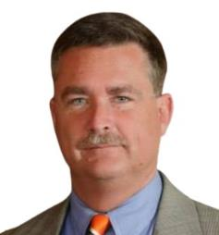
Guest Speaker
Jeffrey Smith
Workforce Liaison / Program Analyst
Office of Apprenticeship
U.S. Department of Labor
Notes:
Today, we are privileged once again to be joined by Jeffrey Smith. Jeffrey is a Workforce Liaison and Program Analyst with the US Dept of Labor’s Office of Apprenticeship. You may remember Jeffrey from previous sessions, as he has been an integral partner at the national office level for us throughout this series. Jeffrey has served in various positions related to workforce development, government relations, and development/public affairs throughout his career in both the public and private sectors.
Jeff recently joined the U.S. Department of Labor’s Office of Apprenticeship, working as the Workforce Liaison with their Division of Industry Engagement and Strategic Partnerships. Prior to this role, he most notably served as the senior Program Manager for Apprenticeship and Training with the Maryland Department of Labor, where among other duties he had oversight responsibilities for the state’s Apprenticeship Maryland youth apprenticeship initiative, which has grown to include all of Maryland’s twenty-four local public-school systems. Earlier in his career, Jeff served as the Acting Chief of Staff and Director of Government and Community Relations for the Maryland Transportation Authority, the state’s toll facilities agency. He also served the City of Baltimore as the Executive Liaison for Public Policy for the Mayor’s Office of Employment Development. Jeff is a 1995 Honors graduate of the University of Maryland, College Park where he studied History and Government and Politics.
It's been an exciting few weeks watching hundreds of workforce and apprenticeship training professionals come together to learn more about what each other’s roles are within the workforce system and how the roles complement each other. We have built some strong momentum for the Capstone session this Thursday and look forward to diving deeper into collaboration to complete this training series.
On behalf of the national Office of Apprenticeship, I am honored to join you in kicking off today’s session. As you have heard from various leadership throughout these sessions, the Office invested in this Center of Excellence to accelerate the number and quality of strategic partnerships in the field building sustainable Registered Apprenticeship programs and to more strategically and consistently collaborate with the workforce system in supporting those programs. While the Office has placed an emphasis on system alignment between workforce and registered apprenticeship, we cannot do it without you. Every partnership is important, and it can start with you at your local level. Some of you may already be partnering with your local BSRs, but if that’s not the case, you will leave today’s session with a better understanding of the BSR approach and practical tips to begin that collaboration.
Thank you again for your attendance here today.

Slide 6
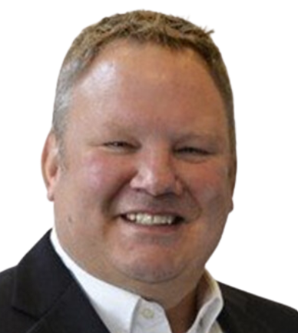
Today’s Presenters
Joel Elsenbroek
Project Manager, Apprenticeships
West Michigan Works!, Strategic Workforce Solutions
Amy Lebednick
Director, Business Solutions
West Michigan Works!, Strategic Workforce Solutions
Notes:
We are joined by Joel Elsenbroek and Amy Lebednick of Strategic Workforce Solutions who will lead today’s training session. Strategic Workforce Solutions is a division of West Michigan Works!.
West Michigan Works! is a Local Workforce Development Board in Michigan that has been committed to modernizing, diversifying, and expanding Registered Apprenticeship since 2015. In 2022 West Michigan Works! was recognized by DOL as an inaugural member of the first cohort of the Apprenticeship Ambassador Initiative. As an intermediary Registered Apprenticeship sponsor, they have 46 occupations on their program standards, which support 190 active apprentices through 80 participating employers in the Western Michigan area.
Joel Elsenbroek serves as Project Manager of Registered Apprenticeship Programs and Amy Lebednick serves as the Director of Business Solutions.

Slide 7
Objectives for Today
Increase ATR knowledge about workforce system
Increase ATR knowledge about Functions of Business Services Representatives
Encourage more proactive outreach by ATRs to BSRs in a local workforce area
Increase discussion and engagement between BSRs and ATRs
Increase coordination between BSRs and ATRs when conducting outreach to businesses in local workforce areas
Notes:
We are happy to be with all of you here today for the second of this two-part series.
This session is being recorded and will be posted to the Center of Excellence website which will be noted in the chat. We would like to encourage attendee participation, so if you have not already, please do introduce yourself in the chat now –include your name, entity you are with, and the state or region where you work. Please use the question button at the bottom of your screen to pose a question. To maximize our time together, we will gather all questions and respond in a follow up to today’s webinar.
Our main objectives for today’s presentation are:
Increase ATRs knowledge about the local workforce system, and the role of the Business Services Representatives.
Encourage more proactive outreach and increase engagement from ATRs to BSRs and;
Increase employer outreach coordination between BSRs and ATRs in their local workforce areas

Slide 8
Recap of Services at the Local Workforce Level
Business and Job Seeker Services
Notes:
I am going to start by providing a brief recap of the content that was presented in session one of this series, where we provided an overview of the Public Workforce system and information basic information of the Business Services Representative role.

Slide 9
LWDB Mission
Notes:
In short, the public workforce is a network of federal, state, and local entities that provide employment services, training programs, and support to help individuals find and keep jobs. One-stop career centers, also known as American Job Centers, or AJCs, are the backbone of this system, offering centralized access to a wide range of resources for both job seekers and employers. These centers also serve employers by helping them find qualified candidates and offering resources for workforce development.
The core mission of Local Workforce Development Boards, or LWDBs, is to understand the talent needs of employers and the employment needs of job seekers, then connect them with effective solutions. This mission ensures that both employers find the right talent and job seekers find suitable employment opportunities.
The services offered at an American Job Center can vary based on the local area’s priorities and resources. This is known as local discretion. Its important to understand local discretion, because, core services such as job search assistance, labor market information, resume workshops, and career counseling are consistently available. However, additional services and funding for vocational training, may differ one LWDB to the next.
Additionally, LWDBs may use different models to deliver services. Some may have:
Physical Centers: Your traditional brick-and-mortar building offering a wide range of services under one roof.
Virtual Services: Online platforms providing remote access to services, which have become increasingly important.
Mobile Services: Outreach programs using mobile units to bring services to underserved areas or specific populations.
Essentially, local discretion allows each LWDB the flexibility to tailor their services to meet the unique needs of their local communities. Again, this means that services and training funds will vary from one LWDB to another.
Regardless of that variation, LWDBs are tasked with ensuring a seamless array of services by coordinating and collaborating with partner organizations such as educational institutions, community-based organizations, and employers. This collaboration aims to provide comprehensive support to both job seekers and employers.

Slide 10
Business Services
Services for employers may include:
Employer Engagement & Relationship Building
Networking and Collaboration
Facilitating Access to Funding
Compliance and Documentation
Recruitment Assistance
Provision of Labor Market Information/Wage Analysis
Notes:
Let’s recap the array of services that may be offered at local workforce development agencies, in catering to employer needs. A few include:
1.Employer Engagement & Relationship Building: Establishing and nurturing relationships with employers to understand their business models and foster long-term partnerships.
2.Networking and Collaboration: Organizing networking events and collaborating with educational institutions and industry associations to create comprehensive workforce solutions.
3.Facilitating Access to Funding: BSRs continuously meet with employers to educate them about available workforce services, resources, and incentives such as tax credits or training programs, depending on their specific talent need.
4.Compliance and Documentation: Ensuring compliance with regulations and guidelines related to workforce development programs and maintaining accurate records.
5. Another very popular service is Recruitment Assistance: this may include job postings, recruitment events, job fairs, candidate screening, and referral services. These resources streamline the hiring process and connect employers with qualified candidates.
6. Labor Market Information/Wage Analysis: Employers can access vital labor market information and wage analysis through WIOA-funded resources. This data enables informed decision-making, helping employers strategize their workforce plans based on current market trends and demands.

Slide 11
Funding Support for Businesses
LWDB WIOA funding opportunities for employers may include:
Incumbent Worker Training
Customized Training
On-the-Job Training
Additional funding opportunities:
Subsidized Employment
Federal Grants for Apprenticeship Expansion
This Photo by Unknown Author is licensed under CC BY-SA
Notes:
Some of the key LWDB funding opportunities for employers may include:
1.Incumbent Worker Training: This funding, supported by WIOA, is designed to enhance the skills of incumbent workers, ensuring they remain competitive and adaptable to changes within the company or industry.
2.Customized Training: Employers can utilize WIOA funds to tailor training programs to meet their specific needs. Whether it's upgrading the skills of existing employees or preparing individuals for specialized roles, customized training ensures alignment with employer requirements.
3.On-the-Job Training (OJT): Through OJT, employers can receive reimbursement for a portion of the wages paid to newly hired employees during their training period. This incentivizes the hiring of individuals who may require additional training to excel in their roles.
Additionally, local, philanthropic, state administered funds and/or competitive grant awards may be available through your LWDB. Examples include:
Subsidized Employment Programs that provide financial assistance to employers to offset the costs of hiring and training new employees.
Federal Grants for apprenticeship expansion, such as the State Apprenticeship Grant: aimed at expanding apprenticeship programs, supporting employers in offering valuable hands-on training to their workforce.
As you can see, these services are instrumental in supporting employers and fostering workforce development within our communities.

Slide 12
Job Seeker Services
American Job Centers provide access to a range of partner programs and services to help job seekers find employment and advance in their careers, including:
Veteran Services (Priority of Services)
Youth Services
Career Development & Job Coaching
Job Search Assistance
Employability workshops
Hiring events
Labor Market Information
Referral to Partner Program Services
Notes:
As mentioned earlier, American Job Centers, are mandated to provide a spectrum of services aimed at aiding job seekers in finding employment and advancing in their careers. Some of these include:
1.Veteran Services – Priority of Service: Ensuring that veterans receive priority assistance in accessing employment resources, reflecting our commitment to those who've served our nation.
2.Youth Services: Tailored programs to support the unique needs of young job seekers, offering guidance and resources to kickstart their careers.
3.Career Development & Job Coaching: Personalized counseling to assess skills, interests, and career goals, providing guidance on resume writing, job search strategies, and interview preparation.
4.Job Search Assistance: Offering a range of resources and support for job search activities, including access to job listings, online platforms, job fairs or simply access to computers and office essentials
5.Employability Workshops: Interactive sessions aimed at enhancing job seekers' skills and marketability in today's workforce.
6.Hiring Events: Opportunities to connect directly with employers, facilitating meaningful interactions and potential job placements.
7.Labor Market Information: Providing insights into local job market trends, in-demand occupations, and industry growth projections to inform career decisions.
8.Referrals to Partner Agencies: Collaborating with community organizations to offer specialized support services, such as housing assistance, financial counseling, and mental health resources.
These services are crafted to address a diverse array of needs, empowering job seekers to overcome barriers, acquire essential skills, and achieve their career aspirations.

Slide 13
Funding Support for Job Seekers
LWDBs may provide WIOA funding to cover costs associated with:
Individual Training Accounts (ITAs)
Paid Work Experience (Youth & Adult)
Supportive Services
Childcare
Transportation
Books
Tools
Notes:
Job seekers have access to a range of funding and resources aimed at skill development and training programs to enhance their employability. Here's a snapshot of what's available:
1.Individual Training Accounts (ITAs): Similar to scholarships, these accounts provide financial assistance for job seekers to pursue training programs and certifications tailored to their career goals.
4.Paid Work Experience: Offering job seekers valuable on-the-job training opportunities, facilitating hands-on experience to enhance their skill set and marketability in the workforce.
5.Supportive Services: Addressing barriers to employment, such as childcare, transportation, books, and tools, to ensure job seekers can fully engage in training and employment opportunities.

Slide 14
Excellence in Practice: Engaging BSRs Elements of the BSR Approach
Notes:
Now I am going to hand it off to my colleague Joel, who will start to delve into the role of the Business Services Representative and best practices for collaboration.

Slide 15
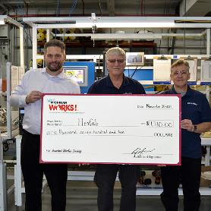
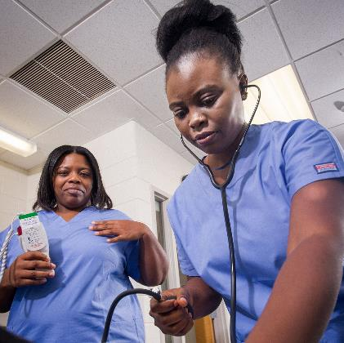
BSR Approach: Solutions Driven
Philosophy: We can best serve our communities by engaging with all partners to identify and overcome challenges through a collaborative approach.
Methods should be Proactive. Integrated. Sustainable.
This work is ongoing and dynamic and requires a continuous improvement approach!

Slide 16
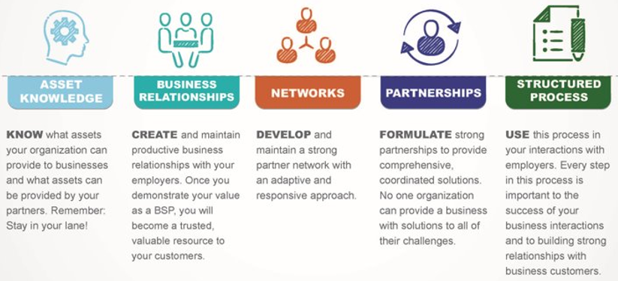
Elements of the BSR Approach
“Let no encounter with a business go to waste”
Notes:
Review/Recap from Session I

Slide 17
Elements of the BSR Approach 2
Key Partnerships
Asset Knowledge – Who else needs to have a seat at the table?
Business Relationships – Which Industry employers could benefit?
Developed Networks – Which stakeholders should I convene?
Partnerships – Who’s already engaged/connected?
Structured Process – Ensure a well thought out strategy

Slide 18
Elements of the BSR Approach 3
The BSR Structured Process
The most important question a BSR can ask: Why?
Follow-Up
Establishes ongoing business relationships, promotes sustained success and encourages process improvement.
What happened?
How did this project go?
What was the result?
Where might you improve for future projects?
What happens next?
Implementation
Your detailed plan for successful implementation of the proposed solution.
What steps are involved in the implementation of your plan?
Who is the lead contact during this phase of the project?
What are each partner's responsibilities?
What is the monitoring process?
Solutions Design
The recommended solution presented to the business by you and relevant partners.
What is the best solution for this employer/project?
What relevant assets could be provided by you and your partners?
Don't promise anything you can't deliver.
Stay in your lane.
Fact Finding
The discovery process to understand an employer's needs and bridging to solutions design.
Ask "why?"
What does the business need/what are their pain points?
Take caution not to jump to conclusions before you understand the situation.
Entry
Your introduction to a new employer/customer or initiating a project with an existing customer.
How do you contact them/get in the door?
What is the goal of outreach and potential partnership?

Slide 19
Excellence in Practice:
ATR and BSR Partnerships
Tips for ATRs for a Successful BSR Partnership

Slide 20
Tips for Effective Partnerships
Move from transactional connections to a collaborative approach
Establish ongoing open communication
Identify a high performing champion
Utilize available resources that allow access to programs

Slide 21
Building Effective Partnerships
Work with State Workforce Agency to have joint meetings with BSRs & ATRs across the state
Schedule short, regular, touch-base meetings with BSRs working with employers on RA program development
Send email updates announcing when new programs or occupations get approved
Promote online training sessions for BSRs interested in Registered Apprenticeship

Slide 22
Building Effective Partnerships 2
Identify a High Performing Registered Apprenticeship Program Champion
A Program Champion can:
Introduce RA program model to interested employers
Deliver testimonials/trainings
Provide TA for employers starting new programs
Advocate and recruit others to promote the RA program model

Slide 23
Building Effective Partnerships 3
Promote available resources that will allow greater access to programs
Apprenticeship.gov
RA Academy
Apprenticeship Finder
Apprenticeship Standards.org
Workforce GPS
State Department of Labor/Economic Development
Center Of Excellence/Safal Partners

Slide 24
Excellence in Practice: Overcoming Challenges
Strategies for Continuous Improvement

Slide 25
Developing Partnerships & Collaboration
ATRs can be the link by supporting & informing Business Solutions Representatives (BSRs) in the development of Registered Apprenticeship Programs.

Slide 26
Developing Partnerships & Collaboration2
“If you want to go fast, go alone. If you want to go far, go together.”
- African Proverb

Slide 27
Challenging Elements of Business Services
Matching employer needs with available workforce resources
Balancing diverse employer requirements
Addressing skill gaps or training needs of workforce
Serving as neutral convener
Managing multiple partners with varying priorities

Slide 28
A First Step: Assess the Workforce System’s Knowledge of RA
Knowledge Assessment Tool
Assess LWDBs knowledge threshold on Registered Apprenticeship to drive high, medium, or low engagement levels.
Handout: Knowledge Assessment Tool
Safal Partners © 2024
Notes:
Handout: Knowledge Assessment Tool here and on Tools and Takeaway Slide:

Slide 29
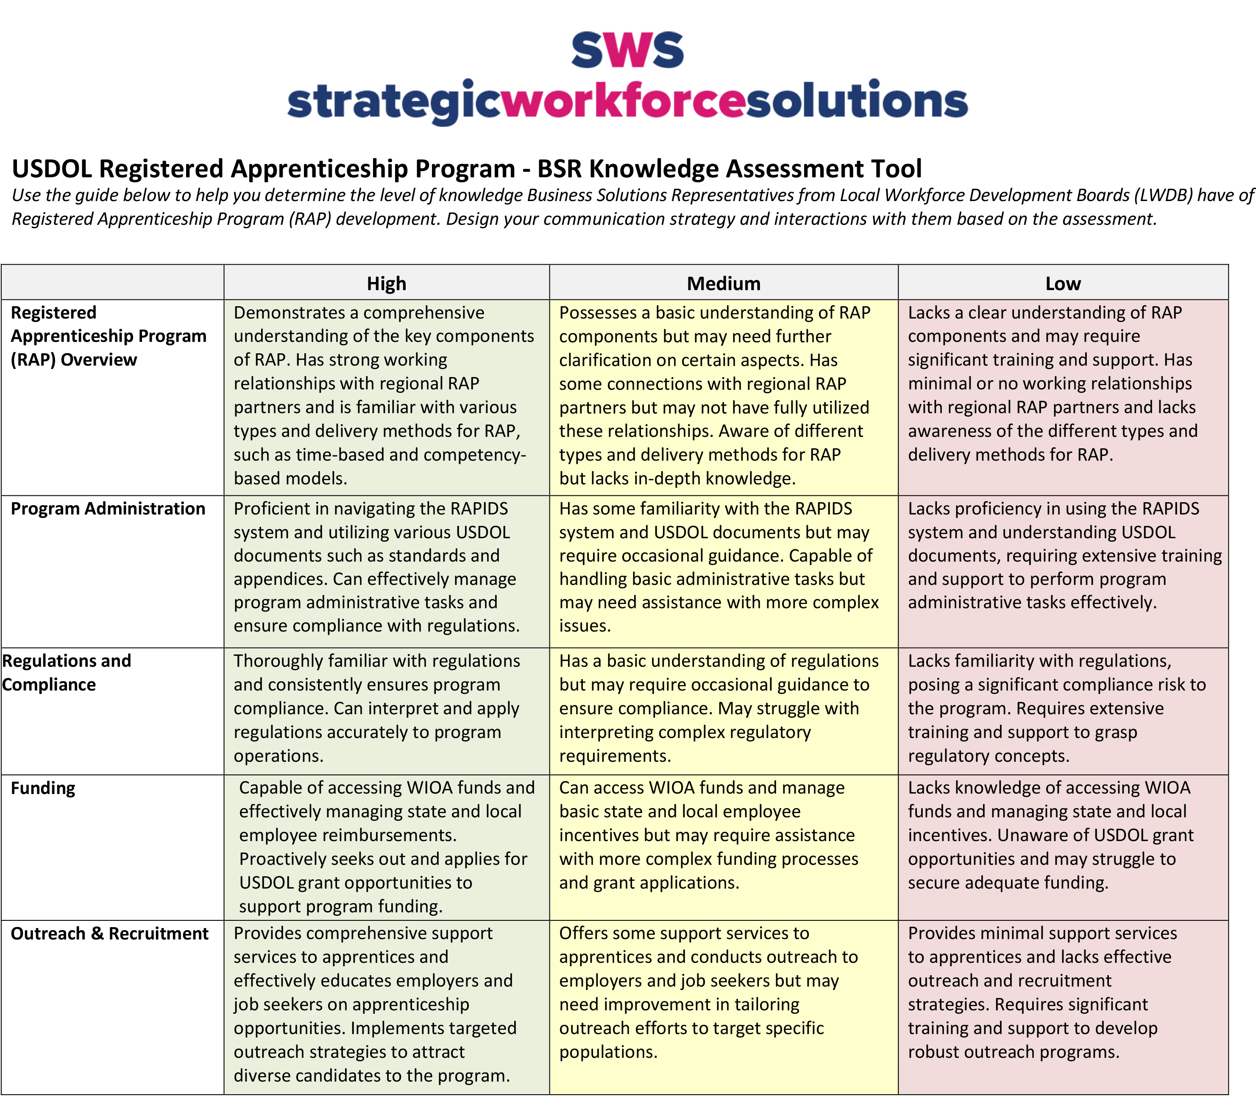
Assess the Workforce System’s Knowledge of RA
Safal Partners © 2024
Notes:
Knowledge Assessment Tool

Slide 30
Strategies for Overcoming Challenges
Tailor conversations to match BSR knowledge level
Consistent touch-bases to share information
Providing resources and connections
Offer BSRs an active role in the development process

Slide 31
Next Step: Sharing Assets
Asset Mapping Tool
Identify and track key stakeholders in RAP development to include in partner outreach & engagement.
Handout: Asset Mapping Tool
Notes:
Handout: Asset Mapping Tool– will be linked here and on Tools and Takeaway Slide:

Slide 32
Developing Partnerships & Collaboration3
Notes:
Handout: Asset Mapping Tool– will be linked here and on Tools and Takeaway Slide:

Slide 33
Collaboration for Overcoming Challenges
Connecting partners together helps to identify challenges and can lead to collaborative, robust solutions
Recognizing and identifying a facilitator or neutral convener to manage regional collaboration
Innovative development of new occupations in non-traditional industries

Slide 34
Developing Partnerships & Collaboration4
Vision for Future of ATR/BSR Partnership
Innovation in service delivery
Adapting to evolving workforce needs
Enabling and facilitating collaborations with key partners

Slide 35
Accessing Workforce System Funding
ATR/BSR Collaboration to Discover Funding Solutions

Slide 36
Funding Sources
Leverage funding from community partners
Braid federal, state, & local funds
WIOA Title 1 funds to support OJT, RTI, Support Services
Notes:
As you have heard throughout Joels portion of the presentation, partnerships play a vital role in workforce development. Particularly when it comes to braided funding, which involves combining resources from multiple funding streams to provide comprehensive services without losing the identity or accountability of each source.
First and foremost, partnerships allow workforce development programs to leverage diverse resources. No single organization can address all the needs of a community on its own. By collaborating, partners can pool their unique strengths and funding sources, which might include federal, state, local, and private funds. This collective approach enhances the service delivery to the end user, combining the expertise of different organizations and increases flexibility in how resources are used. It allows organizations to fill gaps and address specific needs that might not be covered by any single funding source.
A partnership approach to funding ultimately maximizes the impact and efficiency of available resources and partners are able to mutually benefit from the outcomes.

Slide 37
Accessing Workforce Training Funds
ATRs can play a crucial role in equipping registered apprenticeship sponsors and employers to access local workforce development system funding through collaboration with Business Services Representatives
Notes:
ATRs can play a crucial role in equipping registered apprenticeship sponsors and employers to access local workforce development system funding through collaboration with Business Services Representatives
ATRs can help RA sponsors and employers understand there may be multiple funding sources that align with their needs and objectives, whether it's funding for apprenticeship program development, training, or related supportive services.

Slide 38
Accessing Workforce Training Funds 2
Step 1: Reach out to your local workforce development board to find out who provides business services for the local workforce system.
Step 2: Meet regularly with your local BSR(s)
Encourage and participate in collaboration between businesses, LWDBs, and training institutions
Explore joint initiatives or partnerships to optimize training outcomes.
Handout: Workforce Training Fund Questions for BSRs
Notes:
How and where, as an ATR, do you start?
Step 1: Reach out to your local workforce development agency to find out who your BSR point of contact is. Katie Adams shared a link in the chat thread earlier and it will be linked on this slide, for a search tool from the DOL’s website that can help you find the LWDB in your area. Once you have that contact information, simply contact them directly and ask to get connected to the manager or director over their Business Services team. Again, because of local discretion, services and processes will vary from one LWDB to another so it is important to connect and partner with each of the LWDBs in your geographic area of oversight, if there is more than one. Then,
Step 2: Meet Regularly with your local BSRs. Policies, procedures and funding availability change often so it is imperative that you keep an open, two-way dialogue active between you and your BSRs. It should never be a simple one-and done meeting.
Encourage and participate in ongoing collaboration between businesses, LWDBs, and training institutions
Explore joint initiatives or partnerships to optimize training outcomes.
In session I we shared a handout that we are sharing here as well. The linked document is a wonderful tool for ATRs to reference when they meet with their BSRs. It provides key questions an ATR can ask a BSR in order gain basic knowledge of services and funding available at LWDB in your geographic area of oversight.
Handout: Workforce Training Fund Questions for BSRs

Slide 39
Tools and Takeaways
Handout: Knowledge Assessment Tool
Handout: Asset Mapping Tool
Handout: Workforce Training Fund Questions for BSRs
Safal Partners © 2024
Notes:
I encourage you to access the handouts linked here, as well as referenced throughout the presentation. We hope you will utilize these as you move forward in connecting with BSRs at the local workforce boards in your area. At this time, I would like to hand it back over to Katie to close us out.
Tools and Takeaway
Knowledge Assessment Tool for ATRs: https://www.westmiworks.org/app/uploads/2024/03/Asset-Map-1-1.pdf
Asset Mapping Tool: https://www.westmiworks.org/app/uploads/2024/03/Asset-Map-1-1.pdf
Workforce Training Fund Questions for BSRs: https://www.westmiworks.org/app/uploads/2024/03/Session-I-and-II-Handout_Workforce-Training-Fund-Questions-for-BSRs.pdf

Slide 40
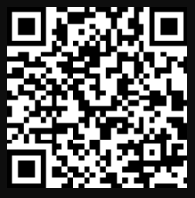
Last Chance to Register!
Capstone for ATRs and BSRs: Collaborating to Expand Registered Apprenticeship
Interactive learning from workforce experts
Effective ATR and BSR partnerships
Implement training at the local level
June 13th from 11am-12:30pm ET
Scan to Register:

Slide 41
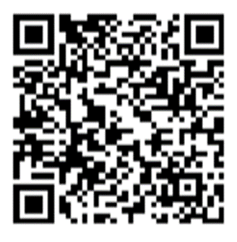
Contact Us, Become a Partner
Scan for Partner Form
Receive no-cost expert TA, materials, and assistance
Network with potential partners nationwide
Be nationally recognized for your work
Notes:
We’d like to encourage you to become a partner with the Center of Excellence if you have not signed up yet. Please take a moment to scan the QR code on screen. As a partner you have the opportunity to receive no-cost technical assistance and materials, network with partners nationwide and be nationally-recognized for your work. Thank you all again for attending our session today!

Slide 42
Email us your questions at RA_COE@SafalPartners.com
For more information, visit: dolcoe.safalapps.com
Safal Partners © 2024
Notes:
Thank you for your interest and participation in this webinar. I would like to remind you that this is the second webinar of a 2-part series and there will be a capstone training for both ATRs and BSRs held on June 27th. By the end of this series, we hope you are inspired to use the tools you will be provided with, to embark on this journey together with BSRs, leveraging collaboration to maximize the impact of our efforts in workforce development.
As a reminder, please submit any questions you have for us using the button at the bottom of your screen. We will compile those questions and provide responses in a follow-up to today’s webinar. Once again, I would like to thank everyone for attending – enjoy the rest of your day.

