Slide 1
Engage Series Uniting Registered Apprenticeship Programs and Tribal Workforce/ College Career Centers for Apprenticeship Recruitment
June 13, 2024
Notes:
Hello and WELCOME to the Center of Excellence, Engage Series: Uniting Registered Apprenticeship Programs and Tribal Workforce / College Career Centers for Apprenticeship Recruitment. We are very pleased to have you here. Please introduce yourself in the chat with your name and organization so we can get to know who is with us today. (next slide)

Slide 2
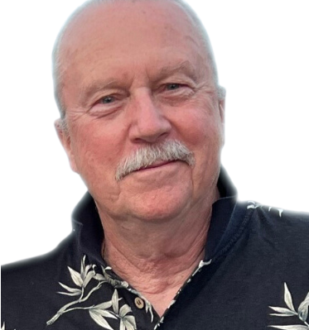
Moderator
Gene Ellis
Senior Subject Matter Expert
Safal Partners
Notes:
My name is Gene Ellis, and I am a Senior Subject Matter Expert at Safal Partners. It’s my pleasure to be your host today. (Next slide)

Slide 3
Center of Excellence Overview
U.S. DOL initiative to increase systems alignment across apprenticeship, education, and workforce
Led by Safal Partners; 5 national partners
We provide no-cost TA including:
Monthly webinars
Quarterly virtual office hours
Individual TA/coaching sessions
Online resources (desk aids, guides, frameworks, etc.)
Visit our website, request TA
Notes:
I’d like to give you an overview of the Center of Excellence. Safal Partners was awarded the opportunity to lead the US DOL Registered Apprenticeship Technical Assistance Center of Excellence for Strategic Partnerships and Systems Alignment in 2021.
We are here to help close the gap between the apprenticeship and workforce systems and accelerate partnerships across education, economic development, and other partners to increase adoption of RA nationwide.
The Center is supported by five national partners including the National Association of Workforce Development Professionals, the Coalition on Adult Basic Education, the National Disability Institute, FASTPORT, and the Wireless Infrastructure Association.
Our national partners were strategically chosen to help us reach specific groups whether on the workforce, education or employer side.
The Center of Excellence provides no-cost technical assistance – online, in-person and through hybrid delivery - to accelerate sustainable partnerships and align apprenticeship, workforce and education systems.

Slide 4
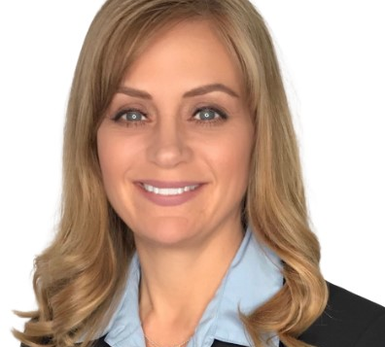
U.S. DOL Guest Speakers
Jennifer Whitmore
Corinna Pereira
Federal Project Officer
U.S. DOL Division of Indian and Native American Programs
Region 6 Multi-State Navigator
U.S. DOL Office of Apprenticeship
Notes:
Gene
It is my pleasure to introduce our guest speakers from the U.S. Department of Labor.
Ms. Whitmore is a Federal Project Officer for the U.S. DOL's Division of Indian Native American Programs and out stationed in California. She’s an enrolled member of Tohono O’odham Nation in Arizona. Her duties include serving the pacific northwest tribal grantees, authorized under Section 166 of the Workforce Innovation and Opportunity Act (WIOA).
Tohono O’odham easy pronunciation = Thaw-naw Awe-thumb
Corinna is one of 6 Multi-State Navigators with USDOL’s Office of Apprenticeship. Her role is to provide oversight and technical assistance to state apprenticeship agencies in 6 states to include the Pacific Northwest states WA and OR. She also supports federal agency and tribal apprenticeship programs in her region and works closely with Safal Partners on projects that help bring awareness, information, and resources regarding registered apprenticeship to the public.
Kayla, I’ll pass it off to you.
Kayla speaks. Corrina speaks. Corrina says (next slide)

Slide 5
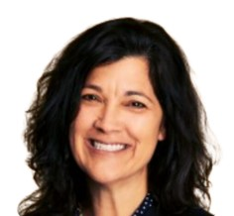
Today’s Presenters
Angela Baker
Wendy Levy
Jessee Skittral
Corinna Pereira
Safal Partners
Cyber and Tech Industry Intermediary
Alliance for Media Arts and Culture
Arts2Work Registered Apprenticeship Program
Atarashii
Apprenticeship Program
Puget Sound Naval Shipyard
Puget Sound Naval Shipyard Apprenticeship
Notes:
Gene
I am very pleased to welcome today’s presenters starting with Angela Baker, my colleague, at Safal Partners. Angela comes with a wealth of knowledge and experience as an apprenticeship subject matter expert with almost two decades of experience in Registered Apprenticeship and Continuing Technical Education.
Wendy Levy is the Executive Director of The Alliance for Media Arts and Culture. She is focused on catalyzing collaboration, innovation, and cultural impact for the media arts field with experience at Sundance and the Producers Institute for New Media Technologies. Under Wendy’s leadership, the Alliance was awarded the MIT Solve Prize for Reimagining Pathways to Employment in the US – for Arts2Work, the first federally-registered national Apprenticeship Program in Media Arts + Creative Technologies.
Coming from six generations of hairdressers in the Northwest, Jessee Skittrall’s experience as a salon owner, creative artist, and hair educator keeps him in demand among clients, leading beauty companies, and prestigious organizations throughout the U.S. Jessee is Technical Coach for KIN North America. And the President and Program Director for the Atarashii Apprentice Program, a federally approved apprenticeship Training Program in Cosmetology, Barbering, Esthetics, Manicuring, and Hair Design.
And Corinna Pereira will be presenting on behalf of the Puget Sound Naval Shipyard.
(next slide)

Slide 6
Agenda
Welcome and Introduction
Cyber and Tech Industry Intermediary Registered Apprenticeship Program
Alliance for Media Arts and Culture Arts2Work Program
Atarashii Apprenticeship Program
Puget Sound Naval Shipyard Apprenticeship Program
Q&A
Notes:
Gene
Throughout today’s presentation, we will hear about the Cybersecurity and Technology Industry Intermediary, Alliance for Media Arts and Culture Arts2Work Program, the Atarashii Apprenticeship Program, and Puget Sound Naval Shipyard Apprenticeship Program.
We ask that you place your questions in the chat during the presentation or hold your questions until our Q&A section at the end. This will ensure time to hear from each presenter. (next slide)

Slide 7
Cyber and Tech Industry Intermediary
Notes:
Gene
And now I’ll pass it over to Angela Baker to tell us about Safal Partner’s work as a Cyber and Tech Industry Intermediary

Slide 8
U.S. DOL Cyber Leadership
technical expertise to build and/or facilitate approval of a customized program for your organization's own sponsorship if preferred
ongoing technical assistance to successfully launch and sustain your customized program
connections to federal, state, and local resources including funding support through tax credits
direct limited incentive funding on a per-apprentice basis to assist with non- wage program costs
help identifying potential candidates through a network of partners including two- and four-year colleges and universities, military installations, workforce systems partners, and community-based organizations serving targeted populations
ongoing program support such as marketing and administrative assistance
Angela Baker
angela.baker@safalpartners.com
cyber.safalpartners.com
Notes:
Angela
Safal Partners is a US. Department of Labor Cyber and Tech Industry Intermediary for Registered Apprenticeship. We offer, at NO-COST:
technical expertise to build and/or facilitate approval of a customized program for your organization's own sponsorship if preferred
ongoing technical assistance to successfully launch and sustain your customized program
connections to federal, state, and local resources including funding support through tax credits
direct limited incentive funding on a per-apprentice basis to assist with non- wage program costs
help identifying potential candidates through a network of partners including two- and four-year colleges and universities, military installations, workforce systems partners, and community-based organizations serving targeted populations
ongoing program support such as marketing and administrative assistance

Slide 9
Alliance for Media Arts and Culture
Notes:
Gene
Thank you, Angela. Now let’s hear from Wendy Levy about the Alliance for Media Arts and Culture apprenticeship program. Wendy….

Slide 10
ARTS2WORK
THE FIRST FEDERALLY-REGISTERED
NATIONAL APPRENTICESHIP PROGRAM
in MEDIA ARTS + CREATIVE TECHNOLOGIES
WINNER OF THE MIT SOLVE PRIZE 2021
Reimagining Pathways to Employment in the US

Slide 11
Career Pathways for…
Multimedia Producers, Digital Video Editors and Multimedia Graphic Designers
Coming Soon: Digital Archivists

Slide 12
A National Program
Philadelphia
Baltimore
Atlanta
Albany
Miami
Oakland
Los Angeles
Colorado Springs
…and more to come

Slide 13
To Register: https://arts2work.media
TO LEARN AND FIND COMMUNITY:
https://edu.arts2work.media

Slide 14
New Opportunities for Industry-connected Learning
Pre-Apprenticeship programs, NEA-funded online Learning Hub, industry certification, competency-based on-the-job training, mentorship, equity labs, peer networks

Slide 15
Arts2Work Program
Benefits.
Benefits for Business
Highly-skilled employees
Reduced turnover costs
Higher productivity
More diverse workforce
Benefits for Workers
Increased skills
Higher wages
National credential
Career advancement
Artists and Creative Producers are innovators and economic engines of our country – they should be able to benefit from a set of professional training and on-the-job learning opportunities like those available to their counterparts in health, science, technology, business and the trades. Because of Arts2Work, now they can.

Slide 16
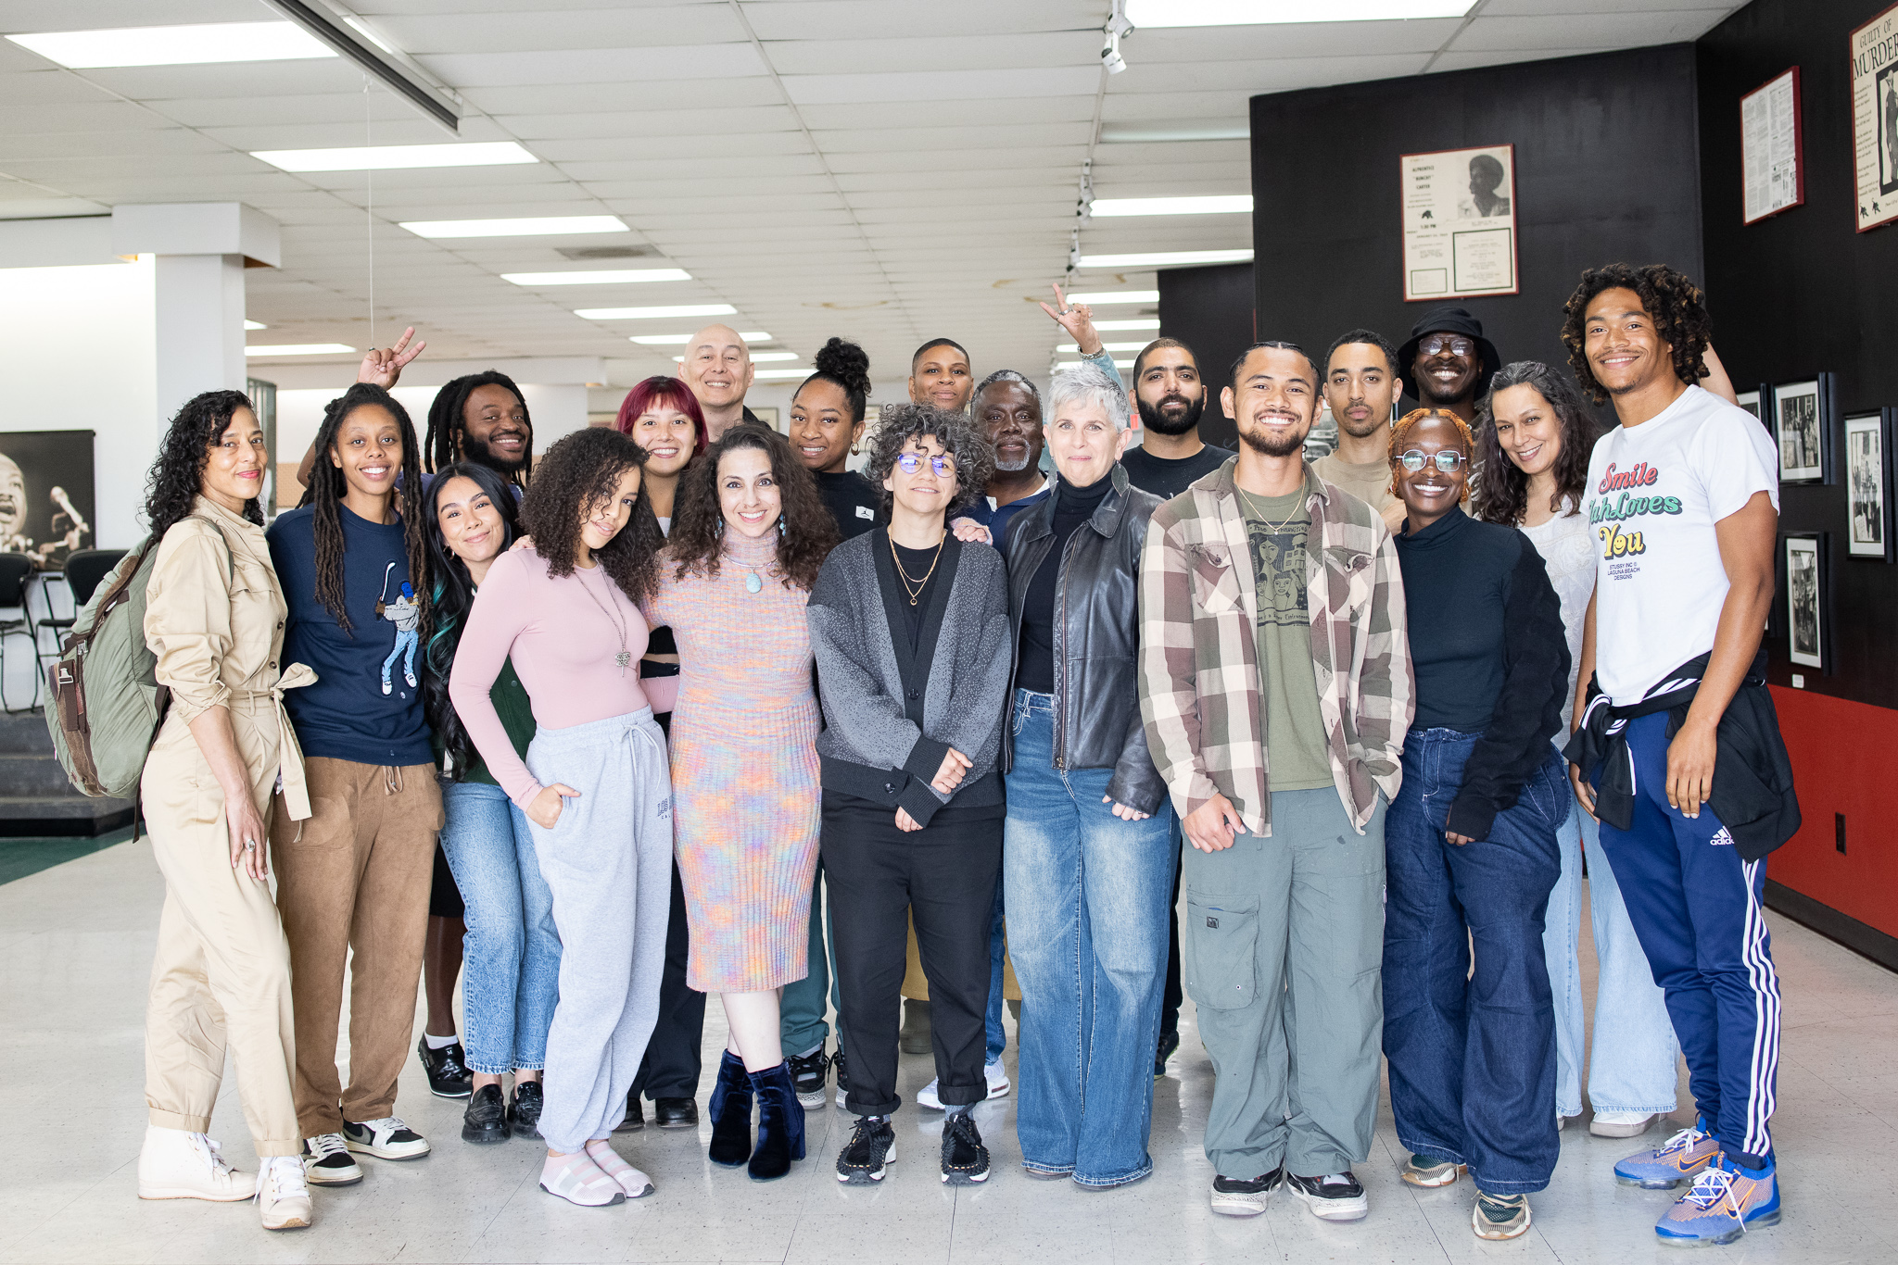
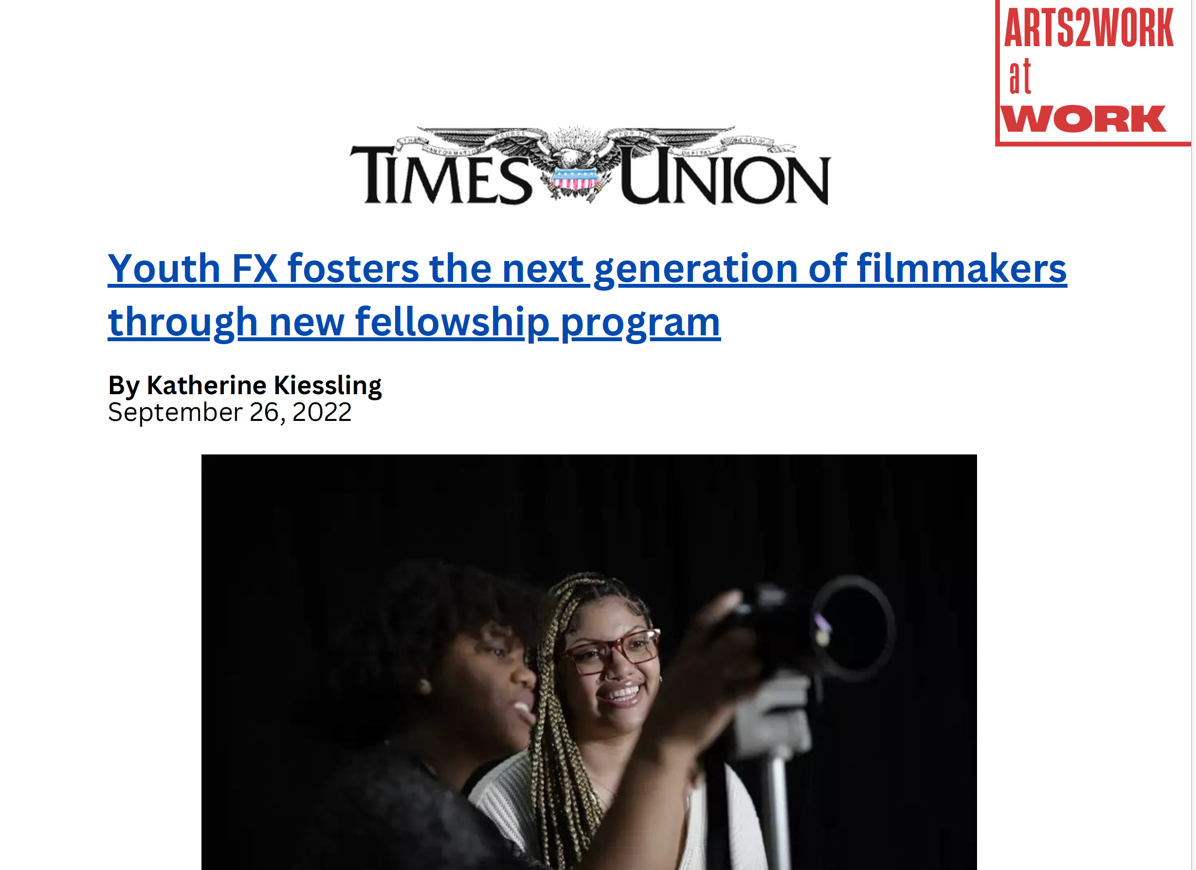
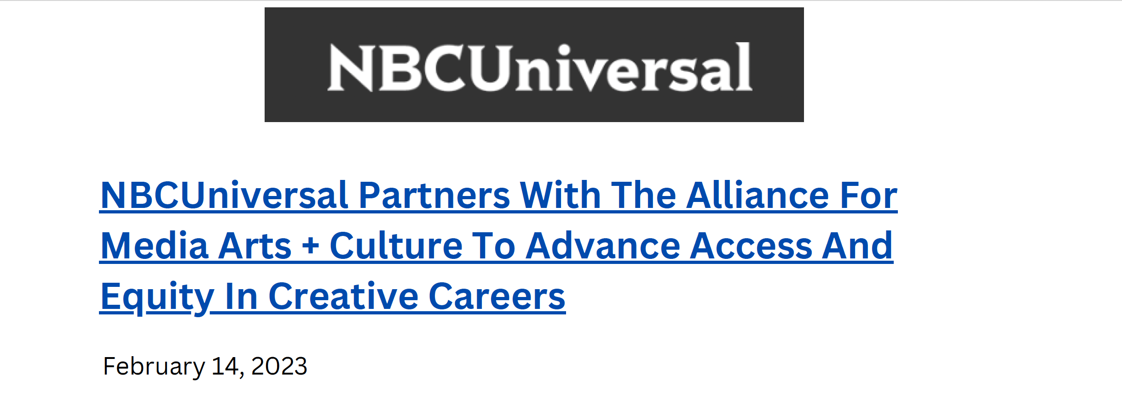
Arts2Work 2

Slide 17
Contact Arts2Work
Executive Director Wendy Levy
wendy@thealliance.media

Slide 18
Atarashii Apprentice Program
Notes:
Gene
Thank you so much Wendy. Next, we have Jessee Skitrall from Atarashii telling us about the Atarashii apprentice program. Jessee, I’ll pass it over to you….

Slide 19
Introduction
Licensed Instructor
Licensed: Cosmetologist, Barber, Esthetician, Master Esthetician, Manicurist, Massage Therapist
ICE Certified Credentialing Specialist through National Commission for Certifying Agencies (NCCA)
Salon Owner
Board Certified Haircolorist
Internationally Board Certified Haircolorist
Manufacturer Educator
Sales & Education for Distributor

Slide 20
Occupation
Offerings
Cosmetology
Hairdesign
Barbering
Esthetics
Nail Technology

Slide 21
Application Process
Apply through the website link
Dedicated Applicant Liaison
Supply required documents
Video Interview Process
Applicant Committee Approval
Placed in the applicant pool
Notes:
Multi employer Sponsor

Slide 22
Expectations
Treat apprenticeship like a job
Regular attendance
Concurring RSI
Meet with Learning Leader monthly
Complete Assignments
Receive a ”4” or higher on behavioral assessments

Slide 23
Wages
Follow the wage progressions
Commissions & Tips
Benefits based on employer

Slide 24
Program Costs
Apprentice -
$450 Seat Fee
$125 per month for RSI
Employer –
$325 Enrollment Fee
$125 Monthly Participation Fee
Notes:
E

Slide 25
Locations
Multi Employer Sponsor
Currently in WA over 120 employer Partners
Often time applicants bring Employer Partners
Notes:
E

Slide 26
Shipyards Trades Pathway
Helper Trainee
Entry level
12 months
Apprentice
Internal application
4 years
Journeyperson
Internal application
Permanent appointment
Safal Partners © 2024
Notes:
First, apply as a Helper Trainee (federal worker). Helper is an entry level position. Helper program is 12 months in duration.
After 12 months, and as soon as apprentice opportunities open, internal employees (helpers) compete for open apprentice positions. Apprenticeships are 4 years or 48 months.
After completing the apprenticeship, apprentices move into journeypersons.

Slide 27
Puget Sound Naval Shipyard Apprenticeship
Notes:
Gene
Thank you so much Jessee. Next, Corinna Pereira is going to present on behalf of the Puget Sound Naval Shipyard and give us an overview of their apprenticeship program. Corinna….

Slide 28
Shipyards Trades Pathway 2
Helper Trainee
Entry level
12 months
Apprentice
Internal application
4 years
Journeyperson
Internal application
Permanent appointment
Safal Partners © 2024
Notes:
First, apply as a Helper Trainee (federal worker). Helper is an entry level position. Helper program is 12 months in duration.
After 12 months, and as soon as apprentice opportunities open, internal employees (helpers) compete for open apprentice positions. Apprenticeships are 4 years or 48 months.
After completing the apprenticeship, apprentices move into journeypersons.

Slide 29
Helper Trainee Program
Advance through the program by completing required On the Job Learning (OJL) hours over 12-months and demonstrating knowledge in a set list of competencies.
Take 4 courses after regular work hours and maintain a 2.0 GPA or better. Tuition and books are covered by the program.
Starting pay rate is $20.13 an hour. Wage scale goes from WG-1 to WG-5 at end of program
Notes:
Class are: basic math, blueprints, shipyard terminology and fundamentals, intro to college

Slide 30
How to Apply
Visit www.USAJOBS.GOV
Search “Helper”
Location “Bremerton, Washington”
Direct Link:
https://www.usajobs.gov/ job/732658200
Safal Partners © 2024
Notes:
Start by first applying for a Helper Trainee from the USAJobs.gov page.

Slide 31
How to Apply cont..
Read Entire Announcement
Scroll down to “How to Apply”
Send Resume to:
dhaproductionjob.fct@navy.mil
Safal Partners © 2024

Slide 32
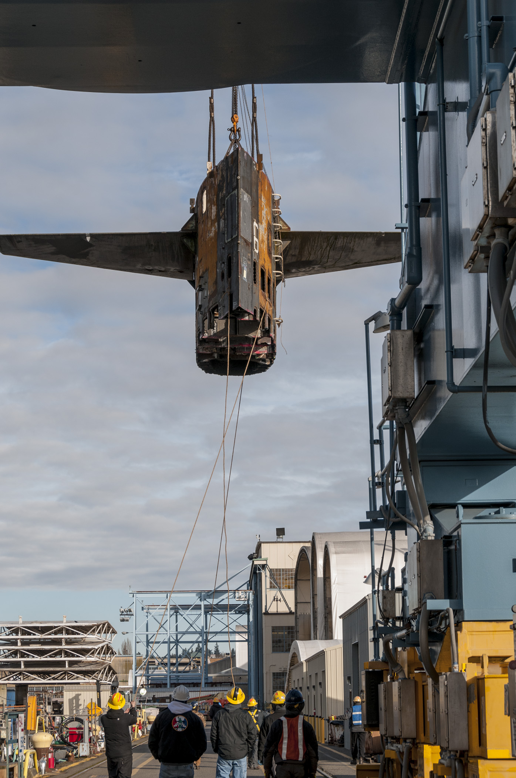
Apprentice Program
The apprenticeship was first established in 1901 and has been in partnership with Olympic College since 1952
Apprentices are hired one time per year from the Helper Trainee pool
Safal Partners © 2024
Notes:
After 12 months, and when opportunities open, helper trainees can pathway into the Apprentice Program

Slide 33
Apprenticeship Program
The apprenticeship is an 8000-hour hybrid program
The apprenticeship includes accredited academics, on-the-job training, and demonstration of skills testing
Program is a 4-year commitment to a selected trade
Apprentices Earn:
Associate of Technical Arts Degree from Olympic College
Journeyperson Certification from the U.S. Department Of Labor
Journeyperson Certification from the U.S. Department of the Navy
Apprentice pay begins on the federal WT pay scale starting at $22.81 (2024)
Journeyperson pay begins on the federal GS pay scale starting at $35.09 (2024)
Safal Partners © 2024

Slide 34
Shipyard Trades
Tool Parts Attendant
Production Machinery Mechanic
Production Machinery Electrician
Electronic Industrial Control Mechanic
Shipfitter
Sheet Metal Mechanic
Welder
Machinist
Electroplater
Tool Maker & Tool Grinder
Marine Machinery Mechanic
Marine Electrician
Marine Pipefitter
Thermal Insulator
Safal Partners © 2024

Slide 35
Shipyard Trades cont..
Shipwright
Composite Plastic Fabricator
Fabric Worker
Electronic Mechanic
Painter
Temporary Services Electrician
Temporary Services Pipefitter
Temporary Services Filtered Vent
Crane Electrician
Crane Mechanic
Crane Painter
Rigger
Safal Partners © 2024

Slide 36
Federal Benefits
Competitive Pay
11 Paid Holidays
104 hours of annual sick leave
104 hours of annual vacation leave
Medical Insurance
Retirement Investment Plan
Life Insurance
BENEFITS
INCLUDE:
Safal Partners © 2024
Notes:
BEING AN EMPLOYEE WITH THE DEPARTMENT OF THE NAVY IS A POSITION WITHIN THE FEDERAL GOVERNMENT

Slide 37
Contact Information
Jeff Mcgloin
360-340-2012
Jeff.A.Mcgloin.civ@us.navy.mil
Safal Partners © 2024

Slide 38
Questions and Answers
Notes:
Corinna
Asks questions to presenters from the chat and opens it up to the audience to ask any questions.
STOP at 5 minutes before the hour and pass to Gene.

Slide 39
Contact Us, Become a Partner
Scan for Partner Form
Receive no-cost expert TA, materials, and assistance
Network with potential partners nationwide
Be nationally recognized for your work
Notes:
Gene
Thank you so much to all of our presenters for telling us all about these exciting apprenticeship opportunities. And we want to thank all of you for joining us today. We appreciate your participation.
We’d like to encourage you to become a partner with the Center of Excellence if you have not signed up yet. Please take a moment to scan the QR code on the screen. As a partner you have the opportunity to receive no-cost technical assistance and materials, network with partners nationwide, and be nationally-recognized for your work.
Colleen will pop up a short evaluation of this training and we would really appreciate your feedback as we plan for future trainings.
(Wait a minute). (Next slide)

Slide 40
Email us your questions at RA_COE@SafalPartners.com
For more information, visit: dolcoe.safalapps.com
Safal Partners © 2024
Notes:
Once again, I would like to thank everyone for attending. Please feel free to contact the center directly through emailing us or visiting our website. Enjoy the rest of your day.

