Slide 1
Engage Series Uniting Registered Apprenticeship Programs and Tribal Workforce/ College Career Centers for Apprenticeship Recruitment
June 20, 2024
Notes:
Hello and WELCOME to the Center of Excellence, Engage Series: Uniting Registered Apprenticeship Programs and Tribal Workforce / College Career Centers for Apprenticeship Recruitment. We are very pleased to have you here. Please introduce yourself in the chat with your name and organization so we can get to know who is with us today. (next slide)

Slide 2
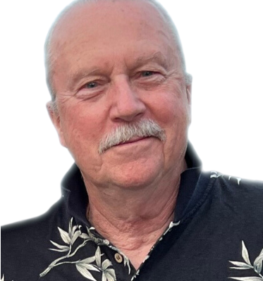
Moderator
Gene Ellis
Senior Subject Matter Expert
Safal Partners
Notes:
My name is Gene Ellis, and I am a Senior Subject Matter Expert at Safal Partners. It’s my pleasure to be your host today. (Next slide)

Slide 3
Center of Excellence Overview
U.S. DOL initiative to increase systems alignment across apprenticeship, education, and workforce
Led by Safal Partners; 5 national partners
We provide no-cost TA including:
Monthly webinars
Quarterly virtual office hours
Individual TA/coaching sessions
Online resources (desk aids, guides, frameworks, etc.)
Visit our website, request TA
Notes:
I’d like to give you an overview of the Center of Excellence. Safal Partners was awarded the opportunity to lead the US DOL Registered Apprenticeship Technical Assistance Center of Excellence for Strategic Partnerships and Systems Alignment in 2021.
We are here to help close the gap between the apprenticeship and workforce systems and accelerate partnerships across education, economic development, and other partners to increase adoption of RA nationwide.
The Center is supported by five national partners including the National Association of Workforce Development Professionals, the Coalition on Adult Basic Education, the National Disability Institute, FASTPORT, and the Wireless Infrastructure Association.
Our national partners were strategically chosen to help us reach specific groups whether on the workforce, education or employer side.
The Center of Excellence provides no-cost technical assistance – online, in-person and through hybrid delivery - to accelerate sustainable partnerships and align apprenticeship, workforce and education systems.

Slide 4
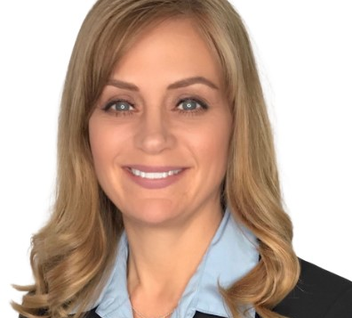
U.S. DOL Guest Speakers
Carl Duncan
Corinna Pereira
Workforce Development Specialist
U.S. DOL ETA DINAP
Region 6 Multi-State Navigator
U.S. DOL Office of Apprenticeship
Notes:
Gene
It is my pleasure to introduce our guest speakers from the U.S. Department of Labor.
Carl Duncan - Carl Duncan (Ute/Tohono O’Odham)
Workforce Development Specialist
ETA-Division of Indian and Native American Programs
Carl Duncan is an enrolled member of the Ute Indian Tribe and a descendent of the Tohono O’odham Nation. He was a recipient of the George Washington University, Native American Political Leadership Program (NAPLP) scholarship and worked for a tribal lobbying firm as a legislative associate on Native American issues. Later, he became a Senior Program Analyst for Tribal Tech, LLC, with the Department of Labor. Since 2020, Carl has been working as a Workforce Development Specialist with the Employment and Training Administration’s Division of Indian and Native American Programs. In this position he helps Native American tribes and tribal entities implement their WIOA Sec. 166 INA grant.
Corinna Pereira is one of 6 Multi-State Navigators with USDOL’s Office of Apprenticeship. Her role is to provide oversight and technical assistance to state apprenticeship agencies in 6 states to include the Pacific Northwest states WA and OR. She also supports federal agency and tribal apprenticeship programs in her region and works closely with Safal Partners on projects that help bring awareness, information, and resources regarding registered apprenticeship to the public.
Carl, I’ll pass it off to you.
Carl speaks. Corrina speaks. Corrina says (next slide)

Slide 5
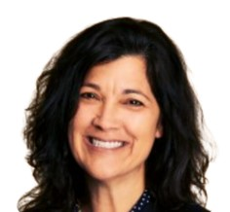
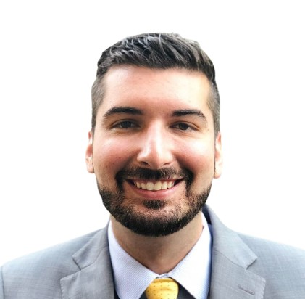
Today’s Presenters
Angela Baker
Joe Brown
Ryan Covert
Jason Goodfellow
Safal Partners
Cyber and Tech Industry Intermediary
Avista
Avista Training Programs
Seafarers International Union
My Maritime Career Apprenticeship Program
Army Corps of Engineers
Hydro Power Plant Training Program Supervisor
Notes:
Gene
I am very pleased to welcome today’s presenters starting with Angela Baker, my colleague, at Safal Partners. Angela comes with a wealth of knowledge and experience as an apprenticeship subject matter expert with almost two decades of experience in Registered Apprenticeship and Continuing Technical Education.
Joe Brown is the Craft Training Manager at Avista Utilities. Joe leads a team of instructors, coordinators and developers supporting Avista’s training programs. In this role, Joe leads programs that support Avista’s workforce, including 13 apprentice and a multitude of journeyman level training programs. Prior to joining Avista in 2016, Joe was a Director of Community, Safety and Environment at TC Energy. Joe has a broad background in enterprise technology, training, safety, environment, land, and regulatory compliance in his 20+ years in the energy industry.
Ryan Covert is the national Director of Recruiting for the Seafarers International Union. Ryan also has experience with the Seafarers International Union as a union representative, the Detroit Wayne County Port Authority in communications, and as an elected city council member for the City of New Baltimore.
Jason Goodfellow is the Hydro Power Plant Training Program Supervisor and Training Manager at the Army Corps of Engineers in Washington. Jason was a graduate of the Puget Sound Naval Shipyard’s 4-year Apprentice Program and was a Shipfitter at the Puget Sound Naval Shipyard for 8 years. Jason has a degree in Workforce Development, spent three years on active duty in the Army, and has served for over two decades as an instructor, manager, and supervisor in several capacities.
(next slide)

Slide 6
Agenda
Welcome and Introduction
Cyber and Tech Industry Intermediary Registered Apprenticeship Program
Avista Training Programs
My Maritime Career Apprenticeship Program
U.S. Army Corps of Engineers Northwestern Division Hydro Power Plant Training Program
Q&A
Notes:
Gene
Throughout today’s presentation, we will hear about the Cybersecurity and Technology Industry Intermediary, the Avista Training Programs, the My Maritime Career Apprenticeship Program, and the U.S. Army Corps of Engineers Northwestern Division Hydro Power Plant Training Program.
.
We ask that you place your questions in the chat during the presentation or hold your questions until our Q&A section at the end. This will ensure time to hear from each presenter. (next slide)

Slide 7
Cyber and Tech Industry Intermediary
Notes:
Gene
And now I’ll pass it over to Angela Baker to tell us about Safal Partner’s work as a Cyber and Tech Industry Intermediary

Slide 8
U.S. DOL Cyber Leadership
technical expertise to build and/or facilitate approval of a customized program for your organization's own sponsorship if preferred
ongoing technical assistance to successfully launch and sustain your customized program
connections to federal, state, and local resources including funding support through tax credits
direct limited incentive funding on a per-apprentice basis to assist with non- wage program costs
help identifying potential candidates through a network of partners including two- and four-year colleges and universities, military installations, workforce systems partners, and community-based organizations serving targeted populations
ongoing program support such as marketing and administrative assistance
Angela Baker
angela.baker@safalpartners.com
cyber.safalpartners.com
Notes:
Angela
Safal Partners is a US. Department of Labor Cyber and Tech Industry Intermediary for Registered Apprenticeship. We offer, at NO-COST:
technical expertise to build and/or facilitate approval of a customized program for your organization's own sponsorship if preferred
ongoing technical assistance to successfully launch and sustain your customized program
connections to federal, state, and local resources including funding support through tax credits
direct limited incentive funding on a per-apprentice basis to assist with non- wage program costs
help identifying potential candidates through a network of partners including two- and four-year colleges and universities, military installations, workforce systems partners, and community-based organizations serving targeted populations
ongoing program support such as marketing and administrative assistance

Slide 9
Avista Training Programs
Notes:
Gene
Thank you Angela. And now let’s hear about the Avista Training Program from Joe Brown. Joe I’ll pass it over to you…

Slide 10
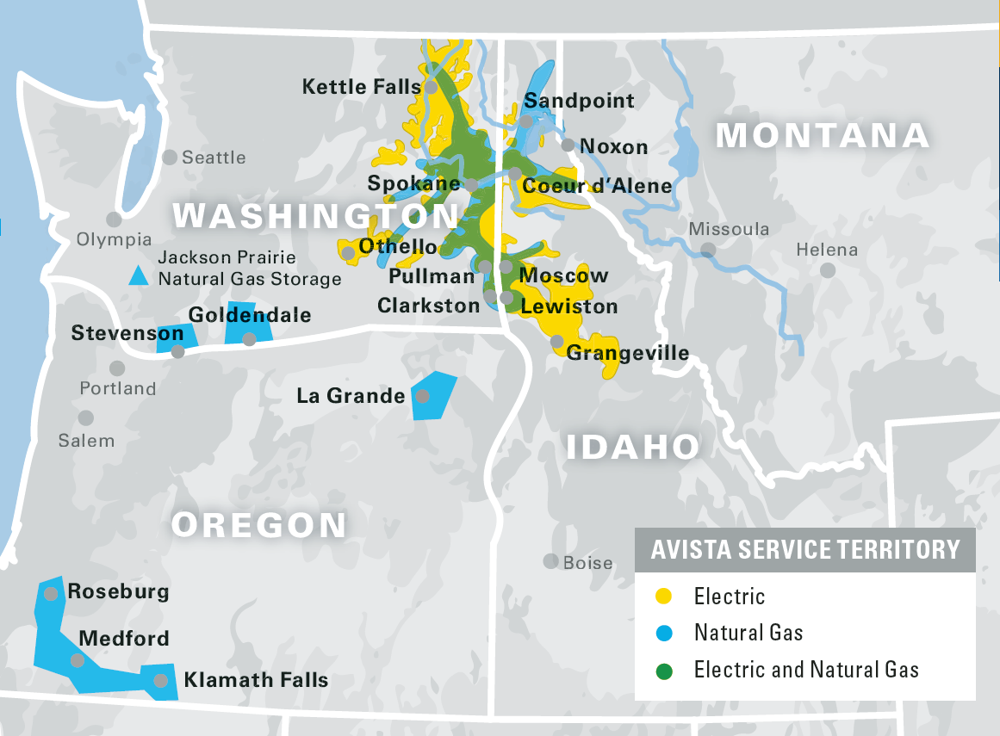
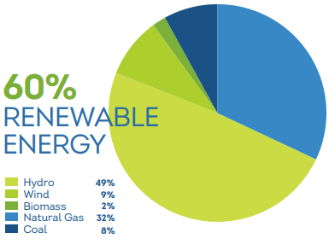
Avista Utilities Overview
Est. 1889
Our Customers
369,000 Gas Customers
403,000 Electric Customers
Our People
1,858 Total Employees
695 Bargaining Unit Employees

Slide 11
Avista Registered Apprenticeships
Registered since 1949
13 Apprenticeships*
Long-standing program management and governance model with IBEW Local 77
* Not all apprenticeships have active apprentices at this time

Slide 12
Apprenticeship Occupation Overview
Generation [GPSS]
Hydro & Substation Operator
Electrical Mechanic
Protection Control Meter Technician
Mechanical Structural Mechanic
Electric Operations
Lineman
Electric Meterman
Cableman
Gas Operations
Gas Mainfitter
Gas Meter Technician
Gas Serviceman
Fleet Mechanic**
ET Operations
Communications Technician
Network Technician

Slide 13
Apprenticeship Process Overview
Minimum Qualifications
High School or GED
CDL*
Avista Employee *
Wages & Governance
Joint Committee [Union & Management]
Monthly Reviews
6-Month Step Progressions
First Step App: ~$40/hr
Top Out: ~$50 - $60/hr
Term and Training
2,000 – 8,000 Hours
Min 144 Hrs Related Instruction
Avista In-House Instructors
Avista Pays for All Outside Tech Training
Structured Work Process / Task Books
*CDL NOT required for all positions [Helper / Crewman / Groundman Entry Level Positions are Typical but not Required]

Slide 14
Workforce Opportunities / Addressing Challenges
Craft Student Program
Pre-Apprentice Training
Incremental Improvements
Pilot Program
High School Craft Employee
Learning and process similar to apprenticeship
Supported by Journeyworkers and IBEW Local 77
Enhanced Training
Focusing on 3 entry level, temp positions
3-week onboarding and training program
Structured program management and governance similar to apprenticeship
Collaborative Efforts to Improve Programs
Periodic program reviews with Journeyworker committees
Enhancing apprentice feedback and processes
JATC Roundtables

Slide 15
My Maritime Career Apprenticeship Program
Notes:
Gene
Thank you, Joe. Next we have Ryan Covert to tell us about My Maritime Career apprenticeship program. Ryan….

Slide 16
Pictures

Slide 17
What Is the Merchant Marine?
United States Civilian Mariners (Sailors, Seafarers)
Power America - Transport goods, commodities, and passengers
Sail on a variety of American owned, flagged, crewed vessels
Freighters, tankers, container ships, tugs/barges, towboats, ferries, cruise ships, riverboats
MSC civ mariners carry vital USNS cargoes

Slide 18
What Do the Jobs Look Like?
DECK DEPARTMENT
VESSEL NAVIGATION, WATCH STANDING
Care of cargo
Maintenance of deck area
Anchoring, mooring
STEWARD DEPARTMENT
PREPARATION OF MEALS
Stock supplies/pantry
General housekeeping aboard
ENGINE DEPARTMENT
OPERATION, CLEANING, AND MAINTENANCE OF ENGINE/PROPULSION SYSTEMS

Slide 19
Paul Hall Center
Founded in 1967 in Piney Point, Maryland
Nation's largest facility for deep sea and inland waterway mariners
Training for entry level - Unlicensed Apprenticeship
Advancement training for credentialed mariners
Programs for transitioning military veterans
Tuition free, room & board included
Serves unlicensed mariners in three departments (deck, engine, steward)
Accredited by the Department of Labor and United States Coast Guard
GI BILL

Slide 20
Harry Lundeberg School of Seamanship
Part of the Paul Hall Center
Operates the Unlicensed Apprenticeship Program
Combination training - classroom, simulation, practical assessments
About a year to complete
Eligibility
Age: 18+
US Work Eligible
No degree necessary
MMC, TWIC eligible
No probation or parole
Meet physical requirements
Drug free

Slide 21
Unlicensed Apprenticeship
Deck and Engine - Rated mariners
Most in demand
Achieve rating faster than on own
Steward - Chief Cook
Trained to lead vessel galleys
Guaranteed 1st Job
Accelerated Advancement
Tuition-Free
Room & Board Provided

Slide 22
Apprenticeship Phases (Deck and Engine)
16 WEEK ON SITE TRAINING
-General shipboard knowledge
120 DAY AT SEA
-Entry Employment
60 DAYS AT SEA
-In the department of your choice
Complete On Site Training 3-4 weeks - FOWT/AB

Slide 23
UA Apprenticeship Phases (Steward)
16 WEEK CLASSROOM
-General shipboard knowledge & safe cooking
200 DAYS AT SEA
-Not concurrent, employment
5 WEEKS CLASSROOM
-Completion of Chief Cook coureses

Slide 24
UA Application Process
Step
Submit application online - My Maritime Career
Complete interview at local port, basic math & english testing
Step
Obtain necessary documentation (Passport, TWIC, start MMC)
Obtain union physicals, drug test, vaccines, dental examination
Step
Scheduling letter sent
Travel arranged with admissions
Arrange uniforms

Slide 25
Unlicensed Apprentice - Costs
TWIC $125
Passport $160
MMC $140
Union Exams $270
Uniforms $475
Total $1,170
Union Exams cover the following:
UA Physical, Drug screening, MSC Shots
*Additional drug screen $60
*Functional Capacity $165
Travel not included in costs

Slide 26
U.S. Army Corps of Engineers Northwestern Division Hydro Power Plant Training Program
Notes:
Gene
Thank you so much Ryan. And now let’s hear from our last presenter in this series, Jason Goodfellow, to tell us about the Hydro Power Plant Training Program with the Army Corps of Engineers.
Jason, I’ll pass it over to you….

Slide 27
Northwestern Division (nwd)
Hydro Power Plant Training Program (HPPTP)
Jason Goodfellow
HPPTP Manager
Chief Joseph Dam
Seattle District

Slide 28
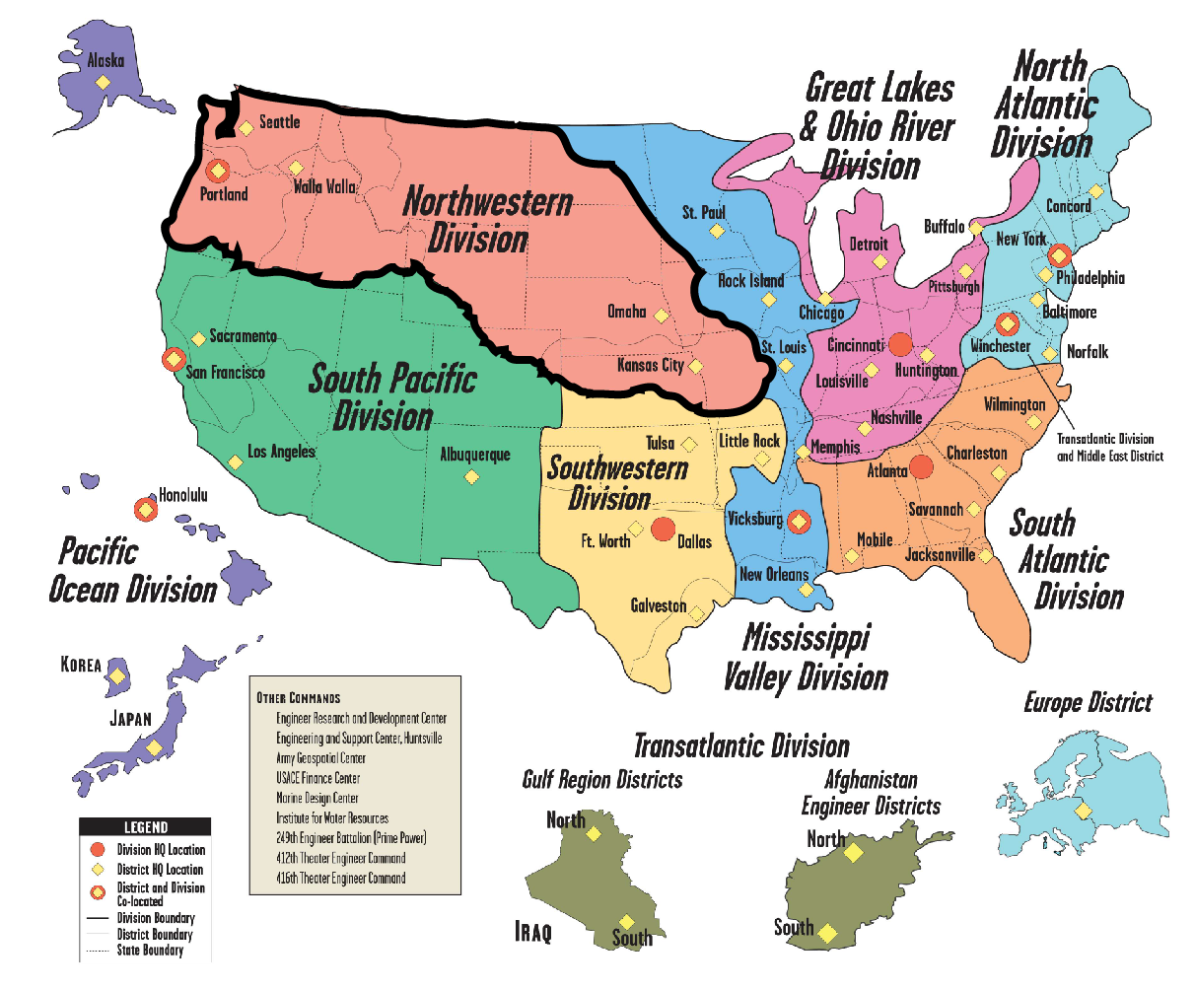
U.S. Army Corps of Engineers (USACE)
Mission: Provide vital public engineering services in peace and war to strengthen our Nation’s security, energize the economy, and reduce risks from disasters.
9 Divisions
Transatlantic Division has 2 Districts overseas in Afghanistan
Support to over 100 countries
46 Districts across the U.S., Europe, and Asia
Northwestern Division Districts
Walla Walla
Seattle
Portland
Omaha
Kansas City

Slide 29
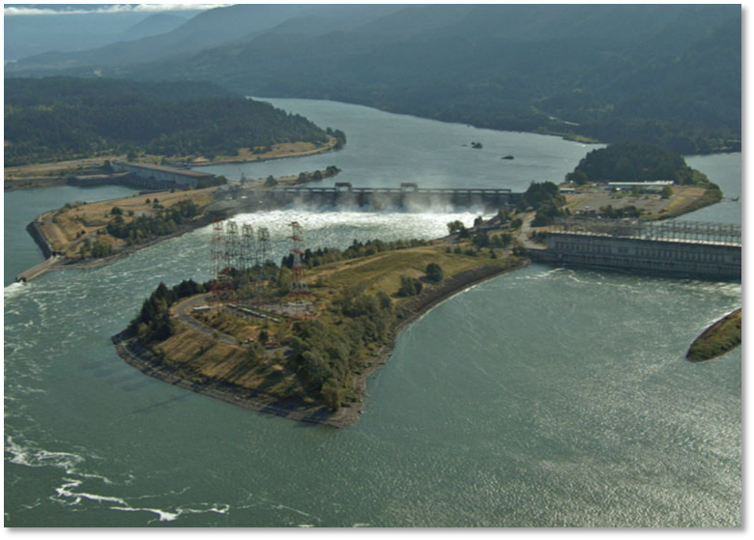
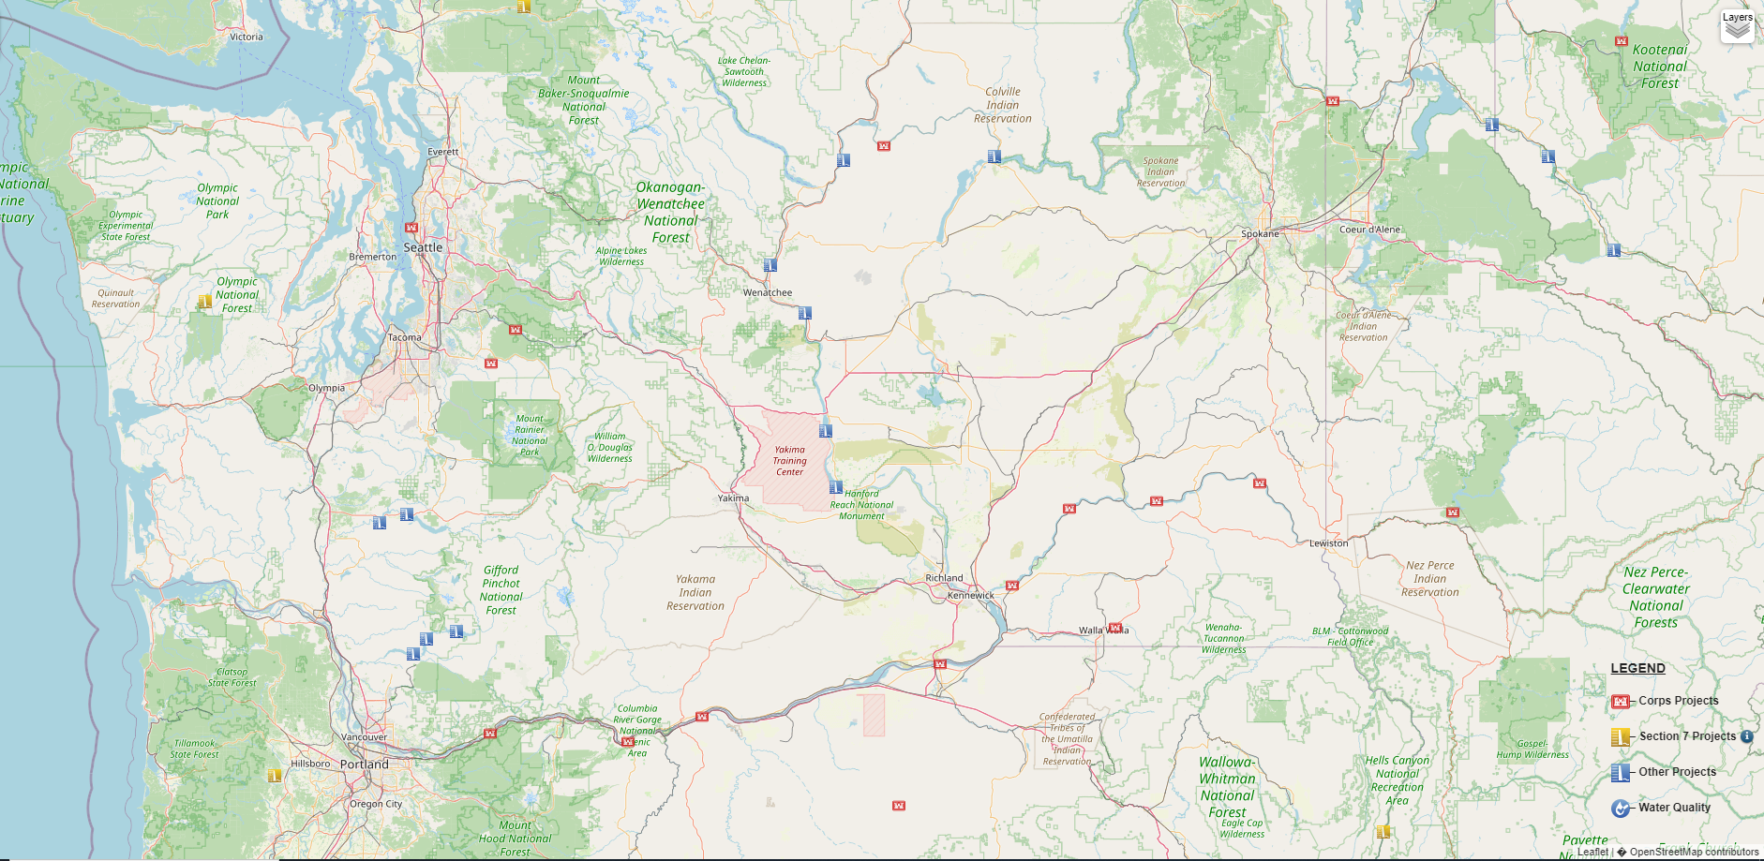
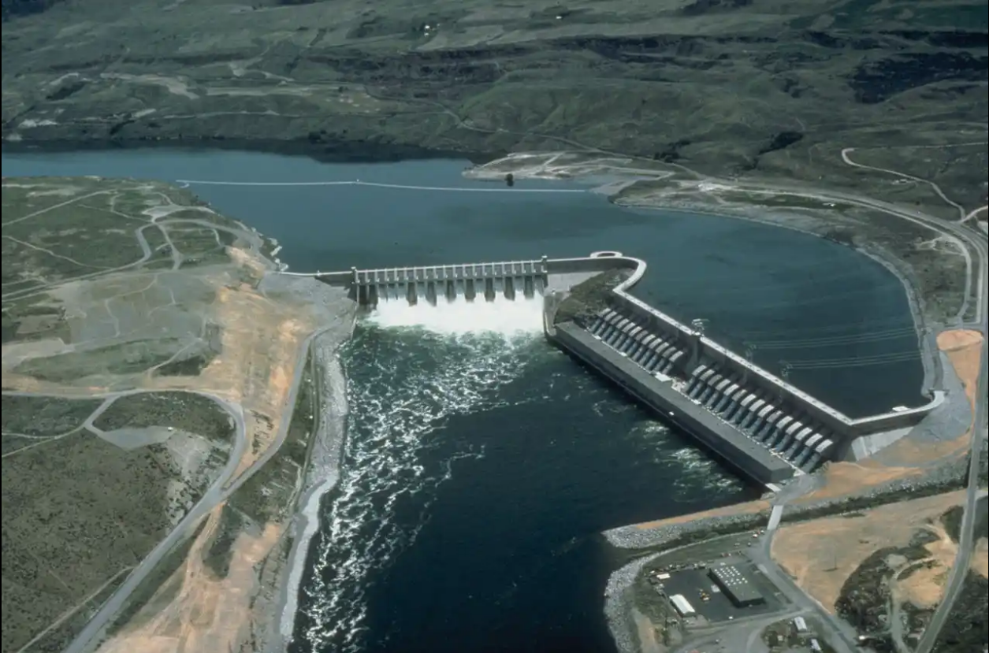
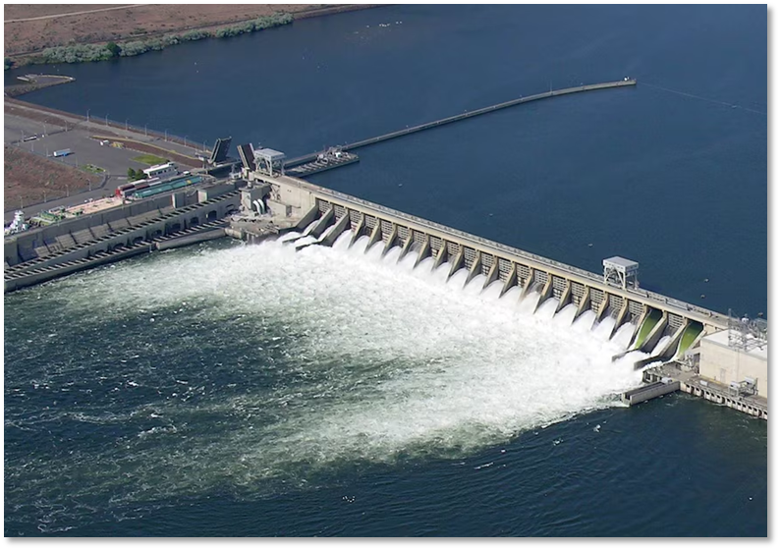
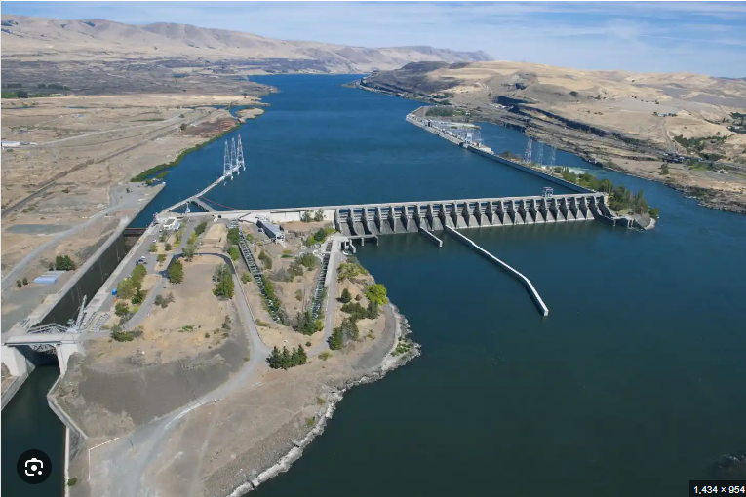
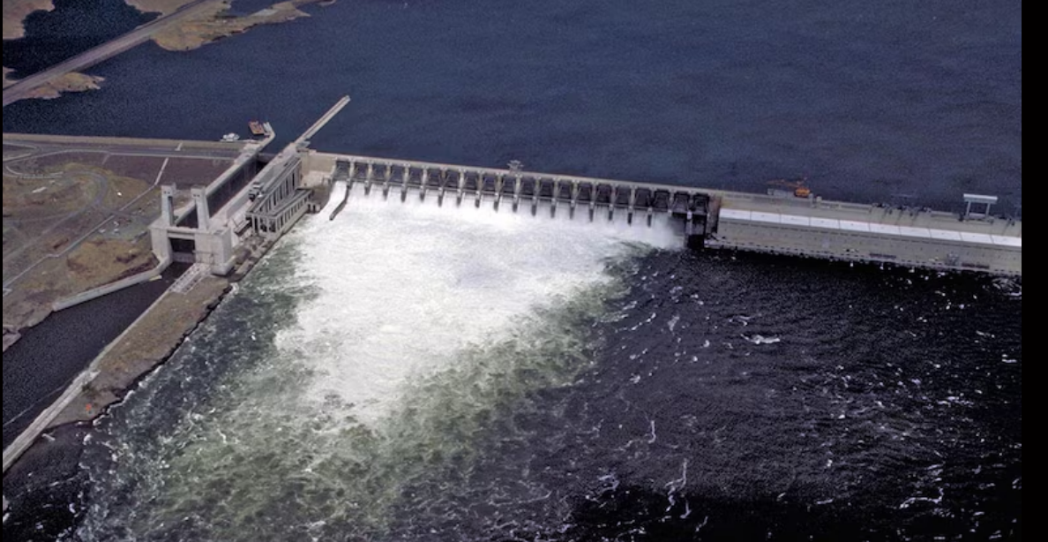
NWD HPPTP Locations
Chief Joseph Dam - Seattle District
McNary Dam - Walla Walla District
Bonneville Dam - Portland District
John Day Dam- Portland District
The Dalles Dam - Portland District
Notes:
Is there a reason for the overlapping big photos on this slide?

Slide 30
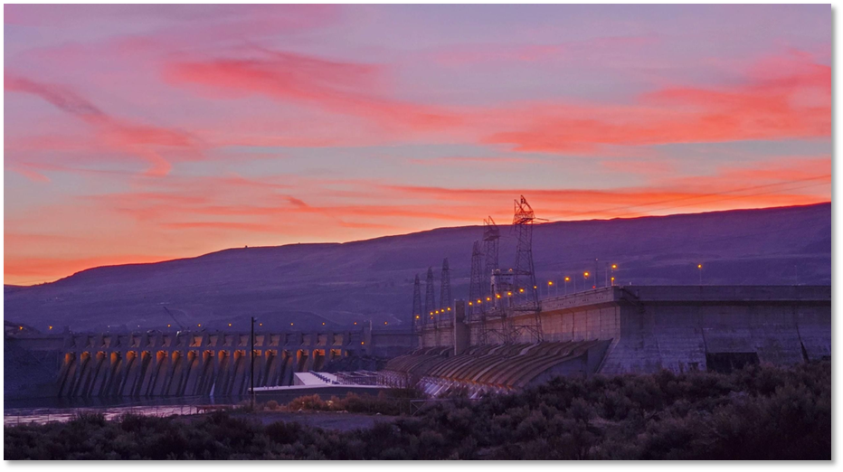
NWD HPPTP
The mission of the Apprenticeship Program is to enable students to assimilate “corporate” knowledge quickly by using a variety of training methodologies.
The program’s primary goal is to produce and maintain highly skilled Journey Level workers to ensure continuous and reliable operation of hydropower facilities within the NWD.
The program is designed to provide trainees, apprentices and Journey Level workers with a thorough and up-to-date knowledge of the operation and maintenance of the U. S. Army Corps of Engineers’ hydropower facilities.
This will be accomplished by giving students a strong background in theory and plant system operation, that will enable them to make use of the high quality On the Job Training (OJT) provided in the field.

Slide 31
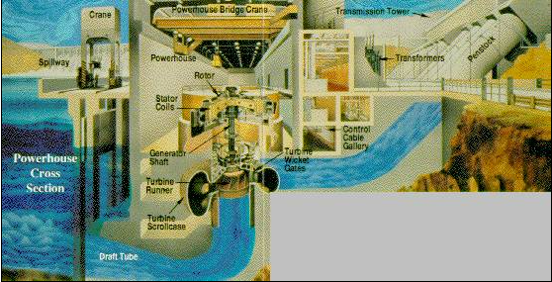
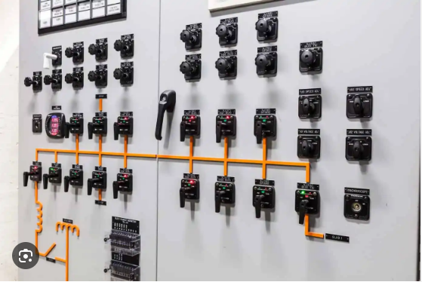
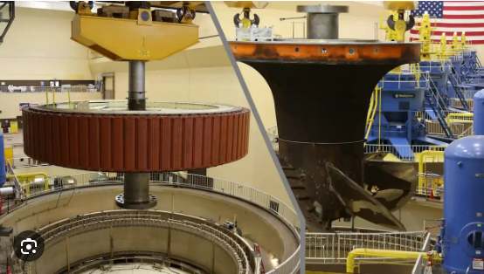
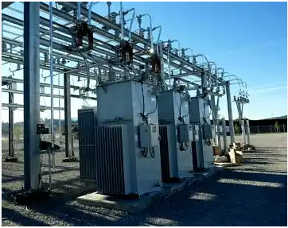
HPPTP Crafts
This training program provides specific orientation, guidance and instruction on the various aspects of hydroelectric power station operation and maintenance. The three craft occupational specialties include:
Power Plant Operator
Power Plant Electrician
Power Plant Mechanic

Slide 32
Hiring and Structure
Hiring is based on the respective district/project’s needs.
Program is designed for entry-level positions.
A 4-year program with potential to receive credit for previous experience, as determined by the respective district's programs.
Placement is determined by respective district’s requirements.

Slide 33
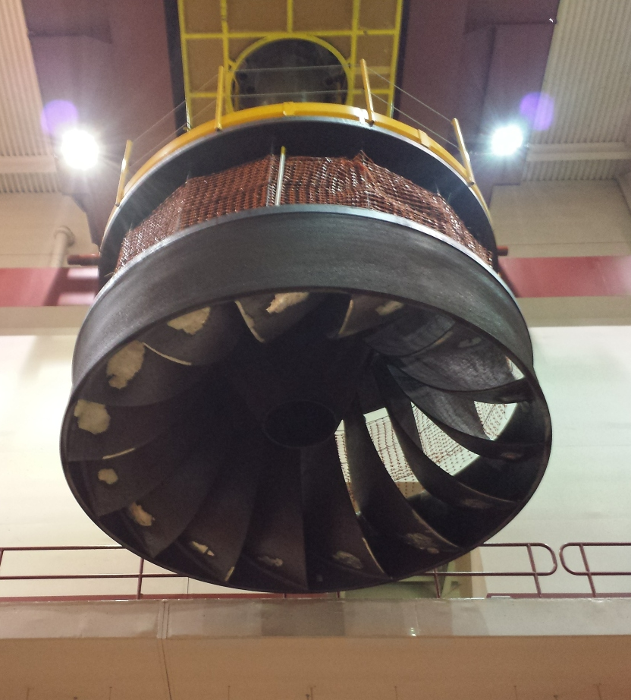
Wages and Benefits
Wages are based on the Northwest Power Rate Schedule:
Year 1 Trainee: $33.52
Year 2 Apprentice: $42.53
Year 3 Apprentice: $49.39
Year 4 Apprentice: $56.24
Journey-level: $59.19
Benefits:
104 hours of annual sick leave.
104 hours of annual vacation leave (starting rate).
Medical insurance.
11 paid federal holidays.
Retirement Investment Plan/Thrift Savings Plan (TSP).
Life insurance.

Slide 34
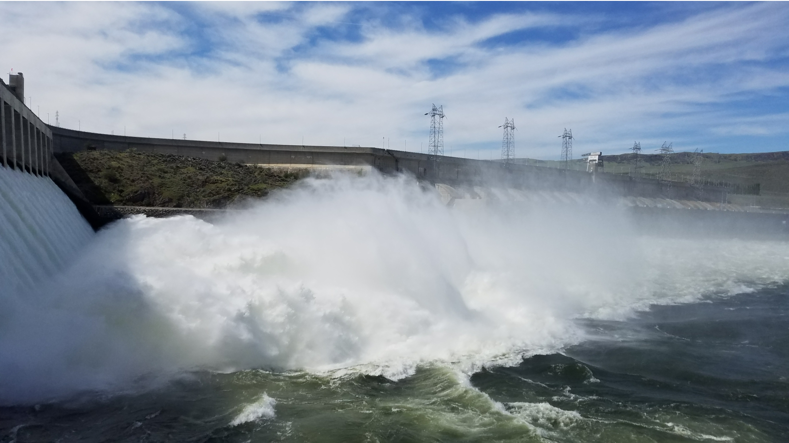
Contact Us
Jason Goodfellow
Seattle District HPPTP Manager
509 686 2262
Jason.l.goodfellow@usace.army.mil
Seattle District HPPTP webpage:
https://www.nws.usace.army.mil/Careers/Hydropower-Plant-Apprenticeship-Program/
Robin Floyd
Walla Walla District HPPTP Manager
509 424 0900
robin.e.floyd@usace.army.mil
Walla Walla HPPTP webpage: https://www.nww.usace.army.mil/Careers/Power-Plant-Apprenticeship-Program/

Slide 35
Questions and Answers
Notes:
Corinna
Asks questions to presenters from the chat and opens it up to the audience to ask any questions.
STOP at 5 minutes before the hour and pass to Gene.

Slide 36
Contact Us, Become a Partner
Scan for Partner Form
Receive no-cost expert TA, materials, and assistance
Network with potential partners nationwide
Be nationally recognized for your work
Notes:
Gene
Thank you so much to all of our presenters for telling us all about these exciting apprenticeship opportunities. And we want to thank all of you for joining us today. We appreciate your participation.
We’d like to encourage you to become a partner with the Center of Excellence if you have not signed up yet. Please take a moment to scan the QR code on the screen. As a partner you have the opportunity to receive no-cost technical assistance and materials, network with partners nationwide, and be nationally-recognized for your work.
Colleen will pop up a short evaluation of this training and we would really appreciate your feedback as we plan for future trainings.
(Wait a minute). (Next slide)

Slide 37
Email us your questions at RA_COE@SafalPartners.com
For more information, visit: dolcoe.safalapps.com
Safal Partners © 2024
Notes:
Once again, I would like to thank everyone for attending. Please feel free to contact the center directly through emailing us or visiting our website. Enjoy the rest of your day.

