Slide 1
Building Student Awareness of Apprenticeship Career Pathways
August 22, 2024

Slide 2


Presenters
Alan D. Dodkowitz
Jeff Smith
Senior Subject Matter Expert
Safal Partners
Workforce Liaison/Program Analyst
Office of Apprenticeship
U.S. Department of Labor
Notes:
Jeffrey W. Smith
Workforce Liaison/Program Analyst |Office of Apprenticeship | U.S. Department of Labor

Slide 3
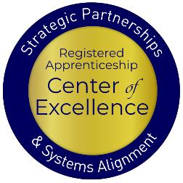
Welcome and Agenda
Center of Excellence Overview
An Overview of Registered and Youth Apprenticeship
What are the Benefits of Apprenticeship for Youth and Schools
High-School and College-Aligned Youth Apprenticeship Pathways
How can we Develop these Pathways
Intermediaries- An Opportunity to Build Your System
Questions and Closing Thoughts
Safal Partners © 2024
Notes:
AD

Slide 4

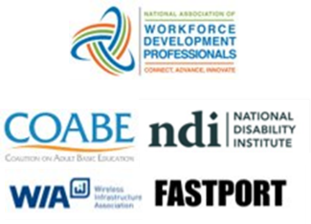

Center of Excellence Overview
U.S. DOL initiative to increase systems alignment across apprenticeship, education, and workforce
Led by Safal Partners; 5 national partners
We provide no-cost TA including:
  Monthly webinars
  Quarterly virtual office hours
  Individual TA/coaching sessions
  Online resources (desk aids, guides, frameworks, etc.)
Visit our website, request TA
Notes:
Safal was awarded the opportunity to lead the US DOL Registered Apprenticeship Technical Assistance Center of Excellence for Strategic Partnerships and Systems Alignment in 2021.
We are here to help close the gap between the apprenticeship and workforce systems and accelerate partnerships across education, economic development, and other partners to increase adoption of RA nationwide.
The Center is supported by five national partners including the National Association of Workforce Development Professionals, the Coalition on Adult Basic Education, the National Disability Institute, FASTPORT, and the Wireless Infrastructure Association.
Our national partners were strategically chosen to help us reach specific groups whether on the workforce, education or employer side
The Center of Excellence provides no-cost technical assistance – online, in-person and through hybrid delivery - to accelerate sustainable partnerships and align apprenticeship, workforce and education systems.

Slide 5
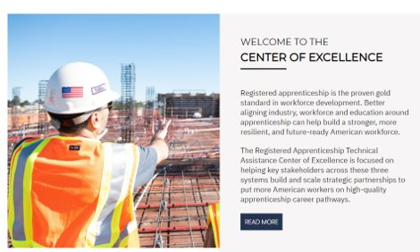


Online Resources, On-Demand TA
Registered Apprenticeship Partner Profile Questionnaire
Center of Excellence Resources and Tools
Notes:
AD

Slide 6

Quick Pulse Poll #1
Are you a….
Workforce Board Staff
Service Provider Staff
Educational Partner
Vocational Rehabilitation Partner
Employer
Board Member
Registered Apprenticeship Staff
Other
Safal Partners © 2024

Slide 7

Quick Pulse Poll #2
When it comes to Registered Apprenticeship I am…
Just starting out
Somewhat familiar with the basics but don’t utilize it often
Very knowledgeable and refer people often to programs
What is RA?????
Safal Partners © 2024

Slide 8

What is Registered Apprenticeship?
Registered Apprenticeship (RA) is a proven, customizable, and industry-relevant and US Department of Labor-approved model for organizations to find, train and retain diverse new talent as well as upskill current workers in critical occupations.
Safal Partners © 2024
Notes:
Alan
Registered Apprenticeship Academy

Slide 9



Five Core Components of RA
Employer Involvement
Structured On-the-Job Learning (OJL)
Related Instruction (RI)
Rewards for
Skill Gains
National Occupational Credential
Safal Partners © 2024
Notes:
Alan

Slide 10










A Diverse Range of Industries
Agriculture
Healthcare
Cybersecurity
Biotechnology
Transportation
Construction
Energy
Hospitality
Financial
Services
Information
Technology
Education
Advanced
Manufacturing
Critical
Supply Chain
Infrastructure
Engineering
Telecommunications
Safal Partners © 2024
Notes:
A college and high school education help supplement this. Not your grandparent’s apprenticeship
Apprenticeship spans hundreds of occupations, including careers in:
Early Childhood Education
K-12 Education
Health care
Cybersecurity
Information technology
Biotechnology
Transportation
Construction
Financial services
Advanced manufacturing
Hospitality
Engineering
Energy
Telecommunications

Slide 11

What is Youth Apprenticeship?
A youth apprentice is defined as…​
an in-school OR out-of-school youth between the
ages of 16 and 24…​
​
who receives industry-validated Related Instruction for an RA program (for in-school youth) from their school while… ​
​
completing part-time, paid, work-based
experience ​from an employer under a ​
mentored supervision as part of… ​
​
a Registered Apprenticeship program approved ​
by DOL or a state apprenticeship agency (SAA) or a pre-apprenticeship program.​
Safal Partners © 2024
Notes:
Alan
Discuss pre-apprenticeship modules

Slide 12
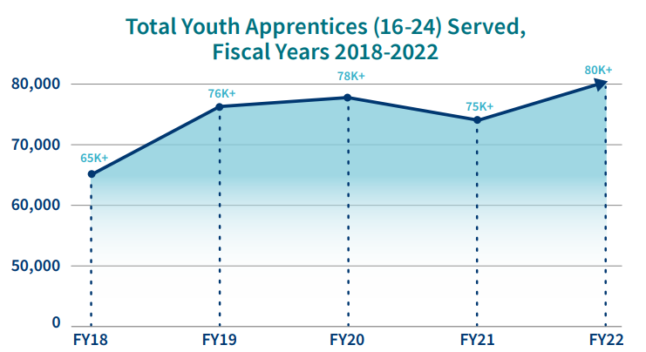
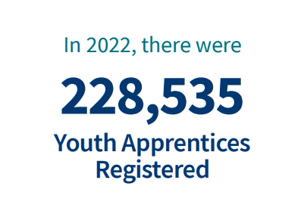
Apprenticeship for Youth
Source: https://www.apprenticeship.gov/
Safal Partners © 2024
Notes:
We want to point out that youth apprenticeship already exists. This is about getting colleges and high schools involved

Slide 13
Youth Apprenticeship by Age
Source: Urban Institute calculations from RAPIDS data
Safal Partners © 2024
Notes:
Some of this may not capture youth pre-apprenticeship programs

Slide 14





High-Quality Youth Apprenticeship
In addition to meeting core RA requirements, high quality youth programs:
Provide dual enrollment pathway for college credit for RI
(if school is sponsor) Include articulated
agreement with another program sponsor to ensure students can continue paid OJL (and RI if needed) after graduation​
Provide apprentice with a clearly-outlined career pathway beyond RA program completion for occupations that provide a family-supporting wage ​
Embed, or prepares student to test out for, industry-recognized certifications or credentials​
Build equity in program design including qualifications, supports for persistence, etc.
Safal Partners © 2024
Notes:
Alan

Slide 15
Apprenticeship Benefits for Students and Schools
Safal Partners © 2024
Notes:
Clare

Slide 16
Substantial Benefits for Youth
Helping students understand the benefits of RA is crucial:
RA is a pathway to a career from the start
RA provides a way to get paid to learn skills and get work experience
Often leads to offer of full-time employment following graduation or program completion soon after graduation
Increases your lifetime earnings potential: average starting salary for apprentice completers is $80,000 per year (U.S. DOL)
Provides way to earn national credential – move and earn anywhere
Can help lower – or even eliminate – the cost of taking college courses
Safal Partners © 2024
Notes:
Clare
It is critical to help students understand the benefits of registered apprenticeship. Students are often unaware that these opportunities exist, it is also common that their parents are unaware. So it is very crucial for staff interacting with students to share the opportunities as well as the benefits they bring.
These benefits include that registered apprenticeship is a career from the start and provides them a way to get paid while learning skills and obtaining work experience.
Registered apprenticeships are jobs, so after high school it can transition to full time employment for them or after the completion of the program depending on how the program is set up.
Some statics on earning from the US Department of labor show an increase in lifetime potential compared to their peers and apprentice completers have an average starting salary of 80,000 a year.
Apprentices also receive a national credential that is portable and can move with them.
On top of earning more in lifetime earnings than their peers, it can also help lower or even eliminate the cost of college.

Slide 17
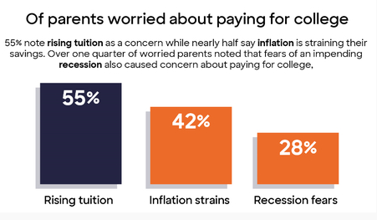
Less Debt, More Opportunities
Nationally....
42.8 million Americans owe more than $1.75 trillion in student loans (2024)
61% of college graduates had taken on student loan debt (2024)
Average debt of student loan holder is $37,853 (2024)
Safal Partners © 2024
Notes:
Clare
I think many of us here today understand the rising issue of student debt. A national survey from discover student loans, showed 66% of parents with 16–18-year-olds reporting that they are worried about paying for college, of these parents 55% cite rising tuition, 42% cite inflation strains, and 28% share fears of a recession. Nationally 42.8 million Americans owe a collective total of more than 1.75 trillion in student loans. 61% of college grades had taken out student loan debt with the average debt being 37, 853.
Fifty Percent of Parents With College Bound Children Have Saved Less Than $15,000 for Their Child’s Education | Business Wire

Slide 18

Benefits for Schools Involved in Apprenticeship
Apprenticeship programs connect students to colleges
Program sponsors, federal and state programs, and/or students can pay for related instruction
Sponsors can provide additional resources beyond tuition to support students and colleges (curriculum development, student supports, additional funding)
Notes:
Clare
While it’s often thought that student will go to either a career or college after school, apprenticeship has the ability to connect the two for students.
Apprenticeships help connect students to college while many programs offer college credits or degrees. Related instruction, the schooling portion of an apprenticeship, can be covered by program sponsors, many different federal or state program or the student is sometimes paying these costs. It can also be a combination of these. When there are costs associated, they tend to be much less than a traditional college education.
There can also be additional resources available to students and colleges through sponsors including curriculum development, supportive services, and additional funding.

Slide 19
Federal / State Funding for RI
Several programs can help pay for RA related instruction courses at local colleges, making it more attractive for local employers to participate. Examples include:
  The Workforce Innovation and Investment Act (WIOA) (through Individual Training Accounts) / On-the-Job Training / Supportive Services )
  Pell Grants (Up to $6,895 per Apprentice)
  Federal Work Study Funds (average of $2,500 per Apprentice)
  State Tax Credits and Tuition Support
  GI Bill Benefits (for approved programs)
Notes:
Clare
There are several federal and state funding programs available to help with the costs of related instruction. This helps to make the programs more attractive to both students and employers to participate

Slide 20
Youth Apprenticeship Pathways- High School or College
Safal Partners © 2024
Notes:
Alan

Slide 21




High-School Aligned Apprenticeship Programs
Juniors or seniors eligible to apply for paid on-the-job training experience with an employer while receiving RI at school.
Embeds industry credentials in RI curriculum.
RI counts toward high school graduation requirements and potentially college credits, creating a seamless transition from secondary to post-secondary education.
Often acts as pre-apprenticeship programs that provide a pathway to a full RA program.
Safal Partners © 2024
Notes:
Alan
Five characteristics of a high-quality pre-apprenticeship program:
Partnership with registered apprenticeship program sponsors
Sustainability through partnerships
Meaningful training combined with hands-on experience replicating a workplace that does not displace paid employees
Access to career and supportive services
Increased access for underrepresented or underserved populations
Safal has developed a pre-apprenticeship module on the RA Academy which can be found here: https://rise.articulate.com/share/NaNHfXPRpo4CVc-tMcIXy_iN_n7P8Y7W#/

Slide 22

College-Aligned Youth Apprenticeship Programs
Available at vocational, community, and four-year colleges and generally for 18-24 year olds.
Embeds industry credentials in RI curriculum and oftentimes leads to the award of industry-recognized credentials.
RI counts towards college credits, enabling student to graduate.
Generally, a Registered Apprenticeship program that leads to the award of a DOL-issued certificate.
Safal Partners © 2024
Notes:
Alan

Slide 23
Developing Apprenticeship Pathways
Safal Partners © 2024
Notes:
Alan

Slide 24

Key Questions
  What occupations does local labor market information show are in high demand and what interests youth?
  What partnerships do we need? What partners do we already have that can support a program?
  How will we integrate industry needs/occupation requirements into our RI?
  How will we create a Dual/Concurrent Enrollment plan (for high school apprentices)?
  How will we ensure RI and OJT count toward both high school graduation and RA program requirements (for high school apprentices)?
Safal Partners © 2024

Slide 25





Gen Z- They’re Interested in Different Occupations
Sustainable Energy Specialist
Digital Content Creator
Health and Wellness Coach
Cybersecurity Analyst
App Developer
Social Impact Consultant
User Experience (UX) Designer
Remote Work Specialist
E-Sports Professional
Mental Health Professional
Safal Partners © 2024
Notes:
LinkedIn survey- these are all apprenticeable occupations
My challenge for you- can you identify what your students want?

Slide 26

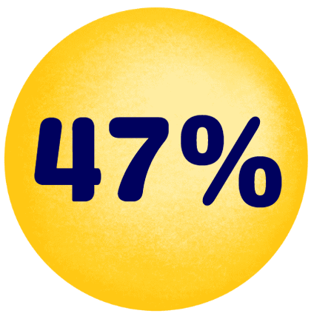
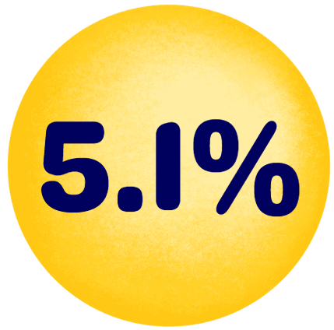
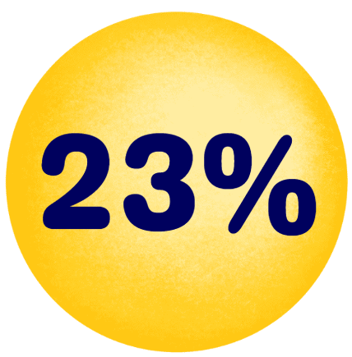
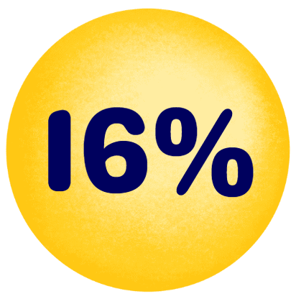


But They are Also the “Toolbelt Generation”
Young adults interested in trades career
Pay increase for new construction hires vs. 2.7% in professional services.
Students studying construction trades rose from 2018 to 2024
Vocational-focused community colleges increase in enrollment
More electricians than 2014 - median age fell by 2.9 years.
Optimistic about job security and believe they won’t be replaced by AI - Thumbtack
  Source: Wall Street Journal
Safal Partners © 2024
Notes:
47 percent of young adults are interested in pursuing a career in the trades.
From 2018 to 2024, the number of students studying construction trades rose by 23%, with those in HVAC and vehicle maintenance programs increasing by 7%.
There are 229,000 more electricians than a decade ago though their median age fell by 2.9 years.
The median pay for new construction hires grew by 5.1% to $48,089 last year, compared to a 2.7% increase in professional services.
Vocational-focused community colleges saw a 16% increase in enrollment last year, the highest increase since tracking began.
Many of these professions are considered “AI-proofed” and less likely to be replaced. A survey by Thumbtack found 95 percent are optimistic about their job security and believe they won’t be replaced by AI.
Wall Street Journal Article: https://www.wsj.com/lifestyle/careers/gen-z-trades-jobs-plumbing-welding-a76b5e43
The last bullet point is by Thumbtack: https://press.thumbtack.com/announcements/new-report-from-thumbtack-examines-forces-behind-skilled-trade-labor-shortage-offering-optimistic-outlook-for-the-future/

Slide 27
What Can Each Partner Bring?
Businesses, trade organizations, and chambers of commerce identify needed skills, provide on-the-job training, and employ apprentices.
Schools help design curriculum, provide classroom instruction, and facilitate student recruitment.
Workforce boards can help recruit apprentices, offer funding, and connect partners.
State agencies develop curriculum frameworks, provide guidance on laws/regulations, and offer funding.
Community organizations assist with student recruitment, academic support, funding, and program oversight.
Safal Partners © 2024
Notes:
Alan

Slide 28




Key Organizational Apprenticeship Roles
Sponsor
Employer
RI Provider
Partner
An organization that agrees to operate an apprenticeship program and in whose name the program is registered.
Hires and provides paid OJL for apprentices under supervision of a designated mentor who is a skilled professional in that occupation.
Entity that provides instruction to apprentices in the designated occupation’s core knowledge, skills, and abilities.
Organizations committed to assisting RA programs. They can play one or more roles.
Notes:
Alan
My challenge for you- what role can you provide

Slide 29

Align with CTE Standards and Ensure Hands-On Training
Align Curriculum with Industry Needs: Incorporate CTE standards by aligning the curriculum with current industry needs.
Integrate Work-Based Learning: Embed work-based learning opportunities within CTE programs, allowing students to gain hands-on experience in real-world settings.
Collaborate with Industry Partners: Partner with local businesses to design apprenticeship programs that meet both educational and industry requirements.
Incorporate Industry-Recognized Credentials: Include industry-recognized credentials in apprenticeship programs to validate students' skills and competencies according to CTE standards.
Safal Partners © 2024
Notes:
Alan

Slide 30

Enabling Dual/Concurrent Enrollment Plan
The Urban Institute has outlined a six-step process for achieving dual-enrollment and youth apprenticeship:
Publicly state the equity goal and report progress toward it.
Monitor course quality and ensure credit articulation.
Remove financial barriers for apprentices.
Ensure equal access to courses and pathways.
Recruit and support a diverse cadre of well-qualified instructors.
Give all students information and support to enable them to navigate career pathways.
Safal Partners © 2024
Notes:
Alan
JFF: https://www.jff.org/dual-transformation-in-dual-enrollment/
JFF has worked to develop the dual enrollment model Developing shared regional dual enrollment agreements (as opposed to the typical one-to-one agreements between colleges and high schools) to ensure equitable access for students, regardless of their home district’s ability to negotiate a favorable partnership agreement;
Creating staffing models that solve for the shortage of qualified dual enrollment instructors and allow instructors to travel flexibly across districts, increasing student access to a range of dual enrollment courses;
Collapsing course catalogs and only offering dual enrollment courses that meet our definition of strategic to ensure students are earning the most valuable college credit and address major challenges in applicability, articulation, and portability of credits;
Focusing on recruiting students underrepresented in higher education to close the persistent gaps students face in accessing and successfully completing dual enrollment.

Slide 31

Ensuring High-School Students Receive Credit
Synchronize Curriculum with Graduation Objectives: Collaborate with local school districts to ensure the apprenticeship curriculum meets high school graduation requirements.
Dual Enrollment and Credit Recognition Agreements: Create dual enrollment agreements that allow apprentices to earn high school credits for both RI and OJT components of their apprenticeship.
Performance-Based Assessments: Integrate assessments that align with both high school and apprenticeship standards.
Consistent Tracking: Ensure apprenticeship coordinators, school counselors, and educators track apprentices' progress and ensure all requirements are met.
Safal Partners © 2024
Notes:
Alan
It is crucial that these steps are followed to also ensure high school students can transition into Registered Apprenticeship programs after they graduate.
My challenge to you is: Can you create this system? What partners do you need? What plan can you put in place

Slide 32
Intermediaries: Helping to Put it All Together
Safal Partners © 2024
Notes:
Clare

Slide 33

Types of Intermediaries
Educational institutions or systems/training providers
For-profit companies
Nonprofits
Staffing companies
Consulting firms
Trade associations
Chambers of commerce
Tip: Actual RA expertise and
experience – even among formally designated Intermediaries - can
vary widely.
Safal Partners © 2024
Notes:
Clare
Intermediaries are organizations with expertise in the apprenticeship system that can reduce the burden of establishing and managing an apprenticeship. Their purpose is to make apprenticeships more realizable as a workforce training model and to expand their presence across industries, occupations, and diverse workers. There are many different types of intermediaries including educational institutions or systems, training providers, for profit companies, nonprofits, staffing companies, consulting firms, trade associations or chambers of commerce.
Remember that actual RA expertise and experience, even among formally designated intermediaries can vary widely.

Slide 34

Intermediaries: Array of RA Services
Every RA intermediary determines their own role, scope, and services.
Possibilities include:
Engaging employers
Recruiting apprentice candidates
Program design, development, registration with agency
Providing RI
Serving as employer/employer of record
Identifying and braiding funding for RA program
Managing program data, performance reporting
Case management for apprentices, supportive services
Mentor training and support
Safal Partners © 2024
Notes:
Clare

Slide 35




















Apprenticeship Funding
– ACCESSING RESOURCES – For more information, check out the Industry Intermediary Fact Sheet on Apprenticeship.gov
Registered Apprenticeship Industry Intermediaries: Through a partnership with DOL, these 20 industry intermediaries offer expertise to help employers and labor organizations successfully launch, promote, and expand RA programs in growing industries.
Information Technology
Clean Energy
Early Childhood Education
Education
Early Childhood Education
Notes:
Clare
Optional/draft talking points:
The slide shows you the eighteen Intermediaries that make up the sixteen Industry Intermediary Contractors and the four Youth Apprenticeship Intermediaries.
As you can see, we've added the specific industry and sub-sector under each Intermediary logo. We're currently servicing multiple industry sectors, including healthcare, information technology, public service, the Care Economy, supply chain, cybersecurity, advanced manufacturing, transportation, construction, telecommunications, and hospitality.

Slide 36
Youth Apprenticeship Examples
Safal Partners © 2024
Notes:
Clare

Slide 37

Wisconsin Youth Apprenticeship Project
Launched in 1991
Partnership between the Wisconsin SAA, 39 local consortia, and local school districts
Organized into 13 broad industries
In the 2022–23 school year, 5,719 employers provided apprenticeships to 8,357 high school students
Receives $6 million in funding from the State of Wisconsin
Requires employers to provide at least 450 hours of on-the-job learning and paid work experience and schools to offer at least 180 hours of related technical instruction.
Safal Partners © 2024
Notes:
Clare

Slide 38

TRACK: Tech Ready Apprentices for Careers in Kentucky
Launched during the 2013-2014 school year
Partnership between state Office of Career and Technical Education and Kentucky Office of Apprenticeship
Provides high school students with pre-apprenticeships and opportunities to transition to Registered Apprenticeship programs.
Employers partner with area technical centers to design the selection process and the program of study sequence, allowing them to tailor the program to their specific need.
Initially trades-focused but now in 16 different career areas.
Has served over 500 youth apprentices in various career pathways and over 90 employers.
Safal Partners © 2024
Notes:
Clare

Slide 39
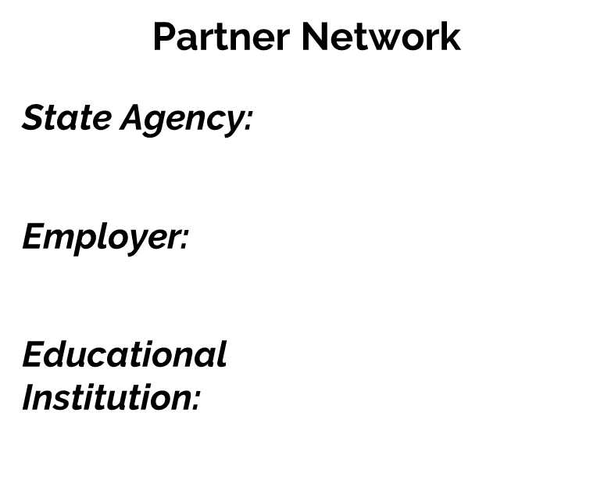



Tech Related Youth RA Program
Program Framework
Junior Year
Cisco Networking Academy 1, Apply to RA Program
Senior Year
Paid, registered youth apprentice working 20 hours/week after school – 3 rotations
After Graduation
Complete RA program, earn Cisco CCNA certification, FTE
Safal Partners © 2024
Notes:
Clare
Cisco’s networking academy works with high school students
To be considered for the apprenticeship, students must have completed Cisco Networking Academy 1 and be recommended by their instructor. Their commitment requires them to work 20 hours per week after school as a configuration technical apprentice. Apprentices will cycle through three rotations during the year and be considered for full-time employment at its completion.

Slide 40

Howard County Community College
Serves as a Sponsor of Registered Apprenticeship Programs.
Offers apprenticeships in 11 different fields (HVAC, IT, Hospitality, Child Care, Licensed Practice Nurse, etc.) and provides the related instruction for these occupations.
Partners with several different employers to provide OJT, including the University of Maryland Medical Center, MedStar Health, Associated Builders & Contractors of Greater Baltimore, Johns Hopkins and others.
Has a close relationship with the local workforce board and workforce system.
Utilizes funds from employers and local and state grants to support their programs.
Safal Partners © 2024
Notes:
Alan
If you’ll recall on slide 28 regarding the roles

Slide 41

Nevada Youth Apprenticeship Project
Partnership between the Nevada SAA, Nevada System of Higher Education, and Local Workforce Boards
Available in Advanced Manufacturing, Healthcare and Social Support, Transportation, and other industries.
Has served more than 700 youth college apprentices with over 20 participating employers
Scaled in 2020 with a nearly $2.5 million Youth Apprenticeship Readiness Grant
Youth Apprenticeship Readiness Grant Program Framework
Employers: Tesla and Renown Health
Training Providers: Truckee Meadows Community College, College of Southern Nevada, Great Basin College, and Western Nevada College
Target Populations: In-school and out-of-school youth, specifically under-represented and rural populations
Safal Partners © 2024
Notes:
Alan

Slide 42

Contact Us, Become a Partner
Scan for Partner Form
Receive no-cost expert TA,
materials, and assistance
Network with potential
partners nationwide
Be nationally recognized for your work
Notes:
We want to thank all of you for joining us today. We appreciate your participation.
We’d like to encourage you to become a partner with the Center of Excellence if you have not signed up yet. Please take a moment to scan the QR code on the screen. As a partner you have the opportunity to receive no-cost technical assistance and materials, network with partners nationwide, and be nationally-recognized for your work.

Slide 43

Office Hours Follow-up
September 5th
1:00-2:00pm ET
https://safal.partners/Sept5
Interactive, open discussion
Bring questions
address questions from this session
Scan to Register
Safal Partners © 2024

Slide 44
Thank You for Joining Us
Email us your questions at RA_COE@SafalPartners.com
For more information, visit: dolcoe.safalapps.com

