Slide 1
Registered Apprenticeship: An Employer Pipeline Solution and Why You Should be Selling It
August 2024

Slide 2
Presenters
Stacy O’Keefe
Alan D. Dodkowitz
Melissa Byers
Subject Matter Expert
Safal Partners
Subject Matter Expert
Safal Partners
Business Liaison & Apprenticeship Navigator
CareerSource Brevard Flagler Volusia
Notes:
Alan

Slide 3
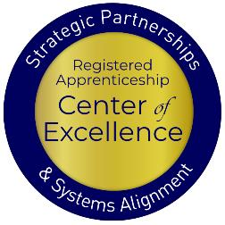
Welcome and Agenda
Center of Excellence Overview
An Overview of Registered Apprenticeship
The Registered Apprenticeship Ecosystem
Engaging with Local Businesses- Workforce Boards Hold the Key
Working with ATRs and Assisting in Apprenticeship Navigation
Coordinating Service Delivery
Questions and Closing Thoughts
Safal Partners © 2024
Notes:
Alan

Slide 4
Landscape Assessment
Are you a….
Workforce Board Staff
Service Provider Staff
Educational Partner
Vocational Rehabilitation Partner
Employer
Board Member
Other
Safal Partners © 2024

Slide 5
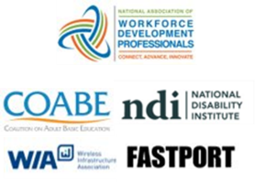
Center of Excellence Overview
U.S. DOL initiative to increase systems alignment across apprenticeship, education, and workforce
Led by Safal Partners
Collaboration with 5 national partners
We provide no-cost technical assistance (TA) including:
Monthly webinars
Quarterly virtual office hours
Individual TA/coaching sessions
Online resources (desk aids, guides, frameworks, etc.)
Visit our website & request TA
Notes:
Alan
I’d like to give you an overview of the Center of Excellence. Safal Partners was awarded the opportunity to lead the US DOL Registered Apprenticeship Technical Assistance Center of Excellence for Strategic Partnerships and Systems Alignment in 2021.
We are here to help close the gap between the apprenticeship and workforce systems and accelerate partnerships across education, economic development, and other partners to increase adoption of RA nationwide.
The Center is supported by five national partners including the National Association of Workforce Development Professionals, the Coalition on Adult Basic Education, the National Disability Institute, FASTPORT, and the Wireless Infrastructure Association.
Our national partners were strategically chosen to help us reach specific groups whether on the workforce, education or employer side.
The Center of Excellence provides no-cost technical assistance – online, in-person and through hybrid delivery - to accelerate sustainable partnerships and align apprenticeship, workforce and education systems.

Slide 6
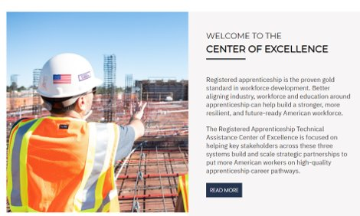
Online Resources, On-Demand TA
Registered Apprenticeship Partner Profile Questionnaire
Center of Excellence Resources and Tools
Notes:
Alan

Slide 7
An Overview of Registered Apprenticeship
Safal Partners © 2024
Notes:
Alan

Slide 8
What is Registered Apprenticeship?
Registered Apprenticeship is a proven, customizable, and structured model to find and train diverse new talent as well as upskill current workers in critical occupations.
Safal Partners © 2024
Notes:
Alan

Slide 9
Five Core Components of RA
Employer Involvement
Structured On-the-Job Learning (OJL)
Related Instruction (RI)
Rewards for
Skill Gains
National Occupational Credential
Safal Partners © 2024
Notes:
Alan

Slide 10
How's Your RA Knowledge?
Basic
Intermediate
Expert
I know what it means, but I don’t know how to utilize it and don't have significant experience with it.
I understand RA, I've had experience with RA in some capacity, and I feel comfortable educating internal and external stakeholders about it.
I have extensive knowledge and relevant experience:
developing programs
accessing multiple sources of funding;
convening stakeholders ;
adding programs to the ETPL;
recruiting apprentices or employers.
Notes:
Alan

Slide 11
Key Organizational Apprenticeship Roles
Sponsor
Employer
RI Provider
Partner
An organization that agrees to operate an apprenticeship program and in whose name the program is registered.
Hires and provides paid OJL for apprentices under supervision of a designated mentor who is a skilled professional in that occupation.
Entity that provides instruction to apprentices in the designated occupation’s core knowledge, skills, and abilities.
Organizations committed to assisting RA programs. They can play one or more roles.
Notes:
Alan

Slide 12
What Do Apprenticeship Standards Look Like?
An occupation and O*NET code, identification of apprenticeship type, program length
Sponsor responsibilities (such as record-keeping, health and safety)
Apprentice qualifications, selection procedures, wage progression
Work process schedule (on-the-job learning)
Related instruction outline (144 hours per 2,000 OJT hours)
Notes:
Alan

Slide 13
Engagement Poll
How would you rate your organization's level of RA engagement?
Low
Medium
High
Notes:
Alan

Slide 14
The Registered Apprenticeship Ecosystem
Notes:
Alan

Slide 15
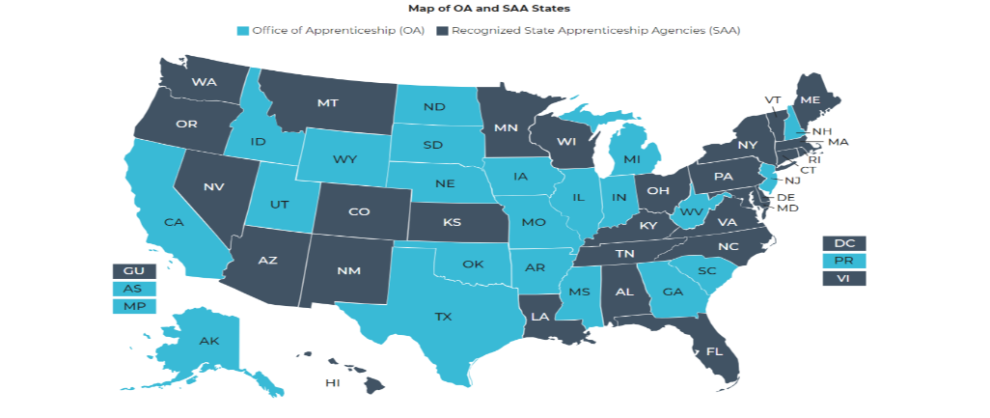
The National Registered Apprenticeship System
Notes:
Alan

Slide 16
Program Registration
State-registered programs (SAA states)
Federally registered programs
National programs: multi-state, national programs
National Program Standards must receive reciprocal approval in all states
Notes:
Alan

Slide 17
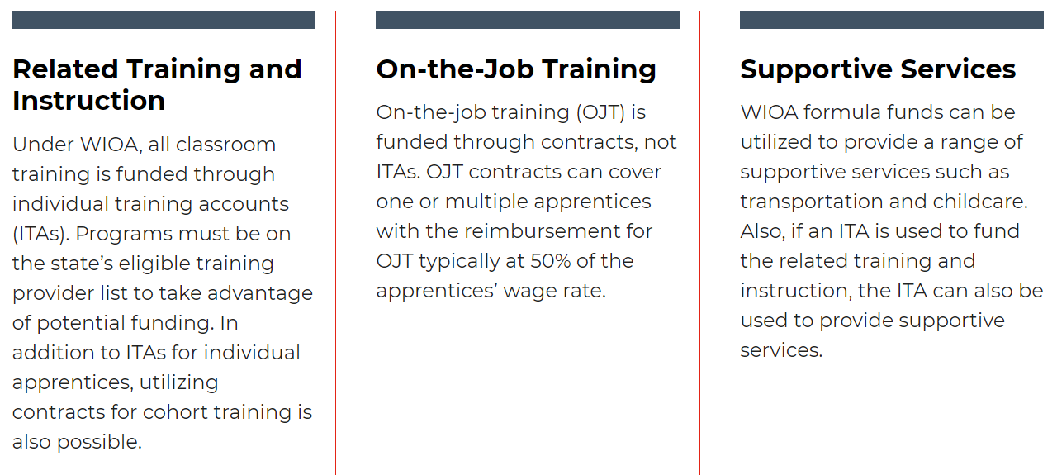
WIOA Funding, Supports for RA
Notes:
Alan

Slide 18
Investing in America Agenda Funds
The Investing in America Agenda - consists of extensive resources and rules to support the advancement of Registered Apprenticeship:
The CHIPS and Science Act $52.7 billion for American semiconductor research, development, manufacturing, and workforce development.
The Bipartisan Infrastructure Bill $550 billion in new funds for infrastructure.
The Inflation Reduction Act Nearly $1.2 trillion in incentives for green energy and increased Affordable Care Act (ACA) subsidies.
The American Rescue Plan $1.9 trillion recovery bill with more than $40 billion for
workforce development.
Safal Partners © 2024
Notes:
Alan

Slide 19
State Funding, Private Sources
Increasing number of states providing:
Direct incentive (per apprentice) funding
Tuition subsidy to offset RTI costs
Grants to support program start-up, expansion, sustainability
Private foundations increasingly supporting RA and youth RA
Notes:
Alan

Slide 20
Braiding Funds to Support RA
Students
WIOA
Veterans Benefits
SNAP/TANF
Tuition
Fees
Supplies
Wrap-Around Services
Institution
State/Federal Grants
DOL – Apprenticeship Grants
State Workforce Grants
Adult Ed Grant Funds
Notes:
Alan

Slide 21
Recent RA System Initiatives and Funding Opportunities
Executive Order: Scaling and Expanding the Use of Registered Apprenticeships in Industries and the Federal Government and Promoting Labor-Management Forums
TEN 23-23: Quality Pre-Apprenticeship Programs
Building Pathways to Infrastructure Jobs grant
Apprenticeship Building America
State Apprenticeship Expansion grants
Investing in America Funding
Notes:
Alan

Slide 22
Apprenticeship Funding
– ACCESSING RESOURCES – For more information, check out the Industry Intermediary fact sheet on Apprenticeship.gov
Registered Apprenticeship Industry Intermediaries: Through a partnership with DOL, these 20 industry intermediaries offer expertise to help employers and labor organizations successfully launch, promote, and expand RA programs in growing industries.
Information Technology
Clean Energy
Early Childhood Education
Education
Early Childhood Education
Notes:
Alan
Optional/draft talking points:
The slide shows you the eighteen Intermediaries that make up the sixteen Industry Intermediary Contractors and the four Youth Apprenticeship Intermediaries.
As you can see, we've added the specific industry and sub-sector under each Intermediary logo. We're currently servicing multiple industry sectors, including healthcare, information technology, public service, the Care Economy, supply chain, cybersecurity, advanced manufacturing, transportation, construction, telecommunications, and hospitality.

Slide 23
Partners and Resources
Industry Intermediaries for Registered Apprenticeship
Apprenticeship Ambassadors
Apprenticeship Trailblazers
Youth Apprenticeship Week
Advanced Manufacturing Sprint
Notes:
Alan

Slide 24
Local Workforce Systems, Business Services & Registered Apprenticeship
Notes:
I

Slide 25
Business Engagement and RA
Registered Apprenticeship is the gold standard for training and workforce development.
Understanding RA is critical to offering the best workforce solutions to your local business community.

Slide 26
Poll
How would you assess your local workforce system's business engagement efforts?
EMERGING - there is interest in business engagement and offering diverse solutions to business needs, but we are not sure where to start
ADVANCING - there is an active plan and for business engagement and training for BSRs on business solutions beyond the traditional
LEADING - business engagement efforts are prioritized by the local workforce board, there is a structured and colllaborative approach for outreach, efforts are tracked, and BSRs are well-informed on all business solutions they can offer to business

Slide 27
Advancing from Emerging to Leading: the BSR Approach
While services may vary depending on the organization, region, or specific objectives, a Business Services Representative (BSR) serves as the bridge between businesses and workforce development resources, aiming to create mutually beneficial partnerships that enhance employment opportunities and support economic growth.
Safal Partners © 2024

Slide 28
BSR Approach: Solutions Driven
Philosophy: We can best serve our communities by engaging with all partners to identify and overcome challenges through a collaborative approach.
Methods should be Proactive. Integrated. Sustainable.
This work is ongoing and dynamic and requires a continuous improvement approach!

Slide 29
Achieving Effective Business Engagement Efforts with an RA Focus
Secure
Know
Find
Promote
Demonstrate
Formulate
Secure Local Workforce Development Board support.
Know what assets your workforce system and RA can provide to businesses.
Find your Apprenticeship Representative/ATR – he/she knows the RA landscape and can support your efforts with businesses.
Promote training sessions for BSRs on Registered Apprenticeship .
Consistently demonstrate your value to your business customers.
Formulate strong partnerships to provide comprehensive coordinated solutions.

Slide 30
Local Workforce Development Board Support
LWDBs that support effective business engagement prioritize:
Equitable services to both the job seeker and the business customer.
Registered Apprenticeship as a key solution for businesses.
Policies and procedures that support business engagement efforts with a focus on RA as a solution for businesses.
A staffing structure that includes one or more BSRs with RA expertise and/or promotes collaboration between BSRs and ATRs.
On-going training and education for business services representatives.
Safal Partners © 2024

Slide 31
What can you do to secure/enhance LWDB support?
Ensure you are at the table.
Make sure the right businesses are represented on the board, and the business majority is maintained.
Help the board gather input from business, industry associations, and economic development agencies to understand the needs in the local area.
Offer to provide training and education to the LWDB and its members on business solutions and RA.
What else?
Safal Partners © 2024

Slide 32
What’s the Return on the RA Investment?
Notes:
Stacy

Slide 33
Benefits of Apprenticeship – Business Case
Skilled Workforce
Recruit and develop a diverse and highly-skilled workforce
Improved Productivity
Improve profitability and positive impact to your bottom line
Reduced Turnover
Minimize cost with reduced turnover and liability
Customizable Training
Create flexible training options that ensure workers develop the right skills
Retain Workers
94% of apprentices continue employment after completing an apprenticeship
Diversity
Foster a diverse and inclusive culture
Notes:
Stacy
A Registered Apprenticeship program is a documented plan designed to move an apprentice from a low or no skill entry level position to full occupational proficiency. This systematic training approach provides consistency in training and builds competency across the industry, which in turn will improve safety, quality, and efficiency. Upon completion of the program, an apprentice earns a Completion of Registered Apprenticeship certificate, a nationally recognized credential.

Slide 34
Businesses Report Benefits
Improved company culture
96%
Improved pipeline of skilled workers
91%
Improved employee loyalty
91%
Improved co-worker productivity
87%
Reduced turnover
81%
Product or process innovation
78%
Future manager development
76%
More
on-time delivery
74%
Reduced downtime
68%
Notes:
Stacy

Slide 35
Benefits of Apprenticeship – Workforce System
Training And Employment Guidance Letter WIOA No. 13-16: Operating Guidance for the Workforce Innovation and Opportunity Act
Adopting Registered Apprenticeship as a workforce strategy can help advance the goals of WIOA and meet the needs of the hardest to serve job seekers:
Helps meet WIOA Performance Outcomes: employment rate, median earnings, credential attainment, and skill gains.
Provides training while also earning a wage.
Provides job seekers the opportunity to move into living-wage jobs
Can help prevent layoffs.
Adds valued trainers to the Eligible Training Provider List
Notes:
Stacy

Slide 36
BSRs Working with Apprenticeship Representatives for Successful Apprenticeship Navigation
Notes:
Stacy

Slide 37
Poll 2
Which level best describes your current partnership with your RA system?
None
Communication: Share Information
Coordination: Work Together
Collaboration: Plan/Act Jointly
Notes:
Stacy

Slide 38
Apprenticeship Representatives Complement the Work of BSRs
Apprenticeship Representatives or ATRs perform functions that can support the efforts of BSRs.
Complementary functions of ATRs include:
Management of RA programs and ensuring adherence to laws and regulations
Oversight of the development and implementation of registered apprenticeship programs
Provision of technical assistance to employers, sponsors, and other stakeholders
Conducting outreach to promote apprenticeship programs
Provision of support to apprentices and sponsors throughout the duration of the program
Although each State is different, collaboration between the BSR and ATR will consistently support success.
Notes:
Stacy

Slide 39
Framework for ATR and BSR Collaboration
Three Critical Pillars
Roles and Responsibilities: Defining who does what
Communication: Keeping the lines open
Leadership: Setting expectations
Notes:
Stacy
And now I have the pleasure of introducing our presenters from Brevard County, Florida. They have had great success with a collaborative approach to business engagement. One where the workforce business representative and the Apprenticeship Training Representatives work together to outreach to businesses and grow apprenticeship opportunities.

Slide 40
Excellence in Practice: Brevard County, Florida
Making Apprenticeship Central
to WIOA Business Services
Notes:
Melissa
The Brevard County Florida Model
As Nicole mentioned, I am Deb Bennett, Vice President of Registered Apprenticeship at the Wireless Infrastructure Association (WIA). WIA is a national trade association of companies that design, build, maintain, and support the nation’s telecommunications infrastructure. We operate TIRAP, the national Telecommunication Industry Registered Apprenticeship Program, with 104 employer sponsors, 16 apprenticeable occupations, and over 4800 apprentices since our start in 2017.
Some of you may remember me from BSR Training Webinar #1, which was held in April. I’m pleased to be back with you today.
And now I have the pleasure of introducing our presenters from Brevard County, Florida. They have had great success with a collaborative approach to business engagement. One where the workforce business representative and the Apprenticeship Training Representatives work together to outreach to businesses and grow apprenticeship opportunities. (Next Slide)

Slide 41
From Business Liaison to Apprenticeship Navigator
Before Apprenticeship Navigator (AN) role:
Engagement with Registered Apprenticeship was minimal.
Business Liaisons provided services to businesses, including those that were operating RA programs.
Business services included:
Recruitment
Job postings
OJT services
Point of Contact for RA:
Role fulfilled by a Business Liaison
Increased awareness and growth of workforce and RA collaboration
Led to creation of an AN position
Notes:
Melissa

Slide 42
The BSR: When a Local WDB does not have the AN Position
It’s about functions not position titles.
BSR and AN functions are similar:
Business Engagement
Use of LMI data
Relationship-building with business and other partner
programs like WIOA
Industry-led work
The AN FUNCTIONS can and should be performed by BSR(s)
Designate one BSR to be the lead for RA
Provide training to all or one BSR on RA programs and alignment with WIOA
Forge a partnership with the ATR to help the BSR team with needs of RA – development and expansion
Notes:
Melissa

Slide 43
Coordinated Service Delivery Efforts
Notes:
Melissa

Slide 44
An RA-Focused BSR Plus an ATR Yields Great Results
Both roles are clearly defined. Important to stay in your lane:
ATR- Federal/State Registered Apprenticeship Laws and documents
AN- CareerSource WIOA Services
Both work in collaboration with educators, businesses, RA sponsors, and other community partners to create unique pathways.
Connecting veterans and programs to Veterans Registered Education Training Provider
Using Skillbridge
Developing curriculum
The power of two yields great results.
Necessary support services for RA can be addressed when both the ATR and AN are present.
Lines of communication transparent.
ATR and AN phone calls/meetings
Invite to meetings (when appropriate)
Collaboration is facilitated by:
Identification of common goals
Passion for supporting local economy and the workforce
Notes:
Melissa

Slide 45
Business Engagement Tips
Group Meetings – businesses and RA sponsors
Businesses with interest meet with RA program sponsors
Provide an overview of RA defining program and roles
Group Education – small & large consortiums/associations
Present the benefits of RA to all stakeholders
On-going service provided through the one-stop center
Offer long-term solutions and investment in their business(es)
Career and Technical Education (CTE) and Adult and Community Education – talent pipeline development
First stage component to help feed into RA programs
CTE and Pre-apprenticeship programs developed around RA programs in local area.
Notes:
Melissa

Slide 46
Challenges To Triumphs
Not all engagements lead to new or expanded programs.
The more education you can provide and successes you can share, the more stakeholders will engage.
Funding and sustainability of RA programs can be challenging.
Be familiar with potential funding that can support RA programs. Options available through different sources.
Potential development can come to a complete stop, if businesses want to proceed, they will reengage.
Many stakeholders are unaware of RA successes.
Witnessing a graduation of apprentices is powerful
Notes:
Melissa

Slide 47
Lessons Learned
Be strategic when looking at workforce solutions
Use networking opportunities to engage with businesses, educators, associations and start the conversation about RA
Use LMI data with community needs to identify opportunities to support existing RA programs and/or to create new RA programs
Must know your ATR – he/she knows the RA landscape and can support your efforts with businesses
Notes:
Melissa
Be strategic when looking at workforce solutions
Take advantage of networking opportunities to engage with businesses, educators, associations and more to start the conversation about RA
Use LMI data in conjunction with community needs to identify opportunities to support existing RA programs and/or to create new RA programs.
Must get to know your ATR – he/she knows the RA landscape and can support your efforts with businesses.

Slide 48
Words of Wisdom
Customer Service
Collaboration
Ask Questions
Network
Be Open to Change
Monitor Trends in Your Region
Notes:
Melissa

Slide 49
Assessing and Enhancing Collaboration
Safal Partners © 2024
Notes:
Stacy
Slides 24-31 Deb
Thank you Melissa & Anne. You just shared an outline or guide for collaboration that has produced optimal results for your organizations. NOW we’ll have an opportunity to reflect inward and begin to assess the current state within our own organizations and determine how to integrate these concepts.

Slide 50
Level of Interaction with Your ATR
Keep this tool handy as a reminder to work on your partnership with the ATR in your region and/or state.
View the Desk Tool
Notes:
These three Cs are woven into the efforts in Brevard County and really led to the success of those efforts.
Build the ability to efficiently communicate with one another, ask questions, provide context offer guidance to one another
Agree on some methods or processes and act jointly – common tools, resources, establish cross functional teams
Question: How can I assess and/or enhance collaboration in my area?
Answer: Even though both BSRs and ATRs are charged with working with employers to address workforce issues, in many instances they work in parallel systems and lack the coordinated approach employers need. Better communication, coordination, and collaboration help to ensure that the parallel systems interact with each other and align on employer needs and solutions.
This tool illustrates the three Cs of effective partnership: Communication, Coordination, and Collaboration and offers key questions for assessing your current level of interaction.

Slide 51
Tips for Moving to the Next Level of Interaction
Currently do not work with the ATR
Currently work with the ATR and want to enhance the impact
Good working relationship with the ATR but want to plan/act jointly
Find out who the ATR for your region is and introduce yourself
Talk about your respective outcome measures and how you can support each other
Share the list of companies you are working with
Plan a joint partner visit
Develop a strategic approach to company outreach
Create a shared informational database
Get buy-in from leadership
Conduct joint outreach to high priority companies
Track outcomes to show impact of the collaboration
Notes:
Share who you have been working with
Maybe there are common businesses
Strategically plan for joint visits
Gathering and building together
Track your outcomes – you want to show the ijmpact of your collaboration
Transparency

Slide 52
Poll 3
Could you benefit from additional training on enhancing your working relationship with the ATRs in your region?
Yes
No
It depends
Notes:
We’ve shared quite a bit of information for what I consider to be best practices for enhance interaction and collaboration. Our next poll is intended to help the COE plan future events and resources.
Our question for you – Could you benefit from additional training on enhancing your working relationship with the ATRs in your region?

Slide 53
Key Takeaways
Registered Apprenticeship is an important resource that can help the employers you work with.
Registered Apprenticeship can help workforce agencies achieve their performance goals.
It is important to reach out to your ATRs. Collaboration is the key to success.

Slide 54
Questions and Answers
Notes:
AD

Slide 55
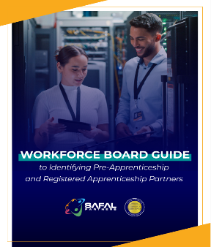
No-Cost Resources
Request no-cost online or in-person training for your organization
Become a Center partner to receive notification of upcoming webinars, Virtual Office Hours
Visit our website for downloadable materials
Guide to Identifying Partners

Slide 56
Contact Us
Stacy O’Keefe
Subject Matter Expert
Safal Partners
Stacy.okeefe@safalpartners.com
Alan D. Dodkowitz
Subject Matter Expert
Safal Partners
Alan.Dodkowitz@safalpartners.com
Melissa Byers
Business Liaison & Apprenticeship Navigator
CareerSource Brevard Flagler Volusia
mbyers@careersourcebfv.com
Notes:
AD

Slide 57
Contact Us, Become a Partner
Scan for Partner Form
Receive no-cost expert TA, materials, and assistance
Network with potential partners nationwide
Be nationally recognized for your work
Notes:
We want to thank all of you for joining us today. We appreciate your participation.
We’d like to encourage you to become a partner with the Center of Excellence if you have not signed up yet. Please take a moment to scan the QR code on the screen. As a partner you have the opportunity to receive no-cost technical assistance and materials, network with partners nationwide, and be nationally-recognized for your work.

Slide 58
Thank You for Joining Us
Email us your questions at RA_COE@SafalPartners.com
For more information, visit: dolcoe.safalapps.com

