Slide 1
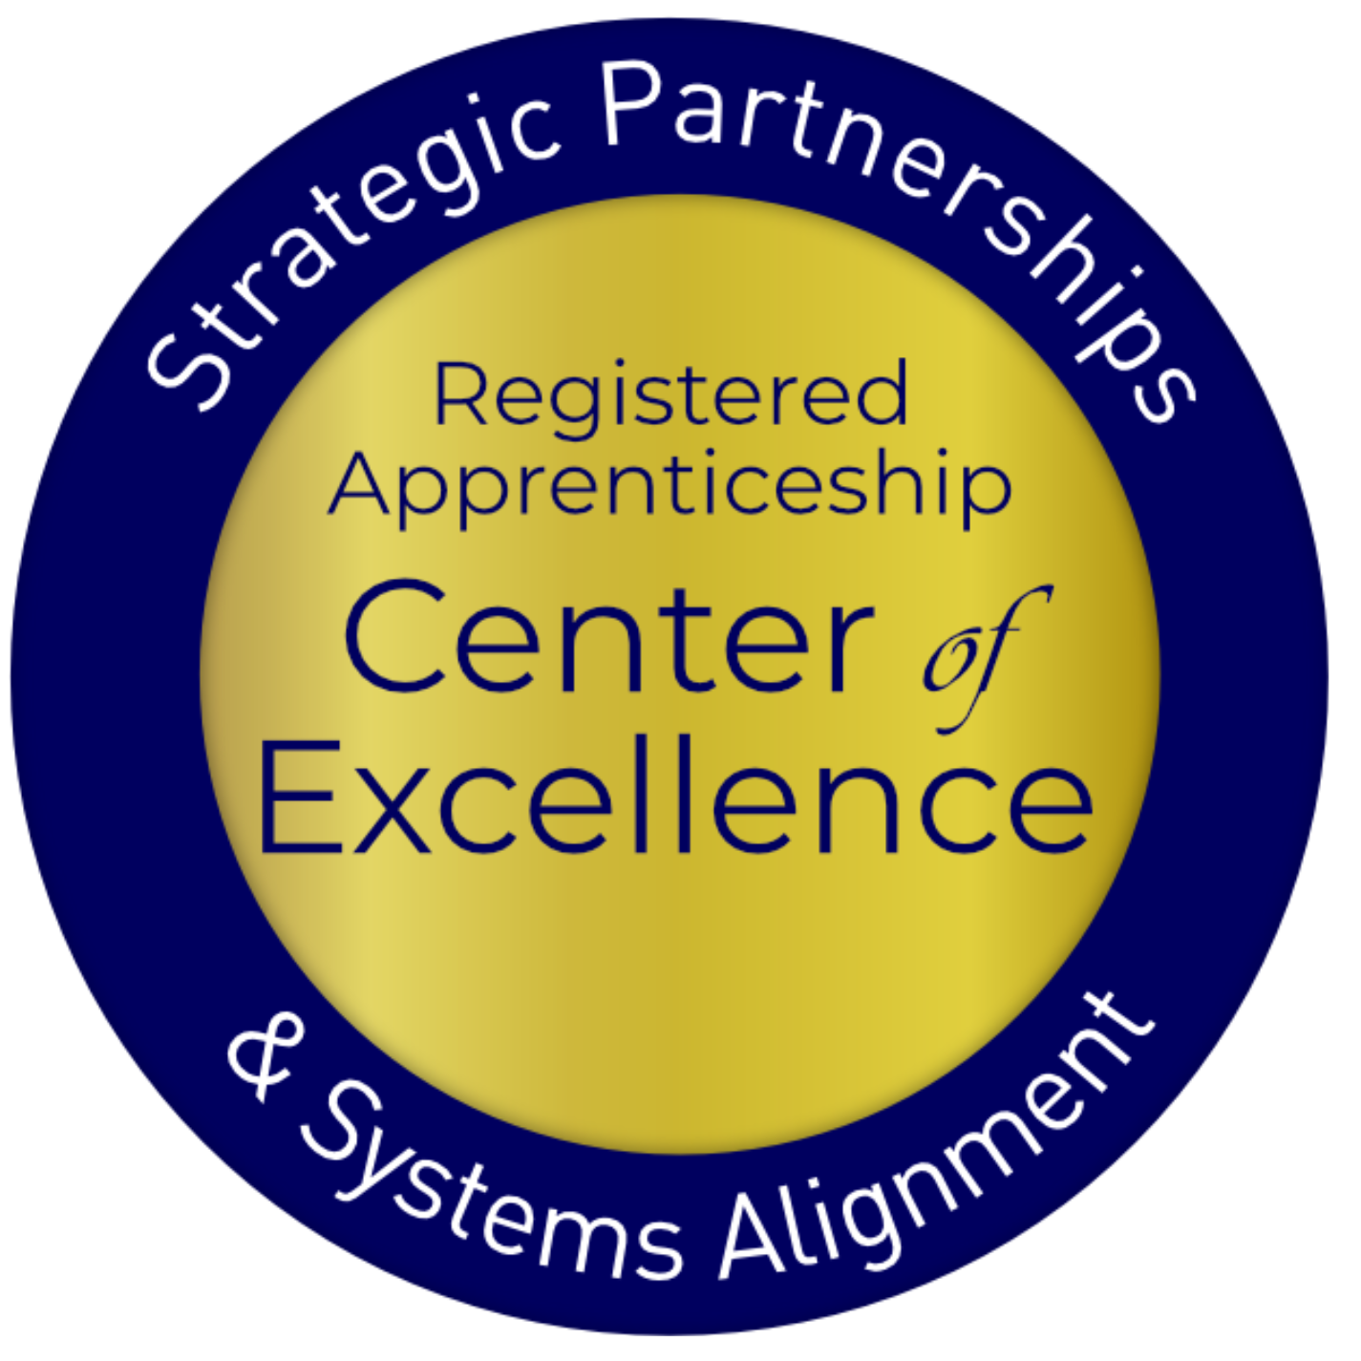
Office Hours: Aligning the Workforce and Apprenticeship Systems: Registered Apprenticeship and WIOA 101 for Case Managers
August 15, 2024

Slide 2
Presenters
Clare Vanderpool
Lisa Rice
Subject Matter Expert
Safal Partners
Subject Matter Expert
Safal Partners

Slide 3
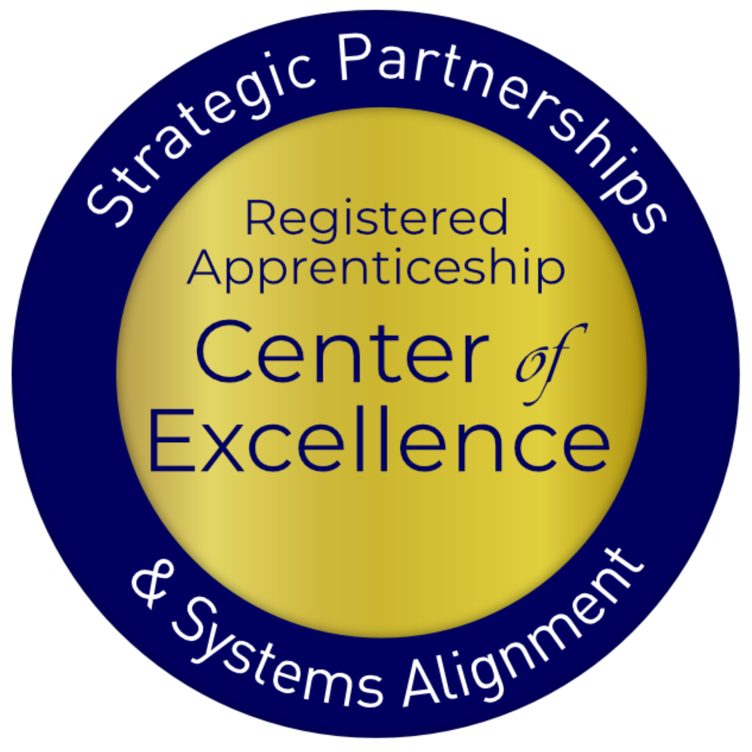
Welcome and Agenda
Center of Excellence Overview
Review Core Components of Registered Apprenticeship
Resources
Questions and Discussion
Safal Partners © 2024

Slide 4
Center of Excellence Overview
U.S. DOL initiative to increase systems alignment across apprenticeship, education, and workforce
Led by Safal Partners; 5 national partners
We provide no-cost TA including:
Monthly webinars
Quarterly virtual office hours
Individual TA/coaching sessions
Online resources (desk aids, guides, frameworks, etc.)
Visit our website, request TA
Notes:
Safal was awarded the opportunity to lead the US DOL Registered Apprenticeship Technical Assistance Center of Excellence for Strategic Partnerships and Systems Alignment in 2021.
We are here to help close the gap between the apprenticeship and workforce systems and accelerate partnerships across education, economic development, and other partners to increase adoption of RA nationwide.
The Center is supported by five national partners including the National Association of Workforce Development Professionals, the Coalition on Adult Basic Education, the National Disability Institute, FASTPORT, and the Wireless Infrastructure Association.
Our national partners were strategically chosen to help us reach specific groups whether on the workforce, education or employer side
California Workforce Association (CWA) is our partner in the state, helping increase workforce system awareness and utilization of RA as a workforce solution for both employers and jobseekers.
The Center of Excellence provides no-cost technical assistance – online, in-person and through hybrid delivery - to accelerate sustainable partnerships and align apprenticeship, workforce and education systems.

Slide 5
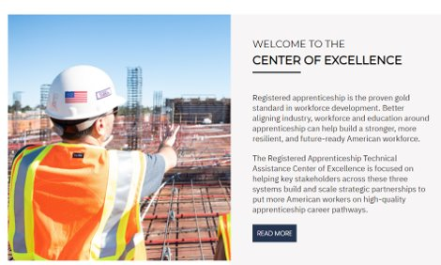
Online Resources, On-Demand TA
Registered Apprenticeship Partner Profile Questionnaire
https://dolcoe.safalapps.com/resources/resourcesandtools
Notes:
Our website is continually updated with relevant news, TA resources and tools including frameworks, case studies, webinars, customizable templates, questionnaires, and more.
Since 2021 more than 3,000 organizations have become no-cost Center partners and utilized our tools – such as the "RA Partner Profile Questionnaire" - to accelerate their organizations' understanding and effective usage of RA.
Link to Questionnaire - https://dolcoe.safalapps.com/sites/default/files/2022-11/Partnership%20Questionnaire.pdf
This questionnaire is intended to help you build a network in your area around Registered Apprenticeship (RA). With the information gathered here, your board should be better able to engage with and convene RA stakeholders to expand RA program opportunities. It is designed to be used in conjunction with the USDOL RA TA Center of Excellence “Workforce Board Guide to Identifying Pre-Apprenticeship and Apprenticeship Partners” publication. This publication and more information on the Center can be found online at dolcoe.safalapps.com﻿

Slide 6
Five Core Components of RA
Employer Involvement
Structured On-the-Job Learning (OJL)
Related Instruction (RI)
Rewards for
Skill Gains
National Occupational Credential
Safal Partners © 2024
Notes:
There are 5 core components of RA.
Apprenticeship is an employer-driven tool for the workforce system.
It includes On the Job Learning at the job site
And of course the related instruction which can be either at the job site or with an external training provider
There are wage gains as people meet milestones in the apprenticeship journey
And finally, when they are done there is a nationally recognized occupational credential

Slide 7
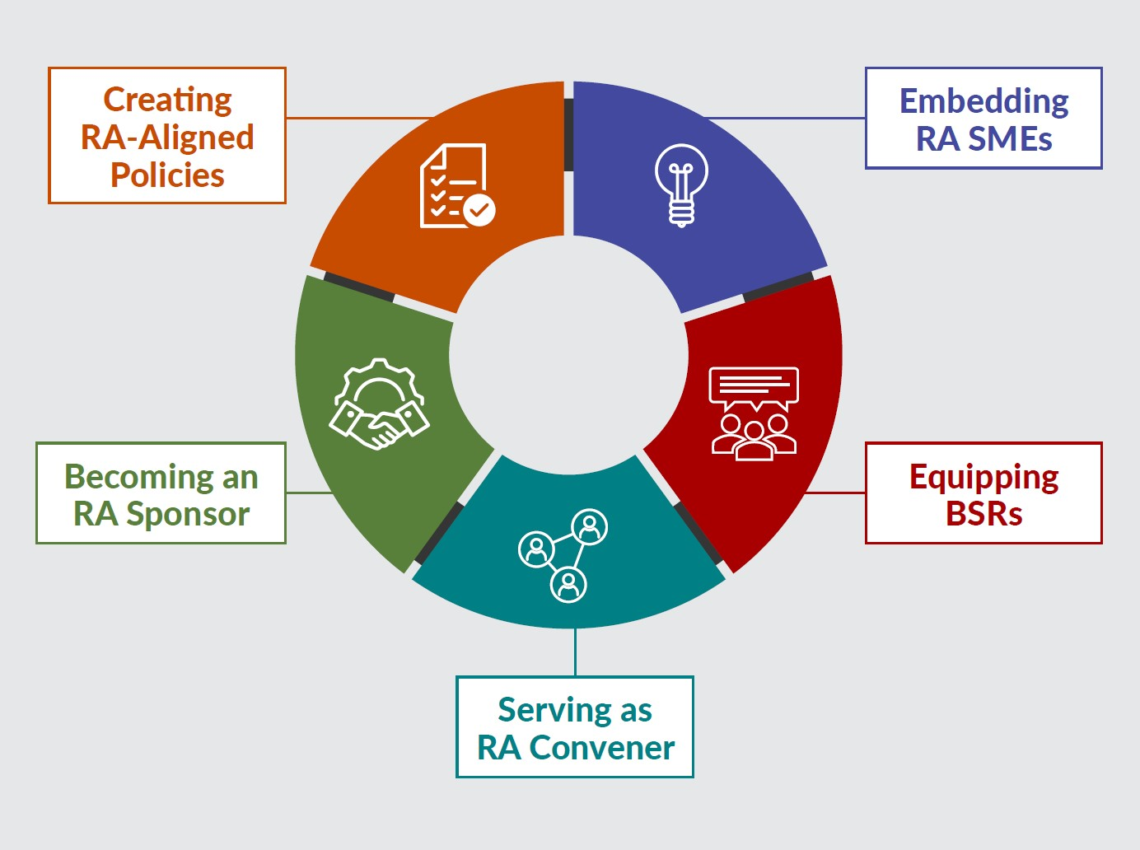
New Tool
Key Components of Workforce System Alignment with Registered Apprenticeship
https://dolcoe.safalapps.com
Safal Partners © 2024
Notes:
The reason this tool was built was to help the workforce system and it’s partners look at ways that you can enhance your RA efforts. They are not linear, you could be doing things in several different areas and we acknowledge that this is not all inclusive, but rather it gives you a starting point to grow your RA work.

Slide 8
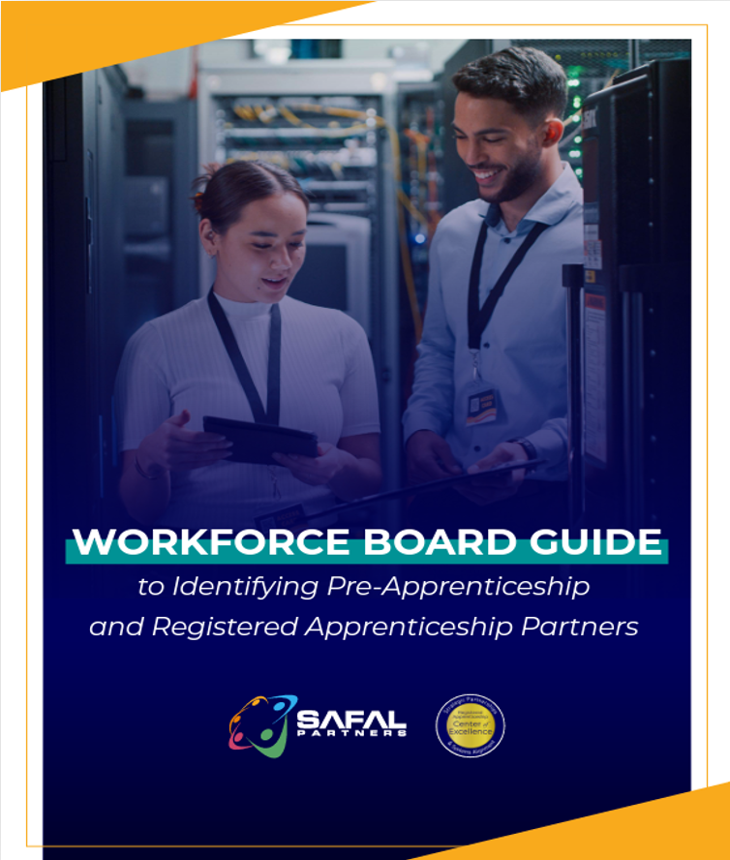
No-Cost Resources
Guide to Identifying Partners
Safal Partners © 2024

Slide 9
Questions, Thoughts, Discussion?
Safal Partners © 2024

Slide 10
Contact Us, Become a Partner
Scan for Partner Form
Receive no-cost expert TA, materials, and assistance
Network with potential partners nationwide
Be nationally recognized for your work
Notes:
We want to thank all of you for joining us today. We appreciate your participation.
We’d like to encourage you to become a partner with the Center of Excellence if you have not signed up yet. Please take a moment to scan the QR code on the screen. As a partner you have the opportunity to receive no-cost technical assistance and materials, network with partners nationwide, and be nationally-recognized for your work.

Slide 11
Thank You for Joining Us
Email us your questions at RA_COE@SafalPartners.com
For more information, visit: dolcoe.safalapps.com

