Slide 1
Office Hours: Building Student Awareness of Apprenticeship Career Pathways
September 5, 2024

Slide 2
Presenters
Clare Vanderpool
Alan D. Dodkowitz
Subject Matter Expert
Safal Partners
Subject Matter Expert
Safal Partners

Slide 3
Welcome and Agenda
Center of Excellence Overview
Review Core Components of Registered Apprenticeship
Resources
Questions and Discussion
Safal Partners © 2024

Slide 4
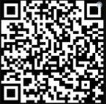
Center of Excellence Overview
U.S. DOL initiative to increase systems alignment across apprenticeship, education, and workforce
Led by Safal Partners; 5 national partners
We provide no-cost TA including:
Monthly webinars
Quarterly virtual office hours
Individual TA/coaching sessions
Online resources (desk aids, guides, frameworks, etc.)
Visit our website, request TA

Slide 5
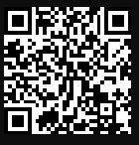
Online Resources, On-Demand TA
Registered Apprenticeship Partner Profile Questionnaire
https://dolcoe.safalapps.com/resources/resourcesandtools

Slide 6
Five Core Components of RA
Employer Involvement
Structured On-the-Job Learning (OJL)
Related Instruction (RI)
Rewards for
Skill Gains
National Occupational Credential
Safal Partners © 2024

Slide 7
What is Youth Apprenticeship?
A youth apprentice is defined as…​
an in-school OR out-of-school youth between the ages of 16 and 24…​
​
who receives industry-validated Related Instruction for an RA program (for in-school youth) from their school while… ​
​ completing part-time, paid, work-based experience ​from an employer under a ​ mentored supervision as part of… ​
​
a Registered Apprenticeship program approved ​ by DOL or a state apprenticeship agency (SAA) or a pre-apprenticeship program.​
Safal Partners © 2024

Slide 8
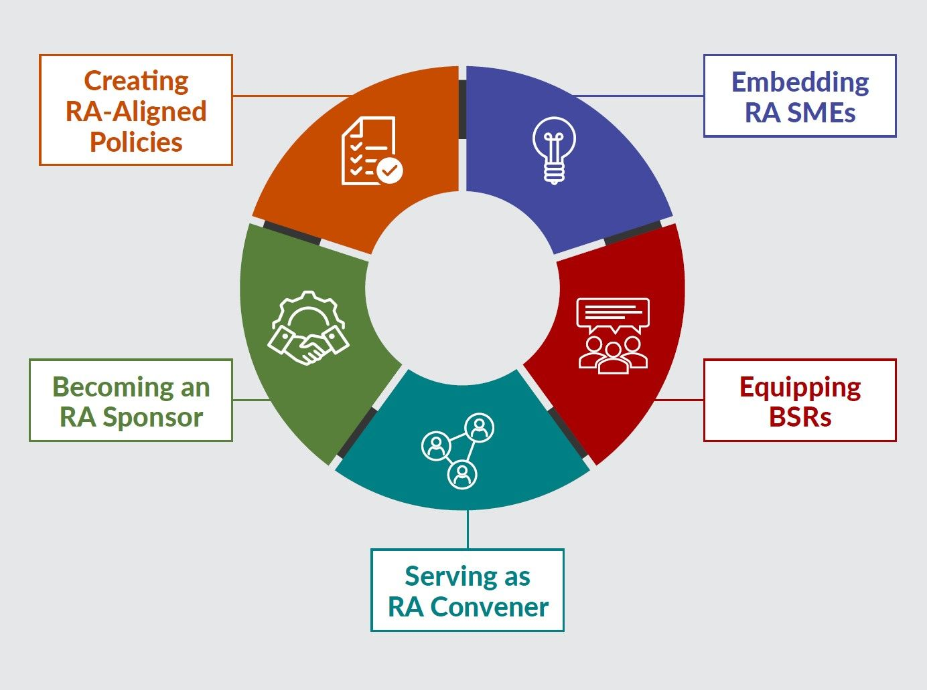
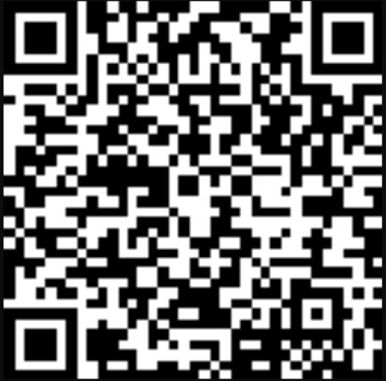
New Tool
Key Components of Workforce System Alignment with Registered Apprenticeship
https://dolcoe.safalapps.com
Safal Partners © 2024

Slide 9
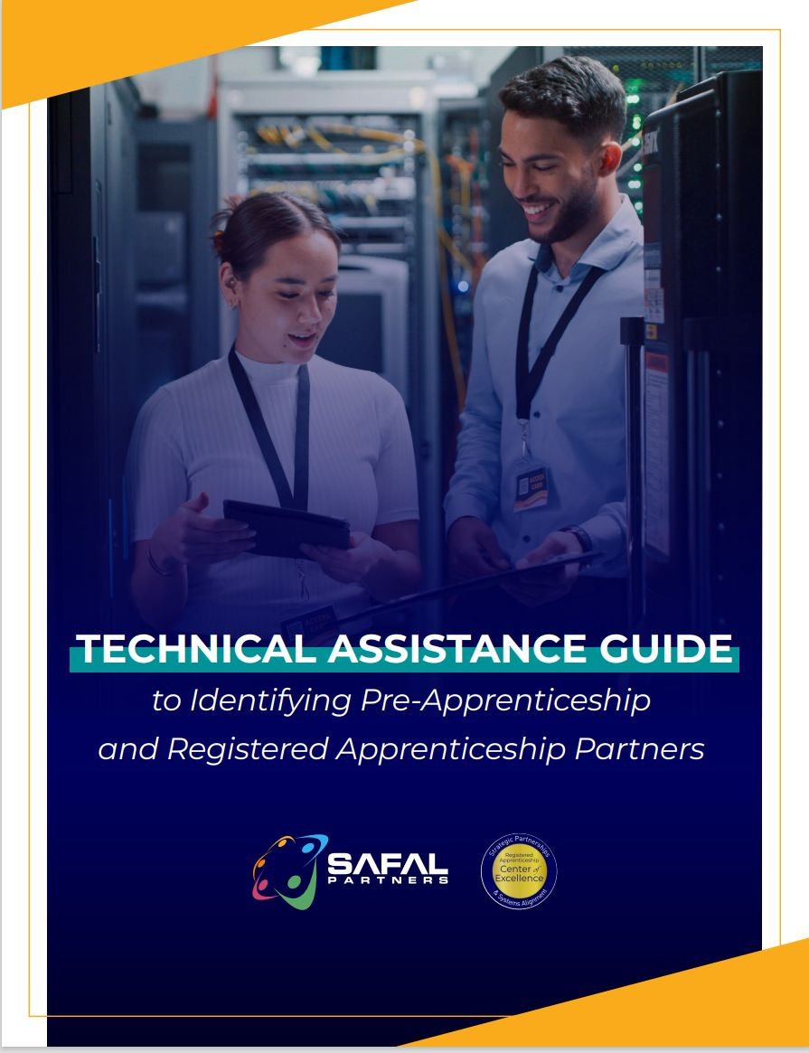
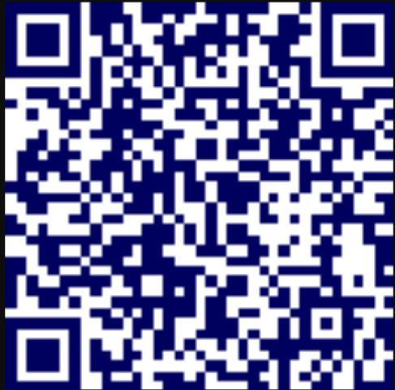
No-Cost Resources
Guide to Identifying Partners
Safal Partners © 2024

Slide 10
Questions, Thoughts, Discussion?
Safal Partners © 2024

Slide 11
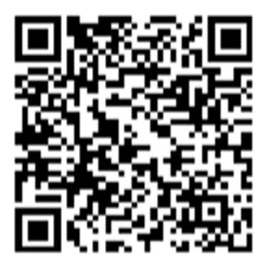
Contact Us, Become a Partner
Scan for Partner Form
Receive no-cost expert TA, materials, and assistance
Network with potential partners nationwide
Be nationally recognized for your work

Slide 12
Thank You for Joining Us
Email us your questions at RA_COE@SafalPartners.com
For more information, visit: dolcoe.safalapps.com

