Slide 1
Engaging Employers in Registered Apprenticeship: Tools and Tips for Business Service Representative
September 20th, 2024

Slide 2



Center of Excellence Overview
U.S. DOL initiative to increase systems alignment across apprenticeship, education, and workforce
Led by Safal Partners
We provide no-cost TA including:
  Monthly webinars
  Quarterly virtual office hours
  Individual TA/coaching sessions
  Online resources (desk aids, guides, frameworks, etc.)
Visit our website, request TA

Slide 3
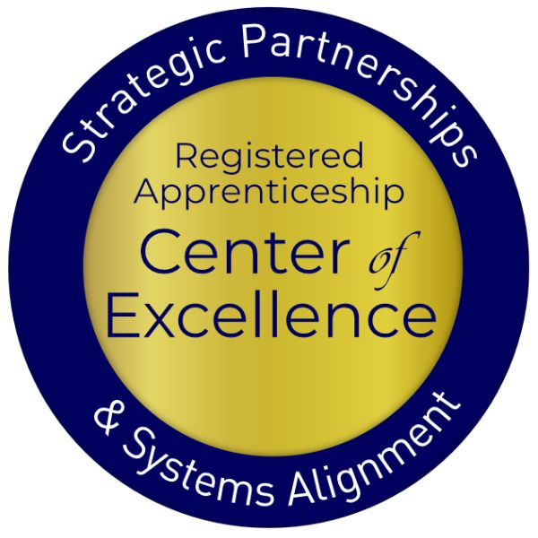
Agenda
Welcome and Introduction
How Registered Apprenticeship is structured and works in concert with the workforce system
Recent RA system initiatives, funding opportunities, and partners
WIOA funding and RA
How to speak to employers about RA
Q&A

Slide 4

Presenter
Jeremy Faulkner
Senior Subject Matter Expert
Safal Partners

Slide 5

Poll #1
What is your role in the workforce system?
  Business Service Representative (BSR)
  Workforce staff that has some BSR responsibility
  Workforce Manager/Administrator
  Local Veterans Employment Representative (LVER)
  Other

Slide 6
Registered Apprenticeship
Safal Partners © 2024

Slide 7
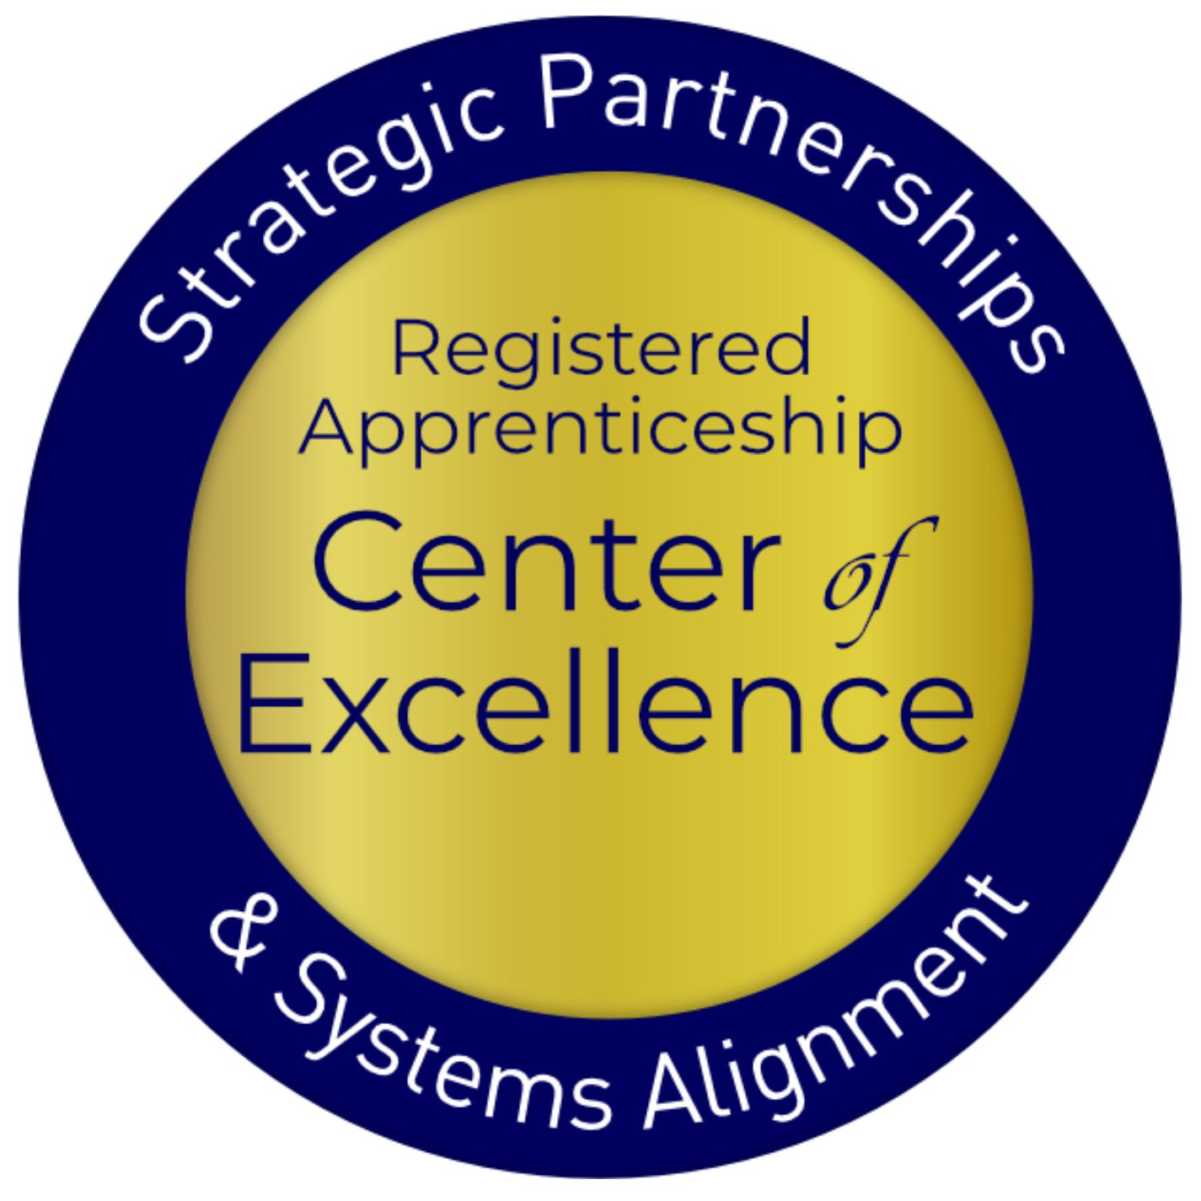
Registered Apprenticeship Defined
Apprenticeship:
A Proven
Workforce Solution
Registered Apprenticeship is a proven, customizable, and structured model to find and train diverse new talent as well as upskill current workers in critical occupations.
Safal Partners © 2024

Slide 8



Five Core Components of Registered Apprenticeship
Rewards for
Skill Gains
National Occupational Credential
Employer Involvement
Related Instruction (RI)
Structured On-the-Job Learning (OJL)
Safal Partners © 2024

Slide 9




Roles of Apprenticeship
Sponsor
RI Provider
Employer
Partner
An organization that agrees to operate an apprenticeship program and in whose name the program is registered.
Entity that provides instruction to apprentices in the designated occupation’s core knowledge, skills, and abilities.
Hires and provides paid on-the-job learning (OJL) for apprentices under
supervision of a designated mentor who is a skilled professional in
that occupation.
Organizations
committed to assisting RA programs. They can play one or more roles.
Safal Partners © 2024

Slide 10

ABOUT US
886K+
25K+
7,454
85%
FY 2023 FAST FACTS
Apprentices served
Active apprenticeship programs
New apprenticeship programs since 2021
Growth of new apprentices over the past decade
OUR MISSION
The U.S. Department of Labor’s Office of Apprenticeship promotes and oversees quality, accessible Registered Apprenticeship opportunities for workers seeking higher-skilled, higher-paying jobs and engages employers seeking to build a qualified, diverse, and inclusive workforce.
Learn more at our About Us fact sheet

Slide 11
Core Components of Registered Apprenticeship
Industry Led
Programs are industry-vetted and approved to ensure alignment with industry standards and apprentices are trained for highly skilled, high-demand occupations.
Paid Job
Apprenticeships are jobs! Apprentices earn progressive wage increases as their skills and productivity increase.
Structured On-the-Job Learning/ Mentorship
Programs provide structured on-the-job training to prepare for a successful career, which includes instruction from an experienced mentor.
Supplemental Education
Apprentices are provided supplemental classroom education based on the employers' unique training needs to ensure quality and success.
Diversity
Programs are designed to reflect the communities in which they operate through strong non-discrimination, anti-harassment, and recruitment practices to ensure access, equity, and inclusion.
Quality & Safety
Apprentices are worker protections while receiving rigorous training to equip them with the skills they need to afforded succeed and the proper training and supervision they need to be safe.
Credentials
Apprentices earn a portable, nationally-recognized credential within their industry.

Slide 12

Types of Registered Apprenticeship
Time-based, competency-based, or hybrid
Some programs are managed by a joint apprenticeship training committee
Individual or group sponsorship

Slide 13












A DIVERSE RANGE OF INDUSTRIES
Agriculture
Healthcare
Cybersecurity
Biotechnology
Transportation
Construction
Energy
Hospitality
Advanced
Manufacturing
Critical
Supply Chain
Telecommunications
Financial
Services
Information
Technology
Education
Infrastructure
Engineering

Slide 14
















Growing Apprenticeship
SUCCESSFUL ENGAGEMENT WITH MAJOR EMPLOYERS TO GROW APPRENTICESHIP

Slide 15
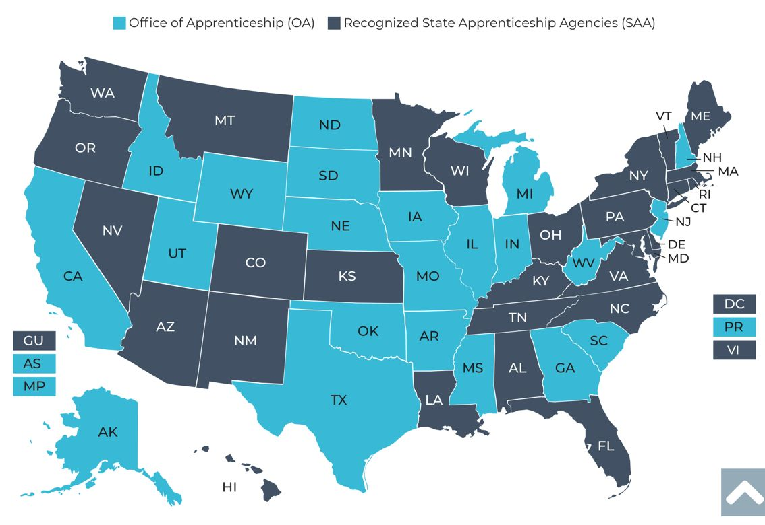
The Apprenticeship System
25 states and territories are Office of Apprenticeship (OA) states
32 states and territories have state apprenticeship agencies (SAA)
https://www.apprenticeship.gov/about-us/apprenticeship-system

Slide 16

What Do Apprenticeship Standards Look Like?
An occupation and O*NET code, identification of apprenticeship type, program length
Sponsor responsibilities (such as record-keeping, health and safety)
Apprentice qualifications, selection procedures, wage progression
Work process schedule (on-the-job learning)
Related instruction outline (144 hours per 2,000 OJT hours)

Slide 17






Benefits of Apprenticeship – Business Case
Skilled Workforce
Recruit and develop a diverse and highly-skilled workforce
Improved Productivity
Improve profitability and positive impact to your bottom line
Reduced Turnover
Minimize cost with reduced turnover and liability
Customizable Training
Create flexible training options that ensure workers develop the right skills
Retain Workers
94% of apprentices continue employment after completing an apprenticeship
Diversity
Foster a diverse and inclusive culture

Slide 18
RA and WIOA Business Services
BSRs are ideally situated to help companies understand all their options, including Registered Apprenticeship
Companies partnering on WIOA services will likely be interested in apprenticeship as an important option
Employer partners are looking to minimize the number of different contacts, meetings, and reports
Workforce and apprenticeship systems can benefit each other
Apprenticeship is an important option for business partners receiving WIOA services.

Slide 19

Recent RA System Initiatives and Funding Opportunities
Executive Order: Scaling and Expanding the Use of Registered Apprenticeships in Industries and the Federal Government and Promoting Labor-Management Forums
TEN 23-23: Quality Pre-Apprenticeship Programs
Notice of proposed rulemaking to enhance the National Apprenticeship System
Building Pathways to Infrastructure Jobs grant
Apprenticeship Building America
State Apprenticeship Expansion grants

Slide 20



Partners and Resources
Industry Intermediaries for Registered Apprenticeship
Apprenticeship Ambassadors
Apprenticeship Trailblazers
Youth Apprenticeship Week
Advanced Manufacturing Sprint

Slide 21




















Apprenticeship Funding
Registered Apprenticeship Industry Intermediaries: Through a partnership with DOL, these 20 industry intermediaries offer expertise to help employers and labor organizations successfully launch, promote, and expand RA programs in growing industries.
For more information, check out the Industry Intermediary fact sheet on Apprenticeship.gov
Information Technology
Clean Energy
Early Childhood Education
Education
Early Childhood Education

Slide 22
Advanced Manufacturing
Apprenticeship Sprint
In the 109 days between October 6, 2023, and January 23, 2024:
+160
Organizations made new commitments
to workforce development and job quality.
4,937
NEW APPRENTICES WERE HIRED
New advanced manufacturing-related Registered Apprenticeship programs
and occupations have been created
or are newly under development.
+150
  Advanced Manufacturing-related Apprenticeship Accelerators and outreach events were held by industry and workforce system partners.
+127

Slide 23

WIOA Funding and RA
Under WIOA, registered apprenticeship programs automatically qualify to be included on the state’s Eligible Training Provider List
Individual Training Accounts are an effective support for WIOA participants to enter an apprenticeship
Incumbent worker training and apprenticeship may be prioritized in WIOA state programs

Slide 24
RA Helps Advance WIOA Goals
Adopting Registered Apprenticeship as a workforce strategy can help advance the goals of WIOA. RA:
Helps meet WIOA Performance Outcomes: employment rate, median earnings, credential attainment, and skill gains.
Gives more individuals on Individual Training Accounts an opportunity to move into living-wage jobs
Can help support Incumbent Worker Training
Can increase the need for and use of On-the-Job Training Contracts
Adds valued trainers to the Eligible Training Provider List
Training And Employment Guidance Letter WIOA No. 13-16: Operating Guidance for the Workforce Innovation and Opportunity Act

Slide 25

How to Speak to Employers about RA
Speak in the language of business:
  Return on investment, productivity, employee retention
Stress the benefits to the employer and its workers
Focus on results, not process
Employers are already investing in training—it makes sense to take part in the benefits of RA, including incentives to support program start-up and training expenses.

Slide 26

Conclusion
Registered Apprenticeship is the gold standard for training and workforce development.
Understanding RA is important to helping employers in your region to take advantage of the benefits of apprenticeship.
There are resources in the apprenticeship system and partners, such as industry intermediaries, to help your employers to succeed.

Slide 27
Become A Center Partner
Receive no-cost expert TA,
materials, and assistance
Network with potential
partners nationwide
Be nationally recognized for
your work
Scan for Partner Form

Slide 28
THANK YOU FOR JOINING US
Email us your questions at RA_COE@SafalPartners.com
For more information, visit: dolcoe.safalapps.com

