Slide 1
Building Student Awareness of Apprenticeship Career Pathways to Meet Maryland’s Ambitious Goals
September 26, 2024

Slide 2
Presenters
Alan D. Dodkowitz
Jeffrey Smith
Senior Subject Matter Expert
Safal Partners
Workforce Liaison/Program Analyst
Office of Apprenticeship
U.S. Department of Labor
Notes:
Jeffrey W. Smith
Workforce Liaison/Program Analyst |Office of Apprenticeship | U.S. Department of Labor

Slide 3
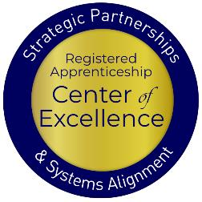
Welcome and Agenda
Center of Excellence Overview
An Overview of Registered and Youth Apprenticeship
What are Maryland’s Goals
What are the Benefits of Apprenticeship for Youth and Schools
High-School and College-Aligned Youth Apprenticeship Pathways
How can we Develop these Pathways
Connecting with Local Workforce Boards
Questions and Closing Thoughts
Safal Partners © 2024
Notes:
AD

Slide 4
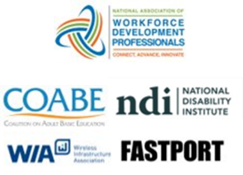
Center of Excellence Overview
U.S. DOL initiative to increase systems alignment across apprenticeship, education, and workforce
Led by Safal Partners; 5 national partners
We provide no-cost TA including:
Monthly webinars
Quarterly virtual office hours
Individual TA/coaching sessions
Online resources (desk aids, guides, frameworks, etc.)
Visit our website, request TA
Notes:
Safal was awarded the opportunity to lead the US DOL Registered Apprenticeship Technical Assistance Center of Excellence for Strategic Partnerships and Systems Alignment in 2021.
We are here to help close the gap between the apprenticeship and workforce systems and accelerate partnerships across education, economic development, and other partners to increase adoption of RA nationwide.
The Center is supported by five national partners including the National Association of Workforce Development Professionals, the Coalition on Adult Basic Education, the National Disability Institute, FASTPORT, and the Wireless Infrastructure Association.
Our national partners were strategically chosen to help us reach specific groups whether on the workforce, education or employer side
The Center of Excellence provides no-cost technical assistance – online, in-person and through hybrid delivery - to accelerate sustainable partnerships and align apprenticeship, workforce and education systems.

Slide 5
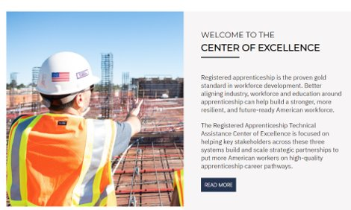
Online Resources, On-Demand TA
Registered Apprenticeship Partner Profile Questionnaire
Center of Excellence Resources and Tools
Notes:
AD

Slide 6
Quick Pulse Poll #1
Are you a….
Workforce Board Staff
Service Provider Staff
Educational Partner
Vocational Rehabilitation Partner
Employer
Board Member
Registered Apprenticeship Staff
Other
Safal Partners © 2024

Slide 7
Quick Pulse Poll #2
When it comes to Registered Apprenticeship I am…
Just starting out
Somewhat familiar with the basics but don’t utilize it often
Very knowledgeable and refer people often to programs
What is RA????
Safal Partners © 2024

Slide 8
What is Registered Apprenticeship?
Registered Apprenticeship (RA) is a proven, customizable, and industry-relevant and US Department of Labor-approved model for organizations to find, train and retain diverse new talent as well as upskill current workers in critical occupations.
Safal Partners © 2024
Notes:
Alan
Registered Apprenticeship Academy

Slide 9
Five Core Components of RA
Employer Involvement
Structured On-the-Job Learning (OJL)
Related Instruction (RI)
Rewards for
Skill Gains
National Occupational Credential
Safal Partners © 2024
Notes:
Alan

Slide 10
A DIVERSE RANGE OF INDUSTRIES
Agriculture
Healthcare
Cybersecurity
Biotechnology
Transportation
Construction
Energy
Hospitality
Advanced Manufacturing
Critical Supply Chain
Telecommunications
Financial Services
Information Technology
Education
Infrastructure
Engineering
Notes:
Apprenticeship spans hundreds of occupations. We tend to think of construction, other trades, or manufacturing when it comes to RA, but that simply isn’t the case any longer.
Early Childhood Education
K-12 Education
Health care
Cybersecurity
Information technology
Biotechnology
Transportation
Construction
Financial services
Advanced manufacturing
Hospitality
Engineering
Energy
Telecommunications

Slide 11
What is Youth Apprenticeship?
A youth apprentice is defined as…​
an in-school OR out-of-school youth between the ages of 16 and 24…​
​
who receives industry-validated Related Instruction for an RA program (for in-school youth) from their school while… ​
​ completing part-time, paid, work-based experience ​from an employer under a ​ mentored supervision as part of… ​
​
a Registered Apprenticeship program approved ​ by DOL or a state apprenticeship agency (SAA) or a pre-apprenticeship program.​
Safal Partners © 2024
Notes:
Alan
Discuss pre-apprenticeship modules

Slide 12
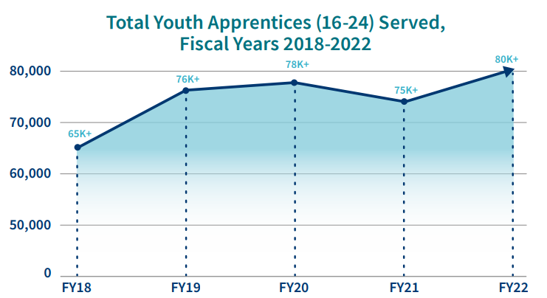
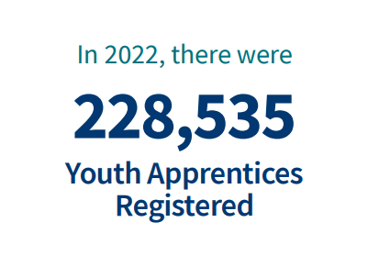
Apprenticeship for Youth
Source: https://www.apprenticeship.gov/
Safal Partners © 2024
Notes:
We want to point out that youth apprenticeship already exists. This is about getting colleges and high schools involved

Slide 13
High-Quality Youth Apprenticeship
In addition to meeting core RA requirements, high quality youth programs:
Provide dual enrollment pathway for college credit for RI
(if school is sponsor) Include articulated agreement with another program sponsor to ensure students can continue paid OJL (and RI if needed) after graduation​
Provide apprentice with a clearly-outlined career pathway beyond RA program completion for occupations that provide a family-supporting wage
Embed, or prepares student to test out for, industry-recognized certifications or credentials​
Build equity in program design including qualifications, supports for persistence, etc.
Safal Partners © 2024
Notes:
Alan

Slide 14
Maryland School Apprenticeship Goals
© 2024 Safal Partners
Notes:
Katie

Slide 15
Maryland 2030- Ambitious Goals for the State!
The Blueprint sets a goal for 45% of high school graduates completing an apprenticeship or an industry-recognized occupational credential by the 2030-2031 school year
Coordinated through The Apprenticeship Maryland Program (AMP), the program consists of at least one year of related classroom instruction and a workplace component of at least 450 hours
There are nearly 300 employers approved to participate, representing industries including architecture, healthcare, construction, hospitality, manufacturing, government, and others
© 2024 Safal Partners
Notes:
Alan / Katie

Slide 16
But the State has a Long Way to Go
To meet the 45% goal, 25,840 of these graduates would have needed to complete an apprenticeship or industry credential
In 2021, about 7% of graduates met these criteria
In the 2021-2022 school year, 271 employers were participating in the program
Favorably, for the most recent 2023 – 2024 academic year, the total number of youth apprentices has grown exponentially, to a total of 1,045 by June 2024.
© 2024 Safal Partners
Notes:
Alan / Katie

Slide 17
Apprenticeship Benefits for Students and Schools
Safal Partners © 2024
Notes:
Clare

Slide 18
Substantial Benefits for Youth
Helping students understand the benefits of RA is crucial:
RA is a pathway to a career from the start
RA provides a way to get paid to learn skills and get work experience
Often leads to offer of full-time employment following graduation or program completion soon after graduation
Increases your lifetime earnings potential: average starting salary for apprentice completers is $80,000 per year (U.S. DOL)
Provides way to earn national credential – move and earn anywhere
Can help lower – or even eliminate – the cost of taking college courses
Safal Partners © 2024
Notes:
Clare
It is critical to help students understand the benefits of registered apprenticeship. Students are often unaware that these opportunities exist, it is also common that their parents are unaware. So it is very crucial for staff interacting with students to share the opportunities as well as the benefits they bring.
These benefits include that registered apprenticeship is a career from the start and provides them a way to get paid while learning skills and obtaining work experience.
Registered apprenticeships are jobs, so after high school it can transition to full time employment for them or after the completion of the program depending on how the program is set up.
Some statics on earning from the US Department of labor show an increase in lifetime potential compared to their peers and apprentice completers have an average starting salary of 80,000 a year.
Apprentices also receive a national credential that is portable and can move with them.
On top of earning more in lifetime earnings than their peers, it can also help lower or even eliminate the cost of college.

Slide 19
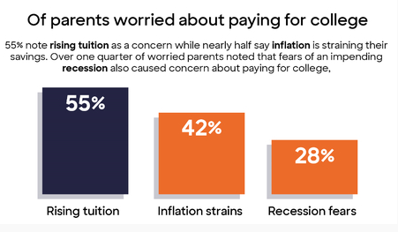
Less Debt, More Opportunities
Nationally....
42.8 million Americans owe more than $1.75 trillion in student loans (2024)
61% of college graduates had taken on student loan debt (2024)
Average debt of student loan holder is $37,853 (2024)
Safal Partners © 2024
Notes:
Clare
I think many of us here today understand the rising issue of student debt. A national survey from discover student loans, showed 66% of parents with 16–18-year-olds reporting that they are worried about paying for college, of these parents 55% cite rising tuition, 42% cite inflation strains, and 28% share fears of a recession. Nationally 42.8 million Americans owe a collective total of more than 1.75 trillion in student loans. 61% of college grades had taken out student loan debt with the average debt being 37, 853.
Fifty Percent of Parents With College Bound Children Have Saved Less Than $15,000 for Their Child’s Education | Business Wire

Slide 20
Benefits for Schools Involved in Apprenticeship
Apprenticeship programs connect students to colleges
Program sponsors, federal and state programs, and/or students can pay for related instruction
Sponsors can provide additional resources beyond tuition to support students and colleges (curriculum development, student supports, additional funding)
Notes:
Clare
While it’s often thought that student will go to either a career or college after school, apprenticeship has the ability to connect the two for students.
Apprenticeships help connect students to college while many programs offer college credits or degrees. Related instruction, the schooling portion of an apprenticeship, can be covered by program sponsors, many different federal or state program or the student is sometimes paying these costs. It can also be a combination of these. When there are costs associated, they tend to be much less than a traditional college education.
There can also be additional resources available to students and colleges through sponsors including curriculum development, supportive services, and additional funding.

Slide 21
Federal / State Funding for RI
Several programs can help pay for Registered Apprenticeship related instruction courses as local colleges, making it more attractive for local employers to participate. Examples include:
The Workforce Innovation and Investment Act (WIOA) (through Individual Training Accounts) / On-the-Job Training / Supportive Services )
Pell Grants (Up to $6,895 per Apprentice)
Federal Work Study Funds (average of $2,500 per Apprentice)
State Tax Credits and Tuition Support
GI Bill Benefits (for approved programs)
Notes:
Clare
There are several federal and state funding programs available to help with the costs of related instruction. This helps to make the programs more attractive to both students and employers to participate

Slide 22
Financial Support for Apprenticeship
Apprenticeship Tax Credit: For the first five eligible Apprentices claimed, employers may receive $3,000 per Registered Apprentice and $1,000 per Youth Apprentice
Sponsor Apprentice Incentive Reimbursement (SAIR) offers Sponsors up to $2,500 to offset the costs of Related Instruction (RI)
Maryland Business Works is an incumbent worker training program that provides up to $4,500 per apprentice
© 2024 Safal Partners
Notes:
Alan

Slide 23
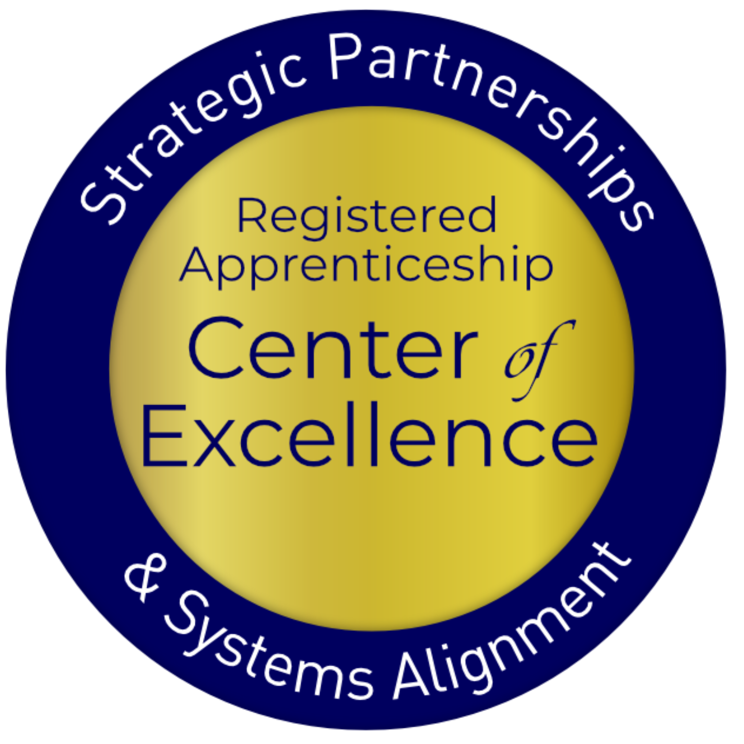
Employ Prince George’s ARPA Initiative
Allows job seekers to obtain credentials in Registered Apprenticeships and Pre-Apprenticeships through two initiatives: Apprenticeship Expansion Fund and the Apprentices Ready initiative.
The Apprenticeship Expansion Fund is a provides employers $2,500 - $5,000 per new employee placed into an apprenticeship.
Apprentices Ready Initiative pays for residents who don’t qualify for employment through an apprenticeship to receive pre-apprenticeship training and be paid $15 per hour during training.
© 2024 Safal Partners
Notes:
Alan

Slide 24
Leveraging Federal Support
Federal Discretionary Apprenticeship Funding
Funding | Amount
2016 Apprenticeship Accelerator | $200,000
2016 ApprenticeshipUSA plus Capbreaker | $2,000,000
2019 Expansion Grant | $2,854,797
2020 Expansion Grant | $6,012,924
Good Jobs Challenge | $22,900,000
2023 Expansion & Formula Grant | $6,650,620
Total Federal Apprenticeship Funding | $40,618,341
© 2024 Safal Partners
Notes:
Alan
Doesn’t include ARPA dollars that went to boards

Slide 25
Youth Apprenticeship Pathways- High School or College
Safal Partners © 2024
Notes:
Alan

Slide 26
High-School Aligned Apprenticeship Programs
Juniors or seniors eligible to apply for paid on-the-job training experience with an employer while receiving RI at school.
Embeds industry credentials in RI curriculum.
RI counts toward high school graduation requirements and potentially college credits, creating a seamless transition from secondary to post-secondary education.
Often acts as pre-apprenticeship programs that provide a pathway to a full RA program.
Safal Partners © 2024
Notes:
Alan
Five characteristics of a high-quality pre-apprenticeship program:
Partnership with registered apprenticeship program sponsors
Sustainability through partnerships
Meaningful training combined with hands-on experience replicating a workplace that does not displace paid employees
Access to career and supportive services
Increased access for underrepresented or underserved populations
Safal has developed a pre-apprenticeship module on the RA Academy which can be found here: https://rise.articulate.com/share/NaNHfXPRpo4CVc-tMcIXy_iN_n7P8Y7W#/

Slide 27
College-Aligned Youth Apprenticeship Programs
Available at vocational, community, and four-year colleges and generally for 18-24 year olds.
Embeds industry credentials in RI curriculum and oftentimes leads to the award of industry-recognized credentials.
RI counts towards college credits, enabling student to graduate.
Generally, a Registered Apprenticeship program that leads to the award of a DOL-issued certificate.
Safal Partners © 2024
Notes:
Alan

Slide 28
Developing Apprenticeship Pathways
Safal Partners © 2024
Notes:
Alan

Slide 29
Key Questions
What occupations does local labor market information show are in high demand and what interests youth?
What partnerships do we need? What partners do we already have that can support a program?
How will we integrate industry needs/occupation requirements into our RI?
How will we create a Dual/Concurrent Enrollment plan (for high school apprentices)?
How will we ensure RI and OJT count toward both high school graduation and RA program requirements (for high school apprentices)?
Safal Partners © 2024

Slide 30
Gen Z- They’re Interested in Different Occupations
Sustainable Energy Specialist
Digital Content Creator
Health and Wellness Coach
Cybersecurity Analyst
App Developer
Social Impact Consultant
User Experience (UX) Designer
Remote Work Specialist
E-Sports Professional
Mental Health Professional
Safal Partners © 2024
Notes:
LinkedIn survey- these are all apprenticeable occupations
My challenge for you- can you identify what your students want?

Slide 31
But They are Also the “Toolbelt Generation”
Young adults interested in trades career
Pay increase for new construction hires vs. 2.7% in professional services.
Students studying construction trades rose from 2018 to 2024
Vocational-focused community colleges increase in enrollment
More electricians than 2014 - median age fell by 2.9 years.
Optimistic about job security and believe they won’t be replaced by AI - Thumbtack
Source: Wall Street Journal
Safal Partners © 2024
Notes:
47 percent of young adults are interested in pursuing a career in the trades.
From 2018 to 2024, the number of students studying construction trades rose by 23%, with those in HVAC and vehicle maintenance programs increasing by 7%.
There are 229,000 more electricians than a decade ago though their median age fell by 2.9 years.
The median pay for new construction hires grew by 5.1% to $48,089 last year, compared to a 2.7% increase in professional services.
Vocational-focused community colleges saw a 16% increase in enrollment last year, the highest increase since tracking began.
Many of these professions are considered “AI-proofed” and less likely to be replaced. A survey by Thumbtack found 95 percent are optimistic about their job security and believe they won’t be replaced by AI.
Wall Street Journal Article: https://www.wsj.com/lifestyle/careers/gen-z-trades-jobs-plumbing-welding-a76b5e43
The last bullet point is by Thumbtack: https://press.thumbtack.com/announcements/new-report-from-thumbtack-examines-forces-behind-skilled-trade-labor-shortage-offering-optimistic-outlook-for-the-future/

Slide 32
What Can Each Partner Bring?
Businesses, trade organizations, and chambers of commerce identify needed skills, provide on-the-job training, and employ apprentices.
Schools help design curriculum, provide classroom instruction, and facilitate student recruitment.
Workforce boards can help recruit apprentices, offer funding, and connect partners.
State agencies develop curriculum frameworks, provide guidance on laws/regulations, and offer funding.
Community organizations assist with student recruitment, academic support, funding, and program oversight.
Safal Partners © 2024
Notes:
Alan

Slide 33
Key Organizational Apprenticeship Roles
Sponsor
Employer
RI Provider
Partner
An organization that agrees to operate an apprenticeship program and in whose name the program is registered.
Hires and provides paid OJL for apprentices under supervision of a designated mentor who is a skilled professional in that occupation.
Entity that provides instruction to apprentices in the designated occupation’s core knowledge, skills, and abilities.
Organizations committed to assisting RA programs. They can play one or more roles.
Notes:
Alan
My challenge for you- what role can you provide

Slide 34
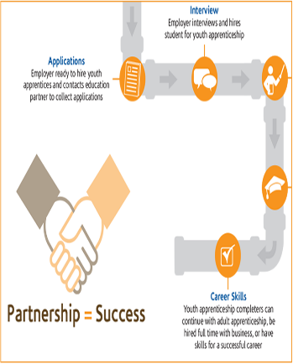
State and Local Partners to Work With
Maryland State Department of Education (MSDE)
Maryland Department of Labor
Local Education Agencies (LEA)
Maryland Apprenticeship Training Council (MATC)
Youth Apprenticeship Advisory Council (YAAC)
Maryland Department of Commerce
Youth Apprenticeship Sponsors/ Employers
Blueprint CTE Committee
© 2024 Safal Partners
Notes:
Alan

Slide 35
Align with CTE Standards and Ensure Hands-On Training
Align Curriculum with Industry Needs: Incorporate CTE standards by aligning the curriculum with current industry needs.
Integrate Work-Based Learning: Embed work-based learning opportunities within CTE programs, allowing students to gain hands-on experience in real- world settings
Collaborate with Industry Partners: Partner with local businesses to design apprenticeship programs that meet both educational and industry requirements.
Incorporate Industry-Recognized Credentials: Include industry-recognized credentials in apprenticeship programs to validate students’ skills and competencies according to CTE standards.
Safal Partners © 2024
Notes:
Alan

Slide 36
Enabling Dual/Concurrent Enrollment Plan
The Urban Institute has outlined a six-step process for achieving dual-enrollment and youth apprenticeship:
Publicly state the equity goal and report progress toward it.
Monitor course quality and ensure credit articulation.
Remove financial barriers for apprentices.
Ensure equal access to courses and pathways.
Recruit and support a diverse cadre of well-qualified instructors.
Give all students information and support to enable them to navigate career pathways.
Safal Partners © 2024
Notes:
Alan
JFF: https://www.jff.org/dual-transformation-in-dual-enrollment/
JFF has worked to develop the dual enrollment model Developing shared regional dual enrollment agreements (as opposed to the typical one-to-one agreements between colleges and high schools) to ensure equitable access for students, regardless of their home district’s ability to negotiate a favorable partnership agreement;
Creating staffing models that solve for the shortage of qualified dual enrollment instructors and allow instructors to travel flexibly across districts, increasing student access to a range of dual enrollment courses;
Collapsing course catalogs and only offering dual enrollment courses that meet our definition of strategic to ensure students are earning the most valuable college credit and address major challenges in applicability, articulation, and portability of credits;
Focusing on recruiting students underrepresented in higher education to close the persistent gaps students face in accessing and successfully completing dual enrollment.

Slide 37
Ensuring High-School Students Receive Credit
Synchronize Curriculum with Graduation Objectives: Collaborate with local school districts to ensure the apprenticeship curriculum meets high school graduation requirements.
Dual Enrollment and Credit Recognition Agreements: Create dual enrollment agreements that allow apprentices to earn high school credits for both RI and OJT components of their apprenticeship.
Performance-Based Assessments: Integrate assessments that align with both high school and apprenticeship standards.
Consistent Tracking: Ensure apprenticeship coordinators, school counselors, and educators track apprentices' progress and ensure all requirements are met.
Safal Partners © 2024
Notes:
Alan
It is crucial that these steps are followed to also ensure high school students can transition into Registered Apprenticeship programs after they graduate.
My challenge to you is: Can you create this system? What partners do you need? What plan can you put in place

Slide 38
Youth Apprenticeship Examples
Safal Partners © 2024
Notes:
Clare

Slide 39
Howard County Community College
Serves as a Sponsor of Registered Apprenticeship Programs.
Offers apprenticeships in 11 different fields (HVAC, IT, Hospitality, Child Care, Licensed Practice Nurse, etc.) and provides the related instruction for these occupations.
Partners with several different employers to provide OJT, including the University of Maryland Medical Center, MedStar Health, Associated Builders & Contractors of Greater Baltimore, Johns Hopkins and others.
Has a close relationship with the local workforce board and workforce system.
Utilizes funds from employers and local and state grants to support their programs.
Safal Partners © 2024
Notes:
Alan
If you’ll recall on slide 28 regarding the roles

Slide 40
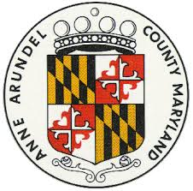
Anne Arundel County
The Anne Arundel County Public Schools (AACPS) work with businesses to develop high school apprenticeship programs, ensuring they meet the MD Labor’s Youth Apprenticeship Standards.
If AACPS cannot directly provide the instruction, they collaborate with businesses to find relevant programs through Anne Arundel Community
College or outside training providers.
Anne Arundel Workforce Development Corporation (AAWDC) provides support for candidate recruitment, interviews, and funding applications, helping to streamline the process for businesses.
The program offers apprenticeships in various industries, including National Security, Transportation, Technology, Insurance, and Construction.
Safal Partners © 2024
Notes:
Alan
If you’ll recall on slide 28 regarding the roles

Slide 41
Harford County
As of 2021, Harford County Public Schools (HCPS) had one of the highest percentages (21.6%) of students receiving industry credentials or completing youth apprenticeship programs among Maryland school district.
HCPS partners with Harford Community College to offer free workforce opportunities for high school seniors, allowing them to ern industry-recognized credentials.
HCPS was awarded $1,000,000 in funding to bolster its Apprenticeship Maryland Program by strengthening infrastructure for sustainable apprenticeship opportunities.
Safal Partners © 2024
Notes:
Alan
If you’ll recall on slide 28 regarding the roles

Slide 42
Workforce Boards: The Key Ingredient
Safal Partners © 2024

Slide 43
How Workforce Boards Can Help Education Providers
Provide WIOA Individual Training Account (ITA) funding to support apprentices' RI costs
Make connections with employers, sponsors
Host convenings between education and industry
Provide pipeline of Opportunity Youth to enroll in programs
Add programs to the Eligible Training Provider List (ETPL)
Support the development of RI curriculum using labor market information and industry standards
Safal Partners © 2024

Slide 44
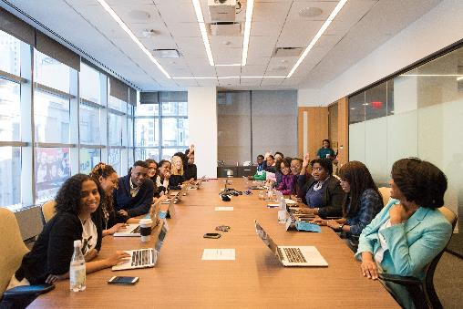
How Workforce Boards Can Help Employers/Sponsors
Provide a pipeline of Opportunity Youth Apprentices:
Publicize RA program opening
Screen candidates
Provide pre-apprenticeship training
Provide supportive services to Opportunity Youth
Provide WIOA OJT contract funding to support percentage of apprentice wages
Build partnerships w/training providers on ETPL for RI; utilize ITAs to pay for all/portion of apprentices' RI costs
Support registering and implementing RA programs
Host convenings (job fairs, recruiting events, etc.) to connect potential apprentices and employers
Safal Partners © 2024

Slide 45
How Workforce Boards Can Help Community-Based Organizations
Provide education on RA
Connect potential apprentices with employers
Provide supportive services to apprentices
Connect potential apprentices to other resources available within the community
Leverage funding programs
Safal Partners © 2024

Slide 46
Get to Know Your Workforce Board
Each Workforce Board has:
Sector strategies: priority occupations and key industries
Policies on OJT contracts, which WIOA and non-WIOA funding "buckets" and services they will apply to RA
Funding levels, fiscal year cycle and how quickly they anticipate spending funds
Supportive services offered and how that maps to your program's needs
Candidate pool – IS and OS Youth Programs
ETPL program registration process
Safal Partners © 2024
Notes:
Different Examples
Incumbent Worker Funding – specific to occupations and key industries
WIOA eligibility – different requirements for different customer groups
Funding levels – important to know the fiscal cycle, and when they anticipate spending funds so you can align on funding opportunities with your program enrollment

Slide 47
Contact Us, Become a Partner
Scan for Partner Form
Receive no-cost expert TA, materials, and assistance
Network with potential partners nationwide
Be nationally recognized for your work
Notes:
We want to thank all of you for joining us today. We appreciate your participation.
We’d like to encourage you to become a partner with the Center of Excellence if you have not signed up yet. Please take a moment to scan the QR code on the screen. As a partner you have the opportunity to receive no-cost technical assistance and materials, network with partners nationwide, and be nationally-recognized for your work.

Slide 48
Thank You for Joining Us
Email us your questions at RA_COE@SafalPartners.com
For more information, visit: dolcoe.safalapps.com

