Slide 1
How the Investing in America Agenda Can Provide Registered Apprenticeship Pathways for Opportunity Youth
PA Workforce Leaders Symposium September 17, 2024
March 2024

Slide 2


Presenters
Alan D. Dodkowitz
Senior Subject Matter Expert
Safal Partners

Slide 3
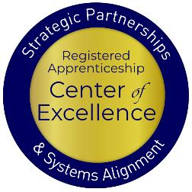
Welcome and Agenda
Center of Excellence Overview
An Overview of Opportunity Youth
How Apprenticeships Can Serve Opportunity Youth
Ways the Investing in America Agenda Can Connect Opportunity Youth to Apprenticeships
The Role of the Workforce System
Questions and Wrap Up
Safal Partners © 2024

Slide 4

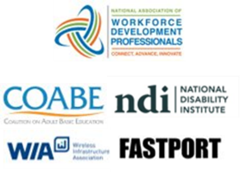

Center of Excellence Overview
U.S. DOL initiative to increase systems alignment across apprenticeship, education, and workforce
Led by Safal Partners
  Collaboration with 5 national partners
We provide no-cost TA including:
  Monthly webinars
  Quarterly virtual office hours
  Individual TA/coaching sessions
  Online resources (desk aids, guides, frameworks, etc.)
Visit our website & request TA
Notes:
Safal was awarded the opportunity to lead the US DOL Registered Apprenticeship Technical Assistance Center of Excellence for Strategic Partnerships and Systems Alignment in 2021.
We are here to help close the gap between the apprenticeship and workforce systems and accelerate partnerships across education, economic development, and other partners to increase adoption of RA nationwide.
The Center is supported by five national partners including the National Association of Workforce Development Professionals, the Coalition on Adult Basic Education, the National Disability Institute, FASTPORT, and the Wireless Infrastructure Association.
Our national partners were strategically chosen to help us reach specific groups whether on the workforce, education or employer side
California Workforce Association (CWA) is our partner in the state, helping increase workforce system awareness and utilization of RA as a workforce solution for both employers and jobseekers.
The Center of Excellence provides no-cost technical assistance – online, in-person and through hybrid delivery - to accelerate sustainable partnerships and align apprenticeship, workforce and education systems.

Slide 5
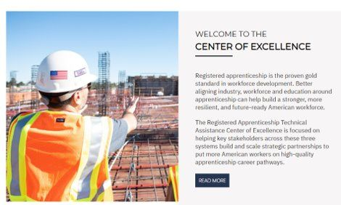
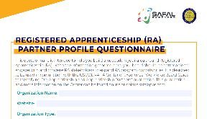

Online Resources, On-Demand TA
Registered Apprenticeship Partner Profile Questionnaire
https://dolcoe.safalapps.com/resources/resourcesandtools
Notes:
Our website is continually updated with relevant news, TA resources and tools including frameworks, case studies, webinars, customizable templates, questionnaires, and more.
Since 2021 more than 3,000 organizations have become no-cost Center partners and utilized our tools – such as the "RA Partner Profile Questionnaire" - to accelerate their organizations' understanding and effective usage of RA.
Link to Questionnaire - https://dolcoe.safalapps.com/sites/default/files/2022-11/Partnership%20Questionnaire.pdf
This questionnaire is intended to help you build a network in your area around Registered Apprenticeship (RA). With the information gathered here, your board should be better able to engage with and convene RA stakeholders to expand RA program opportunities. It is designed to be used in conjunction with the USDOL RA TA Center of Excellence “Workforce Board Guide to Identifying Pre-Apprenticeship and Apprenticeship Partners” publication. This publication and more information on the Center can be found online at dolcoe.safalapps.com﻿

Slide 6
Opportunity Youth:
Meeting Them Where They Are with Innovative Solutions
Safal Partners © 2024

Slide 7
Opportunity Youth Defined
Young people between the ages
of 16 and 24 who are
neither enrolled in school
nor participating in the labor market.
Safal Partners © 2024

Slide 8
Challenges They Face
Disability: Over 16% of disconnected youth have a disability, while only 5% of connected youth face similar challenges.
Expectant and Parenting Youth and Young Adults: Approximately 28% of opportunity youth are expectant or parenting- four times more likely to be mothers than their connected counterparts.
Homelessness: A significant portion of youth experiencing homelessness are also disconnected from school due to substantial disruptions in their education.
Incarceration: Youth with a history of incarceration face an elevated risk of disconnection from their communities, with a higher representation of Black individuals (12%) compared to white peers (7%).
Impoverished: Nearly twice as likely to live in poverty. Individuals from high-poverty areas are significantly more likely (21%) to be opportunity youth compared to their peers from low-poverty areas (6%).
Safal Partners © 2024

Slide 9
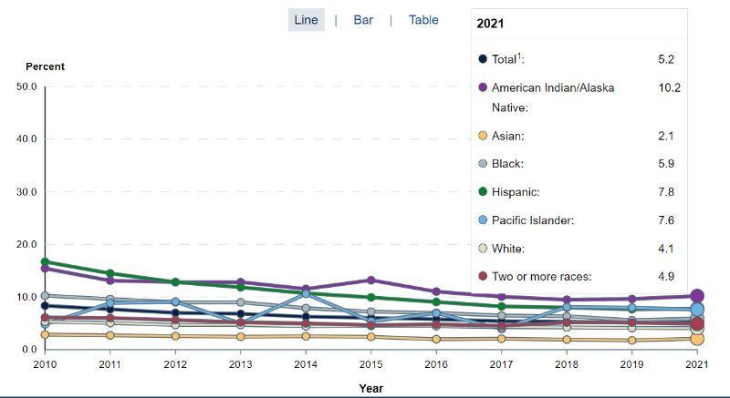
Opportunity Youth… The Numbers
Estimate in 2021: 1.9 million students dropped out of high school… (3.46m in 2016)
16-24 years olds
https://nces.ed.gov/
Safal Partners © 2024

Slide 10
What Did this Info Tell Us?
Were we effectively working with all youth populations?
Were we working with the right organizations?
Were we meeting youth where they were or asking them to walk thru our doors?
Was our staffing and experience effective in engaging youth populations?
Where were we lacking funding and partnerships to serve opportunity youth?
Were we missing data?
Safal Partners © 2024

Slide 11
Apprenticeship…
A Way to Engage Opportunity Youth
Safal Partners © 2024

Slide 12

What is Registered Apprenticeship?
Registered Apprenticeship is a proven, customizable, and structured model to find and train diverse
new talent as well as upskill current workers in critical occupations.
Safal Partners © 2024

Slide 13



Five Core Components of RA
Employer Involvement
Structured On-the-Job Learning (OJL)
Related Instruction (RI)
Rewards for
Skill Gains
National Occupational Credential
Safal Partners © 2024

Slide 14

Apprenticeships for Opportunity Youth
Connection to employment AND education.
Career pathway beyond RA Program completion for occupations that provide a family-supporting wage. ​​
​Roadmap to credential, certification, and degree attainment.
Connection to mentors who can offer support
and guidance.
Linkages to critical supports to assist them in
their learning and earning pathway.
Safal Partners © 2024

Slide 15
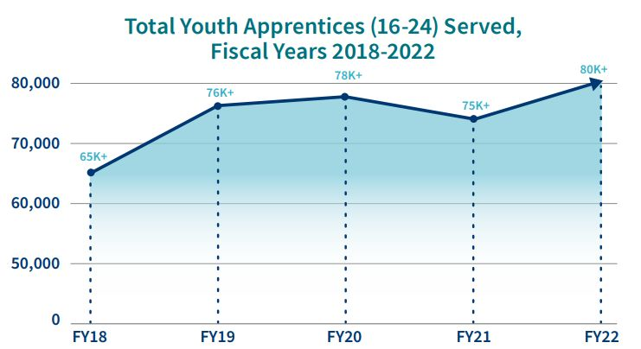
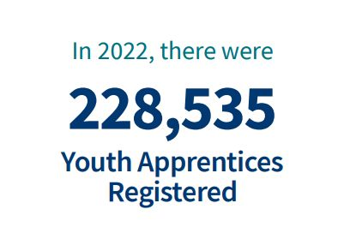
Apprenticeships for Youth
https://www.apprenticeship.gov/
Safal Partners © 2024

Slide 16
The Investing in America Agenda and Opportunity Youth…
A Match Made for Each Other
Safal Partners © 2024

Slide 17

What is the Investing in America Agenda
The Investing in America Agenda - consists of extensive resources and rules to support the advancement of Registered Apprenticeship:
  The Bipartisan Infrastructure Bill
  $550 billion in new funds for infrastructure.
  The CHIPS and Science Act
  $52.7 billion for American semiconductor research, development, manufacturing, and workforce development.
  The American Rescue Plan
  $1.9 trillion recovery bill with more than $40 billion for workforce development.
  The Inflation Reduction Act
  Nearly $1.2 trillion in incentives for green energy and
  increased Affordable Care Act (ACA) subsidies.
Safal Partners © 2024

Slide 18
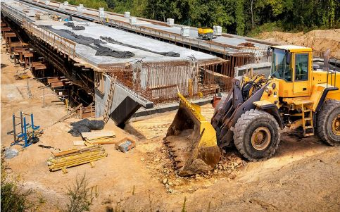
The Bipartisan Infrastructure Law
Safe Streets and Roads for All (SS4A) Grant program:
$1 billion to enhance roadway safety and includes pre-apprenticeship, apprenticeship readiness, and youth service initiatives, with a clear path towards registered apprenticeships.
Building Pathways to Infrastructure Jobs Grant Program:
Supports enhanced training models in H-1B industries and focuses on sectors like advanced manufacturing, information technology, professional services, supporting renewable energy, transportation, and broadband infrastructure.
Workforce Development:
Expands existing workforce development programs
encompassing trade schools, community colleges, and union
training programs in Registered Apprenticeship. Participants
gain expertise in conducting energy assessments for small-
and mid-sized manufacturing businesses.
Safal Partners © 2024

Slide 19

The Bipartisan Infrastructure Law 2
National Electric Vehicle Infrastructure Formula Program:
Provides $5 billion to states to strategically deploy electric vehicle (EV) charging infrastructure and to establish an interconnected network to facilitate data collection, access, and reliability. States are using NEVI funds for Registered Apprenticeship.
Grid Resilience and Innovation Partnerships (GRIP) Program:
Includes $10.5 billion to enhance grid flexibility and improve the resilience of the power system against growing threats of extreme weather and climate change. Substantial opportunities are included for Registered Apprenticeship
for opportunity youth to conduct this work.
Safal Partners © 2024

Slide 20
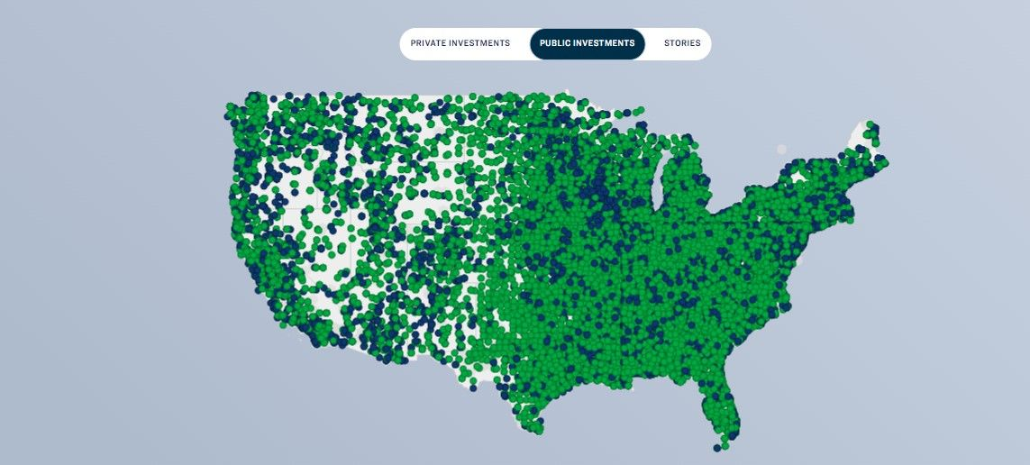
Over $400 Billion in Public Infrastructure Investments So Far!
Safal Partners © 2024

Slide 21
An Investment Boom that Needs Workers: Construction
The industry faces an enormous skills gap given the $10 trillion global construction output, with a need to build 13,000 buildings each day between now and 2050 to support an expected population of 7.7 billion people living in cities.
The McKinsey Global Institute estimates that, by 2030, there will be up to 200 million construction jobs worldwide.
Overall employment in construction and extraction occupations is projected to grow about as fast as the average for all occupations from 2022 to 2032.
About 646,100 openings are projected each year, on average, in these occupations due to employment growth and the need to replace workers who leave the occupations permanently.
2023: The number of open, unfilled jobs in the overall construction industry totaled 300,000 to 400,000 positions.
Construction and Extraction Occupations :
Occupational Outlook Handbook: :
U.S. Bureau of Labor Statistics (bls.gov)
Spring 2023 construction labor market report (hbi.org)
www.rics.org
Safal Partners © 2024

Slide 22

The CHIPS and Science Act
Regional Innovation and Technology Hubs:
These hubs will create jobs, spur regional economic development, and position communities throughout the country to lead in high-growth, high-wage sectors such as artificial intelligence, advanced manufacturing, and clean energy technology.
CHIPS for America Workforce and Education Fund:
The Fund is $200 million and provides $25 million for Fiscal Year (FY) 2023, $25 million for FY2024, and $50 million for each fiscal year 2025-2027.
Embedding Apprenticeship Within the Incentives Program:
Companies seeking funding via the CHIPS Incentives Program
must submit workforce development plans for facility operators
and construction workers, with applicants committing to hiring
individuals who complete training programs and to consider
partnerships with various skill-building programs, including
Registered Apprenticeships, pre-apprenticeships, community
and technical college programs, high school career pathways
and paid work-based learning initiatives in the semiconductor
industry.
Safal Partners © 2024

Slide 23
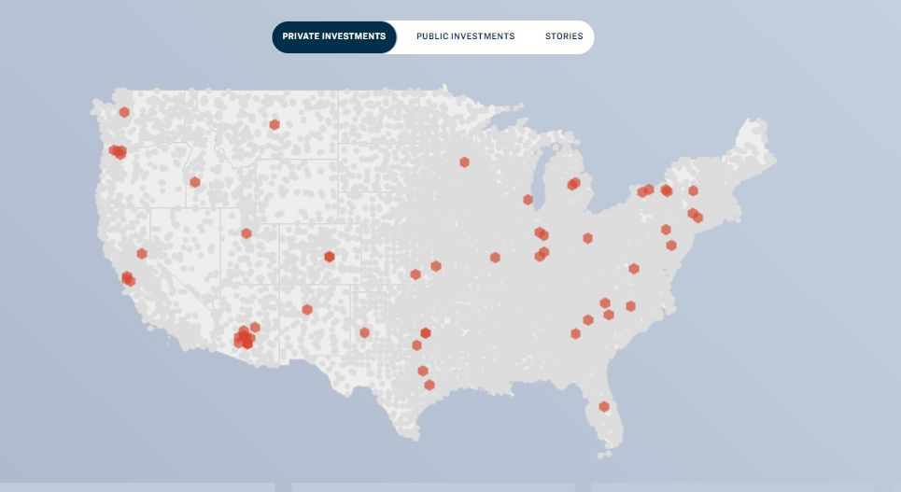
$395 Billion in Semiconductor Manufacturing!
Safal Partners © 2024

Slide 24
An Investment Boom that Needs Workers:
IT and Cybersecurity
Global cybersecurity job vacancies grew by 350 percent, from one million openings in 2013 to 3.5 million in 2021, according to Cybersecurity Ventures.
The number of unfilled jobs remains at 3.5 million in 2023, with more than 750,000 of those positions in the U.S.
Industry efforts to source new talent and tackle burnout continues, but we predict that the disparity between demand and supply will remain through at least 2025.
The computer systems design and related services industry is the eighth fastest growing industry, growing at a rate of 1.8 percent annually over the 2022-32 decade. This industry is also seen adding 474,800 jobs over the projections period, the second most of any industry.
Employment Projections: 2022-2032 Summary - 2022 A01 Results (bls.gov)
Since 2021, semiconductor employment has increased an average of 4.3% per year to over 203,000 workers in 2023.
U.S. Semiconductor Jobs are Making a Comeback
Cybersecurity Jobs Report: 3.5 Million Unfilled Positions In 2025 | AP News
Safal Partners © 2024

Slide 25

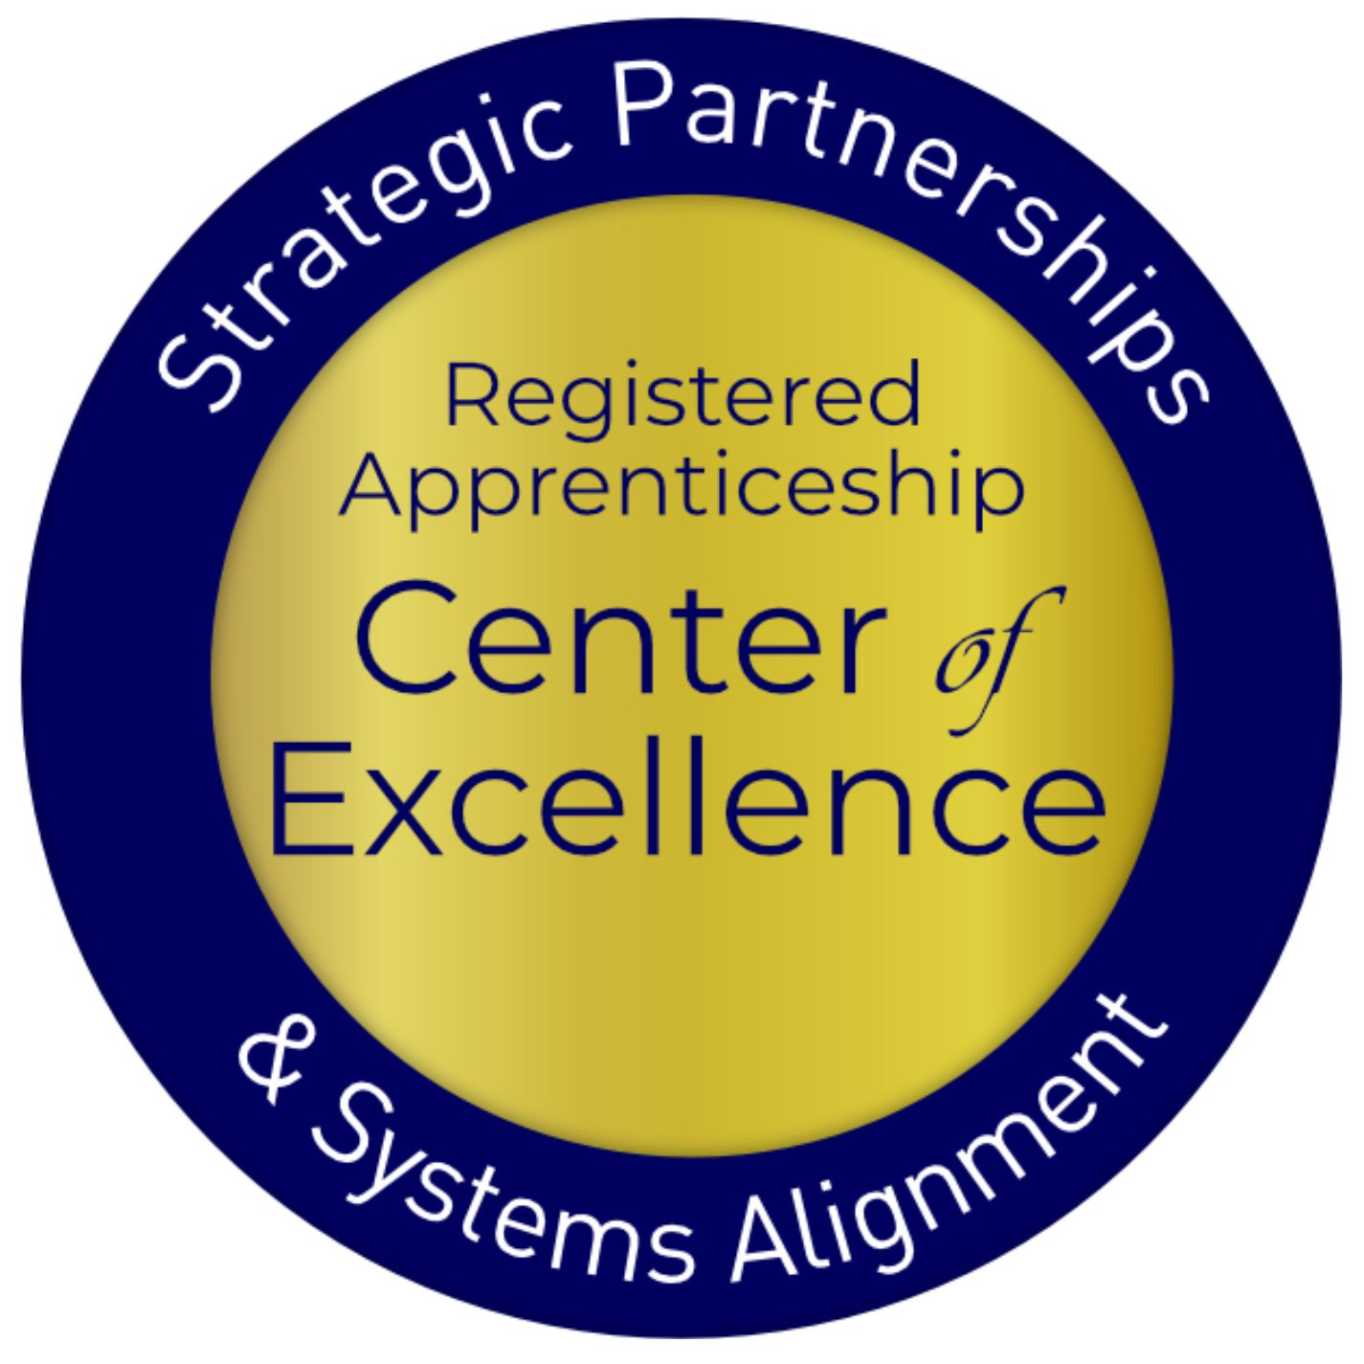
The Inflation Reduction Act (IRA)
Labor Hours Requirements:
Ten separate tax credits in the IRA note that employers who access these funds must set aside a minimum of 15% of their labor hours for apprentices.
National Clean Investment Fund:
$14 billion to provide grants to 2–3 national nonprofit clean financing institutions to provide accessible, affordable financing for tens of thousands of clean technology projects across the country with a goal of supporting Registered Apprenticeship.
Domestic Manufacturing Conversion Grants:
$2 billion for applicants must commit to signing a project labor agreement that includes precise objectives related to investing in workforce
education and training and using registered apprentices and
creating opportunities for local workers to participate in the
construction project.
Safal Partners © 2024
Notes:
Alan

Slide 26

The Inflation Reduction Act 2
Environmental and Climate Justice Community Change Grants:
$2 billion in grants available to support community-driven projects that deploy clean energy. Grantees will be awarded based on the inclusion of pre-apprenticeships or Registered Apprenticeship Programs, that are worker-centered, demand-driven, and lead to good jobs.
Clean Communities Investment Accelerator:
$6 billion to establish hubs that provide funding and technical assistance to community lenders working in low-income and disadvantaged communities, providing an immediate pathway to deploy projects in those communities while also building capacity of hundreds of community lenders to finance projects for years.
Latest and Zero Building Energy Code Adoption:
$1 billion for States and units of local government with the
authority to adopt building energy codes to adopt and implement
the latest building energy code. States are expected to include
plans to engage opportunity youth with Registered Apprenticeship
a particular area.
Safal Partners © 2024

Slide 27
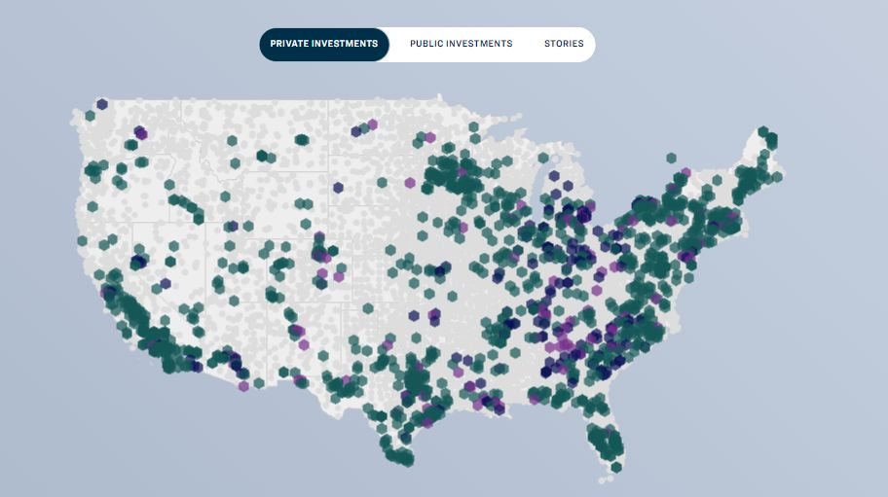
$412 Billion in Clean Energy Manufacturing!
Safal Partners © 2024

Slide 28
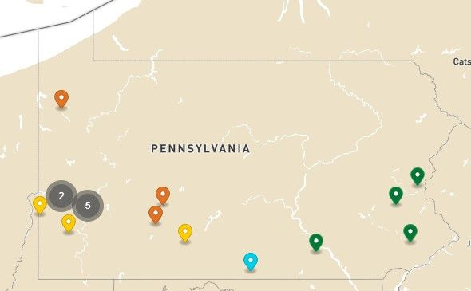
Clean Energy Investments in PA
Safal Partners © 2024

Slide 29
An Investment Boom that Needs Workers:
Manufacturing and EV
Stronger demand for electric vehicle batteries and energy battery storage systems is expected to result in rapid employment growth in battery production.
That growth is evident in the other electrical equipment and component manufacturing industry, with the fastest growth at a rate of 3.0 percent annually over the projections period, gaining 52,700 jobs over the decade.
Investment. Over the last 9 years, manufacturers have announced $188 billion in concrete investment in U.S. EV and EV battery manufacturing facilities. Federal policies have dramatically expanded and accelerated these investments: 61 percent of announced EV investments have occurred in the last 18 months since passage of the Inflation Reduction Act (IRA) and 82 percent have occurred in the last 27 months since passage of the Bipartisan Infrastructure Law (BIL).
Jobs. EV and battery manufacturing could also generate up to 876,000 additional jobs in indirect/secondary employment.
.
An aging manufacturing workforce requires workers. Upwards of 2.1 million manufacturing jobs will be unfilled in 2030.
EDF_US_EV_Manufacturing_Investments_Spring2024.pdf
Diversity, Equity and Inclusion Key to Filling High-Skilled Manufacturing Jobs
Safal Partners © 2024

Slide 30
IIA Needs Apprentices and is Making a Big Impact on Pennsylvania
Safal Partners © 2024

Slide 31
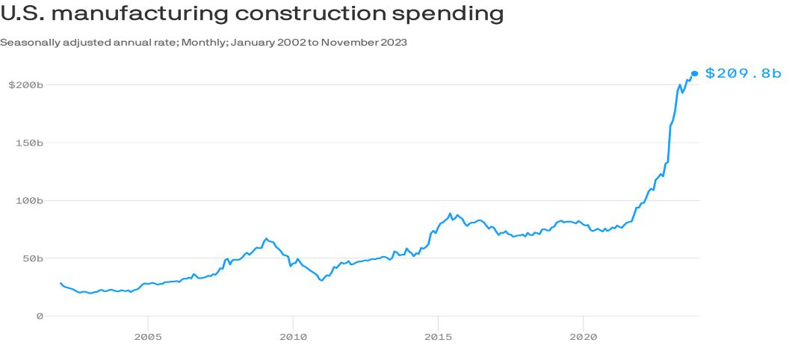
An Investment Boom for Apprentices
Safal Partners © 2024

Slide 32

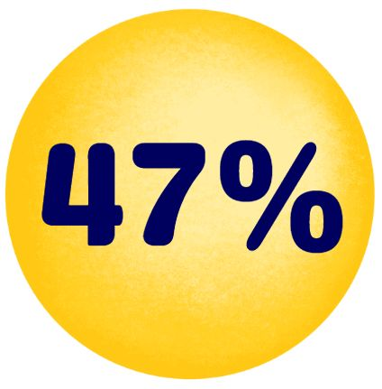
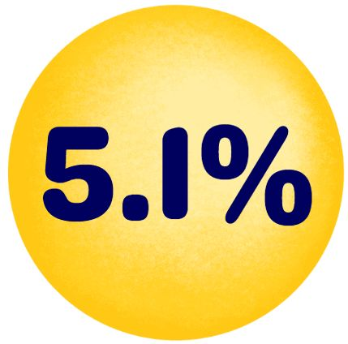
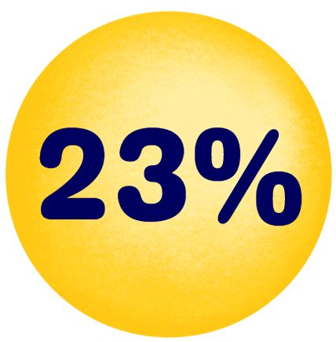
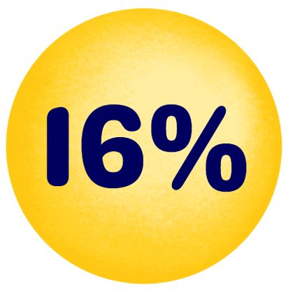

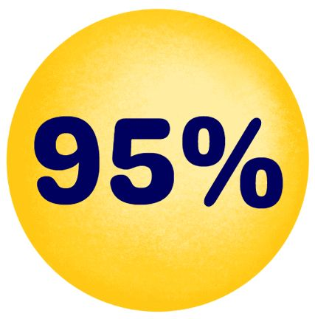
Good Jobs for the “Toolbelt Generation”
Young adults interested in trades career
Pay increase for new construction hires vs. 2.7% in professional services.
Students studying construction trades rose from 2018 to 2024
Vocational-focused community colleges increase in enrollment
More electricians than 2014 - median age fell by 2.9 years.
Optimistic about job security and believe they won’t be replaced by AI - Thumbtack
  Source: Wall Street Journal
Safal Partners © 2024
Notes:
47 percent of young adults are interested in pursuing a career in the trades.
From 2018 to 2024, the number of students studying construction trades rose by 23%, with those in HVAC and vehicle maintenance programs increasing by 7%.
There are 229,000 more electricians than a decade ago though their median age fell by 2.9 years.
The median pay for new construction hires grew by 5.1% to $48,089 last year, compared to a 2.7% increase in professional services.
Vocational-focused community colleges saw a 16% increase in enrollment last year, the highest increase since tracking began.
Many of these professions are considered “AI-proofed” and less likely to be replaced. A survey by Thumbtack found 95 percent are optimistic about their job security and believe they won’t be replaced by AI.
Wall Street Journal Article: https://www.wsj.com/lifestyle/careers/gen-z-trades-jobs-plumbing-welding-a76b5e43
The last bullet point is by Thumbtack: https://press.thumbtack.com/announcements/new-report-from-thumbtack-examines-forces-behind-skilled-trade-labor-shortage-offering-optimistic-outlook-for-the-future/

Slide 33
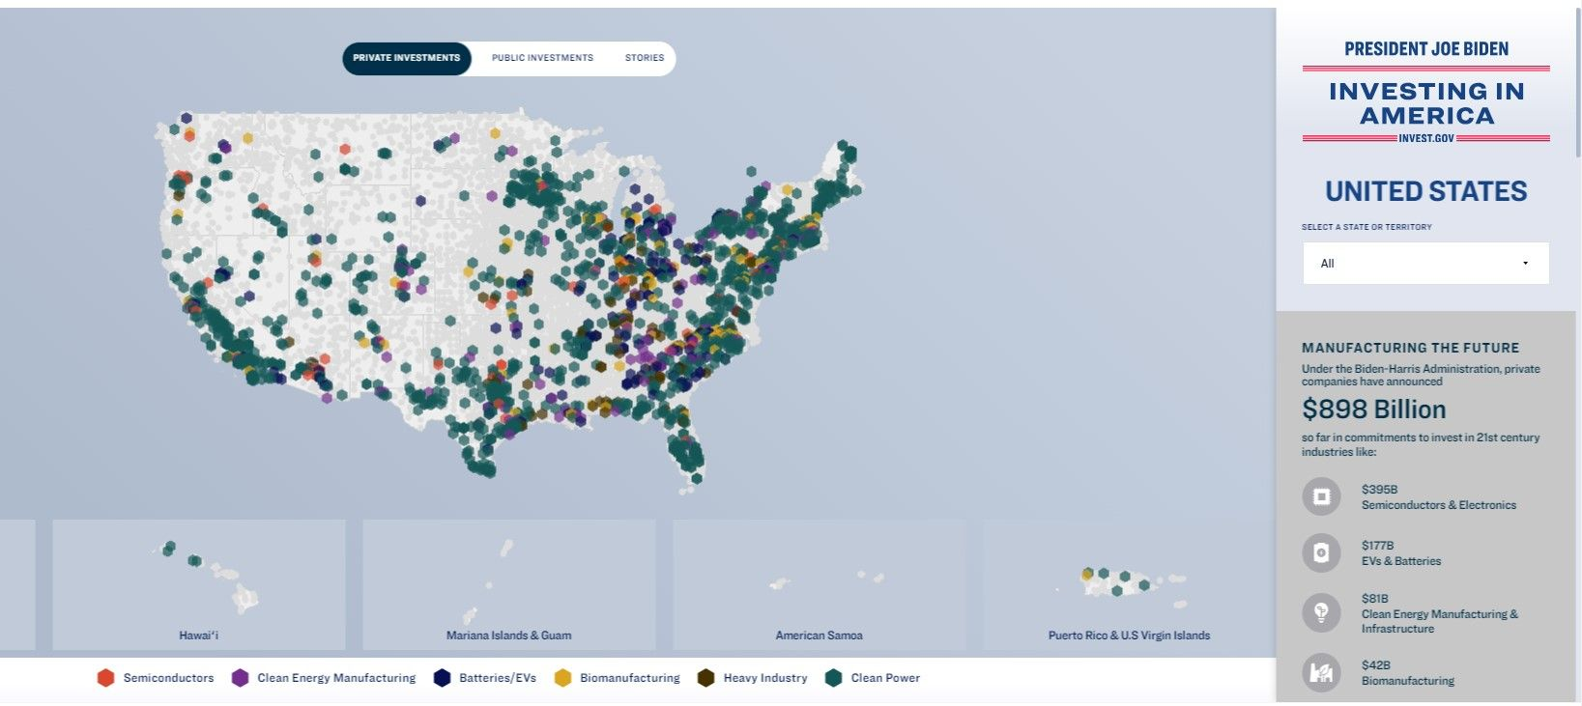
IIA is Investing in the Future
Build a Holistic Workforce System!
Think “FUTURE”!
Partner with NEW Partners!
Safal Partners © 2024

Slide 34

Massive Opportunities for Pennsylvania
Pittsburgh is one of nine workforce hubs and create Over 1,000 new jobs to expand apprenticeship programs in industries spurred by the Investing in America Agenda.
Eos Energy Enterprises is investing $500 million to expand its battery manufacturing operations in Turtle Creek, Pennsylvania, creating 1,000 new jobs.
The Department of Energy is awarding up to $750 million to the Mid-Atlantic Hydrogen Hub, covering Pennsylvania, Delaware, and New Jersey.
Through an investment of $858 million from the Bipartisan Infrastructure Law, the U.S. Army Corps of Engineers has broken ground on a project to upgrade and expand the nearly century-old Montgomery Locks near Pittsburgh – one of the oldest locks on the Ohio River.
Over $4.4 billion in new private investments for Pennsylvania!
Pennsylvania IIA Fact Sheet
Safal Partners © 2024

Slide 35
Workforce Boards…
The Key Ingredient
Safal Partners © 2024

Slide 36

How Workforce Boards Can Help Education Providers
Provide WIOA Individual Training Account (ITA) funding to support apprentices' RI costs.
Make connections with employers, sponsors.
Host convenings between education and industry.
Provide pipeline of Opportunity Youth to enroll in programs.
Add programs to the Eligible Training Provider List (ETPL).
Support the development of RI curriculum using labor market information and industry standards.
Safal Partners © 2024

Slide 37
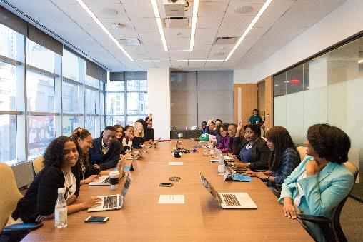
How Workforce Boards Can Help Employers/Sponsors
Provide a pipeline of Opportunity Youth Apprentices:
  Publicize RA program opening
  Screen candidates
  Provide pre-apprenticeship training
Provide supportive services to Opportunity Youth.
Provide WIOA OJT contract funding to support percentage of apprentice wages.
Build partnerships w/training providers on ETPL for RI; utilize ITAs to pay for all/portion of apprentices' RI costs.
Support registering and implementing RA programs.
Host convenings (job fairs, recruiting events, etc.) to connect potential apprentices and employers.
Safal Partners © 2024

Slide 38

How Workforce Boards Can Help Community-Based Organizations
Provide education on RA.
Connect potential apprentices with employers.
Provide supportive services to apprentices.
Connect potential apprentices to other resources available within the community.
Leverage funding programs.
Safal Partners © 2024

Slide 39

Get to Know Your Workforce Board
Each Workforce Board has:
  Sector strategies: priority occupations and key industries.
  Policies on OJT contracts, which WIOA and non-WIOA funding "buckets" and services they will apply to RA.
  Funding levels, fiscal year cycle and how quickly they anticipate spending funds.
  Supportive services offered and how that maps to your program's needs.
  Candidate pool – IS and OS Youth Programs.
  ETPL program registration process.
Safal Partners © 2024
Notes:
Different Examples
Incumbent Worker Funding – specific to occupations and key industries
WIOA eligibility – different requirements for different customer groups
Funding levels – important to know the fiscal cycle, and when they anticipate spending funds so you can align on funding opportunities with your program enrollment

Slide 40






More Opportunity than Ever!
Create New Perspectives on Partnerships
Devise Win-Win Collaboration Strategies
Innovate Outside Your Normal Box
Influence and Leverage New Funding
Expand Your Reach Into Communities
Safal Partners © 2024
Notes:
Different Examples
Incumbent Worker Funding – specific to occupations and key industries
WIOA eligibility – different requirements for different customer groups
Funding levels – important to know the fiscal cycle, and when they anticipate spending funds so you can align on funding opportunities with your program enrollment

Slide 41
Questions and Discussion
2024

Slide 42

Contact Us, Become a Partner
Scan for Partner Form
Receive no-cost expert TA,
materials, and assistance
Network with potential
partners nationwide
Be nationally recognized for your work

Slide 43
Email us your questions at RA_COE@SafalPartners.com
For more information, visit: dolcoe.safalapps.com
Safal Partners © 2024

