Slide 1
Help is Here! Federal Resources to Create Industry-Aligned Pre-Apprenticeship Programs
December 2024

Slide 2
Presenter
Katie Adams
Chief Delivery Officer
Safal Partners

Slide 3
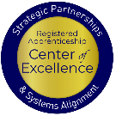
Center of Excellence Overview
U.S. DOL initiative to increase alignment across apprenticeship, education, and workforce systems
Led by Safal Partners; 5 national partners
We provide no-cost TA including:
Monthly webinars
Quarterly virtual office hours
Individual TA/coaching sessions
Online resources (desk aids, guides, frameworks, etc.) – dolcoe.safalapps.com
Visit our website, request TA
Notes:
Stacy

Slide 4
Assessing Your RA Knowledge 1
Basic
I know what it means, but I don’t know how to utilize it and don’t have significant experience with it.
Intermediate
I understand RA, I’ve had experience with RA in some capacity, and I feel comfortable educating internal and external stakeholders about it.
Expert
I have extensive knowledge and relevant experience developing and implementing programs and standards, recruiting apprentices, and convening stakeholders.

Slide 5
Getting Started: RA Basics and Benefits
Safal Partners © 2024

Slide 6
What Is Registered Apprenticeship (RA)?
A proven model of job preparation that combines paid on-the-job learning (OJL) with mentorship and coursework/“related instruction” (RI) to progressively increase workers’ skill levels and wages.
The most time-tested, industry-validated model for employers to recruit, train, upskill, and retain workers for critical occupations.

Slide 7
Spans all Sectors
Notes:
The registered apprenticeship model was honed by the building trades over the last century and they largely made it into what it is today. I like to mention that because so much of what we know about what makes apprenticeship successful comes from work in the building trades labor unions and labor-management partnerships. But now it's expanding into new industries and we have many more apprentices – across many sectors – in the United States. You can see a selection of them here in the slide. You can probably see industries that our learners are currently in or aspire to be in.
Within these sectors are a wide variety of careers, including entry-level positions in which apprentices can begin, accessing higher-prestige/higher-wage positions over time. If we can help our students prepare for and eventually access an RA program in these industries, they will have a good chance of staying employed and have the opportunity to advance over time.
While our students can and do go into a broad range of careers after completing their participation in Adult Education, frontline healthcare positions are some examples of in-demand occupations with clear career ladders or pathways that our students can access through registered apprenticeship. In New Mexico, we are beginning to talk about education apprenticeships, and these careers include not only teachers but also teachers' aides with pathways to becoming a licensed teacher, and positions like bus drivers.

Slide 8
Five Core Components of RA
Industry Led
Structured On-the-Job Learning & Mentorship
Related Instruction (RI)
Paid Job & Rewards for
Skill Gains
National Occupational Credential
Safal Partners © 2024

Slide 9
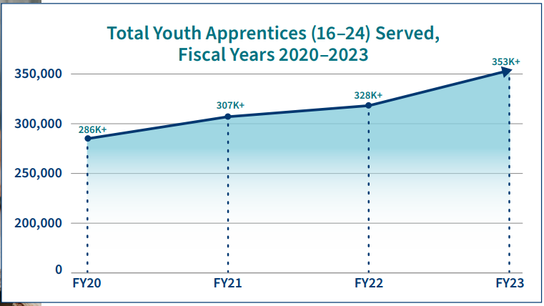
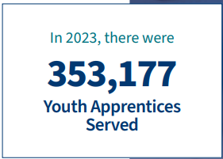
Growth of 16-24 Year Old Students in RA
Source: https://www.apprenticeship.gov/

Slide 10
RA Offers Clear Benefits for Students
Academically-linked career pathway
“Earn and learn” – training is paid while gaining work experience
Often leads to offer of full-time non-apprentice employment following program completion (94% of completers are retained)
Provides family-support wages, economic mobility
$80,000 average starting salary (U.S. DOL)
$300,000 higher lifetime earnings than non-apprentice peers (U.S. DOL)
Increases academic and industry-valued credential attainment
Lowers – or eliminates – potential student debt for post-secondary education
Notes:
It is critical to help students understand the benefits of registered apprenticeship. Students are often unaware that these opportunities exist, it is also common that their parents are unaware. So it is very crucial for staff interacting with students to share the opportunities as well as the benefits they bring.
These benefits include that registered apprenticeship is a career from the start and provides them a way to get paid while learning skills and obtaining work experience.
Registered apprenticeships are jobs, so after high school it can transition to full time employment for them or after the completion of the program depending on how the program is set up.
Some statics on earning from the US Department of labor show an increase in lifetime potential compared to their peers and apprentice completers have an average starting salary of 80,000 a year.
Apprentices also receive a national credential that is portable and can move with them.
On top of earning more in lifetime earnings than their peers, it can also help lower or even eliminate the cost of college.

Slide 11
Quality Pre-Apprenticeship Programs
Safal Partners © 2024

Slide 12
What is Pre-Apprenticeship?
A program or set of strategies designed to prepare individuals for entry into an RA program.
May vary in length and scope, and may include basic skills training, academic skills remediation, and industry awareness.
Completers may be accorded preferential consideration for direct entry into an apprenticeship program and/or apply coursework and experience toward RA program requirements through CPE/CPL.

Slide 13
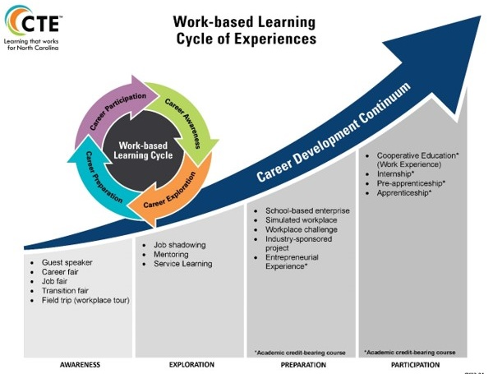
Well Aligned with CTE
Safal Partners © 2024
Notes:
Description of image found in Alt text

Slide 14
TRACK: Tech Ready Apprentices for Careers in Kentucky
Launched during the 2013-2014 school year
Partnership between state Office of Career and Technical Education and Kentucky Office of Apprenticeship
Provides high school students with pre-apprenticeship experience and opportunity to fast-track transition to an RA program
Employers partner with area technical centers to design the selection process and the program of study sequence, allowing them to tailor the program to their specific need.
Initially trades-focused but now in 16 different career areas.
Has served over 500 youth apprentices in various career pathways and over 90 employers.
Safal Partners © 2024

Slide 15
Components of Quality Pre-Apprenticeship
Foundational Skill-Building: Communication, teamwork, and problem-solving alongside basic technical training.
Career Exploration and Foundational Training: Exposes students to various career paths while developing technical skills.
MOUs with RA Sponsors: Formalized agreements that provide completers with preferential direct entry, ability to apply coursework to RI requirements (through CPL) and hands-on OJL to competency requirements (through CPE).
Partnership Network: Including workforce system, community and faith-based groups, advocacy organizations, labor groups, and educational institutions for supportive services, pathway development.
Paid Work Experience: Fosters engagement, builds commitment, and helps students adapt to workplace expectations.

Slide 16
What Kind of Help Is Available?
Two Primary Types of Federal Resources
Technical Assistance
No-cost SME by sector, occupation or geography to assist with:
Organizational understanding of RA and pre-apprenticeship
Pre-apprenticeship program design
Connections to local RA program sponsors
MOU development with IHEs (if relevant/desired), RA sponsors
Provided most often by:
State and local apprenticeship system staff
Intermediaries
Grantees
Funding
Provided through federal programs, grants, and incentive funding to assist with:
Program design and development
Program administration
Direct pre-apprentice (student) expenses (e.g., tuition/fees for courses, supplies)
Non-duplicative supportive services
Provided most often by:
Intermediaries
Local workforce development boards
Federal apprenticeship grant recipients

Slide 17
What Kind of Help Is Available?
Two Primary Types of Federal Resources
Technical Assistance
No-cost SME by sector, occupation or geography to assist with:
Organizational understanding of RA and pre-apprenticeship
Pre-apprenticeship program design
Connections to local RA program sponsors
MOU development with IHEs (if relevant/desired), RA sponsors
Provided most often by:
State and local apprenticeship system staff
Intermediaries
Grantees
Funding
Provided through federal programs, grants, and incentive funding to assist with:
Program design and development
Program administration
Direct pre-apprentice (student) expenses (e.g., tuition/fees for courses, supplies)
Non-duplicative supportive services
Provided most often by:
Intermediaries
Local workforce development boards
Federal apprenticeship grant recipients

Slide 18
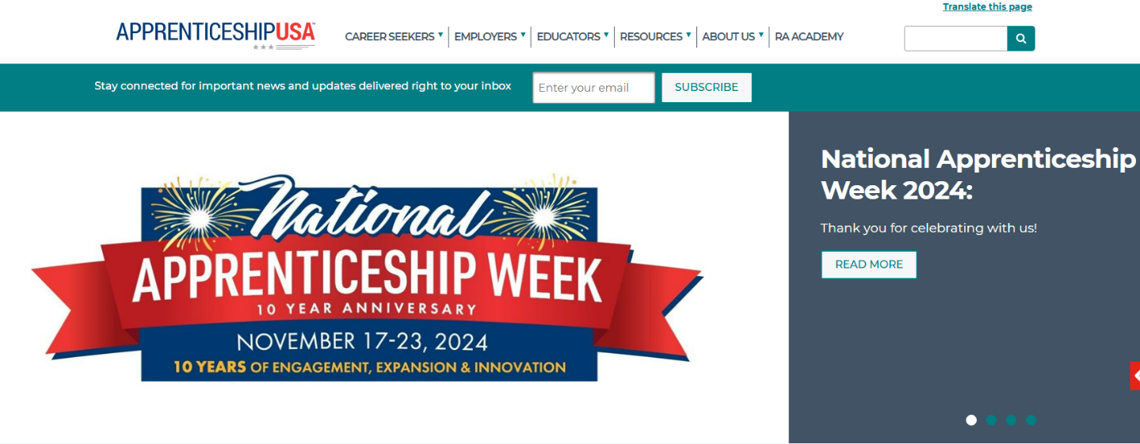
DOL Apprenticeship.gov
www.apprenticeship.gov

Slide 19
Funding, Resources: DOL Intermediaries, Grantees
Federally-designated, contracted intermediaries and grant recipients
Typically focused on specific industries, sectors or occupations
Grant and Incentive Funds Can Often Pay For
Programmatic Expenses
Program Administration
Staffing and planning, implementation, operations
Direct Program Expenses (not participant wages or reimbursement)
Tuition and fees
Curriculum development
Training materials
Pre-Apprentice Supports
Participant Expenses (reasonable and directly related to program participation), i.e. non-duplicative supportive services:
Transportation
Child care
Training equipment
Supplies
Books
Uniforms

Slide 20
Funding, Resources: DOL Intermediaries, Grantees 1
Federally-designated, contracted intermediaries and grant recipients
Typically focused on specific industries, sectors or occupations
Grant and Incentive Funds Can Often Pay For
Programmatic Expenses
Program Administration
Staffing and planning, implementation, operations
Direct Program Expenses (not participant wages or reimbursement)
Tuition and fees
Curriculum development
Training materials
Pre-Apprentice Supports
Participant Expenses (reasonable and directly related to program participation), i.e. non-duplicative supportive services:
Transportation
Child care
Training equipment
Supplies
Books
Uniforms

Slide 21
Funding, Resources: WIOA Title I
Administered by Local Workforce Development Boards (LWDBs) and their American Job Centers (AJCs)
Eligible beneficiaries:
Adult learners (Adult or Dislocated Worker programs)
In-school (Youth program) or Opportunity Youth eligible participants
WIOA Title I Funds Can Often Pay For
Pre-Apprenticeship Paid Work Experience
Allowability varies by LWDB policy
Amount and length of wage reimbursement to be determined by LWDB policy
Paid to provider of work experience
Likely uses OJT-type contracts
Training Costs (through Individual Training Accounts)
Paid to ETPL approved training providers
Can be used toward pre-apprentice training expenses
Tuition/fees
Books
Uniforms, training equipment, etc.
Supportive services

Slide 22
Funding, Resources: WIOA Title
Administered by Local Workforce Development Boards (LWDBs) and their American Job Centers (AJCs)
Eligible beneficiaries:
Adult learners (Adult or Dislocated Worker programs)
In-school (Youth program) or Opportunity Youth eligible participants
WIOA Title I Funds Can Often Pay For
Pre-Apprenticeship Paid Work Experience
Allowability varies by LWDB policy
Amount and length of wage reimbursement to be determined by LWDB policy
Paid to provider of work experience
Likely uses OJT-type contracts
Training Costs (through Individual Training Accounts)
Paid to ETPL approved training providers
Can be used toward pre-apprentice training expenses
Tuition/fees
Books
Uniforms, training equipment, etc.
Supportive services

Slide 23
Funding, Resources: SNAP E&T
Run through states or state partners (i.e. colleges, CBOs, AJCs, etc.)
Post-secondary age eligible participants
SNAP E&T Funds Can Pay For
100% or 50-50 Funds
Administrative Expenses
State staffing and planning, implementation, operations
Partner provider administrative expenses
Direct Program Expenses (not participant reimbursement)
Tuition and fees
Case management/career navigation
Job Development
ONLY 50-50 Funds
Participant Expenses (reasonable and directly related to program participation), i.e. supportive services, e.g.:
Transportation
Child care
Training equipment and supplies
Books
Uniforms
Licensing fees

Slide 24
Funding, Resources: SNAP E&T 1
Run through states or state partners (i.e. colleges, CBOs, AJCs, etc.)
Post-secondary age eligible participants
SNAP E&T Funds Can Pay For
100% or 50-50 Funds
Administrative Expenses
State staffing and planning, implementation, operations
Partner provider administrative expenses
Direct Program Expenses (not participant reimbursement)
Tuition and fees
Case management/career navigation
Job Development
ONLY 50-50 Funds
Participant Expenses (reasonable and directly related to program participation), i.e. supportive services, e.g.:
Transportation
Child care
Training equipment and supplies
Books
Uniforms
Licensing fees

Slide 25
Federal Student Aid Programs
Federal student can be utilized if pre-apprenticeship program is embedded in a credit-bearing academic certificate or degree program
Grant and Funding Resources
Pell Grant
Course tuition/fees
Pre-apprenticeship program equipment or supplies
Books and materials
Federal Work Study
Training wages associated with pre-apprenticeship work experience for students who meet eligibility (financial need) criteria

Slide 26
Federal Student Aid Programs 1
Federal student can be utilized if pre-apprenticeship program is embedded in a credit-bearing academic certificate or degree program
Grant and Funding Resources
Pell Grant
Course tuition/fees
Pre-apprenticeship program equipment or supplies
Books and materials
Federal Work Study
Training wages associated with pre-apprenticeship work experience for students who meet eligibility (financial need) criteria

Slide 27
Helpful QR Codes
DOL TEN: Quality Pre-Apprenticeship
DOL Investments
RA TA Center of Excellence Website

Slide 28
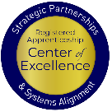
Questions
Safal Partners © 2024

Slide 29
Contact Us, Become a Partner
Scan for Partner Form
Receive no-cost expert TA, materials, and assistance
Network with potential partners nationwide
Be nationally recognized for your work
Notes:
We want to thank all of you for joining us today. We appreciate your participation.
We’d like to encourage you to become a partner with the Center of Excellence if you have not signed up yet. Please take a moment to scan the QR code on the screen. As a partner you have the opportunity to receive no-cost technical assistance and materials, network with partners nationwide, and be nationally-recognized for your work.

Slide 30
Thank You for Joining Us
Email us your questions at RA_COE@SafalPartners.com
For more information, visit: dolcoe.safalapps.com

