Slide 1
Registered Apprenticeship and the Workforce System: A Training Series Session 1: Registered Apprenticeship and Workforce 101
December 11, 2024
Notes:
Stacy

Slide 2
Presenters
Stacy O’Keefe
Subject Matter Expert
Safal Partners
Deb Bennett
Vice President of Apprenticeship, Wireless Infrastructure Association

Slide 3
Center of Excellence Overview
U.S. DOL initiative to increase systems alignment across apprenticeship, education, and workforce
Led by Safal Partners; 5 national partners
We provide no-cost TA including:
Monthly webinars
Quarterly virtual office hours
Individual TA/coaching sessions
Online resources (desk aids, guides, frameworks, etc.)
Visit our website, request TA
Notes:
Stacy

Slide 4
Online Resources, On-Demand TA
Registered Apprenticeship Partner Profile Questionnaire
https://dolcoe.safalapps.com/resources/resourcesandtools
Notes:
Stacy

Slide 5
Getting to Know You
Are you….
Workforce Board Director or Staff
Service Provider Staff, i.e., program or case manager
Educational Partner
Vocational Rehabilitation Partner
Apprenticeship Navigator
Board Member
Other?
Notes:
Stacy

Slide 6
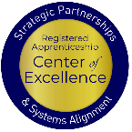
Today’s Agenda
Registered Apprenticeship Basics
Why Local Workforce Boards Should Prioritize RA
Three Key Roles for Local Workforce Boards to Get Started with and Grow RA programs
Convener
Sponsor
Funder
Q&As and Next Steps
Notes:
stacy

Slide 7
Basic Building Blocks of
Registered Apprenticeship
Notes:
Deb

Slide 8
Getting to Know You 1
How would you describe your level of knowledge of and experience with Registered Apprenticeship programs?
Advanced
Emerging
At Square One
Notes:
Deb

Slide 9
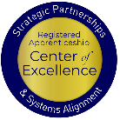
Registered Apprenticeship
Registered apprenticeship is:
Registered apprenticeship is
a proven model of job preparation
that combines paid on-the-job training (OJT) with related instruction to progressively increase workers’ skill levels and wages;
a proven business-driven model that provides an effective way for businesses to recruit, train, and retain highly skilled workers.
Notes:
Deb

Slide 10
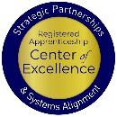
Core Components of Apprenticeship
Employer Involvement
Related Instruction (RI)
Diversity
National Occupational Credential
Structured On-the-Job Learning (OJL)
Rewards for
Skill Gains
Quality and Safety
Safal Partners © 2024
Notes:
Haylie

Slide 11
The Key Characteristics
Industry Led
Programs are industry-vetted and approved to ensure alignment with industry standards and apprentices are trained for highly skilled, high-demand occupations.
Paid Job
Apprenticeships are jobs! Apprentices earn progressive wage increases as their skills and productivity increase.
Structured On- the-Job Learning/ Mentorship
Programs provide structured on-the-job training to prepare for a successful career, which includes instruction from an experienced mentor.
Supplemental Education
Apprentices are provided supplemental classroom education based on the employers' unique training needs to ensure quality and success.
Diversity
Programs are designed to reflect the communities in which they operate through strong non-discrimination, anti-harassment, and recruitment practices to ensure access, equity, and inclusion.
Quality & Safety
Apprentices are worker protections while receiving rigorous training to equip them with the skills they need to afforded succeed and the proper training and supervision they need to be safe.
Credentials
Apprentices earn a portable, nationally-recognized credential within their industry.
Notes:
Deb
Apprenticeship programs are industry-approved to align with standards and prepare individuals for skilled, high-demand careers. Apprenticeships are jobs where participants earn wages that increase as their skills improve. They receive structured on-the-job training from experienced mentors, supplemented by classroom education tailored to the employer's needs. Programs emphasize access, equity, and inclusion through strong recruitment and anti-discrimination policies. Apprentices are protected as workers while undergoing rigorous, safe training and earn a portable, nationally-recognized credential in their industry.

Slide 12
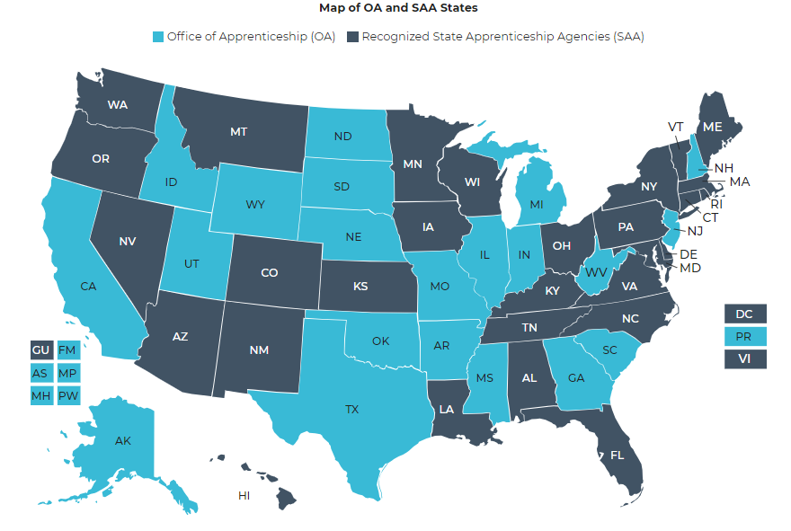
The Apprenticeship System
27 states and territories are Office of Apprenticeship (OA) states
30 states and territories have state apprenticeship agencies (SAA)
Notes:
Melissa
SAA- State apprenticeship agency
Recognized by OA to act on behalf of DOL to register and oversee programs- state employees
OA Office of apprenticeship- staff members are employees of DOL- uses RAPIDS
RAPIDS- registered app partnership data system for the registration and oversight and tracking of apprentice progress an compliance
MO is an OA state
SAA allows for more local alignment
Some state app programs are overseen by cc system or Dept of Ed, or labor and industry.

Slide 13
SAA States 1
All vary in terms of rules, regulations, and restrictions.
State agency sets policies and procedures for RA programs.
Minnesota Rules and Requirements
Notes:
Deb

Slide 14
Types of Registered Apprenticeship Models
Time-based, competency-based, or hybrid
Some programs are managed by a joint apprenticeship training committee
Individual or group sponsorship
Notes:
Deb

Slide 15
Types of Registered Apprenticeship Models `
TIME-BASED PROGRAMS
Apprentices complete a required number of hours in on-the-job training and related instruction.
COMPETENCY-BASED PROGRAMS
Apprentices progress at their own pace and demonstrate competency through proficiency and exams.
HYBRID APPROACH
Apprentices complete minimum hours and successfully demonstrate identified and measured competencies.

Slide 16
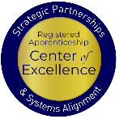
Myths About Registered Apprenticeship
Apprenticeship programs are only for unions.
Most recent data shows more than 80% of active RA programs are employer only.
Apprenticeship programs are only in the trades.
A diverse range of industries are engaged in RA.
Apprenticeship is only for non-college bound individuals.
Apprenticeship is a career path; it is not an “either/or” path.
Notes:
Deb

Slide 17
Why Local Workforce Boards Should Prioritize Registered Apprenticeship
Notes:
Stacy

Slide 18
For Your Job Seeker Customer
The benefits for job seekers to participate in a Registered Apprenticeship program:
The "earn while you learn" concept provides a salary while building a career
A "lead-in" to promising, well-paid careers in a variety of industries
Higher quality of life and skills versatility
Increased marketability and job security
Portable credentials are recognized nationally and often globally
Opportunity for college credit and future degrees
Notes:
Stacy

Slide 19
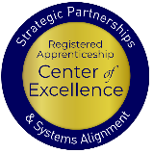
For Your Business Customer
The benefits for businesses to participate in a Registered Apprenticeship program:
Recruit and develop a highly-skilled diverse workforce that helps grow the business
Improve productivity, profitability, and an employer’s bottom line
Create flexible training options that ensure workers develop the right skills
Minimize liability costs through appropriate training of workers
Increase retention of workers, during and following the apprenticeship
Avert layoffs
Notes:
Stacy

Slide 20
For Your WIOA Title I Program Performance
When a WIOA participant is enrolled in an RA program, the impact on performance is unmatched!
Would you like to learn more about this?

Slide 21
Key Roles for Local Workforce Boards
Notes:
Stacy

Slide 22
Key Organizational Apprenticeship Roles
Convener
Convener
Sponsor
RI Provider
Employer
Partner
An organization that agrees to operate an apprenticeship program and in whose name the program is registered.
Entity that provides instruction to apprentices in the designated occupation’s core knowledge, skills, and abilities.
Hires and provides paid OJL for apprentices under
supervision of a designated mentor who is a skilled professional in
that occupation.
Organizations committed to supporting RA programs. They can play one or more roles.

Slide 23
Key Roles for Local Boards
Convene
Sponsor
Fund
Gather key stakeholders through established networks
Register as a Sponsor of Apprenticeship
Manage funding opportunities, incentives, and other financial resources for apprentice training.

Slide 24
Local Boards as RA Conveners 1
Successful apprenticeships are born from collaboration among partners. Leverage partners to identify the resources needed to design your apprenticeship program, and recruit apprentices.
This is your first step in executing new RA programs…. successfully convening key stakeholders Not a top-down or bottom-up strategy – rather it is a collaborative network strategy.
Notes:
Stacy

Slide 25
Local Boards as RA Conveners
Engage partners from Day One!
Create an RA Committee
Host regular meetings for the Committee
Provide education, especially on the benefits of RA, to partners
Showcase successful efforts of peers
Notes:
Stacy

Slide 26
Examples of Convening Partners 4
WORKFORCE SYSTEM
Contributes funds for OJT
COMMUNITY COLLEGE
Creates Related Instruction
Delivers Related Instruction
BUSINESS
Provides OJT
Provides Mentor

Slide 27
Examples of Convening Partners 1 4
WORKFORCE SYSTEM
Contributes funds for OJT
INDUSTRY ASSOCIATON
Sponsor of program
TECHNICAL COLLEGE
Creates Related Instruction
Delivers Related Instruction
BUSINESS
Provides OJT
Provides Mentor

Slide 28
Local Boards as RA Sponsors
The Local Workforce Development Board:
Becomes an approved group RA program sponsor for in-demand occupation(s);
Convenes, or identifies a convener, to create the RA ecosystem of partners;
Provides administrative support, training and assistance to business(es) joining the RA program; and
Ensures the availability of funding sources to sustain RA programs.
Ensures compliance with federal, state and local laws, regulations and policies.
apprenticeship-requirements-reference-guide.pdf
Notes:
DEB

Slide 29
Steps for Getting Started
Notes:
Deb

Slide 30
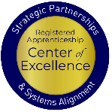
Getting Started
The Key Steps
Get to know apprenticeship, its benefits, and how different employers and sponsors are creating programs across industry and geography.
BUILD
Understand your options, the steps involved in building an apprenticeship program, and the tools we offer to help you get started.
PARTNER
Collaborate with apprenticeship representatives, workforce organizations, educators, and others to build your program.
REGISTER
Take advantage of benefits such as funding opportunities, tax credits, and no-cost technical assistance when you register your program
LAUNCH
Recruit
EXPLORE
BUILD
PARTNER
REGISTER
LAUNCH
Notes:
Deb

Slide 31
So you want to launch a Registered Apprenticeship program
Partner with key players in your local area to develop the program
State Apprenticeship Agency Director; educational institutions; industry associations or labor organizations; other key community organizations
With your partners, explore the industry to identify key businesses for participation
Employers are the foundation of every apprenticeship program and the skills needed by their workforce are at the core. Businesses must play an active role in building the program and be involved in every step in designing the apprenticeship.
With your state apprenticeship office, develop standards (as needed) a OJL plan and register your standards
Begin to train apprentices
Notes:
Deb

Slide 32
So you want to launch a Registered Apprenticeship program
Stay connected to and engaged with your state apprenticeship office.
Your apprenticeship representative is an important resource, who will be there to provide ongoing support and technical assistance when you need help.
As the program continues, track your apprentices’ progress as they advance through the apprenticeship and increase their skills.
Assess and continuously improve. It’s your apprenticeship program! Continue to assess its performance and continuously improve to meet your changing needs.
Share your success. Share your best practices and tell your story.
New employers can follow your path when you highlight your success. Tell us about media coverage of your apprenticeship program or post a resource online at the Registered Apprenticeship Community of Practice

Slide 33
Questions and Answers
Notes:
Haylie

Slide 34
What’s Next
What topics do you consider to be essential to moving forward with Registered Apprenticeship?
Examples:
Local Boards as “Funders” – using WIOA Title I Adult, Dislocated Worker and Youth Funds to support RA programs
Creating RA-Supportive Policies and Procedures
Embedding RA Experts in the AJC – Business Service Representatives, Case Managers and other front-line staff
Action Planning, industry/occupation selection, building standards
Notes:
Stacy

Slide 35
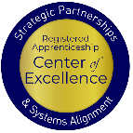
Evaluation
Link to Evaluation
Please take a minute to provide feedback on today’s presentation.
Safal Partners © 2024
Notes:
Stacy

Slide 36
Thank You for Joining Us
Email us your questions at RA_COE@SafalPartners.com
For more information, visit: dolcoe.safalapps.com
Notes:
stacy

