Slide 1
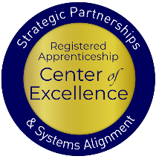
Aligning the Workforce and Apprenticeship Systems: Registered Apprenticeship and WIOA 101 for Case Managers
November 19, 2024
3:45-4:45 pm
Notes:
Katie

Slide 2
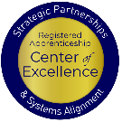
Presenters
Melissa Aguilar-Southard
Lisa Rice
Senior Project Director and Subject Matter Expert
Safal Partners
Lead Subject
Matter Expert
Safal Partners
Notes:
Katie

Slide 3
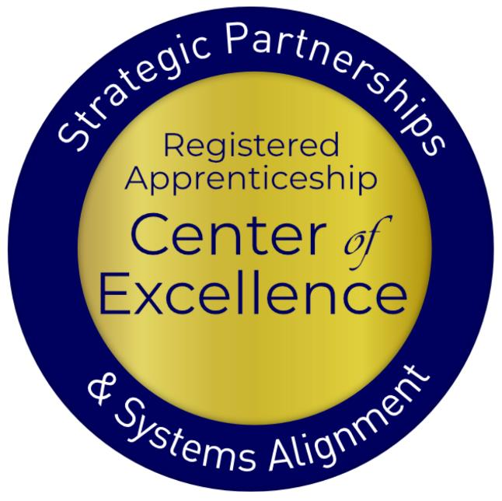
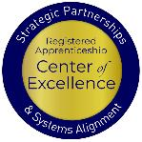
Welcome and Agenda
Center of Excellence Overview
The Basics of Youth Apprenticeships
Youth Oriented Case Management
Questions for Follow Up
Wrap Up
Safal Partners © 2024
Notes:
Melissa

Slide 4
Poll – Getting to Know You
Audience Affiliations:
Employers
Registered Apprenticeship Program Staff
State or Local Workforce Boards
American Job Center Partners
Post-Secondary/Proprietary Education
Service Providers
Community Based Organizations
Other?

Slide 5
Poll – Getting to Know You 1
RA Affiliations:
Self-Proclaimed Expert in RA
I Understand the Concept of RA but Not an Expert
I am at a 101 Level with RA

Slide 6
COE Overview
Safal Partners © 2024
Notes:
Katie

Slide 7
Center of Excellence Overview
U.S. DOL initiative to increase systems alignment across apprenticeship, education, and workforce
Led by Safal Partners; 5 national partners
We provide no-cost TA including:
Monthly webinars
Quarterly virtual office hours
Individual TA/coaching sessions
Online resources (desk aids, guides, frameworks, etc.)
Visit our website, request TA
Notes:
Katie
Safal was awarded the opportunity to lead the US DOL Registered Apprenticeship Technical Assistance Center of Excellence for Strategic Partnerships and Systems Alignment in 2021.
We are here to help close the gap between the apprenticeship and workforce systems and accelerate partnerships across education, economic development, and other partners to increase adoption of RA nationwide.
The Center is supported by five national partners including the National Association of Workforce Development Professionals, the Coalition on Adult Basic Education, the National Disability Institute, FASTPORT, and the Wireless Infrastructure Association.
Our national partners were strategically chosen to help us reach specific groups whether on the workforce, education or employer side
California Workforce Association (CWA) is our partner in the state, helping increase workforce system awareness and utilization of RA as a workforce solution for both employers and jobseekers.
The Center of Excellence provides no-cost technical assistance – online, in-person and through hybrid delivery - to accelerate sustainable partnerships and align apprenticeship, workforce and education systems.

Slide 8
Online Resources, On-Demand TA
Registered Apprenticeship Partner Profile Questionnaire
https://dolcoe.safalapps.com/resources/resourcesandtools
Notes:
Katie

Slide 9
The Basics of Youth Apprenticeship
Safal Partners © 2024
Notes:
Melissa

Slide 10
What is Youth Apprenticeship?
A youth apprentice is defined as…​
an in-school OR out-of-school youth between the ages of 16 and 24…​
​
who receives industry-validated Related Instruction for an RA program (for in-school youth) from their school while… ​
​ completing part-time, paid, work-based experience ​from an employer under a ​ mentored supervision as part of… ​
​
a Registered Apprenticeship program approved ​ by DOL or a state apprenticeship agency (SAA) or a pre-apprenticeship program.​
Safal Partners © 2024
Notes:
Melissa
Discuss pre-apprenticeship modules

Slide 11
Substantial Benefits for Youth
Helping students understand the benefits of RA is crucial:
RA is a pathway to a career from the start
RA provides a way to get paid to learn skills and get work experience
Often leads to offer of full-time employment following graduation or program completion soon after graduation
Increases your lifetime earnings potential: average starting salary for apprentice completers is $80,000 per year (U.S. DOL)
Provides way to earn national credential – move and earn anywhere
Can help lower – or even eliminate – the cost of taking college courses
Safal Partners © 2024
Notes:
Melissa
It is critical to help students understand the benefits of registered apprenticeship. Students are often unaware that these opportunities exist, it is also common that their parents are unaware. So it is very crucial for staff interacting with students to share the opportunities as well as the benefits they bring.
These benefits include that registered apprenticeship is a career from the start and provides them a way to get paid while learning skills and obtaining work experience.
Registered apprenticeships are jobs, so after high school it can transition to full time employment for them or after the completion of the program depending on how the program is set up.
Some statics on earning from the US Department of labor show an increase in lifetime potential compared to their peers and apprentice completers have an average starting salary of 80,000 a year.
Apprentices also receive a national credential that is portable and can move with them.
On top of earning more in lifetime earnings than their peers, it can also help lower or even eliminate the cost of college.

Slide 12
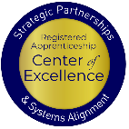
Five Core Components of RA
Employer Involvement
Structured On-the-Job Learning (OJL)
Related Instruction (RI)
Rewards for
Skill Gains
National Occupational Credential
Safal Partners © 2024
Notes:
Katie
There are 5 core components of RA.
Apprenticeship is an employer-driven tool for the workforce system.
It includes On the Job Learning at the job site
And of course the related instruction which can be either at the job site or with an external training provider
There are wage gains as people meet milestones in the apprenticeship journey
And finally, when they are done there is a nationally recognized occupational credential

Slide 13
High-Quality Youth Apprenticeship
In addition to meeting core RA requirements, high quality youth programs:
Provide dual enrollment pathway for college credit for RI
(if school is sponsor) Include articulated agreement with another program sponsor to ensure students can continue paid OJL (and RI if needed) after graduation​
Provide apprentice with a clearly-outlined career pathway beyond RA program completion for occupations that provide a family-supporting wage ​
Embed, or prepares student to test out for, industry-recognized certifications or credentials​
Build equity in program design including qualifications, supports for persistence, etc.
Safal Partners © 2024
Notes:
Katie

Slide 14
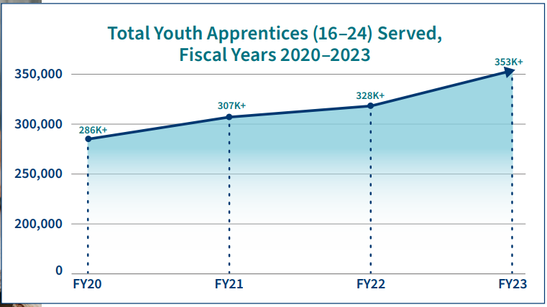
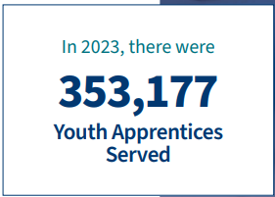
Apprenticeship for Youth
Source: https://www.apprenticeship.gov/
Safal Partners © 2024
Notes:
Melissa

Slide 15
High-School Aligned Apprenticeship Programs
Juniors or seniors are eligible to apply for paid on-the-job training experience with an employer while receiving RI at school.
Embeds industry recognized credentials into RI curriculum.
RI counts toward high school graduation requirements and potentially college credits, creating a seamless transition from secondary to post-secondary education.
Often acts as pre-apprenticeship programs that provide a pathway to a full RA program.
Safal Partners © 2024
Notes:
Katie
Five characteristics of a high-quality pre-apprenticeship program:
Partnership with registered apprenticeship program sponsors
Sustainability through partnerships
Meaningful training combined with hands-on experience replicating a workplace that does not displace paid employees
Access to career and supportive services
Increased access for underrepresented or underserved populations
Safal has developed a pre-apprenticeship module on the RA Academy which can be found here: https://rise.articulate.com/share/NaNHfXPRpo4CVc-tMcIXy_iN_n7P8Y7W#/

Slide 16
College-Aligned Youth Apprenticeship Programs
Available at vocational, community, and four-year colleges and generally for 18-24 year olds.
Embeds industry credentials in RI curriculum and oftentimes leads to the award of industry-recognized credentials.
Generally, a Registered Apprenticeship program that leads to the award of a DOL-issued certificate.
RI counts towards college credits, enabling student to graduate.
Safal Partners © 2024
Notes:
Katie

Slide 17
Youth Oriented Case Management
Safal Partners © 2024
Notes:
Melissa

Slide 18
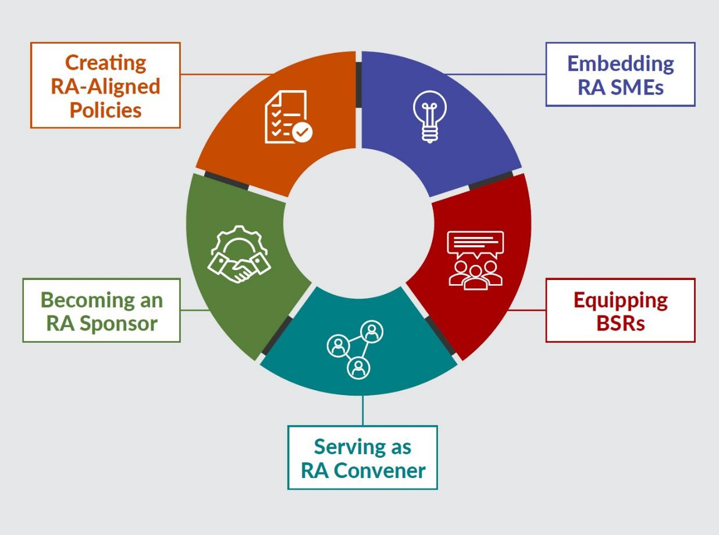
New Tool
Key Components of Workforce System Alignment with Registered Apprenticeship
https://dolcoe.safalapps.com
Safal Partners © 2024
Notes:
Melissa
The reason this tool was built was to help the workforce system and it’s partners look at ways that you can enhance your RA efforts. They are not linear, you could be doing things in several different areas and we acknowledge that this is not all inclusive, but rather it gives you a starting point to grow your RA work.

Slide 19
Embedding RA Knowledge
Frontline case management must have a bit of knowledge about pre-apprenticeship and registered apprenticeship programs to ensure they can talk with the youth customers about the advantages of RA.
Safal Partners © 2024
Notes:
Melissa
How many of you have an Apprentice Navigator or someone in the AJC that is your SME on RA?
This section is really all about the frontline staff – case managers and Wagner-Peyser staff – who can help influence job seekers to pursue RA opportunities. If they have the right knowledge base. Which requires training….
Let’s have a little fun – raise your hand and we’ll call on you for this question - What is one thing you say to your job seekers when you are trying to get them to look at an RA program?

Slide 20
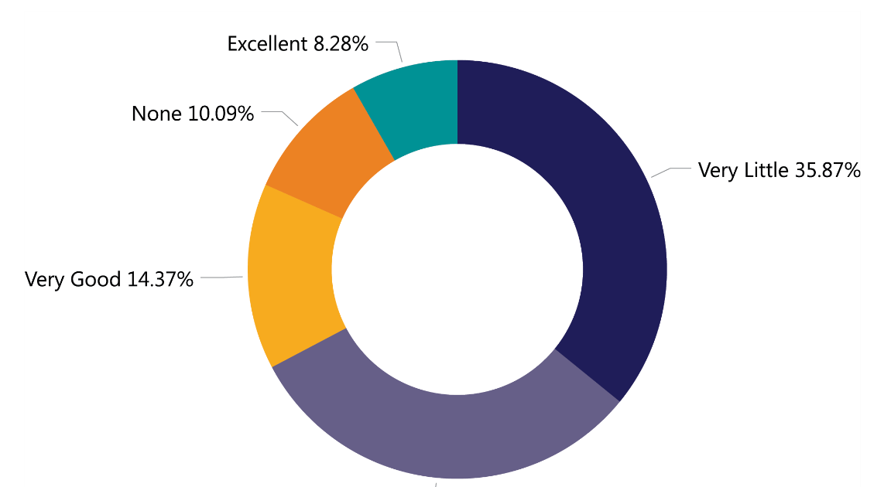
RA & WIOA Performance Measures
How would you rate your knowledge on how Registered Apprenticeship correlates with WIOA performance measures?
Source: 2023 Workforce System Registered Apprenticeship Baseline Knowledge Assessment Report - USDOL Center of Excellence, Safal Partners, NAWDP
Safal Partners © 2024
Notes:
Melissa

Slide 21
RA Alignment: Performance
RA improves performance outcomes!
Entered Employment Rate Q2 and Q4 post exit
Median Earnings Q2 post exit
Measurable Skill gains
Credential Attainment
Effectiveness in Serving Employers
Youth Employment & Education Rate Q2 post exit
Safal Partners © 2024
Notes:
Melissa - When you think about system knowledge, we are looking at things like RA’s impact on WIOA performance measures. RA can have an impact on Entered Employment, Credential, Measurable Skills Gain, Employment for 2nd and 4th quarters, median earnings.

Slide 22
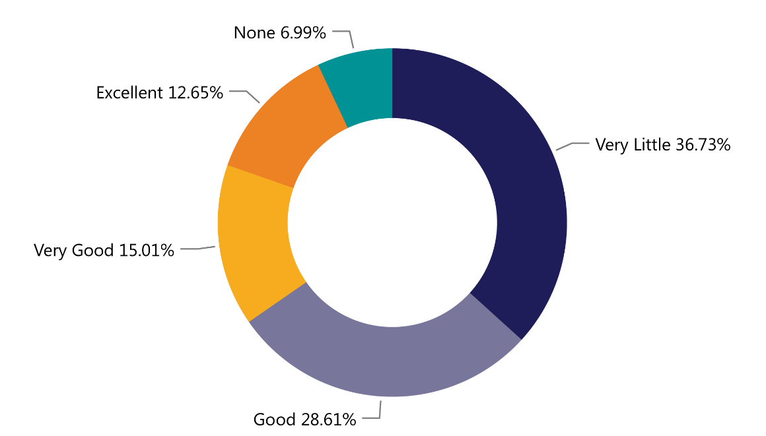
Programs Paying for RA
How would you rate your knowledge of who pays for each part of an apprenticeship program (related instruction, wages, administration)?
Source: 2023 Workforce System Registered Apprenticeship Baseline Knowledge Assessment Report - USDOL Center of Excellence, Safal Partners, NAWDP
Safal Partners © 2024
Notes:
Katie
Funding Knowledge centered on what sources of funding can pay for components of RA and how to use WIOA funding for RA activities. As you can tell about 43% had little or no knowledge about paying for RA activities?
How many of you use WIOA funds to pay for the related instruction portion of a RA program? What about paying for OJT’s?
As a case manager why is it important to know this?
Because you want to provide as many services as you can to help them through the RA program.
Hands up if you are using WIOA funds for RI, how about supportive services, Ojts?

Slide 23
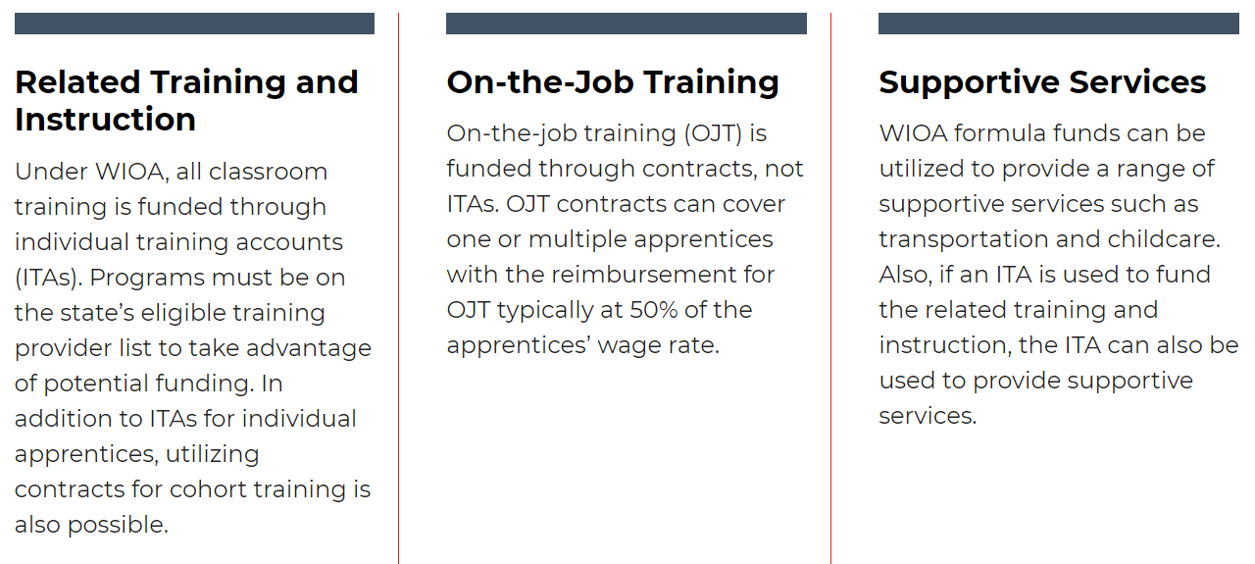
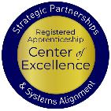
WIOA Funding, Supports for RA
Notes:
Katie
How many of you use WIOA funds to pay for the related instruction portion of a RA program? What about paying for OJT’s? Supportive Services?
As a case manager why is it important to know this?
Because you want to provide as many services as you can to help them through the RA program.
Does anybody have a board policy or funding allocation that targets engaging job seekers in RA’s?

Slide 24
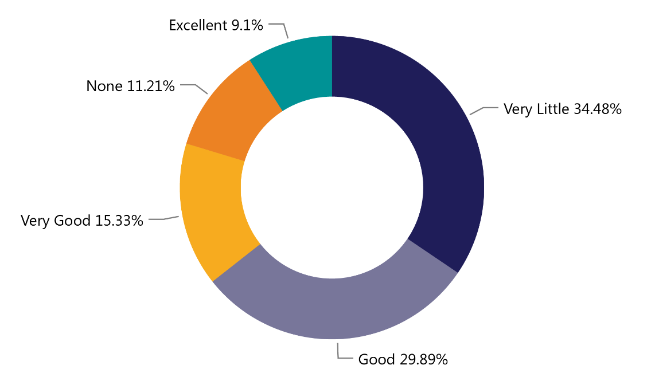
RA & ETPLs
How would you rate your knowledge of the relationship between Registered Apprenticeship related instruction and your state or local eligible training provider list?
Source: 2023 Workforce System Registered Apprenticeship Baseline Knowledge Assessment Report - USDOL Center of Excellence, Safal Partners, NAWDP
Notes:
Melissa
Sharing Knowledge is about communicating the benefits of RA to your customers, which means you need to know not only the basics but also what programs are available.
What can you tell me about RA and the ETPL?
RA programs are automatically eligible to be placed on the ETPL but some choose not to. Why would a RA sponsor choose not to have their program on the ETPL?
So sponsors have to opt in – they have to request that the program is on the ETPL, but it doesn’t have to go through all the regular scrutiny of a training program because it has already been through that and approved by the approving agency. TEGL 13-16, change one has more information on this.

Slide 25
RA Alignment: ETPL
RA programs must be on the state/local eligible training provider (ETP) list to unlock WIOA funds for Related Instruction (RI).
Under WIOA, all RA programs are automatically eligible for the ETP list, and each state workforce agency (SWA) must have a process in place to ensure this happens.
Unlike other training providers/programs, RA programs have no performance-related requirements for inclusion on the ETP list. SWAs and Local WDBs may not require even minimal performance information.
The requirement that training programs on the ETP list be for in-demand occupations does not apply to RA programs.
Notes:
Melissa

Slide 26
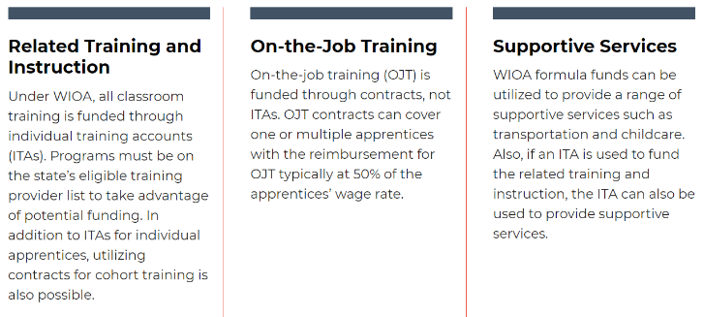
Benefits of Leveraging WIOA / RA Together
Unlock additional sources of RA program support for employers who sponsor programs or hire apprentices
Unlock additional resources for job seekers who are hired as apprentices with supportive services or assistance with classroom training
Shared outcomes
Boost overall alignment understanding for workforce system
Notes:
Katie

Slide 27
Promising Practices
Colorado launched its youth apprenticeship program, CareerWise Colorado, in 2016. CareerWise is an independent public-private partnership that functions as a workforce intermediary. CareerWise Colorado | Youth Apprenticeship Programs
South Carolina has a registered youth apprenticeship programs that operate through community and technical college system… regionally focused. Youth Apprenticeship | Apprenticeship Carolina - a division of the SC Technical College System
Tech Ready Apprentices for Careers in Kentucky (TRACK) is a business and industry driven youth apprenticeship program with a partnership between the Kentucky Department of Education's Office of Career and Technical Education and the Kentucky Office of Apprenticeship to provide secondary students with career pathway opportunities to create a pipeline for students to enter post-secondary apprenticeship training and RA. Students receive a nationally recognized credential at little or no cost. TRACK Resources - Kentucky Department of Education
Safal Partners © 2024
Notes:
Katie and Melissa

Slide 28
Questions for Follow Up
Safal Partners © 2024
Notes:
Melissa

Slide 29
Questions for You?
Are your youth case managers being trained on pre-apprenticeship / registered apprenticeship opportunities – do you know where those opportunities are?
Are there RA navigators/SMEs embedded within AJCs or your local area who can work with you on better understanding and recruiting for RA programs?
Are you purposefully discussing, screening and referring youth to pre-apprenticeship / RA programs?
Are there WIOA / RA co-enrollment procedures being used consistently by case managers and across all mandatory partners?
Safal Partners © 2024
Notes:
Melissa
How many of you have an Apprentice Navigator or someone in the AJC that is your SME on RA?
This section is really all about the frontline staff – case managers and Wagner-Peyser staff – who can help influence job seekers to pursue RA opportunities. If they have the right knowledge base. Which requires training….
Let’s have a little fun – raise your hand and we’ll call on you for this question - What is one thing you say to your job seekers when you are trying to get them to look at an RA program?

Slide 30
Questions for You? 1
Are you working with other AJC partners to engage youth who may interested in RA programs?
What type of outreach is happening to target underserved youth populations, communicating the benefits of RA?
Are you receiving RA training to effectively engage youth and communicate the benefits of RA?
Are you working with Business Services / RA reps to understand which employers may be interested in employing youth?
Safal Partners © 2024
Notes:
Melissa
How many of you have an Apprentice Navigator or someone in the AJC that is your SME on RA?
This section is really all about the frontline staff – case managers and Wagner-Peyser staff – who can help influence job seekers to pursue RA opportunities. If they have the right knowledge base. Which requires training….
Let’s have a little fun – raise your hand and we’ll call on you for this question - What is one thing you say to your job seekers when you are trying to get them to look at an RA program?

Slide 31
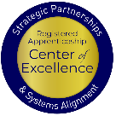
Final Thoughts…
Talk with your colleagues about pre-apprenticeship and registered apprenticeship programs!
Have your youth explore the RA jobs in your area:
Communicate with your local board’s Business Services Representatives to find out about employers who are working with RA.
https://www.apprenticeship.gov/apprenticeship-job-finder
Safal Partners © 2024
Notes:
Katie
Exploring the jobs
Talk to BSR’s about your apprentice candidates, their skills and desire to enter into a RA

Slide 32
Wrap Up
Safal Partners © 2024
Notes:
Katie

Slide 33
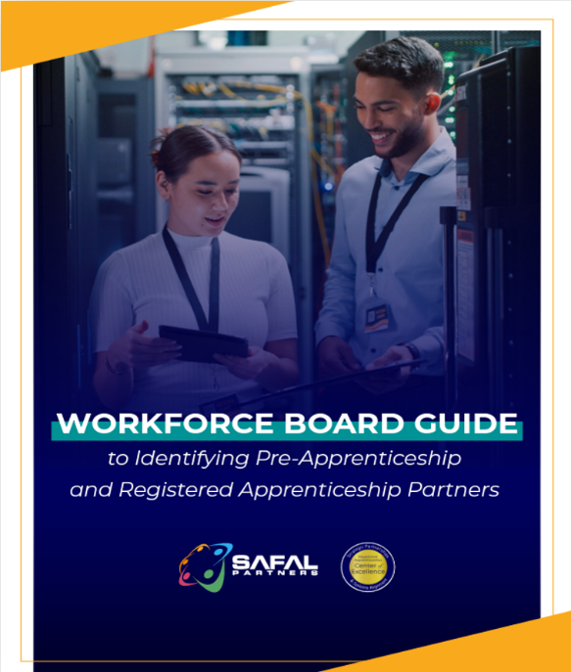
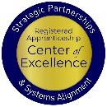
No-Cost Resources
Guide to Identifying Partners
Safal Partners © 2024
Notes:
Katie

Slide 34
Questions, Thoughts, Assistance Needed?
Because we are so close on time, we are asking you to either place your questions in the chat for us to follow up on
or
scan the QR code and send us your question(s) where you may also request technical assistance as well.
We are here to help you!
Email: RA_COE@SafalPartners.com
Safal Partners © 2024
Notes:
Katie

Slide 35
Thank You for Joining Us
For more information, visit: dolcoe.safalapps.com

