Slide 1
Aligning Systems, Scaling Apprenticeship
Urban Institute: Vision 2030
November 21, 2024

Slide 2
Presenters
Katie Adams
Alan Dodkowitz
Chief Delivery Officer
Safal Partners
Senior Subject Matter Expert
Safal Partners
Notes:
Katie Adams is Safal Partners' Chief Delivery Officer where she oversees the firm's workforce practice which provides technical assistance and training, data analytics, program management, and workforce development services to public sector clients including the US Department of Labor (DOL). Katie is a nationally recognized subject matter expert (SME) in Registered Apprenticeship (RA) and workforce development and leads the DOL RA Technical Assistance Center of Excellence on Strategic Partnerships and System Alignment. Over the past 15 years she has led, managed, and served as SME on several DOL and National Science Foundation Advanced Technological Education (NSF ATE) contracts and grants which have built industry-driven, secondary and post-secondary academic-aligned apprenticeship programs registering thousands of new youth and adult apprentices in high-demand occupations across several sectors. She is a frequent speaker at national workforce and education conferences and currently serves as the co-chair of the NIST National Initiative for Cybersecurity Education (NICE) Apprenticeship Community of Interest. Katie is a graduate of the College of William & Mary and resides outside of Washington, D.C.
Alan D. Dodkowitz is an Apprenticeship Senior Subject Matter Expert (SME) at Safal Partners. He works on several different projects for Safal, including the COE project where he offers technical assistance in helping entities align the workforce and apprenticeship system. For the Closing the Skills Gap (CSG) project, he is working to provide technical assistance to project grantees and aid in program development and sustainability. For the Registered Apprenticeship Academy project he is working with DOL to create a learning platform for RA stakeholders to bolster their knowledge of Registered Apprenticeship. Prior to working at Safal, Mr. Dodkowitz was a Research Associate at the Urban Institute where he led the development of competency-based occupational frameworks in the area of advanced manufacturing. He worked with several different organizations to develop modernized and updated competency-based occupational frameworks to be used by sponsors and apprentices throughout the country. He also provided technical assistance to organizations in developing and implementing these frameworks.

Slide 3
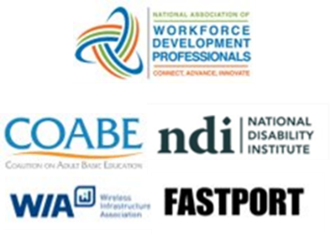
Center of Excellence Overview
Focus: Increase alignment, strategic partnerships between apprenticeship, workforce, educational systems. Tasks include:
Increasing use of RA in WIOA, leveraging of WIOA funding
Doubling statewide WIOA support for RA programs
Informing new policy and program development
3-Tier Approach to TA Products and Service Delivery
Universal: website, monthly webinars, quarterly virtual office hours, desk aides, toolkits, frameworks
Customized: Individual TA/coaching sessions
Intensive: Extended, tailored TA to multiple stakeholders
Notes:
Safal was awarded the opportunity to lead the US DOL Registered Apprenticeship Technical Assistance Center of Excellence for Strategic Partnerships and Systems Alignment in 2021.
We are here to help close the gap between the apprenticeship and workforce systems and accelerate partnerships across education, economic development, and other partners to increase adoption of RA nationwide.
The Center is supported by five national partners including the National Association of Workforce Development Professionals, the Coalition on Adult Basic Education, the National Disability Institute, FASTPORT, and the Wireless Infrastructure Association.
Our national partners were strategically chosen to help us reach specific groups whether on the workforce, education or employer side
California Workforce Association (CWA) is our partner in the state, helping increase workforce system awareness and utilization of RA as a workforce solution for both employers and jobseekers.
The Center of Excellence provides no-cost technical assistance – online, in-person and through hybrid delivery - to accelerate sustainable partnerships and align apprenticeship, workforce and education systems.

Slide 4
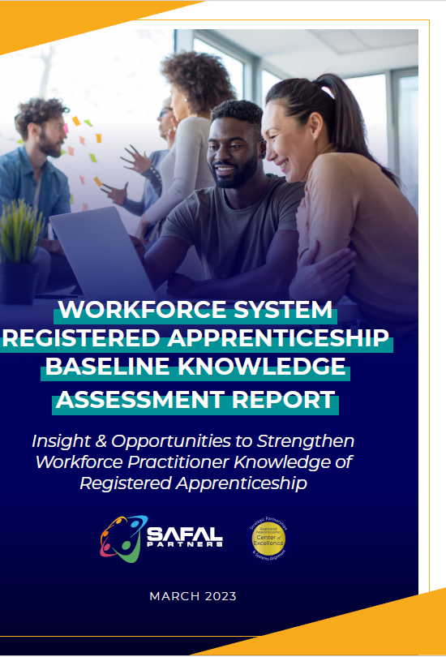
Firsts: Understanding the Field
Deep dive into system understanding of RA
Multiple methodologies: data analysis, interviews, partner surveys, working groups, TA participant feedback, literature review
First analysis of national, state WIOA/RA co-enrollment data
First analysis of WIOA State Unified and Combined Plans for RA
First national assessment, "Workforce System RA Baseline Knowledge Assessment Report"
First national assessment of Title II RA engagement, “Expanding RA through WIOA Title I and Title II Partnerships Report”
First landscape scan, analysis of Apprenticeship Networks across US
Notes:
First analysis of national and state WIOA/RA co-enrollment data
First national ATR/BSR training
First review and analysis of all WIOA State Unified and Combined Plans for RA Alignment
First Adult Education / IET Pre-Apprenticeship RA Framework and National Training
First national assessment of Workforce System RA Awareness and resulting report on “Expanding RA through WIOA title I and title II Partnerships”
First state level CTE RA Bootcamp, replicable model
First review, analysis of Apprenticeship Networks across US and TA on expansion
First Intermediary Assessment tool to assist in MD Governor’s implementation of 2030 Blueprint for youth RA Inclusion
First Chambers of Commerce RA Toolkit to catalyze strategic industry RA partnerships

Slide 5
Rethinking Assumptions
Workforce system stakeholders aren't as engaged in or strategically planning for RA inclusion as initially thought.
Misalignment seen across multiple areas:
- State planning to local implementation
WIOA funding utilization to policy development
…and more

Slide 6
WIOA State Plans: 7 Indicators of RA Alignment
Apprenticeship mentioned as workforce strategy
Plans to apply for/utilize federal grants to expand apprenticeship
Apprenticeship articulated specifically in strategies to meet State Plan vision
State level apprenticeship work group or committee to State Workforce Board
Specialist expertise in American Job Centers
State-level initiative for RA expansion (i.e. investment of additional resources, statutes to incentivize/scale RA programs)
Specific objectives, goals for increased # of apprentices or RA programs

Slide 7
Support at Top, Dropoff in Planning
RA Alignment Indicator | # of State Plans Included | % of States | # of Territories
1. Apprenticeship acknowledged as workforce strategy | 50 | 100% | 6
2. Plans to apply for/utilize federal grants to expand apprenticeship | 42 | 84% | 4
3. Apprenticeship articulated specifically in strategies to meet State Plan vision | 17 | 34% | 3
4. State level apprenticeship work group or committee to SWDB | 17 | 34% | 1
5. Specialist expertise in AJCs | 16 | 32% | 1
6. State level Initiative (e.g., investment of additional resources, statute designed to incentivize or encourage establishment of apprenticeships) | 15 | 30% | 2
7. Specific objectives and goals for increased # of apprentices or apprenticeship programs | 7 | 14% | 0

Slide 8
2020 State WIOA Plan RA Leaders
While no state or territory had all seven indicators of RA alignment in their Unified or Combined Plan, 15 had four or more indicators
Six (6) Indicators | Five (5) Indicators | Four (4) Indicators
Pennsylvania Texas | Arizona Illinois Iowa Kentucky Nevada New Mexico Oklahoma | Alaska Arkansas Connecticut Florida Idaho Kansas Maine Missouri New York Wisconsin US Territories: American Samoa District of Columbia Guam

Slide 9
2020 State WIOA Plan RA Leaders 1
While no state or territory had all seven indicators of RA alignment in their Unified or Combined Plan, 15 had four or more indicators
Six (6) Indicators
Five (5) Indicators
Four (4) Indicators
Pennsylvania
Texas
Arizona
Illinois
Iowa
Kentucky
Nevada
New Mexico
Oklahoma
Alaska
Arkansas
Connecticut
Florida
Idaho
Kansas
Maine
Missouri
New York
Wisconsin
US Territories:
American Samoa
District of Columbia
Guam

Slide 10
Low Utilization Due to Several Factors
Workforce boards, Title I providers cited:
Other state and local priorities
Lack of RA knowledge
Few/no strategic relationships with RA system
Priority of meeting WIOA performance metrics
View of WIOA as "last dollar in" for RA given administrative burden vs. fewer restrictions with non-WIOA $$
Lack of consistent, accessible, modularized training – i.e. Workforce System not a catalog on the RA Academy
Separate data systems
LWDBs don’t see themselves as "conveners” of local industry

Slide 11
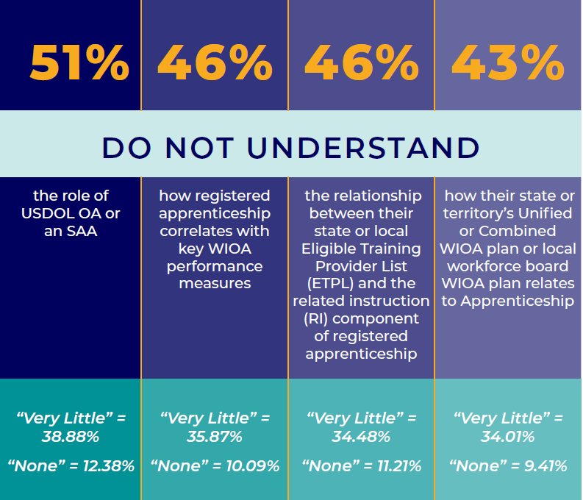
Knowledge Gap: Connecting Systems

Slide 12
Knowledge Gap: How RA Works

Slide 13
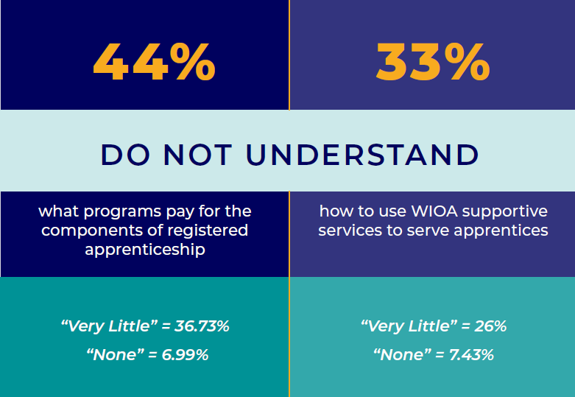
Knowledge Gap: Funding
Notes:
ETA provided clear policy guidance on how WIOA program funding and other sources of federal funding can be used to support registered apprenticeship. However, the assessment report showed that:

Slide 14
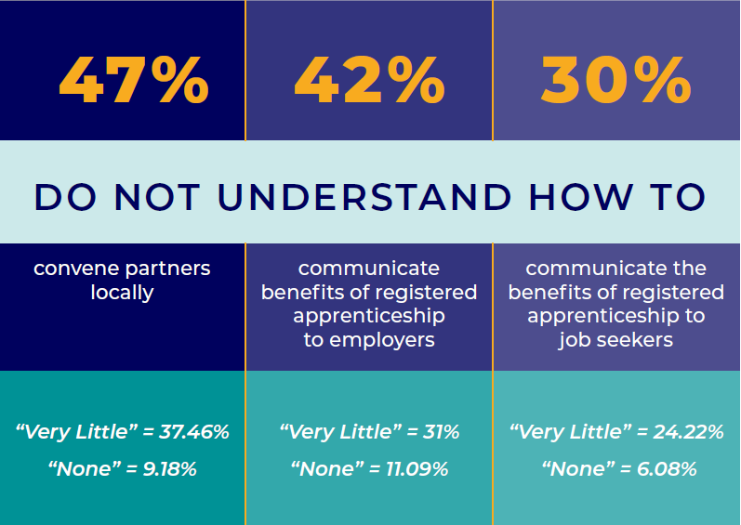
Knowledge Gap: Communication

Slide 15
Field-Informed TA: Creating New Tools
Creating cross-system, responsive TA and training to drive outcomes. Products include:
First national ATR/BSR training (5-part series, capstone)
First series of WIOA State Planning webinars on RA inclusion
First Adult Education / IET Pre-Apprenticeship RA Framework
First state level CTE RA Bootcamp, replicable model
First Intermediary Assessment tool to assist states in RA expansion
First WIOA/RA Co-Enrollment Dashboard
Notes:
First analysis of national and state WIOA/RA co-enrollment data
First national ATR/BSR training
First review and analysis of all WIOA State Unified and Combined Plans for RA Alignment
First Adult Education / IET Pre-Apprenticeship RA Framework and National Training
First national assessment of Workforce System RA Awareness and resulting report on “Expanding RA through WIOA title I and title II Partnerships”
First state level CTE RA Bootcamp, replicable model
First review, analysis of Apprenticeship Networks across US and TA on expansion
First Intermediary Assessment tool to assist in MD Governor’s implementation of 2030 Blueprint for youth RA Inclusion
First Chambers of Commerce RA Toolkit to catalyze strategic industry RA partnerships

Slide 16
State Progress: Interest, Investments
Provided intensive TA, customized tools at request of 12 states on wide range of alignment topics including:
Cross-system collaboration
WIOA funding uses for RA, supportive services
WIOA State Plan development
Braiding funding
High school youth apprenticeship/CTE alignment
Pre-apprenticeship
AJC case manager/BSR training
Increase in state-level support for RA expansion
28 states have enacted RA-supportive legislation in ‘23, ‘24
Employer incentives and tax credits – drive employer demand
Grant programs – LWDBs will seek $$ over/in addition to WIOA
Restructuring governance: RA and Workforce Systems alignment/consolidation (i.e. Virginia, Iowa, Vermont)

Slide 17
Field Needs, Responds to Centers’ TA
Data shows .03% national WIOA/RA
co-enrollment rate….
242% increase in WIOA/RA
co-enrollment in targeted states served by Center
Have produced 82 webinars with 5,000+ attendees….
95% participants “strongly agreed” TA was of high value and planned to implement
Initial goal of 200 partners in system alignment….
3,000 organizations have committed to developing new strategic RA partnerships
82 webinars with 5,000+ attendees; 95% satisfaction (“strongly agreed”) and planned to implement

Slide 18
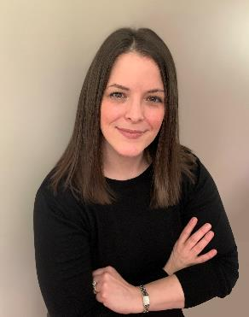
The View from the Field
Carrie Amman
James Disbro
Executive Director, PA Workforce Development Association
Senior Director, Regional Alignment & Programs Development CareerSource Suncoast
Notes:
Carrie Amann , MPA, CAE is Executive Director of the PA Workforce Development Association. She is a go-to resource and advocate for workforce issues in the Commonwealth and across the country. Her tenure has addressed cross-sector work to accelerate worker success, access to quality jobs, efficient and effective delivery systems, and transforming data and information into relevant action (#FreeTheData). Before being Executive Director, Carrie oversaw education and workforce development policy for Governor Tom Wolf. She facilitated the Governor’s Middle-Class Taskforce and was the lead policy staff person in crafting the PAsmart agenda that resulted in precedent setting investments for Computer Science and STEM education, apprenticeships, and industry partnerships. Carrie‘s experience ranges across local, state, and non-profit sectors. Carrie has an undergraduate degree in Policy Studies from Dickinson College and a Master’s degree in Public Administration from Pennsylvania State University.
James Disbro is the Senior Director, Regional Alignment & Programs Development for CareerSource Suncoast (CSS), which serves as the Local Workforce Development Board for Manatee and Sarasota Counties in Florida. He has held senior leadership roles at three of Florida’s Local Workforce Development Boards affording him a perspective that includes medium to large workforce service delivery models. He is highly endorsed as someone knowledgeable in Workforce Development.

Slide 19
Florida’s Apprenticeship Expansion Efforts
CareerSource Florida & The Florida Department of Commerce
State Policy
Funds Apprenticeship Navigators at all of Florida’s LWDBs
Apprentice Florida website: ApprenticeFlorida.com
Florida Department of Education
Florida is a State Apprenticeship Agency (SAA): supported by nine (9) Apprenticeship Training Representatives (ATRs)
Pathways to Career Opportunities Grants (PCOG)
The grant funds are to establish new, operate existing, or expand existing registered apprenticeship or pre-apprenticeship programs.
Since 2019, PCOGs have totaled in excess of $43M.

Slide 20
Florida’s Apprenticeship Expansion Results (PY23/24)
21% increase in the total number of newly registered apprentices from PY22/23
32 new registered apprenticeship programs, for a total of 329 active apprenticeship programs
11 new registered pre-apprenticeship programs, for a total of 68 active
1,100 participating employers to sponsor linkages training in apprenticeable occupations
2,167 apprentices completed their program, an increase of 32 over last year
Apprentices who completed their certificates earned an average exit wage of $27.81 per hour ($57,837 annually), a $4,376 increase from the previous year.

Slide 21
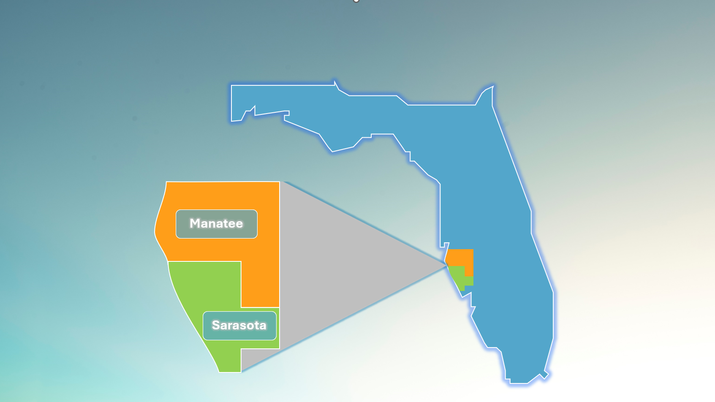
CareerSource Suncoast

Slide 22
CareerSource Suncoast (CSS) RAP Approach
LWDB RAP Sponsor
Increase RAPs in our area
LTOL / ETPL
RAPS
LWDB Funding
Engage Post Secondary Institutions
Collaboration with USDOL intermediaries

Slide 23
CareerSource
2018 – Sponsorship – 1st LWDB in FL to sponsor
Jobs For the Future (JFF) – assisted with development of RAP Standards
Expand Employers/Occupations (RAP/Pre-App)
CSS LWDB Sponsors 6 occupations/3 employers; 2 occupations pending approval
Apprenticeship Navigator – Level of Assistance
Consultant Approach
Works Internally/Externally
Apprenticeship Accelerators
3 completed in PY23/24; 3 scheduled for PY 24/25
Funding Apprentices
Work Based training (OJT/Customized training/IWT)
ITA – RTI
Support Services (special grant)
Florida Apprentices of the Year (4 over the past 3 years)
Notes:
AOY – Manufacturing related
2 PGT – Tool & Die
2 Sun Hydraulics

Slide 24
How Did We Accomplish This?
LWDB Policy & Procedure Changes
Below Self-Sufficiency Definition
Updated LOPs
Staff training & development
Umbrella OJT contracts
Performance
Good, and consistent data (MIS)
Itinerant Credentials within Standards
Demand / Targeted Occupations as much as possible
Spread the Word
Apprenticeship Accelerators
Community engagement (ex. EDC’s, Chambers of Commerce)
CSS website/social media
Other outreach – school districts

Slide 25
Discussion

Slide 26
Visit us online: dolcoe.safalapps.com

