Slide 1
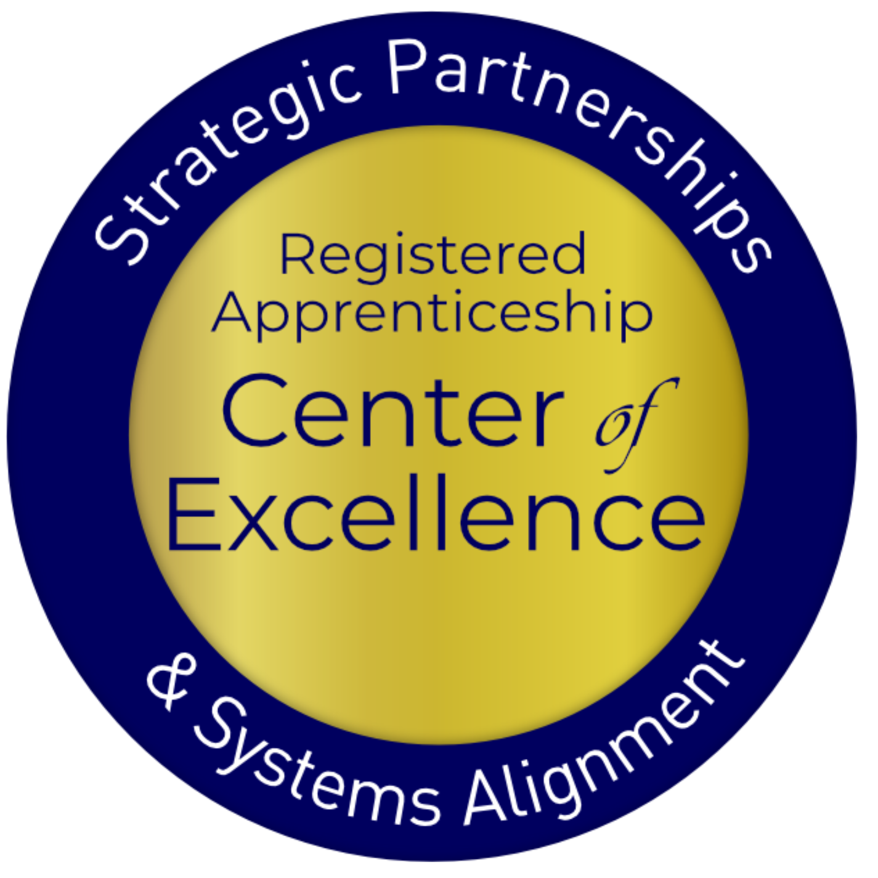
Equipping Chambers of Commerce to Engage in Registered Apprenticeship
January 2025
Notes:
AD

Slide 2
Presenters
Nicole Bentley
Jeremy Faulkner
Alan Dodkowitz
Subject Matter Expert
Safal Partners
Subject Matter Expert
Safal Partners
Subject Matter Expert
Safal Partners
Notes:
AD
Thank you! I’d like to begin by introducing our presenters today.
Jeremy brings over a decade of experience in workforce development with expertise in project management, strategic planning, and Registered Apprenticeship implementation. As a Senior Director at Safal and certified entrepreneurship coach, he has led multi-million-dollar initiatives and provided impactful technical assistance. Jeremy’s background also includes a decade in manufacturing, where he became an expert in lean manufacturing and ISO standards. He has been a featured as a presenter on best practices in business engagement at numerous conferences and webinars, a newspaper columnist on workforce and economic development, and has served in various leadership roles, driving significant innovation and change within workforce systems across the U.S.
Nicole Bentley is a Registered Apprenticeship Subject Matter Expert. She supports the U.S. Department of Labor’s (DOL) Registered Apprenticeship Program Expansion contract and the U.S. DOL Registered Apprenticeship Technical Assistance Center of Excellence for Strategic Partnerships and Alignment. She has spent her career working in economic development with a specialized focus in workforce development and registered apprenticeship growth and expansion. Nicole previously worked for Apprenticeship Carolina, South Carolina’s state agency for apprenticeship growth and expansion. In addition to her duties as an Apprenticeship Consultant, Nicole supported a variety of projects including serving as a Grant Administrator for Jobs for the Future’s Center for Apprenticeship and Work-Based Learning cooperative agreements as well as Interim Grant Administrator for the YARG grant. As a Principal at Resource Development Group and a Sponsorship Associate at the International Economic Development Council, she developed an expertise in c-suite level executive management, strategic partnership and relationship management, high profile fundraising and consulting initiatives, and public speaking. Nicole currently lives in Beaufort, South Carolina.

Slide 3
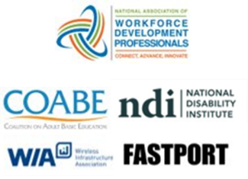
Center of Excellence Overview
U.S. DOL initiative to increase systems alignment across apprenticeship, education, and workforce
Led by Safal Partners; 5 national partners
We provide no-cost TA including:
Monthly webinars
Quarterly virtual office hours
Individual TA/coaching sessions
Online resources (desk aids, guides, frameworks, etc.)
Visit our website, request TA
Notes:
AD
Safal was awarded the opportunity to lead the US DOL Registered Apprenticeship Technical Assistance Center of Excellence for Strategic Partnerships and Systems Alignment in 2021.
We are here to help close the gap between the apprenticeship and workforce systems and accelerate partnerships across education, economic development, and other partners to increase adoption of RA nationwide.
The Center is supported by five national partners including the National Association of Workforce Development Professionals, the Coalition on Adult Basic Education, the National Disability Institute, FASTPORT, and the Wireless Infrastructure Association.
Our national partners were strategically chosen to help us reach specific groups whether on the workforce, education or employer side.
The Center of Excellence provides no-cost technical assistance – online, in-person and through hybrid delivery - to accelerate sustainable partnerships and align apprenticeship, workforce and education systems.

Slide 4
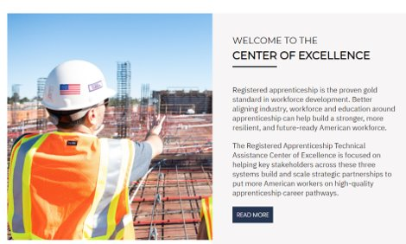
Online Resources, On-Demand TA
Registered Apprenticeship Partner Profile Questionnaire
https://dolcoe.safalapps.com/resources/resourcesandtools
Notes:
AD- Mention the guide
Our website is continually updated with relevant news, TA resources and tools including frameworks, case studies, webinars, customizable templates, questionnaires, and more.
Since 2021 more than 3,000 organizations have become no-cost Center partners and utilized our tools – such as the "RA Partner Profile Questionnaire" - to accelerate their organizations' understanding and effective usage of RA.
This questionnaire is intended to help you build a network in your area around Registered Apprenticeship (RA). With the information gathered here, your board should be better able to engage with and convene RA stakeholders to expand RA program opportunities. It is designed to be used in conjunction with the USDOL RA TA Center of Excellence “Workforce Board Guide to Identifying Pre-Apprenticeship and Apprenticeship Partners” publication. This publication and more information on the Center can be found online at dolcoe.safalapps.com﻿

Slide 5
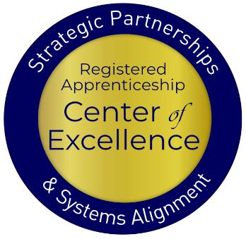
Objectives
Center of Excellence Overview
An Overview of Registered Apprenticeship
Why Registered Apprenticeship and Chambers of Commerce Work Well Together
Current Involvement of Chambers in Registered Apprenticeship
Examples of Chamber Involvement
How Chambers can Engage in RA and Leverage Benefits to Enhance Workforce Strategy
Questions
Safal Partners © 2024
Notes:
AD

Slide 6
Getting to Know You
Are you a….
Chamber of Commerce Executive
Chamber of Commerce Member
Business
Workforce Board Director or Staff
AJC / Career Center Partner
Service Provider
Educational Partner
Board Member
Other?

Slide 7
An Overview of Registered Apprenticeship
Safal Partners © 2024
Notes:
NB

Slide 8
Assessing Your RA Knowledge 1
Basic
I know what it means, but I don’t know how to utilize it and don’t have significant experience with it.
Intermediate
I understand RA, I’ve had experience with RA in some capacity, and I feel comfortable educating internal and external stakeholders about it.
Expert
I have extensive knowledge and relevant experience developing and implementing programs and standards, recruiting apprentices, and convening stakeholders.
Notes:
NB

Slide 9
Registered Apprenticeship
Registered Apprenticeship is:
a proven model of job preparation that combines paid on-the-job training (OJT) with related instruction to progressively increase workers’ skill levels and wages;
a proven business-driven model that provides an effective way for businesses to recruit, train, and retain highly skilled workers.
Notes:
NB

Slide 10
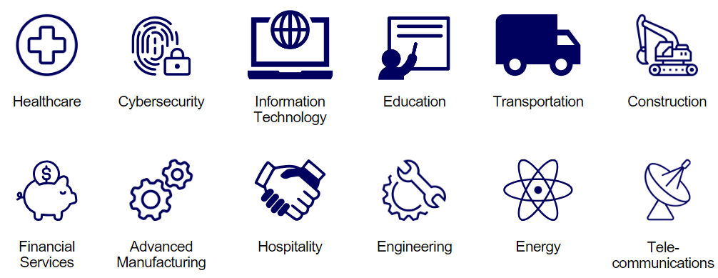
Spans all Sectors
Notes:
NB
The registered apprenticeship model was honed by the building trades over the last century and they largely made it into what it is today. I like to mention that because so much of what we know about what makes apprenticeship successful comes from work in the building trades labor unions and labor-management partnerships. But now it's expanding into new industries and we have many more apprentices – across many sectors – in the United States. You can see a selection of them here in the slide. You can probably see industries that our learners are currently in or aspire to be in.
Within these sectors are a wide variety of careers, including entry-level positions in which apprentices can begin, accessing higher-prestige/higher-wage positions over time. If we can help our students prepare for and eventually access an RA program in these industries, they will have a good chance of staying employed and have the opportunity to advance over time.
While our students can and do go into a broad range of careers after completing their participation in Adult Education, frontline healthcare positions are some examples of in-demand occupations with clear career ladders or pathways that our students can access through registered apprenticeship. In New Mexico, we are beginning to talk about education apprenticeships, and these careers include not only teachers but also teachers' aides with pathways to becoming a licensed teacher, and positions like bus drivers.

Slide 11
Core Components of RA
Industry Led
Structured On-the-Job Learning & Mentorship
Related Instruction (RI)
Paid Job & Rewards for
Skill Gains
Quality &
Safety
National Occupational Credential
Safal Partners © 2024
Notes:
NB

Slide 12
Key Organizational Apprenticeship Roles A
Sponsor
Employer
RI Provider
Partner
An organization that agrees to operate an apprenticeship program and in whose name the program is registered.
Hires and provides paid OJL for apprentices under supervision of a designated mentor who is a skilled professional in that occupation.
Entity that provides instruction to apprentices in the designated occupation’s core knowledge, skills, and abilities.
Organizations committed to assisting RA programs. They can play one or more roles.
Notes:
NB

Slide 13
Benefits of Registered Apprenticeship
Reduced Turnover: Registered Apprenticeship is estimated to have a 93% retention rate (USDOL)
Accessing Financial Benefits: employers with apprenticeship programs can qualify for federal and state tax credits, workforce funding, and a network of partners to support program implementation
Positive ROI: Employers report earning on average $1.44 for every $1 invested in apprenticeship (USDOL)
Earn and Learn Training Model: Apprentices are paid for the duration of their apprenticeship term, allowing them to earn a wage while learning their new occupation.
Standardized Skillset: Every apprentice that completes an employer’s apprenticeship program becomes fully proficient in the same set of skills, creating a more agile workforce
Safal Partners © 2024
Notes:
NB

Slide 14
Registered Apprenticeship and Chambers- A Match Made for Each Other
Safal Partners © 2024
Notes:
AD

Slide 15
Presenter
Amy Shields
Executive Director of the ACCE Foundation & VP of Programs at ACCE
Notes:
AD
Amy Shields oversees the professional development programs offered through Association of Chamber of Commerce Executives (ACCE) and the ACCE Foundation. Amy’s team leads signature programs like ACCE’s Fellowship and the Certified Chamber Executive program, convenings for chamber executives, and ongoing peer learning opportunities. As the Executive Director of the ACCE Foundation, Amy is focused on growing support for chamber community impact work in the areas of education and talent development, diversity, equity and inclusion and economic and community development.

Slide 16
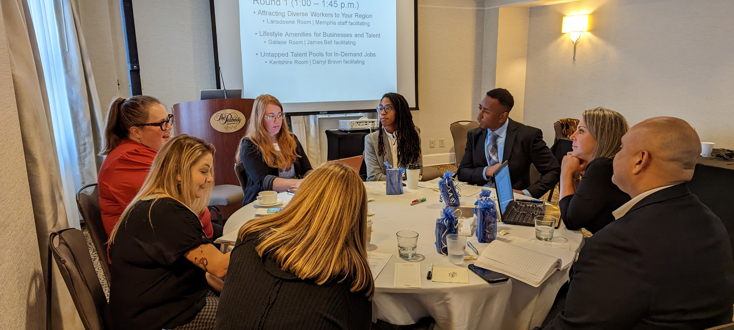
About ACCE and the ACCE Foundation
Safal Partners © 2024
Notes:
Amy

Slide 17
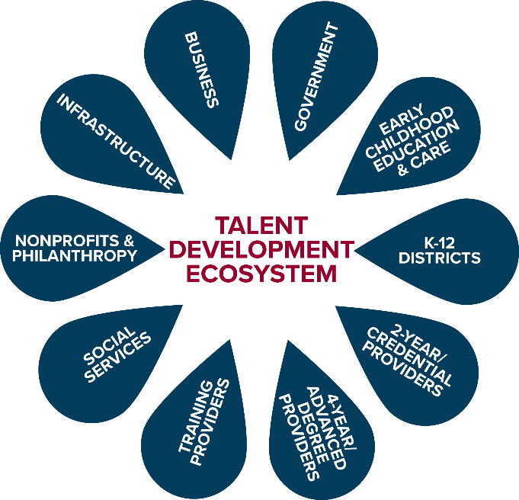
Talent Development Ecosystem
Notes:
Amy

Slide 18
Goals of Workforce Development 1
Public Sector Perspective
Equip workers with the skills and tools they need to succeed, navigate challenges and handle disruptions in the workplace¹
Help businesses find qualified workers
Education institutions, social service providers: sustainable economic security of an individual²
Community and economic developers: sustainable economic growth of a community, region²
Private Sector Perspective
Hire the best talent available
Develop talent on general and industry-specific skills to increase productivity, revenue over time and remain competitive
Invest in future talent
Approach workforce dev. from an organizational perspective²
1 Workforce Development Solutions, U.S. Dept. of Labor, Employment and Training Admin.
2 What is Workforce Development? Federal Reserve Bank of St. Louis
Notes:
Amy

Slide 19
An Individual's Talent Journey
Notes:
Amy

Slide 20
Work-Based Learning Framework

Slide 21
Impact of Work-Based Learning 1
93%
of apprentices stay with an employer after completing an apprenticeship program¹
Average exit wage for youth apprentices of all genders and races, compared to about $12 for all other youth. Differences were most pronounced for Black and Hispanic youth²
$31
53%
of employers surveyed converted interns to full time hires from 2022-2023³
1 ApprenticeshipUSA Factsheet, Apprenticeship.gov 2 Youth Apprenticeships Growing, Disparities Remain, Education Week 3 Intern Conversion Rate Fell, National Association of Colleges and Employers
Notes:
Amy

Slide 22
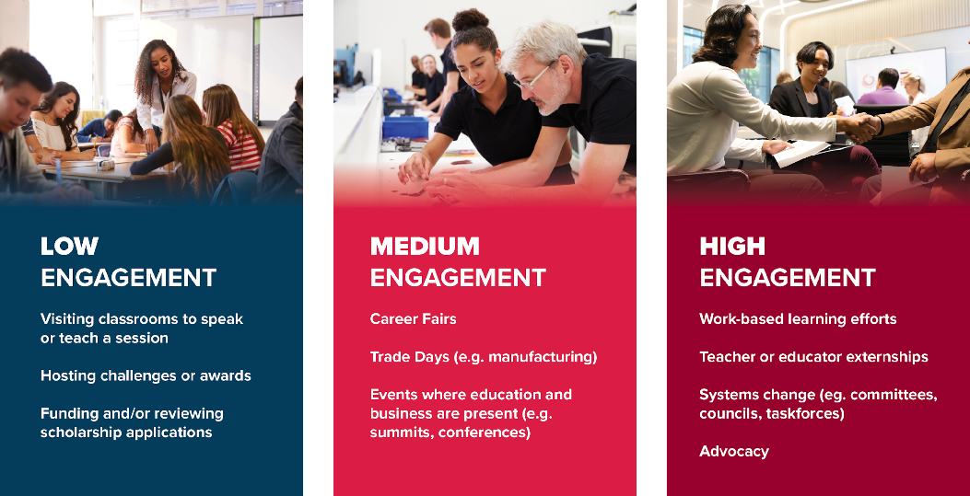
Levels of Involvement in WBL
Notes:
Amy

Slide 23
Benefits of Championing Apprenticeships
Help address talent pipeline gaps in your region
Provide pathways for economic mobility
Connect employers with skilled talent
Strengthen partnerships within the talent development ecosystem
Position the chamber as a problem solver
Potential non-dues revenue opportunity
Notes:
Amy

Slide 24
What Registered Apprenticeship Offers Chambers
Enhanced Portfolio of Opportunities
Stronger Contributions to the Local Community
Improved Policy Advocacy
Safal Partners © 2024
Notes:
JF
Enhanced Portfolio of Opportunities
Engage more deeply with member businesses by offering support and resources, including registration assistance, funding information, and apprentice connections.
Strengthen relationships with educational institutions, government agencies, and community organizations through collaboration.
Stronger Contributions to the Local Community
Reduce workforce shortages and fill jobs.
Help critical and emerging industries meet their workforce needs.
Improved Policy Advocacy
Gain a stronger voice in shaping policies that benefit members and the local economy by participating in Registered Apprenticeship initiatives.
Secure federal and state funding for Registered Apprenticeship programs.

Slide 25
What Registered Apprenticeship Offers Businesses
Standardized, Skilled Workforce
Improved Productivity Reduction in Turnover
Positive ROI
Safal Partners © 2024
Notes:
JF
Creating a Skilled Workforce
Hands-on training and classroom instruction tailored to industry needs.
Ensure programs are industry-driven and aligned with standards.
Help apprentices earn nationally recognized credentials.
Improving Productivity
Allow apprentices to apply skills directly to real work assignments.
Combine on-the-job learning with classroom instruction.
Reducing Turnover
Improve workplace morale and increase company loyalty.
Encourage long-term retention with the "earn while you learn" model.
Provide clear career pathways, reducing the likelihood of employees leaving and lowering costs for businesses.
Positive ROI
What is employees were trained exactly as you want them to be?

Slide 26
What Registered Apprenticeship Offers Businesses (Continued)
Customizing Training
Retaining Workers
Promoting Diversity
Safal Partners © 2024
Notes:
JF
Customizing Training
Design curricula aligned with specific goals and industry needs.
Address skill gaps and future workforce demands.
Retaining Workers
Retain 94% of apprentices a year after completing a program.
Offer structured career pathways with clear advancement opportunities.
Boost loyalty and job satisfaction by investing in employee development.
Promoting Diversity
Ensure programs reflect the communities in which they operate.
Implement strong non-discrimination, anti-harassment, and recruitment practices to ensure access, equity, and inclusion.
Offer underrepresented groups opportunities to enter and advance.

Slide 27
How Chambers are Currently Engaging in RA
Safal Partners © 2024
Notes:
JF

Slide 28
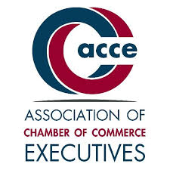
Chamber Pulse Check
Beginning in December 2023, Safal Partners began to speak with Chambers throughout the country to understand their involvement in registered apprenticeship and how they would like to get more involved.
Working with the ACCE, the team also surveyed chambers throughout the country to understand their involvement in registered apprenticeship, their needs, and what resources could help them.
Safal Partners © 2024
Notes:
JF

Slide 29
Chamber Survey Results
Knowledge and Engagement Levels:
Around half of the respondents indicate having relationships with local employers, unions, workforce boards, or educational institutions that sponsor apprenticeship programs.
Only a few chambers are currently sponsoring a registered apprenticeship program themselves.
Priorities and Involvement:
For most chambers, apprenticeships are a moderate priority (rated 2-4 on a 5-point scale) within their broader workforce and talent strategies.
Common ways chambers are involved include promoting apprenticeships to employers, convening employers to identify gaps, and working with school systems to support pre-apprenticeships.
Some chambers are exploring becoming apprenticeship intermediaries or supporting regulatory changes related to apprenticeships.
Safal Partners © 2024
Notes:
JF

Slide 30
Chamber Survey Results (Continued)
Barriers and Challenges:
Lack of employer engagement, funding constraints, limited knowledge about apprenticeships, limited chamber capacity, and the complexity of navigating the apprenticeship process.
Concerns about the ability to identify a sufficient talent pipeline to fill registered apprenticeships.
Resource Needs:
Training on the basics of the registered apprenticeship, guidance on providing technical assistance to employers, sample outreach materials, and how-to guides on different aspects of apprenticeships.
Resources on designing training curricula, promoting opportunities, and models for community collaboration around apprenticeships.
Safal Partners © 2024
Notes:
JF

Slide 31
Engagement Poll
How would you rate your organization's level of RA engagement?
Low
Medium
High
Safal Partners © 2024
Notes:
JF – hand off to AD for Chamber highlights

Slide 32
Noteworthy Chambers
Safal Partners © 2024
Notes:
AD

Slide 33
German-American Chamber of Commerce
Implements German-style Registered Apprenticeship programs across the Midwest and Southern US.
GACC works with 56 employers in fields like advanced manufacturing, pharmaceutical manufacturing, industrial electronics, and business operations (e.g., purchasing, marketing, HR, accounting).
They train company instructors, assist with recruitment and outreach, connect with college providers, and liaise with stakeholders.
Apprentices earn both a USDOL certification and a German journeyworker credential.
GACC expands Registered Apprenticeship initiatives based on workforce needs identified by member companies, partnering with workforce development organizations, and aiming to scale programs to a self-sustaining level.
Safal Partners © 2024
Notes:
AD

Slide 34
Kentucky Chamber Foundation
Partners with over 80 local chambers and 25,000 professionals, they advocate for Registered Apprenticeships to address labor shortages and workforce development.
Providers tools and information to help member businesses establish Registered Apprenticeship programs by equipping smaller chambers through the process.
They foster partnerships between educational institutions and the Registered Apprenticeship ecosystem, enabling students to earn both educational credentials and Registered Apprenticeship certificates.
Emphasizes diversity and inclusion, supporting underrepresented groups such as women, minorities, and individuals with disabilities to increase participation in Registered Apprenticeships.
Safal Partners © 2024
Notes:
JF – Talent Pipeline Management

Slide 35
Charleston Metro Chamber of Commerce
Promotes Registered Apprenticeship growth through their talent development program.
They helped to expand Registered Apprenticeship to nontraditional industries, recruit employers, arrange interviews, hosted signing days, and contributed private investment for related instruction at the local technical college through Accelerate Greater Charleston to over 200 employers across South Carolina.
The Chamber recruits employers, shares information through outreach events, and aligns regional workforce boards and employers to access WIOA funding to offset training costs.
Safal Partners © 2024
Notes:
NB

Slide 36
Greater Cleveland Partnership 1
ABA Category 4 Grant for $5.8 Million
Established a RAP Hub in Greater Cleveland
Used for Staff and for System Support/Growth
GCP serves as the program sponsor and acts as an intermediary to provide mentor training and support, identify and connect to wraparound services, assist with data collection and reporting, and advocate for RA program supported policies at the local, state, and federal level.
14 occupations registered
Safal Partners © 2024
Notes:
AD

Slide 37
How Can You Get Involved
Safal Partners © 2024
Notes:
AD

Slide 38
What Role Do/Could You Play in RA?
Convener
Partner
Sponsor
Engage community to share information about RA and maintain working knowledge of available resources
Actively promote RA, host events for RA stakeholders to present information, support through special initiatives
Register a group program and manage the related administrative duties for employers
Notes:
AD
Registered Apprenticeships (RA) offer incredible workforce solutions, and chambers of commerce can play a pivotal role in promoting and implementing these programs. Chambers can adopt one or more roles—convener, partner, or sponsor—based on their capacity and community engagement in workforce development.
As conveners, chambers connect members and stakeholders through events like industry roundtables, informational sessions, and workshops. By leveraging relationships with employers, educators, and public agencies, chambers accelerate awareness and adoption of RA programs while facilitating connections between members and apprenticeship experts.
As partners, chambers actively support members by coordinating marketing efforts, hosting apprenticeship fairs, and offering employability training or mentorship programs. They can also provide resources to streamline processes, advocate for funding, and host key events like National Apprenticeship Week celebrations.
Lastly, as sponsors, chambers take on administrative responsibilities to manage group RA programs for their members. This includes recruiting employers, maintaining apprentice records, and ensuring compliance with program standards. By assuming the sponsor role, chambers simplify the process for employers, enabling them to benefit from RA programs without added administrative burden.
Chambers of commerce have a unique opportunity to shape workforce development, bridge skills gaps, and help employers thrive by supporting RA in these impactful ways.

Slide 39
Key Resources to Access
Understanding of current state apprenticeship efforts
Engagement with apprenticeship ecosystem and/or
Where and how related apprenticeship funding is accessed
Industries and employers already involved and using RA
Safal Partners © 2024
Notes:
AD
Much of this is offered in our guide

Slide 40
Questions
Safal Partners © 2024

Slide 41
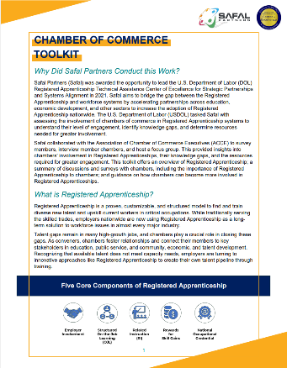
Chamber of Commerce Guide
Scan QR Code for Guide

Slide 42
Contact Us
Nicole Bentley
Subject Matter Expert
Safal Partners
Nicole.Bentley@safalpartners.com
Amy Shields
Executive Director of the ACCE Foundation & VP of Programs at ACCE
ashields@acce.org
Jeremy Faulkner
Subject Matter Expert
Safal Partners
Jeremy.Faulkner@safalpartners.com
Alan D. Dodkowitz
Subject Matter Expert
Safal Partners
Alan.Dodkowitz@safalpartners.com
Notes:
Need to add Amy

Slide 43
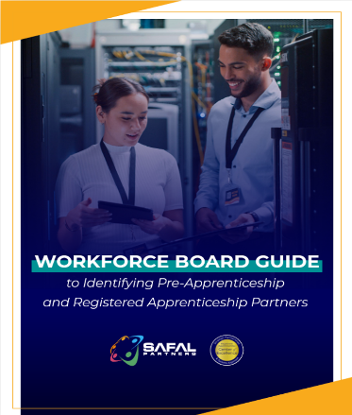
No-Cost Resources
Guide to Identifying Partners
Safal Partners © 2024
Notes:
AD

Slide 44
Thank You for Joining Us
Email us your questions at RA_COE@SafalPartners.com
For more information, visit: dolcoe.safalapps.com

