Slide 1
Understanding and Supporting Registered Apprenticeship in Your Community
July 18, 2024

Slide 2
Presenters
Nicole Bentley
Jeremy Faulkner
Alan D. Dodkowitz
Subject Matter Expert
Safal Partners
Subject Matter Expert
Safal Partners
Subject Matter Expert
Safal Partners

Slide 3
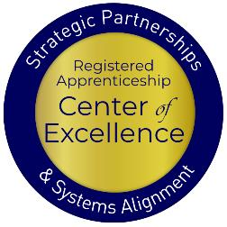
Welcome and Agenda
Center of Excellence Overview
An Overview of Registered Apprenticeship
Current Involvement of Chambers in Registered Apprenticeship
Examples of Chamber Involvement
Overview of the Greater Cleveland Partnership
How Your Chamber Can Get Involved
Questions and Closing Thoughts
Safal Partners © 2024

Slide 4
Center of Excellence Overview
U.S. DOL initiative to increase systems alignment across apprenticeship, education, and workforce
Led by Safal Partners
Collaboration with 5 national partners
We provide no-cost technical assistance (TA) including:
Monthly webinars
Quarterly virtual office hours
Individual TA/coaching sessions
Online resources (desk aids, guides, frameworks, etc.)
Visit our website & request TA

Slide 5
An Overview of Registered Apprenticeship
Safal Partners © 2024

Slide 6
What is Registered Apprenticeship?
Registered Apprenticeship is a proven, customizable, and structured model to find and train new talent as well as upskill current workers in critical occupations.
Safal Partners © 2024

Slide 7
Five Core Components of RA
Employer Involvement
Structured On-the-Job Learning (OJL)
Related Instruction (RI)
Rewards for
Skill Gains
National Occupational Credential
Safal Partners © 2024

Slide 8
How's Your RA Knowledge?
Basic
Intermediate
Expert
I know what it means, but I don’t know how to utilize it and don't have significant experience with it.
I understand RA, I've had experience with RA in some capacity, and I feel comfortable educating internal and external stakeholders about it.
I have extensive knowledge and relevant experience:
developing programs
accessing multiple sources of funding;
convening stakeholders ;
adding programs to the ETPL;
recruiting apprentices or employers.

Slide 9
Key Organizational Apprenticeship Roles
Sponsor
Employer
RI Provider
Partner
An organization that agrees to operate an apprenticeship program and in whose name the program is registered.
Hires and provides paid OJL for apprentices under supervision of a designated mentor who is a skilled professional in that occupation.
Entity that provides instruction to apprentices in the designated occupation’s core knowledge, skills, and abilities.
Organizations committed to assisting RA programs. They can play one or more roles.

Slide 10
Engagement Poll
How would you rate your organization's level of RA engagement?
Low
Medium
High

Slide 11
Registered Apprenticeship and Chambers- A Match Made for Each Other
Safal Partners © 2024

Slide 12
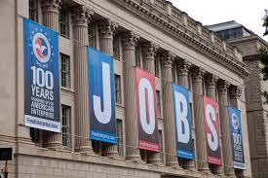
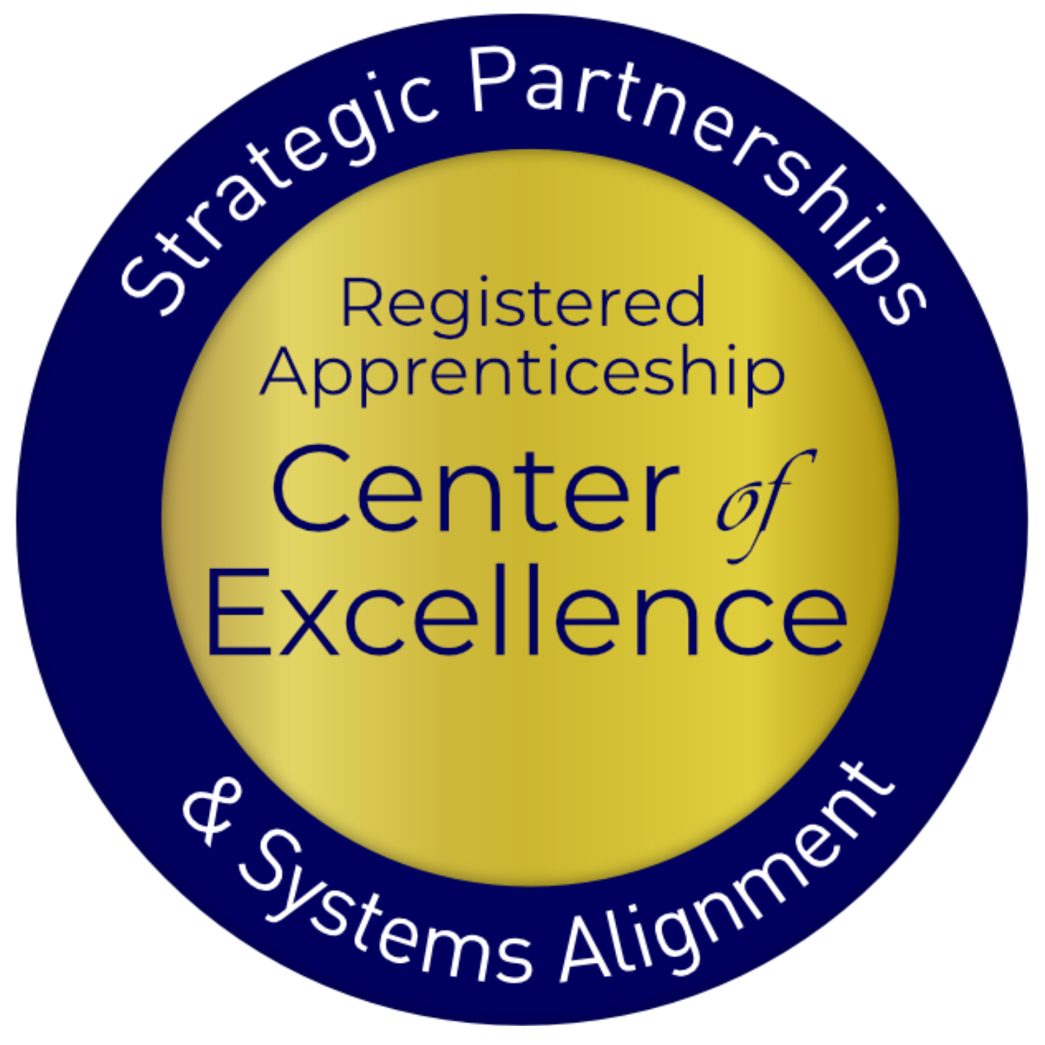
What Registered Apprenticeship Offers Chambers
Enhanced Portfolio of Opportunities
Stronger Contributions to the Local Community
Improved Policy Advocacy
Safal Partners © 2024

Slide 13
What Registered Apprenticeship Offers Businesses
Standardized, Skilled Workforce
Improved Productivity
Reduction in Turnover
Positive ROI
Safal Partners © 2024

Slide 14
What Registered Apprenticeship Offers Businesses (Continued)
Customizing Training
Retaining Workers
Safal Partners © 2024

Slide 15
How Chambers are Currently Engaging in RA
Safal Partners © 2024

Slide 16
Chamber Pulse Check
Beginning in December 2023, Safal Partners began to speak with Chambers throughout the country to understand their involvement in registered apprenticeship and how they would like to get more involved.
Working with the ACCE, the team also surveyed chambers throughout the country to understand their involvement in registered apprenticeship, their needs, and what resources could help them.
Safal Partners © 2024

Slide 17
Chamber Survey Results
Knowledge and Engagement Levels:
Around half of the respondents indicate having relationships with local employers, unions, workforce boards, or educational institutions that sponsor apprenticeship programs.
Only a few chambers are currently sponsoring a registered apprenticeship program themselves.
Priorities and Involvement:
For most chambers, apprenticeships are a moderate priority (rated 2-4 on a 5-point scale) within their broader workforce and talent strategies.
Common ways chambers are involved include promoting apprenticeships to employers, convening employers to identify gaps, and working with school systems to support pre-apprenticeships.
Some chambers are exploring becoming apprenticeship intermediaries or supporting regulatory changes related to apprenticeships.
Safal Partners © 2024

Slide 18
Chamber Survey Results (Continued)
Barriers and Challenges:
Lack of employer engagement, funding constraints, limited knowledge about apprenticeships, limited chamber capacity, and the complexity of navigating the apprenticeship process.
Concerns about the ability to identify a sufficient talent pipeline to fill registered apprenticeships.
Resource Needs:
Training on the basics of the registered apprenticeship, guidance on providing technical assistance to employers, sample outreach materials, and how-to guides on different aspects of apprenticeships.
Resources on designing training curricula, promoting opportunities, and models for community collaboration around apprenticeships.
Safal Partners © 2024

Slide 19
Noteworthy Chambers
Safal Partners © 2024

Slide 20
German-American Chamber of Commerce
Implements German-style Registered Apprenticeship programs across the Midwest and Southern US.
GACC works with 56 employers in fields like advanced manufacturing, pharmaceutical manufacturing, industrial electronics, and business operations (e.g., purchasing, marketing, HR, accounting).
They train company instructors, assist with recruitment and outreach, connect with college providers, and liaise with stakeholders.
Apprentices earn both a USDOL certification and a German journeyworker credential.
GACC expands Registered Apprenticeship initiatives based on workforce needs identified by member companies, partnering with workforce development organizations, and aiming to scale programs to a self-sustaining level.
Safal Partners © 2024

Slide 21
Kentucky Chamber Foundation
Partners with over 80 local chambers and 25,000 professionals, they advocate for Registered Apprenticeships to address labor shortages and workforce development.
Providers tools and information to help member businesses establish Registered Apprenticeship programs by equipping smaller chambers through the process.
They foster partnerships between educational institutions and the Registered Apprenticeship ecosystem, enabling students to earn both educational credentials and Registered Apprenticeship certificates.
Safal Partners © 2024

Slide 22
Charleston Metro Chamber of Commerce
Promotes Registered Apprenticeship growth through their talent development program.
They helped to expand Registered Apprenticeship to nontraditional industries, recruit employers, arrange interviews, hosted signing days, and contributed private investment for related instruction at the local technical college through Accelerate Greater Charleston to over 200 employers across South Carolina.
The Chamber recruits employers, shares information through outreach events, and aligns regional workforce boards and employers to access WIOA funding to offset training costs.
Safal Partners © 2024

Slide 23
Greater Cleveland Partnership
Safal Partners © 2024

Slide 24
Who is GCP?
Region’s leading economic development organization
Over 12,000
members
Nation’s largest metropolitan chamber of commerce
We focus on strategic initiatives, business services, and advocacy
Safal Partners © 2024

Slide 25
GCP’s RAP Journey
ABA Category 4 Grant for $5.8 Million
Established a RAP Hub in Greater Cleveland
Used for Staff and for System Support/Growth
Safal Partners © 2024

Slide 26
OUTCOMES - Programs
10
5
20
New
RA Programs
Expand Existing
RA Programs
Pre-Apprenticeship Programs
Safal Partners © 2024

Slide 27
OUTCOMES - People
600
1500
RAP Enrollees
(Apprentices)
Pre-Apprenticeship
Participants
Safal Partners © 2024

Slide 28
OUTCOMES - Resources
Employers
Jobseekers (Potential Apprentices and Pre-Apprentices)
Community Based Organizations and Other Partners
K-12 Schools, Colleges and Universities, and Other Training Providers
The General Public
32
Technical Assistance (TA) Resources
Safal Partners © 2024

Slide 29
GCP’s Role – Our Promises To Employers
Lead
Program Design
Serve as
the Intermediary
Provide Starter Incentives & Funding
Help Recruit and Interview Candidates
Safal Partners © 2024

Slide 30
GCP’s Role – Our Promises To Employers2
Provide Mentor
Training & Support
Identify & Connect to Wraparound Services
Assist with Data Collection & Reports
Advocate at the Local, State & Federal Levels
Safal Partners © 2024

Slide 31
Ecosystem Partners & Relationship Building
State and/or Federal Apprenticeship Agency
Community Based Organizations (CBOs)
Other Regional Chambers
Workforce
Boards
YOUR ORGANIZATION
Training Providers
K-12 School Systems
Colleges and Universities
Safal Partners © 2024

Slide 32
Lessons Learned
This Takes
Work
Understand Your Audiences
A Win
Is a Win
Safal Partners © 2024

Slide 33
GCP’s Achievements – So Far!
14 Occupations Registered
Signing Day Event
Employer Convening Events
Sales Training for the Hub Team
Safal Partners © 2024

Slide 34
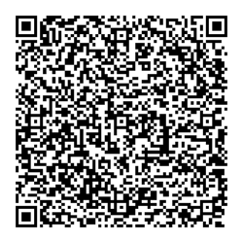
Engage with GCP
Connect with us on social or via apprenticeships@greatercle.com
Safal Partners © 2024

Slide 35
How Can You Get Involved
Safal Partners © 2024

Slide 36
What Role Do/Could You Play in RA?
Convener
Partner
Sponsor
Engage community to share information about RA and maintain working knowledge of available resources
Actively promote RA, host events for RA stakeholders to present information, support through special initiatives
Register a group program and manage the related administrative duties for employers

Slide 37
Key Resources to Access
Understanding of current state apprenticeship efforts
Engagement with apprenticeship ecosystem
Where and how related apprenticeship funding is accessed
Industries and employers already involved and using RA
Safal Partners © 2024

Slide 38
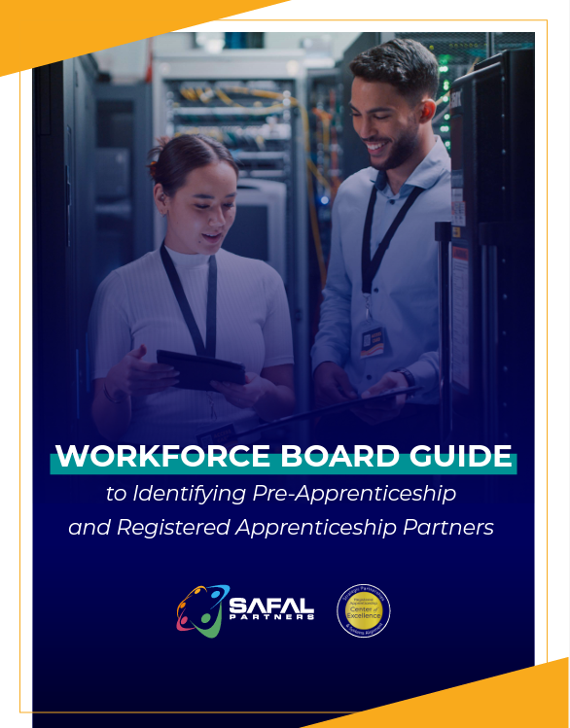
No-Cost Resources
Request no-cost online or in-person training for your organization
Become a Center partner to receive notification of upcoming webinars, Virtual Office Hours
Visit our website for downloadable materials
Guide to Identifying Partners
© 2024 Safal Partners

Slide 39
Questions and Answers

Slide 40
Evaluation
Please take a moment to give us your feedback.

Slide 41
Contact Us
Nicole Bentley
Subject Matter Expert
Safal Partners
Nicole.Bentley@safalpartners.com
Jeremy Faulkner
Subject Matter Expert
Safal Partners
Jeremy.Faulkner@safalpartners.com
Alan D. Dodkowitz
Subject Matter Expert
Safal Partners
Alan.Dodkowitz@safalpartners.com

Slide 42
Contact Us, Become a Partner
Scan for Partner Form
Receive no-cost expert TA, materials, and assistance
Network with potential partners nationwide
Be nationally recognized for your work

Slide 43
Thank You for Joining Us
Email us your questions at RA_COE@SafalPartners.com
For more information, visit: dolcoe.safalapps.com

