Slide 1
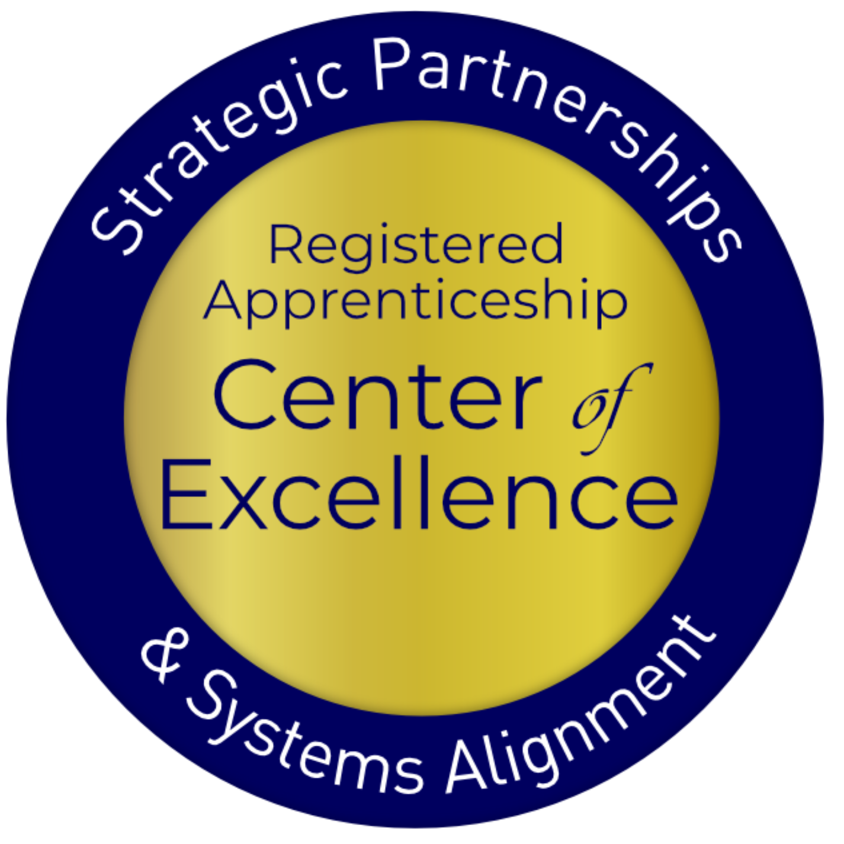
Linking Secondary and Post-Secondary CTE to Pre-Apprenticeship

Slide 2
USDOL Center of Excellence
Mission: Scale partnerships to accelerate adoption of Registered Apprenticeship (RA) and improve RA alignment with our nation's workforce and education systems

Slide 3
Our Work – Three Strategies
Provide technical assistance (TA) on a national scale to:
RA program sponsors
State and local workforce boards and American Job Center (AJC) programs and operators
K-12, college and university, Adult Education, and Career and Technical Education programs
State and federal policymakers
Engage and build partnership with and between essential RA stakeholders
Coordinate with federal and state investments

Slide 4
Apprenticeship: Why and What

Slide 5
Understanding Apprenticeship
How would you rate your general knowledge of Registered Apprenticeship?
How would you rate your knowledge of the existing Registered Apprenticeship programs in your local area?

Slide 6
What is Apprenticeship?
A Proven Workforce
Solution
Registered Apprenticeship is an industry-driven, high-quality career pathway enabling employers to develop new hires and upskill current workers for critical occupations.

Slide 7
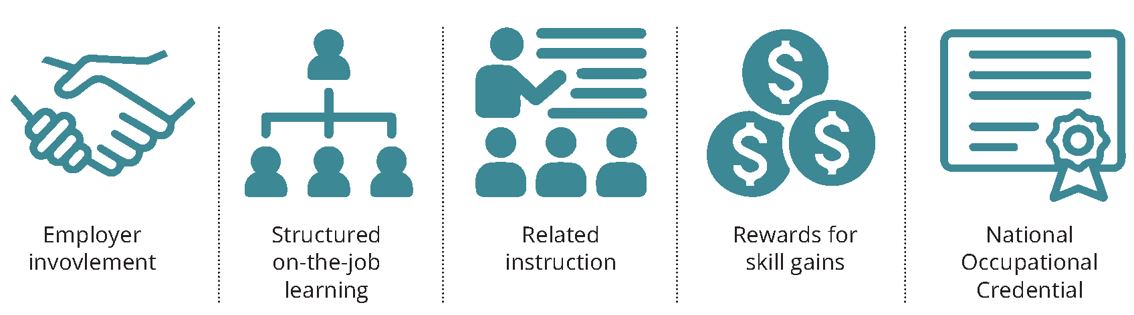
Five Core Components

Slide 8
What’s Driving RA Expansion?
Facts
Half-life of skills is five years
Shrinking labor market participation rate
Rapidly evolving technology, Artificial Intelligence (AI), automation, robotics
Implications
Shift from K-12 to lifelong learning
Career pathways with opportunities for advancement not just a job
Businesses will need to "build, not buy" talent by training them

Slide 9
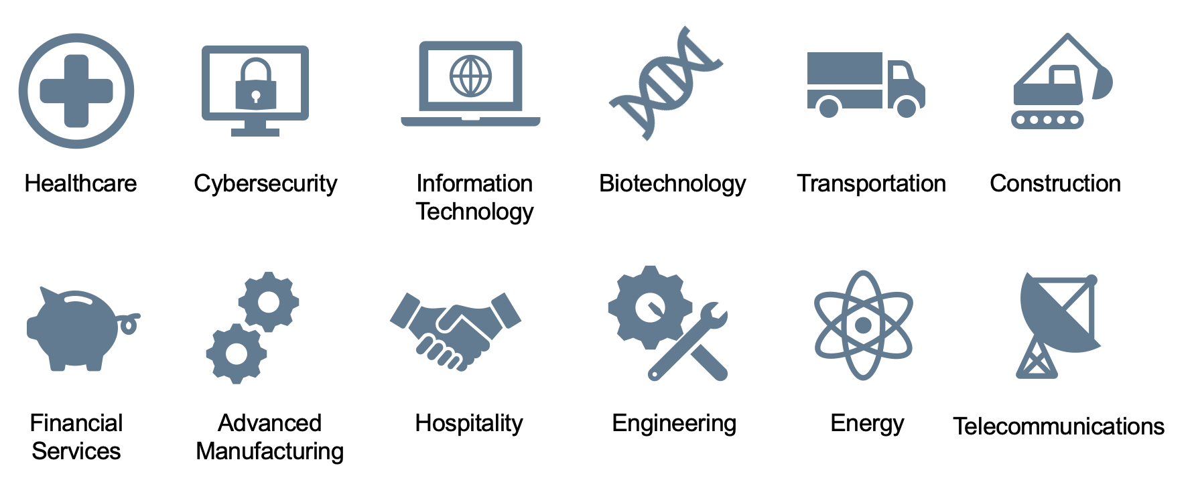
Spanning all Sectors

Slide 10
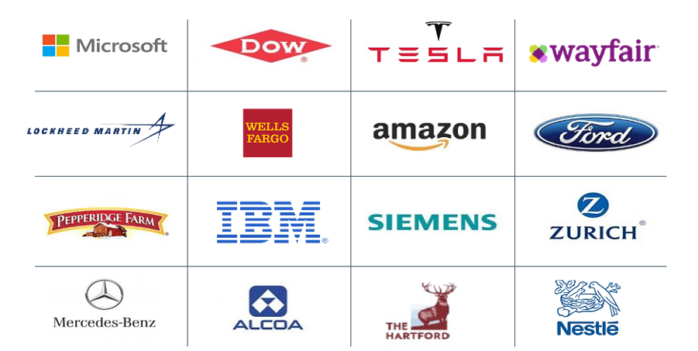
Businesses Using RA

Slide 11
Why They're Choosing RA
Attract New Talent : 70% of workers would be “extremely” or “very” likely to switch to a new employer offering training opportunities
Proven ROI : Employers report on average $1.47 for every $1 invested in RA – highly cost effective in the long term
Expand Workforce : With a training plan in place from day one, employers can take a skills-based approach to hiring which creates much larger talent pipeline
Would you switch to a new employer for training opportunities?
Sources: Gallup 2021, USDOL

Slide 12
Why They're Choosing RA
Better Rate of Hire
Higher 1-Year+ Retention Rate
Sources: Apprenticeship.gov (USDOL),
National Association of Colleges & Employers “2020 Internship & Co-Op Report”

Slide 13
Pre-Apprenticeship: What, Why and How

Slide 14
What is Pre-Apprenticeship?
A program or set of strategies designed to prepare individuals for entry into RA programs.
Not federally overseen / not in National Apprenticeship Act = more flexibility
Expanding and some SAA implications

Slide 15
6 High-Quality Hallmarks
Transparent entry and success requirements
Training in skills sought by employers
Skills training through WBL and hands-on learning
Student support for persistence
Results in 1+ industry-valued credentials
Direct entry/preferred application for linked RAP

Slide 16
Role of CTE in RA
Engage Employers
Create Student Pathways
Collaborate with Workforce
Supply a pool of candidates
Deliver relevant workforce training (soft skills and technical skills) that maps to required related instruction
Design on-ramp to accelerate entry
Leverage students’ instruction and experience to achieve multiple outcomes
Provide training and instruction for in-demand careers
Recruit program candidates (adults)
Access funding for training costs (ITA)
Access supportive services for WIOA-eligible students

Slide 17
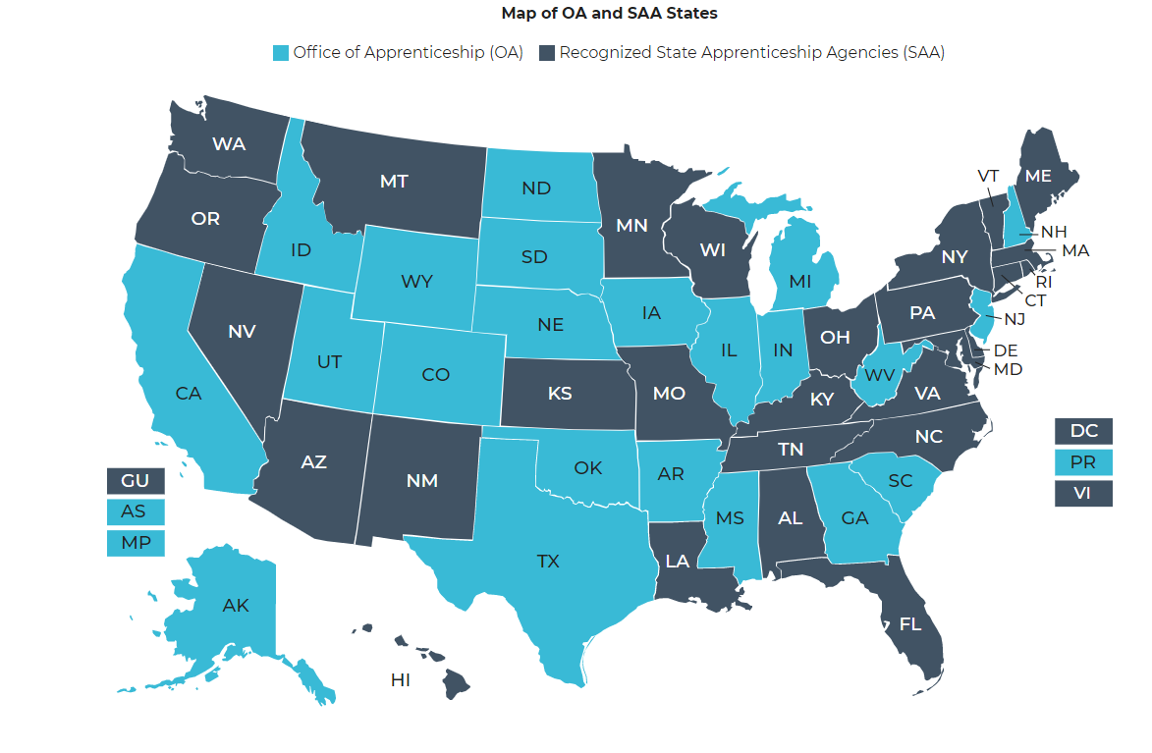
Getting Started: System Connection
Identify local RA sponsors with programs aligned with your programming
https://www.apprenticeship.gov/about-us/state-offices

Slide 18
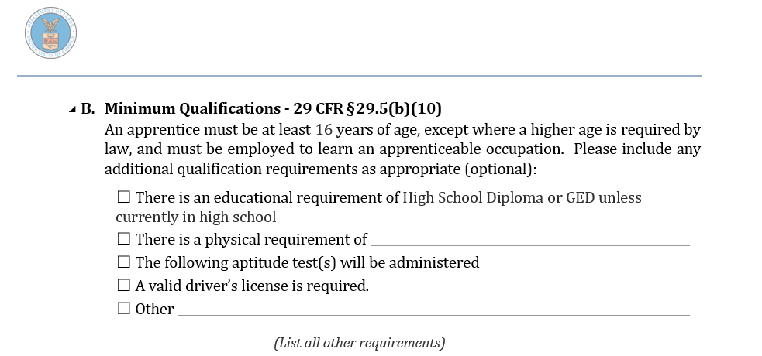
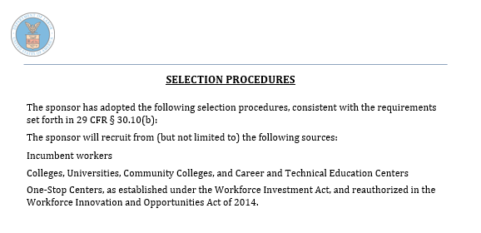
Employer Talk: Quals and Entry
All RAPs have Minimum Qualifications and Selection Procedures
Show:
What applicants will need/be able to pass
Prospective talent pool sources
Can be used for students’ RAP application work
Can help with pre-app program marketing

Slide 19
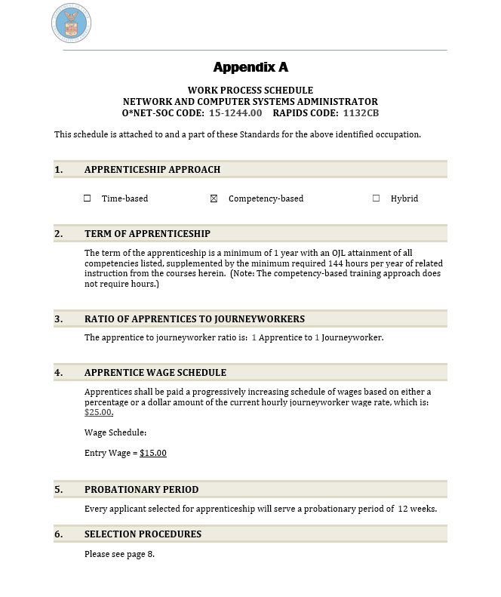
Employer Talk: Standards Review
Discuss Program Standards
Mapping to Program
Minimum qualifications
Selection procedures
Ideal core knowledge (RI)
Ideal basic foundational skills (OJL)
Evaluate current program for alignment
curriculum for RI
Lab work, WBL for OJL
Hours (for TB programs) or competencies (for HY/CB programs)

Slide 20
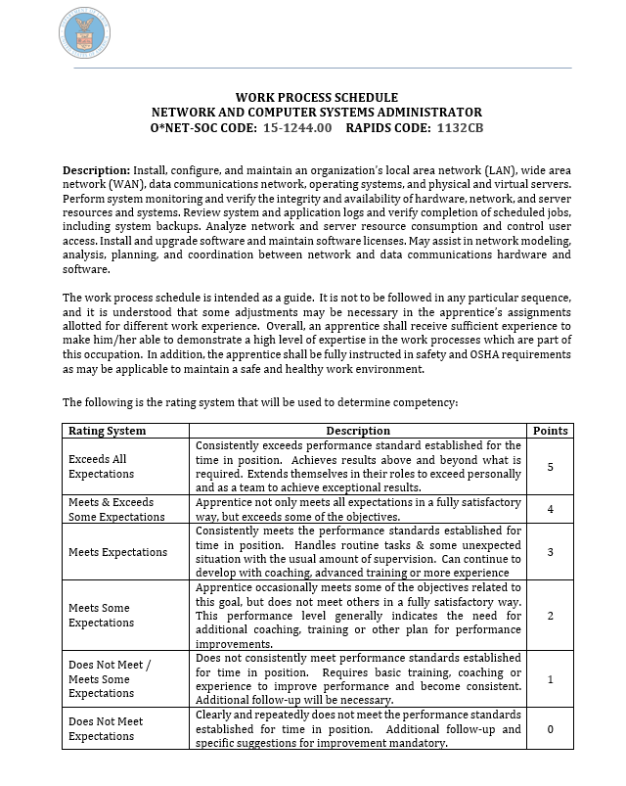
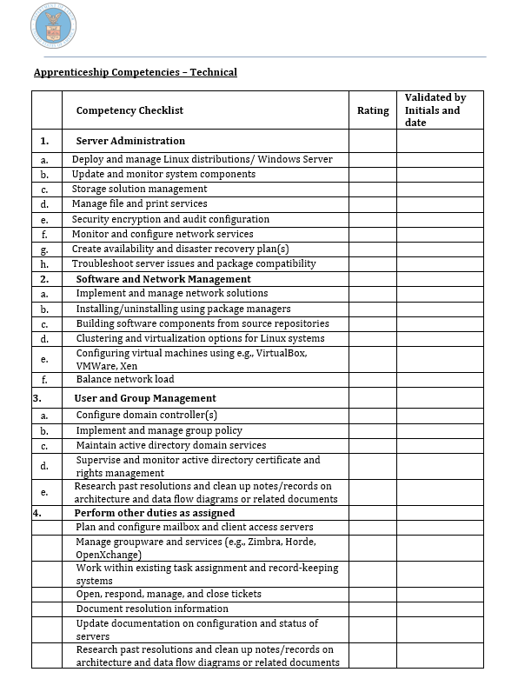
Employer Talk: On the Job Learning Mapping
All RAPs have Work Process (OJL) Outlines
Show model:
Time-based
Hybrid
Competency-based
Show core skills required for RAP – can map to CTE lab work, WBL

Slide 21
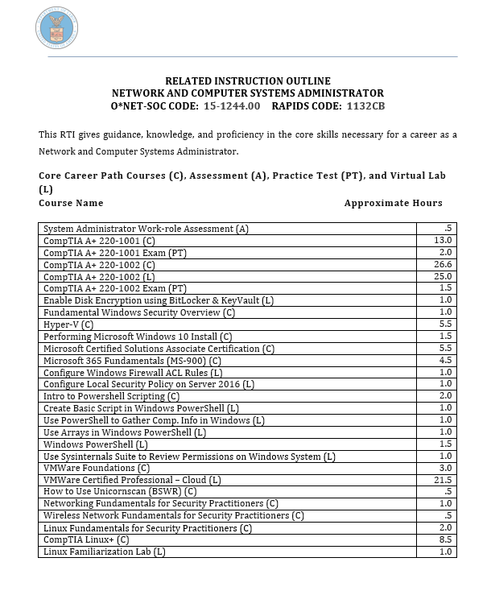
Employer Talk: Related Instruction Mapping
All RAPs have Related Instruction Outlines
Min. 144 hours/yr
Show:
Core technical instruction
Employability instruction
Can be mapped to CTE courses

Slide 22
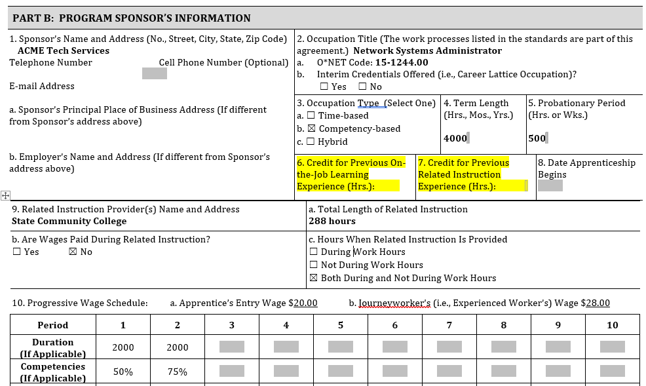
Employer Talk: CPE/CPL
Provide Employer Partner with CPE/CPL Tool
Maximizes students’ pre-apprenticeship program investment
Accelerates apprentice program completion timeframe

Slide 23
Next Step: Partnership Work
Collaborating with Employer
Working with Workforce
Identify employer-based options for pre-RA to RA entry process (i.e., job shadowing)
Co-design program application and referral process
Identify potential support services for pre-apprentices to facilitate completion (i.e., transportation, equipment, etc.)

Slide 24
Go To Market
Employers want to know that successful program completers have:
relevant foundational skills (experience can be applied toward OJL requirement through credit for prior experience)
relevant technical knowledge (coursework can be applied to RTI requirement through CPL)
successfully earned related credential/certification – or are equipped and eligible to test out
met minimum qualifications
may be eligible for continued workforce supportive services during RAP
Goal: Direct entry agreement

Slide 25
Thank You
Katie Adams
Senior Director
katie.adams@safalpartners.com
Connect with the Center
https://dolcoe.safalapps.com
Become a Partner
Open your camera
Scan QR code

