Slide 1
Aligning the Maryland Workforce and Apprenticeship Systems
June 2024

Slide 2
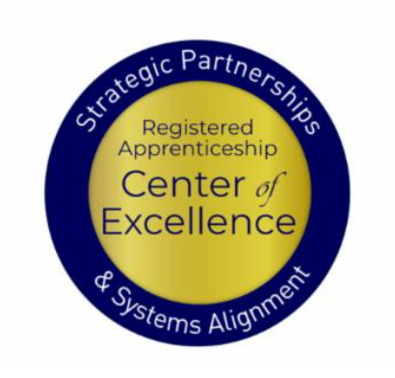
Presenters
Lisa Rice
Jeremy Faulkner
Alan D. Dodkowitz
Subject Matter Expert
Safal Partners
Subject Matter Expert
Safal Partners
Subject Matter Expert
Safal Partners

Slide 3
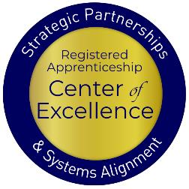
Welcome and Agenda
Center of Excellence Overview
An Overview of Registered and Youth Apprenticeship
What is the State of Registered Apprenticeship (RA) in Maryland
Resources to Support Registered Apprenticeship
Local Workforce Board Involvement in RA
Working with Intermediaries to Support Your Board
Questions and Wrap Up
Safal Partners © 2024
Notes:
Lisa

Slide 4
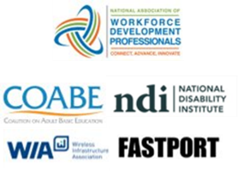
Center of Excellence Overview
U.S. DOL initiative to increase systems alignment across apprenticeship, education, and workforce
Led by Safal Partners
Collaboration with 5 national partners
We provide no-cost TA including:
Monthly webinars
Quarterly virtual office hours
Individual TA/coaching sessions
Online resources (desk aids, guides, frameworks, etc.)
Visit our website & request TA
Notes:
Lisa
Safal was awarded the opportunity to lead the US DOL Registered Apprenticeship Technical Assistance Center of Excellence for Strategic Partnerships and Systems Alignment in 2021.
We are here to help close the gap between the apprenticeship and workforce systems and accelerate partnerships across education, economic development, and other partners to increase adoption of RA nationwide.
The Center is supported by five national partners including the National Association of Workforce Development Professionals, the Coalition on Adult Basic Education, the National Disability Institute, FASTPORT, and the Wireless Infrastructure Association.
Our national partners were strategically chosen to help us reach specific groups whether on the workforce, education or employer side
California Workforce Association (CWA) is our partner in the state, helping increase workforce system awareness and utilization of RA as a workforce solution for both employers and jobseekers.
The Center of Excellence provides no-cost technical assistance – online, in-person and through hybrid delivery - to accelerate sustainable partnerships and align apprenticeship, workforce and education systems.

Slide 5
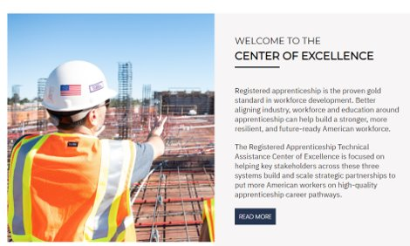
Online Resources, On-Demand TA
Registered Apprenticeship Partner Profile Questionnaire
https://dolcoe.safalapps.com/resources/resourcesandtools
Notes:
Lisa
Our website is continually updated with relevant news, TA resources and tools including frameworks, case studies, webinars, customizable templates, questionnaires, and more.
Since 2021 more than 3,000 organizations have become no-cost Center partners and utilized our tools – such as the "RA Partner Profile Questionnaire" - to accelerate their organizations' understanding and effective usage of RA.
Link to Questionnaire - https://dolcoe.safalapps.com/sites/default/files/2022-11/Partnership%20Questionnaire.pdf
This questionnaire is intended to help you build a network in your area around Registered Apprenticeship (RA). With the information gathered here, your board should be better able to engage with and convene RA stakeholders to expand RA program opportunities. It is designed to be used in conjunction with the USDOL RA TA Center of Excellence “Workforce Board Guide to Identifying Pre-Apprenticeship and Apprenticeship Partners” publication. This publication and more information on the Center can be found online at dolcoe.safalapps.com﻿

Slide 6
An Overview of Registered and Youth Apprenticeship
Safal Partners © 2024
Notes:
Jeremy

Slide 7
What is Registered Apprenticeship?
Registered Apprenticeship is a proven, customizable, and structured model to find and train diverse new talent as well as upskill current workers in critical occupations.
Safal Partners © 2024
Notes:
Jeremy
Three main characteristics
Great way to recruit new talent and train them exactly the way you want them to be trained
Also a great way to identify talent already in your organization and upskill them – help them move to new levels in your org and help them gain the education to complement their work experience

Slide 8
Five Core Components of RA
Employer Involvement
Structured On-the-Job Learning (OJL)
Related Instruction (RI)
Rewards for
Skill Gains
National Occupational Credential
Safal Partners © 2024
Notes:
Jeremy
There are 5 core components of RA – will hear these again in breakout sessions, maybe even alter in this presentation
Count them off with me

Slide 9
How's Your RA Knowledge?
Basic
I know what it means, but I don’t know how to utilize it and don't have significant experience with it
Intermediate
I understand RA, I've had experience with RA in some capacity, and I feel comfortable educating internal and external stakeholders about it.
Expert
I have extensive knowledge and relevant experience:
developing programs
accessing multiple sources of funding;
convening stakeholders ;
adding programs to the ETPL;
recruiting apprentices or employers.
© 2024 Safal Partners
Notes:
Jeremy
A quick poll just to get an idea of the knowledge
No need to feel embarrassed or bad about your level of exposure…that’s why we’re here

Slide 10
Key Organizational Apprenticeship Roles
Sponsor
RI Provider
Employer
Partner
An organization that agrees to operate an apprenticeship program and in whose name the program is registered.
Entity that provides instruction to apprentices in the designated occupation’s core knowledge, skills, and abilities.
Hires and provides paid OJL for apprentices under
supervision of a designated mentor who is a skilled professional in
that occupation.
Organizations
committed to assisting RA programs. They can play one or more roles.
© 2024 Safal Partners
Notes:
Jeremy
Another list – roles to play within the RA ecosystem
Sponsor – you can operate a program
RI Related Instruction provider – offer course learning to apprentices
Employer – you can be the company who hires the apprentice and offers on the job learning
Partner – this is the role most of us in the room today play – we aren’t the apprentice, we aren’t the employer or the instruction provider, but we will have a role to play - we champion RA, we offer it as a solution to workforce challenges, we maintain a working knowledge of trends and evolution in the RA world, we know enough to speak intelligently about it and point business customers in the right direction

Slide 11
What Role Do/Could You Play in RA?
Partner
(Workforce Board,
Intermediary,
Gov Official, Community Org)
RI Provider
(Education Entity, University, Community College)
Employer
(Hire the apprentice,
provide OJL and mentor)
Sponsor
(Register the program, provide documentation)
© 2024 Safal Partners
Notes:
Jeremy
Who typically fulfills each role?

Slide 12
What is Youth Apprenticeship?
A youth apprentice is defined as…​
an in-school OR out-of-school youth between the ages of 16 and 24…​
​
who receives industry-validated Related Instruction for an RA program from an education provider while… ​
​ completing part-time, paid, work-based experience ​from an employer under a ​ mentored supervision as part of… ​
​
a program approved ​ by DOL or a state apprenticeship agency (SAA).​
​
© 2024 Safal Partners
Notes:
Lisa

Slide 13
High-Quality Youth Apprenticeship
In addition to meeting core RA requirements, high quality youth RA programs:
provide dual enrollment pathway for college credit for RI
(if school is sponsor) include articulated agreement with another program sponsor to ensure that student can continue paid OJL (and RI if needed) after graduation​
provide apprentice with a clearly-outlined career pathway beyond RA program completion for occupations that provide a family-supporting wage ​
embeds, or prepares student to test out for, industry-recognized certifications or credentials​
builds equity in program design including qualifications, supports for persistence, etc.
© 2024 Safal Partners
Notes:
Lisa

Slide 14
The Maryland Workforce System
Safal Partners © 2024
Notes:
Alan

Slide 15
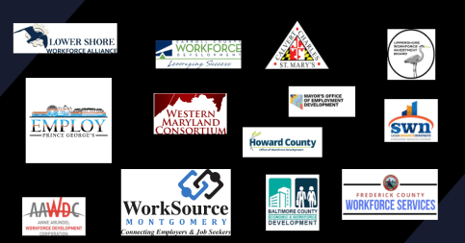
13 Local Workforce Boards
Maryland is split into five regions with a total of 13 local workforce boards
The local boards operate WIOA, Wagner-Peyser, Adult Education, Vocational Rehabilitation, and other services to assist Maryland’s workforce
Funded through combination of federal WIOA dollars, recent ARPA funding, state-level funding, and other grants and partnerships
© 2024 Safal Partners
Notes:
Alan

Slide 16
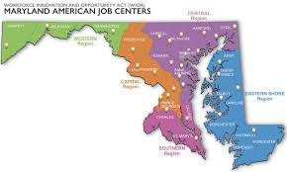
32 American Job Centers
© 2024 Safal Partners
Notes:
Alan / Katie

Slide 17
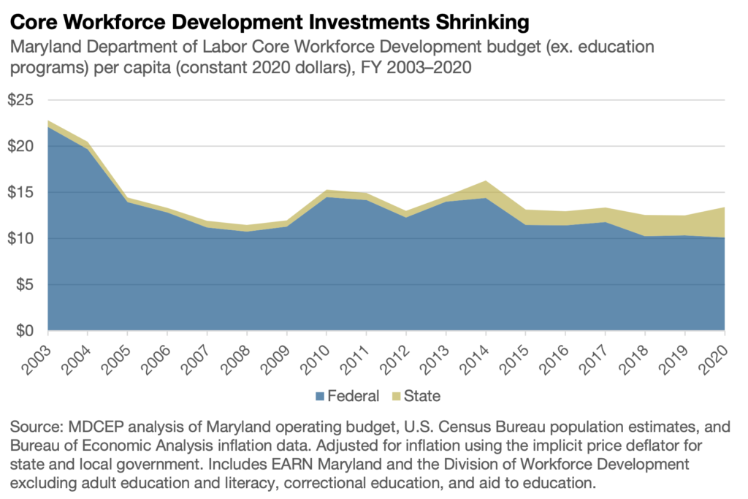
Workforce Development Investments Have Been Shrinking
© 2024 Safal Partners
Notes:
Alan / Katie

Slide 18
What is the Current State of Registered Apprenticeship in Maryland
Safal Partners © 2024
Notes:
Alan

Slide 19
Maryland’s Registered Apprenticeship System
Maryland has its own State Apprenticeship Agency (SAA)- Maryland Apprenticeship and Training Program (MATP) - Division of Workforce Development and Adult Learning
The MATP approves, through the twelve-member Maryland Apprenticeship and Training Council (MATC), formulates policies, registers standards and agreements, determines which skilled trades are apprenticeable, and formulates and adopts standards of apprenticeship.
There are over 12,000 active Registered Apprentices in Maryland- 20% increase since 2015
As of March 2023, Maryland has a total of 516 active, cancelled, and completed registered apprenticeships across various occupations
© 2024 Safal Partners
Notes:
Alan
30 FTEs in MATP- up from 2.5 since 2016

Slide 20
But Only Modest Co-Enrollment
© 2024 Safal Partners
Notes:
Alan / Katie

Slide 21
Maryland 2030- Ambitious Goals for the State!
The Blueprint sets a goal for 45% of high school graduates completing an apprenticeship or an industry-recognized occupational credential by the 2030-2031 school year
Coordinated through The Apprenticeship Maryland Program (AMP), the program consists of at least one year of related classroom instruction and a workplace component of at least 450 hours
There are nearly 300 employers actively participating, representing industries including architecture, healthcare, construction, hospitality, manufacturing, government, and others
© 2024 Safal Partners
Notes:
Alan / Katie

Slide 22
Engagement Poll
How would you rate your organization's level of RA engagement?
Low
Medium
High
© 202 Safal Partners
Notes:
Alan

Slide 23
Resources to Support Registered Apprenticeship- Maryland has a Lot!
Safal Partners © 2024
Notes:
Alan

Slide 24
Financial Support for Apprenticeship
For the first five eligible Apprentices claimed, employers may receive $3,000 per Registered Apprentice and $1,000 per Youth Apprentice
Sponsor Apprentice Incentive Reimbursement (SAIR) offers Sponsors up to $2,500 to offset the costs of Related Instruction (RI)
Maryland Business Works is an incumbent worker training program that provides up to $4,500 per apprentice
© 2024 Safal Partners
Notes:
Alan

Slide 25
Employ Prince George’s ARPA Initiative
Allows job seekers to obtain credentials in Registered Apprenticeships and Pre-Apprenticeships through two initiatives: Apprenticeship Expansion Fund and the Apprentices Ready initiative.
The Apprenticeship Expansion Fund is a provides employers $2,500 - $5,000 per new employee placed into an apprenticeship.
Apprentices Ready Initiative pays for residents who don’t qualify for employment through an apprenticeship to receive pre-apprenticeship training and be paid $15 per hour during training.
© 2024 Safal Partners
Notes:
Alan

Slide 26
Leveraging Federal Support
Federal Discretionary Apprenticeship Funding
2016 Apprenticeship Accelerator | $200,000
2016 ApprenticeshipUSA plus Capbreaker | $2,000,000
2019 Expansion Grant | $2,854,797
2020 Expansion Grant | $6,012,924
Good Jobs Challenge | $22,900,000
2023 Expansion & Formula Grant | $6,650,620
Total Federal Apprenticeship Funding | $40,618,341
© 2024 Safal Partners
Notes:
Alan
Doesn’t include ARPA dollars that went to boards

Slide 27
Funding for RA Programs
Is your organization using State or Federal funds to support Apprenticeship?
Yes
No
Looking into It
Unsure of the Funding Options
© 2024 Safal Partners
Notes:
Alan
How many bring education and business together right now to talk about their workforce needs, skills training, etc?

Slide 28
WIOA, ARPA, and Maryland Alignment
Notes:
Jeff

Slide 29
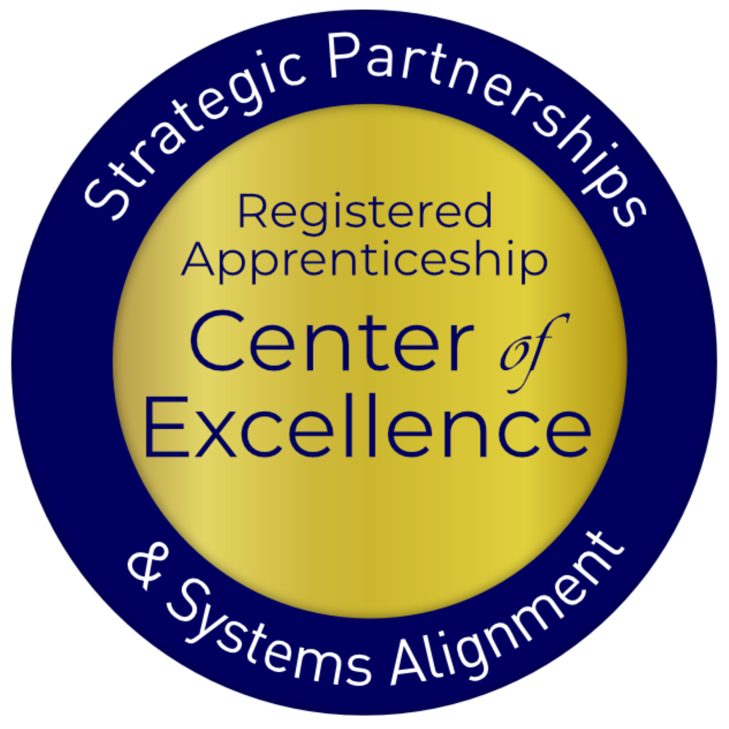
ARPA, WIOA and Apprenticeship Alignment Case Study
In fall of 2022, the Department of Commerce awarded Maryland nearly $23 million dollars under the Good Jobs Challenge grant program to foster the development of a workforce to support the emerging offshore wind industry.
Maryland Works for Wind (MWW)- a regional consortium committed to establishing Maryland as the country’s premier destination for offshore wind training, fabrication, and employment
Robust sectoral partnership of employers, unions, Local Workforce Development Areas, business alliances, and training providers. Also a strong commitment to drive economic development, connect underrepresented populations to good-paying careers, and build upon existing investments
Safal Partners © 2024
Notes:
Jeff

Slide 30
ARPA, WIOA and Apprenticeship Alignment Case Study 1
Safal Partners © 2024
Notes:
Jeff

Slide 31
WIOA- Key Resources to Support RA
© 2024 Safal Partners
Notes:
Lisa

Slide 32
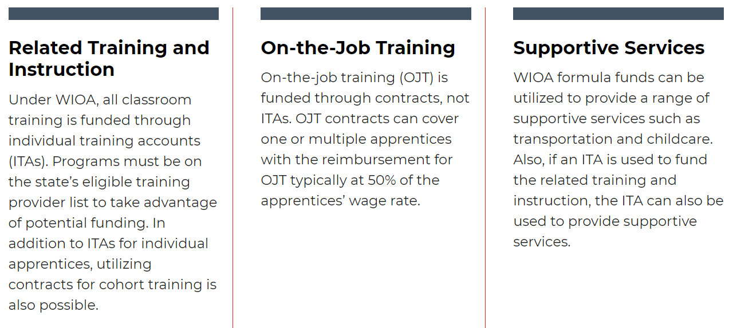
WIOA Funding, Supports for RA
Notes:
Lisa

Slide 33
RA Co-Enrollment and WIOA Benefits
Unlock additional sources of RA program support for employers who sponsor programs or hire apprentices and for job seekers hired as apprentices
Shared outcomes
Boost overall alignment for workforce system
Notes:
Lisa

Slide 34
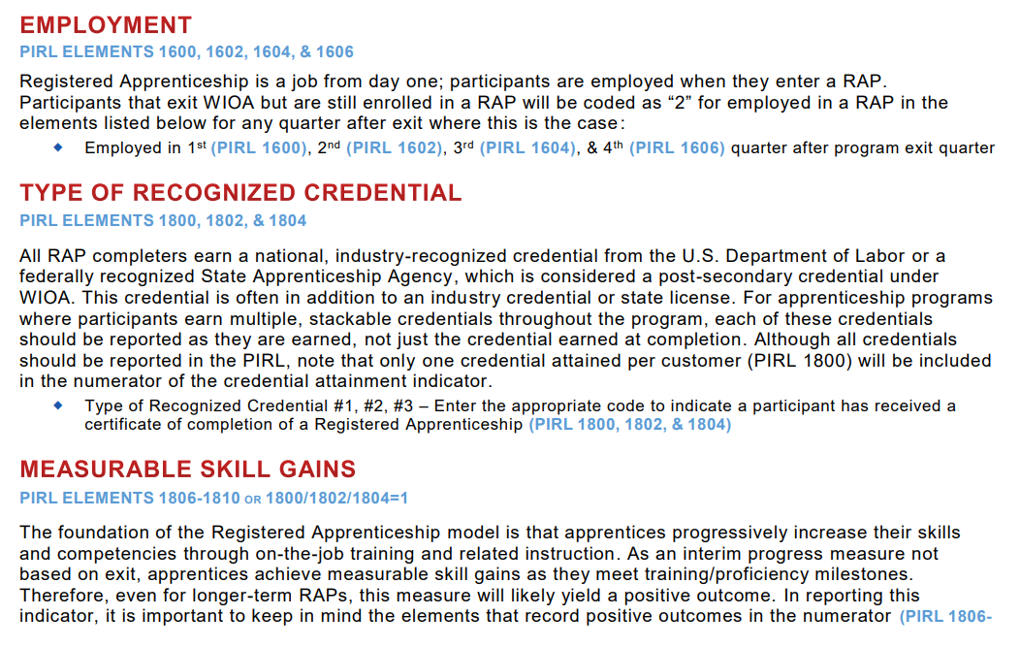
RA Co-Enrollment and WIOA
Understand how to correctly report RA and WIOA Co-Enrollment
Notes:
Lisa
WIOA Desk Reference that helps you understand what each field of the PIRL related to RA is about. Finding that many check that a person went to training and may even indicate it is a RA program, but then there is another box – 931 – that is about the type of training and when that is check for RA then you have co-enrollment that is captured and reported. Why is that important? Clear data, helps with grants when you can point to the validated number in PIRL.
Personal Information Record Locator - PIRL 931

Slide 35
WIOA Engagement Poll
What does your current WIOA co-enrollment look like?
NON-EXISTENT- there is no interest or knowledge of WIOA co-enrollment
EMERGING - there is interest in WIOA co-enrollment, but we are not sure where to start
ADVANCING - there is an active plan to co-enroll WIOA participants
LEADING – we are actively co-enrolling WIOA participants in Registered Apprenticeship programs
© 2024 Safal Partners
Notes:
Lisa
How many bring education and business together right now to talk about their workforce needs, skills training, etc?

Slide 36
How Workforce Boards Can Develop a Conducive Apprenticeship Ecosystem
© 2024 Safal Partners
Notes:
Lisa

Slide 37
How Workforce Boards Can Help Education Providers
Provide WIOA funding (Individual Training Account (ITA) / Supportive Services) to support RA costs.
Make connections with employers, sponsors.
Host convenings between education and industry.
Provide pipeline of potential students to enroll in programs.
Add RA programs to the Eligible Training Provider List (ETPL).
Support the development of RI curriculum using labor market information and industry standards.
© 2024 Safal Partners
Notes:
Lisa
How many bring education and business together right now to talk about their workforce needs, skills training, etc?

Slide 38
How Workforce Boards Can Help Employers/Sponsors
Provide a pipeline of potential apprentices thru publicizing RA program openings, screening candidates, and provide pre-apprenticeship training.
Provide supportive services to apprentices.
Provide WIOA OJT contract funding to support percentage of apprentice wages.
Build partnerships w/training providers on ETPL for RI; utilize ITAs to pay for all/portion of apprentices' RI costs.
Support registering and implementing RA programs.
Host convenings (job fairs, recruiting events, etc.) to connect potential apprentices and employers
© 2024 Safal Partners
Notes:
Lisa
Outreach – telling people about open positions, RA programs, that’s all allowable. TEGL 03-23
OJT contract funding – allocate resources for both ITA’s and OJT’s that support RA
RA job fairs

Slide 39
How Workforce Boards Can Help Community-based Organizations
Provide education on RA
Connect potential apprentices with employers
Provide supportive services to apprentices
Connect potential apprentices to other resources available within the community
© 2024 Safal Partners
Notes:
Alan

Slide 40
Local Boards: Ways to Increase RA Alignment
Evaluate current policies for RA and WIOA integration, co-enrollment
Write specific Youth RA goals into your local WIOA plan
Create an RA work group or committee
Develop partnerships to position yourself for future federal or state RA funding
Convene local employers/trade associations to create RA awareness
Train staff -- leadership, BSRs, Case Managers -- on RA; provide data entry (PIRL) training for front-line case managers on co-enrollment
© 2024 Safal Partners
Notes:
Alan

Slide 41
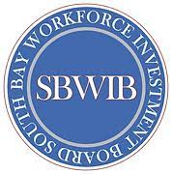
Examples of Board RA Alignment
CareerSource Florida (FL): State provides funding for Apprenticeship Navigators who serve American Job Centers by region.
Northwest Michigan Works (MI): Local board established Apprenticeship Services Department; designated staff work in-the-field to enroll apprentices, provide wrap-around services, create training plans, apply for grants to provide employer funding.
South Bay Workforce Investment Board (CA): Serves as RA sponsor for multiple occupations and numerous employer partners (Lockheed Martin, CVS, etc.), received > $10M in federal, state grant funding, developed Southern California Apprenticeship Network (SCAN) to lead regional RA work.
© 2024 Safal Partners
Notes:
Alan / Katie

Slide 42
Workforce Boards and RA Alignment- Many Opportunities Exist
© 2024 Safal Partners
Notes:
Lisa

Slide 43
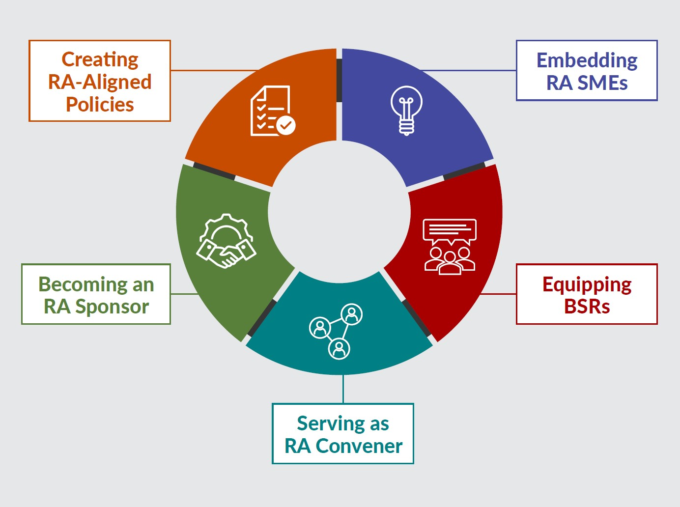
New Tool
Key Components of Workforce System Alignment with Registered Apprenticeship
Safal Partners © 2024
Notes:
Lisa – have the handout passed out during this time.
The reason this tool was built was to help the workforce system and it’s partners look at ways that you can enhance your RA efforts. They are not linear, you could be doing things in several different areas and we acknowledge that this is not all inclusive, but rather it gives you a starting point to grow your RA work.

Slide 44
Creating RA-Aligned Policies
State and Local WDBs have a policy and procedure framework that aligns and supports RA.
RA representative on WDB
Formal, consistently used process for learning of new RA programs and assisting organization in getting on ETPL
WIOA Plans set goals for RA and inclusion for underserved
Clear WIOA/RA co-enrollment policy directives and training for case managers
RA funding allocations
Partners are engaged in RA activities
State/Local WDBs streamline policies and processes to make it easier for businesses to use RA (i.e., maintaining an inventory of RI curriculum)
Safal Partners © 2024
Notes:
Alan

Slide 45
Embedding RA SMEs
State/LWDBs embed RA expertise in the AJC frontline staff to actively help BSRs engage local employers in adopting RA and help case managers create a pipeline of job seekers as RA candidates for local sponsors.
State/LWDBs hire, designate and train staff as RA navigators/SMEs, embed within AJCs or serve entire regions
Case managers purposefully screen and refer job seekers to RA programs
Co-enrollment procedures are used consistently by case managers and across all mandatory partners
Apprentices are supported throughout the RA program
Mandatory partners work with AJCs to engage “shared” job seekers in RA programs
Outreach to job seekers targets underserved populations and communicates benefits of apprentices
Case managers receive regular RA training to effectively engage job seekers and communicate benefits
Wagner-Peyser staff share RA information to job seekers and employers with a warm handoff to AJC/BSR staff as warranted
Safal Partners © 2024
Notes:
Lisa
How many of you have an Apprentice Navigator or someone in the AJC that is your SME on RA?
This section is really all about the frontline staff – case managers and Wagner-Peyser staff – who can help influence job seekers to pursue RA opportunities. If they have the right knowledge base. Which requires training….

Slide 46
Equipping BSRs
BSRs assist employers with RA as a talent pipeline solution and collaborate with their local RA system counterparts.
BSRs...
Regularly work with apprenticeship system counterparts/ATRs to promote and develop RA programs
Guide employers through the RA process, from developing standards for program registration to hiring an apprentice
Create outreach plan based on LMI and with RA system counterparts to raise local business awareness about the benefits of RA, including potential WIOA and non-WIOA support
Interact with intermediaries to assist businesses with RA program development
Provide collateral and education to partners for their business engagement efforts
Communicate regularly with case managers about apprenticeship openings and help businesses understand how to leverage AJCs for candidate recruitment
State/Local Rapid Response efforts include RA
Safal Partners © 2024
Notes:
Jeremy

Slide 47
Serving as RA Convener
State/LWDBs consistently gather businesses and all other stakeholders to engage in, and serve as, regional hubs for RA/workforce alignment.
State/LWDBs coordinate with local ATRs to provide regional RA info sessions to economic development organizations, businesses, and public sector entities
Sector strategy initiatives include RA as a strategy for building the talent pipeline
Create and maintain a network (hub) of RA sponsored programs to accelerate employer participation and to provide technical assistance
State/LWDBs collaborate on high-demand, industry-specific RA programs including technical assistance and funding
Collaborative RA efforts include mandatory partners as part of convening activities
Safal Partners © 2024
Notes:
Lisa

Slide 48
Becoming an RA Sponsor
LWDB becomes a group RA sponsor to support multiple high-demand industry workforce needs.
LWDB becomes an approved group RA program sponsor for in-demand occupation(s)
Occupations are regularly added to RA program based on LMI
Educational system is engaged with LWDB to provide RI
RA sponsorship is sustainable through braided funding
LWDB creates clear path to build pipeline of WIOA-eligible, underserved populations for employers
LWDB provides admin support, training and assistance to employer joining the RA program
LWDB ensures ability to support employers/apprentices with WIOA funding
Safal Partners © 2024
Notes:
Alan

Slide 49
Center of Excellence Resources and Tools... Here to Help You!
© 2024 Safal Partners
Notes:
Alan

Slide 50
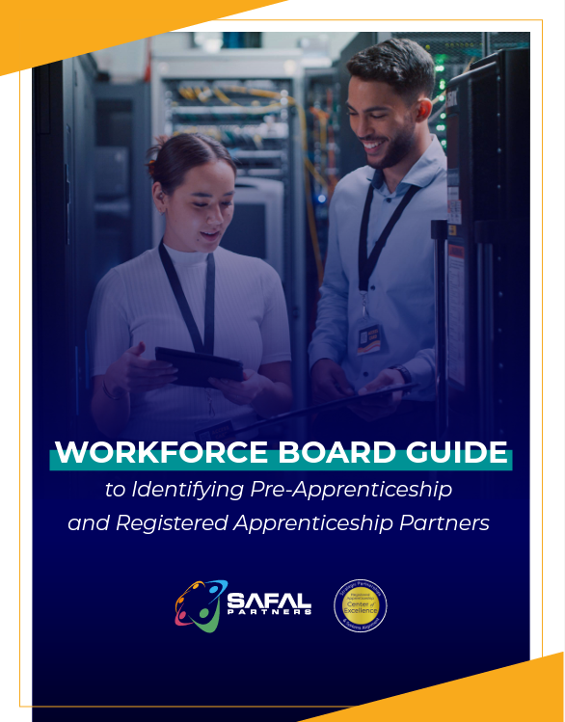
No-Cost Resources
Request no-cost online or in-person training for your organization
Become a Center partner to receive notification of upcoming webinars, Virtual Office Hours
Visit our website for downloadable materials
Guide to Identifying Partners
https://safal.partners/Partner-Resource
© 2024 Safal Partners
Notes:
Alan

Slide 51
Evaluation
Please take a moment to give us your feedback.

Slide 52
Contact Us
Lisa Rice
Subject Matter Expert
Safal Partners
Lisa.Rice@safalpartners.com
Jeremy Faulkner
Subject Matter Expert
Safal Partners
Jeremy.Faulkner@safalpartners.com
Alan D. Dodkowitz
Subject Matter Expert
Safal Partners
Alan.Dodkowitz@safalpartners.com
© 2024 Safal Partners
Notes:
Alan

