Slide 1
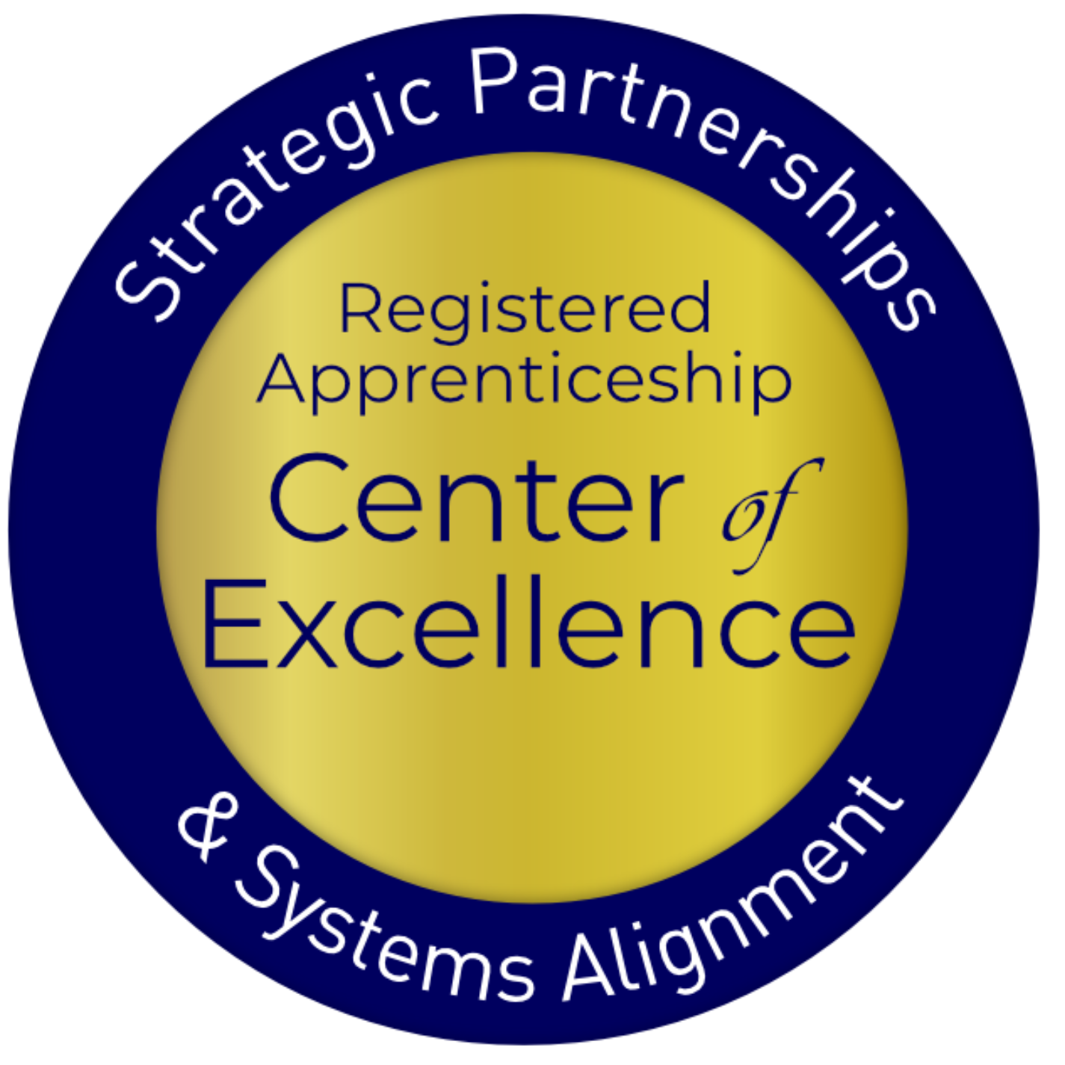
Expanding Employment Opportunities for your Students through Pre-Apprenticeship and Registered Apprenticeship

Slide 2
Agenda
Describe knowledge gaps identified around registered apprenticeship (RA) through the preliminary findings from the Adult Education (AE) and RA survey.
Consider how to close those knowledge gaps and increase awareness on how to link AE to RA programs (RAPs).
Identify strategies to map an adult education integrated education and training (IET) program to pre-apprenticeship and RA.
Learn about the pre-apprenticeship framework, U.S. Department of Education’s IET Design Toolkit, and other federal resources to support IET alignment to RA.

Slide 3
US Department of Labor (DOL) Center of Excellence
Mission: Scale partnerships to accelerate adoption of Registered Apprenticeship (RA) and improve RA alignment with the nation's workforce and education systems.

Slide 4
The Center’s Work – Three Strategies
Provide technical assistance (TA) on a national scale to:
RA program sponsors
State and local workforce boards and American Job Center (AJC) programs and operators
K-12, college and university, Adult Education, and Career and Technical Education programs
State and federal policymakers
Engage and build partnerships with and between essential RA stakeholders
Coordinate with federal and state investments

Slide 5
What is Apprenticeship?
A Proven Workforce
Solution
Registered Apprenticeship is an industry-driven, high-quality career pathway enabling employers to develop new hires and upskill current workers for critical occupations.

Slide 6
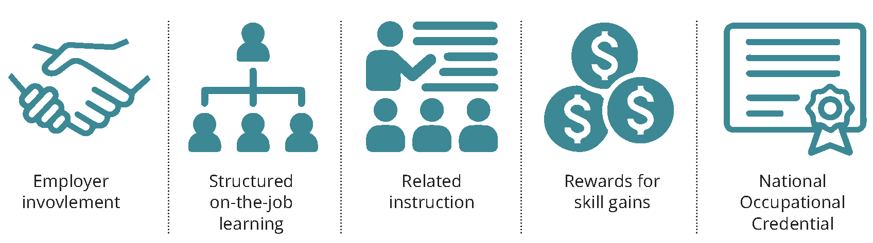
Five Core Components

Slide 7
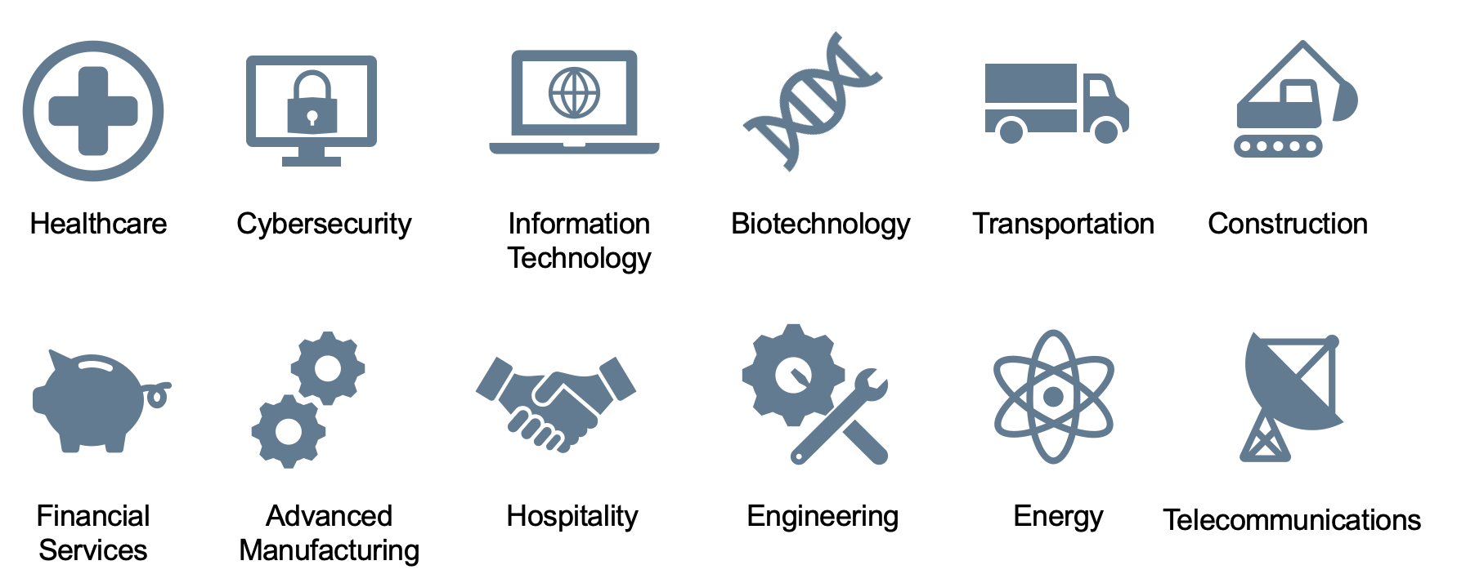
Spans all Sectors

Slide 8
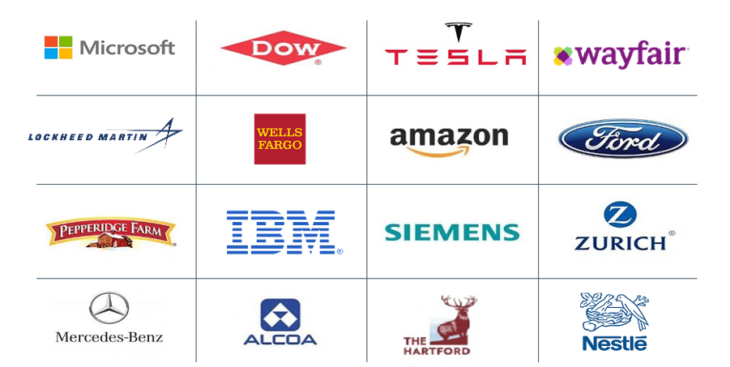
Businesses Using RA

Slide 9
Why Organizations Choose RA
Attract New Talent : 70% of workers would be “extremely” or “very” likely to switch to a new employer offering training opportunities
Proven ROI : Employers report on average $1.47 for every $1 invested in RA – highly cost effective in the long term
Expand Workforce : With a training plan in place from day one, employers can take a skills-based approach to hiring which creates much larger talent pipeline
Would you switch to a new employer for training opportunities?
Sources: Gallup 2021, USDOL

Slide 10
Clear Benefits of RA
Better Rate of Hire
Higher 1-Year+ Retention Rate
Sources: Apprenticeship.gov (USDOL),
National Association of Colleges & Employers “2020 Internship & Co-Op Report”

Slide 11
Apprenticeship and IET: Why and What

Slide 12
Preliminary Findings of Center's AE RA
Knowledge Survey
Awareness
Resources
Collaboration
75%
(average)
Know where to access RA state-specific and general resources
60%
(average)
How-to guides, employer engagement guides, and IET program mapping resources
69%
Interested in participating in focus groups for input on TA resources

Slide 13
What are the challenges in aligning AE with RA?
Awareness about ways to integrate IET with pre-apprenticeship and RA
Meaningful, ongoing connection between adult education, industry, and apprenticeship system to create and sustain high-quality pre-apprenticeship and RA programs (RAPs)
Coordination with the workforce system to enroll eligible adult learners in WIOA Title I services to receive training, supportive services, etc. while co-enrolled in a RAP
In 2017, only FOUR local Adult Education programs in the U.S. self-reported sponsoring a RAP.
Sources: 2017 COABE Survey of AE Members

Slide 14
What is Integrated Education and Training (IET)?
IET is “…a service approach that provides adult education and literacy activities concurrently and contextually with workforce preparation activities and workforce training for a specific occupation or occupational cluster for the purpose of educational and career advancement.”

Slide 15
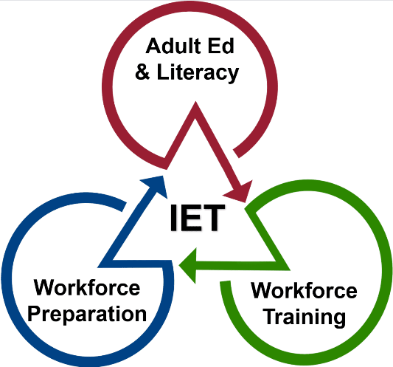
Three Components of IET
Adult education and literacy activities, workforce preparation activities, and workforce training activities must:
Be of sufficient intensity and quality
Be based on the most rigorous research
Occur simultaneously
Use occupationally relevant materials
Be organized through a single set of learning objectives (SSLO) to include adult education content standards, workforce preparation skills, and workforce training competencies.
Be part of a career pathway

Slide 16
AE IET Programs' Intersection with RA
Support Business Engagement
Supply a pool of candidates
Design on-ramp to accelerate entry
Connect with Partners
Access WIOA funding through Individual Training Accounts (ITAs) for training costs*
Deliver relevant workforce preparation skills and workforce training competencies that can map to RA required RTI
Leverage learners’ education and experience to achieve multiple outcomes
Provide training and instruction for in-demand careers
Access supportive services for WIOA-eligible students
Submit IET program for approval to be on state and local Eligible Training Provider List (ETPL)
Create Career Pathways

Slide 17
Pre-Apprenticeship and IET: What and How

Slide 18
What is Pre-Apprenticeship?
A program or set of strategies designed to prepare individuals for entry into RAPs
Provides RAP sponsors with established pipeline of candidates
Not federally regulated so more flexibility by developers in selecting components, establishing requirements
High-Quality Career Preparation

Slide 19
Hallmarks of a High-Quality Pre-Apprenticeship Programs
Transparent entry and success requirements
Training in skills sought by employers
Skills training through OJL and hands-on learning
Student support for persistence
Results in 1+ industry-valued credentials
Direct entry/ preferred application for linked RAP

Slide 20
Getting Started: Mapping IET to Pre-Apprenticeship & RAPs

Slide 21
3 Guiding Principles for Pre-Apprenticeship IET Program Design

Slide 22
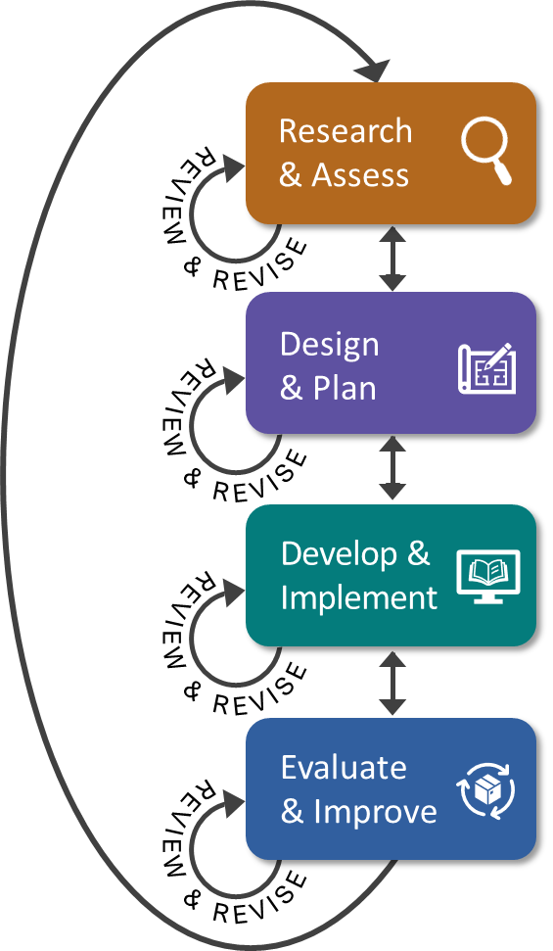
4 Iterative Phases
Approach to designing a pre- apprenticeship program aligned with IET federal requirements
Follows the same process outlined in US Department of Education IET Design Toolkit (Office of Career Technical and Adult Education IET Design Toolkit)

Slide 23
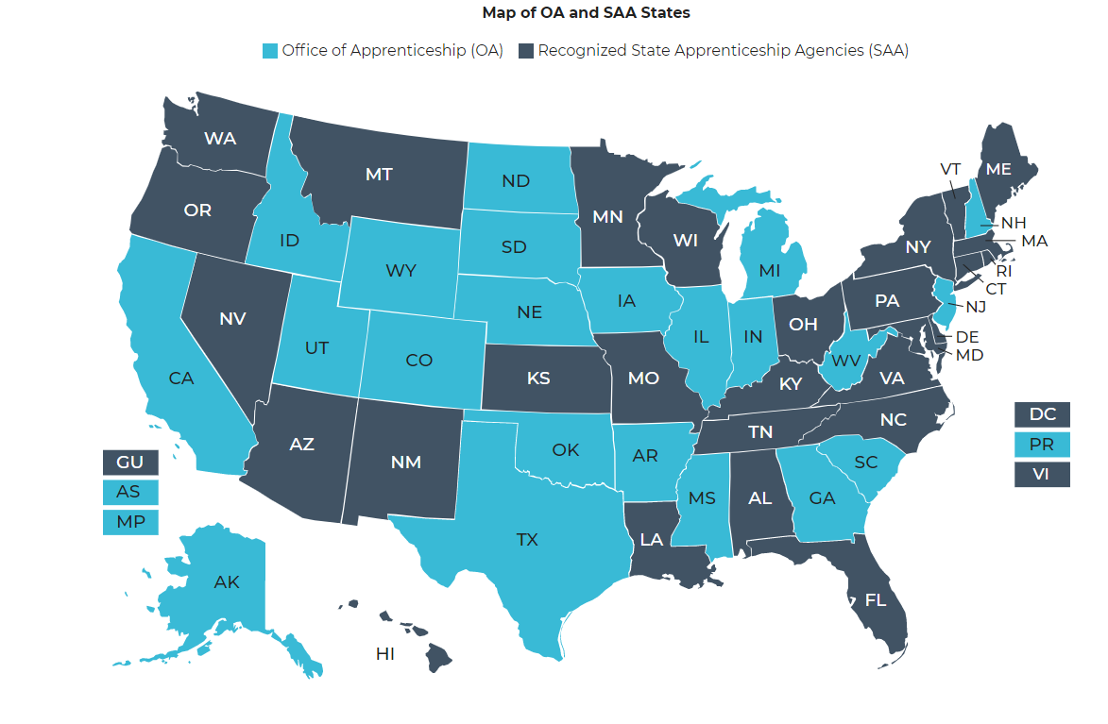
Research and Assess: Connect With RA System
Identify local RAP sponsors to have discussions re: connecting your IET program as a pre-apprenticeship
Determine if your state has pre-apprenticeship program requirements
https://www.apprenticeship.gov/about-us/state-offices

Slide 24
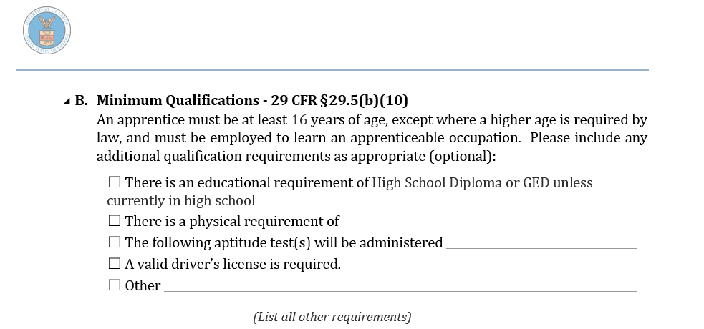
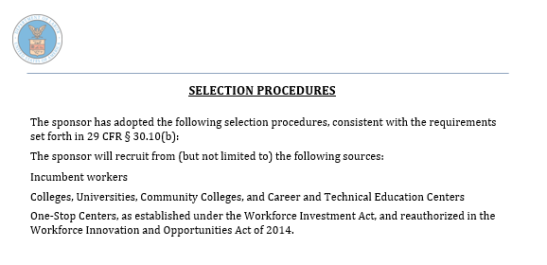
Design and Plan: RAP Entry Requirements, Qualifications
All RAPs have Minimum Qualifications and Selection Procedures
What applicants will need/be able to pass
Prospective talent pool sources
Can be used for adults’ RAP application work
Can help with pre-app program marketing

Slide 25
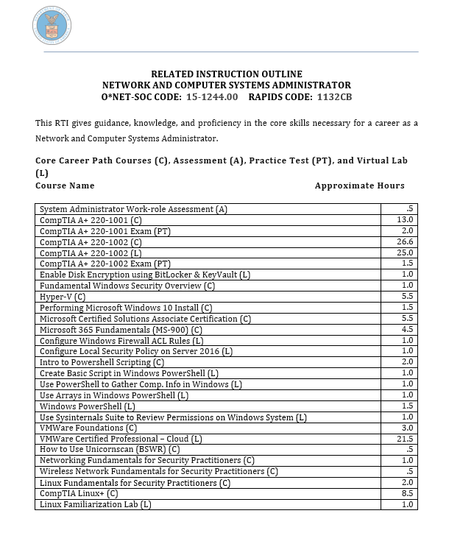
Design and Plan: Related Technical Instruction Mapping
RAP Related Instruction Outlines (require Minimum 144 hours per year)
Core technical instruction (maps to IET Component: Workforce Training Competencies)
Employability instruction (maps to IET Component: Workforce Preparation Skills)

Slide 26
Design and Plan: Partnering for Enrollment and Services
Collaborate with Sponsors and Businesses
Coordinate with Community and Workforce Partners
Review the IET Design Toolkit for helpful ways to take the next step in partnering to develop a pre-apprenticeship program.
Identify employer-based options for pre-RA to RA entry process (i.e., job shadowing)
Co-design program application and referral process with
Identify potential support services for pre-apprentices to facilitate completion (i.e., transportation, equipment, etc.)

Slide 27
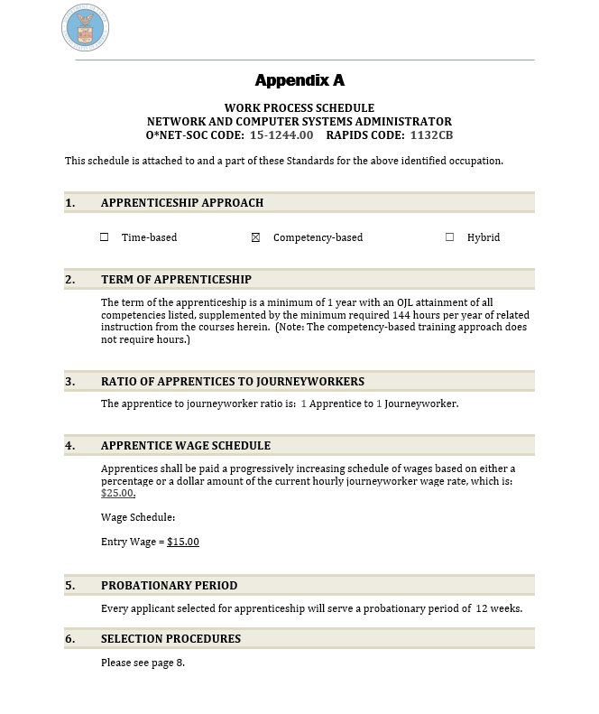
Develop and Implement: Standards Review = SSLO
Discuss Program Standards
Mapping to IET Program
Minimum qualifications
Selection procedures
Ideal core knowledge (RI)
Ideal basic foundational skills (OJL)
Evaluate program for alignment
RTI Curriculum
WBL or OJL
Required hours (for IET programs) or competencies (for IET programs)

Slide 28
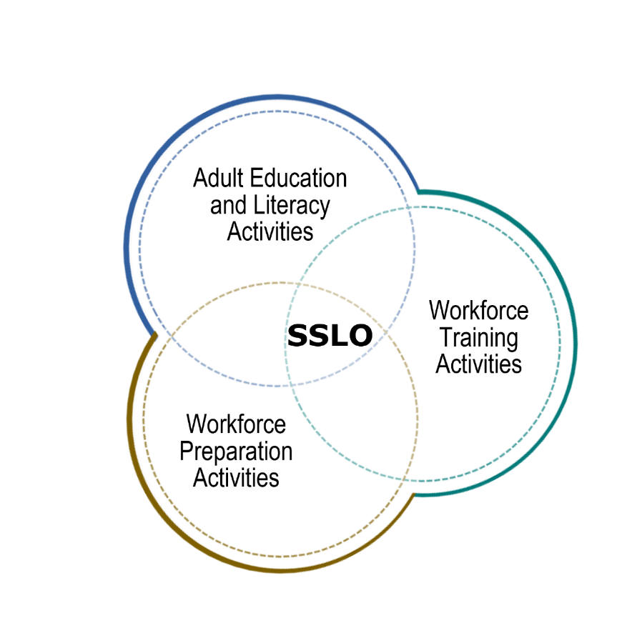
Develop and Implement: Standards Review = SSLO continued
An IET program has a single set of learning objectives that identifies the specific:
Adult education content
Workforce preparation activities
Workforce training (RA program) competencies
Program activities are organized to function cooperatively.
Together, the individual integrated learning objectives become the single set of learning objectives for the IET / pre-apprenticeship program.
Example: OJL

Slide 29
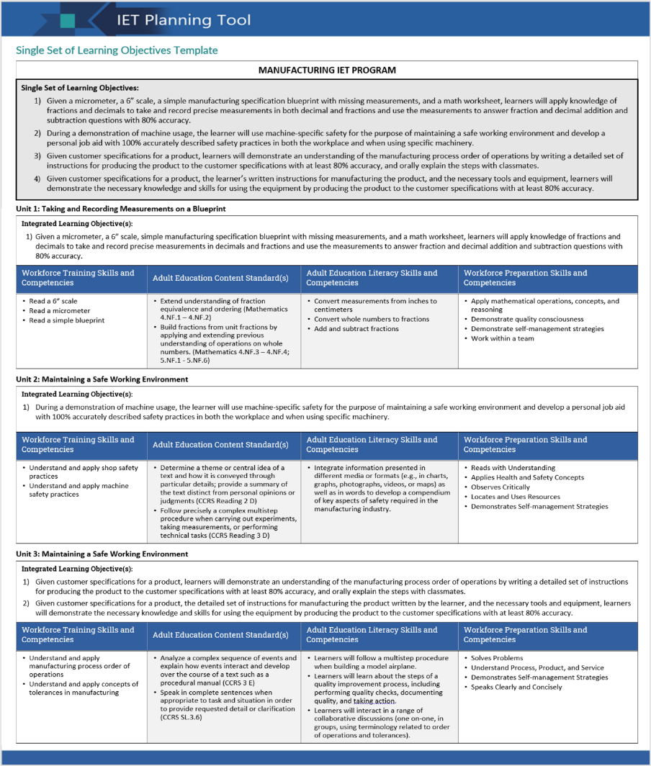
Example of a Completed SSLO Template

Slide 30
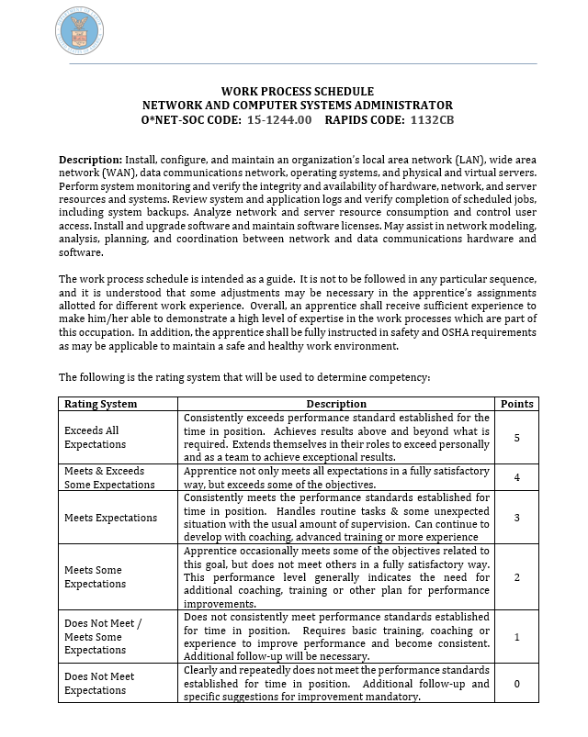
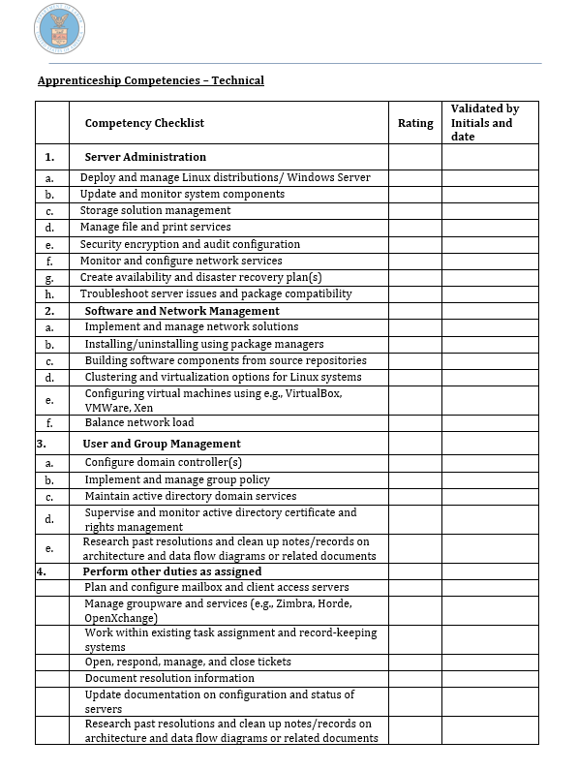
Develop and Implement: On the Job Learning = Workforce Training
All RAPs have Work Process (OJL) Outlines
Show model:
Time-based
Hybrid
Competency-based
Show core skills required for RAP – can map to IET

Slide 31
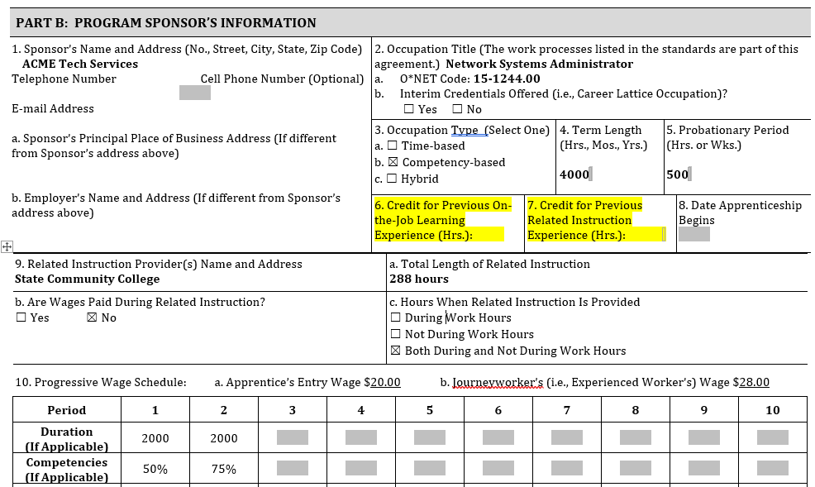
Develop and Implement: Credit for Previous Experience (CPE) & Credit for Prior Learning (CPL)
Reporting IET Pre-Apprenticeship Work through CPE/CPL to RAP Sponsor
Maximizes students’ pre-apprenticeship program time
Accelerates apprentice program completion timeframe

Slide 32
Let’s get started!

Slide 33
Thank You and Resources
Katie Adams
Chief Development Officer
katie.adams@safalpartners.com
Michelle Carson
Senior Director
michelle.carson@safalpartners.com
Nicole Klues
Project Director
nicole.klues@safalpartners.com
Access Resources, Request TA:
https://dolcoe.safalapps.com
Scan to Become a Center Partner!

