Slide 1
Promising Practices in Registered Apprenticeship from a Rural Community College
February 2025

Slide 2
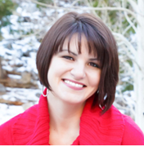
Moderator
Melissa Schroeder
Director
Safal Partners

Slide 3
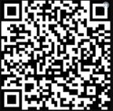
Center of Excellence Overview
U.S. DOL initiative to increase systems alignment across apprenticeship, education, and workforce
Led by Safal Partners; 5 national partners
We provide no-cost TA including:
Monthly webinars
Quarterly virtual office hours
Individual TA/coaching sessions
Online resources (desk aids, guides, frameworks, etc.)
Visit our website, request TA

Slide 4
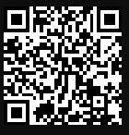
Online Resources, On-Demand TA
Registered Apprenticeship Partner Profile Questionnaire
https://dolcoe.safalapps.com/resources/resourcesandtools

Slide 5
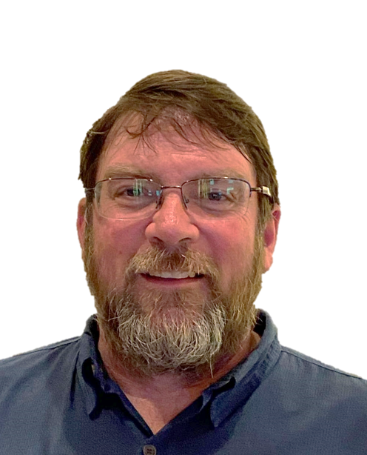
Panelist
David Shofstahl
AHTI Workforce Coach,
Apprenticeship Coordinator,
Skilled Trades Program Manager,
Mountain Gateway Community College

Slide 6
David Shofstahl Apprenticeship Coordinator
GET IN TOUCH
540-863-2920
dshofstahl@mgcc.edu
mgcc.edu
1000 College Drive, Clifton Forge, VA 24422

Slide 7
Mountain Gateway Community College
20+ years of experience providing customized training (RTI).
AACC ECCA Initiative (2019-2022) served 113 Registered Apprentices (RAs).
Addressed common myths and challenges surrounding RA.
Increase number of registered sponsors.
Be an advocate for State Apprenticeship Office.
Promote the Champions
Articulate value of RA clearly and consistently.
Provide flexible RTI alternatives (online, off-campus, etc.).
Greater interest in registered apprenticeships.
Improved communication and collaboration with State RA consultants.
Stronger relationship with area agencies and partners to promote RAs.
Innovative strategies for expanding apprenticeships.
Independent study RTI.
Incumbent worker funds and wrap-a-round funds for RAs (WIOA).
Foster pro-RA culture.
Expanding RTI-approved programing (NCCER).
55 active RAs in skilled trades programs
(1 per 415 workers).

Slide 8
Questions and Discussion

Slide 9
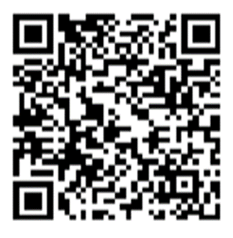
Contact Us, Become a Partner
Scan for Partner Form
Receive no-cost expert TA, materials, and assistance
Network with potential partners nationwide
Be nationally recognized for your work

Slide 10
Thank You for Joining Us
Email us your questions at RA_COE@SafalPartners.com
For more information, visit: dolcoe.safalapps.com

