Slide 1
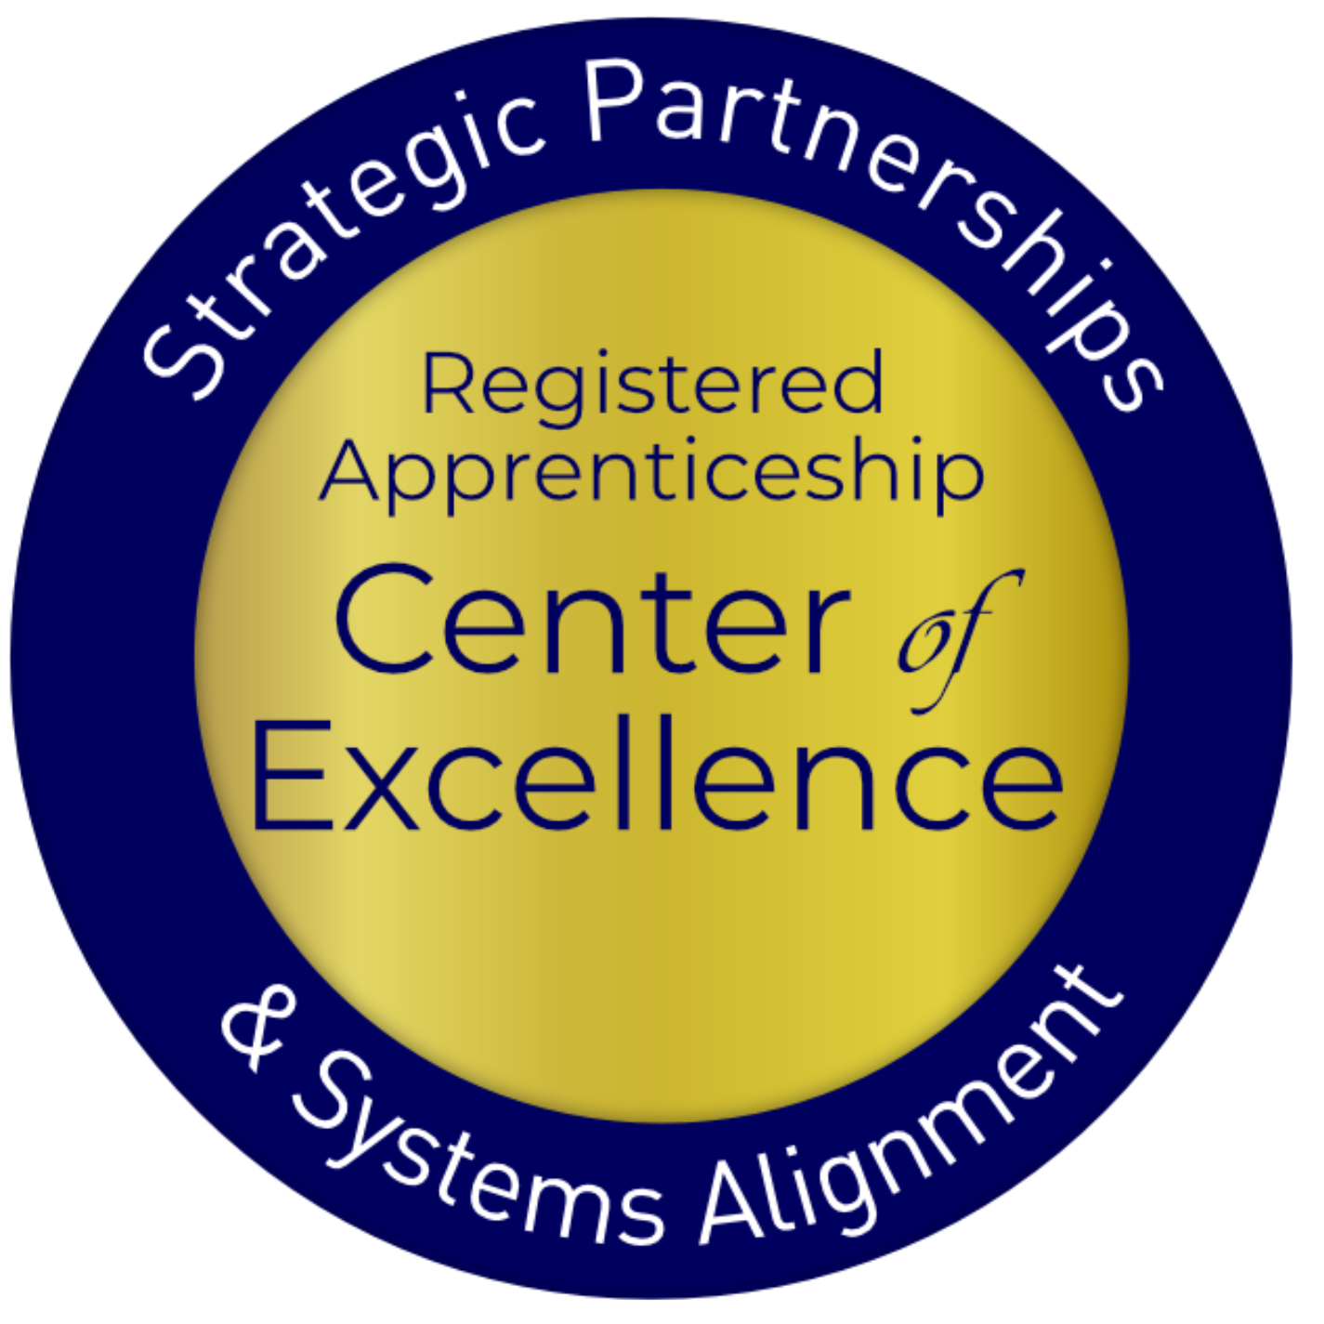
How the Investing in America Agenda Can Provide Registered Apprenticeship Pathways for Opportunity Youth
PA Workforce Leaders Symposium September 17, 2024
September 17th, 2024

Slide 2

Presenter
Alan D. Dodkowitz
Senior Subject Matter Expert
Safal Partners

Slide 3
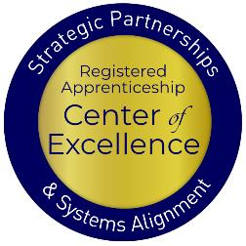
Welcome and Agenda
Center of Excellence Overview
An Overview Opportunity Youth
How Apprenticeships Can Serve Opportunity Youth
Ways the Investing in America Agenda Can Connect Opportunity Youth to Apprenticeships
The Role of the Workforce System
Questions and Wrap Up
Safal Partners © 2024

Slide 4

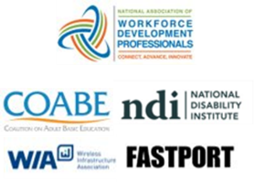


Center of Excellence Overview
U.S. DOL initiative to increase systems alignment across apprenticeship, education, and workforce
Led by Safal Partners
  Collaboration with 5 national partners
We provide no-cost TA including:
  Monthly webinars
  Quarterly virtual office hours
  Individual TA/coaching sessions
  Online resources (desk aids, guides, frameworks, etc.)
Visit our website & request TA

Slide 5
Opportunity Youth:
Meeting Youth Where They Are with Innovative Solutions
Safal Partners © 2024

Slide 6



Opportunity Youth Defined
Young people between the ages
of 16 and 24 who are
neither enrolled in school
nor participating in the labor market
Safal Partners © 2024

Slide 7


Challenges Faced by Opportunity or Disconnected Youth
Disability
16%
(3 x more)
Homeless
Significantly
Poverty
21%
(3 x more)
Parenting
28%
(4 x more)
History of Incarceration
Source: https://youth.gov/youth-topics/opportunity-youth/prevalence
Safal Partners © 2024

Slide 8
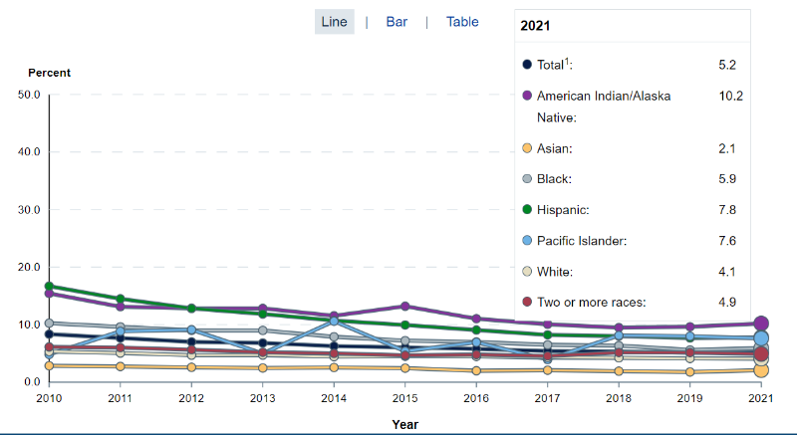
Opportunity Youth: The Numbers
16-24 years olds
In 2021, an estimated
1.9 million students
dropped out of high school.
In 2016, an estimated
3.46 million students dropped out of high school.
Source: https://nces.ed.gov/
Safal Partners © 2024

Slide 9
What Did this Info Tell Us?
Were we effectively working with all youth populations?
Were we working with the right organizations?
Were we meeting youth where they were?
Were we asking youth to walk through our doors?
Were our staffing models and experiences effective in engaging youth populations?
Where were we lacking funding and partnerships to serve opportunity youth?
Were we missing data?
Safal Partners © 2024

Slide 10
Apprenticeship:
A Way to Engage Opportunity Youth
Safal Partners © 2024

Slide 11

What is Registered Apprenticeship?
Registered Apprenticeship is a proven, customizable, and structured model to find and train new talent as well as upskill current workers in critical occupations.
Safal Partners © 2024

Slide 12



Five Core Components of RA
Employer Involvement
Structured On-the-Job Learning (OJL)
Related Instruction (RI)
Rewards for
Skill Gains
National Occupational Credential
Safal Partners © 2024

Slide 13


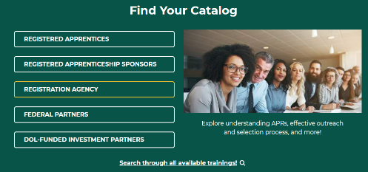
Welcome to the Registered Apprenticeship Academy
The Registered Apprenticeship Academy is an interactive learning hub designed to inform, educate, and assist registered apprenticeship stakeholders in succeeding in their respective roles by providing vital learning pathways that are accessible, impactful, and relevant.

Slide 14



Welcome to the Registered Apprenticeship Academy (1)
The Registered Apprenticeship Academy is an interactive learning hub designed to inform, educate, and assist registered apprenticeship stakeholders in succeeding in their respective roles by providing vital learning pathways that are accessible, impactful, and relevant.
www.apprenticeship.gov/
registered-apprenticeship-academy
raacademy@dol.gov

Slide 15





Apprenticeships for Opportunity Youth
Connection to employment AND education
Career pathway beyond RA Program completion for occupations that provide a family-supporting wage
Roadmap to credential, certification, and degree attainment ​​
Connection to mentors who can offer support and guidance​​
Linkages to critical supports to assist them in their learning and earning pathway​​
Safal Partners © 2024

Slide 16
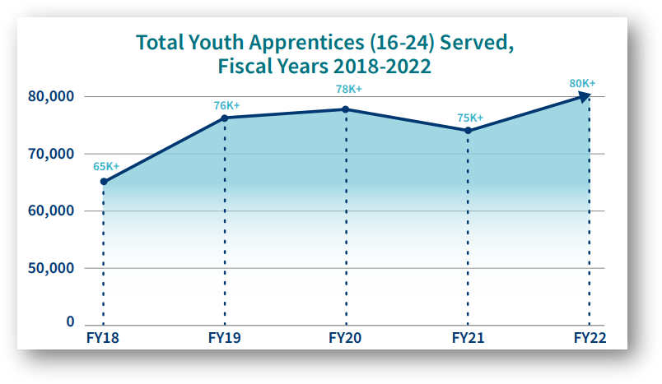
Apprenticeships for Youth
In 2022, there were
228,535
Youth Apprentices
Registered
Source: https://www.apprenticeship.gov/

Slide 17
The Investing in America Agenda and Opportunity Youth:
A Match Made for Each Other
Safal Partners © 2024

Slide 18

What is the Investing in America Agenda?
The Investing in America Agenda consists of extensive resources and rules to support the advancement of Registered Apprenticeship:
  The Bipartisan Infrastructure Bill: $550 billion in new funds for infrastructure
  The CHIPS and Science Act: $52.7 billion for American semiconductor research, development, manufacturing, and workforce development
  The American Rescue Plan Act: $1.9 trillion recovery bill with more than $40 billion dedicated to workforce development
  The Inflation Reduction Act: Nearly $1.2 trillion in incentives for green energy and
  increased Affordable Care Act (ACA) subsidies
Safal Partners © 2024

Slide 19
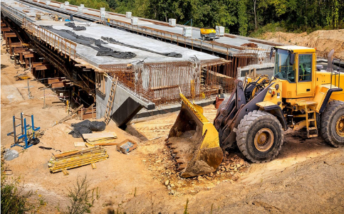
The Bipartisan Infrastructure Law
Safe Streets and Roads for All (SS4A) Grant program:
$1 billion to enhance roadway safety, includes pre-apprenticeship, apprenticeship readiness, and youth service initiatives with a clear path towards registered apprenticeships
Building Pathways to Infrastructure Jobs Grant Program:
Supports enhanced training models in H-1B industries and focuses on sectors like advanced manufacturing, information technology, professional services, supporting renewable energy, transportation, and broadband infrastructure
Workforce Development:
Expands existing workforce development programs
encompassing trade schools, community colleges, and union
training programs in Registered Apprenticeship. Participants
gain expertise in conducting energy assessments for small-
and mid-sized manufacturing businesses.
Safal Partners © 2024

Slide 20

The Bipartisan Infrastructure Law 2
National Electric Vehicle Infrastructure Formula Program:
Provides $5 billion to states to strategically deploy electric vehicle (EV) charging infrastructure and to establish an interconnected network to facilitate data collection, access, and reliability. States are using NEVI funds for Registered Apprenticeship.
Grid Resilience and Innovation Partnerships (GRIP) Program:
Includes $10.5 billion to enhance grid flexibility and improve the resilience of the power system against growing threats of extreme weather and climate change. Substantial opportunities are included for Registered Apprenticeship for opportunity youth to conduct this work.
Safal Partners © 2024

Slide 21
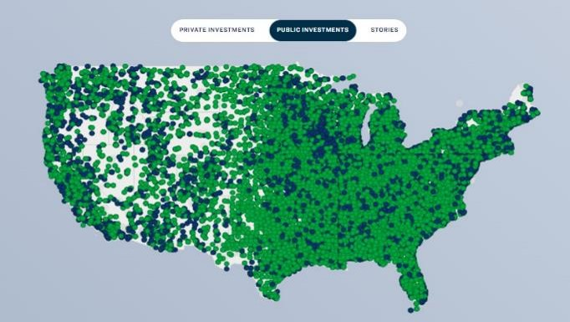
Over $400 Billion in Public Infrastructure Investments So Far!
Public investments refers to federal spending on infrastructure, green energy, advanced manufacturing, and semiconductor development.
Source: https://www.whitehouse.gov/invest/?utm_source=invest.gov

Slide 22
An Investment Boom that Needs Workers: Construction
The industry faces an enormous skills gap given the $10 trillion global construction output, with a need to build 13,000 buildings each day between now and 2050 to support an expected population of 7.7 billion people living in cities. The McKinsey Global Institute estimates that, by 2030, there will be up to 200 million construction jobs worldwide.
Construction and Extraction Occupations : Occupational Outlook Handbook: : U.S. Bureau of Labor Statistics (bls.gov)
Overall employment in construction and extraction occupations is projected to grow about as fast as the average for all occupations from 2022 to 2032. About 646,100 openings are projected each year, on average, in these occupations due to employment growth and the need to replace workers who leave the occupations permanently.
www.rics.org
2023: The number of open, unfilled jobs in the overall construction industry totaled 300,000 to 400,000 positions.
Spring 2023 construction labor market report (hbi.org)
Safal Partners © 2024

Slide 23

The CHIPS and Science Act
Regional Innovation and Technology Hubs:
These hubs will create jobs, spur regional economic development, and position communities throughout the country to lead in high-growth, high-wage sectors such as artificial intelligence, advanced manufacturing, and clean energy technology.
CHIPS for America Workforce and Education Fund:
$200 million fund which provides $25 million for Fiscal Year (FY) 2023, $25 million for FY2024, and $50 million for each fiscal year 2025-2027.
Embedding Apprenticeship Within the Incentives Program:
Companies seeking funding via the CHIPS Incentives Program
must submit workforce development plans for facility operators
and construction workers, with applicants committing to hiring
individuals who complete training programs and to consider
partnerships with various skill-building programs, including
Registered Apprenticeships, pre-apprenticeships, community
and technical college programs, high school career pathways
and paid work-based learning initiatives in the semiconductor
industry.
Safal Partners © 2024

Slide 24
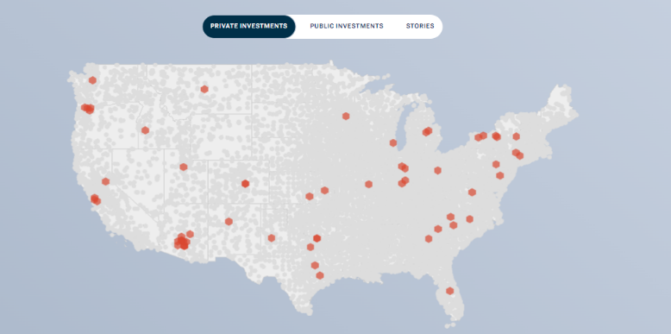
$395 Billion in Semiconductor Manufacturing
Orange dots represent private investment in semiconductor manufacturing
Source: https://www.whitehouse.gov/invest/?utm_source=invest.gov
Safal Partners © 2024

Slide 25
An Investment Boom that Needs Workers:
IT and Cybersecurity
The computer systems design and related services industry is the eighth fastest growing industry, growing at a rate of 1.8 percent annually over the 2022-32 decade. This industry is also seen adding 474,800 jobs over the projections period, the second most of any industry.
Employment Projections: 2022-2032 Summary - 2022 A01 Results (bls.gov)
Since 2021, semiconductor employment has increased an average of 4.3% per year to over 203,000 workers in 2023.
U.S. Semiconductor Jobs are Making a Comeback
Global cybersecurity job vacancies grew by 350 percent, from one million openings in 2013 to 3.5 million in 2021, according to Cybersecurity Ventures. The number of unfilled jobs remains at 3.5 million in 2023, with more than 750,000 of those positions in the U.S.
Industry efforts to source new talent and tackle burnout continues, but we predict that the disparity between demand and supply will remain through at least 2025.
Cybersecurity Jobs Report: 3.5 Million Unfilled Positions In 2025 | AP News

Slide 26

The Inflation Reduction Act (IRA)
Labor Hours Requirements:
Ten separate tax credits in the IRA note that employers who access these funds must set aside a minimum of 15% of their labor hours for apprentices
National Clean Investment Fund:
$14 billion to provide grants to 2–3 national nonprofit clean financing institutions to provide accessible, affordable financing for tens of thousands of clean technology projects across the country with a goal of supporting Registered Apprenticeship
Domestic Manufacturing Conversion Grants:
$2 billion for applicants must commit to signing a project labor
agreement that includes precise objectives related to investing
in workforce education and training and using registered
apprentices and creating opportunities for local workers to
participate in the construction project.
Safal Partners © 2024

Slide 27

The Inflation Reduction Act 2
Environmental and Climate Justice Community Change Grants:
$2 billion in grants available to support community-driven projects that deploy clean energy. Grantees will be awarded based on the inclusion of pre-apprenticeships or Registered Apprenticeship Programs, that are worker-centered, demand-driven, and lead to good jobs.
Clean Communities Investment Accelerator:
$6 billion to establish hubs that provide funding and technical assistance to community lenders, providing an immediate pathway to deploy projects in those communities while also building capacity of hundreds of community lenders to finance projects for years.
Latest and Zero Building Energy Code Adoption:
$1 billion for States and units of local government with the
authority to adopt building energy codes to adopt and implement
the latest building energy code. States are expected to include
plans to engage opportunity youth with Registered Apprenticeship
a particular area.
Safal Partners © 2024

Slide 28
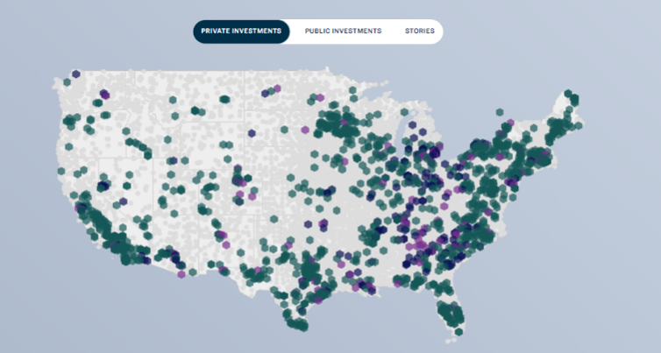
$412 Billion in Clean Energy Manufacturing 2
Green dots indicate investments in Clean Power.
Purple dots indicate investments in Clean Energy Manufacturing.
Source: https://www.whitehouse.gov/invest/?utm_source=invest.gov
Safal Partners © 2024

Slide 29
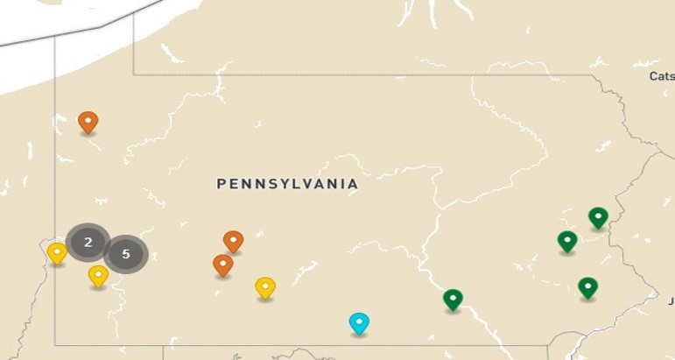
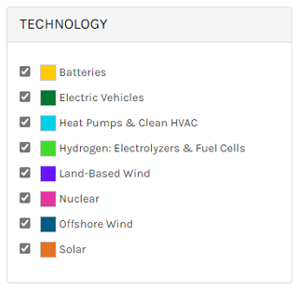
Clean Energy Investments in PA
Source: https://www.energy.gov/invest

Slide 30
An Investment Boom that Needs Workers: Manufacturing and EVs
Stronger demand for electric vehicle batteries and energy battery storage systems is expected to result in rapid employment growth in battery production.
That growth is evident in the other electrical equipment and component manufacturing industry, with the fastest growth at a rate of 3.0 percent annually over the projections period, gaining 52,700 jobs over the decade.
An aging manufacturing workforce requires workers. Upwards of 2.1 million manufacturing jobs will be unfilled in 2030.
Safal Partners © 2024

Slide 31
An Investment Boom that Needs Workers: Manufacturing and EVs
Investment:
Over the last 9 years, manufacturers have announced $188 billion in concrete investment in U.S. EV and EV battery manufacturing facilities.
Federal policies have dramatically expanded and accelerated these investments: 61 percent of announced EV investments have occurred in the last 18 months since passage of the Inflation Reduction Act (IRA) and 82 percent have occurred in the last 27 months since passage of the Bipartisan Infrastructure Law (BIL).
Jobs:
EV and battery manufacturing could also generate up to 876,000 additional jobs in indirect/secondary employment.
Safal Partners © 2024

Slide 32
IIA Needs Apprentices and is Making a Big Impact on Pennsylvania
Safal Partners © 2024

Slide 33
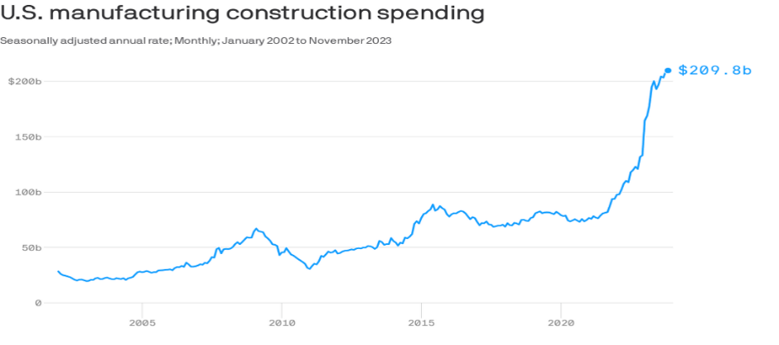
An Investment Boom for Apprentices
Source: https://fred.stlouisfed.org/series/TLMFGCONS
Safal Partners © 2024

Slide 34

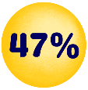
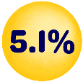
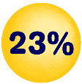
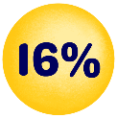


Good Jobs for the “Toolbelt Generation”
Young adults interested in trades career
Pay increase for new construction hires vs. 2.7% in professional services.
Students studying construction trades rose from 2018 to 2024
Vocational-focused community colleges increase in enrollment
More electricians than 2014 - median age fell by 2.9 years.
Optimistic about job security and believe they won’t be replaced by AI - Thumbtack
  Source: Wall Street Journal
Safal Partners © 2024

Slide 35
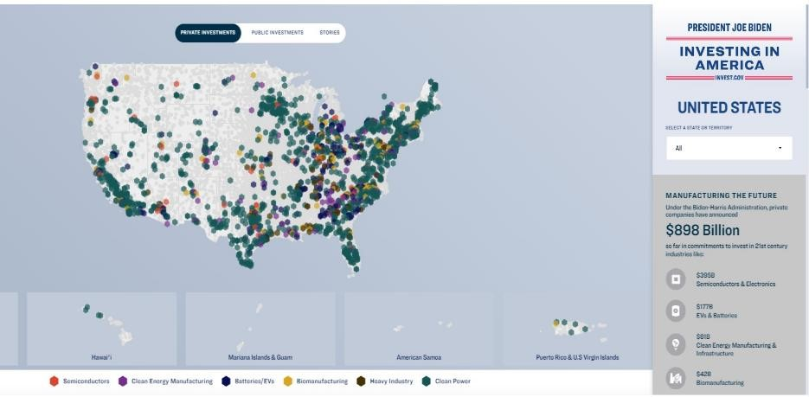
IIA is Investing in the Future
Build a Holistic Workforce System!
Think “FUTURE”!
Partner with NEW Partners!

Slide 36

Massive Opportunities for Pennsylvania 2
Pittsburgh is one of nine workforce hubs and created over 1,000 new jobs to expand apprenticeship programs in industries spurred by the Investing in America Agenda.
Eos Energy Enterprises is investing $500 million to expand its battery manufacturing operations in Turtle Creek, Pennsylvania, creating 1,000 new jobs.
The Department of Energy is awarding up to $750 million to the Mid-Atlantic Hydrogen Hub, covering Pennsylvania, Delaware, and New Jersey.
Through an investment of $858 million from the Bipartisan Infrastructure Law, the U.S. Army Corps of Engineers has broken ground on a project to upgrade and expand the nearly century-old Montgomery Locks near Pittsburgh – one of the oldest locks on the Ohio River.
Over $4.4 billion in new private investments for Pennsylvania!

Slide 37
Workforce Boards:
The Key Ingredient
Safal Partners © 2024

Slide 38

How Workforce Boards Can Help Education Providers
Provide WIOA Individual Training Account (ITA) funding to support apprentices' RI costs
Make connections with employers, sponsors
Host convenings between education and industry
Provide pipeline of Opportunity Youth to enroll in programs
Add programs to the Eligible Training Provider List (ETPL)
Support the development of RI curriculum using labor market information and industry standards
Safal Partners © 2024

Slide 39
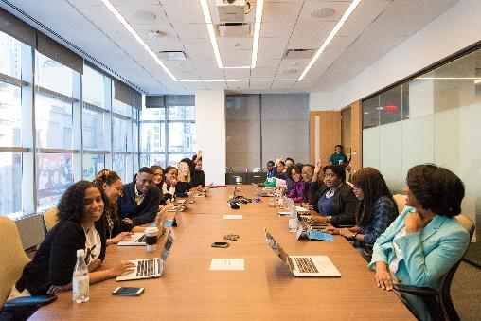
How Workforce Boards Can Help Employers/Sponsors
Provide a pipeline of Opportunity Youth Apprentices:
  Publicize RA program opening
  Screen candidates
  Provide pre-apprenticeship training
Provide supportive services to Opportunity Youth
Provide WIOA OJT contract funding to support percentage of apprentice wages
Build partnerships w/training providers on ETPL for RI; utilize ITAs to pay for all/portion of apprentices' RI costs
Support registering and implementing RA programs
Host convenings (job fairs, recruiting events, etc.) to connect potential apprentices and employers
Safal Partners © 2024

Slide 40

How Workforce Boards Can Help Community-Based Organizations
Provide education on RA
Connect potential apprentices with employers
Provide supportive services to apprentices
Connect potential apprentices to other resources available within the community
Leverage funding programs
Safal Partners © 2024

Slide 41

Get to Know Your Workforce Board
Each Workforce Board has:
  Sector strategies: priority occupations and key industries
  Policies on OJT contracts, which WIOA and non-WIOA funding "buckets" and services they will apply to RA
  Funding levels, fiscal year cycle and how quickly they anticipate spending funds
  Supportive services offered and how that maps to your program's needs
  Candidate pool – IS and OS Youth Programs
  ETPL program registration process
Safal Partners © 2024

Slide 42






More Opportunity than Ever!
Create New Perspectives on Partnerships
Devise Win-Win Collaboration Strategies
Innovate Outside Your Normal Box
Influence and Leverage New Funding
Expand Your Reach Into Communities
Safal Partners © 2024

Slide 43
Questions and Discussion
2024

Slide 44

Contact Us, Become a Partner
Scan for Partner Form
Receive no-cost expert TA,
materials, and assistance
Network with potential
partners nationwide
Be nationally recognized for your work

Slide 45
Email us your questions at RA_COE@SafalPartners.com
For more information, visit: dolcoe.safalapps.com
Safal Partners © 2024

