Slide 1
How the Investing in America Agenda Can Provide Registered Apprenticeship Pathways for Opportunity Youth SETA Spring Conference 2024
March 2024

Slide 2
Presenters
Melissa Aguilar-Southard
Jeffrey Smith
Alan D. Dodkowitz
Director
Safal Partners
Workforce Liaison / Program Analyst
Office of Apprenticeship
U.S. Department of Labor
Subject Matter Expert
Safal Partners

Slide 3
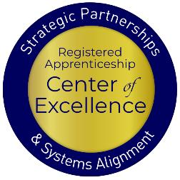
Welcome and Agenda
Center of Excellence Overview
An Overview of Opportunity Youth
How Apprenticeships Can Serve Opportunity Youth
Ways the Investing in America Agenda Can Connect Opportunity Youth to Apprenticeships
The Role of the Workforce System
Questions and Wrap Up
Safal Partners © 2024

Slide 4
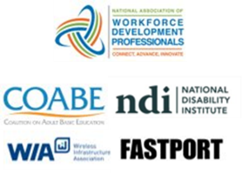
Center of Excellence Overview
U.S. DOL initiative to increase systems alignment across apprenticeship, education, and workforce
Led by Safal Partners
Collaboration with 5 national partners
We provide no-cost TA including:
Monthly webinars
Quarterly virtual office hours
Individual TA/coaching sessions
Online resources (desk aids, guides, frameworks, etc.)
Visit our website & request TA

Slide 5
Opportunity Youth… Meeting Them Where They Are with Innovative Solutions
Safal Partners © 2024

Slide 6
Opportunity Youth… Defined
Young people between the ages of 16 and 24 who are neither enrolled in school nor participating in the labor market.
Safal Partners © 2024

Slide 7
Challenges They Face
Disability: Over 16% of disconnected youth have a disability, while only 5% of connected youth face similar challenges.
Expectant and Parenting Youth and Young Adults: Approximately 28% of opportunity youth are expectant or parenting- four times more likely to be mothers than their connected counterparts.
Homelessness: A significant portion of youth experiencing homelessness are also disconnected from school due to substantial disruptions in their education.
Incarceration: Youth with a history of incarceration face an elevated risk of disconnection from their communities, with a higher representation of Black individuals (12%) compared to white peers (7%).
Impoverished: Nearly twice as likely to live in poverty. Individuals from high-poverty areas are significantly more likely (21%) to be opportunity youth compared to their peers from low-poverty areas (6%).
Safal Partners © 2024

Slide 8
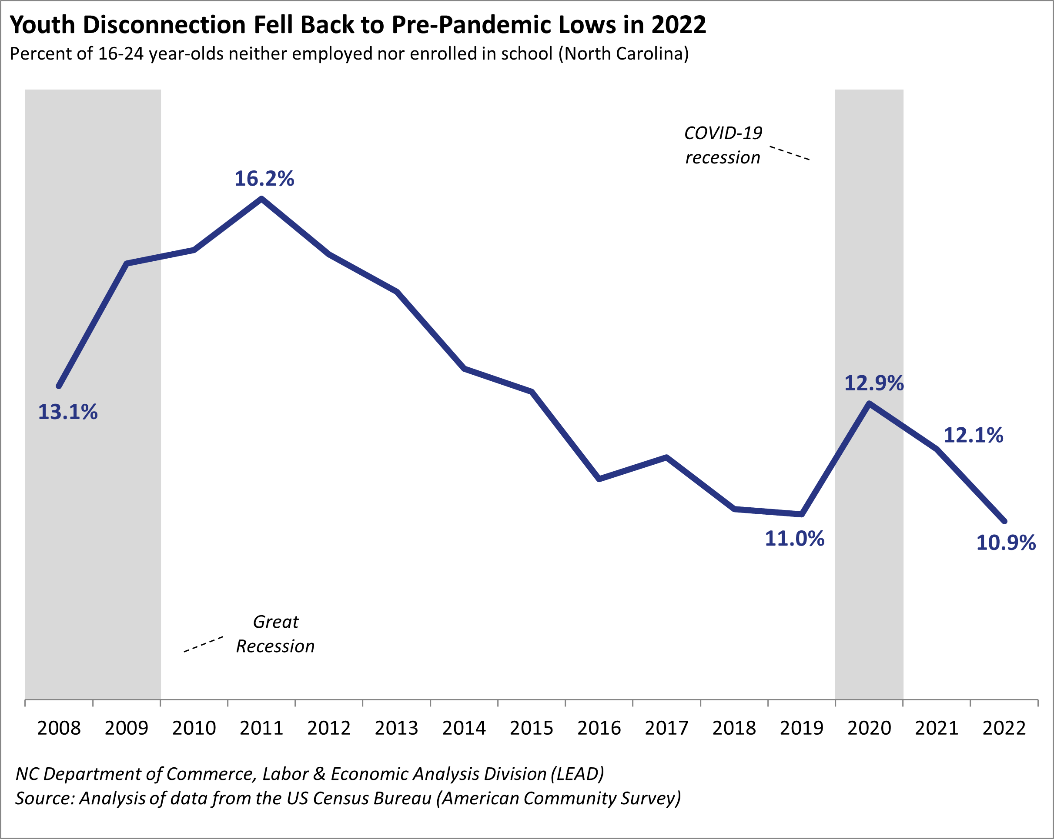
A Significant Portion of North Carolina’s Youth
Safal Partners © 2024

Slide 9
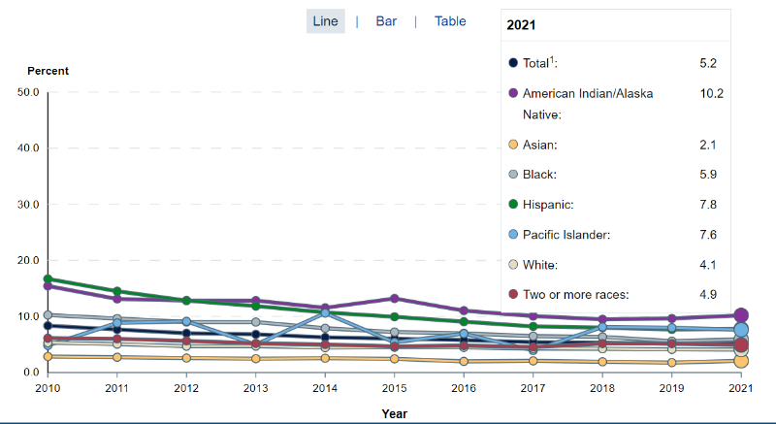
Opportunity Youth… The Numbers
Estimate in 2021: 1.9 million students dropped out of high school… (3.46m in 2016)
16-24 years olds
https://nces.ed.gov/
Safal Partners © 2024

Slide 10
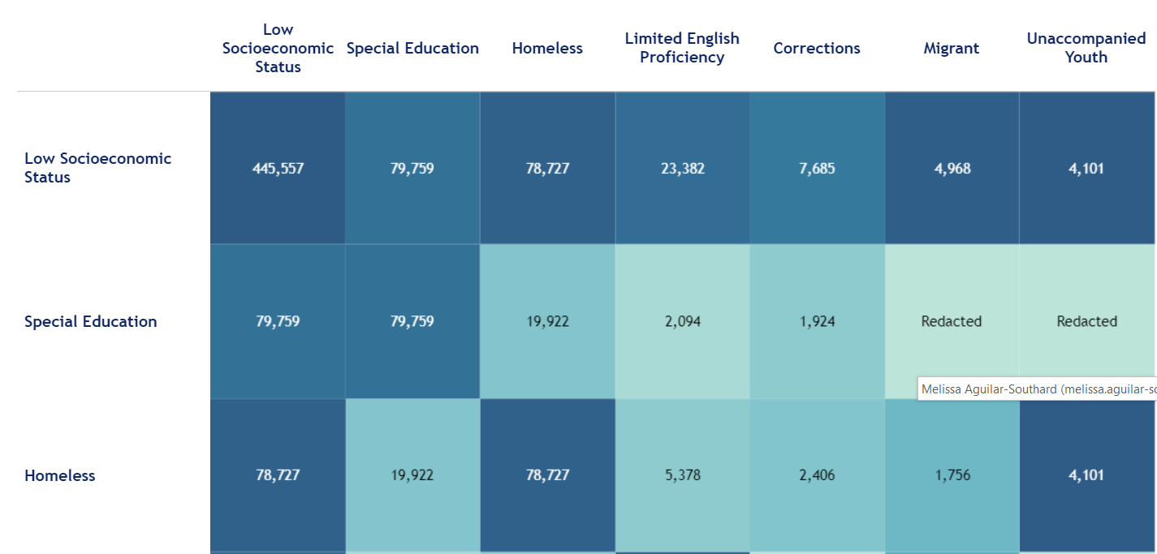
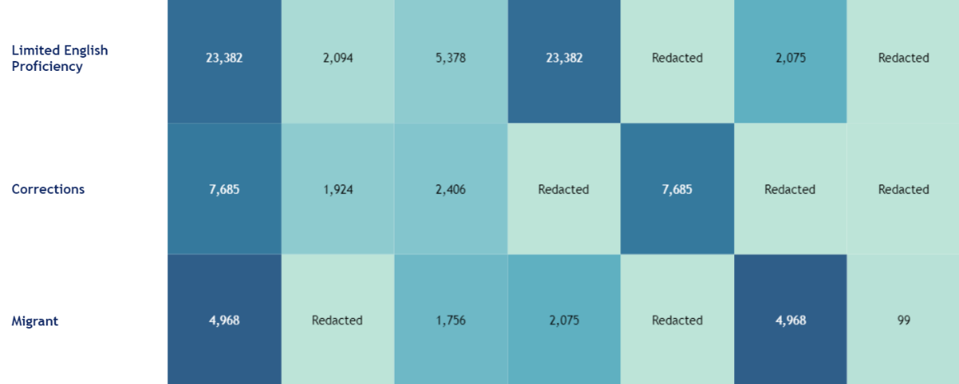
State Breakdown of Opp Youth Stats….KY Example

Slide 11
What Did this Info Tell Us?
Were we effectively working with all youth populations?
Were we working with the right organizations?
Were we meeting youth where they were or asking them to walk through our doors?
Was our staffing and experience effective in engaging youth populations?
Where were we lacking funding and partnerships to serve opportunity youth?
Were we missing data?
Safal Partners © 2024

Slide 12
Apprenticeship… A Way to Engage Opportunity Youth
Safal Partners © 2024

Slide 13
What is Registered Apprenticeship?
Registered Apprenticeship is a proven, customizable, and structured model to find and train new talent as well as upskill current workers in critical occupations.
Safal Partners © 2024

Slide 14
Five Core Components of RA
Employer Involvement
Structured On-the-Job Learning (OJL)
Related Instruction (RI)
Rewards for
Skill Gains
National Occupational Credential
Safal Partners © 2024

Slide 15
Apprenticeships for Opportunity Youth
Connection to employment AND education.
Career pathway beyond RA Program completion for occupations that provide a family-supporting wage. ​​
​Roadmap to credential, certification, and degree attainment.
Connection to mentors who can offer support and guidance.
Linkages to critical supports to assist them in their learning and earning pathway.
Safal Partners © 2024

Slide 16
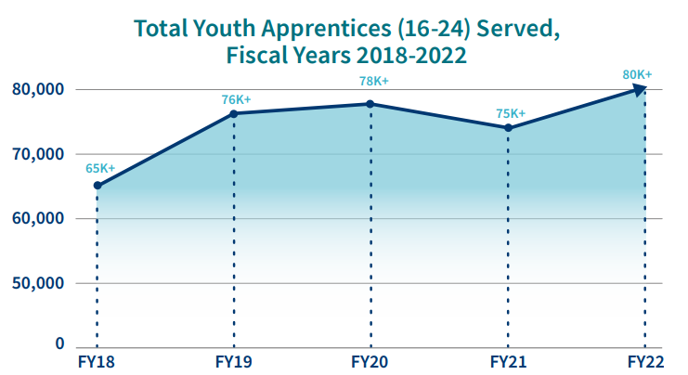
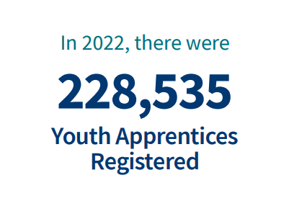
Apprenticeships for Youth
https://www.apprenticeship.gov/
Safal Partners © 2024

Slide 17
The Investing in America Agenda and Opportunity Youth… A Match Made for Each Other
Safal Partners © 2024

Slide 18
What is the Investing in America Agenda
The Investing in America Agenda consists of extensive resources and rules to support the advancement of Registered Apprenticeship:
The Bipartisan Infrastructure Bill $550 billion in new funds for infrastructure.
The CHIPS and Science Act $52.7 billion for American semiconductor research, development, manufacturing, and workforce development.
The American Rescue Plan $1.9 trillion recovery bill with more than $40 billion for workforce development.
The Inflation Reduction Act Nearly $1.2 trillion in incentives for green energy and increased Affordable Care Act (ACA) subsidies.
Safal Partners © 2024

Slide 19
The Bipartisan Infrastructure Law
Safe Streets and Roads for All (SS4A) Grant program: $1 billion to enhance roadway safety and includes pre-apprenticeship, apprenticeship readiness, and youth service initiatives, with a clear path towards registered apprenticeships.
Building Pathways to Infrastructure Jobs Grant Program: Supports enhanced training models in H-1B industries and focuses on sectors like advanced manufacturing, information technology, professional services, supporting renewable energy, transportation, and broadband infrastructure.
Workforce Development: Expands existing workforce development programs encompassing trade schools, community colleges, and union training programs in Registered Apprenticeship. Participants gain expertise in conducting energy assessments for small- and mid-sized manufacturing businesses.
Safal Partners © 2024

Slide 20
The Bipartisan Infrastructure Law 2
National Electric Vehicle Infrastructure Formula Program: Provides $5 billion to states to strategically deploy electric vehicle (EV) charging infrastructure and to establish an interconnected network to facilitate data collection, access, and reliability. States are using NEVI funds for Registered Apprenticeship.
Grid Resilience and Innovation Partnerships (GRIP) Program: Includes $10.5 billion to enhance grid flexibility and improve the resilience of the power system against growing threats of extreme weather and climate change. Substantial opportunities are included for Registered Apprenticeship for opportunity youth to conduct this work.
Safal Partners © 2024

Slide 21
The CHIPS and Science Act
Regional Innovation and Technology Hubs: These hubs will create jobs, spur regional economic development, and position communities throughout the country to lead in high-growth, high-wage sectors such as artificial intelligence, advanced manufacturing, and clean energy technology.
CHIPS for America Workforce and Education Fund: The Fund is $200 million and provides $25 million for Fiscal Year (FY) 2023, $25 million for FY2024, and $50 million for each fiscal year 2025-2027.
Embedding Apprenticeship Within the Incentives Program: Companies seeking funding via the CHIPS Incentives Program must submit workforce development plans for facility operators and construction workers, with applicants committing to hiring individuals who complete training programs and to consider partnerships with various skill-building programs, including Registered Apprenticeships, pre-apprenticeships, community and technical college programs, high school career pathways and paid work-based learning initiatives in the semiconductor industry.
Safal Partners © 2024

Slide 22
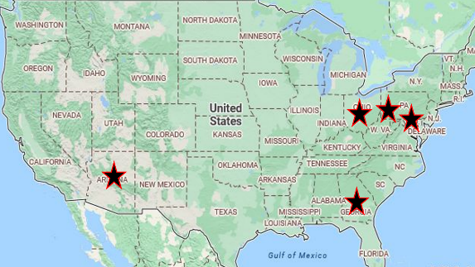
The American Rescue Plan
Workforce Hubs: Five Workforce Hubs (Baltimore, Pittsburgh, Columbus, Phoenix, Augusta) developed to create labor opportunities in these cities.
Good Jobs Challenge: $500 million grant to make investments in high-quality, locally led workforce systems to develop 32 industry-led, worker-centered training partnerships and systems across the country, which impacts 31 states and Puerto Rico and dramatically transform communities.
Workforce Development Funds: Funding to state and local workforce development agencies to help them create and expand Registered Apprenticeship Programs (RAPs), provide training resources, and support outreach efforts to connect individuals with apprenticeship opportunities.
Safal Partners © 2024

Slide 23
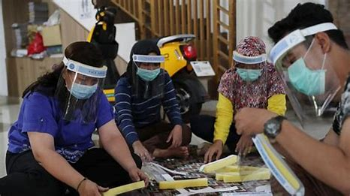
The American Rescue Plan 2
Training and Education: Resources to enhance the quality of training, updates to program curriculum, and apprentice access to the knowledge and skills needed for their chosen trades.
Innovative Practices: Encourages the development and implementation of innovative practices in RAPs. This may involve exploring new training methodologies, technology integration, and industry partnerships to enhance the effectiveness and relevance of apprenticeship training.
Community Health Worker Training Program: $225.5 million awarded to 83 grantees to support training and apprenticeship to support an estimated 13,000 community health workers.
Safal Partners © 2024

Slide 24
The Inflation Reduction Act
Labor Hours Requirements: Ten separate tax credits in the IRA note that employers who access these funds must set aside a minimum of 15% of their labor hours for apprentices.
Defense Production Act: $250 million to boost domestic electric heat pump manufacturing with specific focus on apprenticeship programs, and pre-apprenticeship programs.
Domestic Manufacturing Conversion Grants: $2 billion for applicants must commit to signing a project labor agreement that includes precise objectives related to investing in workforce education and training and using registered apprentices and creating opportunities for local workers to participate in the construction project.
Safal Partners © 2024

Slide 25
The Inflation Reduction Act 2
Environmental and Climate Justice Community Change Grants: $2 billion in grants available to support community-driven projects that deploy clean energy. Grantees will be awarded based on the inclusion of pre-apprenticeships or Registered Apprenticeship Programs, that are worker-centered, demand-driven, and lead to good jobs.
Transmission Siting and Economic Development Program: $760 million to siting authorities to carry out eligible activities that will facilitate the siting and permitting of covered transmission projects. Funding specifies partnerships with labor unions, workforce groups, apprenticeship programs, and pre-apprenticeship programs.
Latest and Zero Building Energy Code Adoption: $1 billion for States and units of local government with the authority to adopt building energy codes to adopt and implement the latest building energy code. States are expected to include plans to engage opportunity youth with Registered Apprenticeship a particular area.
Safal Partners © 2024

Slide 26
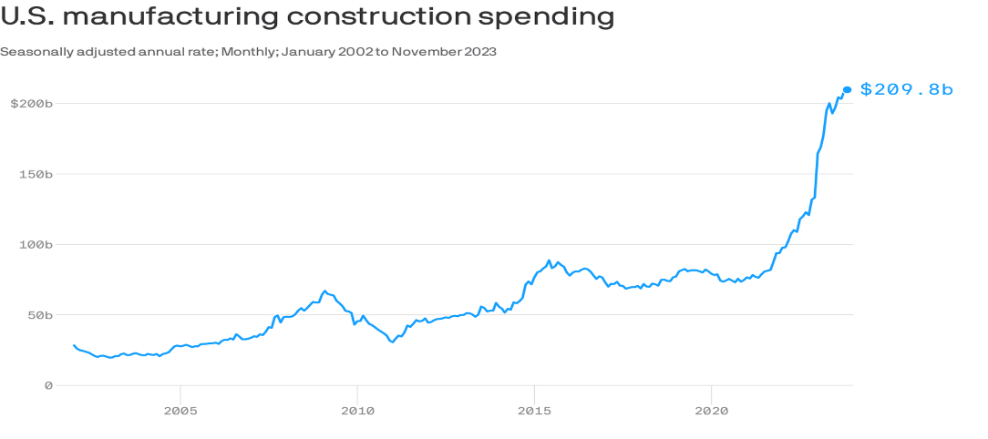
An Investment Boom for Apprentices
Safal Partners © 2024

Slide 27
Workforce Boards… The Key Ingredient
Safal Partners © 2024

Slide 28
How Workforce Boards Can Help Education Providers
Provide WIOA Individual Training Account (ITA) funding to support apprentices' RI costs.
Make connections with employers, sponsors.
Host convenings between education and industry.
Provide pipeline of Opportunity Youth to enroll in programs.
Add programs to the Eligible Training Provider List (ETPL).
Support the development of RI curriculum using labor market information and industry standards.
Safal Partners © 2024

Slide 29
How Workforce Boards Can Help Employers/Sponsors
Provide a pipeline of Opportunity Youth Apprentices:
Publicize RA program opening
Screen candidates
Provide pre-apprenticeship training
Provide supportive services to Opportunity Youth.
Provide WIOA OJT contract funding to support percentage of apprentice wages.
Build partnerships w/training providers on ETPL for RI; utilize ITAs to pay for all/portion of apprentices' RI costs.
Support registering and implementing RA programs.
Host convenings (job fairs, recruiting events, etc.) to connect potential apprentices and employers.
Safal Partners © 2024

Slide 30
How Workforce Boards Can Help Community-Based Organizations
Provide education on RA.
Connect potential apprentices with employers.
Provide supportive services to apprentices.
Connect potential apprentices to other resources available within the community.
Leverage funding programs.
Safal Partners © 2024

Slide 31
Get to Know Your Workforce Board
Each Workforce Board has:
Sector strategies: priority occupations and key industries.
Policies on OJT contracts, which WIOA and non-WIOA funding "buckets" and services they will apply to RA.
Funding levels, fiscal year cycle and how quickly they anticipate spending funds.
Supportive services offered and how that maps to your program's needs.
Candidate pool – IS and OS Youth Programs.
ETPL program registration process.
Safal Partners © 2024

Slide 32
More Opportunity than Ever!
Create New Perspectives on Partnerships
Devise Win-Win Collaboration Strategies
Innovate Outside Your Normal Box
Influence and Leverage New Funding
Expand Your Reach Into Communities
Safal Partners © 2024

Slide 33
Questions and Discussion
2024

Slide 34
Contact Us, Become a Partner
Scan for Partner Form
Receive no-cost expert TA, materials, and assistance
Network with potential partners nationwide
Be nationally recognized for your work

Slide 35
Email us your questions at RA_COE@SafalPartners.com
For more information, visit: dolcoe.safalapps.com
Safal Partners © 2024

