Slide 1
ATRs and BSRs: Collaborating to Expand Registered Apprenticeship Capstone Session
June 13, 2024

Slide 2
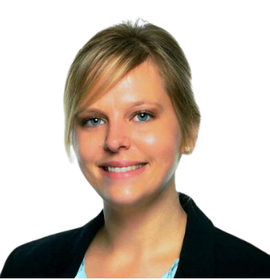
Moderator
Nicole Klues
Project Director
Safal Partners

Slide 3
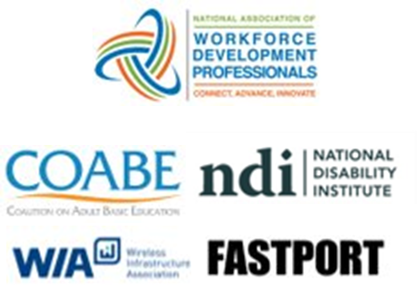
Center of Excellence Overview
U.S. DOL initiative to increase systems alignment across apprenticeship, education, and workforce
Led by Safal Partners; 5 national partners
We provide no-cost TA including:
Monthly webinars
Quarterly virtual office hours
Individual TA/coaching sessions
Online resources (desk aids, guides, frameworks, etc.)
Visit our website, request TA

Slide 4
Training Acknowledgements

Slide 5
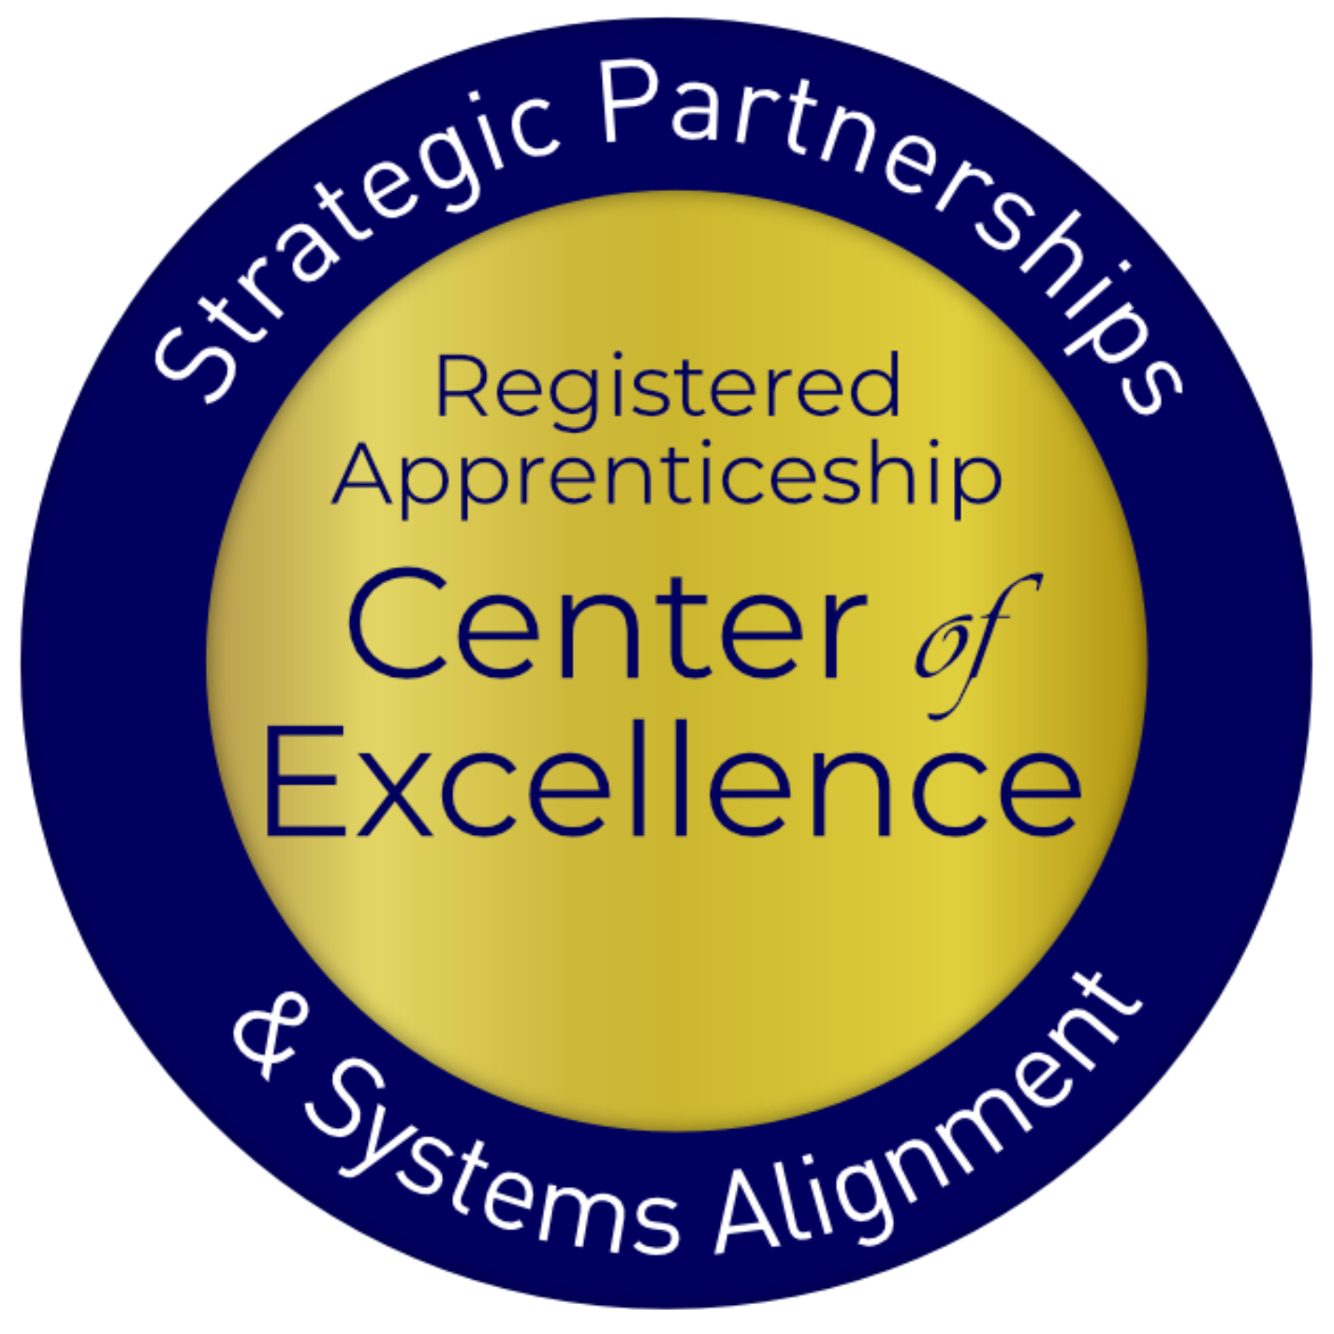
Agenda
Welcome and Introduction
Review of ATR and BSR Roles and Responsibilities
Keys to Effective Collaboration
Promising Practices from Maryland
Connect and Collaborate: Break-Out Rooms Discussion
Q&A

Slide 6
Poll #1
What is your role in the workforce system?
Business Services Representative (BSR)
Apprenticeship Training Representative (ATR)
Workforce partner staff with some BSR responsibility
Apprenticeship Navigator (AN)
Workforce Manager/Administrator
Local Workforce Board Director or Staff
Other

Slide 7
Poll #2
Did you attend one or more of the previous training sessions?
Yes
No

Slide 8
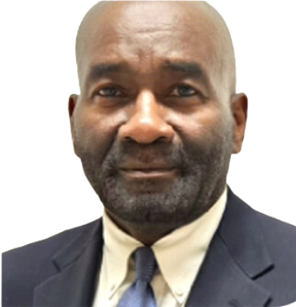
Guest Speakers
Michael Qualter
Deputy Administrator
Office of Apprenticeship
U.S. Department of Labor
Dr. Robert Kight, Ed.D.
Director of the Adult Services and Workforce System
Office of Workforce Investment
U.S. Department of Labor

Slide 9
ATRs and BSRs
Roles and Responsibilities Recap

Slide 10
Summary of ATR Responsibilities
Develop and implement RA programs
Manage and oversee RA programs to ensure adherence to laws and regulations
Provide technical assistance to employers, sponsors, and other stakeholders
Conduct outreach to promote apprenticeship programs
Provide support to apprentices and sponsors throughout the duration of the program

Slide 11
Summary of BSR Responsibilities
BSRs meet with businesses to comprehend their talent needs including staffing requirements, skill gaps, and workforce challenges.
Services often include:
Employer Engagement & Relationship Building
Network and Collaboration
Facilitating Access to Funding
Compliance and Documentation
Data Analysis & Reporting
Safal Partners © 2024

Slide 12
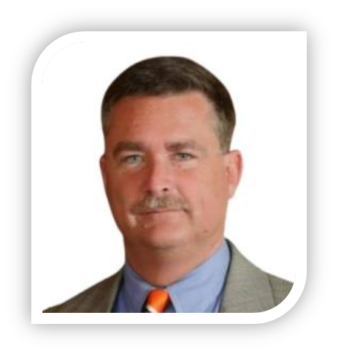
Guest Speaker
Jeffrey Smith
Workforce Liaison / Program Analyst
Office of Apprenticeship
U.S. Department of Labor
Safal Partners © 2024

Slide 13
Keys to Effective ATR and BSR Collaboration

Slide 14
The ATR-BSR Roles Intersect
Both roles require collaboration with stakeholders such as ATRs/BSRs, educational institutions, and industry associations to create comprehensive workforce solutions.
Safal Partners © 2024

Slide 15
Levels of Interaction – Three Cs
No matter what your current level of partnership is, you can take steps to enhance your work together.
Communication
Share information
Coordination
Work Together
Collaboration
Plan/Act Jointly
Assess your current level of interaction and take specific actions to move to the next level

Slide 16
Principles of Collaboration
Communication – Share Information:
Meet your counterpart and discuss how you can support each other in achieving common goals.
Share information, outcomes, and lists of companies you’re working with.
Announce when new programs or occupations get approved.
Coordination – Work Together:
Align services by establishing regular joint touch-base meetings.
Plan joint partner visits and create a strategic approach to company outreach.
Develop a shared informational database and asset map of resources to identify and track key stakeholders to include in outreach and engagement.
Collaboration – Plan/Act Jointly:
Align RA programs with LWDB performance outcomes to reach organizational goals.
Get buy-in from leadership and track outcomes to demonstrate impact.
Leverage apprenticeship system resources and engage employers effectively.
Enhancing interaction between ATRs and BSRs benefits employers and ensures coordinated efforts to address workforce needs.

Slide 17
Vision for Future Partnership
Innovation in service delivery
Adapting to evolving workforce needs
Enabling and facilitating collaborations with key partners

Slide 18
Promising Practices:
Maryland Team

Slide 19
Today’s Presenters
Francine Trout
Retired Workforce Development Professional
Dolly Bermudez
Apprenticeship Coordinator
Howard County, MD, Office of Workforce Development
Sheila Jackson
Apprenticeship Navigator
Division of Workforce Development and
of Adult Learning
Maryland Department Labor

Slide 20
How Did We Start?
Outreach/Education Events for the community to learn the benefits of Apprenticeship
Held separate events for job seekers and businesses
Educated public officials and staff on the benefits of apprenticeship
NAW events, info sessions for job seekers and businesses, industry specific events such as IT.

Slide 21
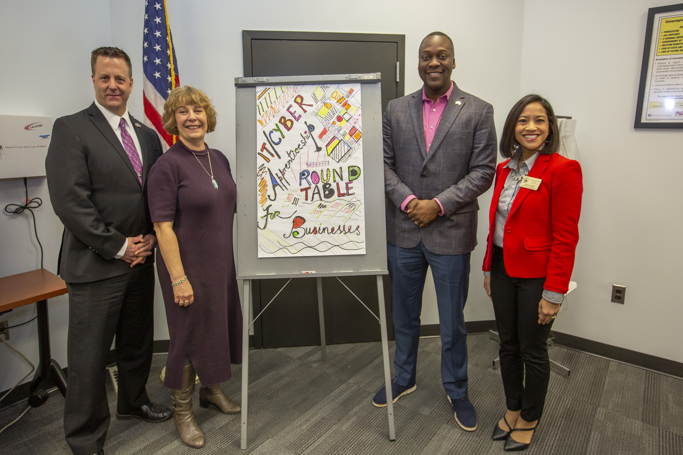
Building a system
Participated with the Howard County Public School System, IEC Chesapeake, MD DOL on a beta test for STA for high school students.​
Howard Community College began apprenticeship programs​
Ho Co WDA hired a dedicated apprenticeship coordinator​
Implemented the vision of the apprenticeship system in Howard County​

Slide 22
Funding
ARPA
WIOA
Pathways to Success
County Funds
MD DOL Funding

Slide 23
System Partners
Howard County Workforce Development Area
MD Labor
Howard Community College
IEC Chesapeake (Nonunion electrical association)
Howard County Public School System
Safal Partners © 2024

Slide 24
How We Work Together
Industry specific apprenticeship events/meetings
Business meetings
Share business contacts
No wrong door approach
Numerous joint events
National Apprenticeship Week
National Youth Apprenticeship Week
Youth job fairs
Incentives
Safal Partners © 2024

Slide 25
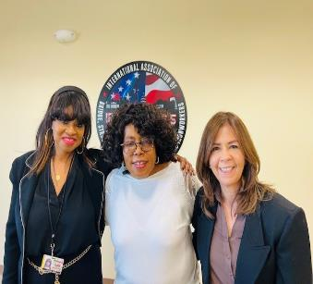
How We Work Together
COLLABORATION
Relationship building with MD DOL Navigator
Ho Co WDA developed a prospective plan
Visit customers together & facilitating events
Ho Co WDA created a local incentive program
Tailored and customized presentations for businesses based on industry needs
HCOWD created an Apprenticeship Newsletter, "The Blitz"
Engaging Employers and jobseekers to promote apprenticeship opportunities
Local, state, and federal Incentives
Safal Partners © 2024

Slide 26
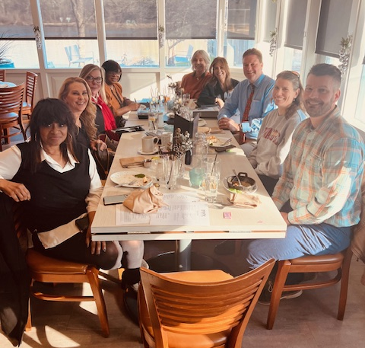
To Conclude
We are like a well-oiled machine fueled by great food and determination.
We are like a well oiled machine fueled by food and determination.
Safal Partners © 2024

Slide 27
Connect and Collaborate: Break-Out Room Discussions

Slide 28
Employment Training Administration Regions
Region 1
Connecticut
Maine
Massachusetts
New Hampshire
New Jersey
New York
Puerto Rico
Rhode Island
Vermont
Virgin Islands
Region 2
Delaware
Maryland
Pennsylvania
Virginia
Washington, D.C.
West Virginia
Region 3
Alabama
Florida
Georgia
Kentucky
Mississippi
North Carolina
South Carolina
Tennessee
Region 4
Arkansas
Colorado
Louisiana
Montana
New Mexico
North Dakota
Oklahoma
South Dakota
Texas
Utah
Wyoming
Region 5
Illinois
Indiana
Iowa
Kansas
Michigan
Minnesota
Missouri
Nebraska
Ohio
Wisconsin
Region 6
Alaska
American Samoa
Arizona
California
Commonwealth Northern Mariana Islands
Guam
Hawaii
Idaho
Nevada
Oregon
Palau
Washington
Safal Partners © 2024

Slide 29
Region Report-Outs
In the chat, please share
Something your region can do right away
Something your region would like to do that would require additional support, guidance or input
One question that your region has

Slide 30
Questions and Answers

Slide 31
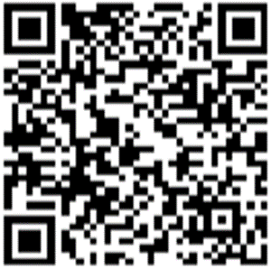
Become A Center Partner
Scan for Partner Form
Receive no-cost expert TA, materials, and assistance
Network with potential partners nationwide
Be nationally recognized for your work

Slide 32
Email us your questions at RA_COE@SafalPartners.com
For more information, visit: dolcoe.safalapps.com
Safal Partners © 2024

