Slide 1
Demonstrated State Apprenticeship Leadership in 2020 Unified/Combined Plans
Part 1
September 14, 2023
Safal Partners © 2023

Slide 2
Welcome and Agenda
Center of Excellence Overview
Today’s Topic: State Leadership in Apprenticeship Noted in 2020 State Plans: Leadership in Planning
Voices from the Field
Questions and Discussion
Closeout
Safal Partners © 2023

Slide 3
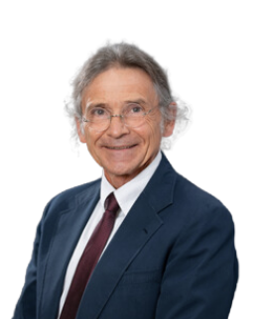
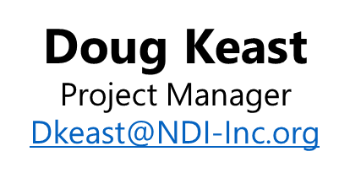
Presenter
Safal Partners © 2023

Slide 4
State Activity and Leadership in Planning
One key indicator identified in the review is the establishment of state level work groups or committees to advise State Workforce Development Boards (SWDBs) and Governor on effective expansion of apprenticeship programs
34% of all state unified/combined plans included an advisory group of stakeholders
Safal Partners © 2023

Slide 5
Leadership vs. Leveraged Role
Leadership Role
Leveraged Role
When a driver as an entity establishes objectives in an area of focus, for our purposes, to expand apprenticeships, as a strategy to meet business objectives, and plans strategically to meet those objectives using expertise and resources available.
When a driver does not assume a leadership role, but resources of that driver are engaged in meeting the objectives of other drivers.
Workforce System
Businesses &
Intermediaries
Apprenticeship Offices &
Advisory
Education &
Training
Education &
Training
Workforce System
Businesses & Intermediaries
Apprenticeship Offices & Advisory
Safal Partners © 2023

Slide 6
Apprenticeship Idaho Steering Committee

Slide 7
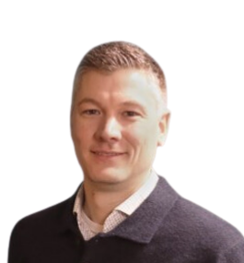
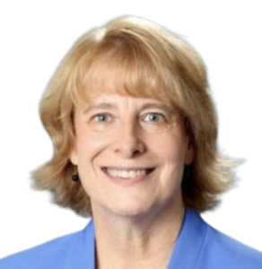
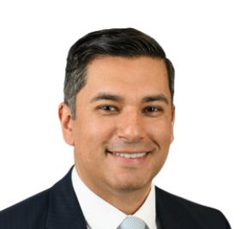
Idaho Panelists
Wendi Secrist
Executive Director, WDC
Matthew Thomsen
Business Partnership MGR. WDC
Gina Robison
Program Supervisor, IDOL
Caleb Tibbets
Apprenticeship Coord., Vocational Rehabilitation
Paula Kellerer
VP for Apprenticeships
Idaho Business for Education
Adrian San Miguel
Chief Program Officer, IDCTE

Slide 8
The Collaboration
History of the Coalition
And
How the Team Operates
Safal Partners © 2023

Slide 9
What comes with Teamwork!
Recent national case study – 2015 to 2021, Idaho has
Increased all apprentices by 116%
Increased new apprentices by 120%
Increased new programs 463%
In State Analysis, AIR and SPR found innovations in
State Leadership and Policy
Outreach and Business Engagement
Capacity to Develop Register and Support Programs
Safal Partners © 2023

Slide 10
Apprenticeship Idaho Partners
Safal Partners © 2023

Slide 11
The Idaho Team Culture
Structure
Coalition Achievements
Apprenticeship Impact
Impact with Policy - Legislation
Lessons Learned
Safal Partners © 2023

Slide 12
Questions and Discussion

Slide 13
Contact US
Gina Robison
Program Supervisor
Idaho Department of Labor
Gina.Robison@labor.idaho.gov
Adrian San Miguel
Chief Program Officer
Idaho Division of Career Technical Education
Adrian.SanMiguel@cte.idaho.gov
Matthew Thomsen
Business Partnership Manager
Idaho Workforce Development Council
Matthew.Thomsen@wdc.idaho.gov
Wendi Secrist
Executive Director
Idaho Workforce Development Council
wendi.secrist@wdc.idaho.gov
Paula Kellerer
Vice President for Apprenticeships
Idaho Business for Education
pkellerer@idahobe.org
Caleb Tibbetts
Apprenticeship Coordinator
Vocational Rehabilitation
Caleb.Tibbetts@vr.idaho.gov
Doug Keast
Project Manager
National Disability Institute
dkeast@ndi-inc.org

Slide 14
Become a Center Partner
Receive no-cost expert TA, materials, and assistance
Network with potential partners nationwide
Be nationally recognized for your work
Scan for Partner Form

Slide 15
Email us your questions at RA_COE@SafalPartners.com
For more information, visit: dolcoe.safalapps.com
Safal Partners © 2023

