Slide 1
Building Student Awareness of Apprenticeship Career Pathways to Meet Maryland’s Ambitious Goals
September 26, 2024

Slide 2
Presenters
Alan D. Dodkowitz
Jeffrey Smith
Senior Subject Matter Expert
Safal Partners
Workforce Liaison/Program Analyst
Office of Apprenticeship
U.S. Department of Labor
Notes:
Jeffrey W. Smith
Workforce Liaison/Program Analyst |Office of Apprenticeship | U.S. Department of Labor

Slide 3
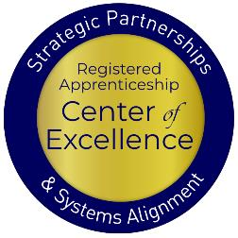
Welcome and Agenda
Center of Excellence Overview
An Overview of Registered and Youth Apprenticeship
What are Maryland’s Goals
What are the Benefits of Apprenticeship for Youth and Schools
High-School and College-Aligned Youth Apprenticeship Pathways
How can we Develop these Pathways
Connecting with Local Workforce Boards
Questions and Closing Thoughts
Safal Partners © 2024

Slide 4
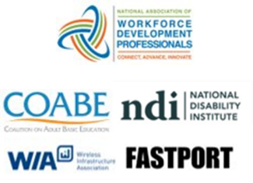
Center of Excellence Overview
U.S. DOL initiative to increase systems alignment across apprenticeship, education, and workforce
Led by Safal Partners; 5 national partners
We provide no-cost TA including:
Monthly webinars
Quarterly virtual office hours
Individual TA/coaching sessions
Online resources (desk aids, guides, frameworks, etc.)
Visit our website, request TA

Slide 5
Quick Pulse Poll #1
Are you a….
Workforce Board Staff
Service Provider Staff
Educational Partner
Vocational Rehabilitation Partner
Employer
Board Member
Registered Apprenticeship Staff
Other
Safal Partners © 2024

Slide 6
Quick Pulse Poll #2
When it comes to Registered Apprenticeship I am…
Just starting out
Somewhat familiar with the basics but don’t utilize it often
Very knowledgeable and refer people often to programs
What is RA????
Safal Partners © 2024

Slide 7
What is Registered Apprenticeship?
Registered Apprenticeship (RA) is a proven, customizable, and industry-relevant and US Department of Labor-approved model for organizations to find, train and retain new talent as well as upskill current workers in critical occupations.
Safal Partners © 2024

Slide 8
Five Core Components of RA
Employer Involvement
Structured On-the-Job Learning (OJL)
Related Instruction (RI)
Rewards for
Skill Gains
National Occupational Credential
Safal Partners © 2024

Slide 9
A WIDE RANGE OF INDUSTRIES
Agriculture
Healthcare
Cybersecurity
Biotechnology
Transportation
Construction
Energy
Hospitality
Advanced Manufacturing
Critical Supply Chain
Telecommunications
Financial Services
Information Technology
Education
Infrastructure
Engineering

Slide 10
What is Youth Apprenticeship?
A youth apprentice is defined as…​
an in-school OR out-of-school youth between the ages of 16 and 24…​
​
who receives industry-validated Related Instruction for an RA program (for in-school youth) from their school while… ​
​ completing part-time, paid, work-based experience ​from an employer under a ​ mentored supervision as part of… ​
​
a Registered Apprenticeship program approved ​ by DOL or a state apprenticeship agency (SAA) or a pre-apprenticeship program.​
Safal Partners © 2024

Slide 11
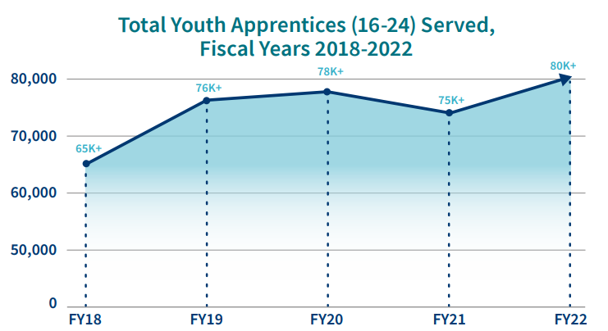
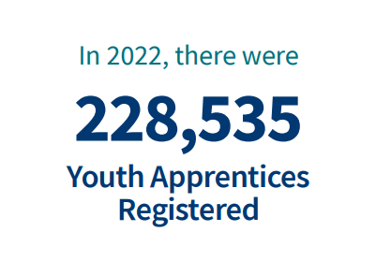
Apprenticeship for Youth
Source: https://www.apprenticeship.gov/
Safal Partners © 2024

Slide 12
High-Quality Youth Apprenticeship
In addition to meeting core RA requirements, high quality youth programs:
Provide dual enrollment pathway for college credit for RI
(if school is sponsor) Include articulated agreement with another program sponsor to ensure students can continue paid OJL (and RI if needed) after graduation​
Provide apprentice with a clearly-outlined career pathway beyond RA program completion for occupations that provide a family-supporting wage
Embed, or prepares student to test out for, industry-recognized certifications or credentials​
Safal Partners © 2024

Slide 13
Maryland School Apprenticeship Goals
© 2024 Safal Partners

Slide 14
Maryland 2030- Ambitious Goals for the State!
The Blueprint sets a goal for 45% of high school graduates completing an apprenticeship or an industry-recognized occupational credential by the 2030-2031 school year
Coordinated through The Apprenticeship Maryland Program (AMP), the program consists of at least one year of related classroom instruction and a workplace component of at least 450 hours
There are nearly 300 employers approved to participate, representing industries including architecture, healthcare, construction, hospitality, manufacturing, government, and others
© 2024 Safal Partners

Slide 15
But the State has a Long Way to Go
To meet the 45% goal, 25,840 of these graduates would have needed to complete an apprenticeship or industry credential
In 2021, about 7% of graduates met these criteria
In the 2021-2022 school year, 271 employers were participating in the program
Favorably, for the most recent 2023 – 2024 academic year, the total number of youth apprentices has grown exponentially, to a total of 1,045 by June 2024.
© 2024 Safal Partners

Slide 16
Apprenticeship Benefits for Students and Schools
Safal Partners © 2024

Slide 17
Substantial Benefits for Youth
Helping students understand the benefits of RA is crucial:
RA is a pathway to a career from the start
RA provides a way to get paid to learn skills and get work experience
Often leads to offer of full-time employment following graduation or program completion soon after graduation
Increases your lifetime earnings potential: average starting salary for apprentice completers is $80,000 per year (U.S. DOL)
Provides way to earn national credential – move and earn anywhere
Can help lower – or even eliminate – the cost of taking college courses
Safal Partners © 2024

Slide 18
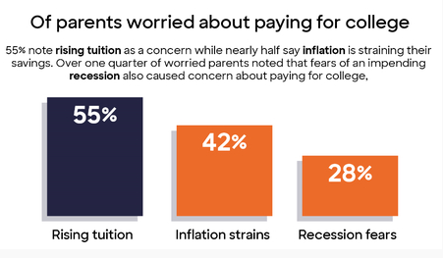
Less Debt, More Opportunities
Nationally....
42.8 million Americans owe more than $1.75 trillion in student loans (2024)
61% of college graduates had taken on student loan debt (2024)
Average debt of student loan holder is $37,853 (2024)
Safal Partners © 2024

Slide 19
Benefits for Schools Involved in Apprenticeship
Apprenticeship programs connect students to colleges
Program sponsors, federal and state programs, and/or students can pay for related instruction
Sponsors can provide additional resources beyond tuition to support students and colleges (curriculum development, student supports, additional funding)

Slide 20
Federal / State Funding for RA
Several programs can help pay for Registered Apprenticeship related instruction courses as local colleges, making it more attractive for local employers to participate. Examples include:
The Workforce Innovation and Investment Act (WIOA) (through Individual Training Accounts) / On-the-Job Training / Supportive Services )
Pell Grants (Up to $6,895 per Apprentice)
Federal Work Study Funds (average of $2,500 per Apprentice)
State Tax Credits and Tuition Support
GI Bill Benefits (for approved programs)

Slide 21
Financial Support for Apprenticeship
Apprenticeship Tax Credit: For the first five eligible Apprentices claimed, employers may receive $3,000 per Registered Apprentice and $1,000 per Youth Apprentice
Sponsor Apprentice Incentive Reimbursement (SAIR) offers Sponsors up to $2,500 to offset the costs of Related Instruction (RI)
Maryland Business Works is an incumbent worker training program that provides up to $4,500 per apprentice
© 2024 Safal Partners
Notes:
Alan

Slide 22
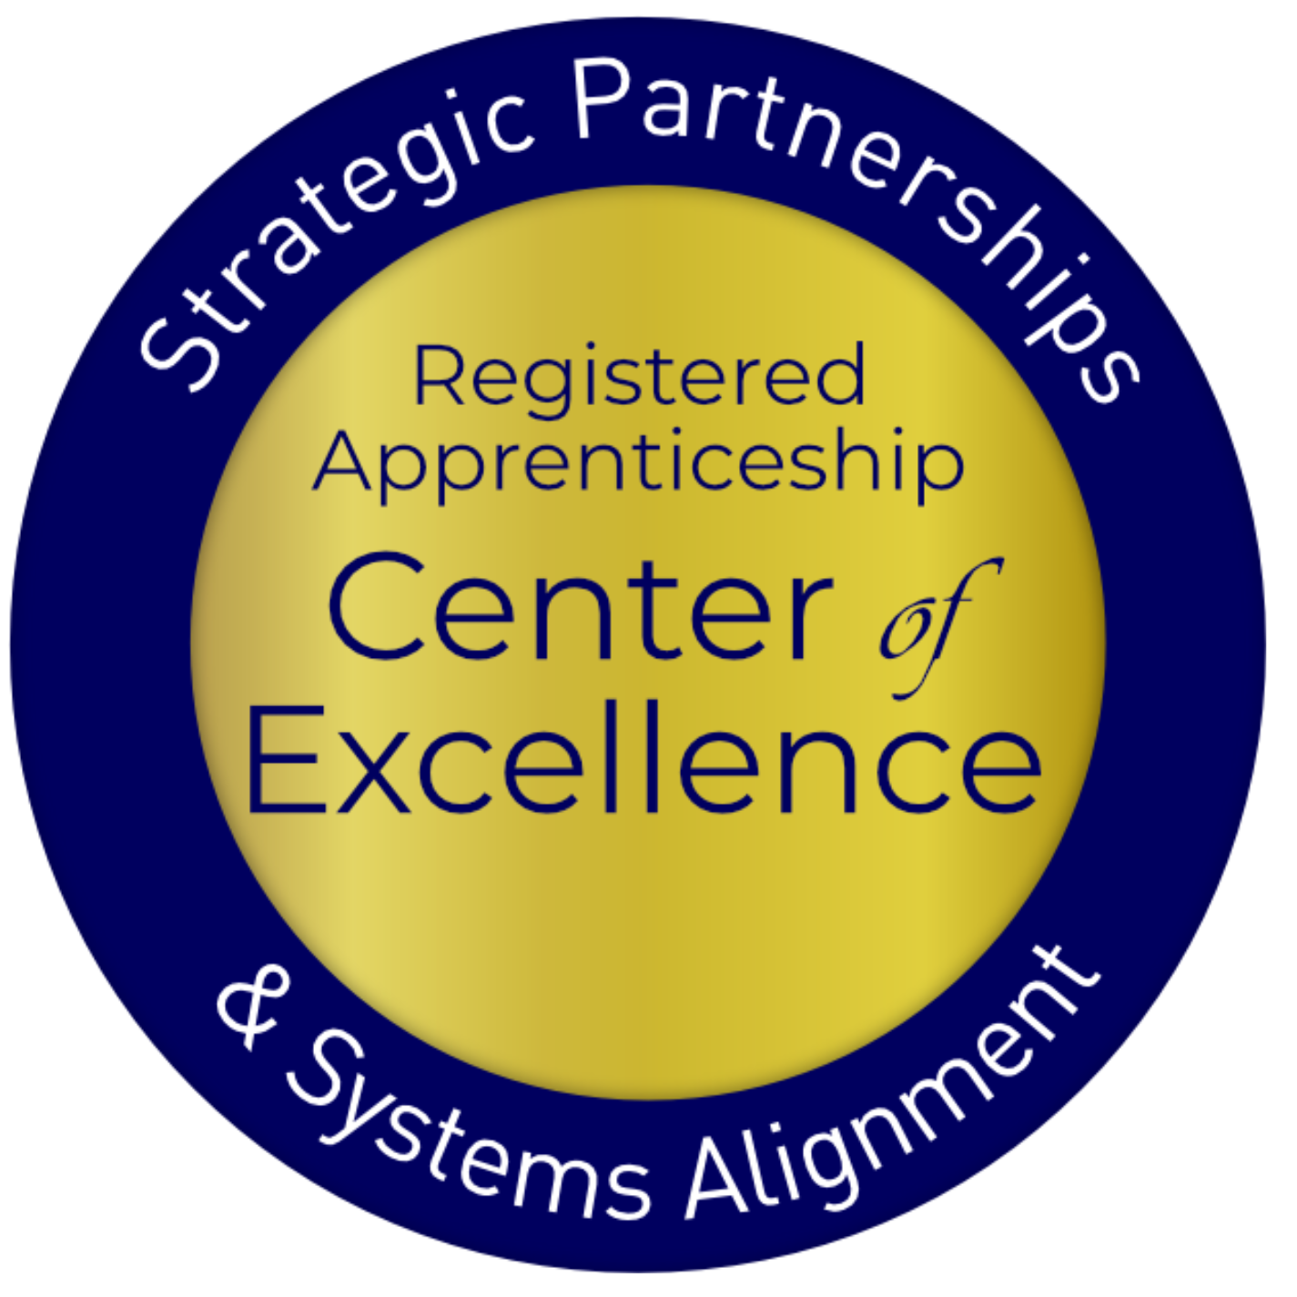
Employ Prince George’s ARPA Initiative
Allows job seekers to obtain credentials in Registered Apprenticeships and Pre-Apprenticeships through two initiatives: Apprenticeship Expansion Fund and the Apprentices Ready initiative.
The Apprenticeship Expansion Fund is a provides employers $2,500 - $5,000 per new employee placed into an apprenticeship.
Apprentices Ready Initiative pays for residents who don’t qualify for employment through an apprenticeship to receive pre-apprenticeship training and be paid $15 per hour during training.
© 2024 Safal Partners

Slide 23
Leveraging Federal Support
Federal Discretionary Apprenticeship Funding
Funding | Amount
2016 Apprenticeship Accelerator | $200,000
2016 ApprenticeshipUSA plus Capbreaker | $2,000,000
2019 Expansion Grant | $2,854,797
2020 Expansion Grant | $6,012,924
Good Jobs Challenge | $22,900,000
2023 Expansion & Formula Grant | $6,650,620
Total Federal Apprenticeship Funding | $40,618,341
© 2024 Safal Partners

Slide 24
Youth Apprenticeship Pathways- High School or College
Safal Partners © 2024

Slide 25
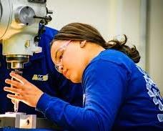
High-School Aligned Apprenticeship Programs
Juniors or seniors eligible to apply for paid on-the-job training experience with an employer while receiving RI at school.
Embeds industry credentials in RI curriculum.
RI counts toward high school graduation requirements and potentially college credits, creating a seamless transition from secondary to post-secondary education.
Often acts as pre-apprenticeship programs that provide a pathway to a full RA program.
Safal Partners © 2024

Slide 26
College-Aligned Youth Apprenticeship Programs
Available at vocational, community, and four-year colleges and generally for 18-24 year olds.
Embeds industry credentials in RI curriculum and oftentimes leads to the award of industry-recognized credentials.
RI counts towards college credits, enabling student to graduate.
Generally, a Registered Apprenticeship program that leads to the award of a DOL-issued certificate.
Safal Partners © 2024

Slide 27
Developing Apprenticeship Pathways
Safal Partners © 2024

Slide 28
Key Questions
What occupations does local labor market information show are in high demand and what interests youth?
What partnerships do we need? What partners do we already have that can support a program?
How will we integrate industry needs/occupation requirements into our RI?
How will we create a Dual/Concurrent Enrollment plan (for high school apprentices)?
How will we ensure RI and OJT count toward both high school graduation and RA program requirements (for high school apprentices)?
Safal Partners © 2024

Slide 29
Gen Z- They’re Interested in Different Occupations
Sustainable Energy Specialist
Digital Content Creator
Health and Wellness Coach
Cybersecurity Analyst
App Developer
Social Impact Consultant
User Experience (UX) Designer
Remote Work Specialist
E-Sports Professional
Mental Health Professional
Safal Partners © 2024

Slide 30
But They are Also the “Toolbelt Generation”
Young adults interested in trades career
Pay increase for new construction hires vs. 2.7% in professional services.
Students studying construction trades rose from 2018 to 2024
Vocational-focused community colleges increase in enrollment
More electricians than 2014 - median age fell by 2.9 years.
Optimistic about job security and believe they won’t be replaced by AI - Thumbtack
Source: Wall Street Journal
Safal Partners © 2024

Slide 31
What Can Each Partner Bring?
Businesses, trade organizations, and chambers of commerce identify needed skills, provide on-the-job training, and employ apprentices.
Schools help design curriculum, provide classroom instruction, and facilitate student recruitment.
Workforce boards can help recruit apprentices, offer funding, and connect partners.
State agencies develop curriculum frameworks, provide guidance on laws/regulations, and offer funding.
Community organizations assist with student recruitment, academic support, funding, and program oversight.
Safal Partners © 2024
Notes:
Alan

Slide 32
Key Organizational Apprenticeship Roles
Sponsor
Employer
RI Provider
Partner
An organization that agrees to operate an apprenticeship program and in whose name the program is registered.
Hires and provides paid OJL for apprentices under supervision of a designated mentor who is a skilled professional in that occupation.
Entity that provides instruction to apprentices in the designated occupation’s core knowledge, skills, and abilities.
Organizations committed to assisting RA programs. They can play one or more roles.

Slide 33
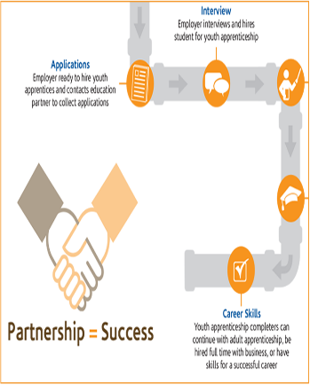
State and Local Partners to Work With
Maryland State Department of Education (MSDE)
Maryland Department of Labor
Local Education Agencies (LEA)
Maryland Apprenticeship Training Council (MATC)
Youth Apprenticeship Advisory Council (YAAC)
Maryland Department of Commerce
Youth Apprenticeship Sponsors/ Employers
Blueprint CTE Committee
© 2024 Safal Partners

Slide 34
Align with CTE Standards and Ensure Hands-On Training
Align Curriculum with Industry Needs: Incorporate CTE standards by aligning the curriculum with current industry needs.
Integrate Work-Based Learning: Embed work-based learning opportunities within CTE programs, allowing students to gain hands-on experience in real- world settings
Collaborate with Industry Partners: Partner with local businesses to design apprenticeship programs that meet both educational and industry requirements.
Incorporate Industry-Recognized Credentials: Include industry-recognized credentials in apprenticeship programs to validate students’ skills and competencies according to CTE standards.
Safal Partners © 2024

Slide 35
Ensuring High-School Students Receive Credit
Synchronize Curriculum with Graduation Objectives: Collaborate with local school districts to ensure the apprenticeship curriculum meets high school graduation requirements.
Dual Enrollment and Credit Recognition Agreements: Create dual enrollment agreements that allow apprentices to earn high school credits for both RI and OJT components of their apprenticeship.
Performance-Based Assessments: Integrate assessments that align with both high school and apprenticeship standards.
Consistent Tracking: Ensure apprenticeship coordinators, school counselors, and educators track apprentices' progress and ensure all requirements are met.
Safal Partners © 2024

Slide 36
Youth Apprenticeship Examples
Safal Partners © 2024

Slide 37
Howard County Community College
Serves as a Sponsor of Registered Apprenticeship Programs.
Offers apprenticeships in 11 different fields (HVAC, IT, Hospitality, Child Care, Licensed Practice Nurse, etc.) and provides the related instruction for these occupations.
Partners with several different employers to provide OJT, including the University of Maryland Medical Center, MedStar Health, Associated Builders & Contractors of Greater Baltimore, Johns Hopkins and others.
Has a close relationship with the local workforce board and workforce system.
Utilizes funds from employers and local and state grants to support their programs.
Safal Partners © 2024

Slide 38
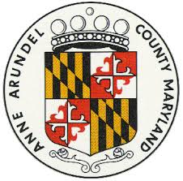
Anne Arundel County
The Anne Arundel County Public Schools (AACPS) work with businesses to develop high school apprenticeship programs, ensuring they meet the MD Labor’s Youth Apprenticeship Standards.
If AACPS cannot directly provide the instruction, they collaborate with businesses to find relevant programs through Anne Arundel Community
College or outside training providers.
Anne Arundel Workforce Development Corporation (AAWDC) provides support for candidate recruitment, interviews, and funding applications, helping to streamline the process for businesses.
The program offers apprenticeships in various industries, including National Security, Transportation, Technology, Insurance, and Construction.
Safal Partners © 2024

Slide 39
Harford County
As of 2021, Harford County Public Schools (HCPS) had one of the highest percentages (21.6%) of students receiving industry credentials or completing youth apprenticeship programs among Maryland school district.
HCPS partners with Harford Community College to offer free workforce opportunities for high school seniors, allowing them to ern industry-recognized credentials.
HCPS was awarded $1,000,000 in funding to bolster its Apprenticeship Maryland Program by strengthening infrastructure for sustainable apprenticeship opportunities.
Safal Partners © 2024

Slide 40
Workforce Boards: The Key Ingredient
Safal Partners © 2024

Slide 41
How Workforce Boards Can Help Education Providers
Provide WIOA Individual Training Account (ITA) funding to support apprentices' RI costs
Make connections with employers, sponsors
Host convenings between education and industry
Provide pipeline of Opportunity Youth to enroll in programs
Add programs to the Eligible Training Provider List (ETPL)
Support the development of RI curriculum using labor market information and industry standards
Safal Partners © 2024

Slide 42
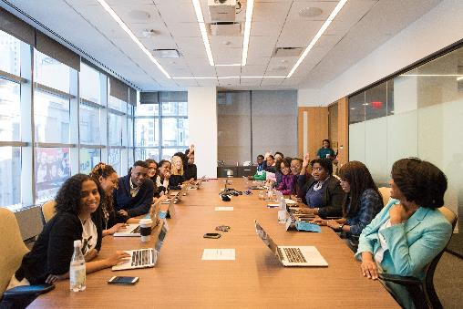
How Workforce Boards Can Help Employers/Sponsors
Provide a pipeline of Opportunity Youth Apprentices:
Publicize RA program opening
Screen candidates
Provide pre-apprenticeship training
Provide supportive services to Opportunity Youth
Provide WIOA OJT contract funding to support percentage of apprentice wages
Build partnerships w/training providers on ETPL for RI; utilize ITAs to pay for all/portion of apprentices' RI costs
Support registering and implementing RA programs
Host convenings (job fairs, recruiting events, etc.) to connect potential apprentices and employers
Safal Partners © 2024

Slide 43
How Workforce Boards Can Help Community-Based Organizations
Provide education on RA
Connect potential apprentices with employers
Provide supportive services to apprentices
Connect potential apprentices to other resources available within the community
Leverage funding programs
Safal Partners © 2024

Slide 44
Get to Know Your Workforce Board
Each Workforce Board has:
Sector strategies: priority occupations and key industries
Policies on OJT contracts, which WIOA and non-WIOA funding "buckets" and services they will apply to RA
Funding levels, fiscal year cycle and how quickly they anticipate spending funds
Supportive services offered and how that maps to your program's needs
Candidate pool – IS and OS Youth Programs
ETPL program registration process
Safal Partners © 2024

Slide 45
Contact Us, Become a Partner
Scan for Partner Form
Receive no-cost expert TA, materials, and assistance
Network with potential partners nationwide
Be nationally recognized for your work
Notes:
We want to thank all of you for joining us today. We appreciate your participation.
We’d like to encourage you to become a partner with the Center of Excellence if you have not signed up yet. Please take a moment to scan the QR code on the screen. As a partner you have the opportunity to receive no-cost technical assistance and materials, network with partners nationwide, and be nationally-recognized for your work.

Slide 46
Thank You for Joining Us
Email us your questions at RA_COE@SafalPartners.com
For more information, visit: dolcoe.safalapps.com

