Slide 1
Aligning the Workforce and Apprenticeship Systems: Registered Apprenticeship and WIOA 101 for Case Managers
July 2024

Slide 2
Presenters
Haylie Schuster
Lisa Rice
Engagement Manager
Safal Partners
Subject Matter Expert
Safal Partners

Slide 3
Welcome and Agenda
Center of Excellence Overview
Registered Apprenticeship Basics
Case Managers as SMEs
New Tool
Co-Enrollment
Questions and Discussion
Safal Partners © 2024

Slide 4
Center of Excellence Overview
U.S. DOL initiative to increase systems alignment across apprenticeship, education, and workforce
Led by Safal Partners; 5 national partners
We provide no-cost TA including:
Monthly webinars
Quarterly virtual office hours
Individual TA/coaching sessions
Online resources (desk aids, guides, frameworks, etc.)
Visit our website, request TA

Slide 5
Poll – Getting to Know You

Slide 6
Registered Apprenticeship Basics
Safal Partners © 2024

Slide 7
What is Registered Apprenticeship?
Registered Apprenticeship is a proven, customizable, and structured model to find and train new talent as well as upskill current workers in critical occupations.
Safal Partners © 2024

Slide 8
Five Core Components of RA
Employer Involvement
Structured On-the-Job Learning (OJL)
Related Instruction (RI)
Rewards for
Skill Gains
National Occupational Credential
Safal Partners © 2024

Slide 9
Case Managers as SMEs
Safal Partners © 2024

Slide 10
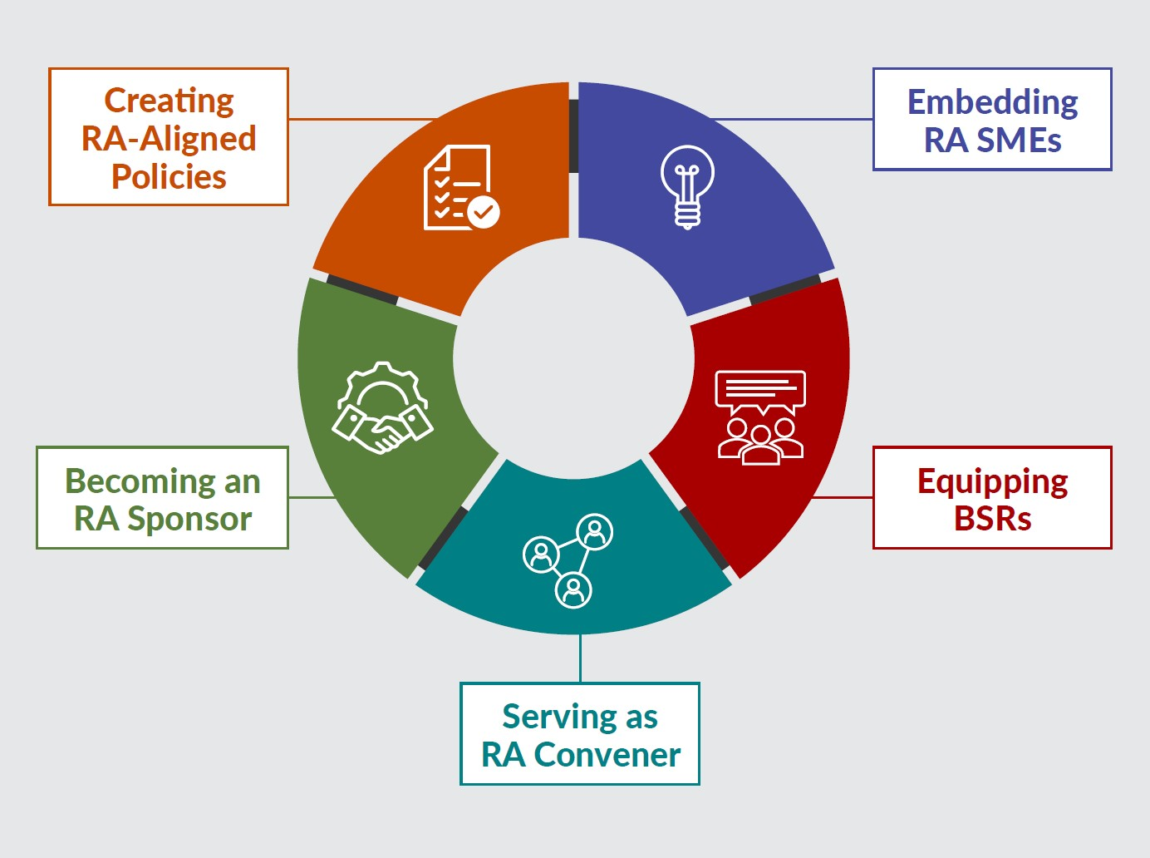
New Tool
Key Components of Workforce System Alignment with Registered Apprenticeship
https://dolcoe.safalapps.com
Safal Partners © 2024

Slide 11
Embedding RA SMEs
State/LWDBs embed RA expertise in the AJC frontline staff to actively help BSRs engage local employers in adopting RA and help case managers create a pipeline of job seekers as RA candidates for local sponsors.
State/LWDBs hire, designate and train staff as RA navigators/SMEs, embed within AJCs or serve entire regions
Case managers purposefully screen and refer job seekers to RA programs
Co-enrollment procedures are used consistently by case managers and across all mandatory partners
Apprentices are supported throughout the RA program
Mandatory partners work with AJCs to engage “shared” job seekers in RA programs
Outreach to job seekers communicates benefits of apprentices
Case managers receive regular RA training to effectively engage job seekers and communicate benefits
Wagner-Peyser staff share RA information to job seekers and employers with a warm handoff to AJC/BSR staff as warranted
Safal Partners © 2024

Slide 12
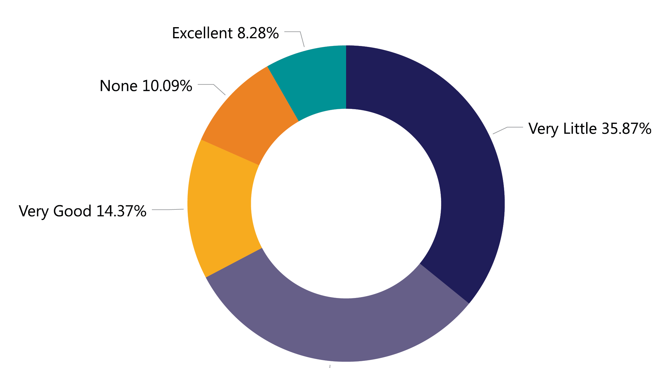
RA & WIOA Performance Measures
How would you rate your knowledge on how Registered Apprenticeship correlates with performance measures?
Source: 2023 Workforce System Registered Apprenticeship Baseline Knowledge Assessment Report - USDOL Center of Excellence, Safal Partners, NAWDP
Safal Partners © 2024

Slide 13
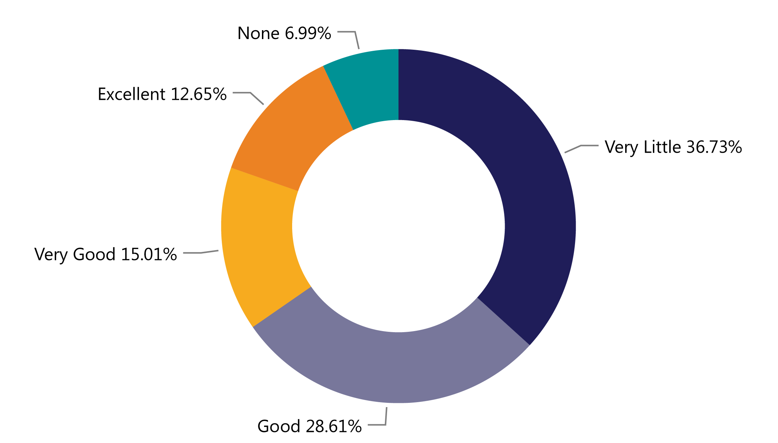
Programs Paying for RA
How would you rate your knowledge of who pays for each part of an apprenticeship program (related instruction, wages, administration)?
Source: 2023 Workforce System Registered Apprenticeship Baseline Knowledge Assessment Report - USDOL Center of Excellence, Safal Partners, NAWDP
Safal Partners © 2024

Slide 14
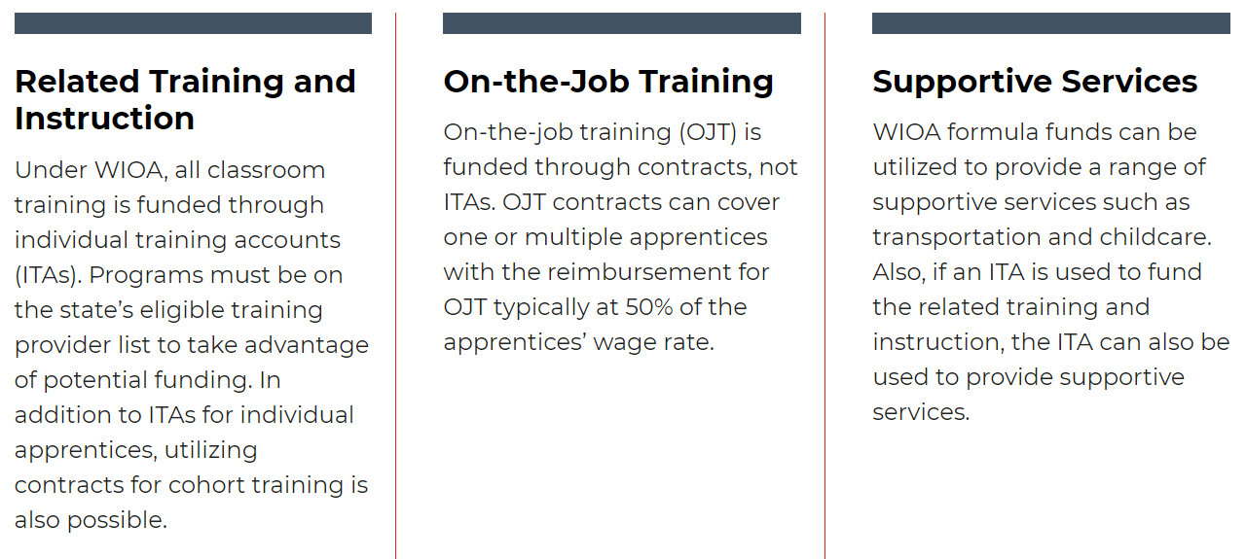
WIOA Funding, Supports for RA

Slide 15
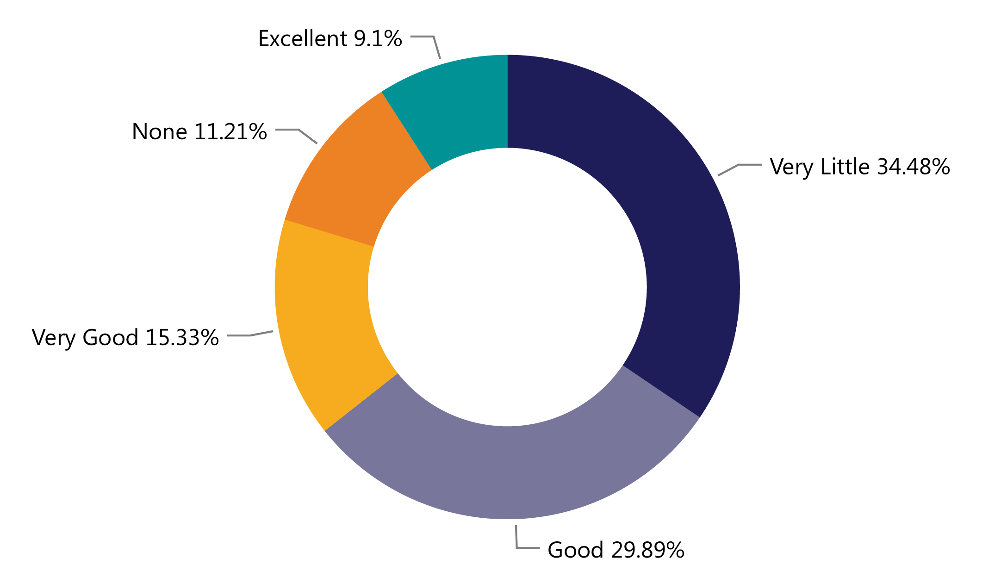
RA & ETPLs
How would you rate your knowledge of the relationship between Registered Apprenticeship related instruction and your state or local eligible training provider list?
Source: 2023 Workforce System Registered Apprenticeship Baseline Knowledge Assessment Report - USDOL Center of Excellence, Safal Partners, NAWDP

Slide 16
WIOA Engagement Poll
What does
your current
WIOA
co-enrollment
look like?
NON-EXISTENT- there is no interest or knowledge of WIOA co-enrollment
EMERGING - there is interest in WIOA co-enrollment, but we are not sure where to start
ADVANCING - there is an active plan to co-enroll WIOA participants
LEADING – we are actively co-enrolling WIOA participants in Registered Apprenticeship programs

Slide 17
RA Co-Enrollment and WIOA Benefits
Unlock additional sources of RA program support for employers who sponsor programs or hire apprentices and for job seekers hired as apprentices
Shared outcomes
Boost overall alignment for workforce system

Slide 18
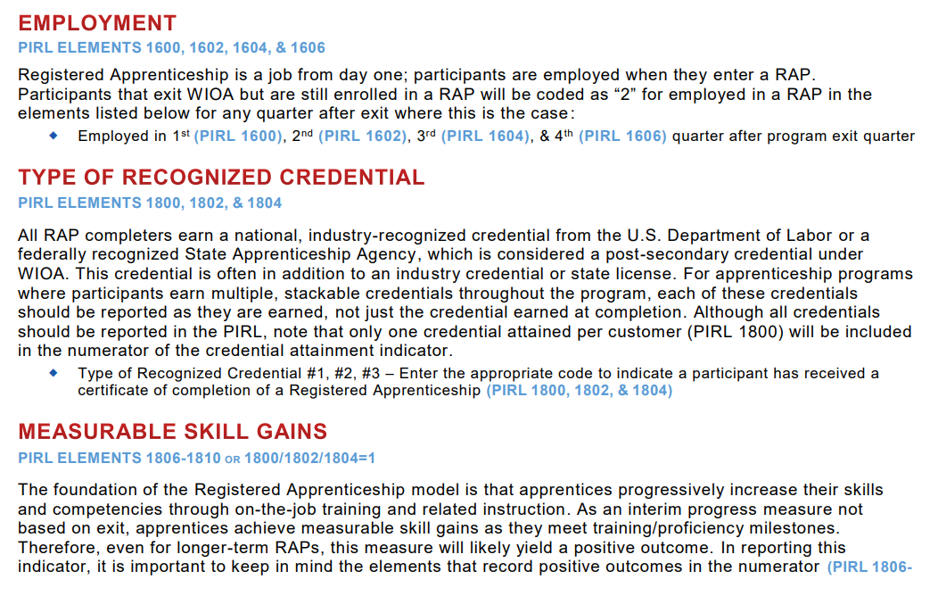
RA Co-Enrollment and WIOA
Understand how to correctly report RA and WIOA Co-Enrollment

Slide 19
How You Can Help With RA
Provide WIOA funding (Individual Training Account (ITA) / Supportive Services) to support RA costs.
Provide pipeline of potential students to enroll in programs.
Know the RA programs on your Eligible Training Provider List (ETPL) and how to refer customers to them.

Slide 20
How You Can Help RA - Continued
Publicize RA program openings and screen candidates.
Encourage your organization to host RA job fairs – specific to open RA positions in your area.
Connect potential apprentices to other resources available within the community
Create an RA work group
Share your knowledge with leadership, BSRs, other Case Managers

Slide 21
Share RA Knowledge
Explain the benefits of RA to your career seeker customer
Have career seeker explore the RA jobs in your area –
Communicate with Business Services Representatives
https://www.apprenticeship.gov/apprenticeship-job-finder
Safal Partners © 2024

Slide 22
Questions, Thoughts, Discussion?
Safal Partners © 2024

Slide 23
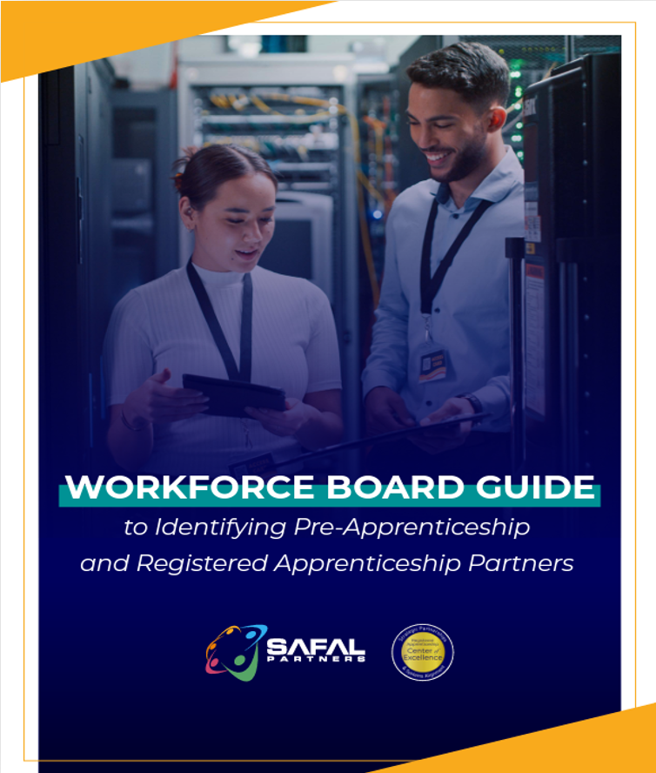
No-Cost Resources
Guide to Identifying Partners
Safal Partners © 2024

Slide 24
Save the Date
August 22 from 1 – 2 ET
Topic: Bridging Education and Apprenticeship
September 20 from 1 – 2 ET
Topic: Registered Apprenticeship as a Talent Development Solution for Employers and Workforce
Visit our Events Page for upcoming events and the latest news.
Safal Partners © 2024

Slide 25
Contact Us, Become a Partner
Scan for Partner Form
Receive no-cost expert TA, materials, and assistance
Network with potential partners nationwide
Be nationally recognized for your work

Slide 26
Thank You for Joining Us
Email us your questions at RA_COE@SafalPartners.com
For more information, visit: dolcoe.safalapps.com

