Slide 1
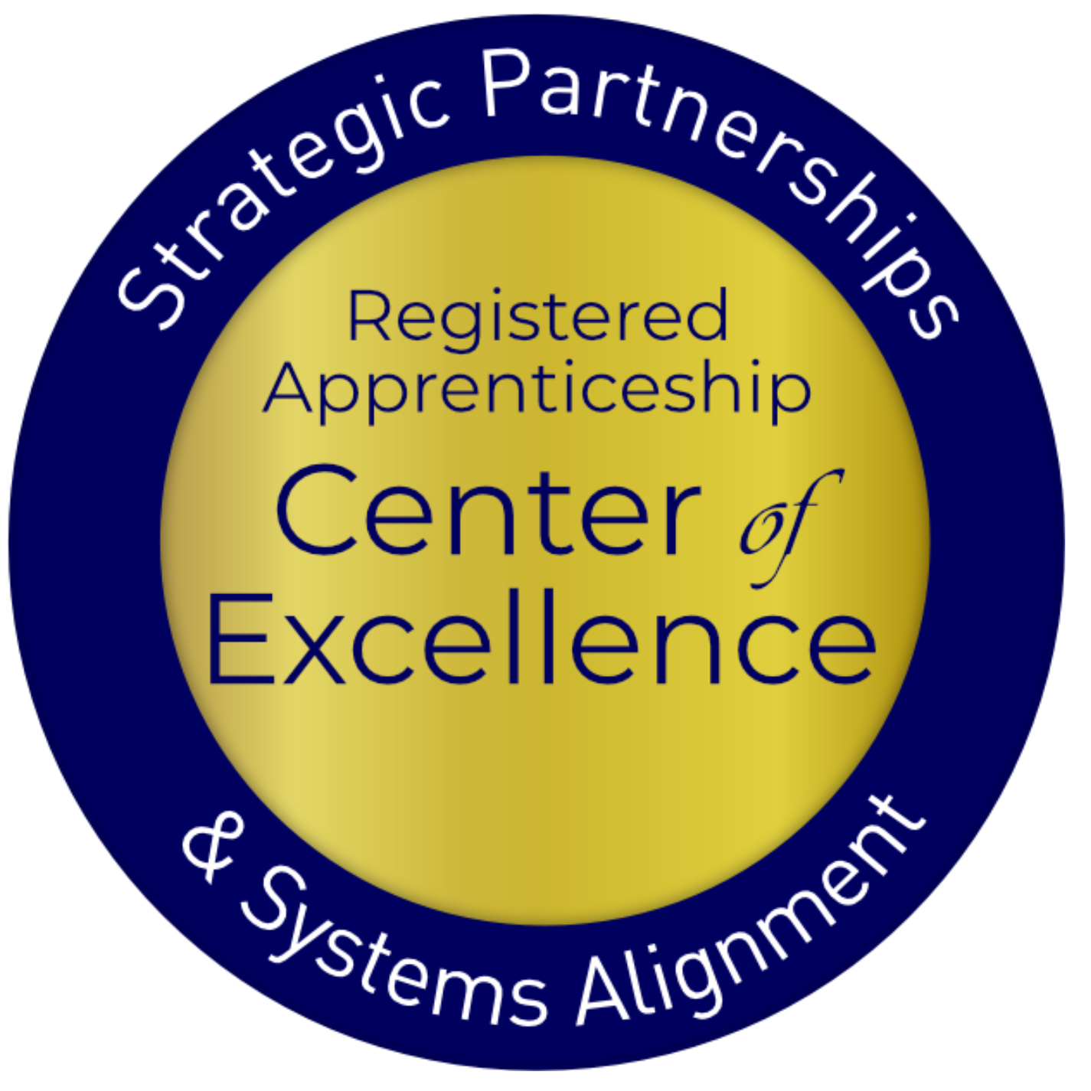
Equipping Chambers of Commerce to Engage in Registered Apprenticeship
January 2025

Slide 2



Presenters
Nicole Bentley
Jeremy Faulkner
Alan Dodkowitz
Subject Matter Expert
Safal Partners
Subject Matter Expert
Safal Partners
Subject Matter Expert
Safal Partners

Slide 3



Center of Excellence Overview
U.S. DOL initiative to increase systems alignment across apprenticeship, education, and workforce
Led by Safal Partners; 5 national partners
We provide no-cost TA including:
  Monthly webinars
  Quarterly virtual office hours
  Individual TA/coaching sessions
  Online resources (desk aids, guides, frameworks, etc.)
Visit our website, request TA

Slide 4
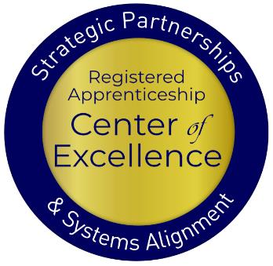
Objectives
Center of Excellence Overview
An Overview of Registered Apprenticeship
Why Registered Apprenticeship and Chambers of Commerce Work Well Together
Current Involvement of Chambers in Registered Apprenticeship
Examples of Chamber Involvement
How Chambers can Engage in RA and Leverage Benefits to Enhance Workforce Strategy
Questions
Safal Partners © 2024

Slide 5

Getting to Know You
Are you a….
  Chamber of Commerce Executive
  Chamber of Commerce Member
  Business
  Workforce Board Director or Staff
  AJC / Career Center Partner
  Service Provider
  Educational Partner
  Board Member
  Other?

Slide 6
An Overview of Registered Apprenticeship
Safal Partners © 2024

Slide 7
Assessing Your RA Knowledge 1
Basic
I know what it means, but I don’t know how to utilize it and don’t have significant experience with it.
Intermediate
I understand RA, I’ve had experience with RA in some capacity, and I feel comfortable educating internal and external stakeholders
about it.
Expert
I have extensive knowledge and relevant experience developing and implementing programs and standards, recruiting apprentices, and convening stakeholders.

Slide 8


Registered Apprenticeship
Registered Apprenticeship is:
a proven model of job preparation that combines paid on-the-job training (OJT) with related instruction to progressively increase workers’ skill levels and wages;
a proven business-driven model that provides an effective way for businesses to recruit, train, and retain highly skilled workers.

Slide 9
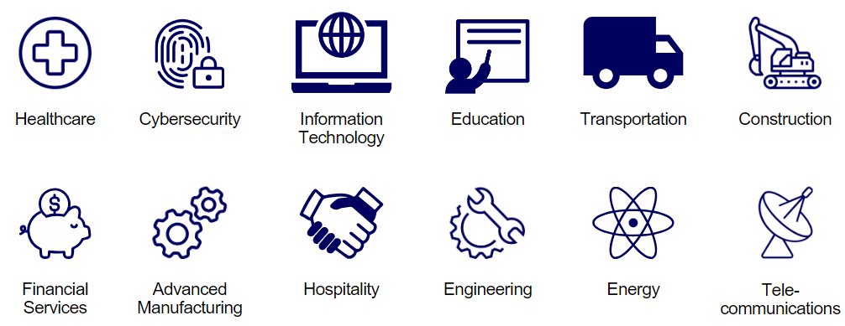
Spans all Sectors

Slide 10




Core Components of RA
Industry Led
Structured
On-the-Job Learning & Mentorship
Related Instruction
(RI)
Paid Job & Rewards for
Skill Gains
Quality &
Safety
National
Occupational Credential
Safal Partners © 2024

Slide 11




Key Organizational Apprenticeship Roles A
Sponsor
Employer
RI Provider
Partner
An organization that agrees to operate an apprenticeship program and in whose name the program is registered.
Hires and provides paid OJL for apprentices under supervision of a designated mentor who is a skilled professional in that occupation.
Entity that provides instruction to apprentices in the designated occupation’s core knowledge, skills, and abilities.
Organizations committed to assisting RA programs. They can play one or more roles.

Slide 12

Benefits of Registered Apprenticeship
Reduced Turnover: Registered Apprenticeship is estimated to have a 93% retention rate (USDOL)
Accessing Financial Benefits: employers with apprenticeship programs can qualify for federal and state tax credits, workforce funding, and a network of partners to support program implementation
Positive ROI: Employers report earning on average $1.44 for every $1 invested in apprenticeship (USDOL)
Earn and Learn Training Model: Apprentices are paid for the duration of their apprenticeship term, allowing them to earn a wage while learning their new occupation.
Standardized Skillset: Every apprentice that completes an employer’s apprenticeship program becomes fully proficient in the same set of skills, creating a more agile workforce
Safal Partners © 2024

Slide 13
Registered Apprenticeship and Chambers-
A Match Made for Each Other
Safal Partners © 2024

Slide 14

Presenter
Amy Shields
Executive Director of the ACCE Foundation
& VP of Programs at ACCE

Slide 15
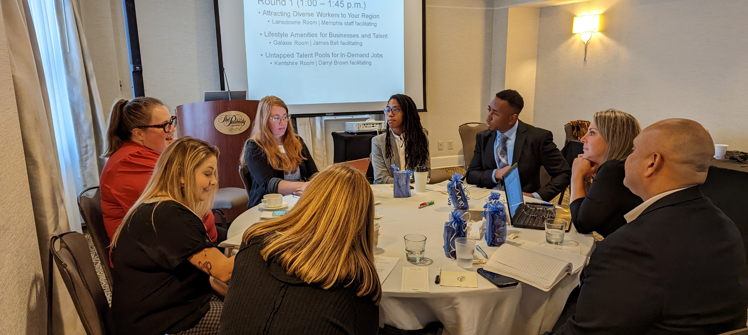
About ACCE and the ACCE Foundation
Safal Partners © 2024

Slide 16
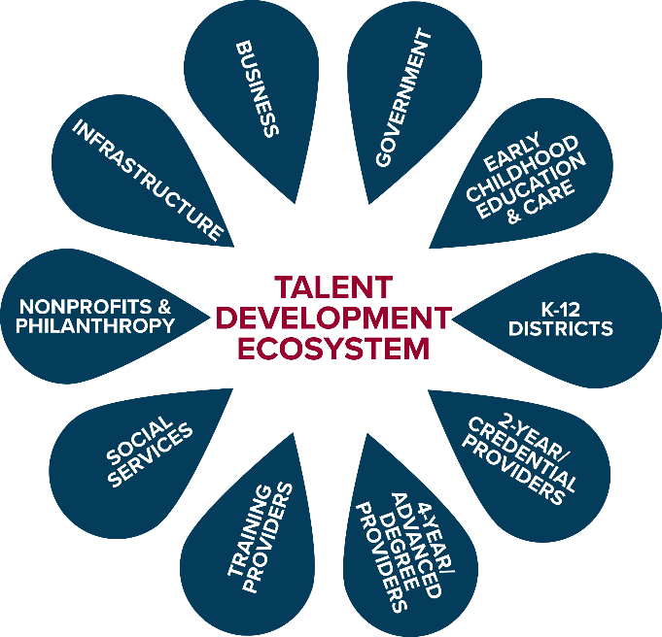
Talent Development Ecosystem

Slide 17
Goals of Workforce Development 1
Public Sector Perspective
Equip workers with the skills and tools they need to succeed, navigate challenges and handle disruptions in the workplace¹
Help businesses find qualified workers
Education institutions, social service providers: sustainable economic security of an individual²
Community and economic developers: sustainable economic growth of a community, region²
Private Sector Perspective
Hire the best talent available
Develop talent on general and industry-specific skills to increase productivity, revenue over time and remain competitive
Invest in future talent
Approach workforce dev. from an organizational perspective²
1 Workforce Development Solutions, U.S. Dept. of Labor, Employment and Training Admin.
2 What is Workforce Development? Federal Reserve Bank of St. Louis

Slide 18

An Individual's Talent Journey

Slide 19
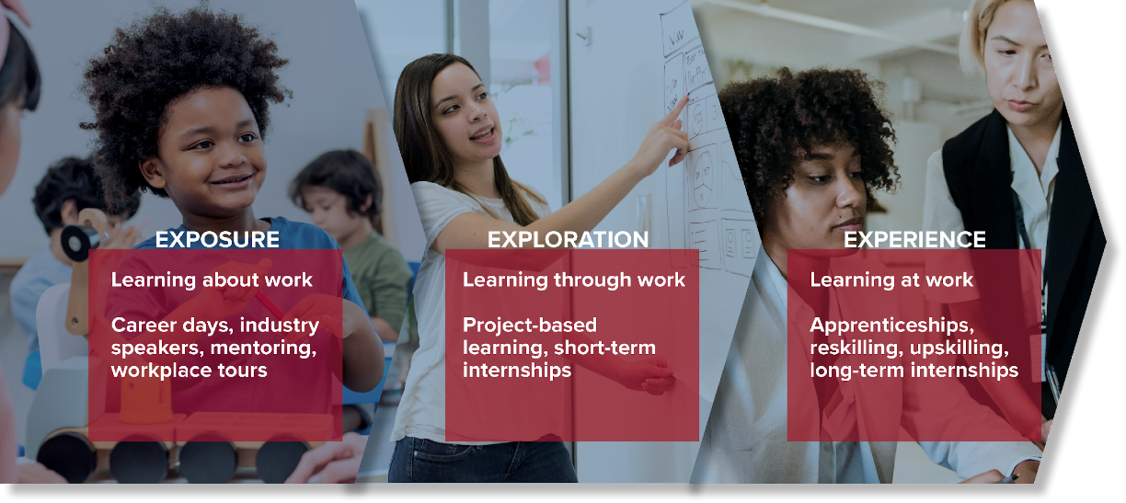
Work-Based Learning Framework

Slide 20
Impact of Work-Based Learning 1
93%
of apprentices stay with an employer after completing an apprenticeship program¹
Average exit wage for youth apprentices of all genders and races, compared to about $12 for all other youth. Differences were most pronounced for Black and Hispanic youth²
$31
53%
of employers surveyed converted interns to full time hires from 2022-2023³
1 ApprenticeshipUSA Factsheet, Apprenticeship.gov 2 Youth Apprenticeships Growing, Disparities Remain, Education Week
3 Intern Conversion Rate Fell, National Association of Colleges and Employers

Slide 21
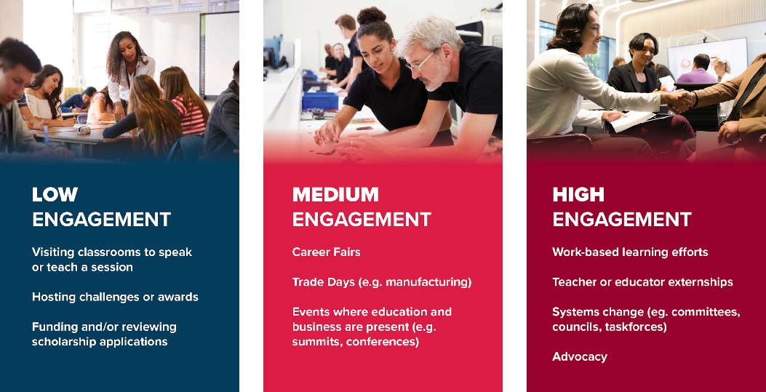
Levels of Involvement in WBL

Slide 22
Benefits of Championing Apprenticeships
Help address talent pipeline gaps in your region
Provide pathways for economic mobility
Connect employers with skilled talent
Strengthen partnerships within the talent development ecosystem
Position the chamber as a problem solver
Potential non-dues revenue opportunity

Slide 23


What Registered Apprenticeship Offers Chambers
Enhanced Portfolio of Opportunities
Stronger Contributions to the Local Community
Improved Policy Advocacy
Safal Partners © 2024

Slide 24

What Registered Apprenticeship Offers Businesses
Standardized, Skilled Workforce
Improved Productivity
Reduction in Turnover
Positive ROI
Safal Partners © 2024

Slide 25

What Registered Apprenticeship Offers Businesses (Continued)
Customizing Training
Retaining Workers
Safal Partners © 2024

Slide 26
How Chambers are Currently
Engaging in RA
Safal Partners © 2024

Slide 27

Chamber Pulse Check
Beginning in December 2023, Safal Partners began to speak with Chambers throughout the country to understand their involvement in registered apprenticeship and how they would like to get more involved.
Working with the ACCE, the team also surveyed chambers throughout the country to understand their involvement in registered apprenticeship, their needs, and what resources could help them.
Safal Partners © 2024

Slide 28

Chamber Survey Results
Knowledge and Engagement Levels:
Around half of the respondents indicate having relationships with local employers, unions, workforce boards, or educational institutions that sponsor apprenticeship programs.
Only a few chambers are currently sponsoring a registered apprenticeship program themselves.
Priorities and Involvement:
For most chambers, apprenticeships are a moderate priority (rated 2-4 on a 5-point scale) within their broader workforce and talent strategies.
Common ways chambers are involved include promoting apprenticeships to employers, convening employers to identify gaps, and working with school systems to support pre-apprenticeships.
Some chambers are exploring becoming apprenticeship intermediaries or supporting regulatory changes related to apprenticeships.
Safal Partners © 2024

Slide 29

Chamber Survey Results (Continued)
Barriers and Challenges:
Lack of employer engagement, funding constraints, limited knowledge about apprenticeships, limited chamber capacity, and the complexity of navigating the apprenticeship process.
Concerns about the ability to identify a sufficient talent pipeline to fill registered apprenticeships.
Resource Needs:
Training on the basics of the registered apprenticeship, guidance on providing technical assistance to employers, sample outreach materials, and how-to guides on different aspects of apprenticeships.
Resources on designing training curricula, promoting opportunities, and models for community collaboration around apprenticeships.
Safal Partners © 2024

Slide 30



Engagement Poll
How would you rate your organization's level of RA engagement?
Low
Medium
High
Safal Partners © 2024

Slide 31
Noteworthy Chambers
Safal Partners © 2024

Slide 32

German-American Chamber of Commerce
Implements German-style Registered Apprenticeship programs across the Midwest and Southern US.
GACC works with 56 employers in fields like advanced manufacturing, pharmaceutical manufacturing, industrial electronics, and business operations (e.g., purchasing, marketing, HR, accounting).
They train company instructors, assist with recruitment and outreach, connect with college providers, and liaise with stakeholders.
Apprentices earn both a USDOL certification and a German journeyworker credential.
GACC expands Registered Apprenticeship initiatives based on workforce needs identified by member companies, partnering with workforce development organizations, and aiming to scale programs to a self-sustaining level.
Safal Partners © 2024

Slide 33

Kentucky Chamber Foundation
Partners with over 80 local chambers and 25,000 professionals, they advocate for Registered Apprenticeships to address labor shortages and workforce development.
Providers tools and information to help member businesses establish Registered Apprenticeship programs by equipping smaller chambers through the process.
They foster partnerships between educational institutions and the Registered Apprenticeship ecosystem, enabling students to earn both educational credentials and Registered Apprenticeship certificates.
Safal Partners © 2024

Slide 34

Charleston Metro Chamber of Commerce
Promotes Registered Apprenticeship growth through their talent development program.
They helped to expand Registered Apprenticeship to nontraditional industries, recruit employers, arrange interviews, hosted signing days, and contributed private investment for related instruction at the local technical college through Accelerate Greater Charleston to over 200 employers across South Carolina.
The Chamber recruits employers, shares information through outreach events, and aligns regional workforce boards and employers to access WIOA funding to offset training costs.
Safal Partners © 2024

Slide 35



Greater Cleveland Partnership 1
ABA Category 4 Grant for $5.8 Million
Established a RAP Hub in Greater Cleveland
Used for Staff and for System Support/Growth
GCP serves as the program sponsor and acts as an intermediary to provide mentor training and support, identify and connect to wraparound services, assist with data collection and reporting, and advocate for RA program supported policies at the local, state, and federal level.
14 occupations registered
Safal Partners © 2024

Slide 36
How Can You Get Involved
Safal Partners © 2024

Slide 37
What Role Do/Could You Play in RA?
Convener
Partner
Sponsor
Engage community to share information about RA and maintain working knowledge of available resources
Actively promote RA, host events for RA stakeholders to present information, support through special initiatives
Register a group program and manage the related administrative duties for employers

Slide 38
Key Resources to Access
Understanding of current state apprenticeship efforts
Engagement with apprenticeship ecosystem and/or
Where and how related apprenticeship funding is accessed
Industries and employers already involved and using RA
Safal Partners © 2024

Slide 39



Questions
Safal Partners © 2024

Slide 40




Contact Us
Nicole Bentley
Subject Matter Expert
Safal Partners
Nicole.Bentley@safalpartners.com
Amy Shields
Executive Director of the ACCE Foundation & VP of Programs at ACCE
ashields@acce.org
Jeremy Faulkner
Subject Matter Expert
Safal Partners
Jeremy.Faulkner@safalpartners.com
Alan D. Dodkowitz
Subject Matter Expert
Safal Partners
Alan.Dodkowitz@safalpartners.com

Slide 41
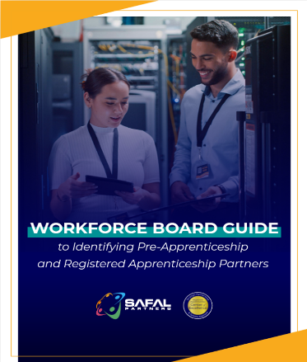

No-Cost Resources
Guide to Identifying Partners
Safal Partners © 2024

Slide 42
Thank You for Joining Us
Email us your questions at RA_COE@SafalPartners.com
For more information, visit: dolcoe.safalapps.com

