Slide 1
Apprenticeship 101: What Is It and Why Should You Be Selling It?
April 25, 2024

Slide 2



Presenters
Haylie Schuster
Melissa Aguilar-Southard
Angela Baker
Engagement Manager
Safal Partners
Subject Matter Expert
Safal Partners
Director
Safal Partners
Safal Partners © 2024

Slide 3
Agenda
Welcome and Introduction
Who we are and how we can help
What is Registered Apprenticeship (RA)
WIOA funding and RA
How to speak to partners about RA
Q&A

Slide 4
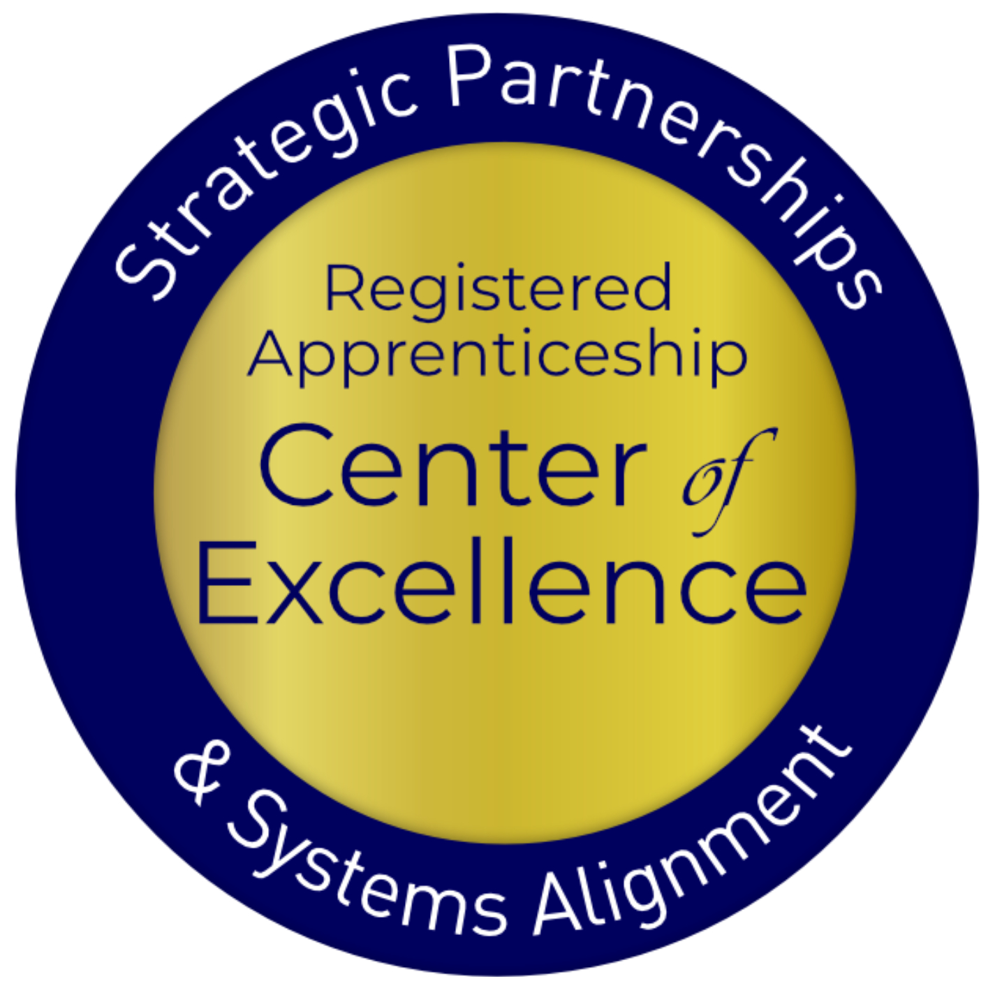
Registered Apprenticeship Defined
Apprenticeship:
A Proven
Workforce Solution
Registered Apprenticeship is a proven, customizable, and structured model to find and train new talent as well as upskill current workers in critical occupations.
Safal Partners © 2024

Slide 5



Center of Excellence Overview
U.S. DOL initiative to increase systems alignment across apprenticeship, education, and workforce
Led by Safal Partners; 5 national partners
We provide no-cost TA including:
  Monthly webinars
  Quarterly virtual office hours
  Individual TA/coaching sessions
  Online resources (desk aids, guides, frameworks, etc.)
Visit our website, request TA

Slide 6

Did you know...
As of March 2024, Missouri ranks third in the nation for completed apprenticeships, third in the nation for new apprentices, and third for active apprentices.

Slide 7
Did you know... 2
Missouri has established Registered Apprenticeship programs in the following industries/occupations:
Agriculture
Carpenter
Certified Medical Assistant
Certified Nursing Assistant
Corrections Officer
Horticulture
Industrial Sewing Operator
Blacksmithing
Library Technician

Slide 8



Five Core Components of Registered Apprenticeship
Employer Involvement
Rewards for
Skill Gains
Related Instruction (RI)
Structured On-the-Job Learning (OJL)
National Occupational Credential
Safal Partners © 2024

Slide 9




Apprenticeship Stakeholders
Sponsor
RI Provider
Employer
Partner
An organization that agrees to operate an apprenticeship program and in whose name the program is registered.
Entity that provides instruction to apprentices in the designated occupation’s core knowledge, skills, and abilities.
Hires and provides paid on-the-job learning (OJL) for apprentices under
supervision of a designated mentor who is a skilled professional in
that occupation.
Organizations
committed to assisting RA programs. They can play one or more roles.
Safal Partners © 2024

Slide 10

ABOUT US
886K+
25K+
7,454
85%
FY 2023 FAST FACTS
Apprentices served
Active apprenticeship programs
New apprenticeship programs since 2021
Growth of new apprentices over the past decade
OUR MISSION
The U.S. Department of Labor’s Office of Apprenticeship promotes and oversees quality, accessible Registered Apprenticeship opportunities for workers seeking higher-skilled, higher-paying jobs and engages employers seeking to build a qualified workforce.
Learn more at our About Us fact sheet

Slide 11
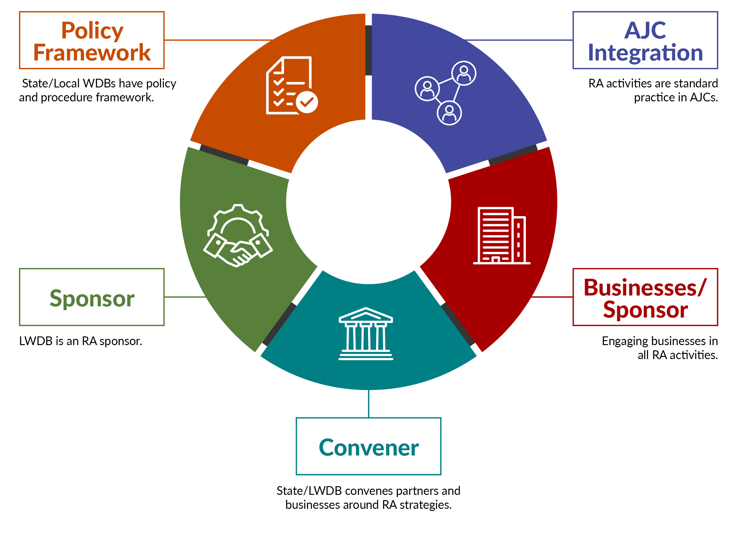
Workforce Engagement in/Utilization of
Registered Apprenticeship

Slide 12

Types of Registered Apprenticeship
Time-based, competency-based, or hybrid
Some programs are managed by a joint apprenticeship training committee
Individual or group sponsorship

Slide 13












A WIDE RANGE OF INDUSTRIES
Agriculture
Healthcare
Cybersecurity
Biotechnology
Transportation
Construction
Energy
Hospitality
Financial
Services
Information
Technology
Education
Advanced
Manufacturing
Critical
Supply Chain
Infrastructure
Engineering
Telecommunications

Slide 14
















Growing Apprenticeship
SUCCESSFUL ENGAGEMENT WITH MAJOR EMPLOYERS TO GROW APPRENTICESHIP

Slide 15


Program Registration
State-registered programs (SAA states)
Federally-registered programs
National programs: multi-state, national programs
National Program Standards must receive reciprocal approval in all states

Slide 16
RA as a Critical Business Service
Business Services are conducted differently across our State and local workforce areas.
How does your local workforce board conduct business services?
No matter how you do it, the "earn and learn" RA model will benefit businesses in several ways....
Apprenticeship is an invaluable tool for the business community.
How does your local workforce/one-stop system get the word out?

Slide 17





Benefits of Apprenticeship – Business Case
Skilled Workforce
Recruit and develop a highly-skilled workforce
Improved Productivity
Improve profitability and positive impact to your bottom line
Reduced Turnover
Minimize cost with reduced turnover and liability
Customizable Training
Create flexible training options that ensure workers develop the right skills
Retain Workers
94% of apprentices continue employment after completing an apprenticeship

Slide 18

WIOA and Registered Apprenticeship
WIOA may be used to pay for training apprentices, including:
  Incumbent Worker Training - pay for training/instruction of current apprentices;
  Customized Training - for eligible instruction costs;
  On-the-Job Training (OJT) contracts - pay for employer’s extraordinary costs of training; and
  Individual Training Accounts - pay for training/instruction of new apprentices.

Slide 19
RA's Positive Impact on WIOA Performance
Adopting Registered Apprenticeship as a workforce strategy can help advance the goals of WIOA:
Helps meet WIOA Performance Outcomes: employment rate, median earnings, credential attainment, and skill gains
Increases the number of individuals, particularly low-income, who enroll in training because they can earn a living wage while engaged in training activities. Helps the workforce system meet the workforce skill needs of businesses
Can help support Incumbent Worker Training
Can increase the need for and use of OJT Contracts
Adds valued trainers to the Eligible Training Provider List
Training And Employment Guidance Letter WIOA No. 13-16: Operating Guidance for the Workforce Innovation and Opportunity Act

Slide 20

Recent RA System Initiatives and Funding Opportunities
TEN 23-23: Quality Pre-Apprenticeship Programs
Notice of proposed rulemaking to enhance the National Apprenticeship System
Building Pathways to Infrastructure Jobs grant
Apprenticeship Building America
State Apprenticeship Expansion grants

Slide 21



Partners and Resources
Industry Intermediaries for Registered Apprenticeship
Apprenticeship Ambassadors
Apprenticeship Trailblazers
Youth Apprenticeship Week
Advanced Manufacturing Sprint

Slide 22

Key Tips for Promoting RA to Partners
LISTEN to the partner and address what they define as an issue with a solution from RA
Be Patient! It can take up to 10 different meetings for partners to decide to implement RA
Research the business and the job openings before visiting or research the type of client the organization helps
Offer solutions to their specific problems- It is not a one size fits all
Know the benefits for the partner to implement RA (tax credits, funding)
Don't overwhelm them
Speak their language - use terms they understand

Slide 23




















APPRENTICESHIP FUNDING
-- ACCESSING RESOURCES--
For more information, check out the Industry Intermediary fact sheet on Apprenticeship.gov
Registered Apprenticeship Industry Intermediaries: Through a partnership with DOL, these 20 industry intermediaries offer expertise to help employers and labor organizations successfully launch, promote, and expand RA programs in growing industries.
Information Technology
Clean Energy
Early Childhood Education
Education
Early Childhood Education

Slide 24


SAVE THE DATE FOR
YOUTH APPRENTICESHIP WEEK - MAY 5-11, 2024
Youth Apprenticeship Week (YAW) is a nationwide celebration that highlights the benefits and value of Registered Apprenticeship programs for youth, ages 16-24.
YAW builds on the success of NAW and is a key part of the Department's Youth Employment Works Strategy. It challenges us to deepen partnerships across sectors and provide "no wrong door" to quality career pathways, paid work and wrap around services, and hire young workers through youth apprenticeships.
YAW is an opportunity for stakeholders to host events to showcase how Registered Apprenticeship creates a sustainable pipeline of skilled talent for youth across multiple high-demand industries such as cybersecurity, healthcare, agriculture, gaming and graphics design, advanced manufacturing, clean energy, engineering, artificial intelligence, transportation, and robotics.
For more information go to: Youth Apprenticeship Week | Apprenticeship.gov

Slide 25
Questions and Answers

Slide 26

Conclusion
Registered Apprenticeship is the gold standard for training and workforce development.
Understanding RA is important to helping employers/partners in your region to take advantage of the benefits of apprenticeship.
There are resources in the apprenticeship system and partners, such as industry intermediaries, to help your employers/partners to succeed.

Slide 27

Become a Center Partner
Receive no-cost expert TA,
materials, and assistance
Network with potential
partners nationwide
Be nationally recognized for
your work
Scan for Partner Form
27

Slide 28
Email us your questions at RA_COE@SafalPartners.com
For more information, visit: dolcoe.safalapps.com

