Slide 1
Business Services Representatives Registered Apprenticeship Workshop
April 23, 2024

Slide 2



Presenters
Haylie Schuster
Melissa Aguilar-Southard
Angela Baker
Engagement Manager
Safal Partners
Subject Matter Expert
Safal Partners
Director
Safal Partners
Safal Partners © 2024

Slide 3
Agenda
Welcome and Introduction
How Registered Apprenticeship is structured and works in concert with the workforce system
Recent RA system initiatives, funding opportunities, and partners
WIOA funding and RA
How to speak to employers about RA
Q&A

Slide 4

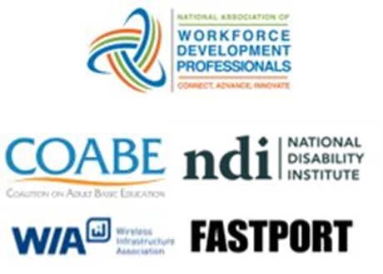

Center of Excellence Overview
U.S. DOL initiative to increase systems alignment across apprenticeship, education, and workforce
Led by Safal Partners; 5 national partners
We provide no-cost TA including:
  Monthly webinars
  Quarterly virtual office hours
  Individual TA/coaching sessions
  Online resources (desk aids, guides, frameworks, etc.)
Visit our website, request TA

Slide 5

Poll #1
What is your role in the workforce system?
  Business Service Representative (BSR)
  Workforce staff that has some BSR responsibility
  Workforce Manager/Administrator
  Local Veterans Employment Representative (LVER)
  Other

Slide 6
Registered Apprenticeship
Safal Partners © 2024

Slide 7
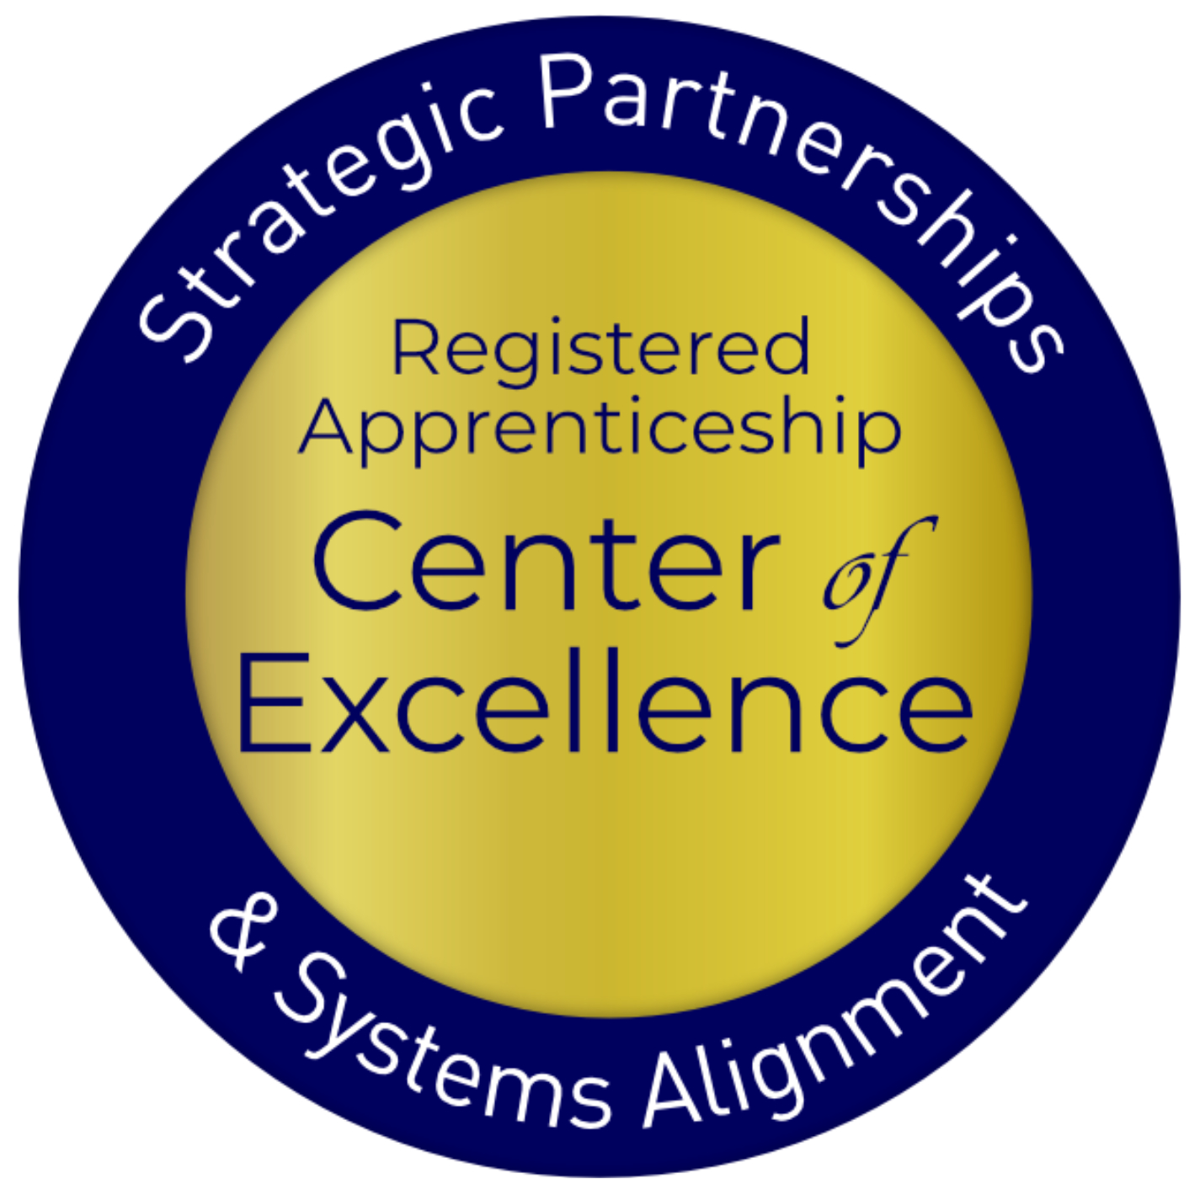
Registered Apprenticeship Defined
Apprenticeship:
A Proven
Workforce Solution
Registered Apprenticeship is a proven, customizable, and structured model to find and train new talent as well as upskill current workers in critical occupations.
Safal Partners © 2024

Slide 8



Five Core Components of Apprenticeship
Employer Involvement
Structured On-the-Job Learning (OJL)
Related Instruction (RI)
Rewards for
Skill Gains
National Occupational Credential
Safal Partners © 2024

Slide 9




Roles of Apprenticeship
Sponsor
RI Provider
Employer
Partner
An organization that agrees to operate an apprenticeship program and in whose name the program is registered.
Entity that provides instruction to apprentices in the designated occupation’s core knowledge, skills, and abilities.
Hires and provides paid on-the-job learning (OJL) for apprentices under
supervision of a designated mentor who is a skilled professional in
that occupation.
Organizations
committed to assisting RA programs. They can play one or more roles.
Safal Partners © 2024

Slide 10

ABOUT US
886K+
25K+
7,454
85%
FY 2023 FAST FACTS
Apprentices served
Active apprenticeship programs
New apprenticeship programs since 2021
Growth of new apprentices over the past decade
OUR MISSION
The U.S. Department of Labor’s Office of Apprenticeship promotes and oversees quality, accessible Registered Apprenticeship opportunities for workers seeking higher-skilled, higher-paying jobs and engages employers seeking to build a qualified workforce.
Learn more at our About Us fact sheet

Slide 11
Core Components of Registered Apprenticeship
Industry Led
Programs are industry-vetted and approved to ensure alignment with industry standards and apprentices are trained for highly skilled, high-demand occupations.
Paid Job
Apprenticeships are jobs! Apprentices earn progressive wage increases as their skills and productivity increase.
Structured On-the-Job Learning/Mentorship
Programs provide structured on-the-job training to prepare for a successful career, which includes instruction from an experienced mentor.
Supplemental Education
Apprentices are provided supplemental classroom education based on the employers' unique training needs to ensure quality and success.
Quality and Safety
Apprentices are afforded worker protections while receiving rigorous training to equip them with the skills they need to succeed and the proper training and supervision they need to be safe.
Credentials
Apprentices earn a portable, nationally-recognized credential within their industry.

Slide 12

Types of Registered Apprenticeship
Time-based, competency-based, or hybrid
Some programs are managed by a joint apprenticeship training committee
Individual or group sponsorship

Slide 13












A WIDE RANGE OF INDUSTRIES
Agriculture
Healthcare
Cybersecurity
Biotechnology
Transportation
Construction
Energy
Hospitality
Financial
Services
Information
Technology
Education
Advanced
Manufacturing
Critical
Supply Chain
Infrastructure
Engineering
Telecommunications

Slide 14
















Growing Apprenticeship
SUCCESSFUL ENGAGEMENT WITH MAJOR EMPLOYERS TO GROW APPRENTICESHIP

Slide 15
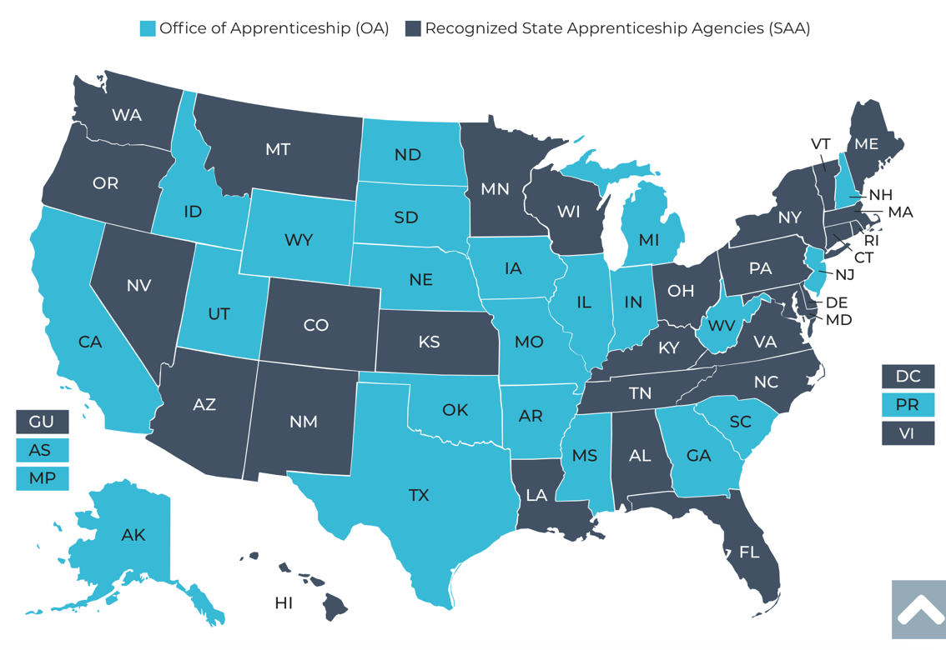
The Apprenticeship System
25 states and territories are Office of Apprenticeship (OA) states
32 states and territories have state apprenticeship agencies (SAA)

Slide 16


Program Registration
State-registered programs (SAA states)
Federally registered programs
National programs: multi-state, national programs
National Program Standards must receive reciprocal approval in all states

Slide 17

What Do Apprenticeship Standards Look Like?
An occupation and O*NET code, identification of apprenticeship type, program length
Sponsor responsibilities (such as record-keeping, health and safety)
Apprentice qualifications, selection procedures, wage progression
Work process schedule (on-the-job learning)
Related instruction outline (144 hours per 2,000 OJT hours)

Slide 18





Benefits of Apprenticeship – Business Case
Skilled Workforce
Recruit and develop a highly-skilled workforce
Improved Productivity
Improve profitability and positive impact to your bottom line
Reduced Turnover
Minimize cost with reduced turnover and liability
Customizable Training
Create flexible training options that ensure workers develop the right skills
Retain Workers
94% of apprentices continue employment after completing an apprenticeship

Slide 19
RA and WIOA Business Services
BSRs are ideally situated to help companies understand all their options, including Registered Apprenticeship
Companies partnering on WIOA services will likely be interested in apprenticeship as an important option
Employer partners are looking to minimize the number of different contacts, meetings, and reports
Workforce and apprenticeship systems can benefit each other
Apprenticeship is an important option for business partners receiving WIOA services.

Slide 20

Recent RA System Initiatives and Funding Opportunities
TEN 23-23: Quality Pre-Apprenticeship Programs
Notice of proposed rulemaking to enhance the National Apprenticeship System
Building Pathways to Infrastructure Jobs grant
Apprenticeship Building America
State Apprenticeship Expansion grants

Slide 21



Partners and Resources
Industry Intermediaries for Registered Apprenticeship
Apprenticeship Ambassadors
Apprenticeship Trailblazers
Youth Apprenticeship Week
Advanced Manufacturing Sprint

Slide 22




















APPRENTICESHIP FUNDING
– ACCESSING RESOURCES
For more information, check out the Industry Intermediary fact sheet on Apprenticeship.gov
Registered Apprenticeship Industry Intermediaries: Through a partnership with DOL, these 20 industry intermediaries offer expertise to help employers and labor organizations successfully launch, promote, and expand RA programs in growing industries.
Information Technology
Clean Energy
Early Childhood Education
Education
Early Childhood Education

Slide 23
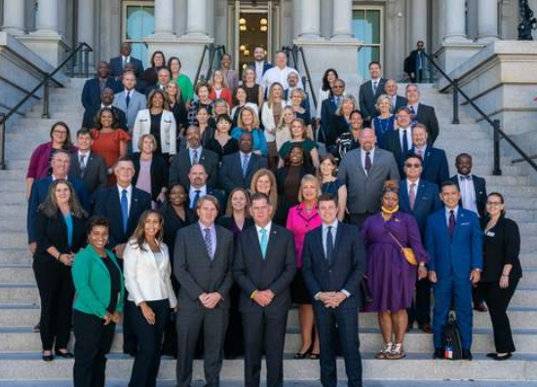
APPRENTICESHIP AMBASSADOR INITIATIVE
The Apprenticeship Ambassador Initiative creates a national network of employers, labor organizations, industry associations, program sponsors, educators, workforce intermediaries, apprentices, community-based organizations, and other stakeholders to serve as champions for expanding Registered Apprenticeship.
For more information check out the Apprenticeship Ambassador page on Apprenticeship.gov

Slide 24

Apprentice Trailblazer Initiative
The Apprentice Trailblazer Initiative is designed to create a national network of apprentices and apprenticeship graduates of all ages and backgrounds to feature their stories and hear their perspectives and bring awareness to other career seekers who may be interested in becoming apprentices.
The first cohort of 57 Trailblazers was announced during National Apprenticeship Week, 2023.

Slide 25


SAVE THE DATE FOR
YOUTH APPRENTICESHIP WEEK - MAY 5-11, 2024
Youth Apprenticeship Week (YAW) is a nationwide celebration that highlights the benefits and value of Registered Apprenticeship programs for youth, ages 16-24.
YAW builds on the success of NAW and is a key part of the Department's Youth Employment Works Strategy. It challenges us to deepen partnerships across sectors and provide "no wrong door" to quality career pathways, paid work and wrap around services, and hire young workers through youth apprenticeships.
YAW is an opportunity for stakeholders to host events to showcase how Registered Apprenticeship creates a sustainable pipeline of skilled talent for youth across multiple high-demand industries such as cybersecurity, healthcare, agriculture, gaming and graphics design, advanced manufacturing, clean energy, engineering, artificial intelligence, transportation, and robotics.
For more information go to: Youth Apprenticeship Week | Apprenticeship.gov

Slide 26
Advanced Manufacturing Apprenticeship Sprint
In the 109 days between October 6, 2023, and January 23, 2024:
+160
Organizations made new commitments
to workforce development and job quality.
4,937
NEW APPRENTICES WERE HIRED
New advanced manufacturing-related Registered Apprenticeship programs
and occupations have been created
or are newly under development.
+150
  Advanced Manufacturing-related Apprenticeship Accelerators and outreach events were held by industry and workforce system partners.
+127

Slide 27

WIOA Funding and RA
Under WIOA, registered apprenticeship programs automatically qualify to be included on the state’s Eligible Training Provider List
Individual Training Accounts are an effective support for WIOA participants to enter an apprenticeship
Incumbent worker training and apprenticeship may be prioritized in WIOA state programs

Slide 28
RA Helps Advance WIOA Goals
Adopting Registered Apprenticeship as a workforce strategy can help advance the goals of WIOA. RA:
Helps meet WIOA Performance Outcomes: employment rate, median earnings, credential attainment, and skill gains.
Gives more individuals on Individual Training Accounts an opportunity to move into living-wage jobs
Can help support Incumbent Worker Training
Can increase the need for and use of On-the-Job Training Contracts
Adds valued trainers to the Eligible Training Provider List
Training And Employment Guidance Letter WIOA No. 13-16: Operating Guidance for the Workforce Innovation and Opportunity Act

Slide 29

How to Speak to Employers about RA
Speak in the language of business:
  Return on investment, productivity, employee retention
Stress the benefits to the employer and its workers
Focus on results, not process
Employers are already investing in training—it makes sense to take part in the benefits of RA, including incentives to support program start-up and training expenses.

Slide 30
Questions and Answers

Slide 31

Conclusion
Registered Apprenticeship is the gold standard for training and workforce development.
Understanding RA is important to helping employers in your region to take advantage of the benefits of apprenticeship.
There are resources in the apprenticeship system and partners, such as industry intermediaries, to help your employers to succeed.

Slide 32
Become A Center Partner
Scan for Partner Form

Slide 33
Email us your questions at RA_COE@SafalPartners.com
For more information, visit: dolcoe.safalapps.com

