Slide 1


Aligning the Workforce and Apprenticeship Systems: Registered Apprenticeship and WIOA 101 for Case Managers
November 19, 2024
3:45-4:45 pm

Slide 2


Presenters
Melissa Aguilar-Southard
Lisa Rice
Senior Project Director and Subject Matter Expert
Safal Partners
Lead Subject
Matter Expert
Safal Partners

Slide 3

Welcome and Agenda
Center of Excellence Overview
The Basics of Youth Apprenticeships
Youth Oriented Case Management
Questions for Follow Up
Wrap Up
Safal Partners © 2024

Slide 4

Poll – Getting to Know You
Audience Affiliations:
  Employers
  Registered Apprenticeship
  Program Staff
  State or Local Workforce Boards
  American Job Center Partners
  Post-Secondary/Proprietary Education
  Service Providers
  Community Based Organizations
  Other?

Slide 5
Poll – Getting to Know You 1
RA Affiliations:
  Self-Proclaimed Expert
  in RA
  I Understand the Concept of RA but Not an Expert
  I am at a 101 Level with RA

Slide 6
COE Overview
Safal Partners © 2024

Slide 7



Center of Excellence Overview
U.S. DOL initiative to increase systems alignment across apprenticeship, education, and workforce
Led by Safal Partners; 5 national partners
We provide no-cost TA including:
  Monthly webinars
  Quarterly virtual office hours
  Individual TA/coaching sessions
  Online resources (desk aids, guides, frameworks, etc.)
Visit our website, request TA

Slide 8
The Basics of
Youth Apprenticeship
Safal Partners © 2024

Slide 9

What is Youth Apprenticeship?
A youth apprentice is defined as…​
an in-school OR out-of-school youth
between the ages of 16 and 24…​
​
who receives industry-validated Related Instruction for an RA program (for in-school youth)
from their school while… ​
​
completing part-time, paid, work-based
experience ​from an employer under a ​
mentored supervision as part of… ​
​
a Registered Apprenticeship program approved ​
by DOL or a state apprenticeship agency (SAA) or a pre-apprenticeship program.​
Safal Partners © 2024

Slide 10

Substantial Benefits for Youth
Helping students understand the benefits of RA is crucial:
RA is a pathway to a career from the start
RA provides a way to get paid to learn skills and get work experience
Often leads to offer of full-time employment following graduation or program completion soon after graduation
Increases your lifetime earnings potential: average starting salary for apprentice completers is $80,000 per year (U.S. DOL)
Provides way to earn national credential – move and earn anywhere
Can help lower – or even eliminate – the cost of taking college courses
Safal Partners © 2024

Slide 11



Five Core Components of RA
Employer Involvement
Structured On-the-Job Learning (OJL)
Related Instruction (RI)
Rewards for
Skill Gains
National Occupational Credential
Safal Partners © 2024

Slide 12




High-Quality Youth Apprenticeship
In addition to meeting core RA requirements, high quality youth programs:
Provide
dual enrollment pathway for college credit for RI
(if school is sponsor) Include
articulated
agreement
with another program sponsor to
ensure students can continue paid OJL (and RI if needed) after graduation​
Provide apprentice with a
clearly-outlined career pathway beyond RA program completion for occupations that provide a family-supporting wage ​
Embed, or prepares student to
test out for, industry-recognized certifications or credentials​
Safal Partners © 2024

Slide 13
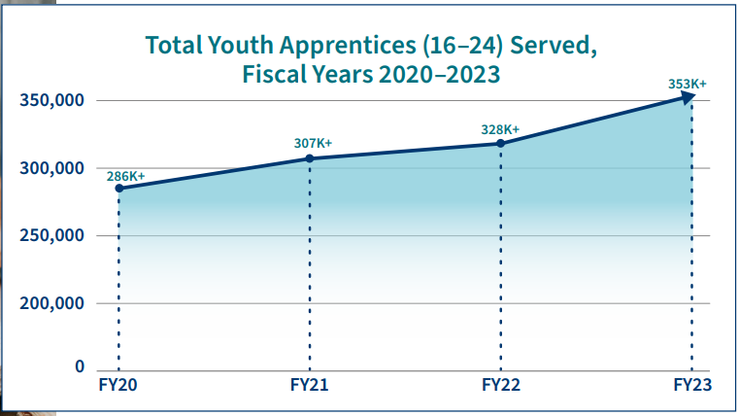
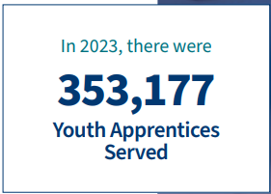
Apprenticeship for Youth
Source: https://www.apprenticeship.gov/
Safal Partners © 2024

Slide 14




High-School Aligned
Apprenticeship Programs
Juniors or seniors are eligible to apply for paid on-the-job training experience with an employer while receiving RI at school.
Embeds industry recognized credentials into
RI curriculum.
RI counts toward high school graduation requirements and potentially college credits, creating a seamless transition from secondary to post-secondary education.
Often acts as pre-apprenticeship programs that provide a pathway to a full RA program.
Safal Partners © 2024

Slide 15


College-Aligned Youth Apprenticeship Programs
Available at vocational, community, and four-year colleges and generally for 18-24 year olds.
Embeds industry credentials in RI curriculum and oftentimes leads to the award of industry-recognized credentials.
Generally, a Registered Apprenticeship program that leads to the award of a DOL-issued certificate.
RI counts towards college credits, enabling student to graduate.
Safal Partners © 2024

Slide 16
Youth Oriented Case Management
Safal Partners © 2024

Slide 17
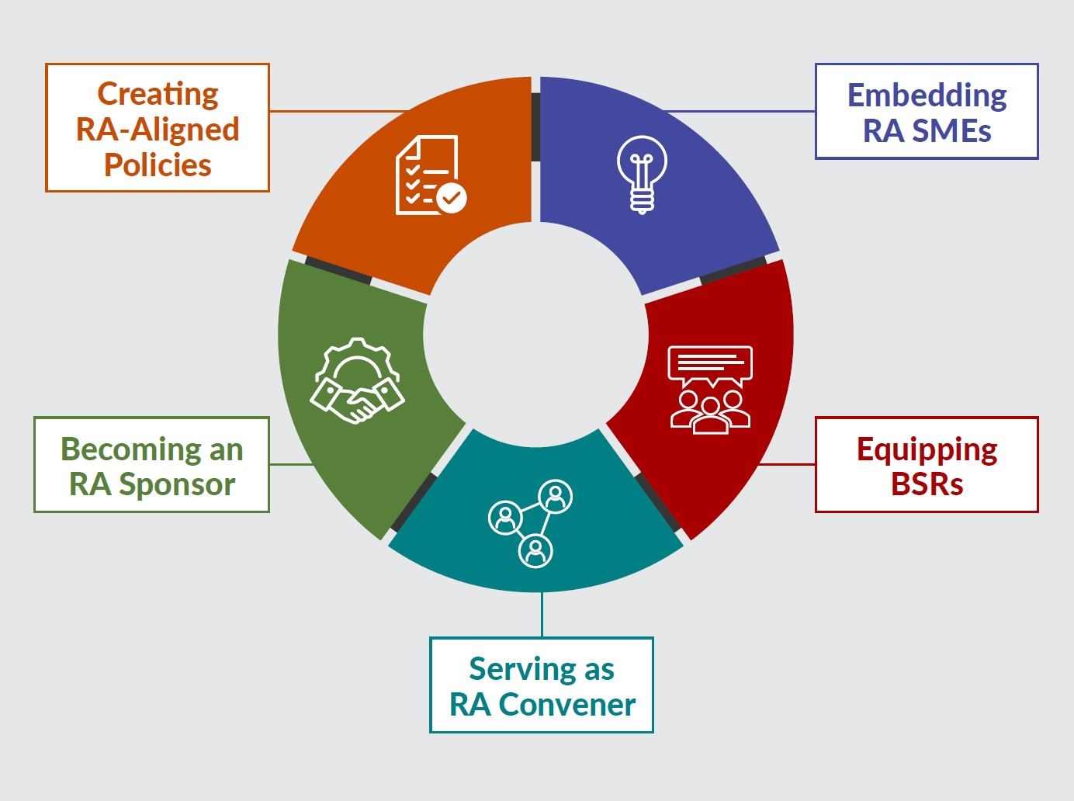
New Tool
Key Components of Workforce System Alignment with Registered Apprenticeship
https://dolcoe.safalapps.com
Safal Partners © 2024

Slide 18

Embedding RA Knowledge
Frontline case management
must have a bit of knowledge about
pre-apprenticeship and registered apprenticeship programs to ensure they can talk with the youth customers
about the advantages of RA.
Safal Partners © 2024

Slide 19
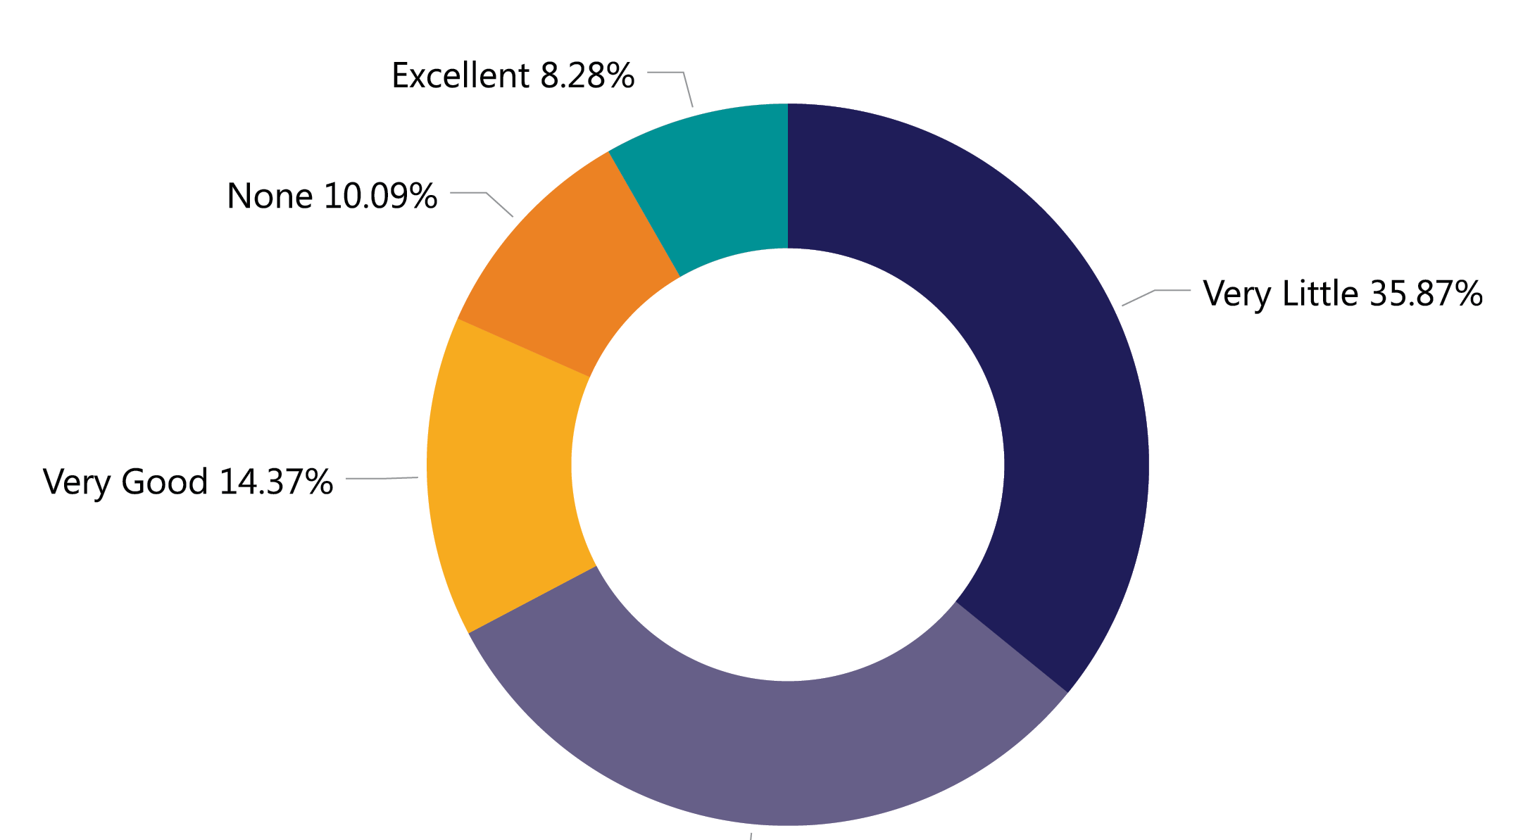
RA & WIOA Performance Measures
How would you rate your knowledge on how Registered Apprenticeship correlates with WIOA performance measures?
Source: 2023 Workforce System Registered Apprenticeship Baseline Knowledge Assessment Report - USDOL Center of Excellence, Safal Partners, NAWDP
Safal Partners © 2024

Slide 20
RA Alignment: Performance
RA improves performance outcomes!
Entered Employment Rate Q2 and Q4 post exit
Median Earnings Q2 post exit
Measurable Skill gains
Credential Attainment
Effectiveness in Serving Employers
Youth Employment & Education Rate Q2 post exit
Safal Partners © 2024

Slide 21
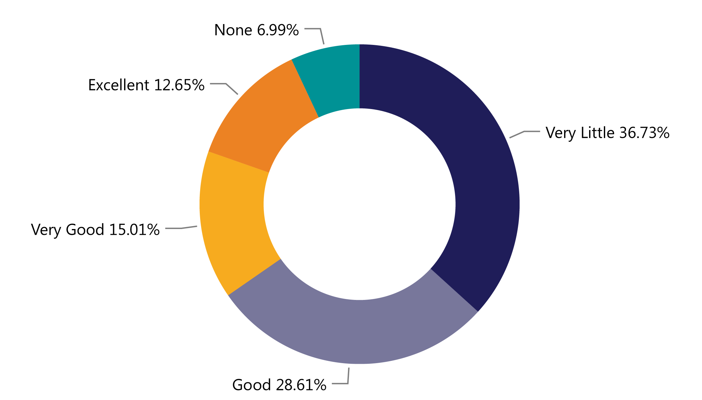
Programs Paying for RA
How would you rate your knowledge of
who pays for each part of an apprenticeship program (related instruction, wages, administration)?
Source: 2023 Workforce System Registered Apprenticeship Baseline Knowledge Assessment Report - USDOL Center of Excellence, Safal Partners, NAWDP
Safal Partners © 2024

Slide 22
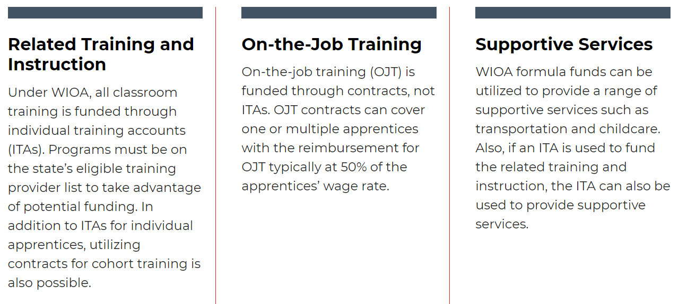
WIOA Funding, Supports for RA

Slide 23
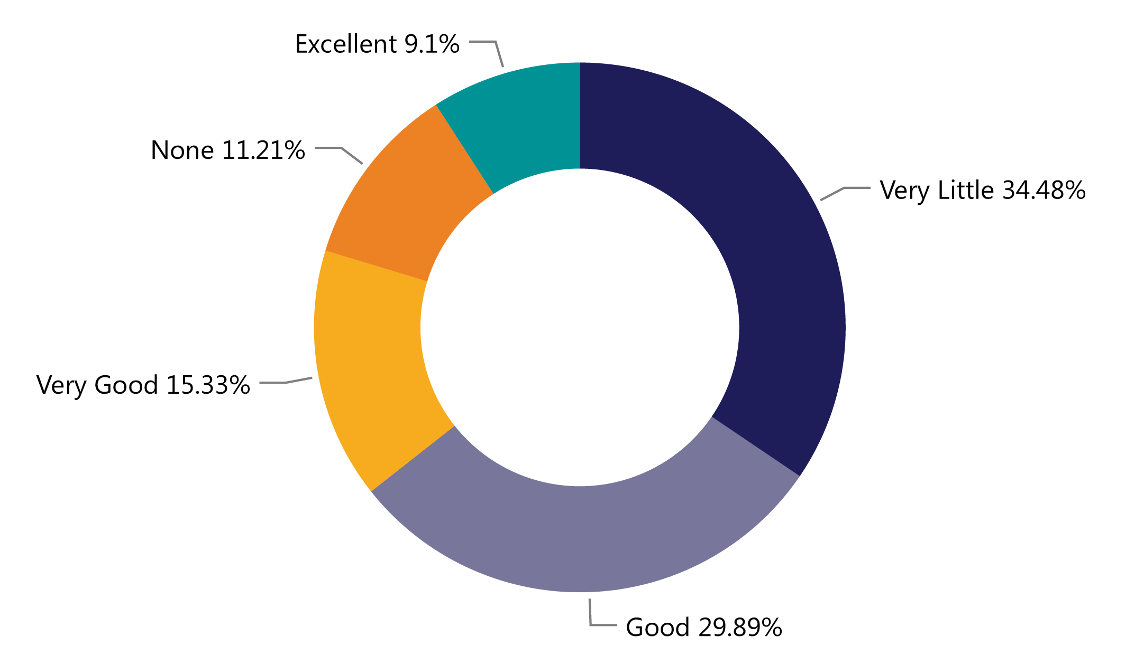
RA & ETPLs
How would you rate your knowledge of the relationship between
Registered Apprenticeship
related instruction and your state or local eligible training provider list?
Source: 2023 Workforce System Registered Apprenticeship Baseline Knowledge Assessment Report - USDOL Center of Excellence, Safal Partners, NAWDP

Slide 24

RA Alignment: ETPL
RA programs must be on the state/local eligible training provider (ETP) list to unlock WIOA funds for Related Instruction (RI).
Under WIOA, all RA programs are automatically eligible for the ETP list, and each state workforce agency (SWA) must have a process in place to ensure this happens.
Unlike other training providers/programs, RA programs have no performance-related requirements for inclusion on the ETP list. SWAs and Local WDBs may not require even minimal performance information.
The requirement that training programs on the ETP list be for in-demand occupations does not apply to RA programs.

Slide 25
Benefits of Leveraging WIOA / RA Together
Unlock additional sources of RA program support for employers who sponsor programs or hire apprentices
Unlock additional resources for job seekers who are hired as apprentices with supportive services or assistance with classroom training
Shared outcomes
Boost overall alignment
understanding for
workforce system

Slide 26



Promising Practices
  Colorado launched its youth apprenticeship program, CareerWise Colorado, in 2016. CareerWise is an independent public-private partnership that functions as a workforce intermediary. CareerWise Colorado | Youth Apprenticeship Programs
  South Carolina has a registered youth apprenticeship programs that operate through community and technical college system… regionally focused.
  Youth Apprenticeship | Apprenticeship Carolina - a division of the SC Technical College System
Tech Ready Apprentices for Careers in Kentucky (TRACK) is a business and industry driven youth apprenticeship program with a partnership between the Kentucky Department of Education's Office of Career and Technical Education and the Kentucky Office of Apprenticeship to provide secondary students with career pathway opportunities to create a pipeline for students to enter post-secondary apprenticeship training and RA. Students receive a nationally recognized credential at little or no cost. TRACK Resources - Kentucky Department of Education
Safal Partners © 2024

Slide 27
Questions for Follow Up
Safal Partners © 2024

Slide 28
Questions for You
Are your youth case managers being trained on pre-apprenticeship /
registered apprenticeship opportunities – do you know where those opportunities are?
Are there RA navigators/SMEs embedded within AJCs or your local area who can work with you on better understanding and recruiting for RA programs?
Are you purposefully discussing, screening and referring youth to pre-apprenticeship / RA programs?
Are there WIOA / RA co-enrollment procedures being used consistently by case managers and across all mandatory partners?
Safal Partners © 2024

Slide 29
Questions for You 1
Are you working with other AJC partners to engage youth who may interested in RA programs?
What type of outreach is happening to target youth populations, communicating the benefits of RA?
Are you receiving RA training to effectively engage youth and communicate the benefits of RA?
Are you working with Business Services / RA reps to understand which employers may be interested in employing youth?
Safal Partners © 2024

Slide 30
Final Thoughts…
Talk with your colleagues about pre-apprenticeship and registered apprenticeship programs!
Have your youth explore the RA jobs in your area:
Communicate with your local board’s Business Services Representatives to find out about employers who are working with RA.
https://www.apprenticeship.gov/apprenticeship-job-finder
Safal Partners © 2024

Slide 31
Wrap Up
Safal Partners © 2024

Slide 32
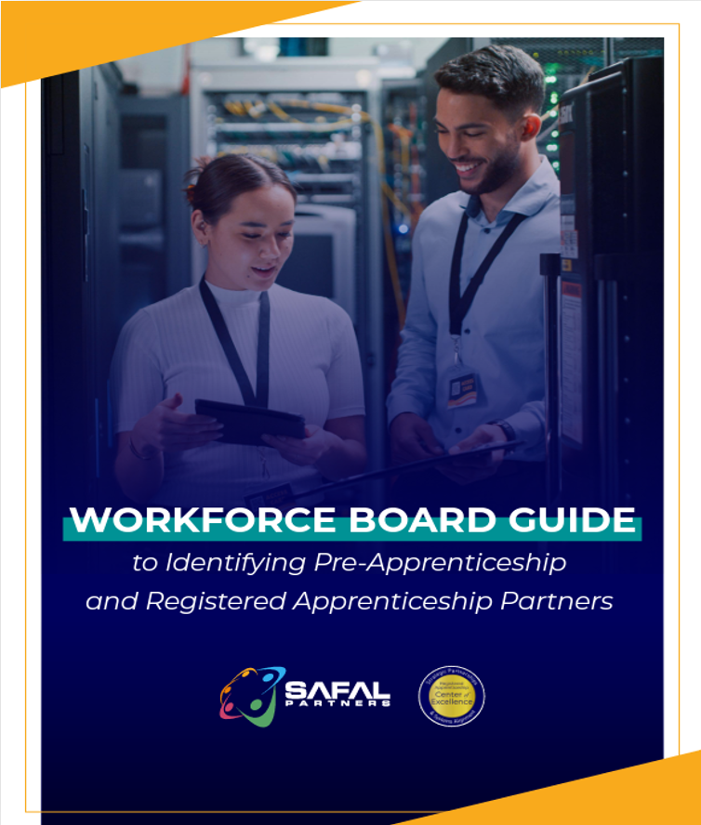

No-Cost Resources
Guide to
Identifying Partners
Safal Partners © 2024

Slide 33
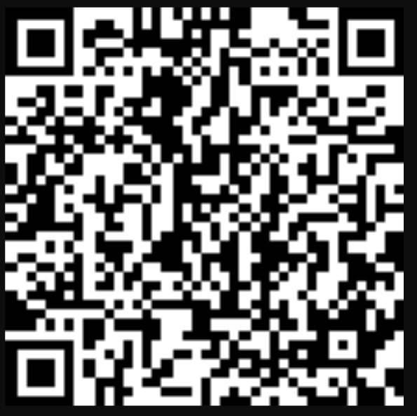
Questions, Thoughts, Assistance Needed?
Because we are so close on time,
we are asking you to either
place your questions in the chat
for us to follow up on
or
scan the QR code and
send us your question(s)
where you may also request
technical assistance as well.
We are here
to help you!
Email: RA_COE@SafalPartners.com
Safal Partners © 2024

Slide 34
Thank You for Joining Us
For more information, visit: dolcoe.safalapps.com

