Slide 1
Building Student Awareness of Apprenticeship Career Pathways
National Careers Pathway Network Connect 2025 February 2025

Slide 2
Presenter
Alan Dodkowitz
Subject Matter Expert
Safal Partners

Slide 3
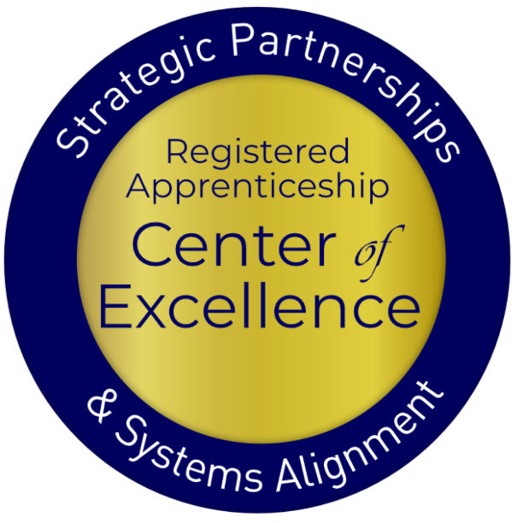
Welcome and Agenda
Center of Excellence Overview
Overview of Registered and Youth Apprenticeship
Benefits of Apprenticeship for Youth and Schools
High-School and College-Aligned Youth Apprenticeship Pathways
How can we Develop these Pathways
Workforce Boards- Putting it all Together
Questions and Closing Thoughts

Slide 4
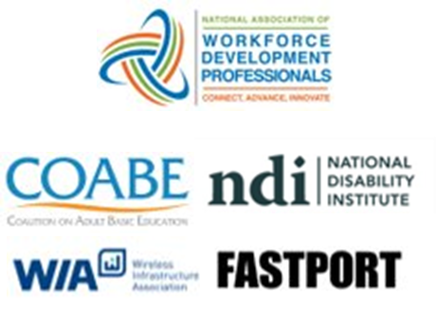
Center of Excellence Overview
U.S. DOL initiative to increase systems alignment across apprenticeship, education, and workforce
Led by Safal Partners; 5 national partners
We provide no-cost TA including:
Monthly webinars
Quarterly virtual office hours
Individual TA/coaching sessions
Online resources (desk aids, guides, frameworks, etc.)
Visit our website, request TA

Slide 5
Online Resources, On-Demand TA
Registered Apprenticeship Partner Profile Questionnaire
https://dolcoe.safalapps.com/resources/resourcesandtools

Slide 6
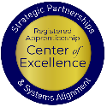
Quick Pulse Poll #1
Are you a….
Workforce Board Staff
Service Provider Staff
Educational Partner
Vocational Rehabilitation Partner
Employer
Board Member
Registered Apprenticeship Staff
Other

Slide 7
Quick Pulse Poll #2
When it comes to Registered Apprenticeship I am…
Just starting out
Somewhat familiar with the basics but don’t utilize it often
Very knowledgeable and often refer people to programs
What is Registered Apprenticeship??

Slide 8
What is Registered Apprenticeship?
Registered Apprenticeship (RA) is a proven, customizable, industry-relevant, and US Department of Labor-approved model for organizations to find, train and retain new talent as well as upskill current workers in critical occupations.

Slide 9
Five Core Components of RA
Employer Involvement
Structured On-the-Job Learning (OJL)
Related Instruction (RI)
Rewards for
Skill Gains
National Occupational Credential

Slide 10
A WIDE RANGE OF INDUSTRIES
Agriculture
Healthcare
Cybersecurity
Biotechnology
Transportation
Construction
Energy
Hospitality
Financial Services
Information
Technology
Education
Advanced Manufacturing
Critical Supply Chain
Infrastructure
Engineering
Telecommunications

Slide 11
What is Youth Apprenticeship?
A youth apprentice is defined as…​
an in-school OR out-of-school youth between the ages of 16 and 24…​
​
who receives industry-validated related instruction for an RA program (for in-school youth) from their school while… ​
​ completing part-time, paid, work-based experience ​from an employer under ​ mentored supervision as part of… ​​
a Registered Apprenticeship program approved ​ by DOL or a state apprenticeship agency (SAA) or a pre-apprenticeship program.​

Slide 12
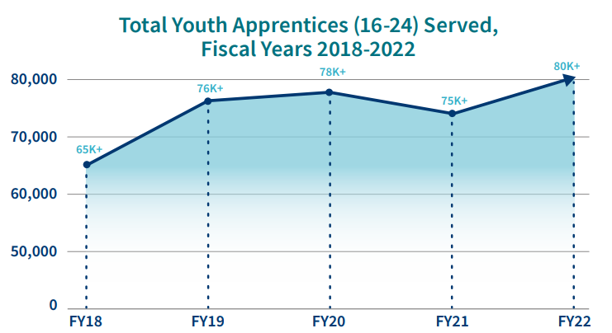
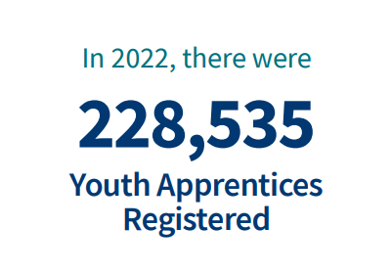
Apprenticeship for Youth
Source: https://www.apprenticeship.gov/

Slide 13
Youth Apprenticeship by Age
Source: Urban Institute calculations from RAPIDS data

Slide 14
High-Quality Youth Apprenticeship
In addition to meeting core RA requirements, high-quality youth apprenticeship programs:
Provide dual enrollment pathway for college credit for RI
(if school is sponsor) Include articulated agreement with another program sponsor to ensure students can continue paid OJL (and RI if needed) after graduation​
Provide apprentice with a clearly-outlined career pathway beyond RA program completion for occupations that provide a family-supporting wage ​
Embed, or prepares student to test out for, industry-recognized certifications or credentials​
Build a strong program design including qualifications, supports for persistence, etc.

Slide 15
Apprenticeship Benefits for Students and Schools

Slide 16
Substantial Benefits for Youth
Helping students understand the benefits of RA is crucial:
RA is a pathway to a career from the start
RA provides a way to get paid to learn skills and get work experience
Often leads to offer of full-time employment following graduation or program completion soon after graduation
Increases your lifetime earnings potential: average starting salary for apprentice completers is $80,000 per year (U.S. DOL)
Provides way to earn national credential – move and earn anywhere
Can help lower – or even eliminate – the cost of taking college courses

Slide 17
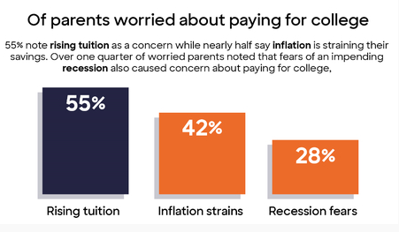
Less Debt, More Opportunities
Nationally....
42.8 million Americans owe more than $1.75 trillion in student loans (2024)
61% of college graduates had taken on student loan debt (2024)
Average debt of student loan holder is $37,853 (2024)
Source: Business Wire

Slide 18
Benefits for Schools Involved in Apprenticeship
Apprenticeship programs connect students to colleges
Program sponsors, federal and state programs, and/or students can pay for related instruction
Sponsors can provide additional resources beyond tuition to support students and colleges (curriculum development, student supports, additional funding)
Safal Partners © 2025

Slide 19
Federal / State Funding for RI
Several programs can help pay for RA related instruction courses at local colleges, making it more attractive for local employers to participate. Examples include:
The Workforce Innovation and Investment Act (WIOA) (through Individual Training Accounts) / On-the-Job Training / Supportive Services )
Pell Grants (Up to $6,895 per Apprentice)
Federal Work Study Funds (average of $2,500 per Apprentice)
State Tax Credits and Tuition Support
GI Bill Benefits (for approved programs)
Safal Partners © 2025

Slide 20
Youth Apprenticeship Pathways- High School or College

Slide 21
High-School Aligned Apprenticeship Programs
Juniors or seniors eligible to apply for paid on-the-job training experience with an employer while receiving RI at school.
Embeds industry credentials in RI curriculum.
RI counts toward high school graduation requirements and potentially college credits, creating a seamless transition from secondary to post-secondary education.
Often acts as pre-apprenticeship programs that provide a pathway to a full RA program.
Safal Partners © 2025

Slide 22
College-Aligned Youth Apprenticeship Programs
Available at vocational, community, and four-year colleges and generally for 18–24-year-olds.
Embeds industry credentials in RI curriculum and oftentimes leads to the award of industry-recognized credentials.
RI counts towards college credits, enabling student to graduate.
Generally, a Registered Apprenticeship program leads to the award of a DOL-issued certificate.
Safal Partners © 2025

Slide 23
Developing Apprenticeship Pathways

Slide 24
Key Questions
What occupations does local labor market information show are in high demand and what interests youth?
What partnerships do we need? What partners do we already have that can support a program?
How will we integrate industry needs/occupation requirements into our RI?
How will we create a Dual/Concurrent Enrollment plan (for high school apprentices)?
How will we ensure RI and OJL count toward both high school graduation and RA program requirements (for high school apprentices)?
Safal Partners © 2025

Slide 25
Gen Z- Interested in Different Occupations
Sustainable Energy Specialist
Digital Content Creator
Health and Wellness Coach
Cybersecurity Analyst
App Developer
Social Impact Consultant
User Experience (UX) Designer
Remote Work Specialist
E-Sports Professional
Mental Health Professional
Source: LinkedIn
Safal Partners © 2025

Slide 26
But They are Also the “Toolbelt Generation”
Young adults interested in trades career
Pay increase for new construction hires vs. 2.7% in professional services
Students studying construction trades rose from 2018 to 2024
Vocational-focused community colleges increase in enrollment
More electricians than 2014 - median age fell by 2.9 years.
Optimistic about job security and believe they won’t be replaced by AI - Thumbtack
Source: Wall Street Journal
Safal Partners © 2025

Slide 27
What Can Each Partner Bring?
Businesses, trade organizations, and chambers of commerce identify needed skills, provide on-the-job training, and employ apprentices.
Schools help design curriculum, provide classroom instruction, and facilitate student recruitment.
Workforce boards can help recruit apprentices, offer funding, and connect partners.
State agencies develop curriculum frameworks, provide guidance on laws/regulations, and offer funding.
Community organizations assist with student recruitment, academic support, funding, and program oversight.

Slide 28
Key Organizational Apprenticeship Roles
Sponsor
Employer
RI Provider
Partner
An organization that agrees to operate an apprenticeship program and in whose name the program is registered.
Hires and provides paid OJL for apprentices under supervision of a designated mentor who is a skilled professional in that occupation.
Entity that provides instruction to apprentices in the designated occupation’s core knowledge, skills, and abilities.
Organizations committed to assisting RA programs. They can play one or more roles.

Slide 29
Align with CTE Standards and Ensure Hands-On Training
Align Curriculum with Industry Needs: Incorporate CTE standards by aligning the curriculum with current industry needs.
Integrate Work-Based Learning: Embed work-based learning opportunities within CTE programs, allowing students to gain hands-on experience in real-world settings.
Collaborate with Industry Partners: Partner with local businesses to design apprenticeship programs that meet both educational and industry requirements.
Incorporate Industry-Recognized Credentials: Include industry-recognized credentials in apprenticeship programs to validate students' skills and competencies according to CTE standards.
Safal Partners © 2025

Slide 30
Ensuring High School Students Receive Credit
Synchronize Curriculum with Graduation Objectives: Collaborate with local school districts to ensure the apprenticeship curriculum meets high school graduation requirements.
Dual Enrollment and Credit Recognition Agreements: Create dual enrollment agreements that allow apprentices to earn high school credits for both RI and OJT components of their apprenticeship.
Performance-Based Assessments: Integrate assessments that align with both high school and apprenticeship standards.
Consistent Tracking: Ensure apprenticeship coordinators, school counselors, and educators track apprentices' progress and ensure all requirements are met.
Safal Partners © 2025

Slide 31
Youth Apprenticeship Examples

Slide 32
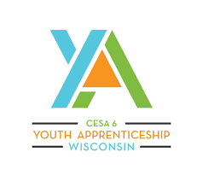
Wisconsin Youth Apprenticeship Project
Launched in 1991
Partnership between the Wisconsin SAA, 39 local consortia, and local school districts
Organized into 13 broad industries
In the 2022–23 school year, 5,719 employers provided apprenticeships to 8,357 high school students
Receives $6 million in funding from the State of Wisconsin
Requires employers to provide at least 450 hours of on-the-job learning and paid work experience and schools to offer at least 180 hours of related technical instruction.

Slide 33
Howard County Community College
Serves as a Sponsor of Registered Apprenticeship Programs.
Offers apprenticeships in 11 different fields (HVAC, IT, Hospitality, Child Care, Licensed Practice Nurse, etc.) and provides the related instruction for these occupations
Partners with several employers to provide OJL, including the University of Maryland Medical Center, MedStar Health, Associated Builders & Contractors of Greater Baltimore, Johns Hopkins and others.
Has a close relationship with the local workforce board and workforce system.
Utilizes funds from employers and local and state grants to support their programs.

Slide 34
Workforce Boards: The Key Ingredient

Slide 35
How Workforce Boards Can Help Education Providers
Provide WIOA Individual Training Account (ITA) funding to support apprentices' RI costs
Make connections with employers, sponsors
Host convenings between education and industry
Provide pipeline of youth to enroll in programs
Add programs to the Eligible Training Provider List (ETPL)
Support the development of RI curriculum using labor market information and industry standards

Slide 36
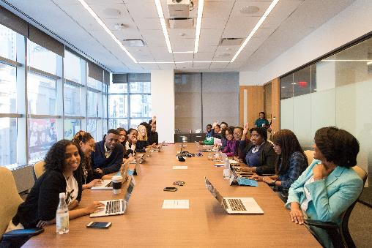
How Workforce Boards Can Help Employers/Sponsors
Provide a pipeline of Youth Apprentices:
Publicize RA program opening
Screen candidates
Provide pre-apprenticeship training
Provide supportive services to youth
Provide WIOA OJL contract funding to support percentage of apprentice wages
Build partnerships with training providers on ETPL for RI; utilize ITAs to pay for all/portion of apprentices' RI costs
Support registering and implementing RA programs
Host convenings (job fairs, recruiting events, etc.) to connect potential apprentices and employers

Slide 37
How Workforce Boards Can Help Community-Based Organizations
Provide education on RA
Connect potential apprentices with employers
Provide supportive services to apprentices
Connect potential apprentices to other resources available within the community
Leverage funding programs

Slide 38
Get to Know Your Workforce Board
Each Workforce Board has:
Sector strategies: priority occupations and key industries
Policies on OJL contracts, which WIOA and non-WIOA funding "buckets" and services they will apply to RA
Funding levels, fiscal year cycle and how quickly they anticipate spending funds
Supportive services offered and how that maps to your program's needs
Candidate pool – In-School and Out-of-School Youth Programs
ETPL program registration process

Slide 39
Questions and Discussion
Safal Partners © 2025

Slide 40
Contact Us, Become a Partner
Scan for Partner Form
Receive no-cost expert TA, materials, and assistance
Network with potential partners nationwide
Be nationally recognized for your work

Slide 41
Thank You for Joining Us
Email us your questions at RA_COE@SafalPartners.com
For more information, visit: dolcoe.safalapps.com

