Slide 1
Putting Your WIOA Plan for Apprenticeship to Work Insight and Opportunities to Strengthen Workforce Practitioner Knowledge of Registered Apprenticeship C2 GPS RA Summit – April 2024

Slide 2
Today’s Presenters
Judy Blanchard
Alan Dodkowitz
Project Director
Safal Partners
Subject Matter Expert
Safal Partners
Safal Partners © 2024

Slide 3
Center of Excellence Overview
Led by Safal Partners (grant awarded July 2021), national partners include NAWDP, COABE, NDI, FASTPORT and WIA
We provide no-cost TA to accelerate sustainable partnerships, alignment of apprenticeship, workforce, and education systems to accelerate RA adoption.
Visit our website, request TA

Slide 4
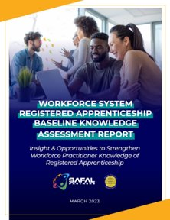
Baseline Report & Knowledge Gaps
Gaps Fell Into Four Areas:
Basic Knowledge
System Knowledge
Funding Knowledge
Sharing Knowledge
dolcoe.safalapps.com/resources/workforce

Slide 5
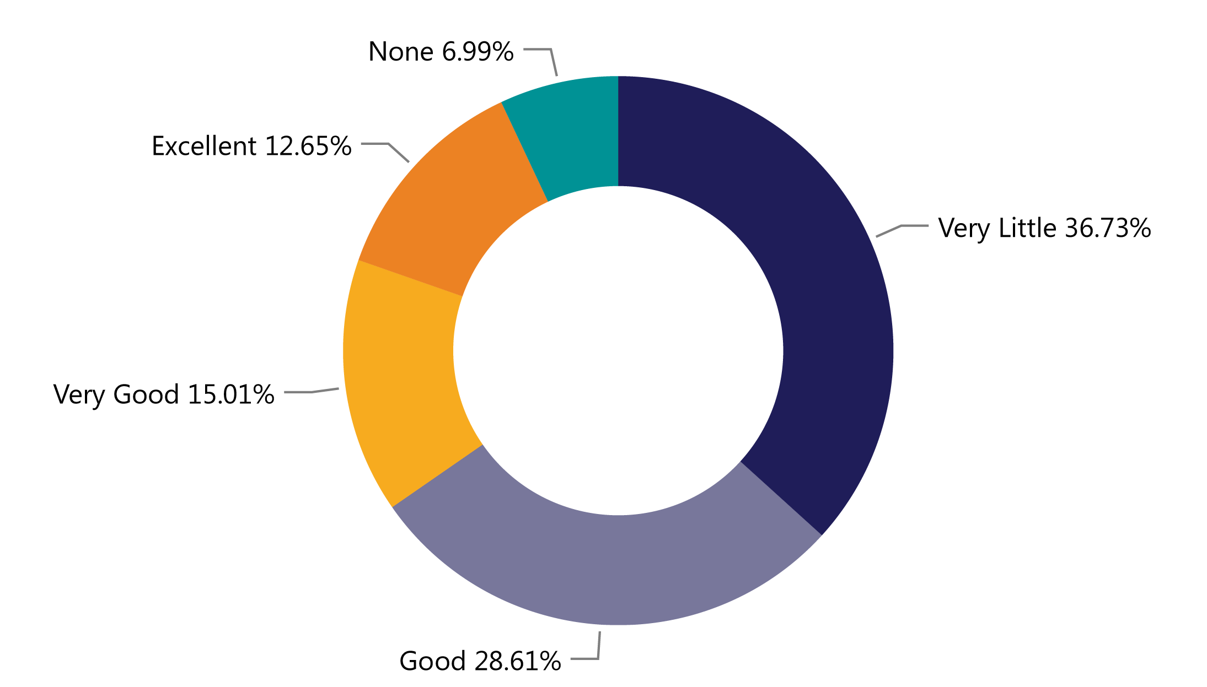
Programs Paying for RA
How would you rate your knowledge of who pays for each part of an apprenticeship program (related instruction, wages, administration)?
Source: 2023 Workforce System Registered Apprenticeship Baseline Knowledge Assessment Report - USDOL Center of Excellence, Safal Partners, NAWDP

Slide 6
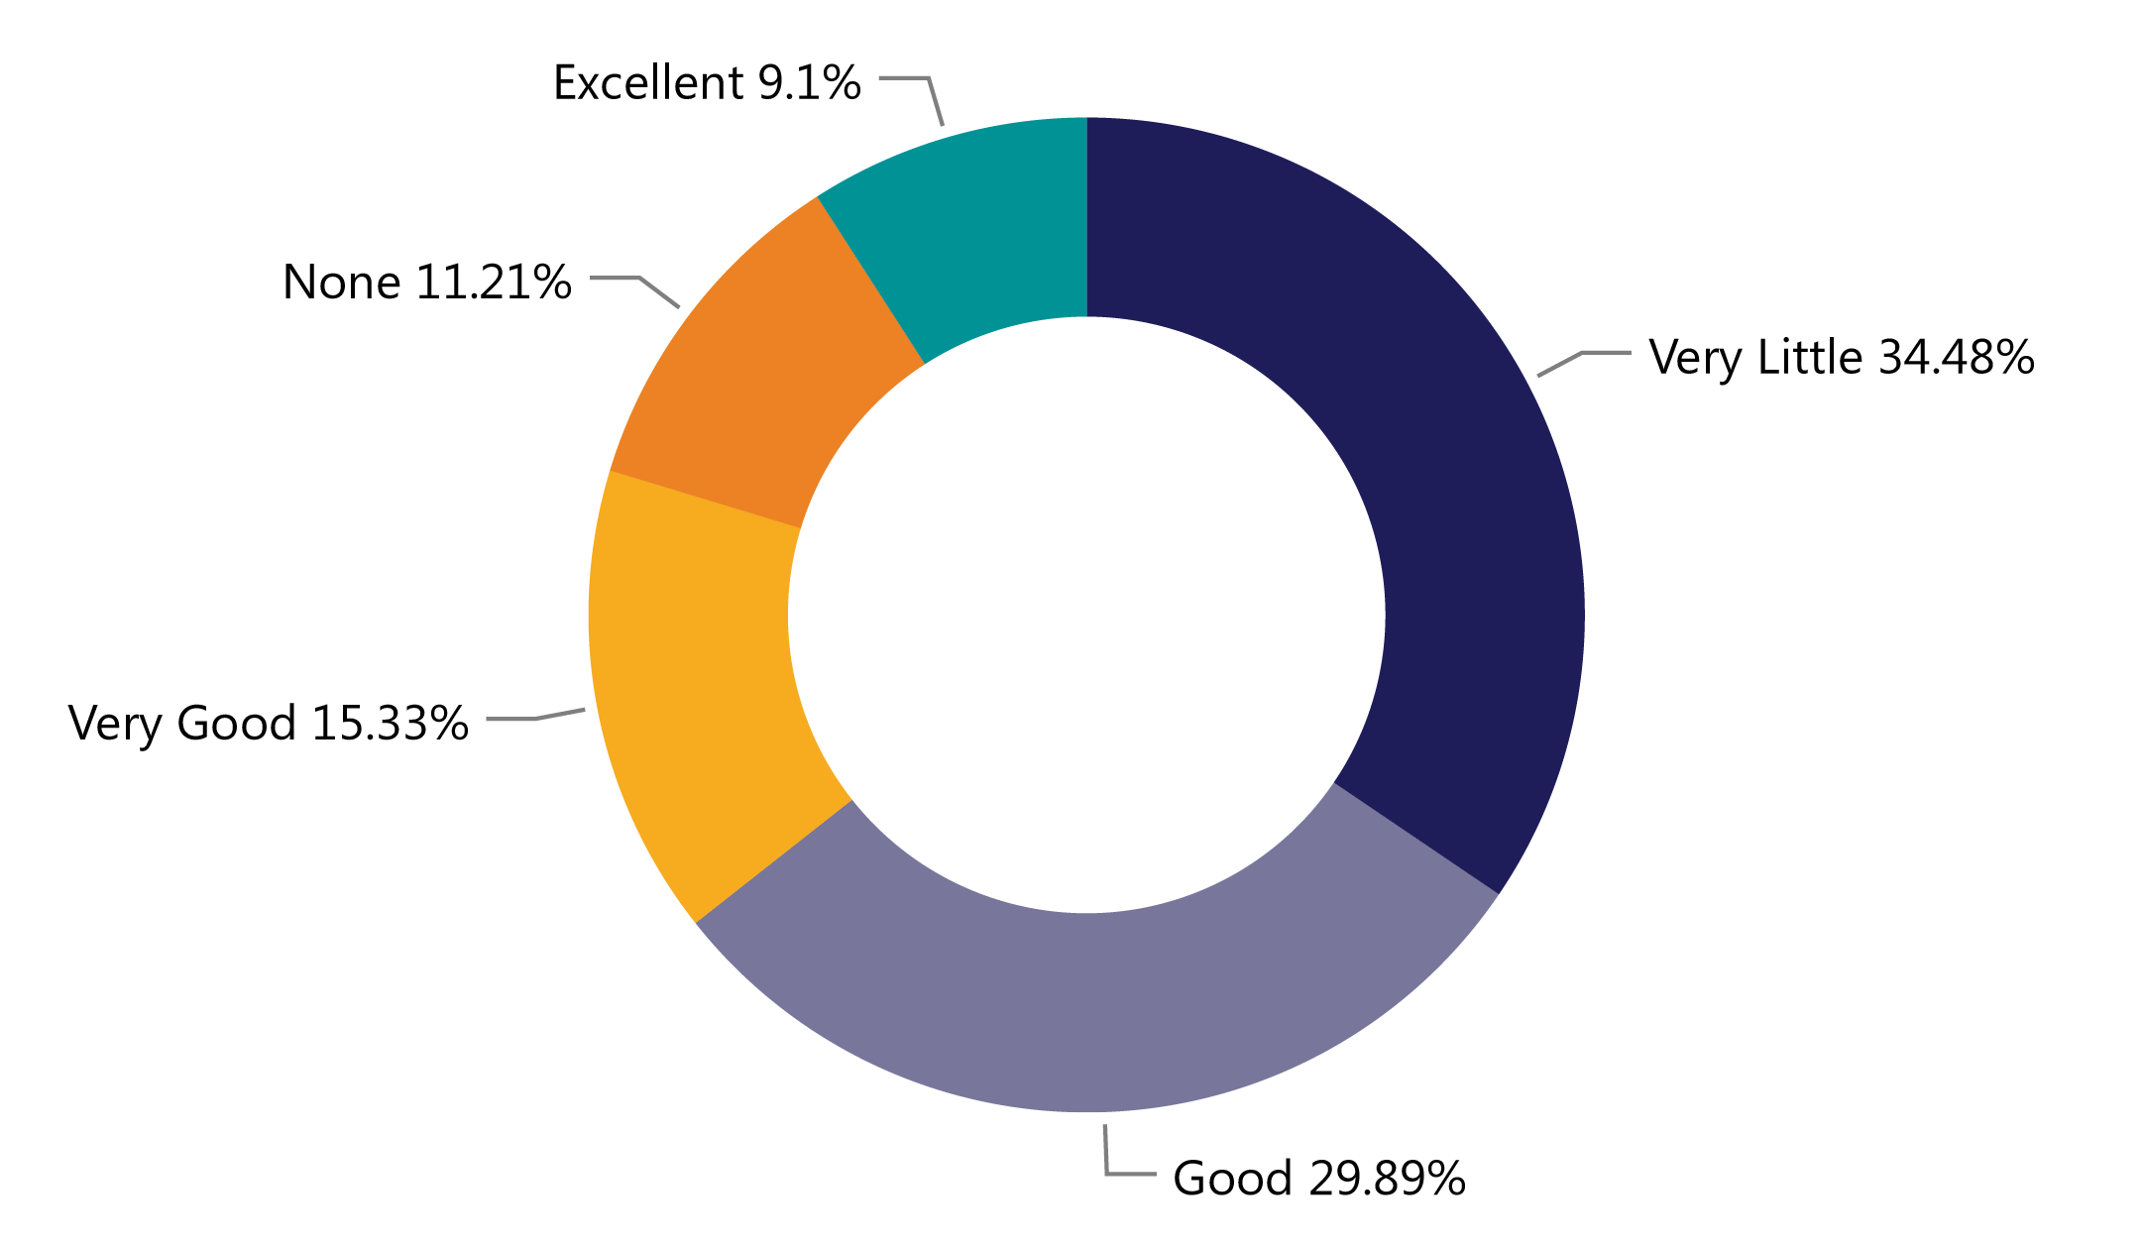
RA & ETPLs
How would you rate your knowledge of the relationship between Registered Apprenticeship related instruction and your state or local eligible training provider list?
Source: 2023 Workforce System Registered Apprenticeship Baseline Knowledge Assessment Report - USDOL Center of Excellence, Safal Partners, NAWDP

Slide 7
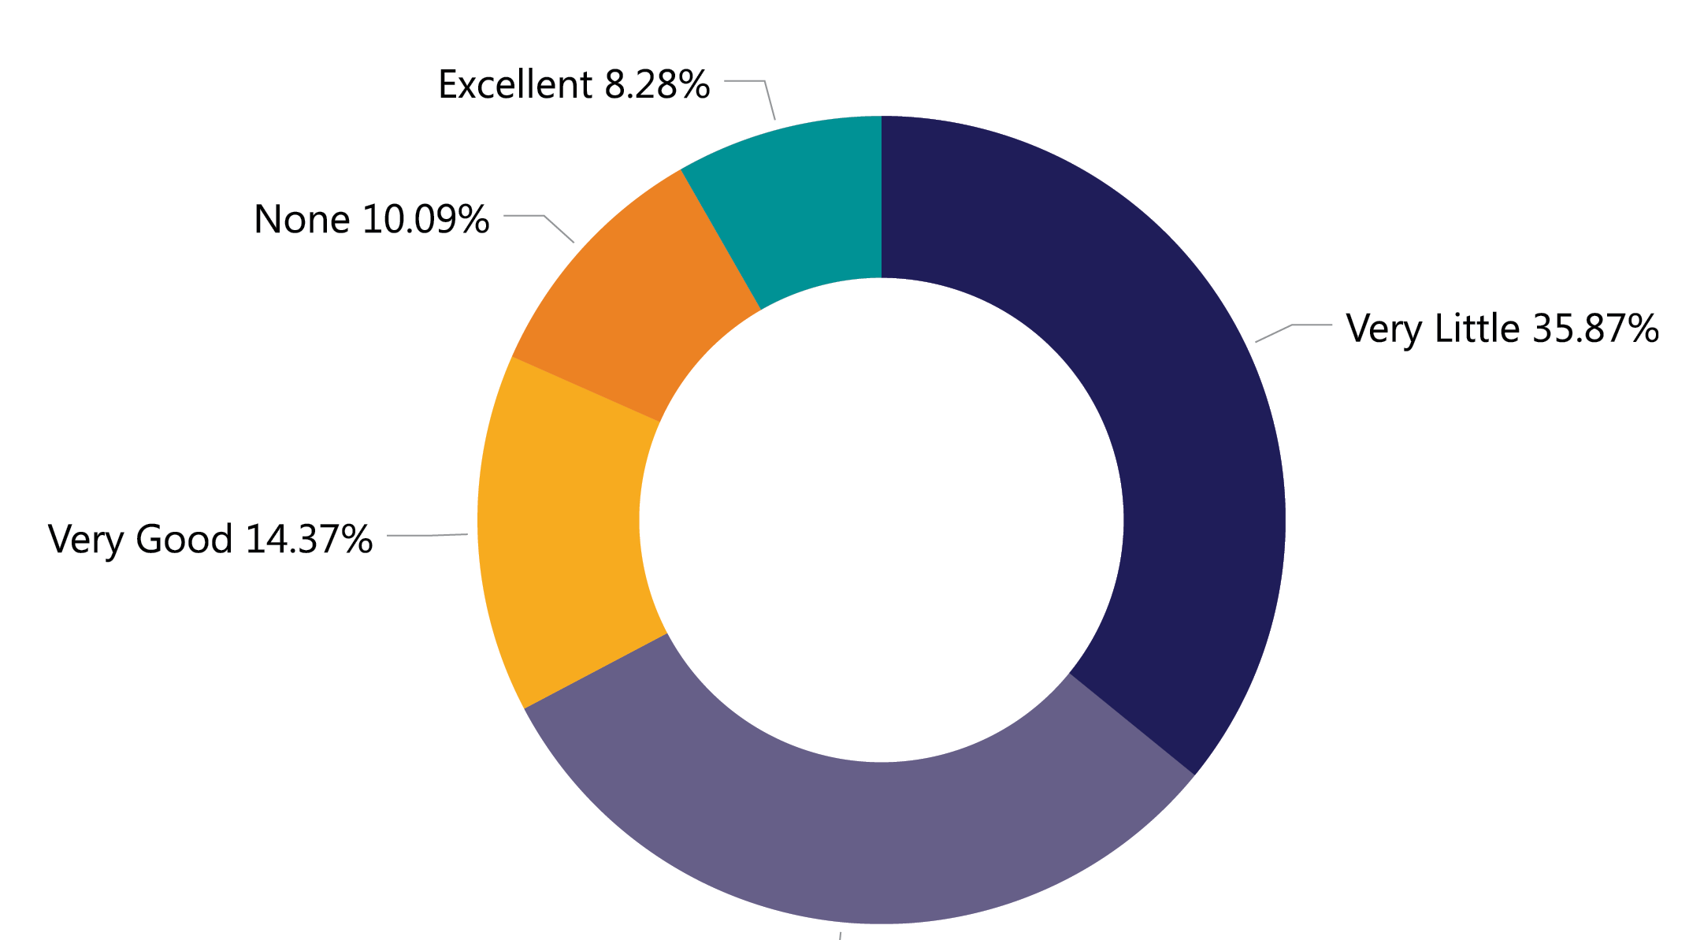
RA & WIOA Performance Measures
How would you rate your knowledge on how Registered Apprenticeship correlates with performance measures?
Source: 2023 Workforce System Registered Apprenticeship Baseline Knowledge Assessment Report - USDOL Center of Excellence, Safal Partners, NAWDP

Slide 8
WIOA/RA Alignment Planning

Slide 9
System Alignment & Partnership
Engaging a Talent Pipeline
Engaging Employers Who Invest in Developing a Talent Pipeline

Slide 10
WIOA Funding, Supports for RA
Related Training and Instruction
On-the-Job Training
Supportive Services
Under WIOA, all classroom training is funded through individual training accounts (ITAs). Programs must be on the state’s eligible training provider list to take advantage of potential funding. In addition to ITAs for individual apprentices, utilizing contracts for cohort training is also possible.
On-the-job training (OJT) is funded through contracts, not ITAs. OJT contracts can cover one or multiple apprentices with the reimbursement for OJT typically at 50% of the apprentices’ wage rate.
WIOA formula funds can be utilized to provide a range of supportive services such as transportation and childcare. Also, if an ITA is used to fund the related training and instruction, the ITA can also be used to provide supportive services.

Slide 11
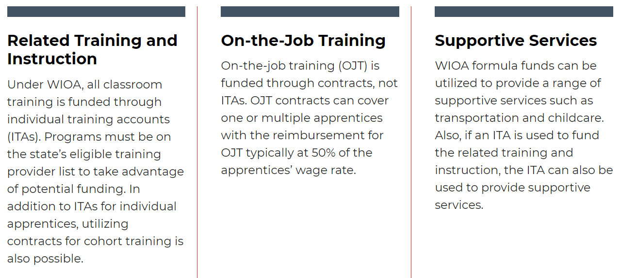
RA Co-Enrollment and WIOA Benefits
Unlock additional sources of RA program support for employers who sponsor programs and job seekers hired as apprentices
Share the outcomes
Boost overall alignment for workforce system

Slide 12
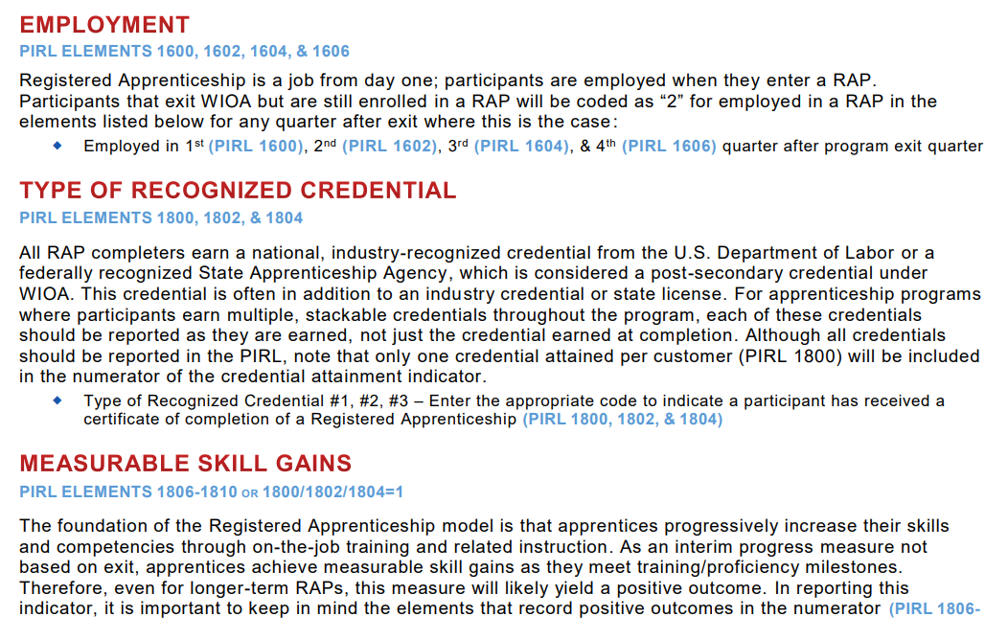
RA Co-Enrollment and WIOA
Does frontline staff and data teams understand how to correctly report RA and WIOA Co-Enrollment?

Slide 13
State, Local Planning for RA
Recent studies show:
100% of WIOA State Unified & Combined Plans mention RA
Key Drivers of RA/Workforce Alignment Utilized by only between 14 - 30% of States:
State level work group/committee with RA focus
Specialist expertise embedded at AJC level
Articulated RA strategies in the state plan
RA state level initiative (funding, incentives, etc.)

Slide 14
State Level Work Groups on RA
Showcase: Illinois
Workforce system began coordinating with state OA office to align, leverage WIOA funding and services for RA
2016: Created an RA task group supported by IL Employment and Training – WBL Programs Division
Focus: weaving support for businesses involved in RA through all workforce services
Task group established a work plan, state received first federal apprenticeship grant.
Monthly virtual meetings, Quarterly in-person meetings
Received additional grant funding, expanded under Governor's Office
Now "Apprenticeship Illinois Committee" (AJC to IL WIB (the state WDB)

Slide 15
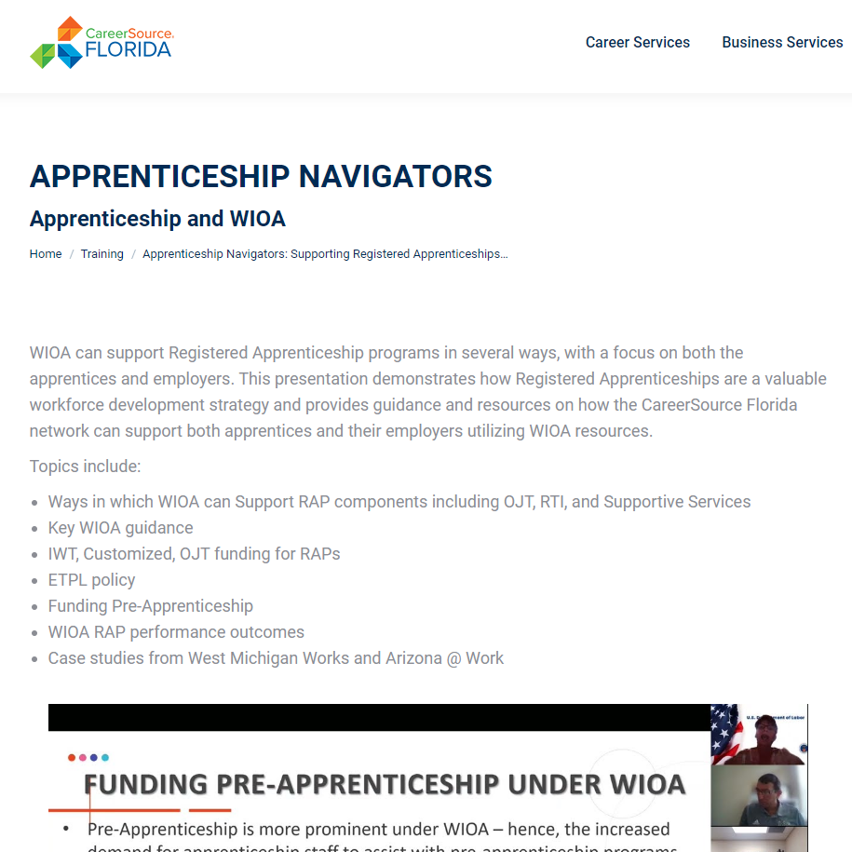
Embedding RA Specialists in AJCs
Showcase: Connecticut
State Apprenticeship Agency (SAA) office is in Connecticut Department of Labor agency. Office alignment streamlines:
Addition of RAPs to state’s ETPL
Connection between the SAA's 6 apprenticeship training representatives with BSRs to ensure that state/local WDBs create RA “wrap-around” services
Showcase: Florida
CareerSource Florida embeds Apprenticeship Navigators statewide in LWDB areas
Provides ongoing RA training

Slide 16
Setting Specific RA Goals
Only seven states (14%) set goals for new RAPs and registered apprentices in WIOA Plan
Oklahoma – Workforce system uses current RA system information on # of apprentices and RAPs to set state expansion goals.
Kentucky – State workforce leadership reviews RAP and apprentice #s with RA system leadership as well as WARN (Worker Adjustment and Retraining Notification) notice analysis including identifying companies and sectors currently sponsoring apprentices, and demographic data on current apprentices. Information supports strategies for rapid response, layoff aversion, business services, and strategic planning for state and local apprenticeship expansion initiatives.

Slide 17
Local Boards: Ways to Increase RA Integration
Evaluate current policies for RA and WIOA integration, co-enrollment
Write specific RA goals into your local WIOA plan
Create an RA work group or committee
Develop partnerships to position yourself for future RA funding
Convene local employers/trade associations to create RA awareness
Train staff -- leadership, BSRs, Case Managers -- on RA

Slide 18
RA Meets WIOA Performance Goals
Employment: Registered Apprenticeship is a job. All apprentices enter employment when they begin an apprenticeship program.
Retention: Registered Apprenticeship programs have high retention rates; 91% of apprentices retain employment after the program ends.
Earnings: The average starting wage for apprentices is $18.00 an hour, with mandated wage increases as apprentice advance in skills and knowledge.
Credential Attainment: All apprenticeship completers earn a national, industry-recognized credential.
TEGL 13-16: Guidance on RA Provisions and Opportunities in WIOA

Slide 19
How Workforce Boards Can Help Education Providers
Provide WIOA Individual Training Account (ITA) funding to support apprentices' RI costs
Make connections with employers, sponsors
Host convenings between education and industry
Provide pipeline of potential students to enroll in programs
Add programs to the Eligible Training Provider List (ETPL)
Support the development of RI curriculum using labor market information and industry standards

Slide 20
How Workforce Boards Can Help Employers/Sponsors
Provide a pipeline of potential apprentices
Publicize RA program opening
Screen candidates
Provide pre-apprenticeship training
Provide supportive services to apprentices
Provide WIOA OJT contract funding to support percentage of apprentice wages
Build partnerships w/training providers on ETPL for RI; utilize ITAs to pay for all/portion of apprentices' RI costs
Support registering and implementing RA programs
Host convenings (job fairs, recruiting events, etc.) to connect potential apprentices and employers

Slide 21
How Workforce Boards Can Help Community-based Organizations
Provide education on RA
Connect potential apprentices with employers
Provide supportive services to apprentices
Connect potential apprentices to other resources available within the community

Slide 22
Questions & Answers

Slide 23
Center of Excellence Resources and Tools... Here to Help You!

Slide 24
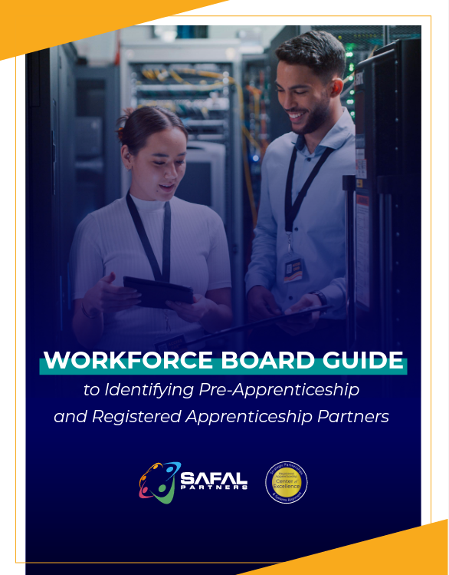
Resources
Case Studies
Fact Sheets
Funding Info
Guides
Podcasts
Reports
Toolkits
Webinars
News
Guide to Identifying Partners
https://dolcoe.safalapps.com

Slide 25
Become a Center Partner
Receive no-cost expert TA, materials, and assistance
Network with potential partners nationwide
Be nationally recognized for your work
Scan for Partner Form

Slide 26
Request Technical Assistance (TA)
Scan for
TA Form
Answers to building strategic partnerships to expand RA
Solutions to building sustainable RAPs
Assistance to train staff, implement tools, etc. to increase system alignment

Slide 27
Technical Assistance at Office Hours
Scan QR Code to Register:

Slide 28
Contact Us
Alan Dodkowitz
Subject Matter Expert, Safal Partners Alan.Dodkowitz@safalpartners.com
Judy Blanchard
Project Director, Safal Partners
Judy.Blanchard@safalpartners.com

Slide 29
Email us your questions at RA_COE@SafalPartners.com
For more information, visit: dolcoe.safalapps.com
Safal Partners © 2024

