Slide 1
Rural America's Registered Apprenticeship Promising Practices
August 25th, 2023

Slide 2

Welcome and Agenda
Center of Excellence Overview
Today’s Topic: Technical Tips for Becoming a Registered Apprenticeship (RA) Sponsor
Voices from the Field
Questions and Discussion
Closeout

Slide 3



Center of Excellence Overview
Led by Safal Partners (grant awarded July 2021), national partners include NAWDP, COABE, NDIC, FASTPORT and WIA
We provide no-cost TA to
accelerate sustainable
partnerships, alignment of
apprenticeship, workforce,
and education systems to
accelerate RA adoption.
Visit our website, request TA

Slide 4
Youth Apprenticeships for Rural America

Slide 5

Urban Institute Speaker
Zach Boren
Senior Policy Manager

Slide 6
About the Urban Institute
OUR MISSION IS TO OPEN MINDS, SHAPE DECISIONS, AND OFFER SOLUTIONS THROUGH ECONOMIC AND SOCIAL POLICY RESEARCH.
The Urban Institute is the trusted source for unbiased, authoritative insights that inform consequential choices about the well-being of people and places in the United States. We are a nonprofit non-partisan research organization that believes decisions shaped by facts, rather than ideology, have the power to improve public policy and practice, strengthen communities, and transform people’s lives for the better.
The views expressed today are my own and should not be attributed to the Urban Institute, its trustees, or its funders.

Slide 7

Rural Apprenticeships for Young People Report
Fill the gap in knowledge about rural apprenticeship programs
Understand challenges faced by rural apprenticeship programs for youth and strategies they use to overcome the challenges
Discuss the economic and labor market landscape for youth and business in rural America

Slide 8



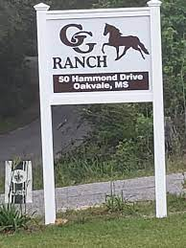
Rural Youth Apprenticeship Case Study Sites
Maine – International Brotherhood of Electrical Workers Local 1253 (IBEW)
Arizona – Tohono O’odham Community College
Missouri – Four Rivers Career Center
Mississippi – Double GG Farms

Slide 9
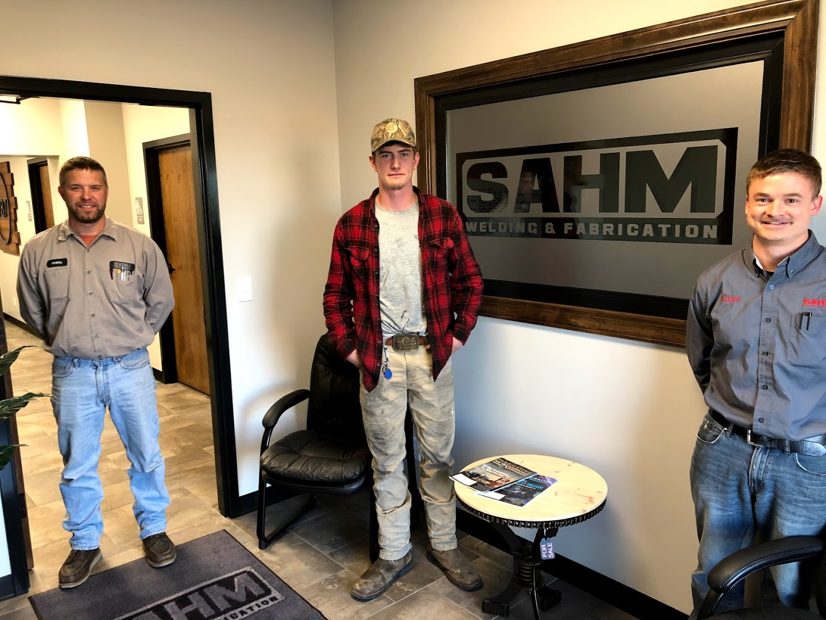
Benefits to Establishing Rural Youth Apprenticeships
Creating a hometown talent pipeline
Expanded economic opportunity
Reduced “brain drain” and enriched communities
Building the middle-skill workforce
Seth Ruther, welding apprentice, at SAHM Welding and Fabrication with his mentors

Slide 10

Common Challenges for Rural Youth Apprenticeship
Traveling distance and lack of public transportation options
Disparities in economy, safety, and health
Lack of infrastructure especially broadband
Small businesses and limited resources

Slide 11

Recommendations to Advance Rural Apprenticeships for Youth
Establishing apprenticeship coordinators
Advancing group (multiple employer) apprenticeships
Addressing the digital divide
Improving transportation (for youth) in the rural landscape

Slide 12
Scaling Youth Apprenticeships: Iowa’s Promising Practice
Scaling Youth Apprenticeships: Iowa’s Promising Practice
Safal Partners © 2023

Slide 13
Iowa’s High School Apprenticeship Initiative
About Funding
Iowa’s Apprenticeship Expansion Grant and Apprenticeship Act (statewide funds) provide over $4 million
Funding to support small companies up to $25,000 for RAP programs
Youth Structure
Approx. 40 high schools as sponsors of Apprenticeship Programs with nearly 100 employers
1-2-year apprenticeships
Industry and Occupational Focus
20 occupational areas
Manufacturing (welding, CNC)
Healthcare (CNA)
Child Care (ECE)
IT (Computer Support Specialist)

Slide 14
Contact Information
Websites:
www.urban.org/tags/apprenticeships
www.urban.org/ya
General Email:
apprenticeship@urban.org

Slide 15
Shasta College Registered Apprenticeships

Slide 16



Shasta College Speaker
Lisa Petty-Hoveman
Director of Apprenticeship Programs, Economic and Workforce Development

Slide 17

Shasta College Office of Apprenticeship
Currently Manages
CA Registered Apprenticeship Forest Training (CRAFT)
Heavy Equipment Logging Operations Pre-apprenticeship (HELO)
CA Registered Accounting Services Employment Training (A$ET)
In Development
Customer Service, pre-apprenticeship
Bookkeeping, pre-apprenticeship

Slide 18

RA Program Development
Re-defined apprenticeship for our rural area
Developed an industry driven program
Built collaborative partnerships between Community College and Division of Apprenticeship Standards (DAS)
Created apprenticeships to serve a community of small and micro businesses

Slide 19
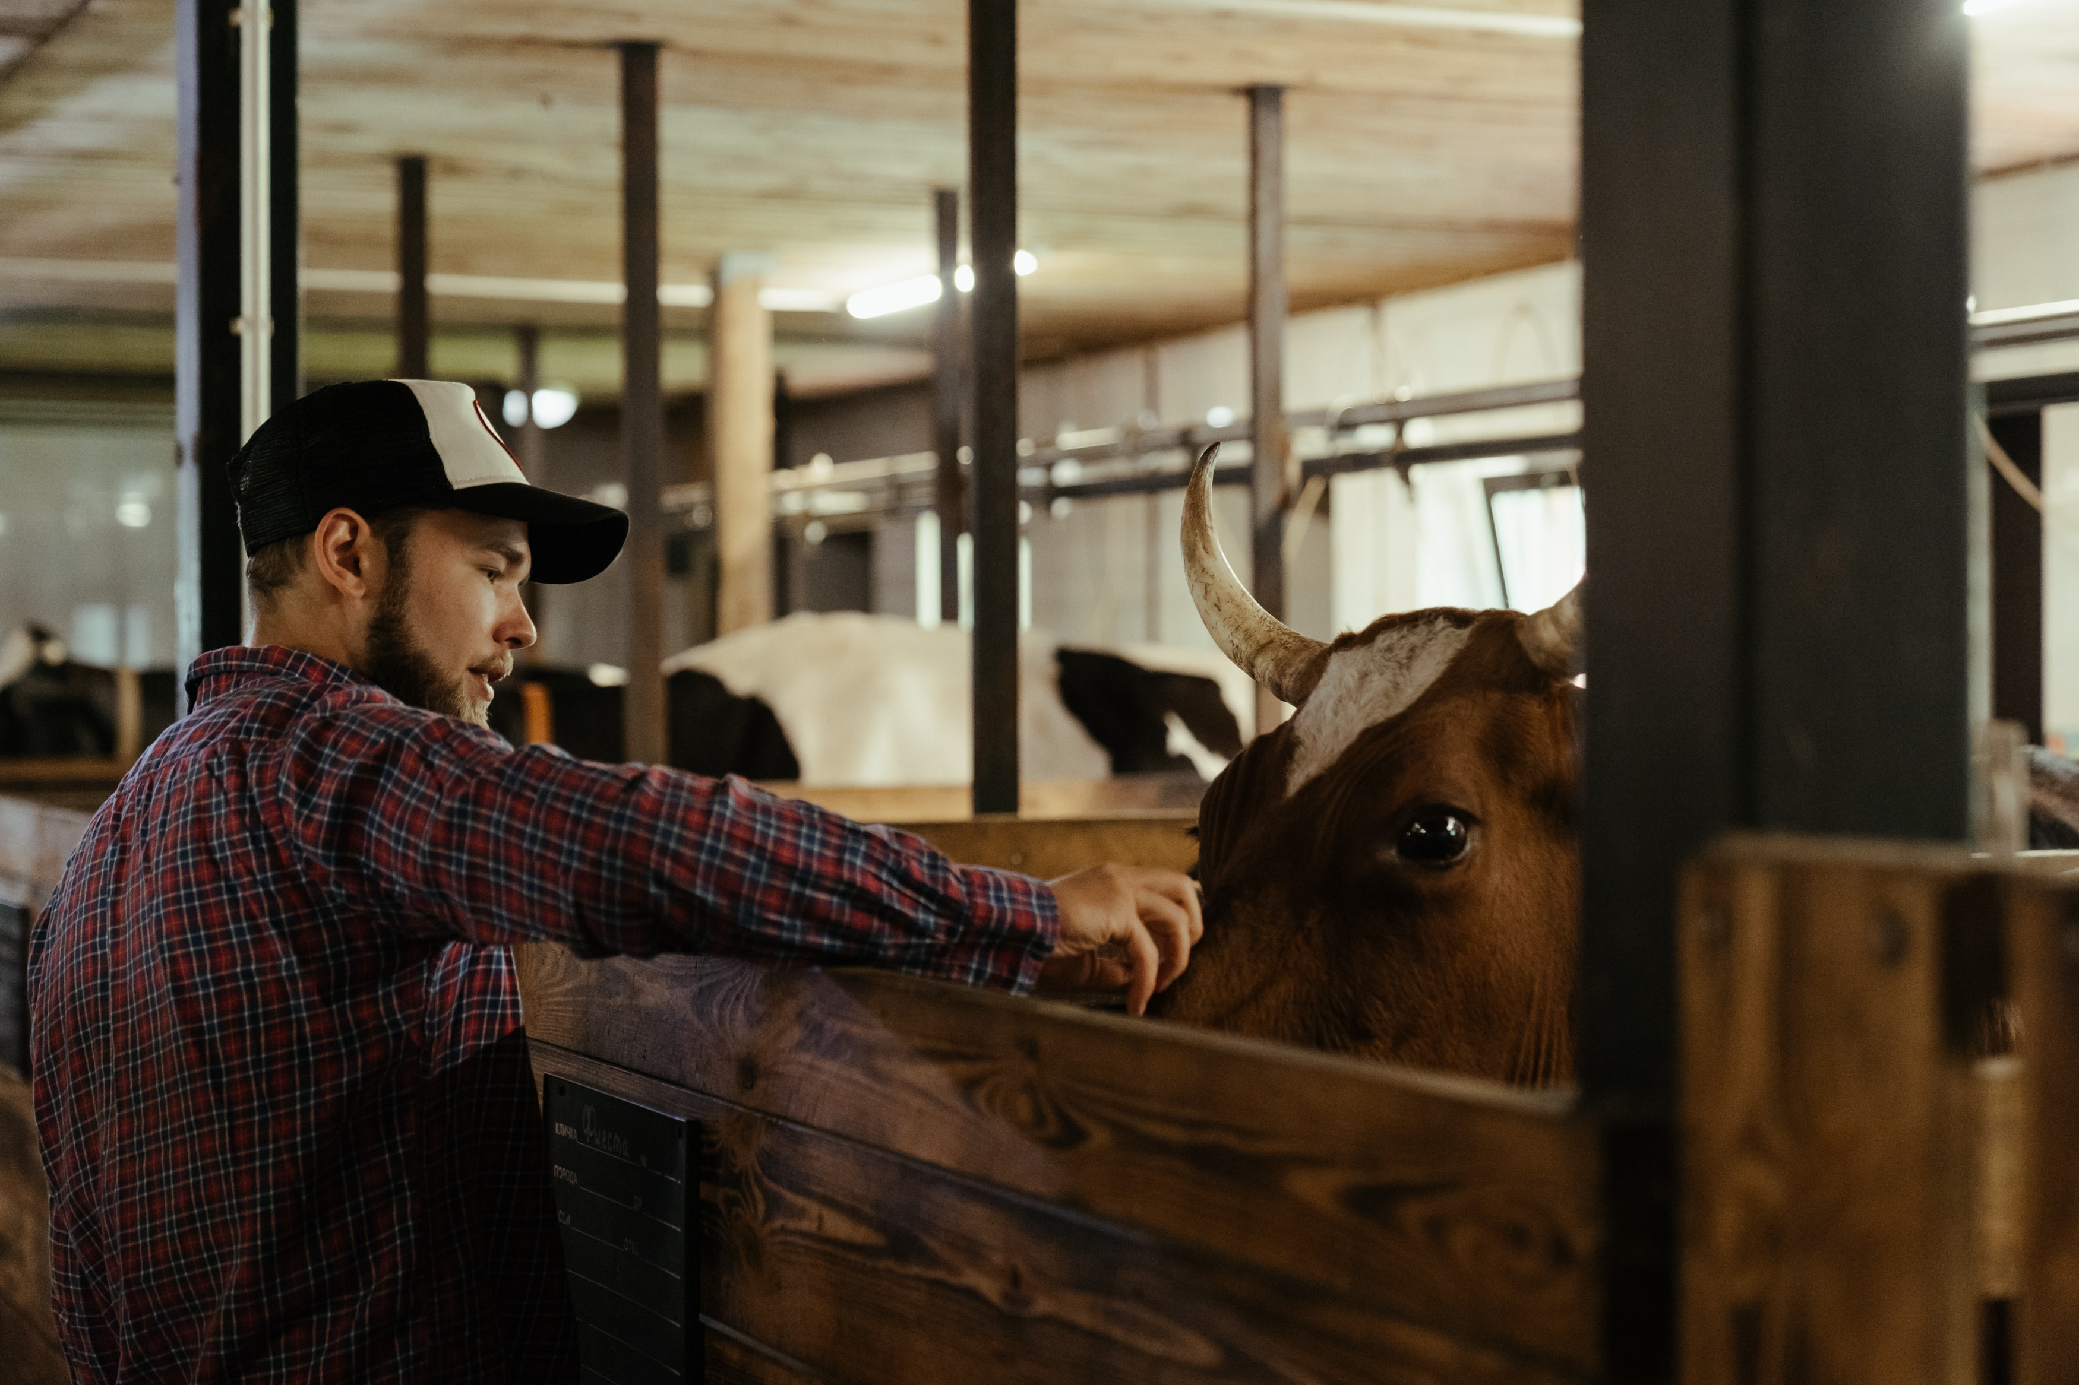
RA Challenges
Again, re-defining “What is an apprenticeship?”
Preparing and training employers to host learners (apprentices)
Understanding & learning the process
Sustainability for our RSI offerings

Slide 20

Stakeholder Support for RA Programs
Built programs around existing needs of stakeholders
Empowered founding stakeholders/partners to be in the drivers' seat of apprenticeship development
Established a collaborative recruitment plan with local workforce boards and organizations

Slide 21
Delta Health Alliance

Slide 22



Delta Health Alliance Speakers
Tyeshia Green
Brooks Ann Gaston
Beth McCullers
Director of Workforce Development Programs
Vice President of Community Engagement
Vice President of Sponsored Programs

Slide 23
Delta Health Alliance 2
Currently administering a Community Health Worker (CHW) registered apprenticeship
RA program includes:
  Minimum of 2,000 hours of on-the-job training, plus 144 hours of classroom instruction (12-month apprenticeship)
  Compensation for all components at $15/hour with full time benefits
  Exposure to different health care topics including diabetes outreach, stroke initiative, maternal and infant health, and county health fairs
RAs learn the knowledge and skills necessary to provide and manage health education programs that help individuals, families, and their communities maximize and maintain healthy lifestyles.
RAs learn to use data to identify community needs prior to planning, implementing, monitoring, and evaluating programs designed to encourage healthy lifestyles, policies, and environments.
RAs work to link health systems, health providers, insurers, and patients to address individual and population health needs.

Slide 24
RA Program Development
First established in April 2022, officially registered on May 17, 2022
Prior to RA certification, all training was in-house due to no standards for CHW education nor formal certification protocols from the state of Mississippi.
Partnership with OA State Director was crucial for:
  Form development
  Protocol establishment
  Process mapping
  Navigating concerns
With assistance from state team, all paperwork was completed and submitted to the state office for review within two weeks!
Partnership was created with Itawamba Community College to establish a state-approved CHW training program, allowing RA cohorts to enroll in one of the earliest certified classes

Slide 25

RA Challenges 2
Initially, no state-approved CHW programs
Relatively low literacy levels with participants
Barriers relating to customer service, professionalism, transportation

Slide 26

Stakeholder Support for RA Programs 2
Critical shortage of health workers has encouraged stakeholder support
Previous internship and volunteer efforts have been a seamless transition for RAs

Slide 27
Questions and Discussion

Slide 28
Contact US
Tyeshia Green
Director of Workforce Development Programs
Delta Health Alliance
tygreen@deltahealthalliance.org
Zach Boren
Senior Policy Manager, Center on Labor, Human Services, and Population
Urban Institute
ZBoren@urban.org
Brooks Ann Gaston
Vice President of Community Engagement
Delta Health Alliance
bgaston@deltahealthalliance.org
Lisa Petty-Hoveman
Director of Apprenticeship Programs, Economic and Workforce Development
Shasta College
LHoveman@shastacollege.edu
Beth McCullers
Vice President of Sponsored Programs
Delta Health Alliance
bmccullers@deltahealthalliance.org

Slide 29

Become a Center Partner
Receive no-cost expert TA,
materials, and assistance
Network with potential
partners nationwide
Be nationally recognized for
your work
Scan for Partner Form

Slide 30

Request Technical Assistance (TA)
Answers to building strategic partnerships to expand RA
Solutions to building sustainable RAPs
Assistance to train staff, implement tools, etc. to increase system alignment
Scan for
TA Form

Slide 31
Email us your questions at RA_COE@SafalPartners.com
For more information, visit: dolcoe.safalapps.com

