Slide 1
The Workforce and
Registered Apprenticeship System:
How Do We Connect the Two?
SETA Conference 2025
March 2025

Slide 2

Presenter
Alan Dodkowitz
Subject Matter Expert
Safal Partners
Safal Partners © 2025

Slide 3
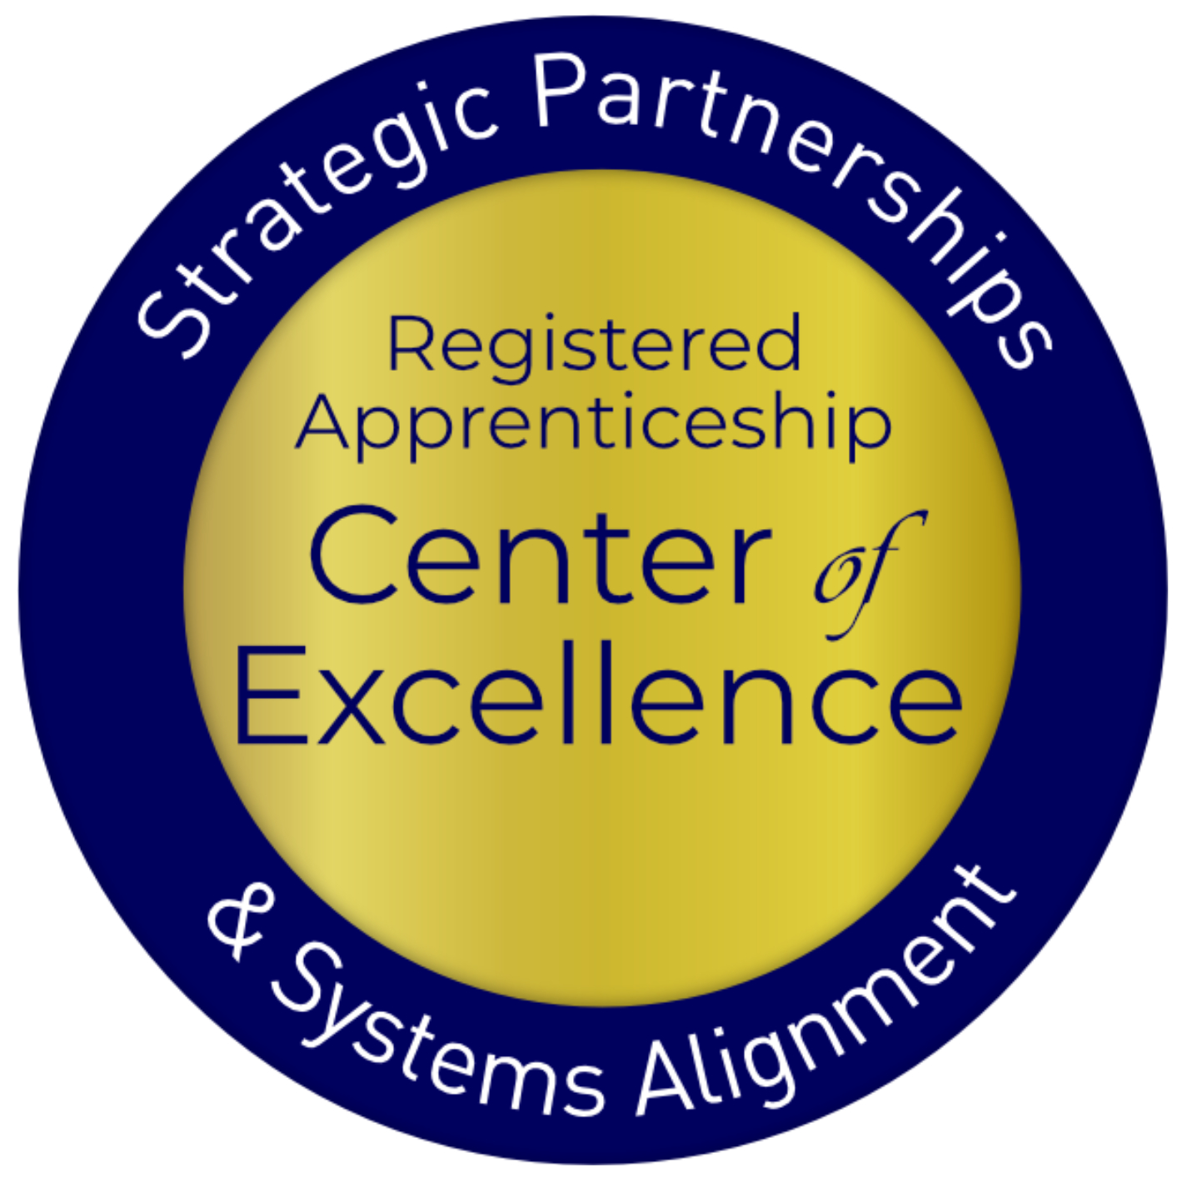
Welcome and Agenda
Center of Excellence Overview
Findings from the Field
Aligning Workforce Boards and RA
Case Studies
Key Take-Aways
Questions and Discussion
Safal Partners © 2025

Slide 4

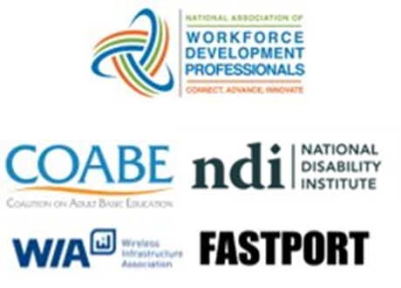

Center of Excellence Overview
U.S. DOL initiative to increase systems alignment across apprenticeship, education, and workforce
Led by Safal Partners; 5 national partners
We provide no-cost services including:
  Monthly webinars
  Quarterly virtual office hours
  Individual compliance assistance and services
  Online resources (desk aids, guides, frameworks, etc.)
Visit our website, request assistance
Safal Partners © 2025

Slide 5
Poll: Who is in the Room with Us Today?
Private Industry Employers
State Workforce Board Members / Staff
Local Workforce Board members / Staff
Partners of the American Job Center System (One-Stop)
Registered Apprenticeship Providers
Education (Secondary / Post Secondary / Proprietary, Etc.)
Community Based Organizations
Other
You May Fit More than 1 Category
Safal Partners © 2025

Slide 6
Findings from the Field
Safal Partners © 2025

Slide 7
Support at Top, Dropoff in Planning
RA Alignment Indicator | # of State Plans Included | % of States | # of Territories
1. Apprenticeship acknowledged as workforce strategy | 50 | 100% | 6
2. Plans to apply for/utilize federal grants to expand apprenticeship | 42 | 84% | 4
3. Apprenticeship articulated specifically in strategies to meet State Plan vision | 17 | 34% | 3
4. State level apprenticeship work group or committee to SWDB | 17 | 34% | 1
5. Specialist expertise in AJCs | 16 | 32% | 1
6. State level Initiative (e.g., investment of additional resources, statute designed to incentivize or encourage establishment of apprenticeships) | 15 | 30% | 2
7. Specific objectives and goals for increased # of apprentices or apprenticeship programs | 7 | 14% | 0
Safal Partners © 2025

Slide 8
2020 State WIOA Plan RA Leaders 1
While no state or territory had all seven indicators of RA alignment in their Unified or Combined Plan, 15 had four or more indicators.
Six Indicators
Five Indicators
Four Indicators
Pennsylvania Arizona Alaska US Territories
Texas Illinois Arkansas American Samoa
Iowa Connecticut District of Columbia
Kentucky Florida Guam
Nevada Idaho
New Mexico Kansas
Oklahoma Maine
Missouri
New York
Wisconsin
Safal Partners © 2025

Slide 9




Low Utilization Due to Several Factors
Workforce Boards, Title I providers cited:
Other state and local priorities
Lack of Registered Apprenticeship Knowledge
Few/no strategic relationships with the RA System
Priority of meeting WIOA performance measures
Safal Partners © 2025

Slide 10




Low Utilization Due to Several Factors 1
Workforce Boards, Title I providers cited:
View of WIOA as “last dollar in” for RA given administrative burden vs. fewer restrictions with non-WIOA $$
Lack of consistent, accessible, modularized training – i.e. Workforce System not a catalog on the RA Academy
Separate data systems
Local Workforce Development Boards don’t see themselves as “conveners” of local industry
Safal Partners © 2025

Slide 11
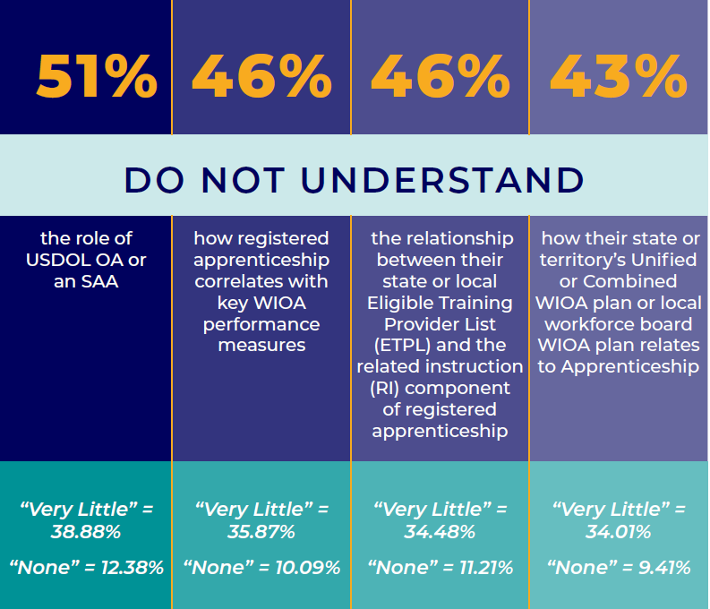
Knowledge Gap: Connecting Systems
Safal Partners © 2025

Slide 12
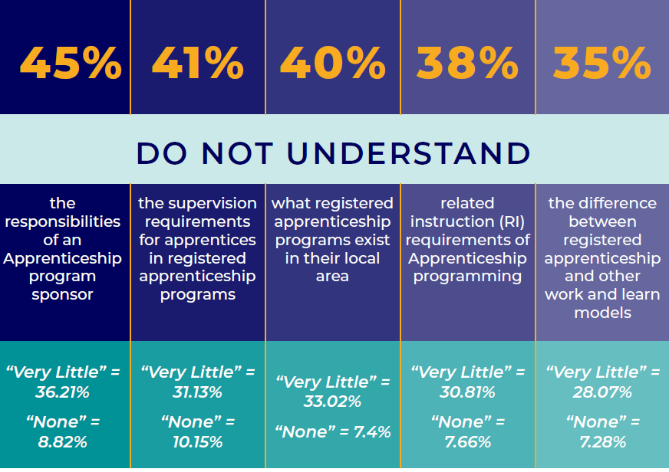
Knowledge Gap: How RA Works
Safal Partners © 2025

Slide 13
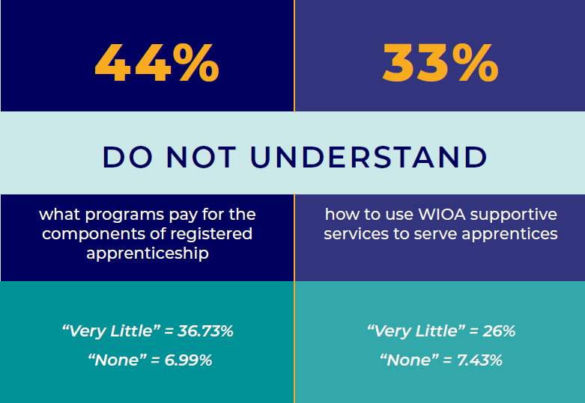
Knowledge Gap: Funding
Safal Partners © 2025

Slide 14
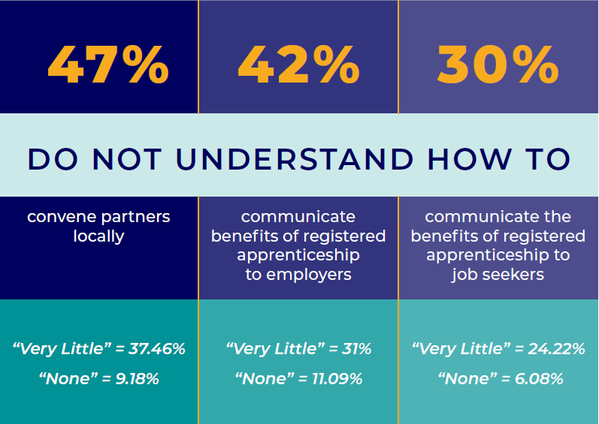
Knowledge Gap: Communication
Safal Partners © 2025

Slide 15
Creating Alignment in the Field
Safal Partners © 2025

Slide 16
POLL:
Which engagement level best describes your experience with Registered Apprenticeship?
Component #1:
Implementing Policy
Component #2:
Engaging Jobseekers
Component #3:
Supporting Sponsors/Jobseekers
Component #4:
Building Registered Apprenticeship
Staffing, Partnerships
Component #5:
Serving as Registered Apprenticeship Convener
Component #6:
Becoming a Registered Apprenticeship Sponsor
Clear Leader
Moderately Engaged
Just Getting Started
Safal Partners © 2025

Slide 17
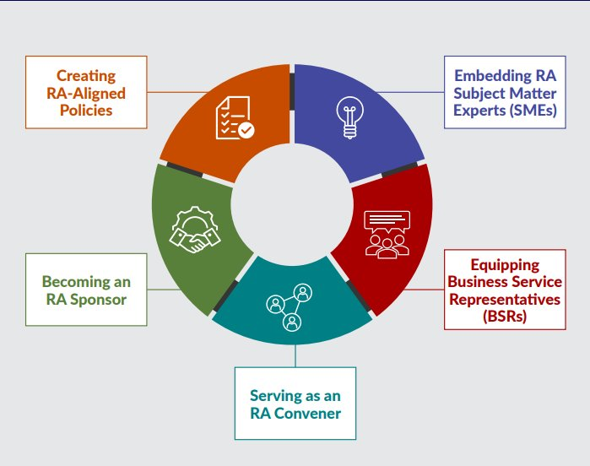
New Tool
Key Components of Workforce System Alignment with Registered Apprenticeship
Safal Partners © 2025

Slide 18

Component #1: Policy Framework
State and Local WDBs often have state and local policies and procedure frameworks that align and guide development of work to support RA program implementation.
Criteria and policies for board membership ensure appropriate representation for RA
Policies/procedures prioritize the use of RA as a service strategy for WIOA Title I and may provide funding to support RA programs
Partnering program service providers have policies/procedures on clear WIOA/RA co-enrollment processes and training towards frontline case managers
Funding-related policies ensure use of available funds supports RA expansion
ETPL policy/procedures provide automatic inclusion of RA programs on ETPLs
Business services policies/procedures include implementation of RA through OJT/IWT
Safal Partners © 2025

Slide 19

Component #2: Embed RA SMEs
State/LWDBs embed RA expertise in the AJC frontline staff to actively help engage employers and create RA pipeline.
State/LWDB have RA navigators/SMEs within AJCs or region
Case managers purposefully screen and refer job seekers to RAPs
Co-enrollment procedures are used by case managers and partners
Apprentices are supported throughout the RA program
Partners work with AJCs to engage job seekers in RAPs
Outreach to job seekers showing benefits to RA
Training for case managers on RA
Wagner-Peyser staff share RA info to job seekers and employers
Safal Partners © 2025

Slide 20

Component #3: Equipping BSRs
Business Services Representatives (BSRs) have the knowledge and expertise to assist employers with adopting RA programs and accessing funding.
BSRs...
  Regularly work with ATRs to promote RA programs
  Guide employers through the RA process
  Create outreach plan based on LMI with RA counterparts
  Interact with intermediaries to assist businesses with RA program development
  Provide collateral and education to partners
  Communicate with case mangers about apprenticeship openings
  Assist businesses with leveraging WIOA and other funding
State/Local Rapid Response efforts include RA
Safal Partners © 2025

Slide 21

Component #4: RA Convener
State/LWDBs engage stakeholders to expand RA, build talent pipelines, address workforce shortages, and increase employment and wages for workers.
Engage with stakeholders to development and implement RA programs that can access funding and resources through workforce system
Sector Strategy initiatives include RA as a strategy for building the talent pipeline
Create and maintain a network (hub) of RA programs to accelerate employer participation and to provide technical assistance
Collaborate on high-demand, industry specific RA programs including technical assistance and funding
Collaborative RA efforts include mandatory partners as part of convening activities
Create concise communication and outreach for RA programs
Safal Partners © 2025

Slide 22

Component #5: RA Sponsorship
LWDB becomes a group RA sponsor increasing opportunities for job seekers to access careers in high-demand industries and for businesses to access funding supports for apprentices.
LWDB becomes a RA program sponsor for in-demand occupation(s)
Occupations are regularly added to RA programs based on LMI
Ed system is engaged with LWDB to provide RI
RA sponsorship is sustainable through braided funding
LWDB creates clear path to build pipeline for employers
LWDB provides admin support, training and assistance to employer joining the RA program
LWDB ensures ability to support employers with WIOA funding
Safal Partners © 2025

Slide 23
Case Studies
Safal Partners © 2025

Slide 24

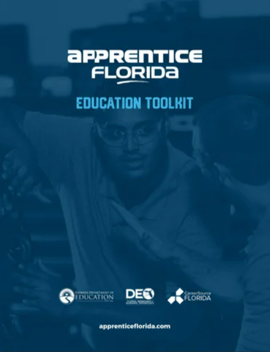
Case Study: Apprentice Florida
Apprentice Florida
(Levels 2, 3, 4, & 5):
  State funding for
  Apprenticeship Navigators
  Locals work regularly with Apprenticeship Training Representatives at state level
  Incorporated RA in state level WIOA plan
Key Alignment Factors:
State leadership and policy changes:
  State/Local hosting of Apprenticeship Accelerators
  Training components and success stories just for employers
  Tools like PowerPoint templates, flyers for outreach, and toolkits for business, education and local workforce boards
Safal Partners © 2025

Slide 25


Case Study: Apprentice Florida
Link:
Webinar of Demonstrated State Apprenticeship Leadership in 2020 Unified-Combined Plans Part Two Apprenticeship Expertise in AJCs
In this engaging webinar from the Center of Excellence, Subject Matter Experts speak about state leadership in Apprenticeship noted in 2020 State Plans as programs demonstrating strong leadership in planning effective apprenticeship programs. Throughout the webinar, participants hear from voices from the field.
Safal Partners © 2025

Slide 26

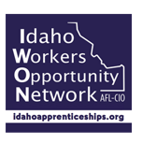










Case Study: Apprenticeship Idaho
Apprentice Idaho Partners
(Levels 1, 2, & 3):
Includes all stakeholders at state and local level
National case study demonstrates in 6 years they had increases in apprentices and new RA programs
Key Alignment Factors:
State leadership and policy changes
Collaborative outreach and business engagement
Building capacity to develop and support RA programs
Safal Partners © 2025
Notes:
Division of Occupational & Professional Licenses

Slide 27
Case Study: Apprenticeship Idaho1
Link:
Webinar of Demonstrated State Apprenticeship Leadership
in 2020 Unified Combined Plans Part 1
In this Center of Excellence webinar , Subject Matter Experts speak about state leadership in apprenticeship …noted in 2020 plans for best practices in leadership in planning. Throughout the webinar, participants hear from voices from the field.
Safal Partners © 2025

Slide 28



Examples
Howard County Community College: State board and local economic development authority provides funding to the college to offer IT apprenticeships to local students.
Indiana Office of Work-Based Learning and Apprenticeship – Through efforts of the state, OWBLA aligned credits with CTE and community college partner, Ivy Tech, to build a pathway for apprentices to complete with an associate's degree.
College of the Canyons and South Bay WIB- Local board received a $12 million Federal grant and worked with the College of the Canyons to deliver services to over 5,000 apprentices and pre-apprentices.
Safal Partners © 2025

Slide 29
Take-Aways
Safal Partners © 2025

Slide 30

Create Connections with State, Local WDBs
Most RA sponsors, participating employers have NO relationships with or awareness of WDBs – not accessing services, funding, or resources.
Educate Partners on WDBs:
  Sector strategies: priority occupations and key industries
  WIOA and non-WIOA funding
  Policies on OJT contracts, which WIOA and non-WIOA funding "buckets" and services they will apply to RA
  Funding levels, fiscal year cycle and how quickly they anticipate spending funds
  Supportive services offered and how that maps to your program's needs
  Candidate pool – IS and OS Youth Programs
  ETPL program registration process
Safal Partners © 2025

Slide 31

Engage Chambers of Commerce
Chambers of Commerce can play a key role in building a stronger RA system by:
  Increasing industry awareness of RA
  Connecting RA sponsors, RTI providers, RA system staff to local businesses and employer groups
  Creating pathway for WDB jobseekers to member RA programs
Safal Partners © 2025

Slide 32

Partner with Secondary, Post-Secondary Ed
Deepen connections with local high schools, community colleges, career and technical education providers, and four-year school to establish a stronger RA programs.
At the high school level, work to develop programs for juniors or seniors eligible to apply for paid on-the-job training experience with an employer while receiving RTI at school.
At the secondary level, build programs that embed industry credentials in RTI curriculum and oftentimes leads to the award of industry-recognized credentials.
Safal Partners © 2025

Slide 33

Participate in Apprenticeship Networks
Apprenticeship networks serve as a platform for organizations to come together, build awareness, and share best practices to expand professional advancement through apprenticeship programs. Safal has worked to identify two primary types of networks:
    Private-Sector Networks: Based out of consortia of businesses, local chambers of commerce, and other business groups. They seek to build a network for businesses to connect and advance apprenticeship.
    Public-Sector Networks: Based out of local workforce systems, they view the alignment of registered apprenticeship and workforce development as crucial. Also serve as conveners of those in the apprenticeship ecosystem, bringing together the workforce system, employers, RI providers, and other different partners.
Safal Partners © 2025

Slide 34
Questions and Discussion

Slide 35
Become a Center Partner
Scan for Partner Form

Slide 36
Email us your questions at RA_COE@SafalPartners.com
For more information, visit: dolcoe.safalapps.com
Safal Partners © 2025

