Slide 1

Promising Practices for Building Effective ATR/BSR Partnerships
Session II
June 11, 2024

Slide 2

Moderator
Katie Adams
Chief Delivery Officer
Safal Partners

Slide 3


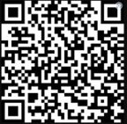
Center of Excellence Overview
U.S. DOL initiative to increase systems alignment across apprenticeship, education, and workforce
Led by Safal Partners; 5 national partners
We provide no-cost TA including:
  Monthly webinars
  Quarterly virtual office hours
  Individual TA/coaching sessions
  Online resources (desk aids, guides, frameworks, etc.)
Visit our website, request TA

Slide 4

Agenda
  Recap of Business Services and Job Seeker Services at the LWDB Level
  Elements of the BSR Approach
  Opportunities for ATRs to Build Effective Partnerships with BSRs
  Best Practice: Strategies for Overcoming Challenges and Developing Partnerships and Collaborations
  How Can ATRs Help Equip RA Sponsors Access Workforce System Funding through Collaboration with BSRs

Slide 5
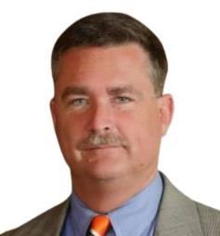
Guest Speaker
Jeffrey Smith
Workforce Liaison / Program Analyst
Office of Apprenticeship
U.S. Department of Labor

Slide 6
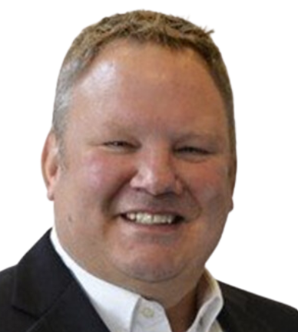

Today’s Presenters
Joel Elsenbroek
Project Manager, Apprenticeships
West Michigan Works!, Strategic Workforce Solutions
Amy Lebednick
Director, Business Solutions
West Michigan Works!, Strategic Workforce Solutions

Slide 7

Objectives for Today
  Increase ATR knowledge about workforce system
  Increase ATR knowledge about Functions of Business Services Representatives
  Encourage more proactive outreach by ATRs to BSRs in a local workforce area
  Increase discussion and engagement between BSRs and ATRs
  Increase coordination between BSRs and ATRs when conducting outreach to businesses in local workforce areas

Slide 8
Recap of Services at the Local Workforce Level
Business and Job Seeker Services

Slide 9

LWDB Mission

Slide 10

Business Services
  Services for employers may include:
    Employer Engagement & Relationship Building
    Networking and Collaboration
    Facilitating Access to Funding
    Compliance and Documentation
    Recruitment Assistance
    Provision of Labor Market Information/Wage Analysis

Slide 11

Funding Support for Businesses
LWDB WIOA funding opportunities for employers may include:
Incumbent Worker Training
Customized Training
On-the-Job Training
Additional funding opportunities:
  Subsidized Employment
  Federal Grants for Apprenticeship Expansion
This Photo by Unknown Author is licensed under CC BY-SA

Slide 12

Job Seeker Services
American Job Centers provide access to a range of partner programs and services to help job seekers find employment and advance in their careers, including:
Veteran Services (Priority of Services)
Youth Services
Career Development & Job Coaching
Job Search Assistance
Employability workshops
Hiring events
Labor Market Information
Referral to Partner Program Services

Slide 13

Funding Support for Job Seekers
LWDBs may provide WIOA funding to cover costs associated with:
  Individual Training Accounts (ITAs)
  Paid Work Experience (Youth & Adult)
  Supportive Services
      Childcare
      Transportation
      Books
      Tools

Slide 14
Excellence in Practice: Engaging BSRs
Elements of the BSR Approach

Slide 15
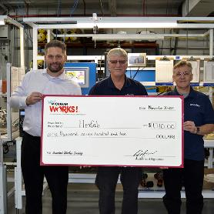




BSR Approach: Solutions Driven
Philosophy: We can best serve our communities by engaging with all partners to identify and overcome challenges through a collaborative approach.
Methods should be Proactive. Integrated. Sustainable.
This work is ongoing and dynamic and requires a continuous improvement approach!

Slide 16
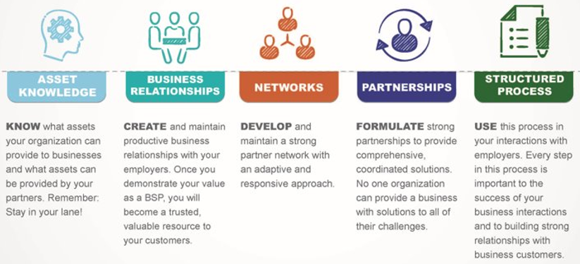
Elements of the BSR Approach
“Let no encounter with a business go to waste”

Slide 17
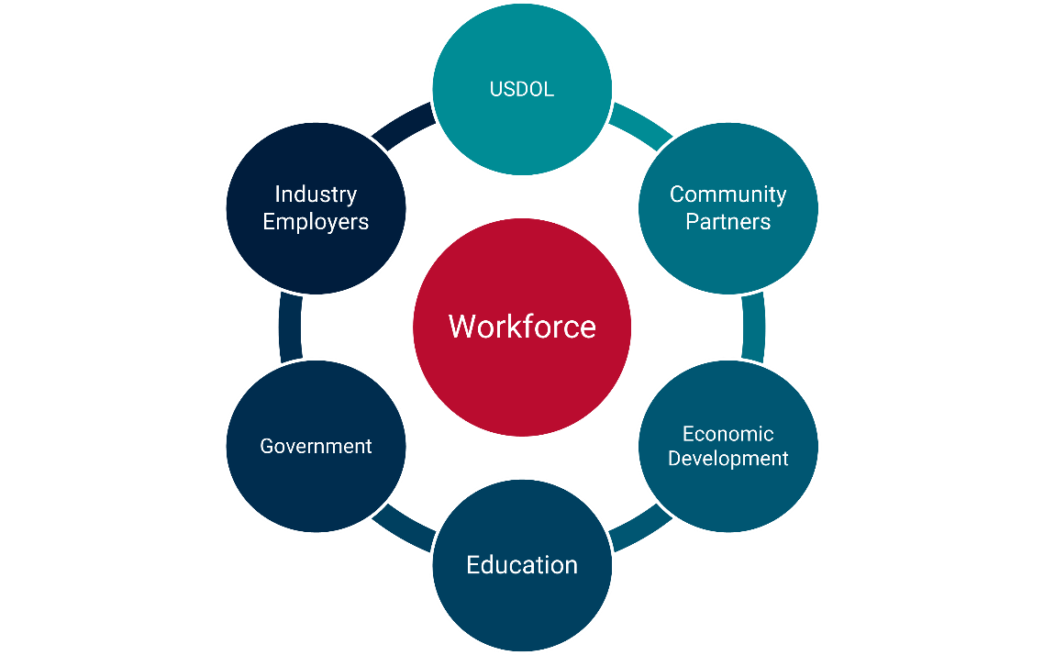
Elements of the BSR Approach 2
Key Partnerships
Asset Knowledge – Who else needs to have a seat at the table?
Business Relationships – Which Industry employers could benefit?
Developed Networks – Which stakeholders should I convene?
Partnerships – Who’s already engaged/connected?
Structured Process – Ensure a well thought out strategy

Slide 18





Elements of the BSR Approach 3
The BSR Structured Process
The most important question a BSR can ask: Why?
Follow-Up
Establishes ongoing business relationships, promotes sustained success and encourages process improvement.
What happened?
How did this project go?
What was the result?
Where might you improve for future projects?
What happens next?
Implementation
Your detailed plan for successful implementation of the proposed solution.
What steps are involved in the implementation of your plan?
Who is the lead contact during this phase of the project?
What are each partner's responsibilities?
What is the monitoring process?
Solutions Design
The recommended solution presented to the business by you and relevant partners.
What is the best solution for this employer/project?
What relevant assets could be provided by you and your partners?
Don't promise anything you can't deliver.
Stay in your lane.
Fact Finding
The discovery process to understand an employer's needs and bridging to solutions design.
Ask "why?"
What does the business need/what are their pain points?
Take caution not to jump to conclusions before you understand the situation.
Entry
Your introduction to a new employer/customer or initiating a project with an existing customer.
How do you contact them/get in the door?
What is the goal of outreach and potential partnership?

Slide 19
Excellence in Practice:
ATR and BSR Partnerships
Tips for ATRs for a Successful BSR Partnership

Slide 20
Tips for Effective Partnerships
Move from transactional connections to a collaborative approach
Establish ongoing open communication
Identify a high performing champion
Utilize available resources that allow access to programs

Slide 21

Building Effective Partnerships
Work with State Workforce Agency to have joint meetings with BSRs & ATRs across the state
Schedule short, regular, touch-base meetings with BSRs working with employers on RA program development
Send email updates announcing when new programs or occupations get approved
Promote online training sessions for BSRs interested in Registered Apprenticeship

Slide 22

Building Effective Partnerships 2
Identify a High Performing Registered Apprenticeship Program Champion
A Program Champion can:
  Introduce RA program model to interested employers
  Deliver testimonials/trainings
  Provide TA for employers starting new programs
  Advocate and recruit others to promote the RA program model

Slide 23

Building Effective Partnerships 3
Promote available resources that will allow greater access to programs
  Apprenticeship.gov
    RA Academy
    Apprenticeship Finder
  Apprenticeship Standards.org
  Workforce GPS
  State Department of Labor/Economic Development
  Center Of Excellence/Safal Partners

Slide 24
Excellence in Practice: Overcoming Challenges
Strategies for Continuous Improvement

Slide 25

Developing Partnerships & Collaboration
ATRs can be the link by supporting & informing Business Solutions Representatives (BSRs) in the development of Registered Apprenticeship Programs.

Slide 26

Developing Partnerships & Collaboration2
“If you want to go fast, go alone. If you want to go far, go together.”
- African Proverb

Slide 27

Challenging Elements of Business Services
  Matching employer needs with available workforce resources
  Balancing varied employer requirements
  Addressing skill gaps or training needs of workforce
  Serving as neutral convener
  Managing multiple partners with varying priorities

Slide 28

A First Step: Assess the Workforce System’s Knowledge of RA
Knowledge Assessment Tool
Assess LWDBs knowledge threshold on Registered Apprenticeship to drive high, medium, or low engagement levels.
Handout: Knowledge Assessment Tool
Safal Partners © 2024

Slide 29
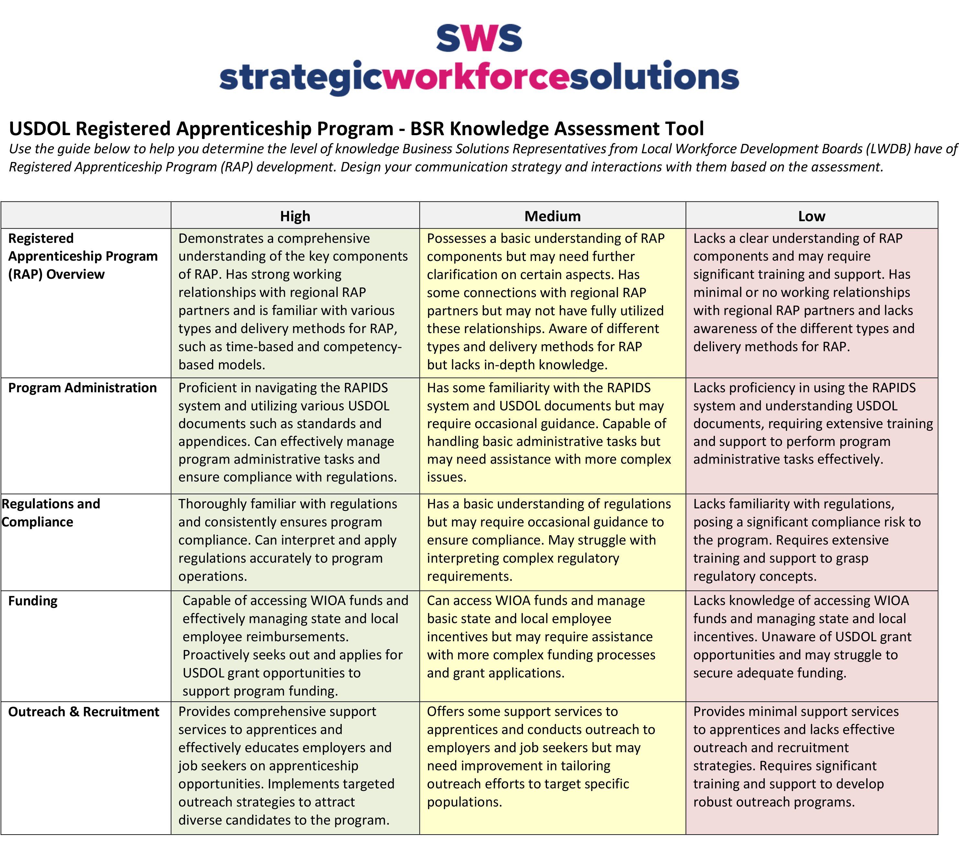
Assess the Workforce System’s Knowledge of RA
Safal Partners © 2024

Slide 30

Strategies for Overcoming Challenges
  Tailor conversations to match BSR knowledge level
  Consistent touch-bases to share information
  Providing resources and connections
  Offer BSRs an active role in the development process

Slide 31
Next Step: Sharing Assets
Asset Mapping Tool
Identify and track key stakeholders in RAP development to include in partner outreach & engagement.
Handout: Asset Mapping Tool

Slide 32
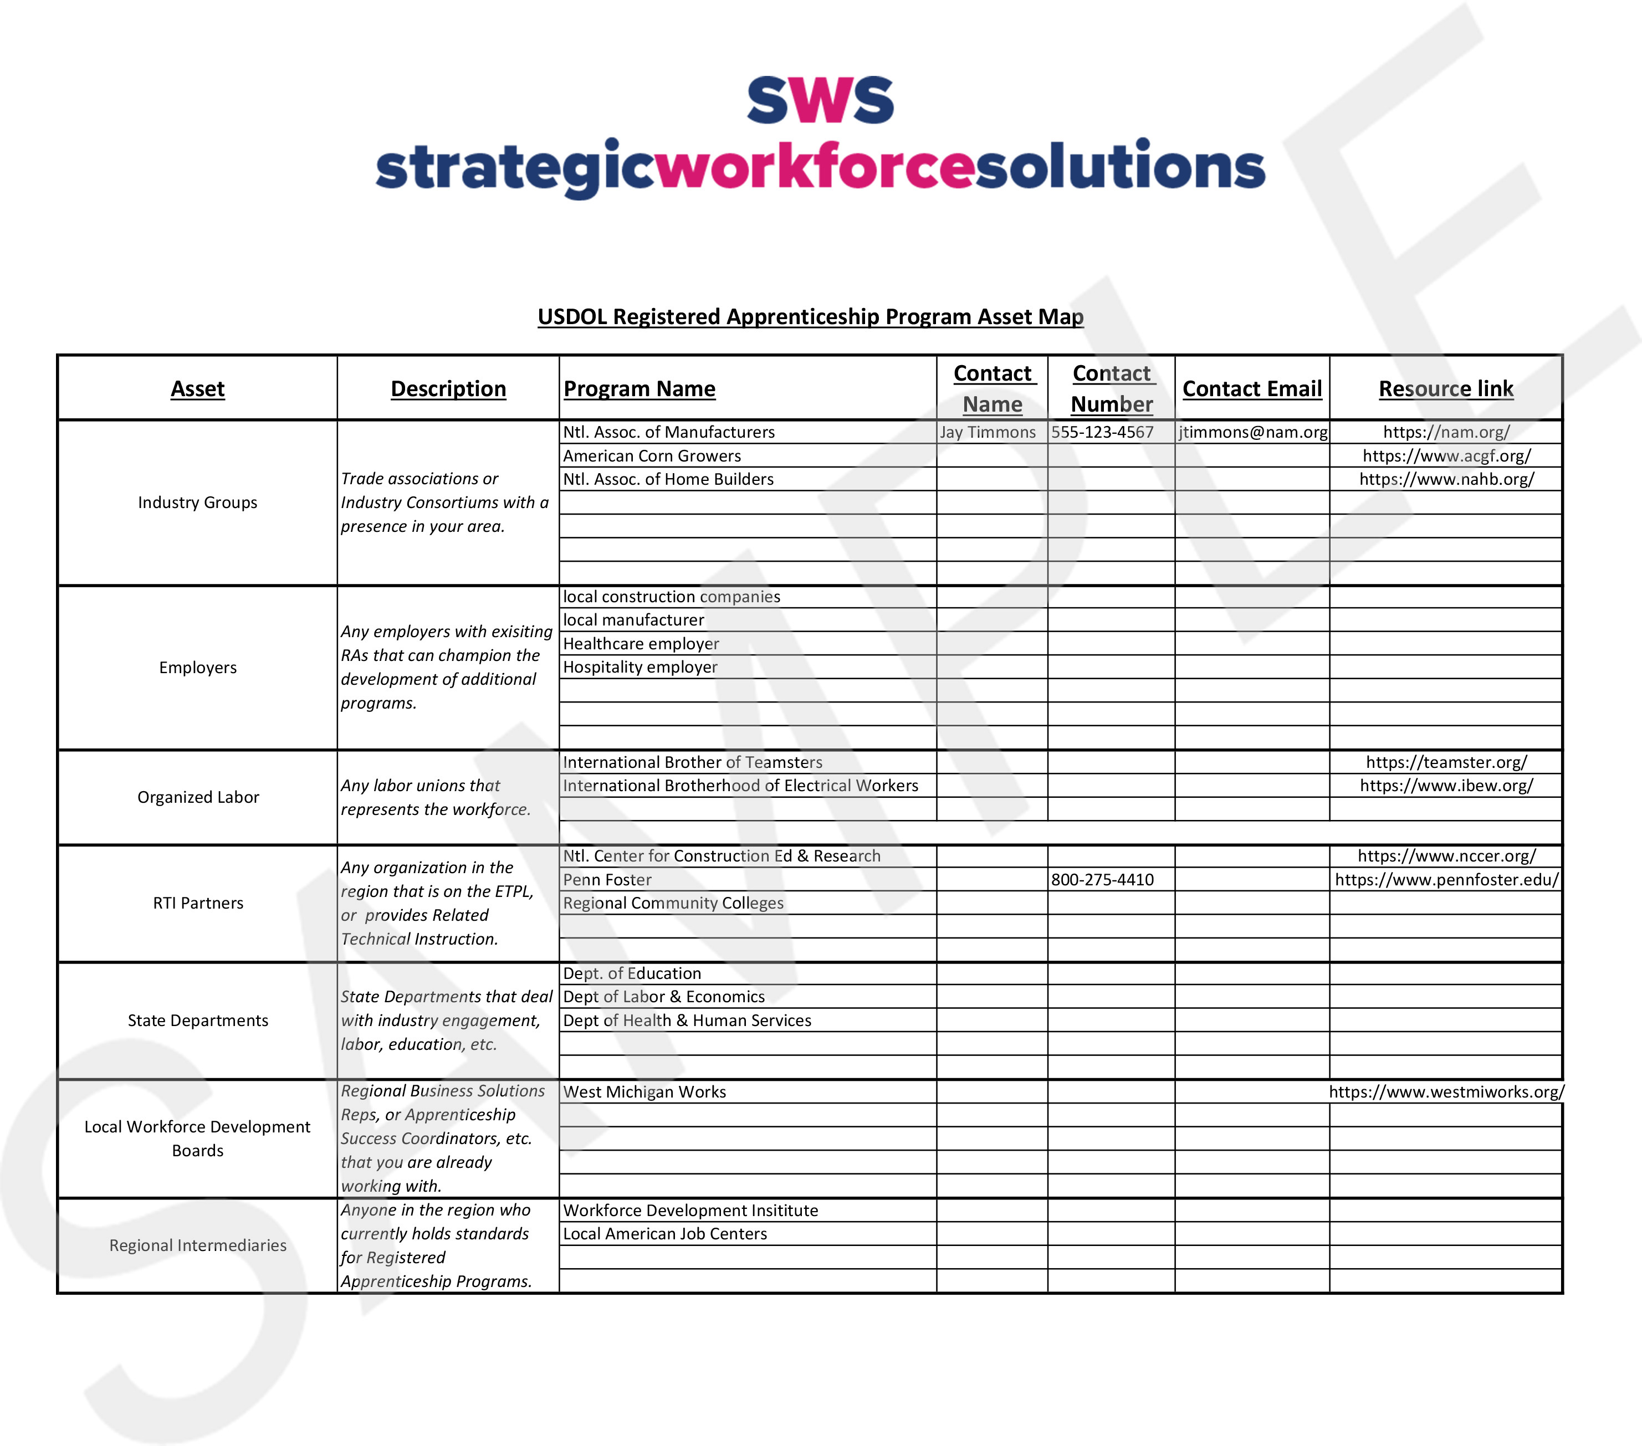
Developing Partnerships & Collaboration3

Slide 33

Collaboration for Overcoming Challenges
Connecting partners together helps to identify challenges and can lead to collaborative, robust solutions
Recognizing and identifying a facilitator or neutral convener to manage regional collaboration
Innovative development of new occupations in non-traditional industries

Slide 34

Developing Partnerships & Collaboration4
Vision for Future of ATR/BSR Partnership
Innovation in service delivery
Adapting to evolving workforce needs
Enabling and facilitating collaborations with key partners

Slide 35
Accessing Workforce System Funding
ATR/BSR Collaboration to Discover Funding Solutions

Slide 36

Funding Sources
Leverage funding from community partners
Braid federal, state, & local funds
WIOA Title 1 funds to support OJT, RTI, Support Services

Slide 37

Accessing Workforce Training Funds
ATRs can play a crucial role in equipping registered apprenticeship sponsors and employers to access local workforce development system funding through collaboration with Business Services Representatives

Slide 38
Accessing Workforce Training Funds 2
Step 1: Reach out to your local workforce development board to find out who provides business services for the local workforce system.
Step 2: Meet regularly with your local BSR(s)
Encourage and participate in collaboration between businesses, LWDBs, and training institutions
Explore joint initiatives or partnerships to optimize training outcomes.
Handout: Workforce Training Fund Questions for BSRs

Slide 39
Tools and Takeaways
Handout: Knowledge Assessment Tool
Handout: Asset Mapping Tool
  Handout: Workforce Training Fund Questions for BSRs
Safal Partners © 2024

Slide 40
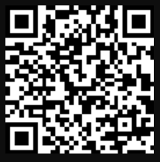
Last Chance to Register!
Capstone for ATRs and BSRs: Collaborating to Expand Registered Apprenticeship
Interactive learning from workforce experts
Effective ATR and BSR partnerships
Implement training at the local level
June 13th from 11am-12:30pm ET
Scan to Register:

Slide 41
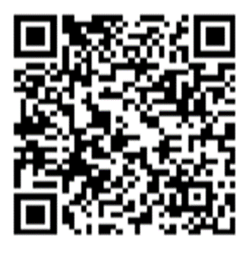
Contact Us, Become a Partner
Scan for Partner Form
Receive no-cost expert TA,
materials, and assistance
Network with potential
partners nationwide
Be nationally recognized for your work

Slide 42
Email us your questions at RA_COE@SafalPartners.com
For more information, visit: dolcoe.safalapps.com
Safal Partners © 2024

