Slide 1
WIOA and Registered Apprenticeship: Taking the Partnership to the Next Level
September 2024

Slide 2

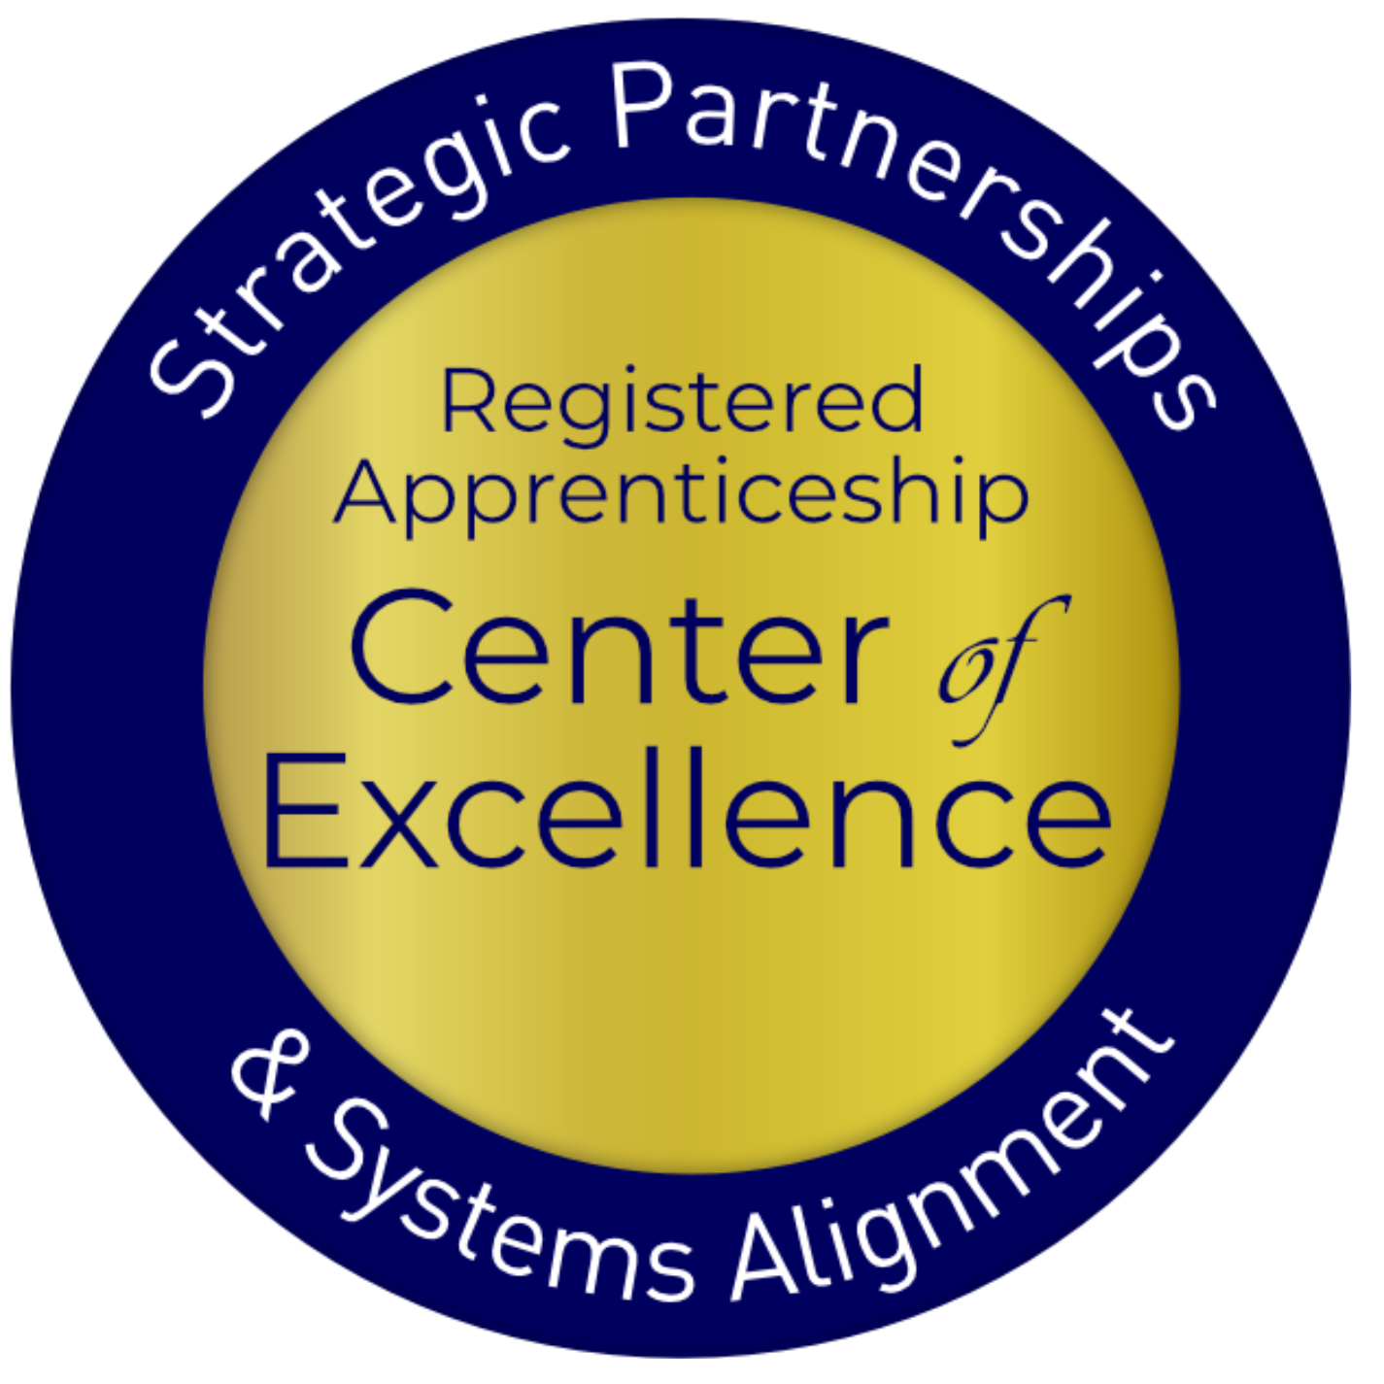
Presenter
Stacy O’Keefe
Subject Matter Expert
Safal Partners

Slide 3

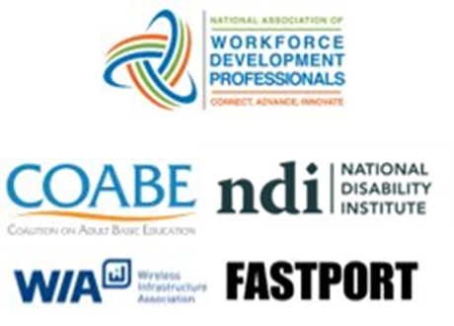

Center of Excellence Overview
U.S. DOL initiative to increase systems alignment across apprenticeship, education, and workforce
Led by Safal Partners; 5 national partners
We provide no-cost TA including:
  Monthly webinars
  Quarterly virtual office hours
  Individual TA/coaching sessions
  Online resources (desk aids, guides, frameworks, etc.)
Visit our website, request TA

Slide 4
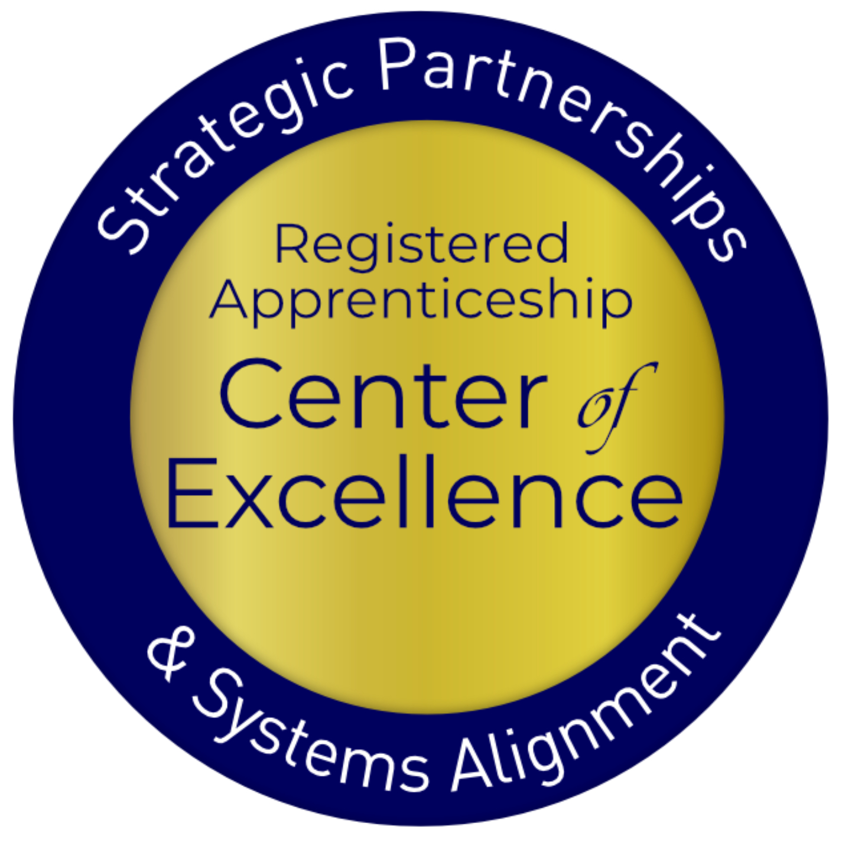
Objectives
Learn why RA and WIOA partnership is so beneficial
Identify the points of intersection between workforce and RA
Learn how to take action around points of intersection for success
Bust myths that may be blocking your successful partnership
Know where to go for additional information and support
Questions and Discussion
Safal Partners © 2024

Slide 5

Getting to Know You
Are you a….
  Workforce Board Director or Staff
  Service Provider Staff
  Educational Partner
  Vocational Rehabilitation Partner
  Apprenticeship Navigator
  Business
  Board Member
  Other?

Slide 6
Assessing Your RA Knowledge?
Basic
I know what it means, but I don’t know how to utilize it and don't have significant
experience
with it.
Intermediate
I understand RA, I’ve had experience with RA in some capacity, and I feel comfortable educating internal and external stakeholders
about it.
Expert
I have extensive knowledge and relevant experience developing and implementing programs and standards, recruiting apprentices, and convening stakeholders.

Slide 7
Assess your WIOA & RA Partnership
EMERGING – we are interested in a partnership, but we are unsure how to get started.
ADVANCING – we have started to build the partnership.
LEADING – we have a successful partnership that includes co-enrollment between WIOA and RA.
How would you assess your RA and WIOA Partnership?

Slide 8
Getting Started: RA Basics
Safal Partners © 2024

Slide 9

Registered Apprenticeship
  Registered apprenticeship is:
  a proven model of job preparation
  that combines paid on-the-job training (OJT) with related instruction to progressively increase workers’ skill levels and wages;
  a proven business-driven model that provides an effective way for businesses to recruit, train, and retain highly skilled workers.

Slide 10



Five Core Components
Employer Involvement
Structured On-the-Job Learning
(OJL)
Related
Instruction
(RI)
Reward for Skill Gains
National Occupational Credential

Slide 11

Spans all Sectors

Slide 12
Forged through Partnerships

Slide 13
Forged through Partnerships 2

Slide 14
The Partnership – Let’s Start with the “Why”

Slide 15
The Benefits
Businesses
Supports recruitment of a highly-skilled workforce
Improves productivity and retention
Reduces turnover
Averts layoffs
Job Seekers & Apprentices
Earn while you learn
Receive a nationally recognized credential
Career pathway to self-sufficiency
Wage growth
Address barriers to employment such as child-care and transportation
WIOA & Other Partner Programs
Facilitates strong program performance results – progressive wage increases, skill gains and nationally recognized credentials
Aligns with WIOA’s vision for business-focused, work-based training

Slide 16
The Benefits 2
Proven ROI: Employers report on average $1.47 for every $1 invested in RA – highly cost effective in the long term
Expand Workforce: With a training plan in place from day one, employers can take a skills-based approach to hiring which creates much larger talent pipeline
Cost: Much less costly for apprentice than traditional college
Retention Rate: 93% of apprentices who complete a Registered Apprenticeship retain employment
Credential: Culminates in a national occupational credential
Wages: Apprentices typically earn $300,000 more over their careers than peers

Slide 17
Workforce & RA Points of Intersection
Safal Partners © 2024

Slide 18
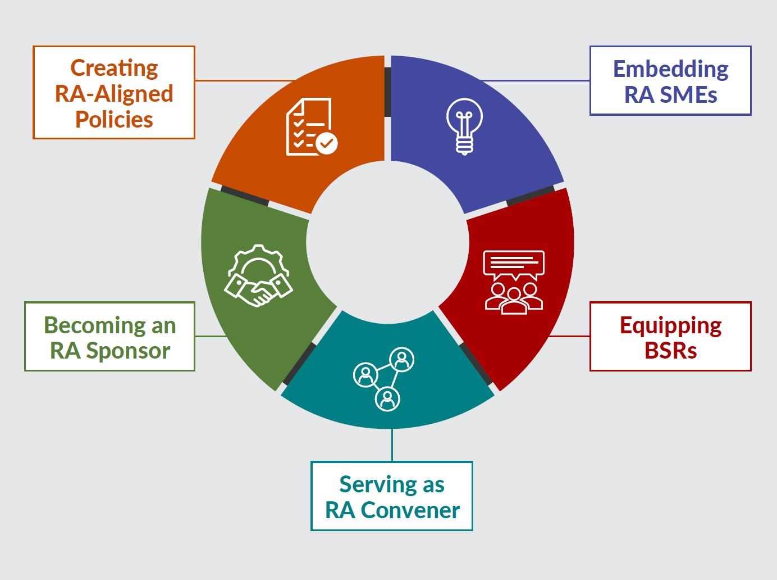
New Tool
Key Components of Workforce System Alignment with Registered Apprenticeship
https://dolcoe.safalapps.com
Safal Partners © 2024

Slide 19

Key WIOA Provisions & their Intersection with RA
State and local workforce boards
Funding supports
ETPs and ETP Lists
Performance outcomes
State and local planning
Policy and procedures

Slide 20

Key WIOA Provisions & their Intersection with RA 2
State and local workforce boards
Funding supports
ETPs and ETP Lists
Performance outcomes
State and local planning
Policy and procedures

Slide 21
State & Local Boards in Action: Cultivating the RA & WIOA Partnerships
Workforce boards and the RA system share the same fundamental mission: connect workers to economic opportunity while meeting the skill needs of employers in high-demand industries. ​

Slide 22

State & Local Boards in Action: Cultivating the RA & WIOA Partnerships 1
It starts at the top
Membership - 20 CFR 679.320
Functions - 20 CFR 679.370
  Convenes
  Sets strategic direction
  Engages and educates key stakeholders
  Develops and executes policies
  Serves as a RA sponsor

Slide 23

State & Local Boards in Action: Cultivating the RA & WIOA Partnership
How does your State or local workforce board support alignment?

Slide 24
Key WIOA Provisions & their Intersection with RA 3
State and local workforce boards
Funding supports
ETPs and ETP Lists
Performance outcomes
State and local planning
Policy and procedures

Slide 25
WIOA Funds: Cultivating the RA & WIOA Partnership
WIOA Title I funds, and funding from the AJC partners/ workforce system established under WIOA, can be used in several ways to support RA programs.

Slide 26
WIOA Funding: Cultivating the RA & WIOA Partnership
Related Training & Instruction
On-the-Job Training
Supportive Services
Under WIOA, all classroom training is funded through individual training accounts (ITAs). Programs must be on the state's eligible training provider list to take advantage of potential funding. In addition to ITAs for individual apprentices, utilizing contracts for cohort training is also possible.
On-the-job training (OJT) is funded through contracts, not ITAs. OJT contracts can cover one or multiple apprentices with the reimbursement for OJT typically at 50% of the apprentices' wage rate.
WIOA formula funds can be utilized to provide a range of supportive services such as transportation and childcare. Also, if an ITA is used to fund the related training and instruction, the ITA can also be used to provide supportive services.

Slide 27
WIOA Funding: Cultivating the RA & WIOA Partnership 1
Co-enrollment Matters!
  With few exceptions, RI, OJT and/or Support Services may NOT be paid with WIOA funds in the absence of WIOA and RA co-enrollment.

Slide 28

Intersection: WIOA Funding Support
WIOA allows for another
type of training that
is a great fit for RA.
Anyone know what that is?

Slide 29

Myth Busting – Part 1
Businesses only want to conduct RA with Incumbent Workers, but I can’t serve those workers because they do not meet WIOA eligibility requirements.
Yes, WIOA can! Businesses can use RA to improve
the skills of their existing employees.
Incumbent Worker Training
20 CFR 680.780 An incumbent worker does not have to meet the eligibility requirements for career and training services for adults and dislocated workers under WIOA, unless they also are enrolled as a participant in the WIOA adult or dislocated worker program.

Slide 30
WIOA Funds: Cultivating the RA &WIOA Partnership
Other requirements for IWT:
Must increase competitiveness – business and/or employee
Employee must have worked with business for at least 6 months
  If a cohort of employees, majority must meet 6-month rule
Retention and layoff aversion are key

Slide 31
Myth Busting – Part 2
Remember 20 CFR 680.800
The local area may reserve up to 20 percent of their combined total of adult and dislocated worker allocations for incumbent worker training.
States and local areas must establish policies and definitions.
States may use their statewide activities funds (per WIOA sec. 134(a)(3)(A)(i)) and Rapid Response funds for statewide incumbent worker training activities.

Slide 32

WIOA Funds: Cultivating the RA & WIOA Partnerships 1
But wait, there is so much more ….
  Basic, Individualized, and Follow-Up Services
    Assessment of skill levels
    Job preparation/coaching
    Resume writing
    Career counseling and support
    Workforce preparation services
    Financial literacy services
    Follow-up services
    20 CFR 678.430

Slide 33

WIOA Funds: Cultivating the RA & WIOA Partnership 2
What challenges or successes have you experienced with the use of WIOA funds for RA programs?

Slide 34
Key WIOA Provisions & their Intersection with RA 5
State and local workforce boards
Funding supports
ETPs and ETP Lists
Performance outcomes
State and local planning
Policy and procedures

Slide 35
The ETP List: Cultivating the RA & WIOA Partnership
There are several misconceptions regarding RA programs & ETPs which must be addressed to ensure apprenticeship continues to grow as an employment opportunity for jobseekers and a talent solution for businesses. ​

Slide 36
Myth Busting – Part 3
The WIOA ETP List prohibits my ability to cover the costs of a RA program’s RI component – too complicated!
  No! RA programs are exempt from ETP requirements!
  MD ETP List Policy
  &
  Use of WIOA funds for OJL and/or Supportive Services is not tied in any way to the ETP List.

Slide 37

Myth Busting – Part 4
WIOA does not allow the use of training contracts instead of ITAs and the ETP List for RA’s related instruction component.
False! It is 100% allowable to use a contract for RI,
when funding a cohort of apprentices.
TEGL_13-16.pdf (dol.gov)

Slide 38
Key WIOA Provisions & their Intersection with RA 4
State and local workforce boards
Funding supports
ETPs and ETP Lists
Performance outcomes
State and local planning
Policy and procedures

Slide 39
Performance Measures: Cultivating the RA & WIOA Partnership 3
Adopting Registered Apprenticeship as a workforce strategy can significantly advance the objectives of WIOA. This approach not only supports overarching goals, such as enhancing career opportunities for job seekers and meeting the skill needs of business, but also addresses the specific performance measures outlined in the statute.

Slide 40
Performance Measures: Cultivating the RA & WIOA Partnership
RA improves performance outcomes!
Entered Employment Rate Q2 and Q4 post exit
Median Earnings Q2 post exit
Measurable Skill gains
Credential Attainment
Effectiveness in Serving Employers
Youth Employment & Education Rate Q2 post exit

Slide 41

Performance Measures: Cultivating the RA & WIOA Partnership​
How would you assess your knowledge around WIOA performance measures and RA's impact on such measures?

Slide 42
Myth Busting – Part 5
If it’s a five-year program, I must stay attached to the participant(s) for the full five years.
Not true. Unless there is a state policy that says otherwise, once WIOA/workforce system resources are complete,
the individual can be exited.
Be strategic about when to exit
Train career counselors/case managers
Establish policies and procedure
Remember, employment rate is achieved following exit.
Examples

Slide 43
Myth Busting – Part 6
Example 1: You are supporting an apprentice through their largely front-loaded classroom training component (RI); when the RI is done, the individual can be allowed to exit.
Example 2: You will support 3 classes for the first semester of the RTI; allow exit after the first semester ends.
Example 3: Exit at the time of a scheduled wage increase.

Slide 44
Performance Measures: Cultivating the RA & WIOA Partnership -
Co-enrollment Matters!
  Unlock additional sources of RA program support for employers who sponsor programs and job seekers hired as apprentices.
  Share the outcomes.
  Boost overall alignment for workforce system.

Slide 45
Take-Away Tool on Performance Measures – Part 1
WIOA Measure: Employment Rate Q2 Post-Exit
RA Impact: RA is an “earn and learn” model offering employment from day one. Whether or not the WIOA participant was an apprentice (i.e., employed) at the time of participation, Adults and DWs will be included in this metric, and because RA is employment, it yields a positive outcome.
TIP: For Adults, to make the low-income priority, enroll potential apprentices before they start their RA program. Exit can occur once WIOA services are complete, still yielding a positive outcome.
WIOA Measure: Youth Employment and Education Rate in the 2nd Quarter after Exit
RA Impact: RA is employment and education combined, yielding a positive outcome for this metric. Exit can occur once WIOA services are complete, still yielding a positive outcome.

Slide 46
Take-Away Tool on Performance Measures – Part 2
WIOA Measure: Employment Rate in the 4th Quarter after Exit
RA Impact: If the individual remains in a RA program (or completes the program), she/he is employed, yielding a positive outcome. Exit can occur once WIOA services are complete, still yielding a positive outcome.
WIOA Measure: Youth Employment and Education Rate in the 4th Quarter after Exit
RA Impact: If the individual remains in a RA program (or completes the program), she/he is employed, yielding a positive outcome for this metric. Exit can occur prior to the completion of the RA program, once WIOA services are complete, still yielding a positive outcome.

Slide 47
Take-Away Tool on Performance Measures – Part 3
WIOA Measure: Median Earnings—2nd Quarter after Exit
RA Impact: If the individual remains in a RA program (or completes the program), she/he is employed, yielding a positive outcome. Exit can occur once WIOA services are complete, still yielding a positive outcome.
WIOA Measure: Credential Attainment
RA Impact: All RA programs end in a nationally portable, employer recognized credential. A RA Completion Certificate is a recognized post-secondary credential under WIOA. Some RA programs also include interim credentials, which are also industry-recognized. As long as the WIOA participant exits within one year of credential attainment, RA will yield a positive outcome for this metric. Also note that if Local Boards are supporting only the OJT component of a RA program, this metric does not apply.

Slide 48
Take-Away Tool on Performance Measures – Part 4
WIOA Measure: Measurable Skill Gains
RA Impact: The apprenticeship model has an increasing skill gain built into the RA program. There are several opportunities for a positive outcome on this metric during RA program participation, such as completion of one year of the full RA program, a scheduled wage increase (which indicates an increase in skill levels), or the completion of the related instruction component. This metric supports longer term RA programs in particular, allowing Local Boards to take credit for positive outcomes during RA program participation.

Slide 49

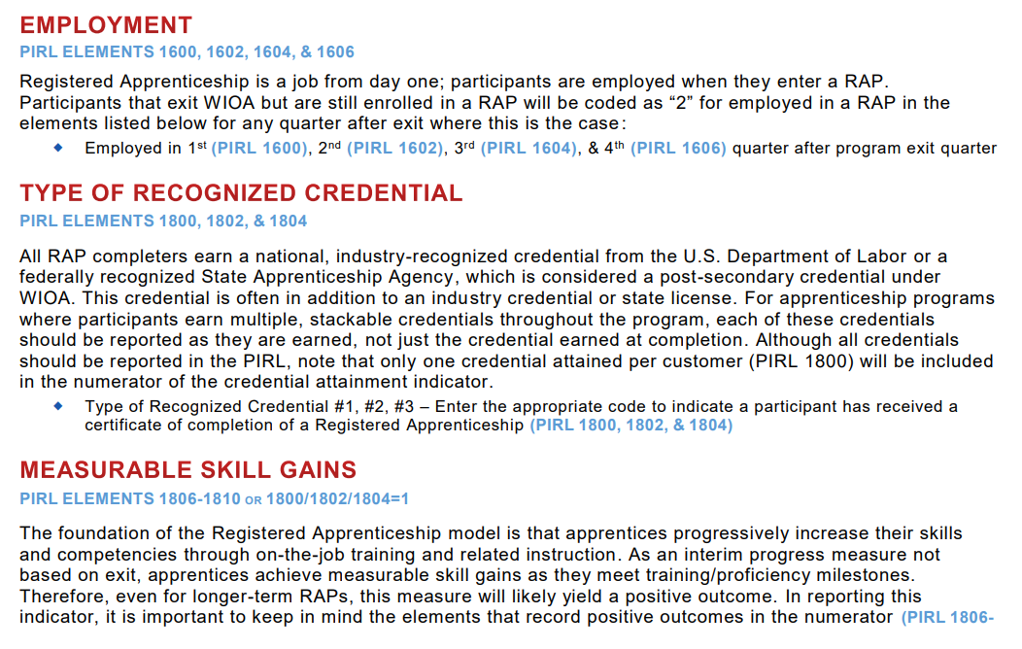
Performance Measures: Cultivating the RA & WIOA Partnership
Understand how to correctly report
RA and WIOA
Co-Enrollment

Slide 50
Key WIOA Provisions & their Intersection with RA 7
State and local workforce boards
Funding supports
ETPs and ETP Lists
Performance outcomes
State and local planning
Policy and procedures

Slide 51
State and Local WIOA Planning: Cultivating the RA & WIOA Partnership 3
The WIOA State and Local Plans provide the strategic framework for collaborative strategies and should establish a roadmap for advancing RA under WIOA​.

Slide 52
State and Local WIOA Planning: Cultivating the RA & WIOA Partnership 4
Fun facts
The word “Apprenticeship” is nowhere to be found in the first TEGL for WIOA State Plans.
Can you guess how many times “apprenticeship” is mentioned in the most recent State planning TEGL?
Requirements for WIOA State Plans PYs 2024 - 2027
How about MDOL’s 2020-2024 WIOA State Plan?
State of Maryland 2022-2024 State Plan

Slide 53

State and Local WIOA Planning: Cultivating the RA & WIOA Partnership 4
Are you at the “planning table?”
Get yourself there…connections are key
Contact the local board director
Attend a local board meeting
and make the necessary connections
Head to your local AJC and
connect with Business Services staff

Slide 54
Key WIOA Provisions & their Intersection with RA 6
State and local workforce boards
Funding supports
ETPs and ETP Lists
Performance outcomes
State and local planning
Policy and procedures

Slide 55
State and Local WIOA Planning:
Cultivating RA & WIOA Partnership
Policies establish the framework for and institutionalize practices that support WIOA and RA alignment.

Slide 56
Policies in Action: Cultivating the RA & WIOA Partnership 4
  PROMISING examples include policies that:
    Establish a goal or even a mandatory level of WIOA funds (Statewide and/or formula) to be spent on one or more RA activities – RI, OJT, Support Services, etc.
    Clearly articulate ETP list requirements for RA.
    Embed RA expertise in the AJC frontline staff. BSRs-ANs-ATRs
    Engage all AJC partners, led by the OSO, in RA efforts.
    Establish state and local board membership and committee requirements that facilitate RA stakeholder engagement
    Establish a local planning process that includes RA stakeholders.
    Require on-going training and education for all key stakeholders.
    What else?
Safal Partners © 2024

Slide 57

Policies in Action: Cultivating the RA & WIOA Partnership 5
What policies have been effective in advancing this partnership in your system and/or local area?

Slide 58
MD's Supportive Framework of Policies and Programs
Apprenticeship Navigators - MATP
Maryland Apprenticeship Ambassador Program
Apprenticeship Incentive Reimbursement Program
Policy MD Hospitality Management RA Program
Public Sector Apprenticeship Innovation Fund
Youth Apprenticeship Grant Guidance

Slide 59

Questions
Safal Partners © 2024

Slide 60
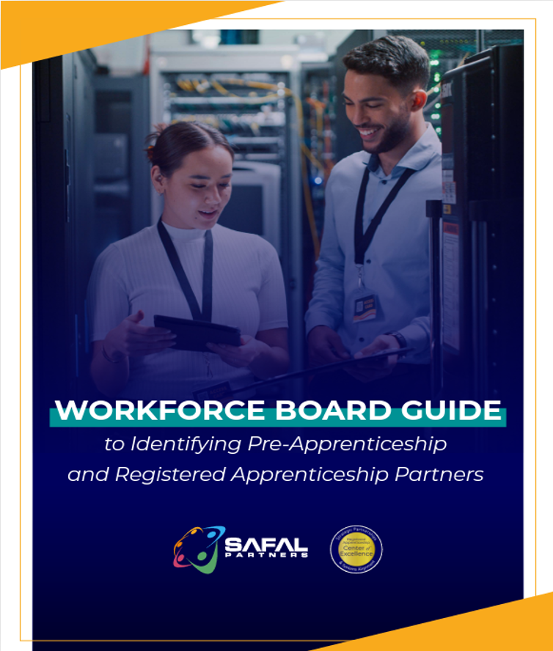

No-Cost Resources
Guide to Identifying Partners
Safal Partners © 2024

Slide 61

Contact Us, Become a Partner
Receive no-cost expert TA,
materials, and assistance
Network with potential
partners nationwide
Be nationally recognized for your work
Scan for Partner Form

Slide 62
Thank You for Joining Us
Email us your questions at RA_COE@SafalPartners.com
For more information, visit: dolcoe.safalapps.com

