Slide 1
Braiding Funds to Support Successful Registered Apprenticeship Programs
An Introduction
December 2024

Slide 2


Presenters
Nicole Bentley
Stacy O’Keefe
Subject Matter Expert
Safal Partners
Subject Matter Expert
Safal Partners

Slide 3




Center of Excellence Overview
U.S. DOL initiative to increase systems alignment across apprenticeship, education, and workforce
Led by Safal Partners; 5 national partners
We provide no-cost TA including:
  Monthly webinars
  Quarterly virtual office hours
  Individual TA/coaching sessions
  Online resources (desk aids, guides, frameworks, etc.)
Visit our website, request TA

Slide 4

Objectives
Understand basic building blocks of Registered Apprenticeship (RA)
Learn the benefits of RA programs for your job seekers and business customers
Understand what it means to braid funds
Learn the elements to success
Complete a braided funds exercise
Explore Alternative Funding Sources
Questions and Discussion
Safal Partners © 2024

Slide 5

Getting to Know You
Are you a….
  Workforce Board Director or Staff
  Service Provider Staff
  Educational Partner
  Vocational Rehabilitation Partner
  Apprenticeship Navigator
  Business
  Board Member
  Other?

Slide 6
Assessing Your RA Knowledge? 1
Basic
I know what it means, but I don’t know how to utilize it and don’t have significant experience with it.
Intermediate
I understand RA, I’ve had experience with RA in some capacity, and I feel comfortable educating internal and external stakeholders
about it.
Expert
I have extensive knowledge and relevant experience developing and implementing programs and standards, recruiting apprentices, and convening stakeholders.

Slide 7

Getting Started:
RA Basics and Benefits
Safal Partners © 2024

Slide 8

Registered Apprenticeship
Registered Apprenticeship is:
a proven model of job preparation that combines paid on-the-job training (OJT) with related instruction to progressively increase workers’ skill levels and wages;
a proven business-driven model that provides an effective way for businesses to recruit, train, and retain highly skilled workers.

Slide 9
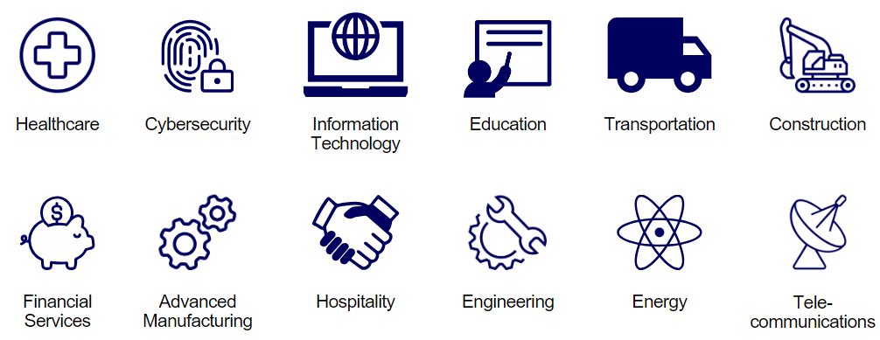
Spans all Sectors

Slide 10




Core Components of RA
Industry Led
Structured
On-the-Job Learning & Mentorship
Related Instruction
(RI)
Paid Job & Rewards for
Skill Gains
Quality &
Safety
National
Occupational Credential
Safal Partners © 2024

Slide 11





Key Organizational Apprenticeship Roles
Convener
Sponsor
RI Provider
Employer
Partner
An organization that agrees to operate an apprenticeship program and in whose name the program is registered.
Entity that provides instruction to apprentices in the designated occupation’s core knowledge, skills, and abilities.
Hires and provides paid OJL for apprentices under
supervision of a designated mentor who is a skilled professional in
that occupation.
Organizations committed to supporting RA programs. They can play one or more roles.

Slide 12


Building Blocks
The Key Steps
Get to know apprenticeship, its benefits, and how different employers and sponsors are creating programs across industry and geography.
BUILD
Understand your options, the steps involved in building an apprenticeship program, and the tools we offer to help you get started.
PARTNER
Collaborate with apprenticeship representatives, workforce organizations, educators, and others to build your program.
REGISTER
Take advantage of benefits such as funding opportunities, tax credits, and no-cost technical assistance when you register your program
LAUNCH
Recruit
EXPLORE
BUILD
PARTNER
REGISTER
LAUNCH

Slide 13
Why Local Workforce Boards Should
Prioritize Registered Apprenticeship

Slide 14

The Benefits
Why does a Local Workforce Board want to engage in a braided funding effort to support RA programs....
What's the ROI?

Slide 15
For Your Job Seeker Customers
The benefits for job seekers to participate in a Registered Apprenticeship program:
  The "earn while you learn" concept provides a salary while building a career
  A "lead-in" to promising, well-paid careers in a variety of industries
  Higher quality of life and skills versatility
  Increased marketability and job security
  Portable credentials are recognized nationally and often globally
  Opportunity for college credit and future degrees

Slide 16
For Your Business Customers
The benefits for businesses to participate in a Registered Apprenticeship program:
  Recruit and develop a highly-skilled workforce that helps grow the business
  Improve productivity, profitability, and an employer’s bottom line
  Create flexible training options that ensure workers develop the right skills
  Minimize liability costs through appropriate training of workers
  Increase retention of workers, during and following the apprenticeship
  Avert layoffs

Slide 17

For Your WIOA Title I Programs’ Performance
When a WIOA participant is enrolled in an RA program, the impact on performance is unmatched!

Slide 18
Defining Braided Funding
Safal Partners © 2024

Slide 19

Braided Funding Defined
What if partners receiving funds to serve similar populations could coordinate their resources to support a common initiative—Registered Apprenticeship—while improving program efficiency, better serving both business and job seeker customers, and enhancing outcomes?
This is braided funding.

Slide 20
Braided Funding Defined 1
To braid funding is to weave together multiple funding sources to support comprehensive, integrated service delivery that is seamless for the customer. Each individual funding source maintains its own identity and is tracked separately per its individual program requirements.

Slide 21

Braided not Blended
Funds are combined into a single pool without discerning their source and specific requirements.

Slide 22

Braided Funding: Essential for RA Programs 1
RA programs must:
Find sustainable ways to cover operating costs.
Maximize funding to best support participating businesses and job seekers and to ensure successful execution and completion of RA programs.
This is what the one-stop system is all
about…who already braids funds to
best serve their customers?

Slide 23
Essential Elements of a Braided
Funding Approach to Support RA
Safal Partners © 2024

Slide 24

Elements of a Successful Braided Funding Approach
Element 1: Map Your RA Program Costs
Element 2: Map Your Assets
Element 3: Outline a Plan
Looks simple on paper...it's the quality of your partnerships that will make or break this approach!

Slide 25

Before You Dive In
The essential elements are not necessarily linear, but all are crucial
Begin where you are
Do NOT do this in a silo
Engage relevant partners from Day 1!
Expect roadblocks
Seek technical assistance when needed

Slide 26
Element 1: Map Your RA Program Costs
Program Development & Administration
Staff Salaries and Benefits
Outreach and Recruitment
One-time Start-Up Costs
Reporting
Related Instruction
Tuition
Books
Licensing Fees
Testing Fees
Assistive Technology
On-the Job Training
Wages – apprentice, mentors
Incentives
Extraordinary costs of training
Skill gains testing
Job Readiness
Remediation
Job Skills
English as a Second Language
Financial Literacy
Supportive Services
Childcare
Transportation
Rent/Housing
Reasonable
Clothing for work
Assistive Technology

Slide 27

Element 2: Map Your Assets
Conduct an environmental scan of your landscape:
  Who are your partners?
  What funding do they bring to the table?
  Do you need to explore new partners/resources?

Slide 28
Element 2: Assets in Your Own Backyard
WIOA has 5 titles – we will talk about first 4:
Title I – Part B. Adult, Dislocated Worker (DW) and Youth
Title II - Adult Education
Title III – Wagner-Peyser
Title IV – Vocational Rehabilitation

Slide 29
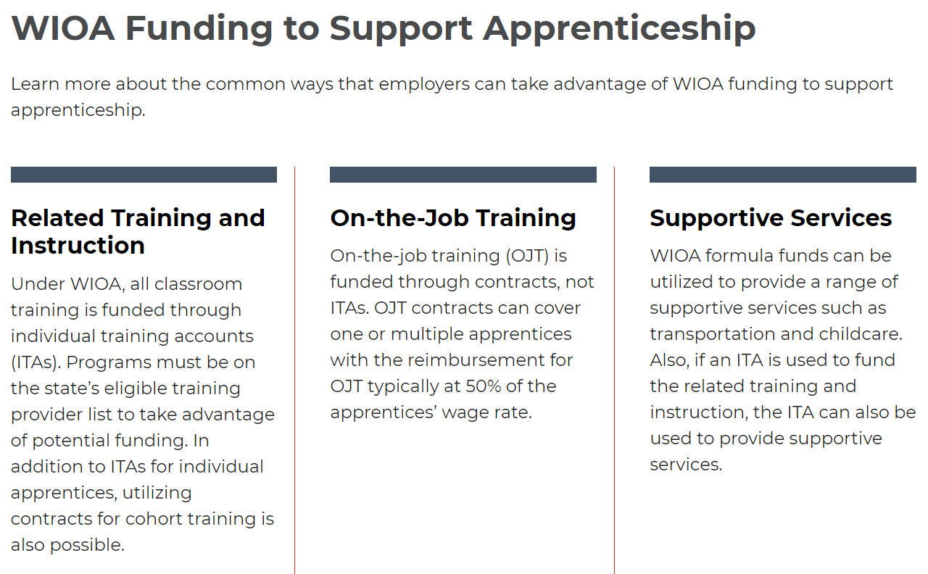
What could WIOA Title IB Support?

Slide 30

Think Strategically
How are you using your WIOA Adult, Dislocated Worker and Youth funds right now?
  What are the priority service strategies and why?
  Are these strategies getting you the outcomes that RA would?
  How much funding is budgeted for training?
This Photo by Unknown Author is licensed under CC BY-NC

Slide 31
Element 2: Start in Your Own Backyard
WIOA has 5 titles – we will talk about first 4:
Title I – Part B. Adult, Dislocated Worker (DW) and Youth
Title II - Adult Education
Title III – Wagner-Peyser
Title IV – Vocational Rehabilitation

Slide 32



What Could WIOA Title II Support?
Job Readiness
Instruction and education to attain a high school diploma or equivalent if needed for RA program participation
Activities or services designed to help the individual acquire critical thinking skills, digital literacy skills, and self-management skills such as working with others, showing up on time, etc. – all needed for RA program participation

Slide 33
Element 2: Start in Your Own Backyard 1
WIOA has 5 titles – we will talk about first 4:
Title I – Part B. Adult, Dislocated Worker (DW) and Youth
Title II - Adult Education
Title III – Wagner-Peyser
Title IV – Vocational Rehabilitation

Slide 34



What Could WIOA Title III Wagner-Peyser Support?
  Think about your
  AJC Resource Rooms!

Slide 35
Element 2: Start in Your Own Backyard
WIOA has 5 titles – we will talk about first 4:
Title I – Part B. Adult, Dislocated Worker (DW) and Youth
Title II - Adult Education
Title III – Wagner-Peyser
Title IV – Vocational Rehabilitation

Slide 36

What Could WIOA Title IV Support?
Recruitment of qualified candidates with disabilities
Training and TA for businesses on accommodations, workplace access.
Did you know?
  Title IV requires State VR agencies to set aside at least 15% of their Federal VR program funds to provide Pre-Employment Transition Services to assist students with disabilities make the transition from secondary school to post-secondary education programs and competitive integrated employment.

Slide 37
Element 3: Develop a Plan
Rules of thumb:
  Could be customer-focused and needs-based
  Could be based on pre-identified services
  Individuals must be eligible for and enrolled in any program that provides funding (in addition to enrollment in RA program)
  Duplication of services is prohibited
    Example: If Title IV can provide supportive services, do not fund supportive services with Title I unless the supportive services Title I is funding are not allowable under Title IV

Slide 38
Element 3: Develop a Plan
Two key components:
  What are the costs – services the participant needs and/or pre-identified RA costs your board has decided to fund.
  What are your assets - which partner programs might fund each of the costs.
  This must be done with key partners at the table!

Slide 39

Let’s Give This a Try
  “Braiding Funds to Help Mary”
  A customer-centered example.
  Review and Discuss Handout

Slide 40
Braiding Funds to Help Mary 1
Participant Service Needs
Funding Options
Math Remediation
Title II, Title IB, Title IV
Workforce Preparation
Title II, Title III
Transportation Assistance
Title IB, Title IV
RA Program OJL
Title IB
RA Program Related Instruction
Title IB
Assistance for Business
re: accommodations
Title IV

Slide 41
Alternative Braided Funding Scenarios: Technical College System
Safal Partners © 2024

Slide 42
Apprenticeship Funding in Georgia
HOPE Grant
  Amount: A percentage of tuition calculated based on institution, hours, etc. Application due last day of the school term.
  Description: This fund covers approximately 70% of student expenses for Georgia residents who are attending a Georgia public technical college to earn a certificate or diploma.
Zell Miller Grant
  Amount: A percentage of tuition calculated based on institution, hours, etc. Application due last day of the school term.
  Description: Available to Georgia residents who are working towards a certificate or diploma at a Technical College System of Georgia (TCSG) or University System of Georgia (USG) institution.
HOPE Career Grant
  Amount: A percentage of tuition calculated based on institution, hours, etc. Application due last day of the school term.
  Description: Available to HOPE-Grant-qualified students who enroll in select majors, including Cybersecurity.

Slide 43
Apprenticeship Funding in Georgia (cont'd)
Work Opportunity Tax Credit (WOTC)
  Amount: $1,200 to $9600 per employee, depending on target group. Submit by the 28th calendar day after the employee starts work.
  Description: Provides employers financial incentives when hiring workers from targeted groups. The most frequently certified WOTC is $2,400 for each adult new hire.
Retraining Tax Credit
  Amount: Up to $1,250 per employee per year. Submit within one year of the original return.
  Description: Businesses can receive a tax credit of 50 percent of their direct training expenses, with up to $500 credit per full-time employee, per training program. Only for retraining current employees in new technologies, not applicable for all apprentices.
High Demand Apprenticeship Program (HDAP)
  Amount: $5,000 per apprentice for up to 10 apprentices. FY2025 Round One employer selections have been made.
  Description: First ever state-funded apprenticeship program. Provides funding to Georgia employers to incentivize the creation and expansion of registered apprenticeship programs throughout the state. It aims to both upskill Georgians and increase skilled talent within Georgia’s high-demand industries.

Slide 44
Braiding Funds to Help Mary
Activity
Funding Options
RA Program OJL
Title IB
Related Instruction
Hope Grant, SAEF Grant
Supportive Services
Intermediary Assistance
Program Related Costs
Work Opportunity Tax Credit, HDAP
Example: Tuition cost for certificate program is $5000. 70% is covered through HOPE Grant.
Remaining 30% can be covered through SAEF or additional DOL Grants that TCSG is awarded to bring final cost to $0

Slide 45

Questions
Safal Partners © 2024

Slide 46
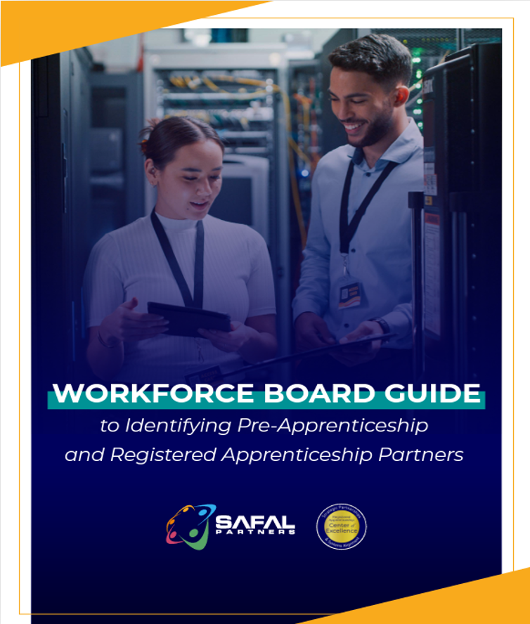

No-Cost Resources
Guide to Identifying Partners
Safal Partners © 2024

Slide 47

Evaluation
Link to Evaluation
Please take a minute to provide feedback on today’s presentation.
Safal Partners © 2024

Slide 48

Contact Us, Become a Partner
Scan for Partner Form
Receive no-cost expert TA,
materials, and assistance
Network with potential
partners nationwide
Be nationally recognized for your work

Slide 49
Thank You for Joining Us
Email us your questions at RA_COE@SafalPartners.com
For more information, visit: dolcoe.safalapps.com

