Slide 1
Demonstrated State Apprenticeship Leadership in 2020 Unified/Combined Plans
Part 3 : Intention in Planning and Measurement
November 16, 2023
Safal Partners © 2023

Slide 2
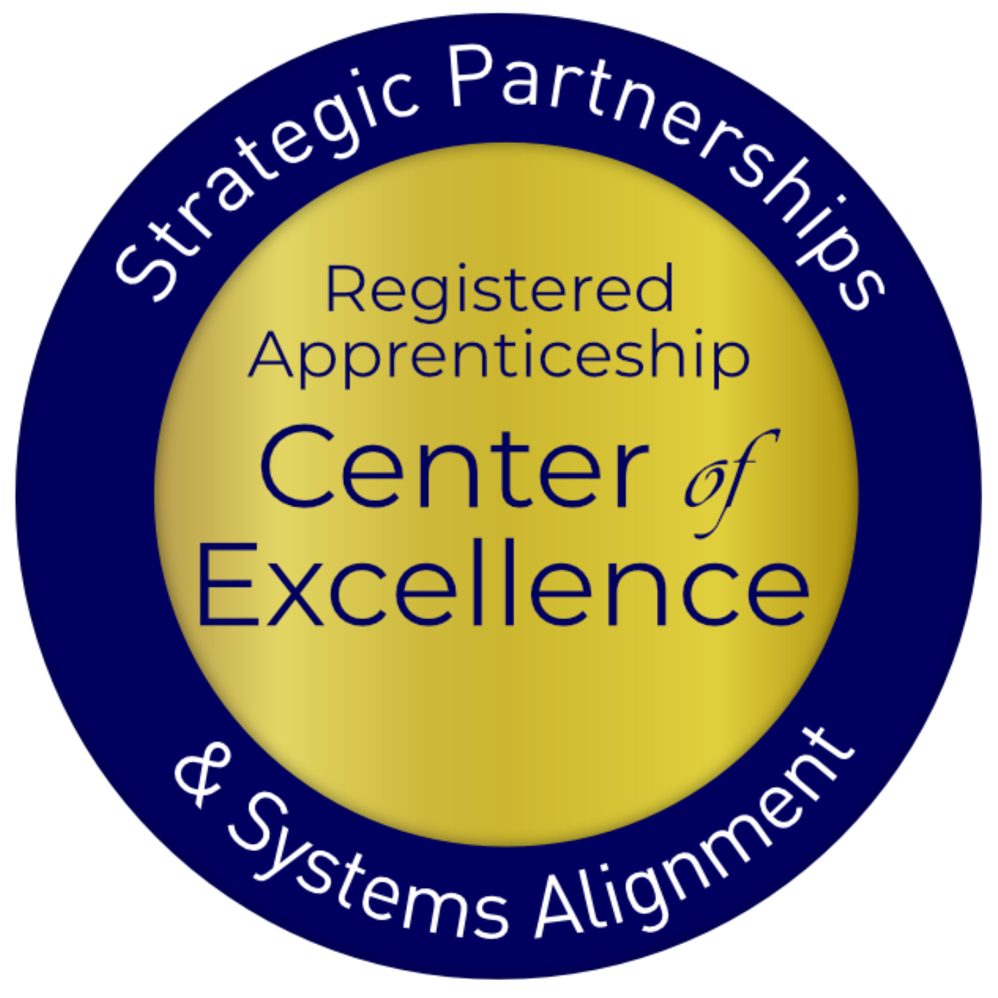
Welcome and Agenda
Center of Excellence Overview
Today’s Topic: Meet State Objectives: Moving the Needle on Apprenticeship Efforts
Voices from the Field
Questions and Discussion
Closeout
Safal Partners © 2023

Slide 3
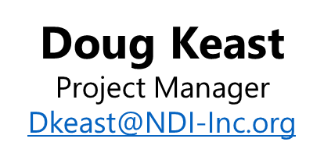
Presenter
Safal Partners © 2023

Slide 4
Intention in State Plans - Strategy
One key indicator identified in the review is the establishment of apprenticeship as a specific strategy to meet state plan vision.
34% of all state unified/combined plans articulated apprenticeship strategies to meet state workforce goals.
Safal Partners © 2023

Slide 5
2020 State Plan Examples
Arkansas
Colorado
Idaho
Maine
Increase the utilization of Registered Apprenticeship programs as viable talent development opportunities.
Map and promote in-demand industries in a future-ready way
Embed opportunities for work-based learning and apprenticeships
Implement an outreach strategy
Increase awareness and perception of apprenticeships as a pathway to careers for students, parents, teachers, and counselors.
Identify strategies to leverage private sector investment in training their workforce
Employer of choice designation for businesses offering quality jobs.
Safal Partners © 2023

Slide 6
Intention in State Plans - Measurement
One key indicator identified in the review is the establishment of objectives in terms of #s of apprentices and #s of programs.
14% of all state unified/combined plans articulated numerical objectives for how many apprentices and/or programs would demonstrate success in their strategy – in their state plans.
Safal Partners © 2023

Slide 7
2020 State Plan Examples 2
Oklahoma
Kentucky
Uses information on the numbers of apprentices and RA programs to set goals for state expansion of apprenticeship
Grants have timeline and objectives
All strategies aligned to support meeting those objectives
Intention is to include objectives numerically and progress in the State Plan moving forward
Successful employer engagement measured by increase 5x # RA and work-based learning opportunities
Currently over 4,000 apprentices in over 300 programs representing 147 unique occupations
Up from 2000 in over 200 programs in over 100 different occupations
Safal Partners © 2023

Slide 8
Intentionality Leads to Impact
Reflects investment and action by leadership
Links activity to State Vision and Goals
Opportunity for Process Improvement in next plan
It is the “so what?” to the State Plan. No numbers – No tangible connection of expressed activity to state objectives
Safal Partners © 2023

Slide 9
Voices from the Field Maine Department of Labor

Slide 10
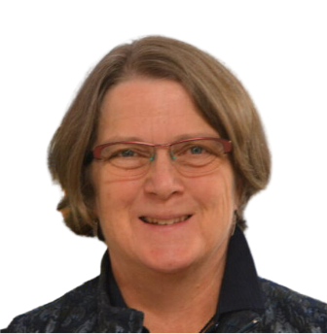
Maine Panelists
Samantha Dina
Director of Special Projects
State of Maine Department of Labor
Joan Dolan
Director of Apprenticeship & Strategic Partnerships
State of Maine Department of Labor
Peter Diplock
Asst. Director
Maine Division for the Blind and Visually Impaired (DBVI)

Slide 11
Questions and Discussion

Slide 12
Contact Us
Samantha Dina
Director of Special Projects
State of Maine Department of Labor
samantha.dina@maine.gov
Joan Dolan
Director of Apprenticeship & Strategic Partnerships
State of Maine Department of Labor
joan.m.dolan@maine.gov
Peter Diplock
Asst. Director
Maine Division for the Blind and Visually Impaired (DBVI)
peter.d.diplock@maine.gov

Slide 13
Become a Center Partner
Receive no-cost expert TA, materials, and assistance
Network with potential partners nationwide
Be nationally recognized for your work
Scan for Partner Form

Slide 14
Email us your questions at RA_COE@SafalPartners.com
For more information, visit: dolcoe.safalapps.com
Safal Partners © 2023

