Slide 1
Workforce System Alignment: Promising Practices for State & Local Boards
April 25th, 2025
Safal Partners © 2025

Slide 2
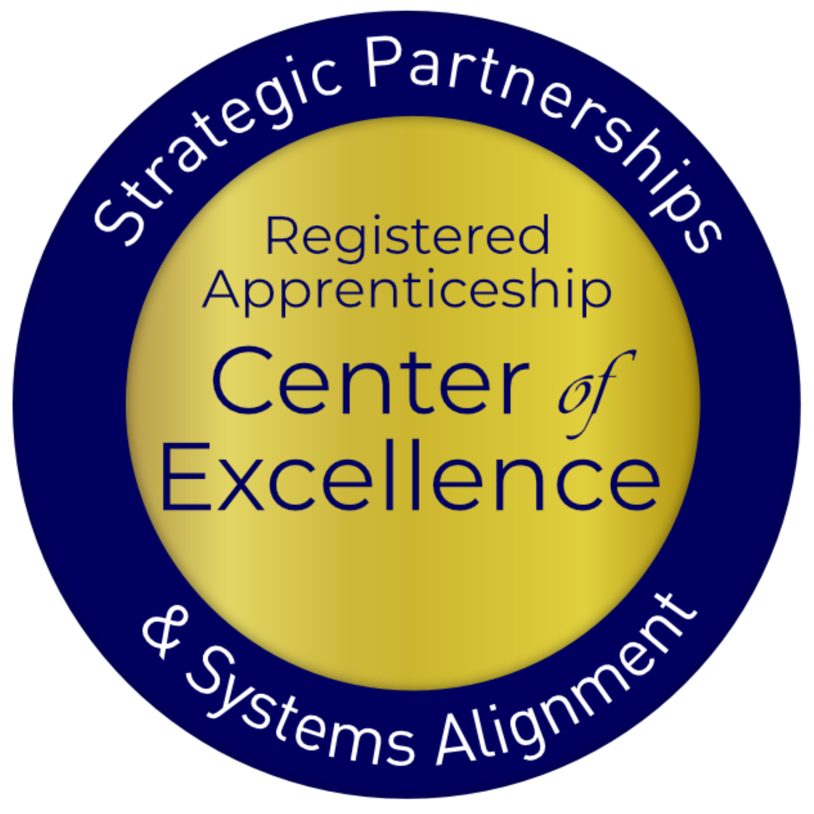
Welcome and Agenda
Center of Excellence Overview
Understanding the Field
WIOA State Plans & 7 Levels of Alignment
Knowledge Gaps & Registered Apprenticeship
Florida’s Apprenticeship Expansion Efforts
Maryland’s Apprenticeship Expansion Efforts
Safal Partners © 2025

Slide 3
Center of Excellence Overview
U.S. DOL initiative to increase systems alignment across apprenticeship, education, and workforce
Led by Safal Partners; 5 national partners
We provide no-cost services including:
Monthly webinars
Quarterly virtual office hours
Individual compliance assistance and services
Online resources (desk aids, guides, frameworks, etc.)
Visit our website, request assistance
Safal Partners © 2025

Slide 4
Presenter
Alan Dodkowitz
Senior Subject Matter Expert
Safal Partners
Safal Partners © 2025

Slide 5
Quick Pulse Poll
Are you a….
Workforce Board Staff
Service Provider Staff
Educational Partner
Vocational Rehabilitation Partner
Employer
Board Member
Registered Apprenticeship Staff
Other
Safal Partners © 2025

Slide 6
Assessing Your RA Knowledge
Basic
I know what it means, but I don’t know how to utilize it and don’t have significant experience with it.
Intermediate
I understand RA, I’ve had experience with RA in some capacity, and I feel comfortable educating internal and external stakeholders about it.
Expert
I have extensive knowledge and relevant experience developing and implementing programs and standards, recruiting apprentices, and convening stakeholders.
Safal Partners © 2025

Slide 7
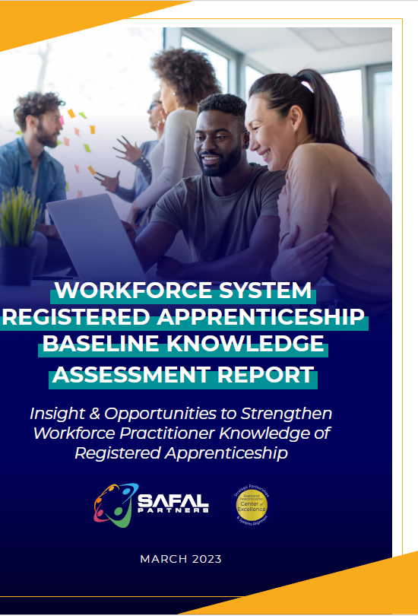
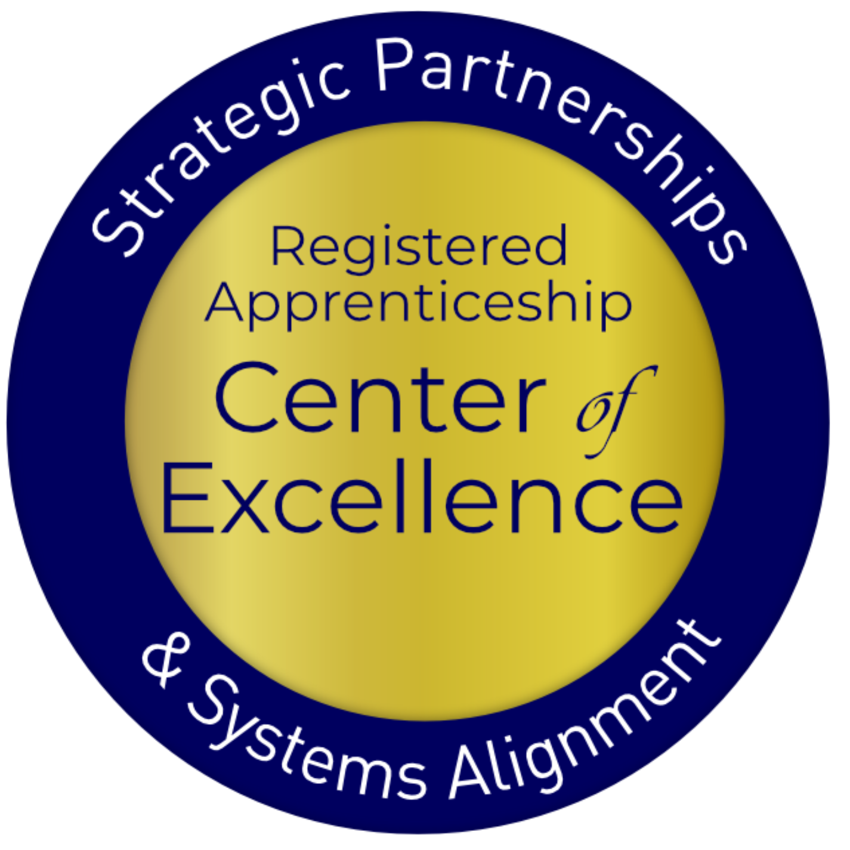
First: Understanding the Field
Deep dive into system understanding of RA
Multiple methodologies: data analysis, interviews, partner surveys, working groups, TA participant feedback, literature review
First analysis of national, state WIOA/RA co-enrollment data
First analysis of WIOA State Unified and Combined Plans for RA
First national assessment, "Workforce System RA Baseline Knowledge Assessment Report"
First national assessment of Title II RA engagement, “Expanding RA through WIOA Title I and Title II Partnerships Report”
First landscape scan, analysis of Apprenticeship Networks across the US
Safal Partners © 2025

Slide 8
Re-thinking Assumptions
Workforce system stakeholders aren't as engaged in or strategically planning for RA inclusion as initially thought.
Misalignment seen across multiple areas:
State planning to local implementation
WIOA funding utilization to policy development …and more
Safal Partners © 2025

Slide 9
WIOA State Plans: 7 Indicators of Alignment
Apprenticeship mentioned as workforce strategy
Plans to apply for/utilize federal grants to expand apprenticeship
Apprenticeship articulated specifically in strategies to meet State Plan vision
State level apprenticeship work group or committee to State Workforce Board
Specialist expertise embedded into the American Job Centers
State-level initiative for RA expansion (i.e. investment of additional resources, statutes to incentivize/scale RA programs)
Specific objectives, goals for increased # of apprentices or RA programs
Safal Partners © 2025

Slide 10
Support at Top, Dropoff in Planning
RA Alignment Indicator | # of State Plans Included | % of States | # of Territories
1. Apprenticeship acknowledged as workforce strategy | 50 | 100% | 6
2. Plans to apply for/utilize federal grants to expand apprenticeship | 42 | 84% | 4
3. Apprenticeship articulated specifically in strategies to meet State Plan vision | 17 | 34% | 3
4. State level apprenticeship work group or committee to SWDB | 17 | 34% | 1
5. Specialist expertise in AJCs | 16 | 32% | 1
6. State level Initiative (e.g., investment of additional resources, statute designed to incentivize or encourage establishment of apprenticeships) | 15 | 30% | 2
7. Specific objectives and goals for increased # of apprentices or apprenticeship programs | 7 | 14% | 0
Safal Partners © 2025

Slide 11
2020 State WIOA Plan RA Leaders
While no state or territory had all seven indicators of RA alignment in their Unified or Combined Plan, 15 had four or more indicators
Six (6) Indicators
Five (5) Indicators:
Four (4) Indicators
Pennsylvania
Texas
Arizona
Illinois
Iowa
Kentucky
Nevada
New Mexico
Oklahoma
Alaska
Arkansas
Connecticut
Florida
Idaho
Kansas
Maine
Missouri
New York
Wisconsin
US Territories
American Samoa
District of Columbia
Guam

Slide 12
Low Utilization Due to Several Factors
Workforce boards, Title I providers cited:
Other state and local priorities
Lack of RA knowledge
Few/no strategic relationships with RA system
Priority of meeting WIOA performance metrics
View of WIOA as "last dollar in" for RA given administrative burden versus fewer restrictions with non-WIOA $$
Lack of consistent, accessible, modularized training – i.e. Workforce System does not have a catalog / familiarity with the RA Academy
Separate data systems
Some LWDBs don’t see themselves as "conveners” of local industry
Safal Partners © 2025

Slide 13
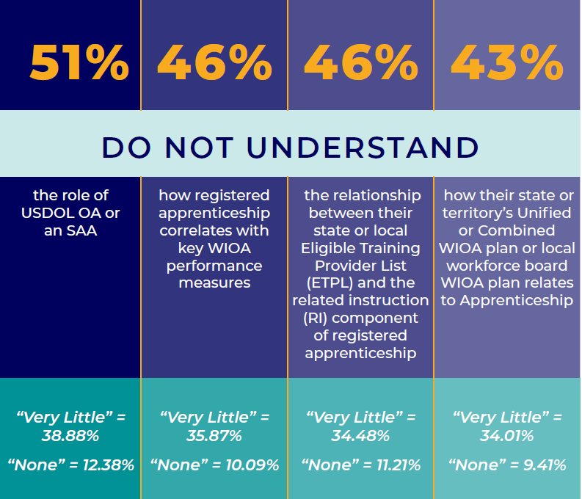
Knowledge Gap: Connecting Systems

Slide 14
Knowledge Gap: How RA Works

Slide 15
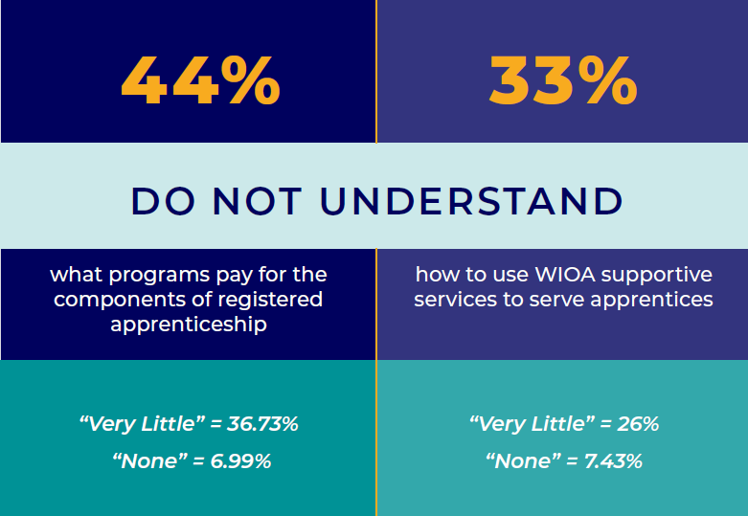
Knowledge Gap: Funding

Slide 16
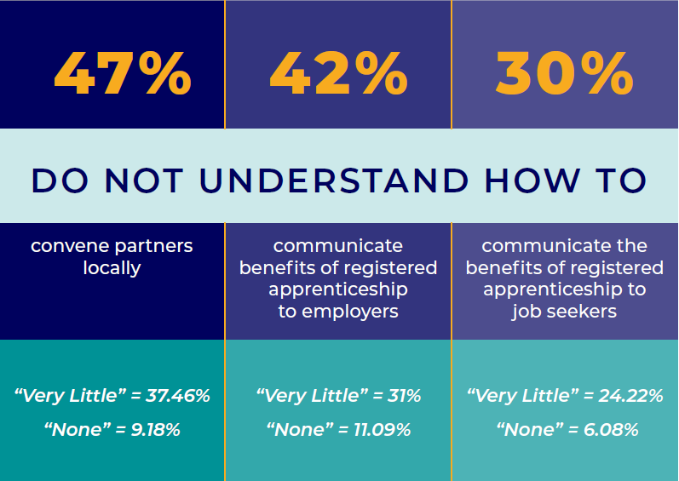
Knowledge Gap: Communication

Slide 17
Field-Informed TA: Creating New Tools
Creating cross-system, responsive TA and training to drive outcomes. Products include:
First national ATR/BSR training (5-part series, capstone)
First series of WIOA State Planning webinars on RA inclusion
First Adult Education / IET Pre-Apprenticeship RA Framework
First state level CTE RA Bootcamp, replicable model
First Intermediary Assessment tool to assist states in RA expansion
First WIOA/RA Co-Enrollment Dashboard
Safal Partners © 2025

Slide 18
State Progress: Interest, Investments
Provided intensive TA, customized tools at request of 12 states on wide range of alignment topics including:
Cross-system collaboration
WIOA funding uses for RA, supportive services
WIOA State Plan development
Braiding funding
High school youth apprenticeship/CTE alignment
Pre-apprenticeship
AJC case manager/BSR training
Increase in state-level support for RA expansion
28 states have enacted RA-supportive legislation in ‘23, ‘24
Employer incentives and tax credits – drive employer demand
Grant programs – LWDBs will seek $$ over/in addition to WIOA
Restructuring governance: RA and Workforce Systems alignment/consolidation (i.e. Virginia, Iowa, Vermont)
Safal Partners © 2025

Slide 19
Field Needs, Responds to Centers’ TA
Data shows .03% national WIOA/RA
co-enrollment rate….
242% increase in WIOA/RA
co-enrollment in targeted states served by Center
Have produced 82 webinars with 5,000+ attendees….
95% participants “strongly agreed” TA was of high value and planned to implement
Initial goal of 200 partners in system alignment….
3,000 organizations have committed to developing new strategic RA partnerships
Safal Partners © 2025

Slide 20
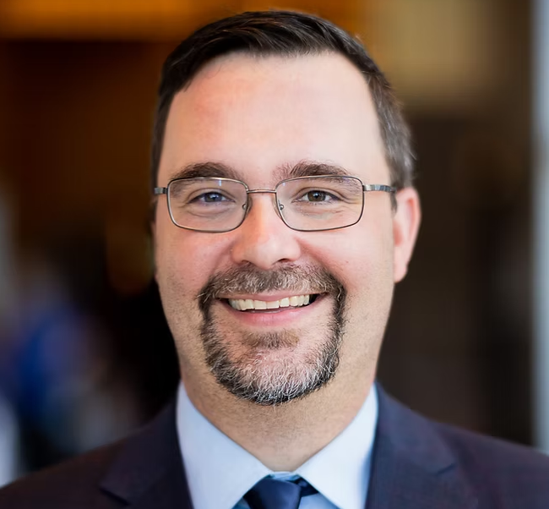
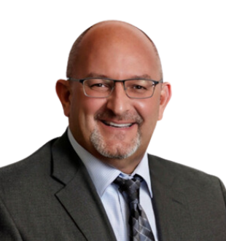
Presenters
Brandon Butler
James Disbro
Executive Director, Maryland Workforce Association
Senior Director, Regional Alignment & Programs Development CareerSource Suncoast
Safal Partners © 2025

Slide 21
Cultivating an Environment for
Registered Apprenticeship Growth

Slide 22
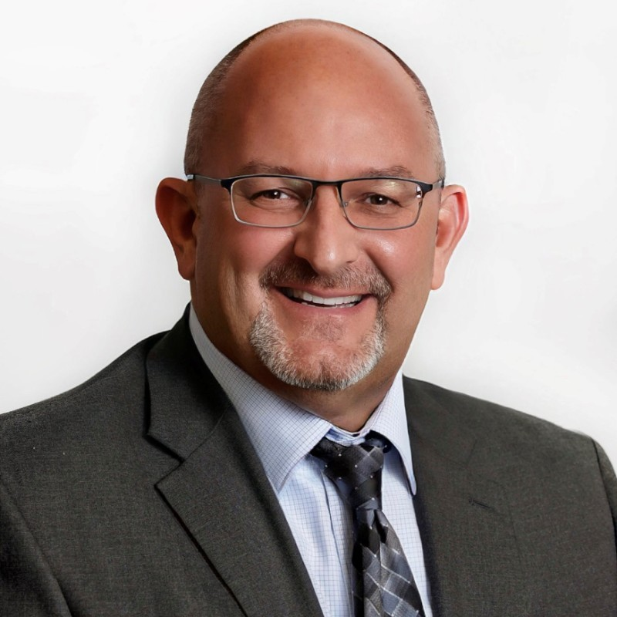
James Disbro
James Disbro
Senior Director, Regional Alignment & Programs Development
CareerSource Suncoast, Sarasota Florida
James has held senior leadership roles at three of Florida’s Local Workforce Development Boards affording him a perspective that includes medium to large workforce service delivery models. He is highly endorsed as someone knowledgeable in Workforce Development.
In his current role, James works collaboratively with internal and external partners ensuring proper alignment, service design, implementation, and regional continuity. In addition, he directs CSS data and reporting analysis, apprenticeship efforts, and special projects/grants.

Slide 23
Florida’s Apprenticeship Expansion Efforts
CareerSource Florida & The Florida Department of Commerce
State Policy - Governor Executive Order 19-24
Florida's goal is to be #1 in Workforce Education by 2030
Funds Apprenticeship Navigators at all 21of Florida’s LWDBs
Apprentice Florida website: ApprenticeFlorida.com
Florida Department of Education (FLDOE)
Florida is a State Apprenticeship Agency (SAA): supported by nine (9) regional Apprenticeship Training Representatives
Pathways to Career Opportunities Grants (PCOG)
Since 2019, PCOGs have totaled more than $43M
The grant funds are to establish new, or expand existing registered apprenticeship or pre-apprenticeship programs

Slide 24
Florida’s Apprenticeship Expansion Results (PY23/24)
21% increase in the number of new apprentices from PY23/24 – 22,444 active apprentices/pre-apprentices
32 new registered apprenticeship programs, for a total of 129 active apprenticeship programs
11 new registered pre-apprenticeship programs, for a total of 68 active
2,167 apprentices completed their program, with an increase of 32 additional apprentices over last year
Apprentices who completed their RAPs earned an average exit wage of $27.81 per hour ($57,837 annually), a $4,376 increase from the previous year

Slide 25
Manatee
CareerSource Suncoast
Sarasota

Slide 26
CareerSource Suncoast’s RAP Journey
RAP Sponsorship
USDOL Intermediary Collaboration
Funding for Apprentices
Engagement of Post Secondary Institutions
Increase RAPs

Slide 27
CareerSource Suncoast (CSS) RAP Sponsorship
1st Florida LWDB to Sponsor a Registered Youth Pre-Apprenticeship (2000-2012)
1st Florida LWDB to Sponsor a Registered Apprenticeship (2018 – current)
Jobs For the Future - assisted with development of RAP Standards
CSS Sponsorship - 8 occupations/5 employers
2022 – 2024 CSS has had 5 Florida Manufacturer Apprentice of the Year Recipients through two of our engaged employers

Slide 28
CareerSource Suncoast (CSS)
RAP Sponsorship
Employers & Occupations -
PGT Innovations
Tool and Die (4/2018)
Industrial Maintenance Mechanic (5/2023)
Teakdecking Systems
Additive Manufacturing Technician (7/2023)
Project Manager (7/2023)
Industrial Production Supervisor (7/2023)
Crown Linen
Laundry-Machine Mechanic (4/2024)
Gold Coast Eagle Distributing
Merchandise Designer (12/2024)
Town of Longboat Key
Building Codes/Official Administrator (12/2024)

Slide 29
CareerSource Suncoast (CSS)
Increase RAPs
Early Learning Coalition of Sarasota County Apprenticeship Program, GNJ (10/2023)
Child Care Development Specialist (10/2023)
Child Care Development Specialist (Adult) Pre-Apprenticeship (10/2023)
Manatee Technical College Registered Apprenticeship Program, GNJ (12/2023)
Child Care Development Specialist (12/2023)
Child Care Development Specialist (Adult) Pre-Apprenticeship (4/2024)
Pharmacist Assistant (12/2024)
Humane Society of Manatee County Apprenticeship Program, INJ (9/2024)
Bayside Pet Resort & Spa, Inc. Apprenticeship Program, GNJ (9/2024)
Laser RITE Business Services Apprenticeship Program, INJ (9/2024)
SAK Enterprises Apprenticeship Program, INJ (11/2024)
NCN Electric Apprenticeship Program INJ (12/2024)
Notes:
Increase RAP Efforts:
CSS Apprenticeship Navigator (AN) collaborated with the above employers to assist in the development of their own RAPs and Pre-Apprenticeships programs in our area.
From 7/1/24 to 2/28/25 - Statewide - 46 new RAPs were created, 23 were facilitated by the states ANs and 8 were developed by the CSS AN and approved by FLDOE
Programs in the Pipeline:
Registered Youth Pre-Apprenticeship
Manatee County School District, Maintenance and Repair Workers General
Registered Apprenticeship
Goodwill Manasota, Retail Operations Specialist
King Plastic, Industrial Maintenance Mechanic

Slide 30
CareerSource Suncoast
USDOL Intermediary Collaboration
Industry Experts - connect area employers, Associations, and other stakeholders to assist development and expansion of RAPs
Facilitate Apprenticeship Accelerator events
5 events held since 6/2023
Webinars & Trainings

Slide 31
CareerSource Suncoast (CSS)
Engagement of Post-Secondary Institutions
Collaborated on the development of Manatee Technical College’s (MTC) first RAP
Childcare Development Specialist and registered Pre-Apprenticeship program
Assisted in development of Standards with MTC -Pharmacy Technician with Manatee Memorial Hospital
Regularly connects area employers to post-secondary institutions for Related Technical Instruction

Slide 32
CareerSource Suncoast
Funding for Apprentices
Funded 41 apprentices for related instruction and on-the-job training in the past 3 program years
Assists registered apprentices with financial wellness training & support services
(private local grant)

Slide 33
CareerSource Suncoast “Apprenticeship in a WIOA World”
Focus on Apprenticeships
Hurdles/Challenges
Outcomes Driven
Spread the Word

Slide 34
How We Do It?
Focus on Apprenticeships
Prioritize Apprenticeship Programs within the organization
Apprentice Navigator – acts as a specialist on RAPs, assisting businesses in starting, expanding, or linking to existing RAPs
Collaborates internally to ensure staff understand RAPs and how WIOA can aid them through current services
Hurdles/Challenges
Update LWDB WIOA policies, procedures and forms
Below Self-Sufficiency Definition
Umbrella OJT contracts
ETPL forms
Staff training & development

Slide 35
How We Do It? 1
Outcomes Driven
Record good, and consistent data (MIS)
Locate itinerant credentials within the RAP Standards
Utilize demand/targeted occupations when possible
Spread the Word
Apprenticeship Accelerators/Lunch & Learn Events
Community engagement (ex. Economic Development Councils, Chambers of Commerce, Trade Associations, School Districts)
LWDB website/social media

Slide 36
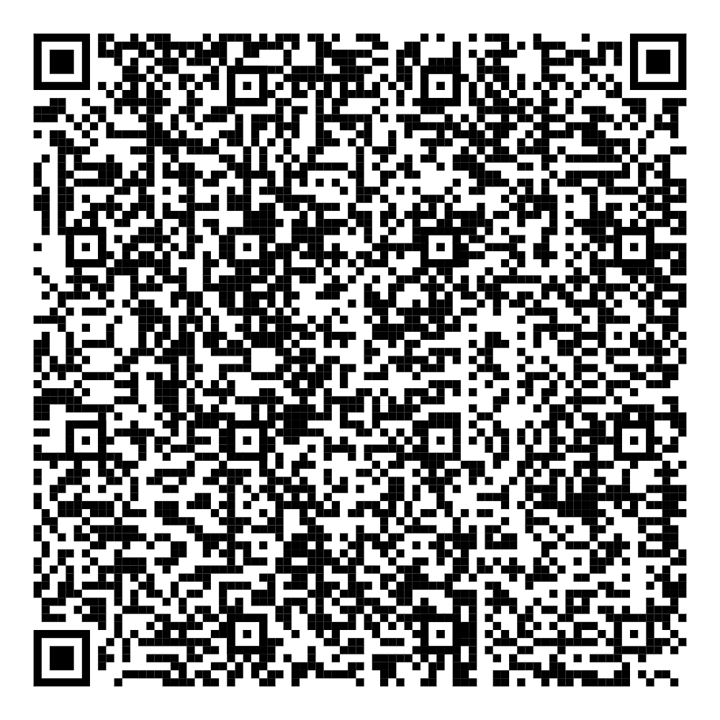
James Disbro
Senior Director, Regional Alignment & Programs Development
CareerSource Suncoast
Email: jdisbro@careersourcesc.com

Slide 37
Maryland's Local Workforce Systems & Their Approach to Registered Apprenticeship Growth in Communities

Slide 38
Maryland's Registered Apprenticeship Approach
Expansion of Registered Apprenticeship Programs
Collaborative Partnerships
Apprenticeship-Friendly Policies
The state has fostered strong partnerships with employers, industry associations, and educational institutions to develop and promote RA programs that meet local workforce needs.
Maryland has actively expanded its Registered Apprenticeship (RA) programs across various industries, including manufacturing, healthcare, and information technology.
Maryland has implemented policies and initiatives that make it easier for employers to establish and maintain RA programs, such as tax credits and funding opportunities.
Through its comprehensive approach to Registered Apprenticeship programs, Maryland is positioning itself as a leader in workforce development and preparing its residents for the jobs of the future.

Slide 39
Challenges in Implementing Registered Apprenticeship
Lack of Employer Awareness
Funding Constraints
Many employers are unfamiliar with the benefits and process of Registered Apprenticeship programs.
Securing adequate funding to support the development and implementation of RA programs.
Navigating Regulatory Requirements
Misalignment of Training Programs
Complexities in navigating the regulatory requirements and approval process for Registered Apprenticeship programs.
Workforce systems often do not align with the structured approach of Registered Apprenticeship.

Slide 40
Maryland's Local Workforce Boards & RA Strategy
Awareness and Outreach
Financial Incentives
Apprenticeship Intermediaries
Professional Development
Local workforce boards are working with MD Labor to expand awareness and to promote the benefits of Registered Apprenticeship programs to employers, industry associations, and job seekers. This includes targeted marketing initiatives, industry-specific information sessions, and partnerships with educational institutions and community organizations.
Local workforce boards were awarded $77 million in ARPA funding - many used that to incentivize apprenticeship growth in their communities. State funding passed this session of the Maryland General Assembly (the RAISE Act) will allow local workforce boards and their partners to build on the learning we have gathered from the use of flexible funding.
Apprenticeship Intermediaries are to convene and educate on apprenticeship opportunities. Local workforce boards are by their very nature convening bodies. So, why can't local workforce boards serve in this capacity rather than reinvent the wheel?
Investing in staff - both management and the frontlines - on understanding apprenticeship opportunities is key. Working with Safal, the Maryland Workforce Association has hosted trainings, and is planning to do the same this year.

Slide 41
Registered Apprenticeship Success Stories
WorkSource Montgomery Career Coach RA
Apprenticeship Hiring Events
MWA's SOC Analyst Apprenticeship
Many local workforce boards host apprenticeship-centric hiring events that are aligned with in-demand sectors in their communities.
The Maryland Workforce Association is working with BCR Cyber and the Maryland Association of Community Colleges in the development of a SOC Analyst apprenticeship. This is the first time where the association is standing in the role of a group, non-joint sponsor.
WSM registered Standards of Apprenticeship with the USDOL’s Office of Apprenticeship and the Maryland Training and Apprenticeship Council. When MoCo CAP Career Coaches complete the program, they receive a certification from Montgomery College and a Certificate of Journey-level status from the USDOL, a recognized, portable national credential.

Slide 42
Brandon Butler
brandon@pinnaclestrategiesconsulting.com

Slide 43
Questions and Discussion

Slide 44
Become a Center Partner
Scan for Partner Form
Receive no-cost expert services, including materials and support
Network with potential partners nationwide
Be nationally recognized for your work
Safal Partners © 2025

Slide 45
Email us your questions at RA_COE@SafalPartners.com
For more information, visit: dolcoe.safalapps.com
Safal Partners © 2025

