Slide 1
Bridging the Gap: Empowering Adult Learners through Registered and Pre-Apprenticeship Programs
COABE Conference
April 2, 2025
Safal Partners © 2025

Slide 2
Presenters
Melissa Schroeder, Ph.D.
Amber Gallup, Ph.D.
Director Safal Partners
Director, Adult Education Division, New Mexico Higher Education Department
Safal Partners © 2025

Slide 3
Welcome and Agenda
Center of Excellence Overview
Background on Registered Apprenticeship
Quality Pre-Apprenticeship
Turning IET Programs into Pre-Apprenticeship Pathways
Connecting with Workforce Partners
Questions and Discussions
Safal Partners © 2025

Slide 4
Center of Excellence Overview
U.S. DOL initiative to increase systems alignment across apprenticeship, education, and workforce
Led by Safal Partners; 5 national partners
We provide no-cost services including:
Monthly webinars
Quarterly virtual office hours
Individual compliance assistance and services
Online resources (desk aids, guides, frameworks, etc.)
Visit our website, request assistance
Safal Partners © 2025

Slide 5
Assessing Your RA Knowledge
Basic
I know what it means, but I don’t know how to utilize it and don’t have significant experience with it.
Intermediate
I understand RA, I’ve had experience with RA in some capacity, and I feel comfortable educating internal and external stakeholders about it.
Expert
I have extensive knowledge and relevant experience developing and implementing programs and standards, recruiting apprentices, and convening stakeholders.
Safal Partners © 2025

Slide 6
Poll – Knowledge of RA
What is your current knowledge level?
Complete our poll on Menti!
Scan the QR code
OR
Visit menti.com
Enter code: 5919 7274
Safal Partners © 2025

Slide 7
Getting Started: RA Basics and Benefits
Safal Partners © 2025

Slide 8
What is Registered Apprenticeship (RA)?
A proven model of job preparation that combines paid on-the-job learning (OJL) with mentorship and coursework/“related instruction” (RI) to progressively increase workers’ skill levels and wages.
The most time-tested, industry-validated model for employers to recruit, train, upskill, and retain workers for critical occupations.

Slide 9
Spans all Sectors

Slide 10
Five Core Components of RA
Industry Led
Structured On-the-Job Learning & Mentorship
Related Instruction (RI)
National Occupational Credential
Paid Job & Rewards for
Skill Gains
Safal Partners © 2025

Slide 11
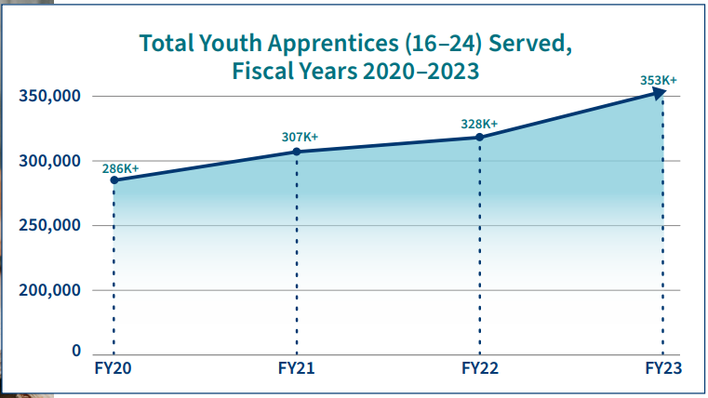
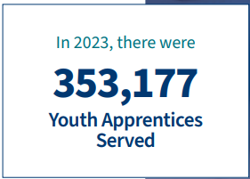
Growth of 16-24 Year Old Students in RA
Source: https://www.apprenticeship.gov/
Safal Partners © 2025

Slide 12
RA Offers Clear Benefits for Students
Academically-linked career pathway
“Earn and learn” – training is paid while gaining work experience
Often leads to offer of full-time non-apprentice employment following program completion (94% of completers are retained)
Provides family-support wages, economic mobility: $80,000 average starting salary (U.S. DOL), $300,000 higher lifetime earnings than non-apprentice peers (U.S. DOL)
Increases academic and industry-valued credential attainment
Lowers – or eliminates – potential student debt for post-secondary education
Safal Partners © 2025

Slide 13
Quality Pre-Apprenticeship Programs
Safal Partners © 2025

Slide 14
What is Pre-Apprenticeship?
A program or set of strategies designed to prepare individuals for entry into an RA program.
May vary in length and scope, and may include basic skills training, academic skills remediation, and industry awareness.
Completers may be afforded preferential consideration for direct entry into an apprenticeship program and/or apply coursework and experience toward RA program requirements through CPE/CPL.

Slide 15
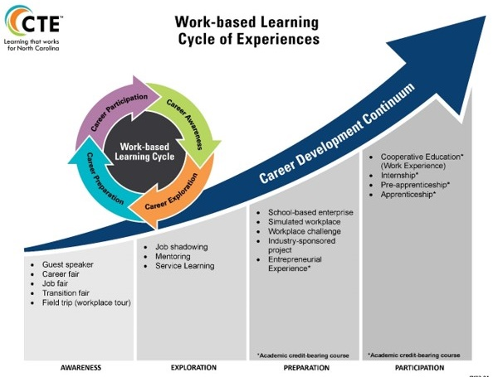
Well-Aligned with CTE
Safal Partners © 2025

Slide 16
Components of Quality Pre-Apprenticeship
Foundational Skill-Building: Communication, teamwork, and problem-solving alongside basic technical training.
Career Exploration and Foundational Training: Exposes students to various career paths while developing technical skills.
MOUs with RA Sponsors: Formalized agreements that provide completers with preferential direct entry, ability to apply coursework to RI requirements (through CPL) and hands-on OJL to competency requirements (through CPE).
Partnership Network: Including workforce system, community and faith-based groups, advocacy organizations, labor groups, and educational institutions for supportive services, pathway development.
Paid Work Experience: Fosters engagement, builds commitment, and helps students adapt to workplace expectations.

Slide 17
Turning IET Programs into Pre-Apprenticeship Pathways
Safal Partners © 2025

Slide 18
Identify and Engage Partners
Identify organizations sponsoring or supporting Registered Apprenticeship (RA) through:
Apprenticeship.gov
Office of Apprenticeship (OA) or State Apprenticeship Agency (SAA) Office
Locate local training and education providers
Contact your local workforce development board
Identify local community supportive services provider(s)
Safal Partners © 2025

Slide 19
Define Pre-Apprenticeship Goals
Define Pre-Apprenticeship Goals for Each Stakeholder:
Participant: Describe expected successful workforce outcomes for the individual
Program: Describe overall outcomes for all participants
Partner: Describe engagement and outcomes important to RAP sponsor
Safal Partners © 2025

Slide 20
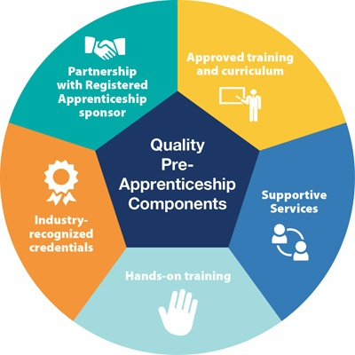
Align IET Curriculum with Apprenticeship Standards
Skills Mapping: Ensure the IET program curriculum covers the foundational technical and employability skills required for entry into related Registered Apprenticeship programs.
Industry-Relevant Instruction: Collaborate with employers and industry experts to design instruction that meets sector-specific needs, ensuring seamless transition to apprenticeships.
Credential Integration: Embed industry-recognized credentials that are portable and aligned with apprenticeship requirements.
Safal Partners © 2025

Slide 21
Embed On-the-Job Learning Opportunities
Determine ways to incorporate parts/ foundations of RAP OJT into adult education pre-apprenticeship program.
Introduce projects that mirror industry challenges to reinforce practical application of skills.
Provide job shadowing, short-term hands-on training on-site through IET/pre-apprenticeship instruction.
Track OJT-related work experience/ competencies toward RAP requirements
Safal Partners © 2025

Slide 22
Implement RAP Pre/Enrollment Process
Develop direct entry agreement with RAP sponsor for pre-apprenticeship program completers
Participants complete preapplication assessments
Present candidates to the RAP sponsor
Assist and coach participants with RAP application process
Support sponsor with articulated CPE/CPL verification toward RAP requirements
Connect pre-apprentices with needed supportive services for ongoing support to improve retention and completion rates
Safal Partners © 2025

Slide 23
Reflect & Share
What are you doing now or hoping to do with IETs and pre-apprenticeship?
What is one challenge you are facing in implementing these programs?
What is one success you have had?
What are your next steps?
Safal Partners © 2025

Slide 24
Workforce Boards: The Key Ingredient
Safal Partners © 2025
Notes:
Melssa

Slide 25
Poll – Workforce Board Engagement
How often do you engage with your workforce board on IET, pre-apprenticeship, or registered apprenticeship programs?
Complete our poll on Menti!
Scan the QR code
OR
Visit menti.com
Enter code: 5919 7274
Safal Partners © 2025

Slide 26
How Workforce Boards Can Help Education Providers
Provide WIOA Individual Training Account (ITA) funding to support apprentices' RI costs
Make connections with employers, sponsors
Host convenings between education and industry
Provide pipeline of participants to enroll in programs
Add programs to the Eligible Training Provider List (ETPL)
Support the development of RI curriculum using labor market information and industry standards
Safal Partners © 2025

Slide 27
How Workforce Boards Can Help Employers/Sponsors
Provide a pipeline of apprentices:
Publicize RA program opening
Screen candidates
Provide pre-apprenticeship training
Provide supportive services to apprentices
Provide WIOA OJT contract funding to support percentage of apprentice wages
Build partnerships w/training providers on ETPL for RI; utilize ITAs to pay for all/portion of apprentices' RI costs
Support registering and implementing RA programs
Host convenings (job fairs, recruiting events, etc.) to connect potential apprentices and employers
Safal Partners © 2025

Slide 28
How Workforce Boards Can Help Community-Based Organizations
Provide education on RA
Connect potential apprentices with employers
Provide supportive services to apprentices
Connect potential apprentices to other resources available within the community
Leverage funding programs
Safal Partners © 2025

Slide 29
Get to Know Your Workforce Board
Each Workforce Board has:
Sector strategies: priority occupations and key industries
Policies on OJT contracts, which WIOA and non-WIOA funding "buckets" and services they will apply to RA
Funding levels, fiscal year cycle and how quickly they anticipate spending funds
Supportive services offered and how that maps to your program's needs
Candidate pool – IS and OS Youth Programs
ETPL program registration process
Safal Partners © 2025

Slide 30
Funding & Resources: WIOA Title I
Administered by Local Workforce Development Boards (LWDBs) and their American Job Centers (AJCs)
Eligible beneficiaries:
Adult learners (Adult or Dislocated Worker programs)
In-school (Youth program) or Opportunity Youth eligible participants
WIOA Title I Funds Can Often Pay For
Pre-Apprenticeship Paid Work Experience
Allowability varies by LWDB policy
Amount and length of wage reimbursement to be determined by LWDB policy
Paid to provider of work experience
Likely uses OJT-type contracts
Training Costs (through Individual Training Accounts)
Paid to ETPL approved training providers
Can be used toward pre-apprentice training expenses
Tuition/fees
Books
Uniforms, training equipment, etc.
Supportive services

Slide 31
Questions and Discussion

Slide 32
Become a Center Partner
Scan for Partner Form
Receive no-cost expert services, including materials and support
Network with potential partners nationwide
Be nationally recognized for your work
Safal Partners © 2025

Slide 33
Email us your questions at RA_COE@SafalPartners.com
For more information, visit: dolcoe.safalapps.com

